Slide 1
Randomized SVD
CSCI 4360/6360 Data Science II

Slide 2


Singular Value Decomposition (SVD)
Given a (any!) matrix M, which is n x m, it can be represented as
U: n x n, unitary matrix (orthogonal)
$Σ$: n x m, diagonal matrix of singular values
V^{T}: m x m, unitary matrix (orthogonal)
Notes:
Recall homework 2

Slide 3
SVD
A_{[m x n]} = U_{[m x r]} Σ _{[ r x r]} (V_{[n x r]})^{T}
A: Input data matrix
m x n matrix (e.g., m documents, n terms)
U: Left singular vectors
m x r matrix (m documents, r concepts)
Σ: Singular values
r x r diagonal matrix (strength of each ‘concept’) (r : rank of the matrix A)
V: Right singular vectors
n x r matrix (n terms, r concepts)

Slide 4
Singular Value Decomposition (SVD)
Columns of U and V are orthonormal bases
Singular values are the ”strength” of each singular vector

Slide 5
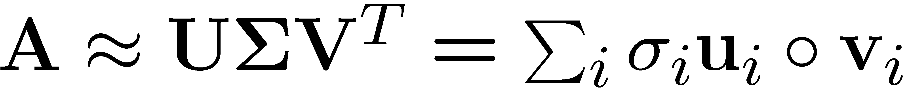
SVD
T
n
n
A
≈
Σ
V^{T}
m
m
U

Slide 6
SVD
T
n
σ₁u₁v₁
σ₂u₂v₂
A
≈
m
+
σ_{i} … scalar
u_{i} … vector
v_{i} … vector

Slide 7
SVD - Properties
It is always possible to decompose a real matrix A into A = U Σ V^{T} , where
U, Σ, V: unique
U, V: column orthonormal
U^{T} U = I; V^{T} V = I (I: identity matrix)
(Columns are orthogonal unit vectors)
Σ: diagonal
Entries (singular values) are positive, and sorted in decreasing order (σ₁ ≥ σ₂ ≥ ... ≥ 0)
Nice proof of uniqueness: http://www.mpi-inf.mpg.de/~bast/ir-seminar-ws04/lecture2.pdf

Slide 8
Why randomize SVD?
Runtime
We’re good at generating [pseudo-]random numbers
Can easily parallelize / distribute matrix algebra
SVD, like PCA, runs O(n³), making anything beyond ~10³ infeasible

Slide 9
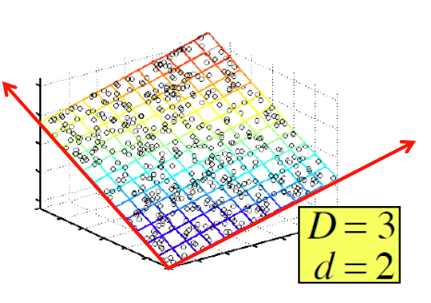
SVD – Example: Users-to-Movies
A = U Σ V^{T} - example: Users to Movies
Matrix
Alien
Serenity
Casablanca
Amelie
n
1 1 1 0 0
3 3 3 0 0
4 4 4 0 0
5 5 5 0 0
0 2 0 4 4
0 0 0 5 5
0 1 0 2 2
SciFi
Σ
V^{T}
=
m
Romance
U
“Concepts” AKA Latent dimensions AKA Latent factors

Slide 10
SVD – Example: Users-to-Movies
A = U Σ V^{T} - example: Users to Movies
Matrix
Alien
Serenity
Casablanca
Amelie
1 1 1 0 0
3 3 3 0 0
4 4 4 0 0
5 5 5 0 0
0 2 0 4 4
0 0 0 5 5
0 1 0 2 2
0.13 0.02 -0.01
0.41 0.07 -0.03
0.55 0.09 -0.04
0.68 0.11 -0.05
0.15 -0.59 0.65
0.07 -0.73 -0.67
0.07 -0.29 0.32
SciFi
12.4 0 0
0 9.5 0
0 0 1.3
=
x
x
Romnce
0.56 0.59 0.56 0.09 0.09
0.12 -0.02 0.12 -0.69 -0.69
0.40 -0.80 0.40 0.09 0.09

Slide 11
SVD – Example: Users-to-Movies
A = U Σ V^{T} - example: Users to Movies
Matrix
Alien
Serenity
Casablanca
Amelie
SciFi-concept
Romance-concept
1 1 1 0 0
3 3 3 0 0
4 4 4 0 0
5 5 5 0 0
0 2 0 4 4
0 0 0 5 5
0 1 0 2 2
0.13 0.02 -0.01
0.41 0.07 -0.03
0.55 0.09 -0.04
0.68 0.11 -0.05
0.15 -0.59 0.65
0.07 -0.73 -0.67
0.07 -0.29 0.32
SciFi
12.4 0 0
0 9.5 0
0 0 1.3
=
x
x
Romnce
0.56 0.59 0.56 0.09 0.09
0.12 -0.02 0.12 -0.69 -0.69
0.40 -0.80 0.40 0.09 0.09

Slide 12
SVD – Example: Users-to-Movies
A = U Σ V^{T} - example:
U is “user-to-concept”
similarity matrix
Matrix
Alien
Serenity
Casablanca
Amelie
SciFi-concept
Romance-concept
1 1 1 0 0
3 3 3 0 0
4 4 4 0 0
5 5 5 0 0
0 2 0 4 4
0 0 0 5 5
0 1 0 2 2
0.13 0.02 -0.01
0.41 0.07 -0.03
0.55 0.09 -0.04
0.68 0.11 -0.05
0.15 -0.59 0.65
0.07 -0.73 -0.67
0.07 -0.29 0.32
SciFi
12.4 0 0
0 9.5 0
0 0 1.3
=
x
x
Romnce
0.56 0.59 0.56 0.09 0.09
0.12 -0.02 0.12 -0.69 -0.69
0.40 -0.80 0.40 0.09 0.09

Slide 13
SVD – Example: Users-to-Movies
A = U Σ V^{T} - example:
Matrix
Alien
Serenity
Casablanca
Amelie
SciFi-concept
“strength” of the SciFi-concept
1 1 1 0 0
3 3 3 0 0
4 4 4 0 0
5 5 5 0 0
0 2 0 4 4
0 0 0 5 5
0 1 0 2 2
0.13 0.02 -0.01
0.41 0.07 -0.03
0.55 0.09 -0.04
0.68 0.11 -0.05
0.15 -0.59 0.65
0.07 -0.73 -0.67
0.07 -0.29 0.32
SciFi
SciFi
12.4 0 0
0 9.5 0
0 0 1.3
=
x
x
Romnce
Romnce
0.56 0.59 0.56 0.09 0.09
0.12 -0.02 0.12 -0.69 -0.69
0.40 -0.80 0.40 0.09 0.09

Slide 14
SVD – Example: Users-to-Movies
A = U Σ V^{T} - example:
Matrix
Alien
Serenity
Casablanca
Amelie
V is “movie-to-concept”
similarity matrix
SciFi-concept
1 1 1 0 0
3 3 3 0 0
4 4 4 0 0
5 5 5 0 0
0 2 0 4 4
0 0 0 5 5
0 1 0 2 2
0.13 0.02 -0.01
0.41 0.07 -0.03
0.55 0.09 -0.04
0.68 0.11 -0.05
0.15 -0.59 0.65
0.07 -0.73 -0.67
0.07 -0.29 0.32
SciFi
12.4 0 0
0 9.5 0
0 0 1.3
=
x
x
Romnce
0.56 0.59 0.56 0.09 0.09
0.12 -0.02 0.12 -0.69 -0.69
0.40 -0.80 0.40 0.09 0.09
SciFi-concept

Slide 15
SVD - Interpretation #1
‘movies’, ‘users’ and ‘concepts’:
U: user-to-concept similarity matrix
V: movie-to-concept similarity matrix
Σ: its diagonal elements: ‘strength’ of each concept

Slide 16
SVD - Interpretation #2
More details
Q: How exactly is dim. reduction done?
A: Set smallest singular values to zero
1 1 1 0 0
3 3 3 0 0
4 4 4 0 0
5 5 5 0 0
0 2 0 4 4
0 0 0 5 5
0 1 0 2 2
0.13 0.02 -0.01
0.41 0.07 -0.03
0.55 0.09 -0.04
0.68 0.11 -0.05
0.15 -0.59 0.65
0.07 -0.73 -0.67
0.07 -0.29 0.32
12.4 0 0
0 9.5 0
0 0 1.3
=
x
x
0.56 0.59 0.56 0.09 0.09
0.12 -0.02 0.12 -0.69 -0.69
0.40 -0.80 0.40 0.09 0.09

Slide 17
SVD - Interpretation #2
More details
Q: How exactly is dim. reduction done?
A: Set smallest singular values to zero
1 1 1 0 0
3 3 3 0 0
4 4 4 0 0
5 5 5 0 0
0 2 0 4 4
0 0 0 5 5
0 1 0 2 2
0.13 0.02 -0.01
0.41 0.07 -0.03
0.55 0.09 -0.04
0.68 0.11 -0.05
0.15 -0.59 0.65
0.07 -0.73 -0.67
0.07 -0.29 0.32
12.4 0 0
0 9.5 0
0 0 1.3
≈
x
x
0.56 0.59 0.56 0.09 0.09
0.12 -0.02 0.12 -0.69 -0.69
0.40 -0.80 0.40 0.09 0.09

Slide 18
SVD - Interpretation #2
More details
Q: How exactly is dim. reduction done?
A: Set smallest singular values to zero
1 1 1 0 0
3 3 3 0 0
4 4 4 0 0
5 5 5 0 0
0 2 0 4 4
0 0 0 5 5
0 1 0 2 2
0.13 0.02 -0.01
0.41 0.07 -0.03
0.55 0.09 -0.04
0.68 0.11 -0.05
0.15 -0.59 0.65
0.07 -0.73 -0.67
0.07 -0.29 0.32
12.4 0 0
0 9.5 0
0 0 1.3
≈
x
x
0.56 0.59 0.56 0.09 0.09
0.12 -0.02 0.12 -0.69 -0.69
0.40 -0.80 0.40 0.09 0.09

Slide 19
SVD - Interpretation #2
More details
Q: How exactly is dim. reduction done?
A: Set smallest singular values to zero
1 1 1 0 0
3 3 3 0 0
4 4 4 0 0
5 5 5 0 0
0 2 0 4 4
0 0 0 5 5
0 1 0 2 2
0.13 0.02
0.41 0.07
0.55 0.09
0.68 0.11
0.15 -0.59
0.07 -0.73
0.07 -0.29
12.4 0
0 9.5
≈
x
x
0.56 0.59 0.56 0.09 0.09
0.12 -0.02 0.12 -0.69 -0.69

Slide 20
SVD - Interpretation #2
More details
Q: How exactly is dim. reduction done?
A: Set smallest singular values to zero
ǁA-Bǁ_{F} = √ Σ_{ij} (A_{ij}-B_{ij})²
^{is “small”}
1 1 1 0 0
3 3 3 0 0
4 4 4 0 0
5 5 5 0 0
0 2 0 4 4
0 0 0 5 5
0 1 0 2 2
0.92 0.95 0.92 0.01 0.01
2.91 3.01 2.91 -0.01 -0.01
3.90 4.04 3.90 0.01 0.01
4.82 5.00 4.82 0.03 0.03
0.70 0.53 0.70 4.11 4.11
-0.69 1.34 -0.69 4.78 4.78
0.32 0.23 0.32 2.01 2.01
≈
Frobenius norm:
ǁMǁ_{F} = √Σ_{ij} M_{ij}²

Slide 21
SVD – Best Low Rank Approx.
A
U
Sigma
=
V^{T}
B is best approximation of A
B
U
Sigma
=
V^{T}

Slide 22
Relationship to PCA
SVD can be applied to any matrix; PCA only works on symmetric covariance matrices
However, there is a relationship
Columns of V are eigenvectors of M^{T}M
Columns of U are eigenvectors of MM^{T}
Singular values are square roots of eigenvalues of M^{T}M or MM^{T}

Slide 23
SVD: Drawbacks
Optimal low-rank approximation in terms of Frobenius norm
Interpretability problem:
A singular vector specifies a linear combination of all input columns or rows
Lack of sparsity:
Singular vectors are dense!
V^{T}
Σ
=
U

Slide 24
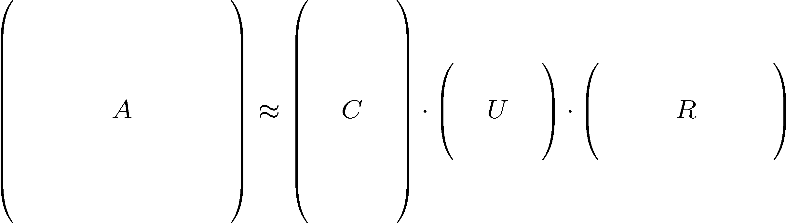
CUR Decomposition
Frobenius norm:
ǁXǁ_{F} = √ Σ_{ij} X_{ij}²
Goal: Express A as a product of matrices C,U,R
Make ǁA-C·U·Rǁ_{F} small
“Constraints” on C and R:
A
C
U
R

Slide 25
CUR Decomposition
Frobenius norm:
ǁXǁ_{F} = √ Σ_{ij} X_{ij}²
Goal: Express A as a product of matrices C,U,R
Make ǁA-C·U·Rǁ_{F} small
“Constraints” on C and R:
Pseudo-inverse of
the intersection of C and R
A
C
U
R

Slide 26
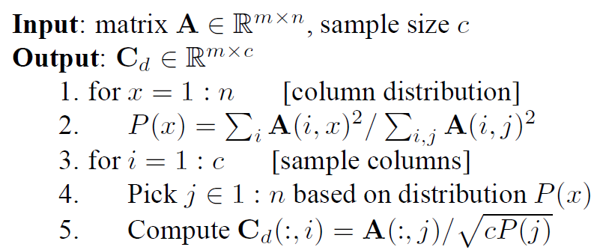
CUR: How it Works
Note this is a randomized algorithm; the same column can be sampled more than once
Sampling columns (similarly for rows):

Slide 27
Computing U
Let W be the “intersection” of sampled columns C and rows R
Let SVD of W = X Z Y^{T}
Then: U = W⁺ = Y Z⁺ X^{T}
Ζ⁺: reciprocals of non-zero singular values: Ζ⁺_{ii} =1/ Ζ_{ii}
W⁺ is the “pseudoinverse”
Why pseudoinverse works?
W = X Z Y then W⁻¹ = X⁻¹ Z⁻¹ Y⁻¹
Due to orthonomality
X⁻¹=X^{T} and Y⁻¹=Y^{T}
Since Z is diagonal Z⁻¹ = 1/Z_{ii}
Thus, if W is nonsingular, pseudoinverse is the true inverse
A
R
W
C
≈
U = W⁺

Slide 28
CUR: Pros & Cons
Easy interpretation
Since the basis vectors are actual columns and rows
Sparse basis
Since the basis vectors are actual columns and rows
Duplicate columns and rows
Columns of large norms will be sampled many times
Actual column
Singular vector

Slide 29
Solution
If we want to get rid of the duplicates:
Throw them away
Scale (multiply) the columns/rows by the square root of the number of duplicates
A
C_{d}
R_{d}
C_{s}
R_{s}
Construct a small U

Slide 30
SVD vs. CUR
sparse and small
SVD: A = U Σ V^{T}
Huge but sparse
Big and dense
dense but small
CUR: A = C U R
Huge but sparse
Big but sparse

Slide 31
Stochastic SVD (SSVD)
Uses random projections to find close approximation to SVD
Combination of probabilistic strategies to maximize convergence likelihood
Easily scalable to massive linear systems

Slide 32
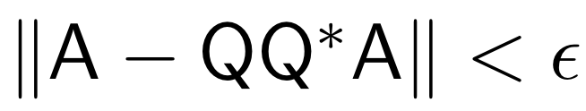
Basic goal
Matrix A
Find a low-rank approximation of A
Basic dimensionality reduction
Preconditioning
Notes:
Construct a low dimensional subspace that approximates the range of A.

Slide 33
Approximating range of A
INPUT: A, k, p
OUTPUT: Q
Draw Gaussian n x k test matrix Ω
Form product Y = AΩ
Orthogonalize columns of Y ➔Q
Notes:
-Matrix A is m by n
-k is the desired number of dimensions of the low-rank representation (e.g. 10, 100, something significantly smaller than n)
-p is the oversampling parameter

Slide 34
Approximating SVD of A
INPUT: Q
OUTPUT: Singular vectors U
Form k x n matrix B = Q^{T}A
Compute SVD of B = ÛΣV^{T}
Compute singular vectors U = QÛ
Notes:
The key point is that B is MUCH SMALLER than A, but approximates the SVD of A

Slide 35
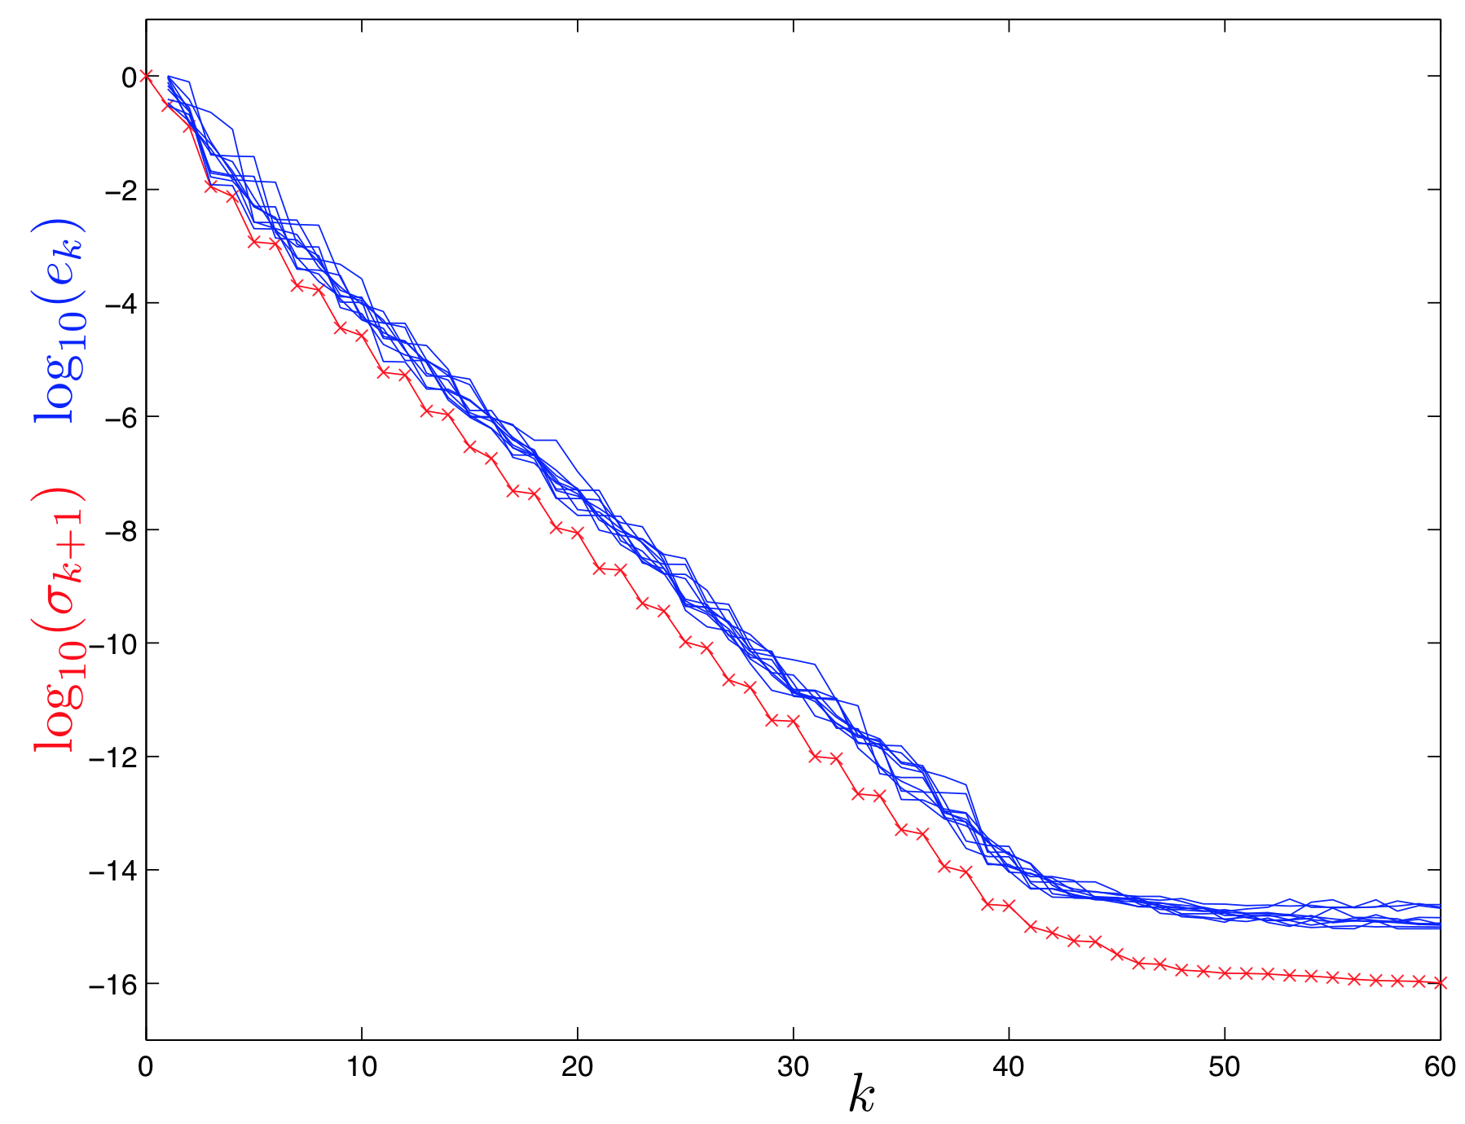
Empirical Results
1000x1000 matrix
Several runs of empirical results (blue) to theoretical lower bound (red)
Error seems to be systemic
Notes:
Blue lines: 10 iterations of SSVD
Red line: full SVD of original A

Slide 36
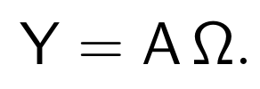

Power iterations
Affects decay of eigenvalues / singular values
Notes:
(sketch small proof of eigenvalue decay rate)

Slide 37
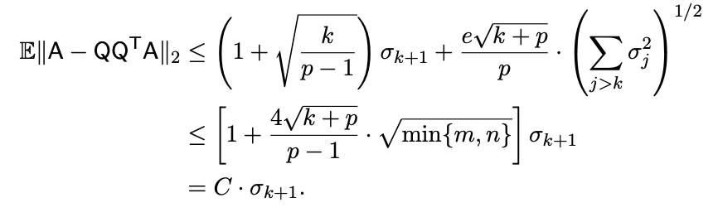
Power iterations
Upshot: after only a single power iteration, the error is proportional to the next [uncomputed] singular value (times a constant C).
Notes:
(sketch small proof of eigenvalue decay rate)

Slide 38
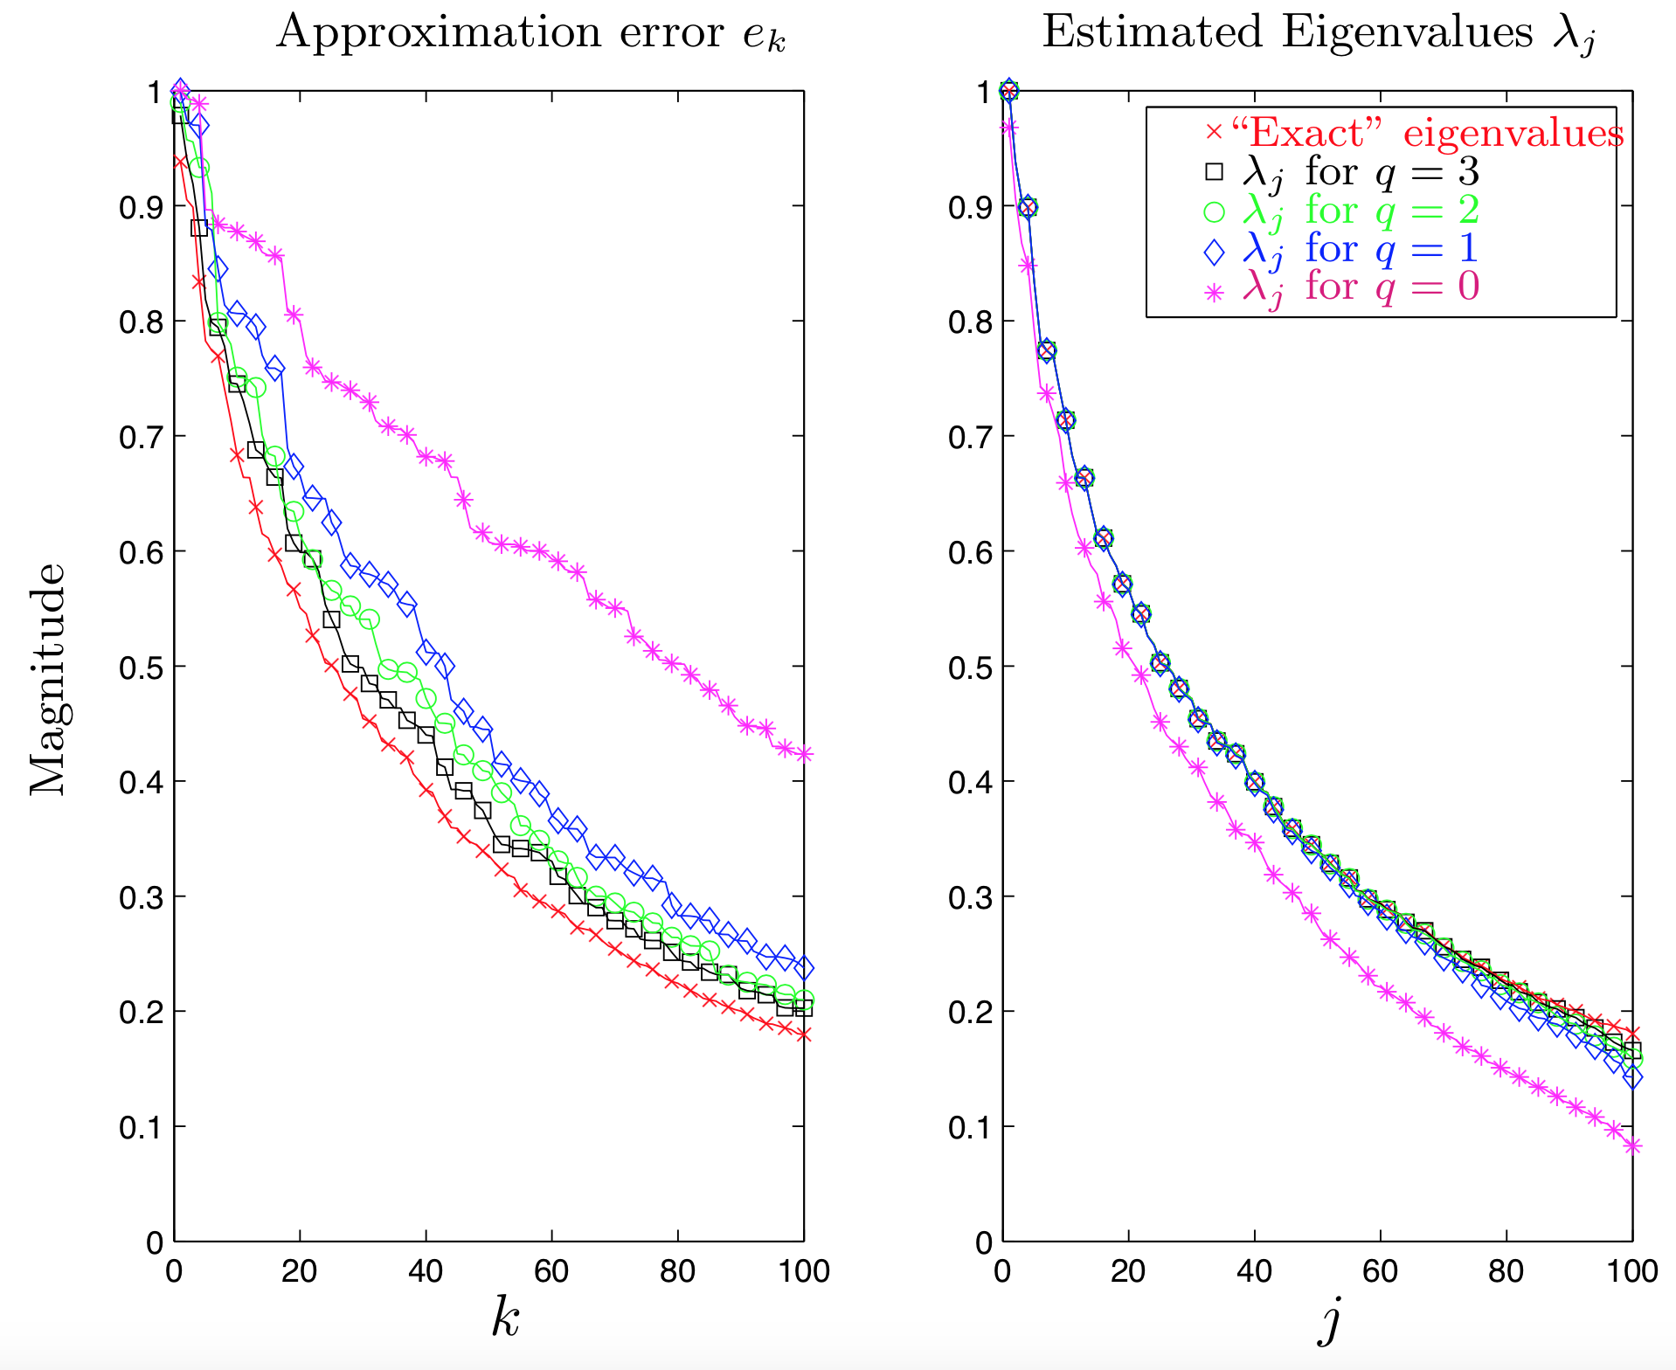
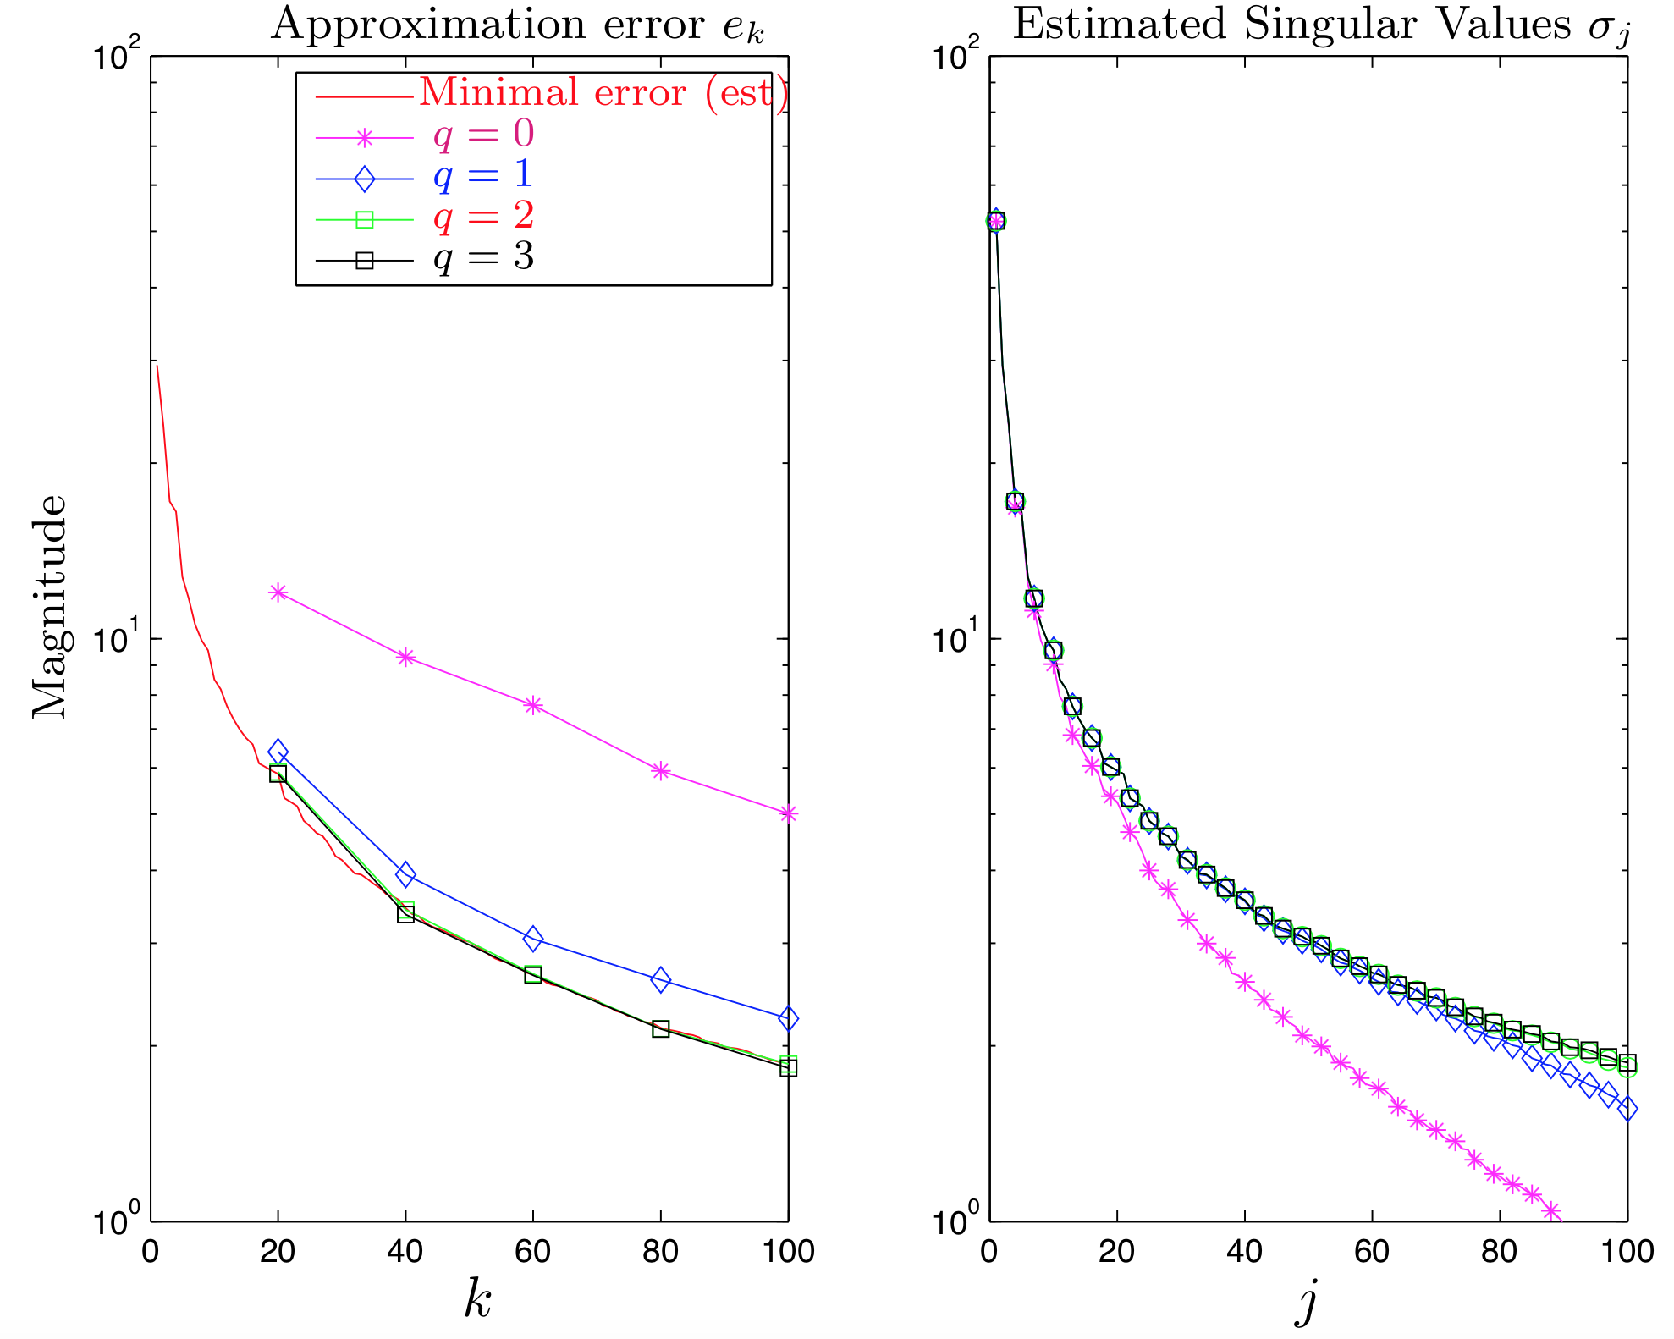
Empirical Results

Slide 39
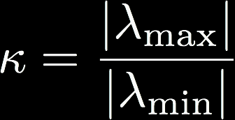
Why does this work?
Three primary reasons:
Johnson-Lindenstrauss Lemma
Low-dimensional embeddings preserve pairwise distances
Concentration of measure
Geometric interpretation of classical idea: regular functions of independent random variables rarely deviate far from their means
Preconditioning
Condition number: how much change in output is produced from change in input (relation to #1)
Q matrix lowers condition number while preserving overall system

Slide 40
Summary
Relationship of SVD and PCA
PCA: eigenvectors and eigenvalues of the covariance matrix (or kernel matrix, for Kernel PCA)
SVD: Low-rank approximation for any matrix
CUR
Randomly sample columns of data matrix A to use as basis
Interpretable and sparse, but potentially oversample high-magnitude columns
SVD via SGD
Reframe SVD as a matrix completion problem
Use SGD in alternating least-squares to infer ”missing” components
SSVD
Full-blown Johnson-Lindenstrauss exploitation
Use random projections to approximate SVD to high accuracy
Requires some empirical tweaks (oversampling, power iterations)

Slide 41
References
“Randomized methods for computing low-rank approximations of matrices”, https://amath.colorado.edu/faculty/martinss/Pubs/2012_halko_dissertation.pdf
“CUR decomposition for compression and compressed sensing of large-scale traffic data”, https://dspace.mit.edu/openaccess-disseminate/1721.1/86879

Slide 43
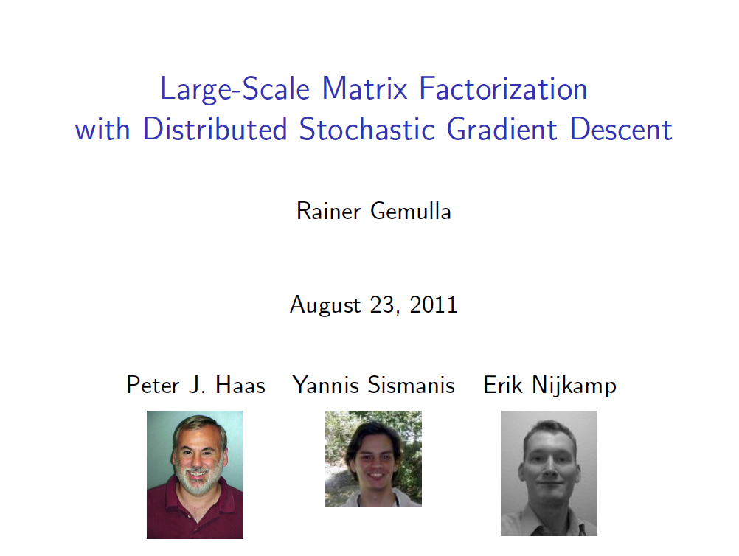

KDD 2011
talk pilfered from → …..

Slide 44
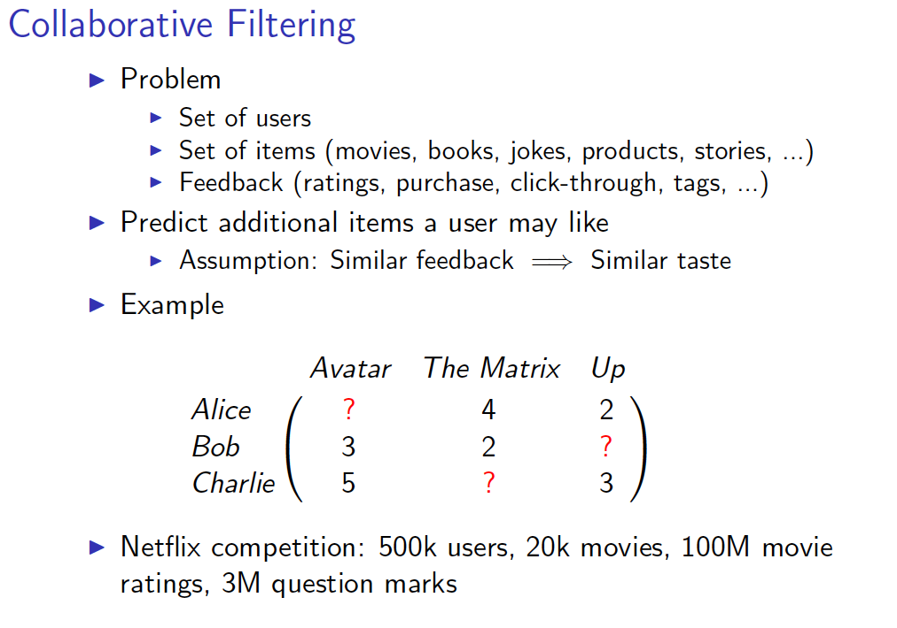

Slide 45
Recovering latent factors in a matrix
r
m movies
m movies
~
H
x1 | y1
x2 | y2
.. | ..
… | …
xn | yn
a1 | a2 | .. | … | am
b1 | b2 | … | … | bm
v11 | …
… | …
 | vij
n users
W
V
 |  |  | …
 |  |  |  | vnm
V[i,j] = user i’s rating of movie j

Slide 46
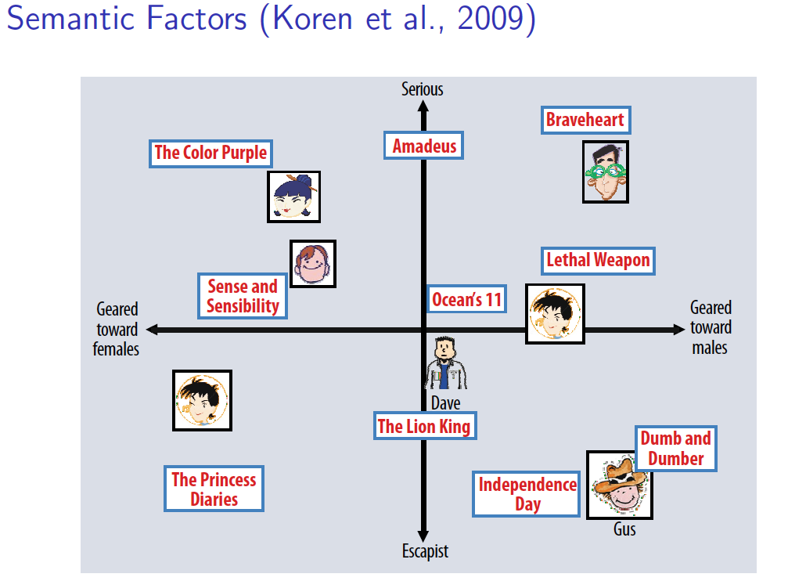

Slide 47
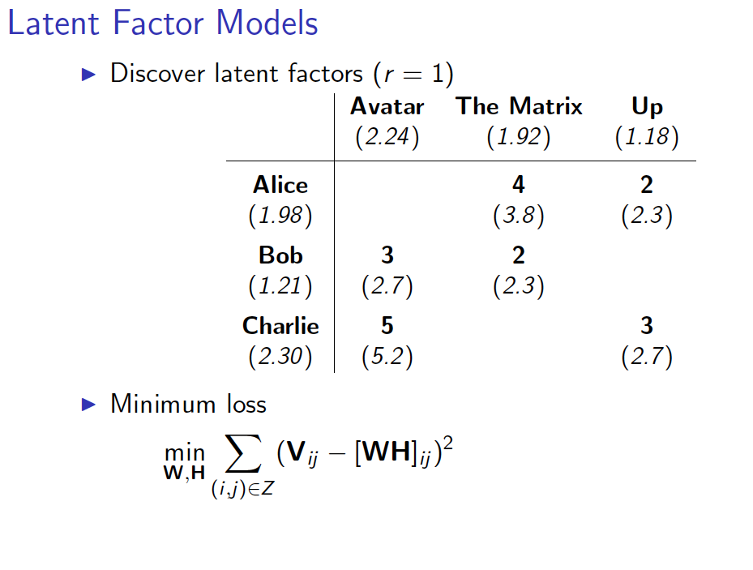

Slide 48
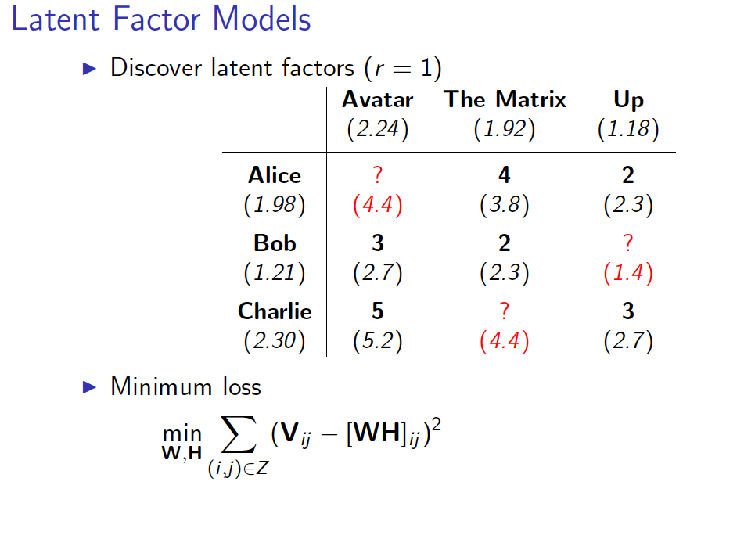
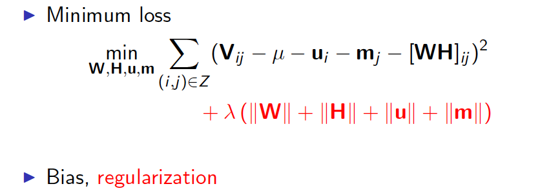

Slide 49
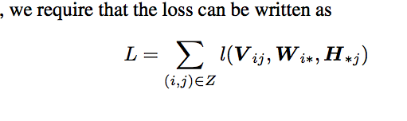
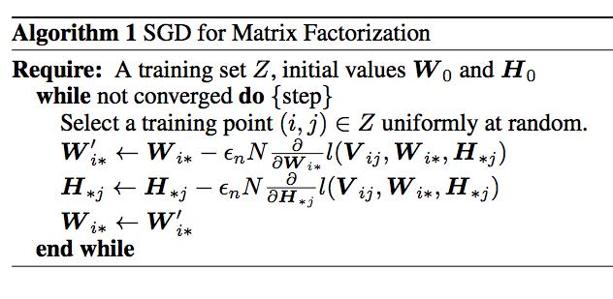
Matrix factorization as SGD
step size
why does this work?

Slide 50
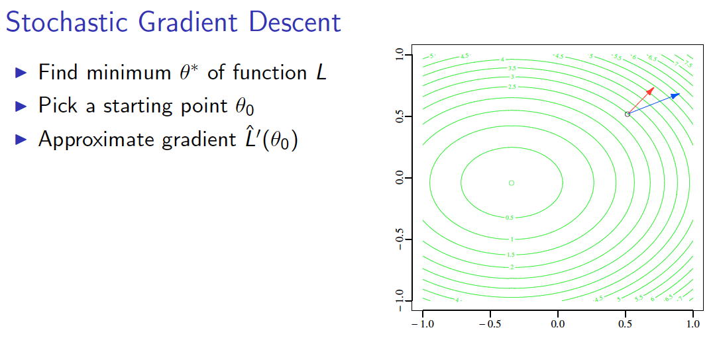

Slide 51
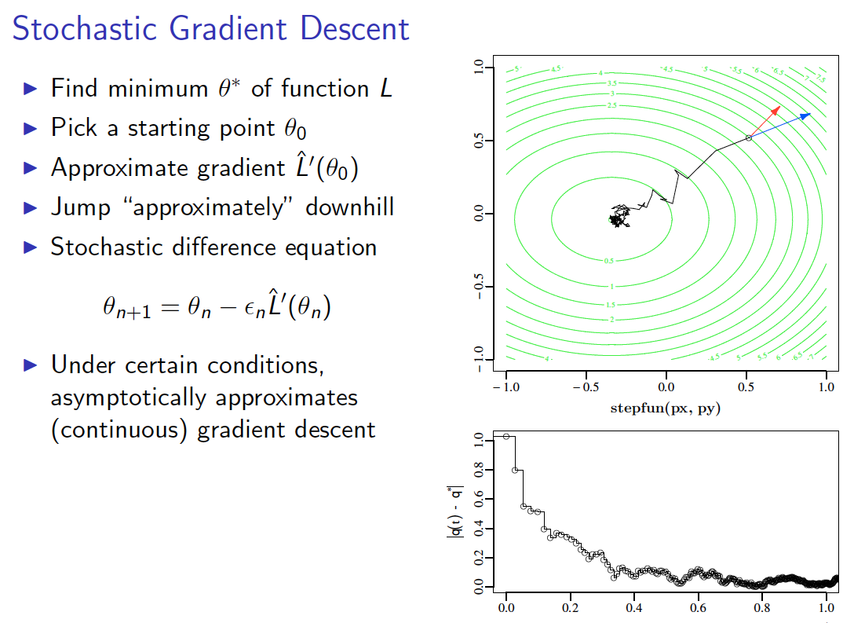

Slide 52
Why does this work?
step size

Slide 53
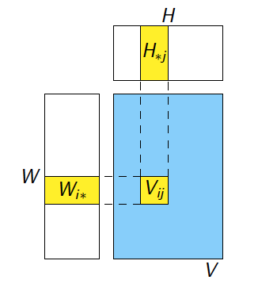
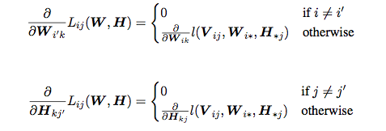
Key Claim

Slide 54




Checking the claim
Think for SGD for logistic regression
LR loss = compare y and ŷ = dot(w,x)
similar but now update w (user weights) and x (movie weight)

Slide 55
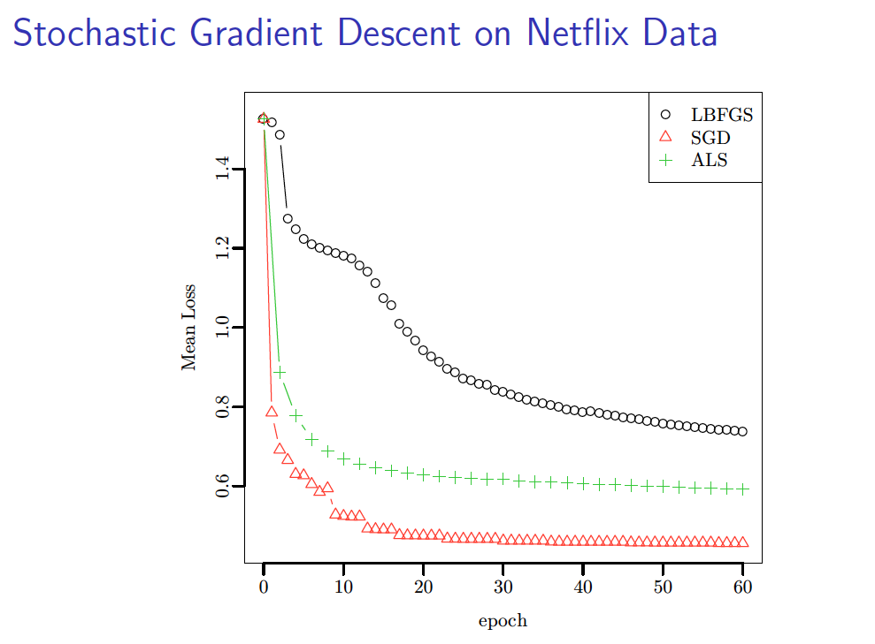
ALS = alternating least squares

