Slide 1
Auto-Differentiation with autograd
I-Huei Ho
CSCI 4/6360 Data SCIENCE II

Slide 2
Content
WHAT? – What is Auto-Differentiation?
WHY? – Why should we use this?
HOW? – How does Auto-Differentiation work?
HOW does it work in tools? In Autograd?

Slide 3
Automatic Differentiation
(Quote by Wikipedia) “Auto-Differentiation (AD), also called algorithmic differentiation or computational differentiation, is a set of techniques to numerically evaluate the derivative of a function specified by a computer program – derivatives of arbitrary order can be computed automatically, accurately to working precision, and using at most a small constant factor more arithmetic operations than the original program.”
Powerful
One of the best scientific computing techniques you’ve never heard of.
The most criminally underused tool in the potential machine learning toolbox.

Slide 4
Automatic Differentiation is a way to,
★
Mathemagically Find Derivatives.
★
★★★★★★★★★★★★★★★★

Slide 5
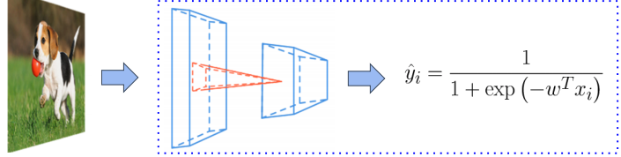
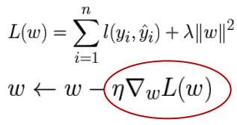
background
Model Training Process
layer 1 layer 2 extractor extractor predictor
Objective
Training

Slide 6
Computation of derivatives in computer programs
Manually working out derivatives and coding them
Numerical Differentiation using finite difference approximations
Symbolic Differentiation using expression manipulation in computer algebra systems
Automatic Differentiation (Algorithmic Differentiation)
When introducing new models, ML researchers: manual derivation >> plug into standard optimization procedure (L-BFGS, SGD)

Slide 7
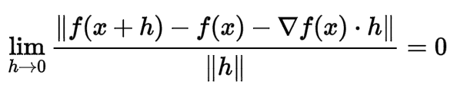
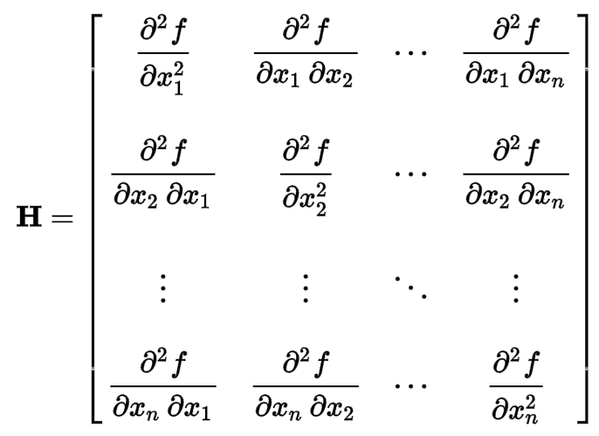
1. (Manual) Derivatives
CONS:
Time consuming
Prone to error
requires models to be expressed as closed-form mathematical formula
Most Forms in ML: (in most traditional learning algorithms)
gradients
Hessians
Hessian matrix: square matrix of second-order partial derivatives of a scalar-valued function, or scalar field

Slide 8
2. Numerical Differentiation
PROS: Simple to implement
CONS:
scales poorly for gradients
scales can be highly inaccurate (round-off, truncation errors)
3. symbolic Differentiation
PROS: address 1 and 2’s CONS
CONS:
results in complex and cryptic expression: “expression swell”
requires models to be expressed as closed-form mathematical formula

Slide 9
4. Automatic differentiation
Algorithmic Differentiation AutoDiff
Systematically apply the chain rule of differential calculus at the elementary operator level
General-purpose AD:
Widespread-used in other fields
Underused in machine learning community (until very recently)
Projects: autograd, torch-autograd, PyTorch are leading the way in bringing it to the mainstream
“automatic”: misnomer, confusing, misleading wrong situations: Put the label autodiff on any method or tool that does not involve manual differentiation

Slide 10
4. Automatic differentiation
Method A specific family of techniques that compute derivatives through accumulation of values during code execution and generate numerical derivative evaluations rather than derivative expressions >> it allows accurate evaluation of derivatives at machine precision with only a small constant factor of overhead and ideal asymptotic efficiency.
Contrast
Symbolic Differentiation: with the effort involved in arranging code as closed-form expressions under the syntactic and semantic constraints
AD applys to regular code with minimal change, allowing branching, loops, and recursion.

Slide 11
Confusion
Wrongly assume AD is either a type of numerical or symbolic differentiation
AD provides only numerical values of derivatives >> opposed to derivative expressions
AD uses symbolic rules of differentiation >> keeps track of derivative values as opposed to the resulting expressions
AD gives a two-sided nature that is partly symbolic and partly numerical

Slide 12



IS NOT Numerical Differentiation
Finite difference approximation of derivatives using values of original function evaluated at some sample points
Simple case, (based on limit definition of a derivative)
is the ith unit vector
is a small step size
PROs: Uncomplicated to implement
CONs: Gradient in n dimensions requires careful consideration in selecting h Still suffer from rounding error

Slide 13

BACKGROUND
Numerical Differentiation
Approximate the gradient:
Reduce the truncation error by using center difference:
Drawbacks: Still suffer from rounding error. (A powerful tool to check the correctness of implementation, usually use h=1e-6)

Slide 14
IS Not symbolic differentiation
Input formula is a symbolic expression tree (computation graph)
Implement differentiation rules (e.g., product rule, sum rule, chain rule)
Drawbacks: 1. For complicated functions, the resultant expression can be exponentially large 2. Wasteful to keep around intermediate symbolic expressions if we need a numeric value of the gradient in the end

Slide 15
BACKGROUND
Symbolic Differentiation
Input formula is a symbolic expression tree (computation graph)
Implement differentiation rules (e.g., product rule, sum rule, chain rule)
Drawbacks: 1. For complicated functions, the resultant expression can be exponentially large 2. Wasteful to keep around intermediate symbolic expressions if we need a numeric value of the gradient in the end

Slide 16
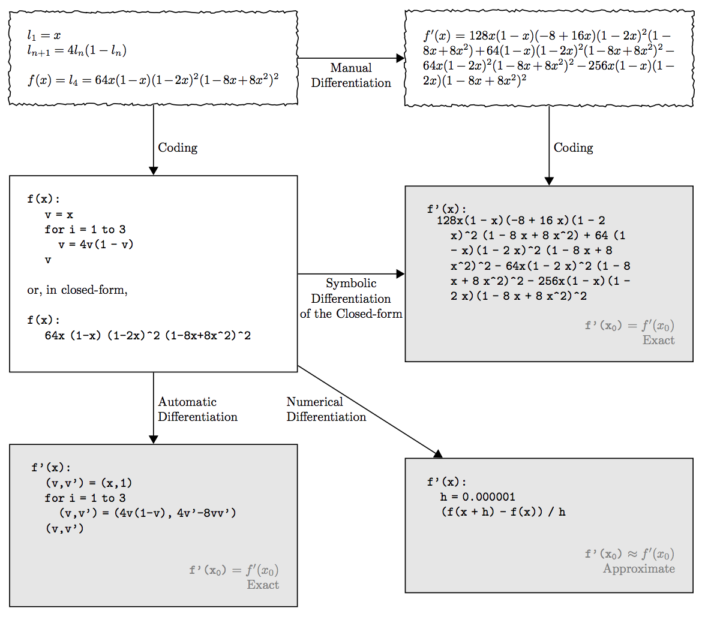
Symbolic diff:
Gives exact results
Requires closed-form input
Suffers from expression swell
AD:
As accurate as symb.
Only constant factor
Support for control flow
Numeric diff:
Problematic accuracy (round-off, truncation errors)

Slide 17


Flow of AUTO-DIFF
“subroutine”: a function in a computer programming language
“function”: a mathematical function
You write a subroutine to compute a function . You know to be differentiable, but don’t feel like writing a subroutine to compute .
You point some auto-differentiation software at your subroutine. It produces a subroutine to compute the gradient.
That new subroutine has the same complexity as the original function! >> It does not depend on the dimensionality of x.
It also does not suffer from round-off errors!

Slide 18
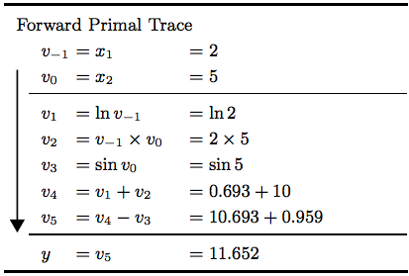
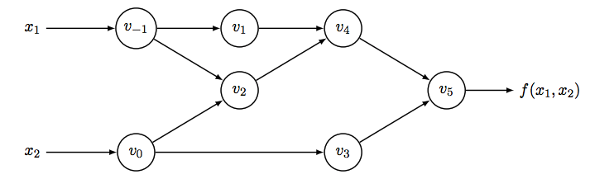
Main modes of AD
Goal:
Set computation function y:
Notations:
: input variables
: working (intermediate) variables
: output variables

Slide 19


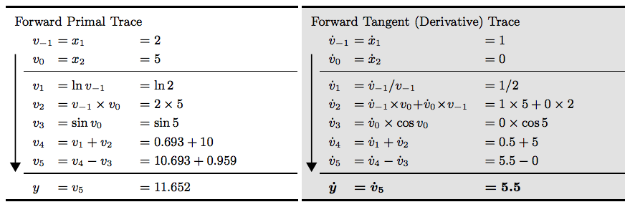
Forward MODE
Start with computing the derivative of with respect to
Associate each intermediate variable with by a derivative
Apply the chain rule to each elementary operation in forward primal trace
Generate the corresponding tangent trace
Required derivative in final variable

Slide 20

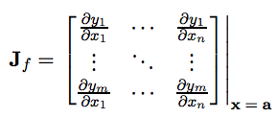
Forward MODE
>> computing the Jacobian of a function with n independent input variables and m dependent output variables
In each forward pass:
Initialized by setting only one of the variables
>> Gives one column of the Jacobian matrix evaluated at point a.
>> full Jacobian needs to compute in n evaluation

Slide 21
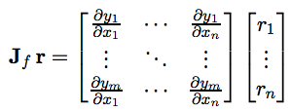
Forward MODE
>> computing the Jacobian of a function with n independent input variables and m dependent output variables
In each forward pass:
Efficient and matrix-free way to compute Jacobian-vector products
If computing a function
In general, for cases where n>>m, AD in reverse mode is more preferable.
>> initialize with
>> compute the Jacobian-vector product in just one forward pass.

Slide 22
forward mode
Problems
Needs n forward passes to get gradient wrt each output
However, DNN typically has a LARGE number of inputs (weights considered as inputs too) and a small number of outputs
AutoDiff in reverse mode computes all gradients in m backward passes, and for many DNN, m=1, so a single back pass (backpropagation)

Slide 23

REVERSE MODE
Corresponds to a generalized backpropagation algorithm >> propagates derivatives backward from a given output
Supplement each intermediate variable with an adjoint represents the sensitivity of a considered output with respect to changes in
Derivatives are computed in second stage of a two-stage process First stage: original function code is run forward, populating intermediate variables and recording the dependencies in the computational graph through a bookkeeping procedure Second stage: derivatives are calculated by propagating adjoints from the outputs to inputs

Slide 24




REVERSE MODE
E.g, variable
Only way to affect : through affecting and
Contribution to the change in :
Contribution is computed in two incremental steps:
adjoint

Slide 25
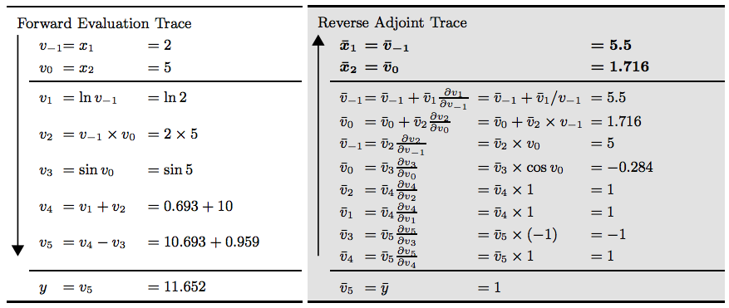
REVERSE MODE

Slide 26



REVERSE MODE
Corresponds to a generalized backpropagation algorithm >> propagates derivatives backward from a given output
After forward pass, run reverse pass of the adjoints
Starts with
In the end, gets the derivatives and in just one reverse pass

Slide 27
REVERSE vs Forward
Significantly less costly to evaluate (in terms of operation count) than forward mode
Extreme case: if ,
Reverse: only 1 application is sufficient to compute the full gradient
Forward: needs n passes
In case: ops(f): operation count to evaluate the original function c: constant guaranteed to be c<6 and c~[2,3] (Griewank and Walther, 2008)
Calculation time for calculating the mxn Jacobian:
Reverse: m*c*ops(f)
Forward: n*c*ops(f)
>> Reverse mode AD performs better when m <<<<< n

Slide 28
backpropagation
Backpropagation
= backward propagation of errors ∵error is calculated at the output distributed back through the network layers
used in artificial neural networks
Calculate the error contribution of each neuron after a batch of data processed
E.g.: image recognition, multiple images
Calculate the gradient of the loss function commonly used in gradient descent optimization algorithm
SVD vs Backpropagation

Slide 29
Reverse autodiff vs backpropagation
Can take derivative of derivative node
Only a forward pass easier to apply graph and schedule optimization to a single graph
Already know the dependencies of the backward graph >> can have better memory optimization
Hard to take derivative
Forward-backward
All intermediate results might be used in the future >> need to keep these values in the memory

Slide 30
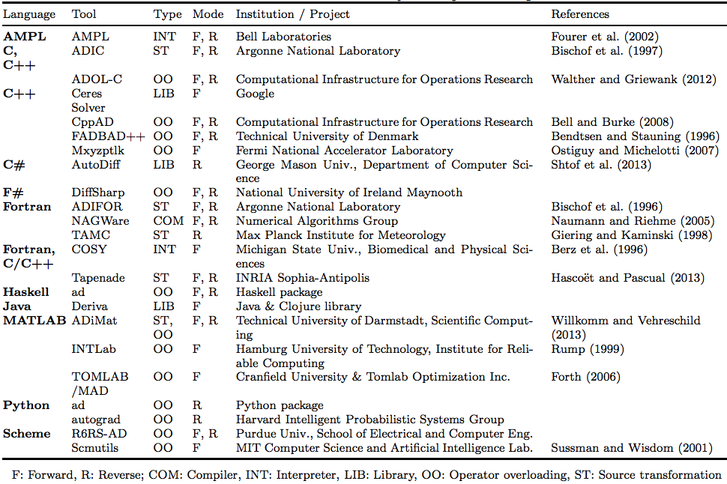
AD Implementation

Slide 31
autograd
https://github.com/HIPS/autograd
Install Autograd: pip install autograd
A python package for automatic differentiation
Can automatically differentiate python and Numpy code
Can handle most of python’s features: loops, if statements, recursion, closures
Can compute higher-order derivatives
Uses reverse-mode differentiation (backpropagation) >> efficiently take gradients of scalar-valued functions with respect to array-valued or vector-valued arguments

Slide 32
autograd
https://github.com/HIPS/autograd
Allows you to compute gradients of many types of data structures Any nested combination of lists, tuples, arrays, or dictionaries >> Use flatten function converts data structures to 1-D vectors
Provides a lot of flexibility in how you store and manipulate the parameters of your model

Slide 33
Q&A

Slide 34
Reference
[1] Atilim Gunes Baydin, Barak A. Pearlmutter, Alexey Andreyevich Radul, Jeffrey Mark Siskind: Automatic Differentiation (2017), https://arxiv.org/pdf/1502.05767.pdf
[2] Tianqi Chen, Haichen Shen, Arvind Krishnamurthy: Automatic Differentiation (2017), http://dlsys.cs.washington.edu/pdf/lecture4.pdf
[3] Autograd tutorial, https://github.com/HIPS/autograd/blob/master/docs/tutorial.md
[4] Paul Vicol: Autograd tutorial, http://www.cs.toronto.edu/~rgrosse/courses/csc321_2017/tutorials/tut4.pdf

