Slide 1
Assignment 1 Postmortem
CSCI 4360/6360 Data Science II
Tuesday, September 5, 2017

Slide 2
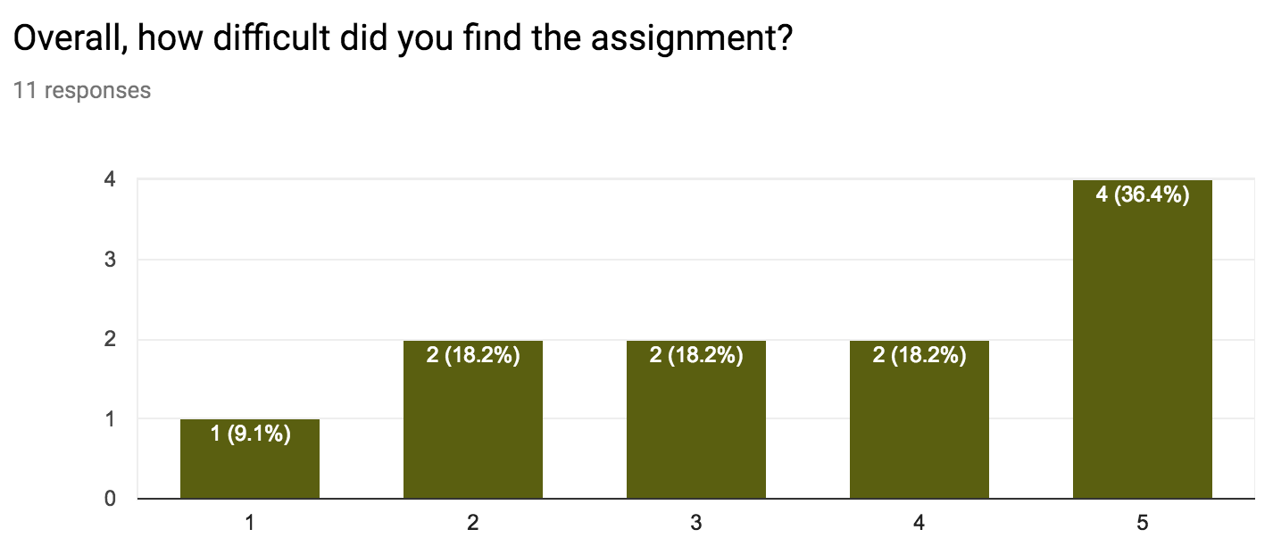
Poll Review
11 responses (as of writing)

Slide 3
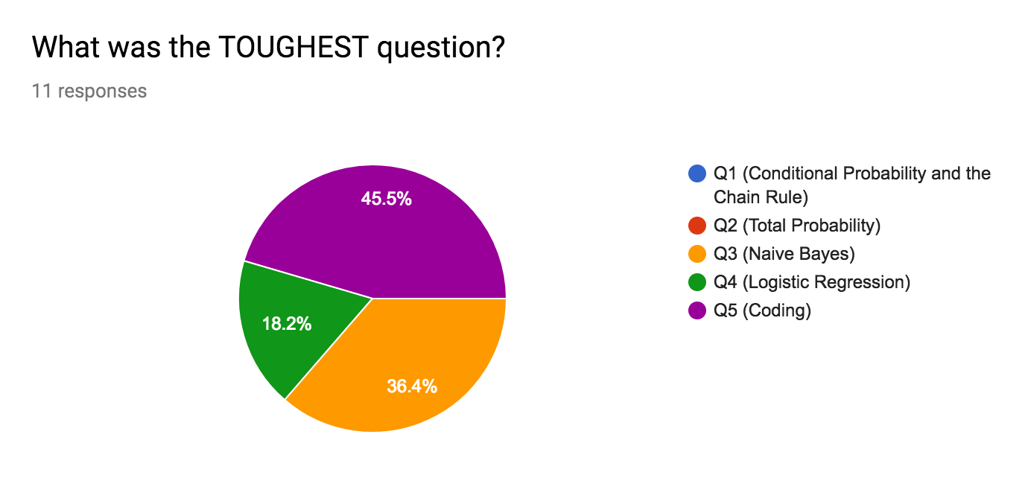
Poll Review
Q3: 4 votes
Q4: 2 votes
Q5: 5 votes

Slide 4
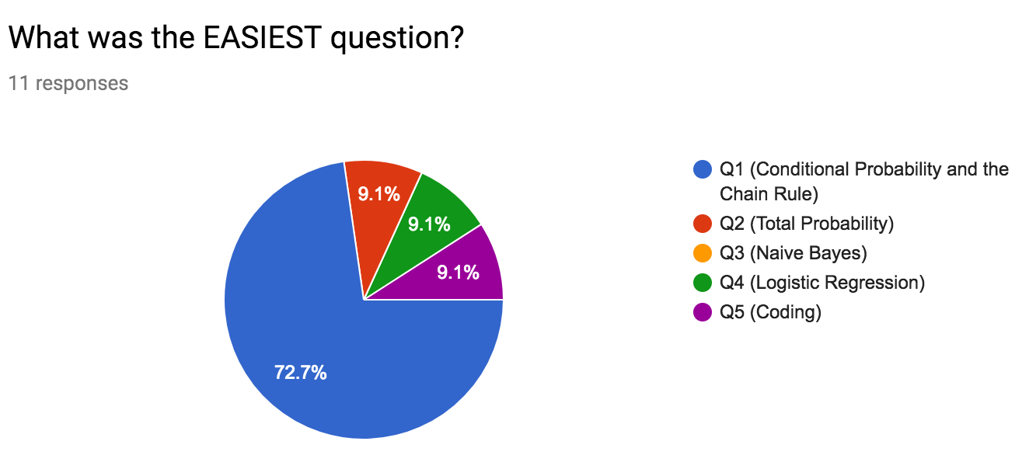
Poll Review
Clear winner: Q1
(No opinion on Q2)

Slide 5
Poll Review
What should be removed?
Nothing (7 votes)
Command line / reading input (2 votes)
Part of Q5 (1 vote)
Q2 (1 vote)

Slide 6
Poll Review
What should be added?
Nothing (3 votes)
Clarifications (3 votes)
Additional background review (2 votes)
Additional proofs (1 vote)
Jupyter notebook submissions (1 vote)
Regularization or K-means (1 vote)
JupyterHub, but hard to do for non-introductory courses
Assignment 2!
Notes:
Clarifications included:
- sample code
- data format explanation
- step-by-step LR / NB coding
Review included:
- gradient descent
- math

Slide 7
Poll Review
What should be kept?
Everything (5 votes)
Q5, i.e. coding (4 votes)
Practice of concepts (1 vote)
General probability (1 vote)

Slide 8
Poll Review
Comments
Coding instructions
I/O details
Expected output format
Background materials
Probability theory
LR / NB theory versus practice
Other
LR decision boundary question
Prior knowledge
Intimidating

Slide 9
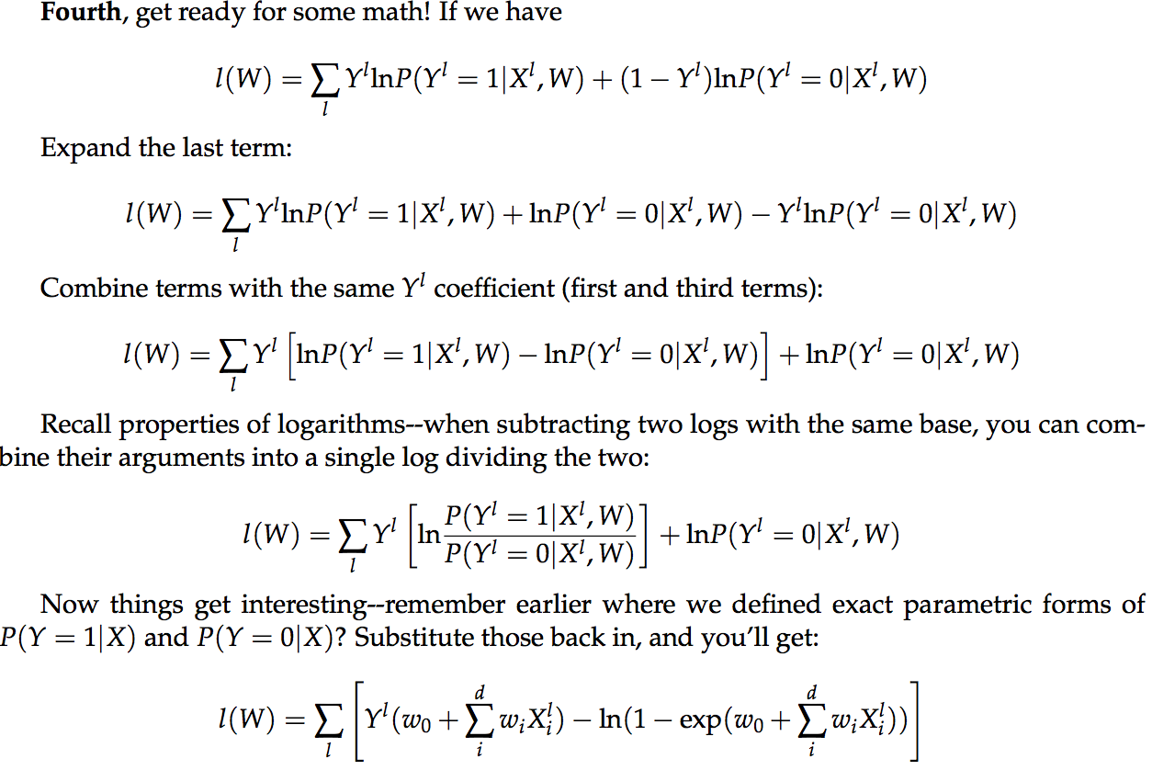
Assignment 1 Review

Slide 10
Take-aways
Clarity of the assignments absolutely needs to be improved
A big part of data science is data preparation and munging… BUT outside of an assignment on that exact topic, time frame is a bit short
Course prerequisites should be noted and not ignored… BUT I will absolutely strive to include background notes
This is a 4000/6000 course. It’s supposed to be hard!
…but you can still ask for help!
Notes:
CSCI 3360 introduced probability theory, statistics, hypothesis testing, sampling, optimization (gradient descent!), learning theory, classification, regression, regularization, clustering, and dimensionality reduction
In a very real way, this should be prerequisite—i.e., expected—knowledge to an advanced ML / DS course

