Slide 1
Detection of Oil Spills
Shrreya Behll

Slide 2

About Me
MSc in Environmental Data Science and Machine Learning at Imperial College London : Sept 2023-2024
B.Tech in Computer Science and Engineer from Guru Gobind Singh Indraprastha University : 2015—2019
Software Engineer III: American Express India Pvt Ltd.(2019-2021)
Software Engineer II: American Express India Pvt Ltd. (2021-2023)
Senior Associate: American Express India Pvt Ltd. (2021-2023)
Shrreya Behll

Slide 3
About the dataset and data
Imbalanced Binary dataset referred of oil spill.
Dataset was introduced in the 1998 paper by Miroslav Kubat, et al. titled Machine Learning for the Detection of Oil Spills in Satellite Radar Images
The dataset consisted of satellite images of the ocean, some of which contain an oil spill and some that do not.
Images were split into sections and processed using computer vision algorithms to provide a vector of features to describe the contents of the image section or patch.
No oil spill assigned the class label of 0
Oil spill is indicated by a class label of 1
TASK: The task is given a vector that describes the contents of a patch of a satellite image, then predicts whether the patch contains an oil spill or not, e.g. from the illegal or accidental dumping of oil in the ocean.
Notes:
Oil spills into rivers, bays, and the ocean most often are caused by accidents involving tankers, barges, pipelines, refineries, drilling rigs, and storage facilities
There are 937 cases. Each case is comprised of 48 numerical computer vision derived features, a patch number, and a class label.
nine satellite images were processed into patches.

Slide 4
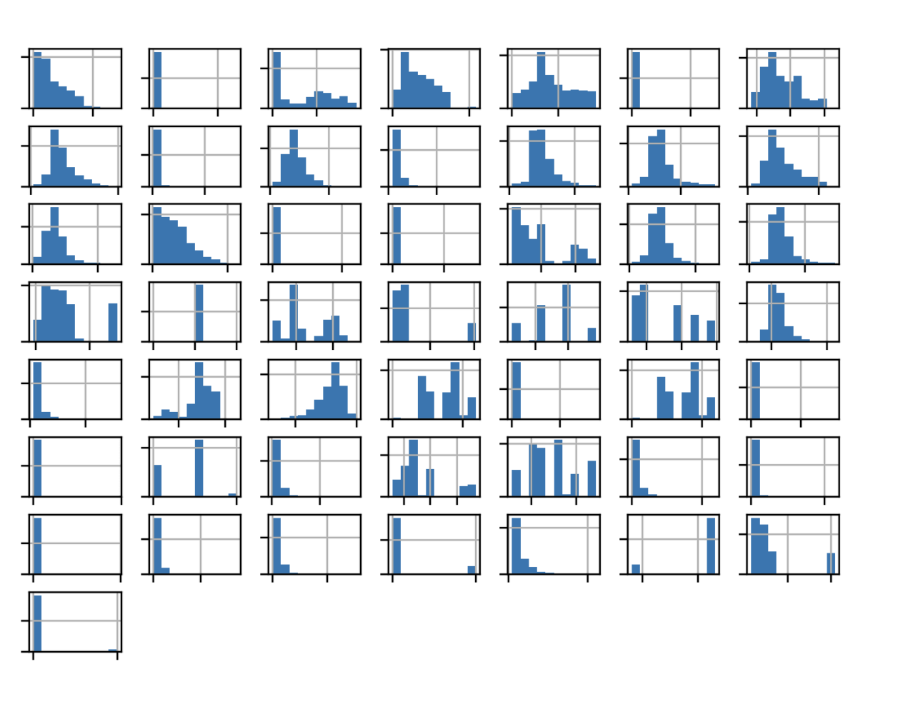
Exploratory Data Analysis

Slide 5
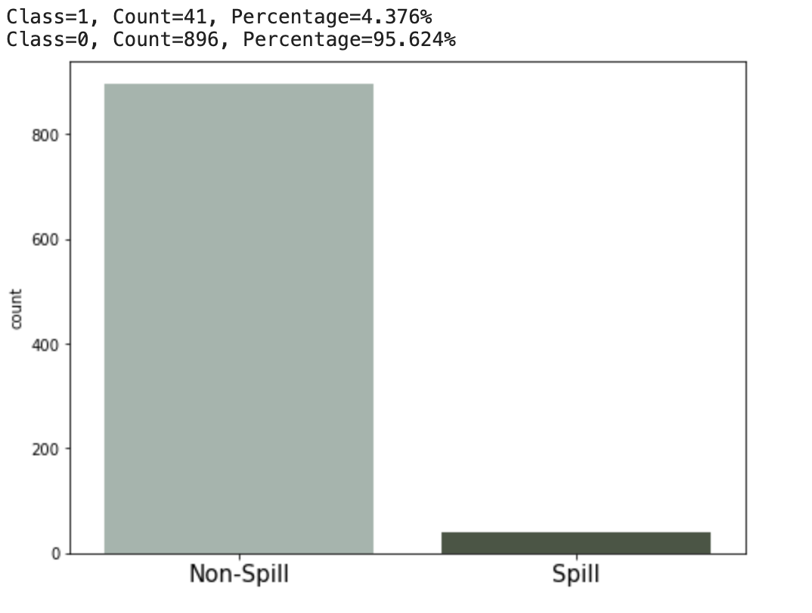
Exploratory Data Analysis
The first column is the patch number.
We can also see that the computer vision derived features are real-valued with differing scales such as thousands in the second column and fractions in other columns.
Imbalanced Binary dataset
Input variables are numeric
There are no missing values

Slide 6
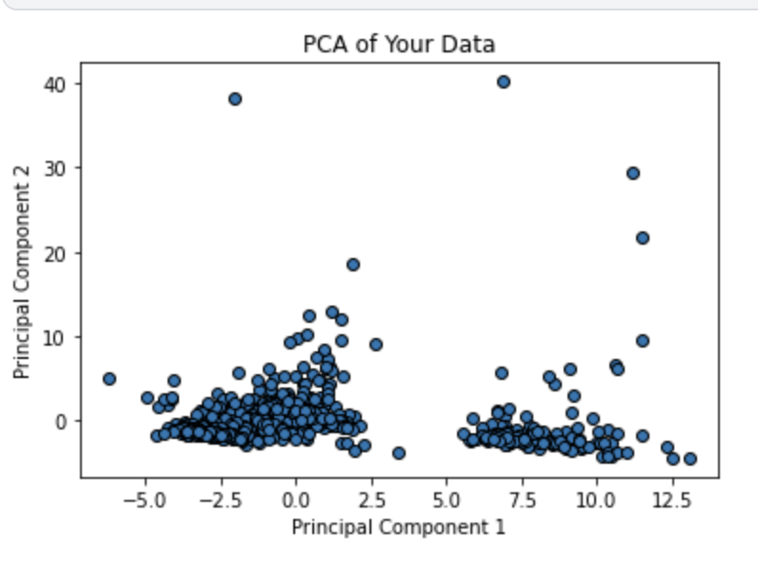

Slide 7
Data Preprocessing
Removed 1st column as it represented the patch number
Removed conditions having less than 5 drugs for treatment
Removing HTML tags
Removing non letters
Converted text to lowercase
Remove stopwords
Applied stemming
Divided data into testing and training set
Performing Bag of Words: CountVectorizer

Slide 8
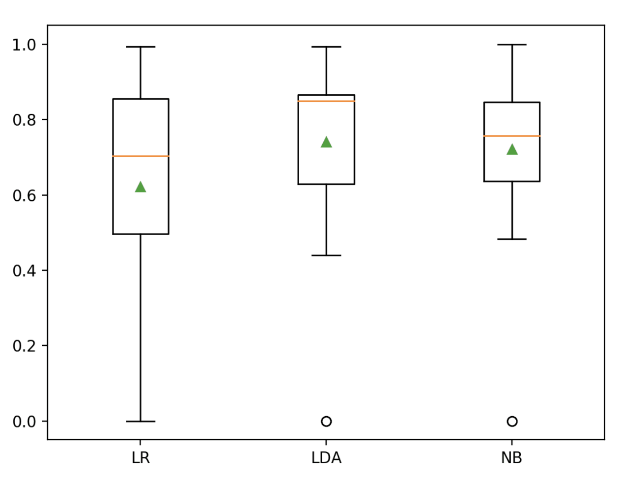
ML Models
Logistic Regression (LR)
Solver: liblinear
G-mean: 0.621 (0.261)
Linear Discriminant Analysis (LDA)
G-mean: LDA 0.741 (0.220)
Gaussian Naive Bayes (NB)
G-mean: NB 0.721 (0.197)

Slide 9
Measures
Notes:
To this end, we have mainly used the geometric mean (g-mean) […] This measure has the distinctive property of being independent of the distribution of examples between classes, and is thus robust in circumstances where this distribution mig
Recall that the sensitivity is a measure of the accuracy for the positive class and specificity is a measure of the accuracy of the negative class.
Sensitivity = TruePositives / (TruePositives + FalseNegatives)
Specificity = TrueNegatives / (TrueNegatives + FalsePositives)
The G-mean seeks a balance of these scores, the geometric mean, where poor performance for one or the other results in a low G-mean score.
G-Mean = sqrt(Sensitivity * Specificity)
ht change with time or be different in the training and testing sets.

Slide 10
ML Models - Light Gradient Boosting
LGBM classifier trained on usefulCount instead of the reviews to verify the trend and check the correlation. Remarks - Just usefulCount does not help in giving good predictions. Accuracy of 66.201% .
Predicting sentiment using TextBlob - The sentiment function of TextBlob returns two properties, polarity, and subjectivity. Using TextBlob we predicted the sentiment as a float value once on cleaned reviews and then on the raw reviews. We find that the polarity scores obtained from the raw reviews have better correlation with the actual userRating and Sentiment Score than that from cleaned reviews.
Implemented feature engineering and calculated various nuances of the data for exploration to see what importance/effect they have on the predictions. These include unique word count, total words in each review, length of review, count of words with capital letters, count average length of words. Trained LGBM again on these new features extracted from feature engineering along with the sentiment predicted from TextBlob. We find that this gives a high accuracy of 79.259% . Feature Importance.

Slide 11
Emotion Analysis
The NRC Emotion Lexicon is a list of 14k unigrams and their associations with eight basic emotions (anger, fear, anticipation, trust, surprise, sadness, joy, and disgust) and two sentiments (negative and positive).
This data for each drug will be displayed in a pi chart, to show the emotions associated with people taking the drug. With the 5 Word-Emotion Association, we tracked emotions in the drug reviews. We matched every word in the review text with unigram in the lexicon file and increased the count of respective emotions for each review. Finally, we took an average of the aggregated count for each drug to show the overall distribution.

Slide 12
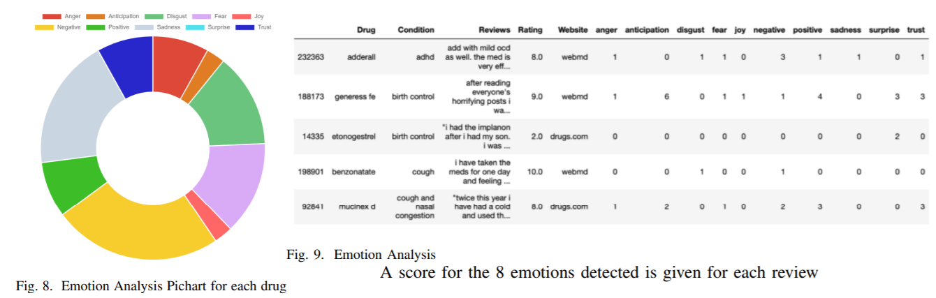

Slide 13
Classifier Combination - Voting
The algorithm used for classifier combination here is weighted match score fusion. The weights for the predictions of each classifier is the normalized accuracy score. We need to combine all the predictions from the array of classifiers and predictive methods used. Each ML model was given a weight in proportion to its accuracy with respect to other ML models. Similar logic was followed for DL models. This gives more weight to better performing classifier each time without having to hard-code the weights.
Predictions from LGBM and Harvard Sentiment Prediction were added directly since they represent separate individualistic predictions. All these 4 components were summed and multiplied by the usefulCount of the respective review.
We clubbed the drugs by their conditions and a final prediction for each drug was calculated by normalising all the predictions for each condition.

Slide 14
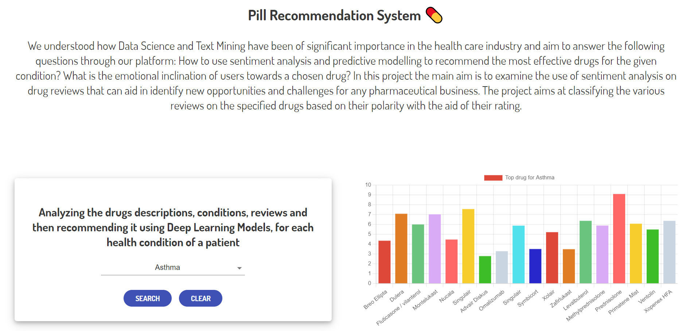
Real Life Visualization/Application
Deployed @ darshitjain04.github.io/PRML-Project-Frontend

Slide 15
