Slide 1


Software Architecture and the UML
Grady Booch

Slide 2

Architecting a dog house
Can be built by one person
Requires
Minimal modeling
Simple process
Simple tools

Slide 3
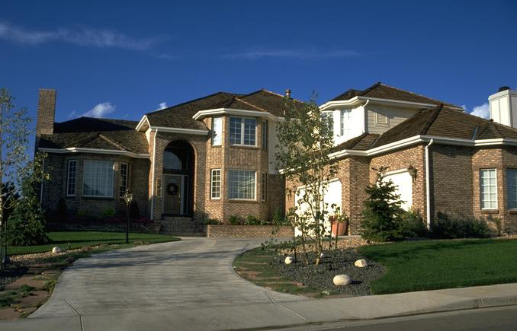
Architecting a house
Built most efficiently and timely by a team
Requires
Modeling
Well-defined process
Power tools

Slide 4
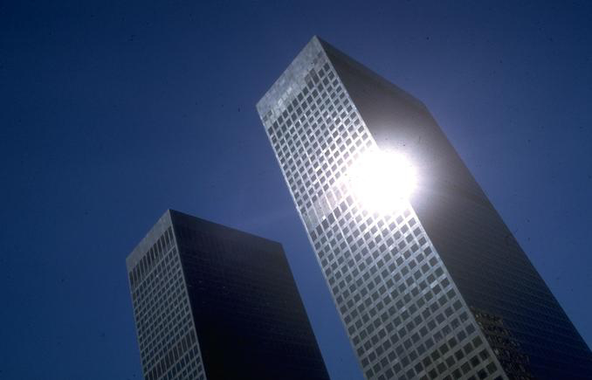
Architecting a high rise

Slide 5
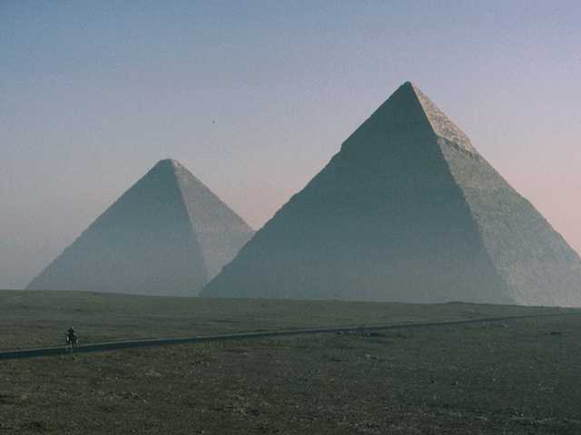
Early architecture
Progress
- Limited knowledge of theory

Slide 6
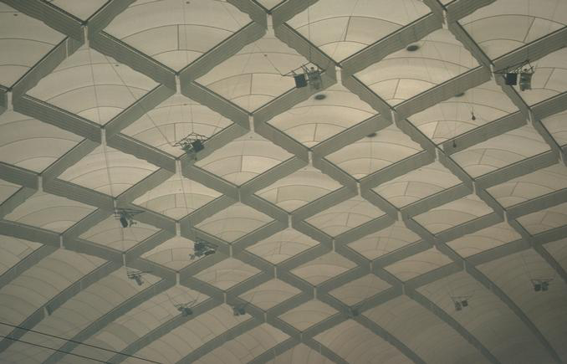
Modern architecture
Progress
- Advances in materials
- Advances in analysis
Scale
- 5 times the span of the Pantheon
- 3 times the height of Cheops

Slide 7
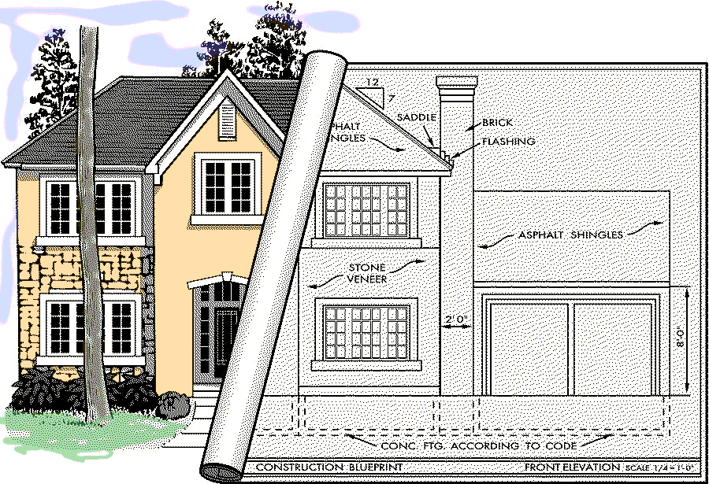
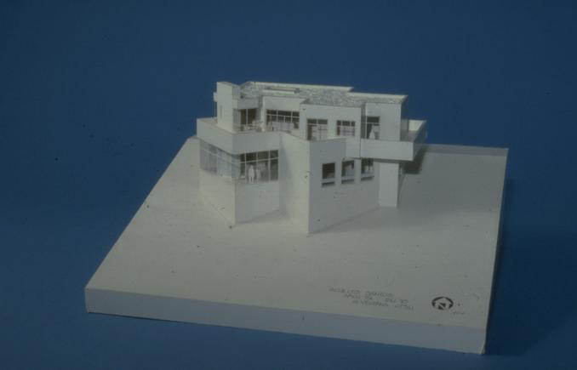
Modeling a house

Slide 8
Movements in civil architecture
Bronze age/Egyptian (Imhotep)
Grecian/Roman (Vitruvius)
Byzantine/Romanesque
Gothic
Mannerism (Michelangelo, Palladio)
Baroque
Engineering/Rational/National/Romantic
Art noveau
Modern movement (Wright, LeCorbusier)
Progress
- Imitation of previous efforts
- Learning from failure
- Integration of other forces
- Experimentation

Slide 9
Kinds of civil architecture
Neufert Architect’s Data
The Handbook of Building Types
Community
  houses, flats and apartments, gardens, education, hospitals, religion
Commerce
  shops and stores, restaurants, hotels, office buildings, banks, airports
Industry
  industrial buildings, laboratories, farm buildings
Leisure
  sport, theaters and cinemas, museums

Slide 10
Forces in civil architecture
Load
Kinds of loads
- Dead loads
- Live loads
- Dynamic loads
Compression
Tension
Avoiding failure
- Safety factors
- Redundancy
- Equilibrium
Load
Any time you depart from established practice, make ten times the
effort, ten times the investigation. Especially on a very large project.
- LeMessuier

Slide 11
Shearing layers of change
Brand, How Buildings Learn
Space plan
Services
Stuff
Structure
Skin
Site

Slide 12
Dimensions of software complexity
Walker Royce
Higher technical complexity
- Embedded, real-time, distributed, fault-tolerant
- Custom, unprecedented, architecture reengineering
- High performance
An average software project:
- 5-10 people
- 10-15 month duration
- 3-5 external interfaces
- Some unknowns & risks
Telecom
Switch
Defense
Weapon System
Commercial
Compiler
National Air Traffic
Control System
Embedded
Automotive
Software
Lower
management
complexity
- Small scale
- Informal
- Single stakeholder
- “Products”
CASE Tool
Large-Scale
Organization/Entity
Simulation
Higher
management
complexity
- Large scale
- Contractual
- Many stake holders
- “Projects”
Small Scientific
Simulation
IS Application
Distributed Objects
(Order Entry)
Enterprise IS
(Family of IS
Applications)
Defense
MIS System
IS Application
GUI/RDB
(Order Entry)
Business
Spreadsheet
Lower technical complexity
- Mostly 4GL, or component-based
- Application reengineering
- Interactive performance

Slide 13
Forces in Software
Functionality
Cost
Compatibility
Capacity
Fail safe
Availability
Fault tolerance
Performance
Throughput
Technology churn
Resilience
The challenge over the next 20 years will not be speed or cost or performance;
it will be a question of complexity.
Bill Raduchel, Chief Strategy Officer, Sun Microsystems
Our enemy is complexity, and it’s our goal to kill it.
Jan Baan

Slide 14
The domain of architecting
Wojtek Kozaczynski
The “what”
The “why”
Architecture
Qualities
System
Features
Satisfies
Architecture
S/W
Requirements
Constrain
Architecture
Representation
System
Quality Attributes
Technology
The “who”
Produces
Defines
The “how”
Follows
Architect
Process
Skills
Defines role
Organization
Stakeholders

Slide 15
We all know that ...
Philippe Kruchten
Architecture and design are the same thing
Architecture and infrastructure are the same thing
<my favorite technology> is the architecture
A good architecture is the work of a single architect
Architecture is flat, one blueprint is enough
Architecture is just structure
System architecture precedes software architecture
Architecture cannot be measured and validated
Architecture is a Science
Architecture is an Art

Slide 16
Architecture defined (again)
Merriam Webster’s Collegiate Dictionary
10th edition
Architecture n (1555) 1: the art of science of building, specifically, the art or practice of designing and building structures and esp. habitable ones 2 a: formation or construction as or as if as the result of conscious act <the ~ of the garden> b: a unifying or coherent form or structure <the novel lacks ~>

Slide 17
Architecture defined (yet again)
Mary Shaw, CMU
Grady Booch,
Philippe Kruchten,
Rich Reitman
Kurt Bittner, Rational
Software architecture encompasses the set of significant decisions about the organization of a software system
  selection of the structural elements and their interfaces by which a system is composed
  behavior as specified in collaborations among those elements
  composition of these structural and behavioral elements into larger subsystem
  architectural style that guides this organization

Slide 18
Architecture defined (continued)
Mary Shaw, CMU
Grady Booch,
Philippe Kruchten,
Rich Reitman
Kurt Bittner, Rational
Software architecture also involves
  usage
  functionality
  performance
  resilience
  reuse
  comprehensibility
  economic and technology constraints and tradeoffs
  aesthetic concerns

Slide 19
Architectural style
Mary Shaw, CMU
An architecture style defines a family of systems in terms of a pattern of structural organization.
An architectural style defines
  a vocabulary of components and connector types
  a set of constraints on how they can be combined
  one or more semantic models that specify how a system’s overall properties can be determined from the properties of its parts

Slide 20
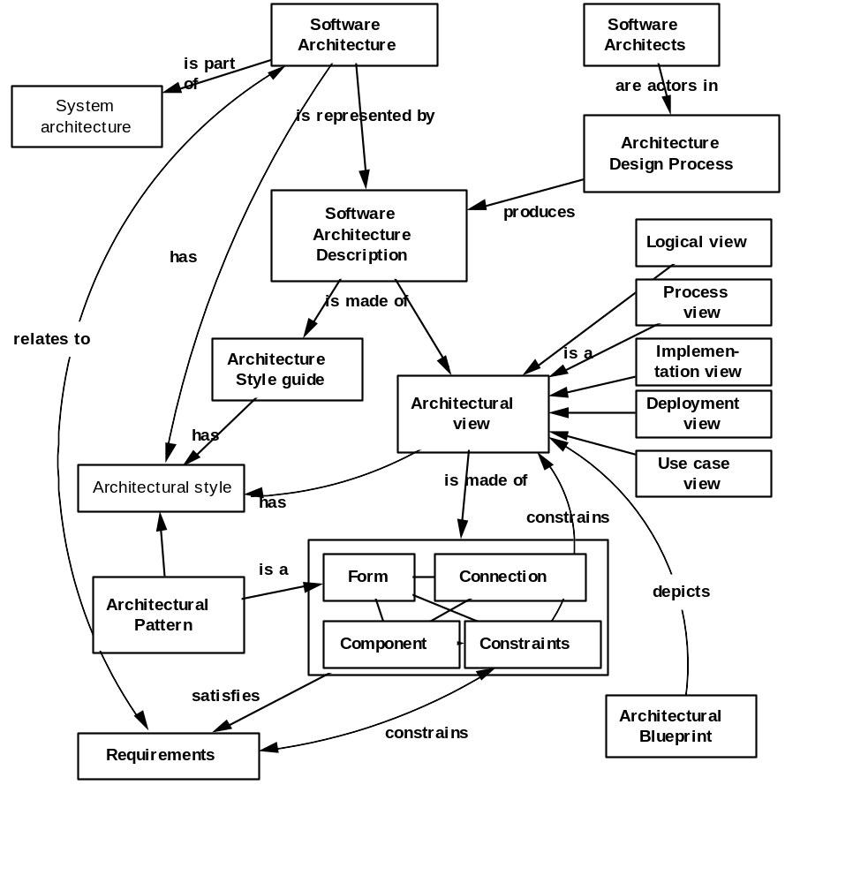
Architecture metamodel

Slide 21
Models
Models are the language of designer, in many disciplines
Models are representations of the system to-be-built or as-built
Models are vehicle for communications with various stakeholders
Visual models, blueprints
Scale
Models allow reasoning about some characteristic of the real system

Slide 22
Many stakeholders, many views
Architecture is many things to many different interested parties
  end-user
  customer
  project manager
  system engineer
  developer
  architect
  maintainer
  other developers
Multidimensional reality
Multiple stakeholders
  multiple views, multiple blueprints

Slide 23
Architectural view
An architectural view is a simplified description (an abstraction) of a system from a particular perspective or vantage point, covering particular concerns, and omitting entities that are not relevant to this perspective

Slide 24
Architecturally significant elements
Not all design is architecture
Main “business” classes
Important mechanisms
Processors and processes
Layers and subsystems
Architectural views = slices through models

Slide 25
Characteristics of a Good Architecture
Resilient
Simple
Approachable
Clear separation of concerns
Balanced distribution of responsibilities
Balances economic and technology constraints

Slide 26
Representing System Architecture
Logical View
Implementation View
End-user
Programmers
Software management
Functionality
Use Case View
Process View
Deployment View
System integrators
System engineering
Performance
Scalability
Throughput
System topology
Delivery, installation
Communication
Conceptual
Physical

Slide 27
Relation Between Views
Logical view
Component view
α
Process view
β
Deployment view

Slide 28
How many views?
Simplified models to fit the context
Not all systems require all views:
  Single processor: drop deployment view
  Single process: drop process view
  Very Small program: drop implementation view
Adding views:
  Data view, security view

Slide 29
The Value of the UML
Is an open standard
Supports the entire software development lifecycle
Supports diverse applications areas
Is based on experience and needs of the user community
Supported by many tools

Slide 30

Creating the UML
UML 1.3
OMG Acceptance, Nov 1997
Final submission to OMG, Sep ‘97
UML 1.1
public
feedback
First submission to OMG, Jan ´97
UML partners
UML 1.0
Web - June ´96
UML 0.9
OOPSLA ´95
Unified Method 0.8
Other methods
Booch method
OMT
OOSE

Slide 31
UML Partners
Rational Software Corporation
Hewlett-Packard
I-Logix
IBM
ICON Computing
Intellicorp
MCI Systemhouse
Microsoft
ObjecTime
Oracle
Platinum Technology
Taskon
Texas Instruments/Sterling Software
Unisys

Slide 32
Contributions to the UML
Harel
Meyer
Gamma, et al
Statecharts
Before and after
conditions
Frameworks and patterns,
HP Fusion
Booch
Operation descriptions and
message numbering
Booch method
Rumbaugh
Embley
OMT
Singleton classes and
high-level view
Jacobson
Wirfs-Brock
OOSE
Responsibilities
Shlaer - Mellor
Odell
Object lifecycles
Classification

Slide 33
Overview of the UML
The UML is a language for
  visualizing
  specifying
  constructing
  documenting
the artifacts of a software-intensive system

Slide 34
Overview of the UML
Modeling elements
Relationships
Extensibility Mechanisms
Diagrams

Slide 35
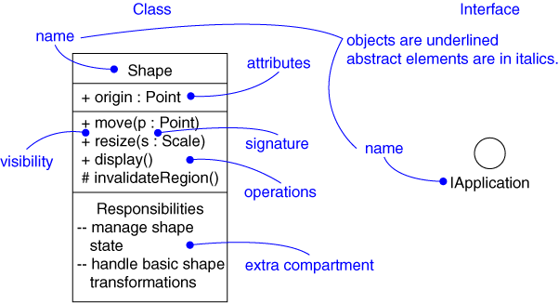
Modeling Elements
Structural elements
  class, interface, collaboration, use case, active class, component, node
Behavioral elements
  interaction, state machine
Grouping elements
  package, subsystem
Other elements
  note

Slide 36
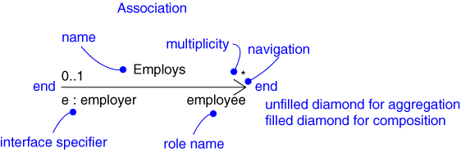
Relationships
Dependency
Association
Generalization
Realization

Slide 37
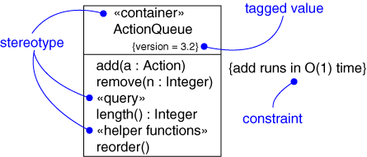
Extensibility Mechanisms
Stereotype
Tagged value
Constraint

Slide 38
Models, Views, and Diagrams
A model is a complete
description of a system
from a particular
perspective
State
Diagrams
State
Diagrams
Class
Diagrams
Use Case
Diagrams
Use Case
Diagrams
State
Diagrams
Use Case
Diagrams
Use Case
Diagrams
State
Diagrams
Use Case
Diagrams
Object
Diagrams
Sequence
Diagrams
Scenario
Diagrams
State
Diagrams
Scenario
Diagrams
State
Diagrams
Collaboration
Diagrams
Component
Diagrams
Models
Scenario
Diagrams
Component
Diagrams
Scenario
Diagrams
Component
Diagrams
Statechart
Diagrams
Deployment
Diagrams
Activity
Diagrams

Slide 39
Diagrams
A diagram is a view into a model
  Presented from the aspect of a particular stakeholder
  Provides a partial representation of the system
  Is semantically consistent with other views
In the UML, there are nine standard diagrams
  Static views: use case, class, object, component, deployment
  Dynamic views: sequence, collaboration, statechart, activity

Slide 40
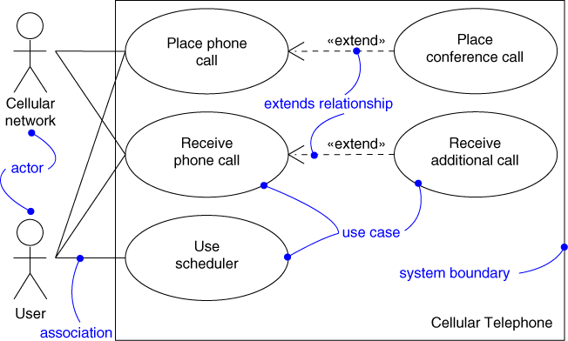
Use Case Diagram
Captures system functionality as seen by users

Slide 41
Use Case Diagram
Captures system functionality as seen by users
Built in early stages of development
Purpose
  Specify the context of a system
  Capture the requirements of a system
  Validate a system’s architecture
  Drive implementation and generate test cases
Developed by analysts and domain experts

Slide 42
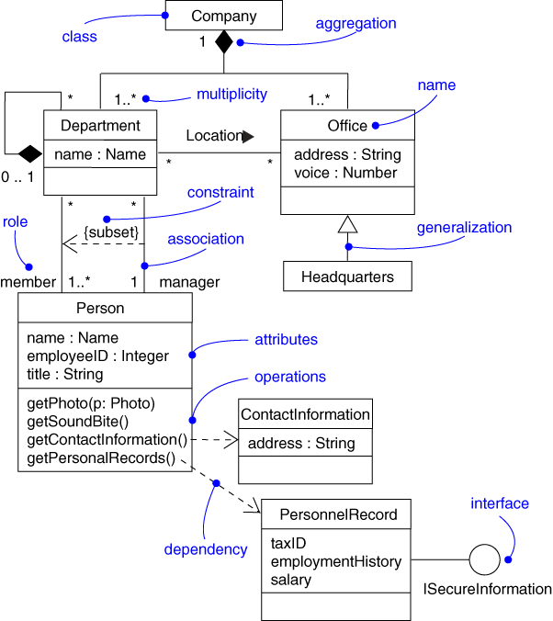
Class Diagram
Captures the vocabulary of a system

Slide 43
Class Diagram
Captures the vocabulary of a system
Built and refined throughout development
Purpose
  Name and model concepts in the system
  Specify collaborations
  Specify logical database schemas
Developed by analysts, designers, and implementers

Slide 44
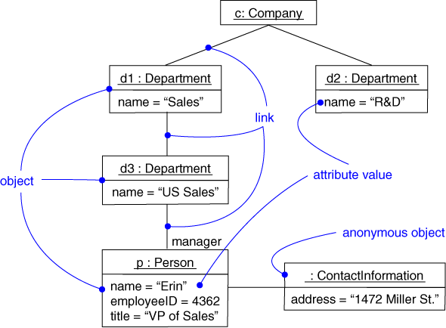
Object Diagram
Captures instances and links

Slide 45
Object Diagram
Shows instances and links
Built during analysis and design
Purpose
  Illustrate data/object structures
  Specify snapshots
Developed by analysts, designers, and implementers

Slide 46
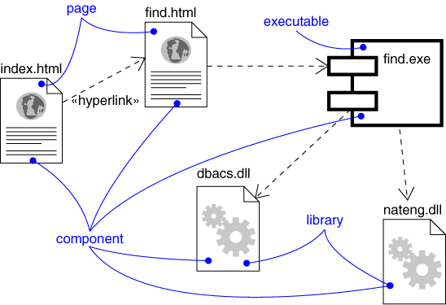
Component Diagram
Captures the physical structure of the implementation

Slide 47
Component Diagram
Captures the physical structure of the implementation
Built as part of architectural specification
Purpose
  Organize source code
  Construct an executable release
  Specify a physical database
Developed by architects and programmers

Slide 48
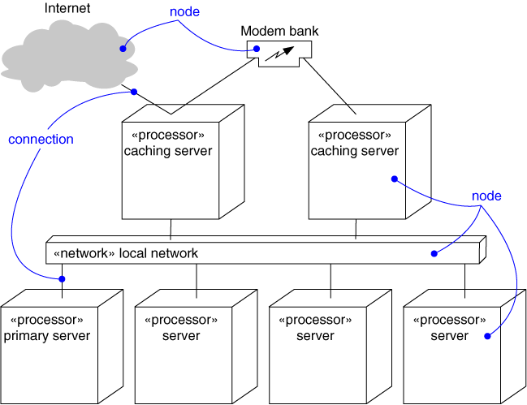
Deployment Diagram
Captures the topology of a system’s hardware

Slide 49
Deployment Diagram
Captures the topology of a system’s hardware
Built as part of architectural specification
Purpose
  Specify the distribution of components
  Identify performance bottlenecks
Developed by architects, networking engineers, and system engineers

Slide 50
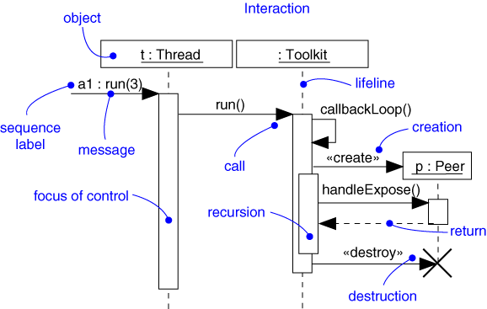
Sequence Diagram
Captures dynamic behavior (time-oriented)

Slide 51
Sequence Diagram
Captures dynamic behavior (time-oriented)
Purpose
  Model flow of control
  Illustrate typical scenarios

Slide 52
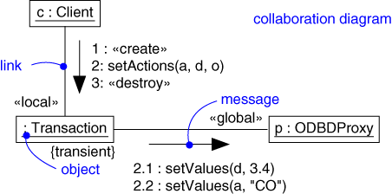
Collaboration Diagram
Captures dynamic behavior (message-oriented)

Slide 53
Collaboration Diagram
Captures dynamic behavior (message-oriented)
Purpose
  Model flow of control
  Illustrate coordination of object structure and control

Slide 54
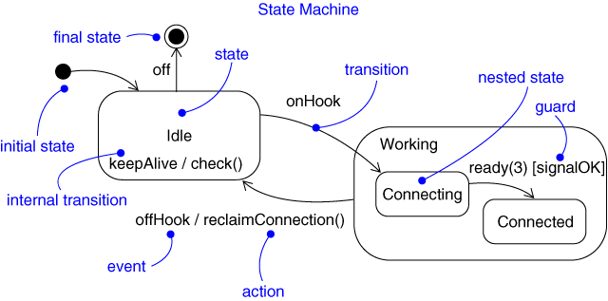
Statechart Diagram
Captures dynamic behavior (event-oriented)

Slide 55
Statechart Diagram
Captures dynamic behavior (event-oriented)
Purpose
  Model object lifecycle
  Model reactive objects (user interfaces, devices, etc.)

Slide 56
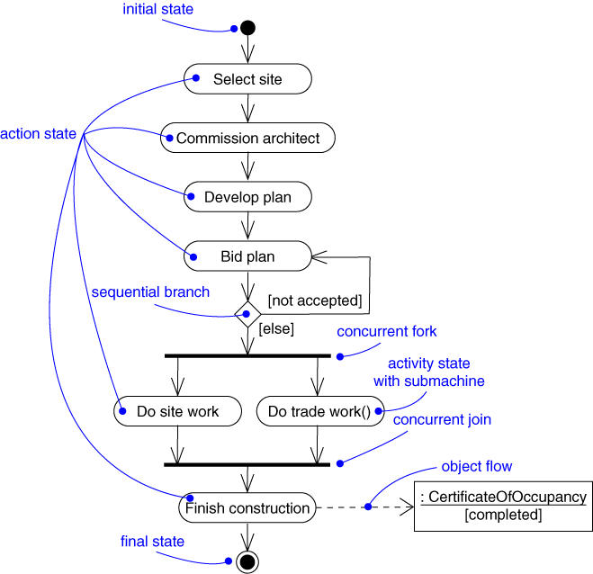
Activity Diagram
Captures dynamic behavior (activity-oriented)

Slide 57
Activity Diagram
Captures dynamic behavior (activity-oriented)
Purpose
  Model business workflows
  Model operations

Slide 58
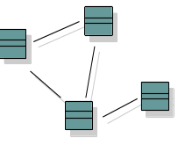

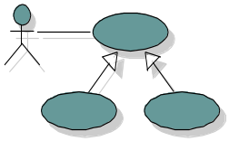
Architecture and the UML
Design View
Implementation View
Classes, interfaces,
collaborations
Use cases
Components
Use Case View
Process View
Deployment View
Active classes
Nodes
Organization
Package, subsystem
Dynamics
Interaction
State machine

Slide 59
Software engineering process
A set of partially ordered steps intended to reach a goal. In software engineering the goal is to build a software product or to enhance an existing one.
Architectural process
  Sequence of activities that lead to the production of architectural artifacts:
    A software architecture description
    An architectural prototype

Slide 60
Rational Unified Process
Iterative
Architecture-centric
Use-case driven
Risk confronting

Slide 61
Focus over time
Discovery
Invention
Implementation
Focus

Slide 62
Key concepts
Phase, Iterations
Process Workflows
  Activity, steps
Artifacts
  models
  reports, documents
Worker: Architect
When does
architecture happen?
What does happen?
What is produced?
Who does it?

Slide 63
Lifecycle Phases
Inception
Elaboration
Construction
Transition
time
Inception Define the scope of the project and develop business case
Elaboration Plan project, specify features, and baseline the architecture
Construction Build the product
Transition Transition the product to its users

Slide 64
Major Milestones
Inception
Elaboration
Construction
Transition
time
Vision
Baseline
Architecture
Initial
Capability
Product
Release

Slide 65
Phases and Iterations
Inception
Elaboration
Construction
Transition
Prelim
Iteration
...
Arch
Iteration
...
Dev
Iteration
Dev
Iteration
...
Trans
Iteration
...
Release
Release
Release
Release
Release
Release
Release
Release
An iteration is a sequence of activities with an established plan and evaluation criteria, resulting in an executable release

Slide 66
Architecture-Centric
Models are vehicles for visualizing, specifying, constructing, and documenting architecture
The Unified Process prescribes the successive refinement of an executable architecture
Inception
Elaboration
Construction
Transition
time
Architecture

Slide 67
Unified Process structure
Phases
Process Workflows
Inception
Elaboration
Construction
Transition
Business Modeling
Requirements
Analysis & Design
Implementation
Test
Deployment
Supporting Workflows
Configuration Mgmt
Management
Environment
Preliminary
Iteration(s)
Iter.
#1
Iter.
#2
Iter.
#n
Iter.
#n+1
Iter.
#n+2
Iter.
#m
Iter.
#m+1
Iterations

Slide 68
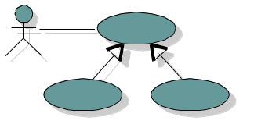
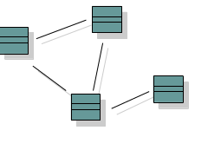
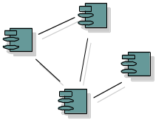
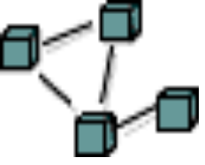
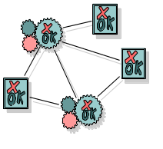
Architecture and Iterations
Use case
Model
Design
Model
Implementation
Model
Deployment
Model
Test
Model
Content

Slide 69
Architectural design
Identify, select, and validate
“architecturally significant” elements
Not everything is architecture
  Main “business” classes
  Important mechanisms
  Processors and processes
  Layers and subsystems
  Interfaces
Produce a Software Architecture Documen

Slide 70
Architectural design workflow
Use case view
Select scenarios: criticality and risk
Identify main classes and their responsibility
Distribute behavior on classes
Structure in subsystems, layers,
define interfaces
Define distribution and concurrency
Implement architectural prototype
Derive tests from use cases
Evaluate architecture
  Iterate
Logical view
Implementation view
Deployment view
Process view

Slide 71
Sources of architecture
Method
Method
Theft
Intuition
Theft
Intuition
Classical system
Unprecedented system

Slide 72
Patterns
A pattern is a solution to a problem in a context
A pattern codifies specific knowledge collected from experience in a domain
All well-structured systems are full of patterns
  Idioms
  Design patterns
  Architectural patterns

Slide 73
Mechanisms
daVinci
Screws • Brakes
Keys • Pipes
Rivets • Valves
Bearings • Springs
Pins, axles, shafts • Cranks and rods
Couplings • Cams
Ropes, belts, and chains • Pulleys
Friction wheels • Engaging gears
Toothed wheels
Flywheels
Levers and connecting rods
Click wheels and gears
Ratchets

Slide 74
Design patterns
Design Patterns
Gamma et al
Creational patterns
  Abstract factory
  Prototype
Structural patterns
  Adapter
  Bridge
  Proxy
Behavioral patterns
  Chain of responsibility
  Mediator
  Visitor
Mechanisms are the soul of an architecture

Slide 75
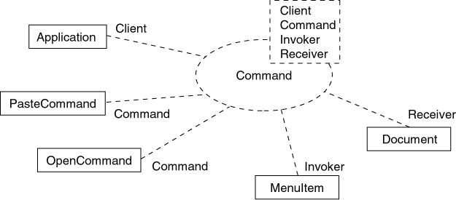
Modeling a design pattern

Slide 76
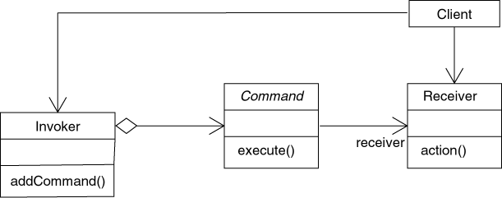
Modeling a design pattern (cont.)

Slide 77
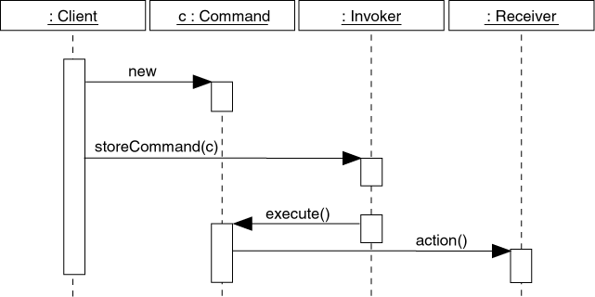
Modeling a design pattern (cont.)

Slide 78
Architectural patterns
Software Architecture
Shaw and Garlan
Buschmann et al
A System of Patterns
Buschman et al
Booch
Distributed • Layered
Event-driven • MVC
Frame-based • IR-centric
Batch • Subsumption
Pipes and filters • Disposable
Repository-centric
Blackboard
Interpreter
Rule-based

Slide 79
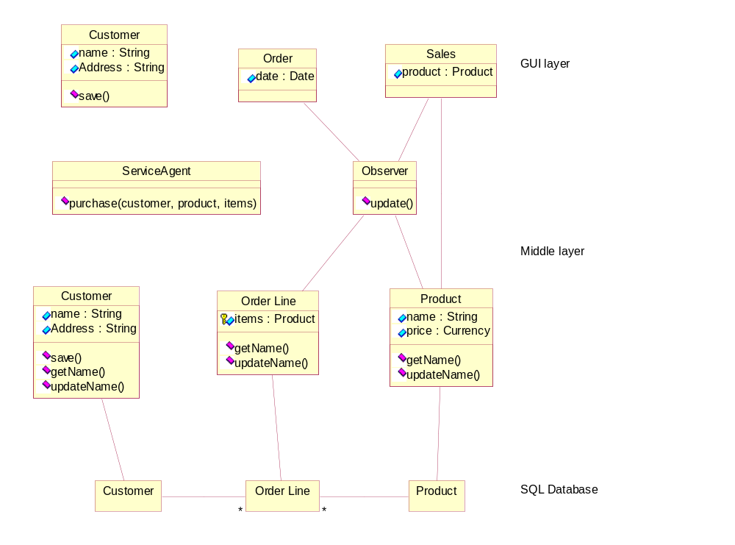
Complex business system
Real-Life Object-oriented Systems
Soren Lauesen

Slide 80

Logical application architecture
Graphical
User
Interface
Graphical
User
Interface
Graphical
User
Interface
Relational
Database
Business
Object
Model
Business
Object
Model
Relational
Database
Relational
Database

Slide 81

Physical application architecture
Thinner client, thicker server
Client A
Client B
Application
Client C
Application
WWW Browser
Business Object
Services
DCOM
ADO/R
CORBA
Beans
Business Object
Engine
Web
Server
HTML
CGI
ASP
Java
Business Object Server
COM
MTS
Beans
ETS
Business Object
Services
Business Object
Services
Business Object
Engine
Business Object
Engine
Relational Database Server(s)

Slide 82
Complex Internet system
The Second Wave
Paul Dreyfus, Netscape
Client
Dynamic HTML, JavaScript, Java
plug-ins, source code enhancements
Server
Java, C, C++, JavaScript, CGI
Application
Server
Java, C, C++, JavaBeans, CORBA, DCOM
Fulfillment
System
Financial
System
Inventory
System
RDBMS
Server
Native languages

Slide 83
Who are the architects?
Experience
  software development
  domain
Pro-active, goal oriented
Leadership, authority
Architecture team
  balance

Slide 84
Architect
Not just a top level designer
    Need to ensure feasibility
Not the project manager
    But “joined at the hip”
Not a technology expert
    Purpose of the system, “fit”,
Not a lone scientist
    Communicator

Slide 85
Software architecture team charter
Defining the architecture of the software
Maintaining the architectural integrity of the software
Assessing technical risks related to the software design
Proposing the order and contents of the successive iterations
Consulting services
Assisting marketing for future product definition
Facilitating communications between project teams

Slide 86
Architecture is making decisions
The life of a software architect is a long (and sometimes painful) succession of suboptimal decisions made partly in the dark.

Slide 87
Futures
ADL: Architecture Description Languages
  UML, UniCon, LILEAnna, P++, LEAP, Wright, µRapid
Standardization of concepts
  IEEE Working Group on Architecture
  INCOSE Working Group on System Architecture
Systematic capture of architectural patterns

Slide 88
References (Architecture)
Len Bass, Paul Clements & Rick Kazman, Software Architecture in Practice, Addison-Wesley, 1998.
Frank Buschmann, Régine Meunier, Hans Rohnert, Peter Sommerlad, and Michael Stahl, Pattern-Oriented Software Architecture - A System of Patterns, Wiley and Sons, 1996.
Christine Hofmeister, Robert Nord, Dilip Soni, Applied Software Architecture, Addison-Wesley 1999.
Eric Gamma, John Vlissides, Richard Helm, Ralph Johnson, Design Patterns, Addison-Wesley 1995.
Philippe Kruchten, “The 4+1 View Model of Architecture,” IEEE Software, 12 (6), November 1995, IEEE.
  http://www.rational.com/support/techpapers/ieee/
Eberhardt Rechtin, Systems Architecting: Creating and Building Complex Systems, Englewood Cliffs NJ, Prentice-Hall, 1991.

Slide 89
References (Architecture)
Eberhardt Rechtin & Mark Maier, The Art of System Architecting, CRC Press, 1997.
Recommended Practice for Architectural Description, Draft 2.0 of IEEE P1471, May 1998
  http://www.pithecanthropus.com/~awg/
Mary Shaw, and David Garlan, Software Architecture—Perspectives on an Emerging Discipline, Upper Saddle River, NJ, Prentice-Hall, 1996.
Bernard I. Witt, F. Terry Baker, and Everett W. Merritt, Software Architecture and Design—Principles, Models, and Methods, New York NY, Van Nostrand Reinhold, 1995.
The World-wide Institute of Software Architects
  http://www.wwisa.org

Slide 90
References (UML)
Grady Booch, James Rumbaugh, Ivar Jacobson, The Unified Modeling Language User Guide, Addison-Wesley, 1999.

Slide 91
References (Process)
Barry Boehm, “A spiral model of software development and enhancement,” IEEE Computer, May 1998.
Barry Boehm, “Anchoring the software process,” IEEE Software, July 1996.
Grady Booch, Object Solutions, Addison-Wesley, 1995.
Philippe Kruchten, “A Rational Development Process,” CrossTalk, July 1996.
  http://www.rational.com/support/techpapers/devprcs/
Philippe Kruchten, The Rational Unified Process - An Introduction, Addison-Wesley, 1999.
Rational Unified Process 5.0, Rational, Cupertino, CA, 1998
Walker Royce, Software Project Management: a Unified Framework, Addison-Wesley, 1998
The Software Program Manager’s Network
  http://www.spmn.com

