Slide 1
UML for e-Commerce
Doug Rosenberg
ICONIX Software Engineering, Inc.
http://www.iconixsw.com

Slide 2
About this webinar
Based on ICONIX UML for e-Commerce class
http://www.iconixsw.com/UMLecommerce.html
Based on Internet Bookstore Example from workbook (Applying Use Case Driven Object Modeling)
http://www.iconixsw.com/UMLworkbook.html
Preview of public classes
http://www.iconixsw.com/public_courses.htm

Slide 3
UML for e-Commerce
2 or 3 day course targeted at internet/intranet development
Students walk through the internet bookstore example.
Hands on lab where the example is extended.
This webinar will walk through 2 use cases
Complete example available in the workbook
http://www.iconixsw.com/UMLecommerce.html

Slide 4
The Workbook
Companion work to Use Case Driven Object Modeling
First book provides theory
Workbook is focused on practice
Internet Bookstore example is dissected in great detail, starting from requirements through detailed design
ICONIX Process is explained in detail: domain models, use cases, robustness diagrams, sequence diagrams, detailed static models
3 chapters on reviews
http://www.iconixsw.com/UMLworkbook.html

Slide 5
ICONIX Process
Synthesized from original Booch/Rumbaugh/Jacobson methods before UML existed (1992)
Refined over 10 years, hundreds of training workshops and products
Minimal yet sufficient subset of UML that is almost universally needed
Book: Use Case Driven Object modeling
http://www.iconixsw.com/UMLBook.html
CDROM: Inside the ICONIX Process
http://www.iconixsw.com/ICONIXProcess.html

Slide 6
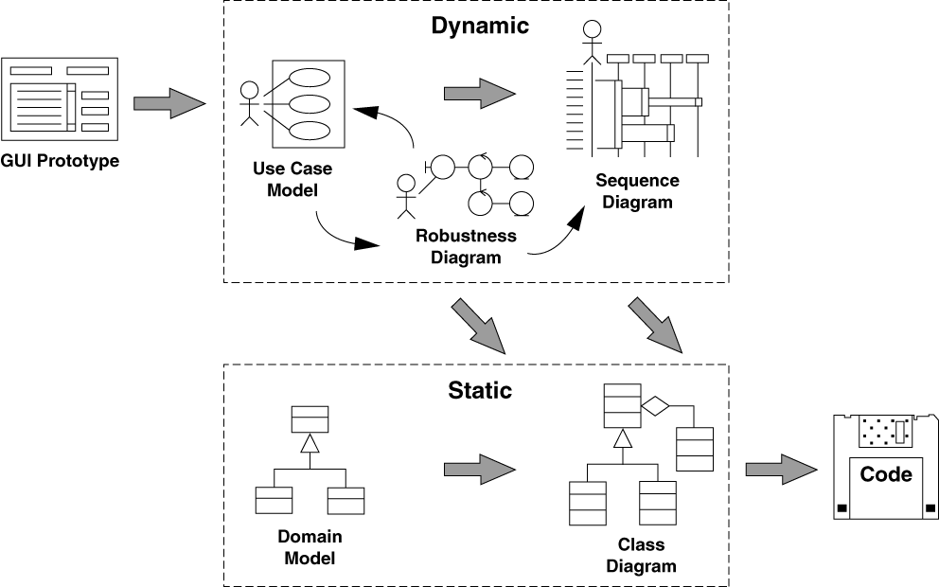
Main elements of the ICONIX Process, and where they came from
Jacobson
Jacobson
Booch
Rumbaugh

Slide 7
Theory vs. practice
In theory, there is no difference between theory and practice, but in practice there is.
In practice, there’s never enough time for modeling.
The ICONIX Process is a STREAMLINED approach to software development that helps you get from use cases to code quickly and efficiently, using a concentrated subset of the UML and related tools and techniques.

Slide 8
Minimal, yet sufficient
UML User Guide, Ch. 32, page 431 says…
80% of modeling can be done with 20% of the UML. Which 20% was that again?
We’re supposed to be “Use Case Driven” but...
“How do we get from Use Cases to Code???”
Smaller than RUP, bigger than XP
Add additional UML diagrams as needed

Slide 9
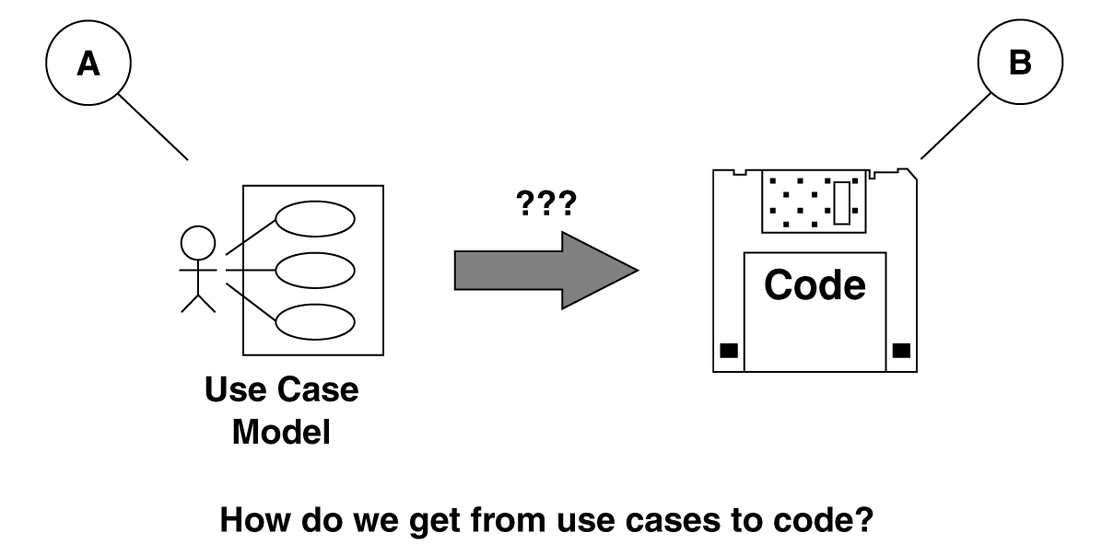
ICONIX Process:
Do OOAD but Keep It Simple

Slide 10
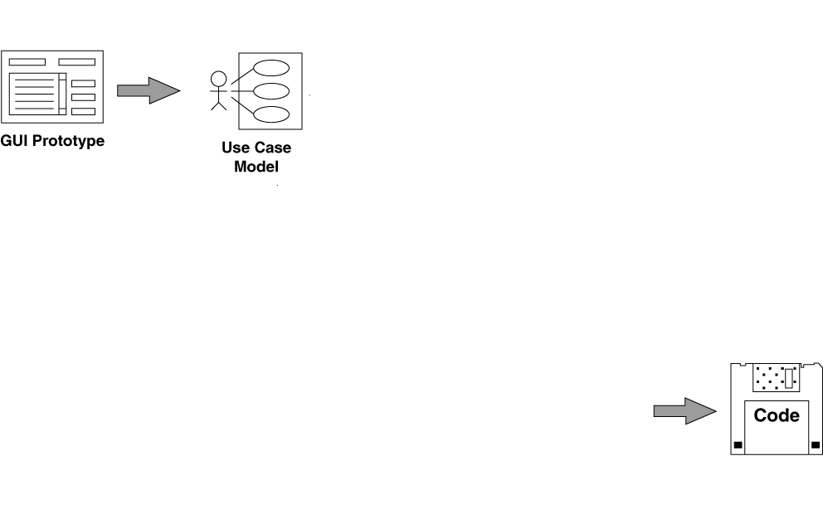
Let’s work backwards from code
Let’s assume that we’ve done a little prototyping, and started to write some use cases.
But code is our desired destination.
?

Slide 11
Before we get to code...
We need a complete set of classes, with accompanying attributes and methods.
We show this information on design-level class diagrams.

Slide 12
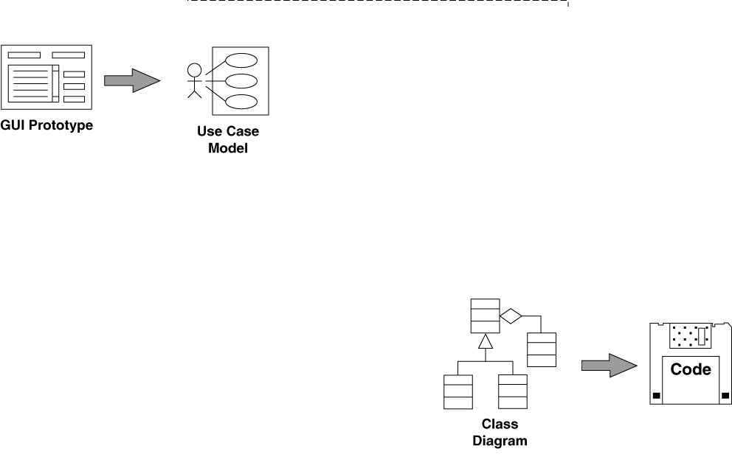
Design-Level Class Diagrams
Our design-level class diagrams serve as the structure for our code.
?

Slide 13
Before we have classes with attributes and methods, though…
We need to allocate behavior into our classes
We have only enough information to make good decisions about which classes are responsible for which methods while we are drawing sequence diagrams.
So, we need to draw a sequence diagram for each use case.

Slide 14
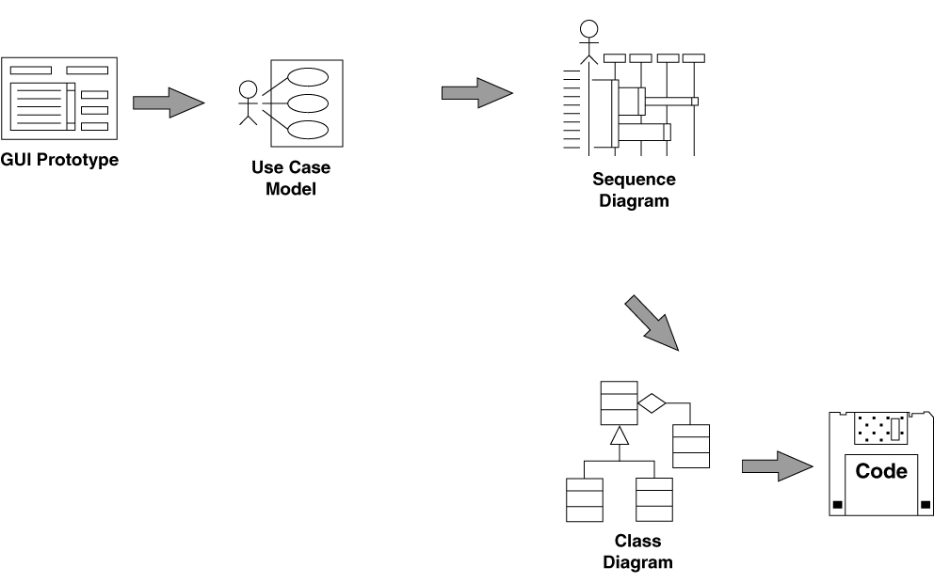
Sequence Diagrams
We allocate methods to classes as we draw sequence diagrams.
?
?

Slide 15
Before we do sequence diagrams, though...
We need to have a good idea about what objects will be performing in which use case, and what functions the system will perform as a result of user actions.
We get this information from robustness diagrams, the result of robustness analysis.

Slide 16
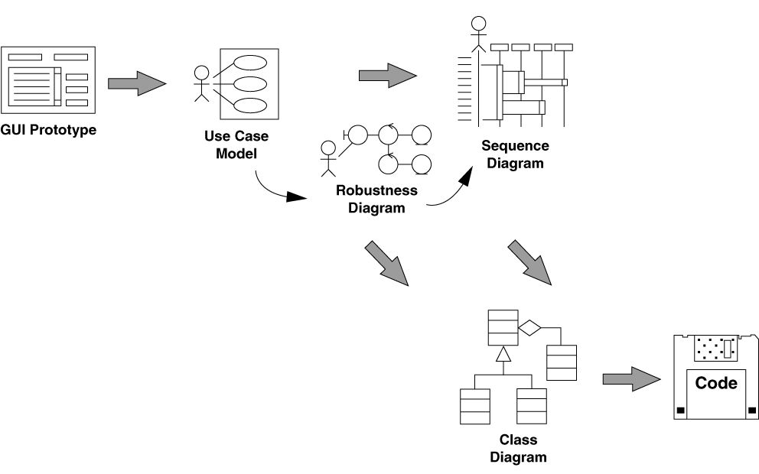
Robustness Diagrams -- the missing link!
We discover new objects, and add attributes to classes, as we draw robustness diagrams.
?

Slide 17
But we can’t draw robustness diagrams before...
We describe system usage in the context of the object model.
This means that we don’t write abstract, vague use cases that we can’t design from.
Instead, we need to write use case text that references the names of objects in the problem domain.
We also reference the names of "boundary objects" in the use case text.

Slide 18
First, though...
We need to identify the main abstractions that are present in the problem domain.
In other words, we need a domain model.
We show our domain model on class diagrams.

Slide 19
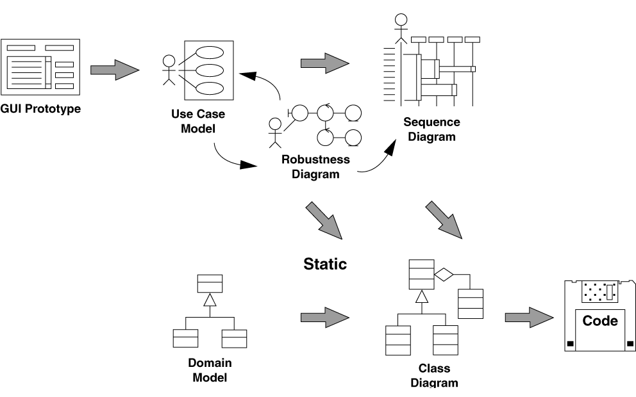
Domain Model
 □ain model completes the picture.
Note the domain model is done before we write use case text

Slide 20
Refining our class diagrams
We'll refine our (static) analysis level class diagrams (our domain model) continuously as we explore the dynamic behavior of the system in more and more detail during analysis and design.
This will ultimately result in our design-level class diagrams, which we can code from.

Slide 21
The ICONIX Process

Slide 22
The Internet Bookstore Example
Domain Model
Use Case Model
2 use cases: Login, Edit Shopping Cart
Robustness and Sequence Diagrams for each use case
Show common errors (Wrong way / Right way)

Slide 23
Requirements
The bookstore shall accept orders over the Internet.
The bookstore shall maintain a list of accounts for up to 1,000,000 customers.
The bookstore shall provide password protection for all accounts.
The bookstore shall provide the ability to search the master book catalog.
The bookstore shall provide a number of search methods on that catalog, including search by author, search by title, search by ISBN number, and search by keyword.
The bookstore shall provide a secure means of allowing customers to pay by credit card.
The bookstore shall provide a secure means of allowing customers to pay via purchase order.
The bookstore shall provide a special kind of account that is preauthorized to pay via purchase order.
The bookstore shall provide electronic links between the Web and database and the shipping fulfillment system.
The bookstore shall provide electronic links between the Web and database and the inventory management system.
The bookstore shall maintain reviews of books, and allow anyone to upload review comments.
The bookstore shall maintain ratings on books, based on customer inputs.

Slide 24
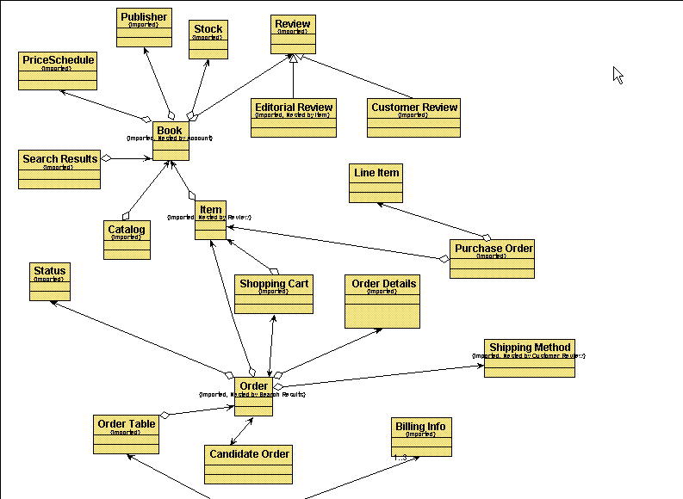
Domain Model

Slide 25
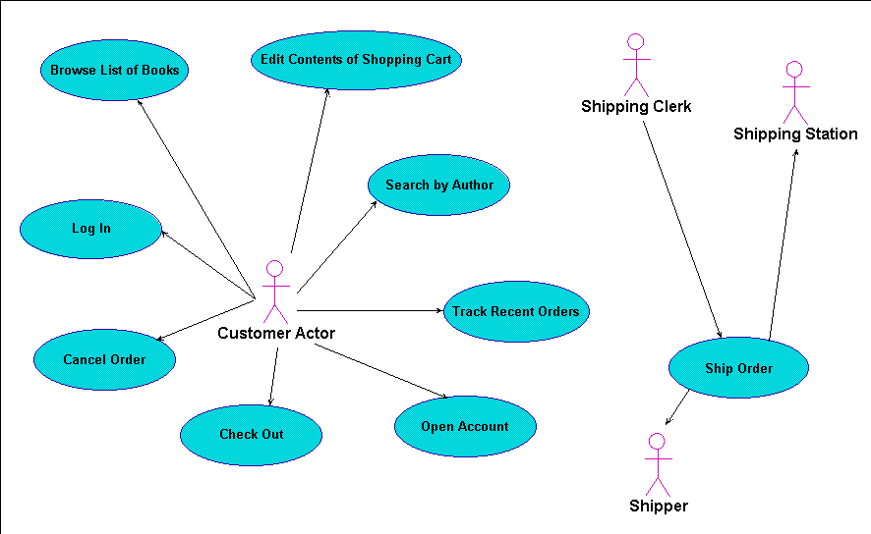
Use Case Model

Slide 26
Login: bad use case text
(Exercise 1) The Customer enters his or her user ID and password, and then clicks the Log In button. The system returns the Customer to the Home Page.
(Exercise 2) Name: Log In
Goal: To log a customer into the system.
Precondition: The Customer is not already logged into the system.
Basic Course: The Customer enters his or her user ID and password, and then clicks the Log In button….
Alternate Courses: …
Postcondition: The Customer is logged into the system.

Slide 27
Login: good use case text
(Exercise 1) Basic Course: The Customer enters his or her user ID and password, and then clicks the Log In button. The system validates the login information against the persistent Account data, and then returns the Customer to the Home Page.
(Exercise 2) Basic Course: The Customer enters his or her user ID and password, and then clicks the Log In button….

Slide 28
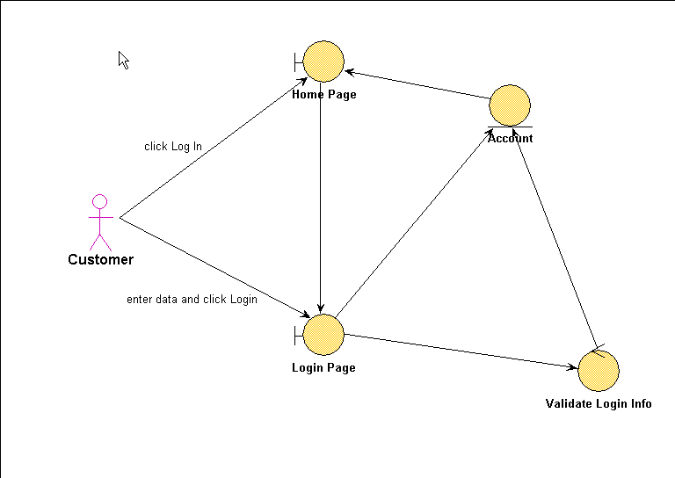
Login: bad robustness diagram

Slide 29
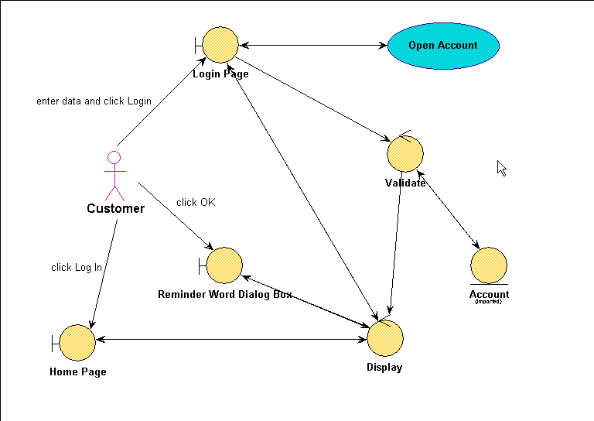
Login: good robustness diagram

Slide 30
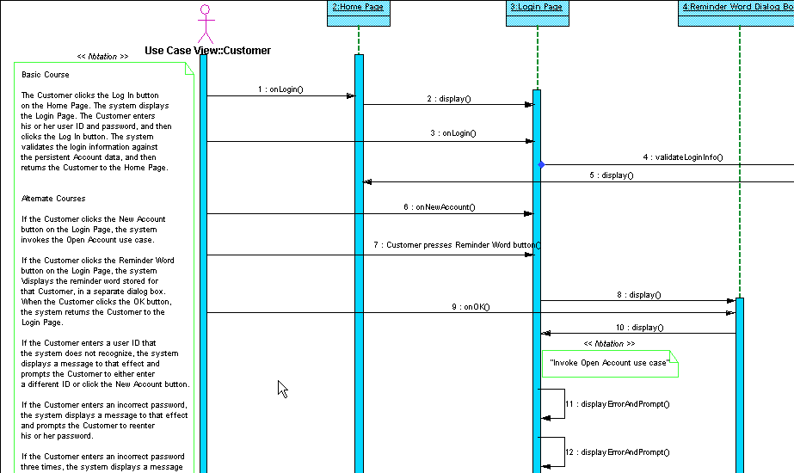
Login: bad sequence diagram

Slide 31
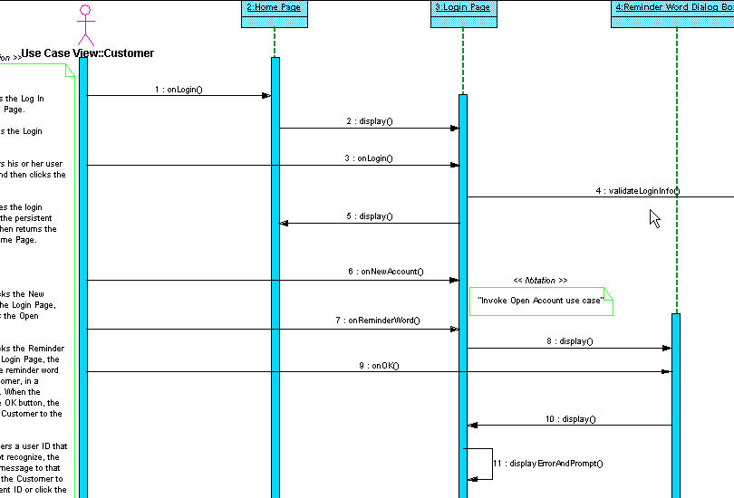
Login: good sequence diagram

Slide 32
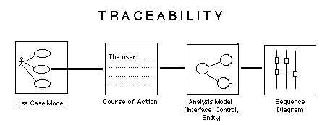
High degree of traceability
Courses of action describe what goes on in a use case (normally and in exceptional cases)
Robustness diagrams bridge the “what/how” gap
Sequence diagrams are done for each use case

Slide 33
Edit Shopping Cart use case text
Basic Course: On the Shopping Cart Page, the Customer modifies the quantity of an Item in the Shopping Cart, and then presses the Update button. The system stores the new quantity, and then computes and displays the new cost for that Item….
Alternate Course: If the Customer changes the quantity of the Item to 0, the system deletes that Item from the Shopping Cart.

Slide 34
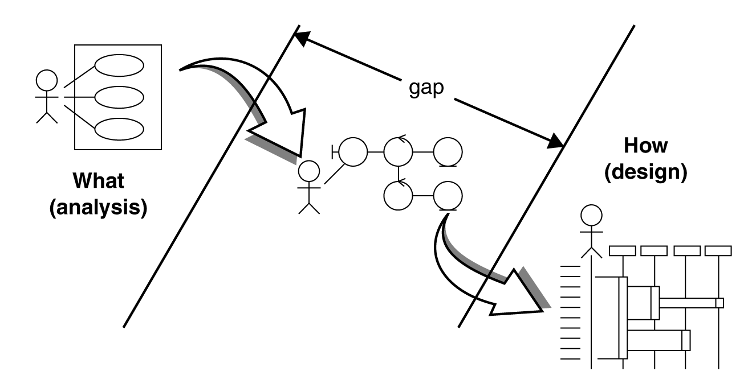
Robustness diagrams bridge the “what/how” gap
Most current UML texts do not address crossing this what/how gap.

Slide 35
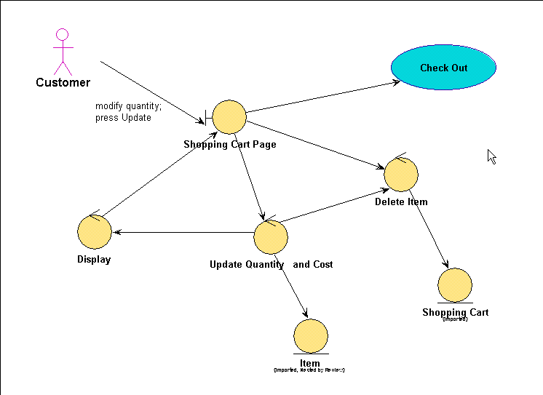
Edit shopping cart robustness diagram

Slide 36
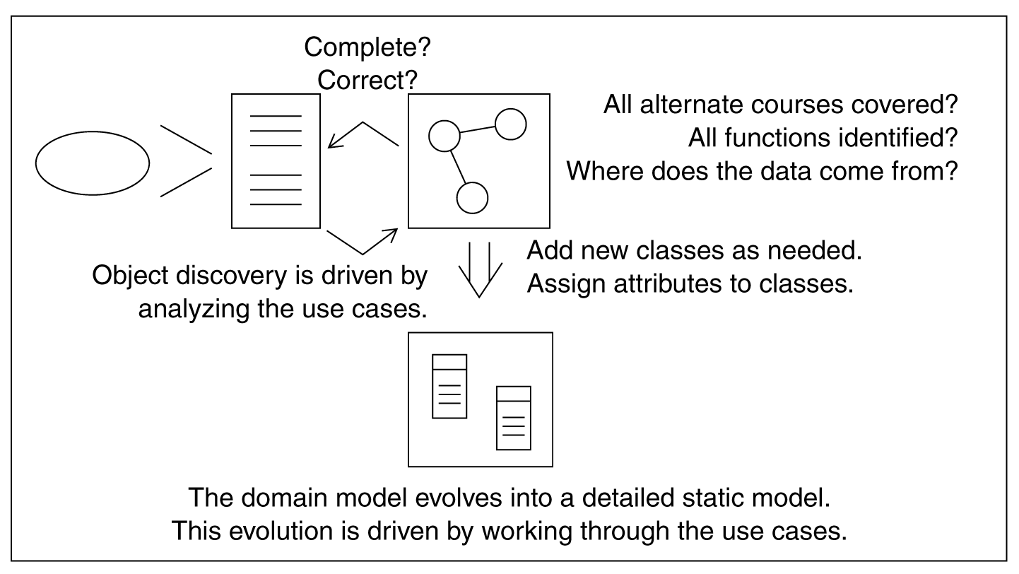
A closer look inside Robustness Analysis

Slide 37
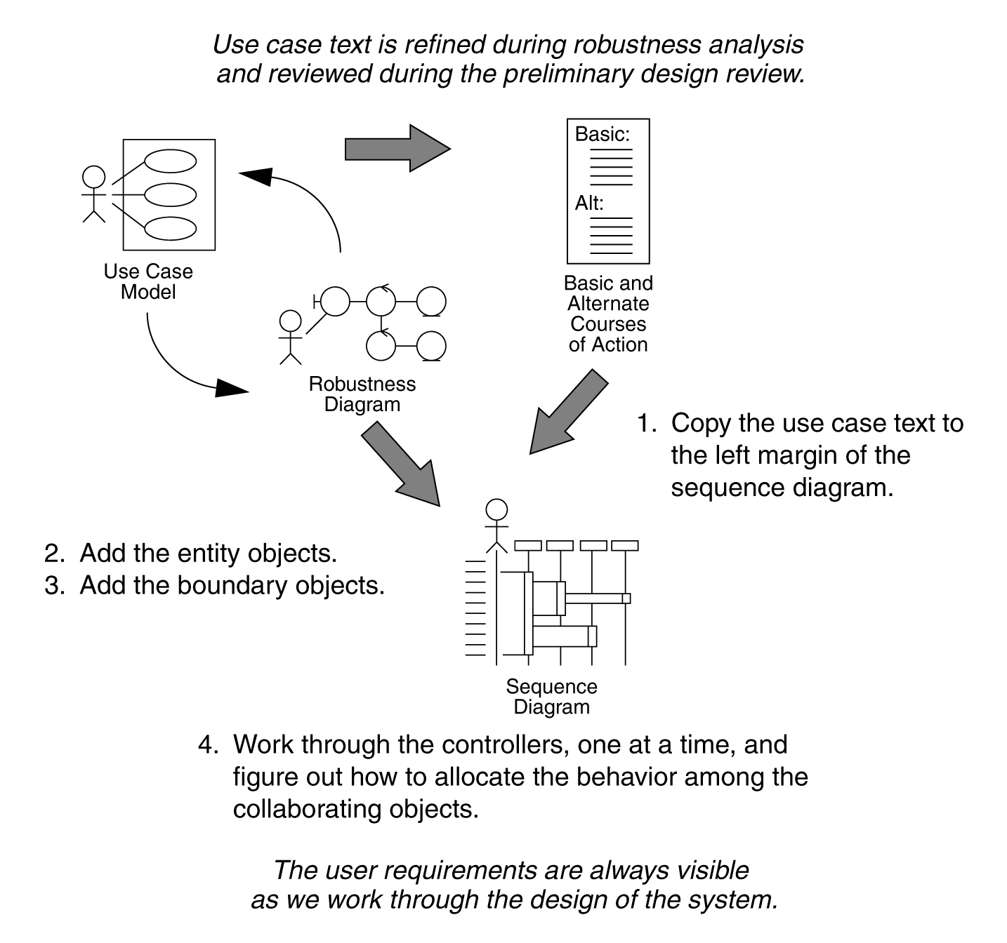
Use the robustness diagram to get the sequence diagram started

Slide 38
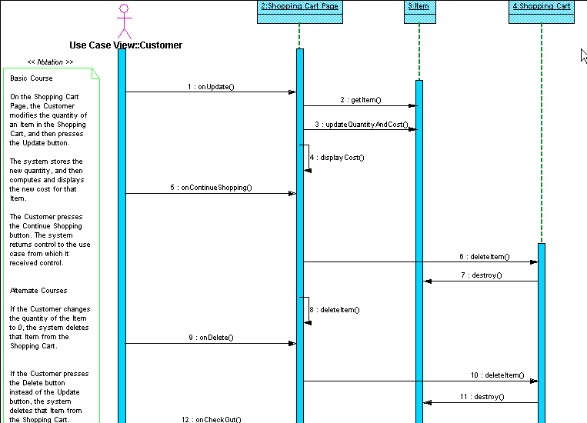
Edit shopping cart sequence diagram

Slide 39
Use the Sequence Diagram to Allocate Behavior
Which class does an operation belong in?
Halbert and O’Brien criteria:
Reusability: does it make this class more general?
Applicability: does it fit? Is it relevant?
Complexity: is it easier to build it here or elsewhere?
Implementation knowledge: does it rely on internal details?

Slide 40
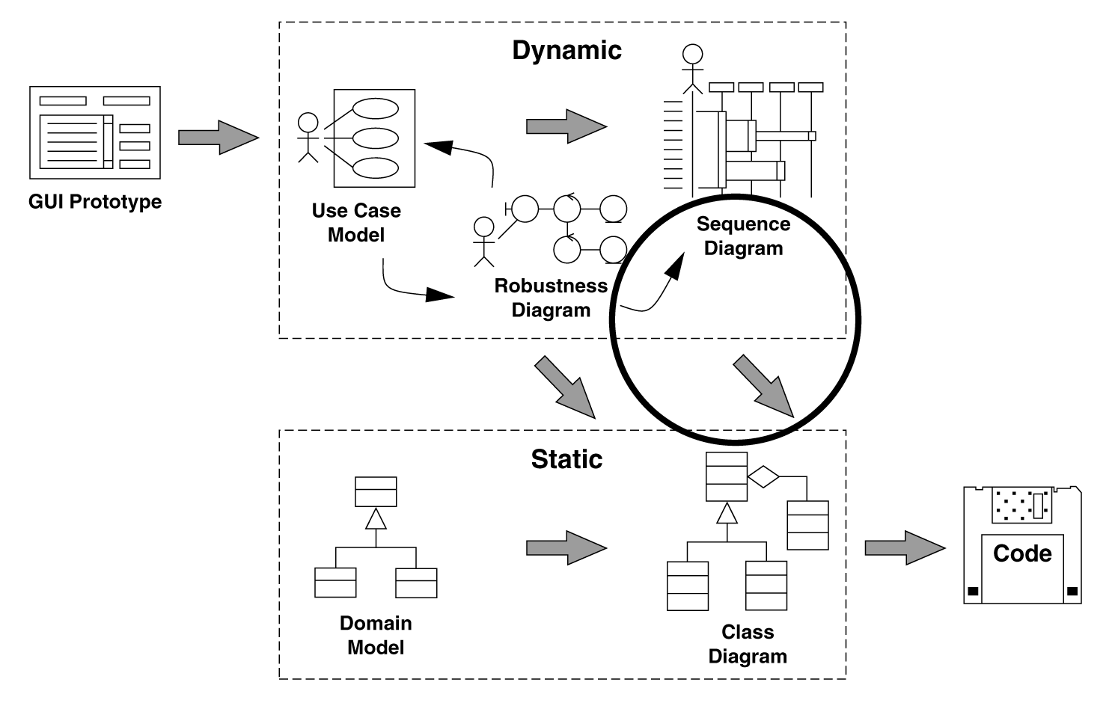
Update your static model, again

Slide 41
What is a “quality” class?
Coupling: should be loosely coupled with other classes
Cohesion: should be highly cohesive
Sufficiency: does it do enough?
Completeness: does it cover all the relevant a abstractions?
Primitiveness: stick to basic operations

Slide 42
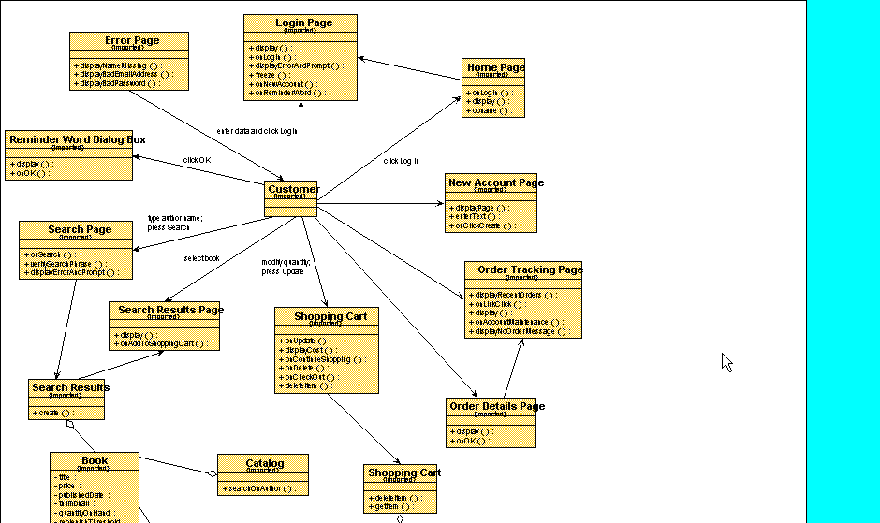
Detailed Static Model (1 of 3)

Slide 43
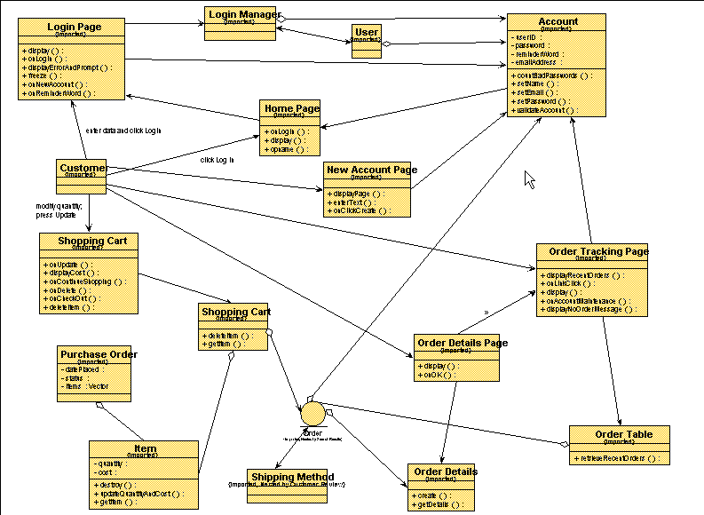
Detailed Static Model (2 of 3)

Slide 44
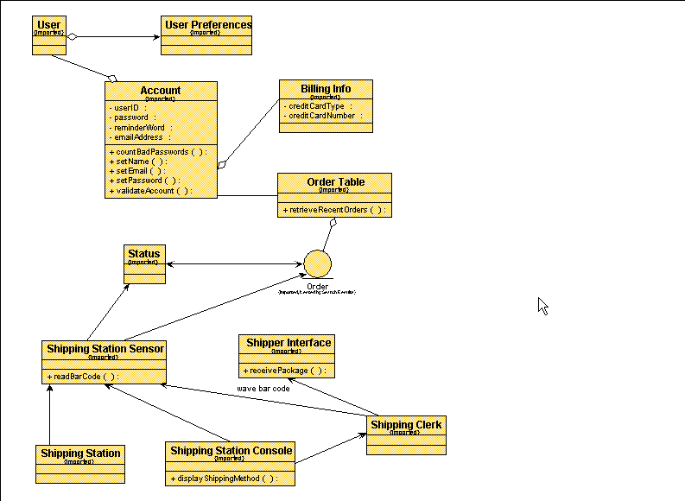
Detailed Static Model (3 of 3)

Slide 45
Code and Test
Component Diagrams show packaging of classes into distributable units
Usage scenarios (use cases) become test scenarios (test cases)
We can link requirements, test cases and other software quality assurance (SQA) information to these models and follow them through the design.

Slide 46
Key features of the ICONIX Process
Avoidance of analysis paralysis
Streamlined usage of the UML
Minimalist yet sufficient
High degree of traceability
Based on fundamental OOAD questions
Work from the outside in
Work from the inside out

Slide 47
Based on fundamental OOAD questions
What are the users doing? (Jacobson)
What are the objects in the real world? (Rumbaugh)
What objects are needed for each use case? (Jacobson)
How do the objects collaborate with each other? (Jacobson and Booch)
How will we implement real-time control? (state models)
How are we really going to build this system? (Booch)

Slide 48
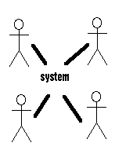
Work from the outside in
Objectory and the ICONIX Process are use-case driven (outside-in)
By keeping use cases as the primary unit of system decomposition, we stay user-focused
By using prototyping in conjunction with use cases, we stay user-focused

Slide 49
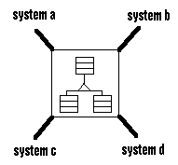
Work from the inside out
OMT was object driven (inside-out)
OMT models == real-world (domain)
Some upfront thought about the problem domain makes everything easier
Reuse across systems comes from the domain model

Slide 50
For further information
EMAIL: doug@iconixsw.com
http://www.iconixsw.com/UMLBook.html
http://www.iconixsw.com/UMLTraining.html
http://www.iconixsw.com/UMLecommerce.html
http://www.iconixsw.com/UMLworkbook.html
http://www.iconixsw.com/public_courses.htm
Phone: 310-458-0092
FAX: 310-396-3454
If interested in public class in SF Dec 10, 11 contact Jon Graff
jon@iconixsw.com 310-458-0092

