Slide 1
Use Case Driven Object Modeling -- A 99% Fat-Free Approach
Doug Rosenberg
ICONIX Software Engineering, Inc.
http://www.iconixsw.com

Slide 2
History
In The Beginning, There Was OMT, Objectory, and The Booch Method
Let There Be A Unified Notation
All that notation and no process?
Let There Be RUP
Help, all this process is paralyzing us!
New Idea -- Code and You’re Done!
There’s another way…Do OOAD but Keep It Simple

Slide 3
In The Beginning, There Was OMT, Objectory, and The Booch Method
Three very different kinds of OO methods.
Each method had strengths.
Each method had weaknesses.
Much of the original modeling knowledge from the OMT, Objectory, and Booch methods is not repeated in the current UML literature, which mostly focuses on notation.

Slide 4
Each method had strengths
Rumbaugh ➔ Domain object (problem space) models
Jacobson ➔ User-driven solution space models
Booch ➔ Detailed design-level models

Slide 5
Each method had weaknesses
Rumbaugh: strong for problem space; simplistic for solution space
Jacobson: deemphasized domain modeling; didn’t offer enough for detailed OOD
Booch: targeted squarely at OOD; not strong with regard to analysis

Slide 6
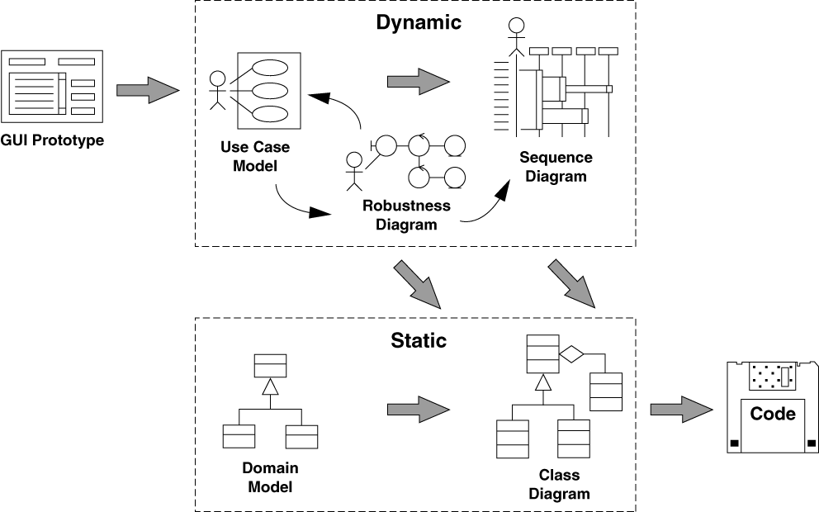
Let There Be A Unified Notation
Jacobson
Jacobson
Booch
Rumbaugh

Slide 7
All that notation and no process?
I can draw all these diagrams, but how do they all relate to each other?
80% of modeling can be done with 20% of the UML. Which 20% was that again?
We’re supposed to be “Use Case Driven” but...
“How do we get from Use Cases to Code???”
We’re “thrashing” with use cases

Slide 8
Let There Be RUP
“Marketing-Driven” process
Hey, we have this big suite of tools…..
But nobody understands how the tools work together
We can repackage this Objectory Process…
And use THAT to explain how the tool suite fits together!

Slide 9
Theory vs. practice
In theory, there is no difference between theory and practice, but in practice there is.
In practice, there’s never enough time for modeling.
The ICONIX Process is a STREAMLINED approach to software development that helps you get from use cases to code quickly and efficiently, using a concentrated subset of the UML and related tools and techniques.

Slide 10
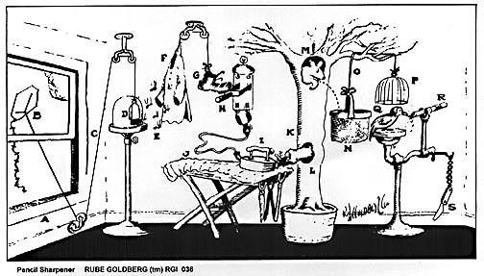
Keep it simple!
Open window (A) and fly kite (B). String (C) lifts small door (D) allowing moths (E) to escape and eat red flannel shirt (F).
As weight of shirt becomes less, shoe (G) steps on switch (H) which heats electric iron (I) and burns hole in pants (J).
Smoke (K) enters hole in tree (L), smoking out opossum (M) which jumps into basket (N), pulling rope (O) and lifting
cage (P), allowing woodpecker (Q) to chew wood from pencil (R), exposing lead. Emergency knife (S) is always handy
in case opossum or the woodpecker gets sick and can't work.

Slide 11
Help, all this process is paralyzing us!
RUP is BIG
When you need an iteration plan planner to plan the plan, you’re dealing with a BIG process
“High in Saturated Fat” -- like Eggs Benedict, with Chocolate Mousse for dessert
Analysis Paralysis -- the great crippler of young software projects
Aren’t “artifacts” what the archaeologists dig up after everybody’s dead?
Many projects don’t need all of RUP -- TAILOR IT to fit
We’re STILL “thrashing” with use cases!

Slide 12
New Idea -- Code and You’re Done!
Knee-Jerk (Extreme) response to too much process
“At least we won’t get bit by Analysis Paralysis”
Code Early and Code Often (is this really a NEW paradigm?)
Catchy slogans…
“Oral Documentation, ”,“The Design Is The Code”, “Design by Testing” etc.
“Tofu Burger with Wheat Grass juice” -- no fat, but...

Slide 13
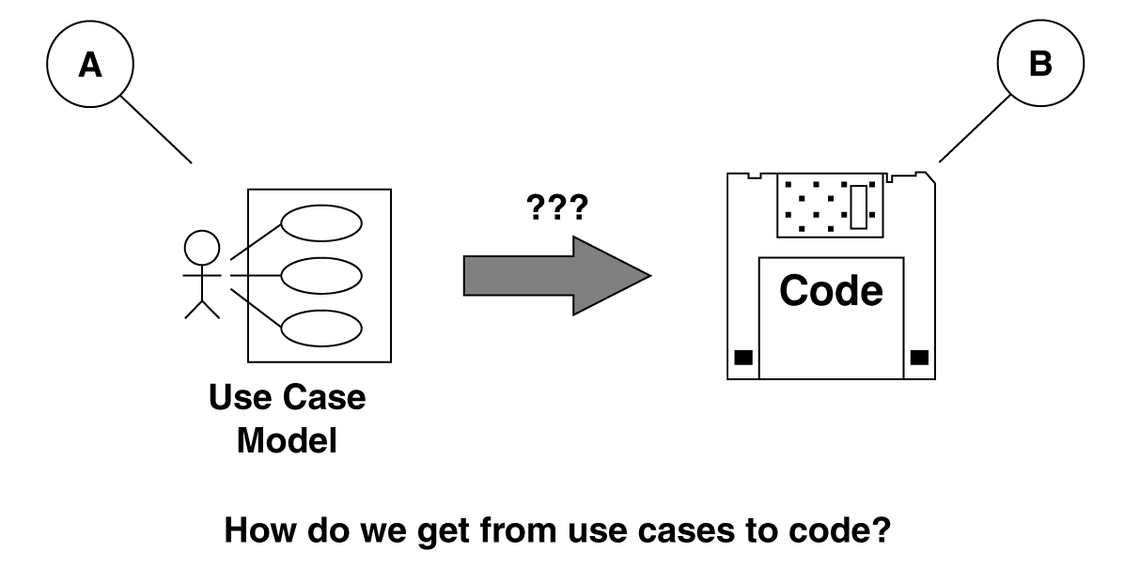
There’s another way…
Do OOAD but Keep It Simple

Slide 14
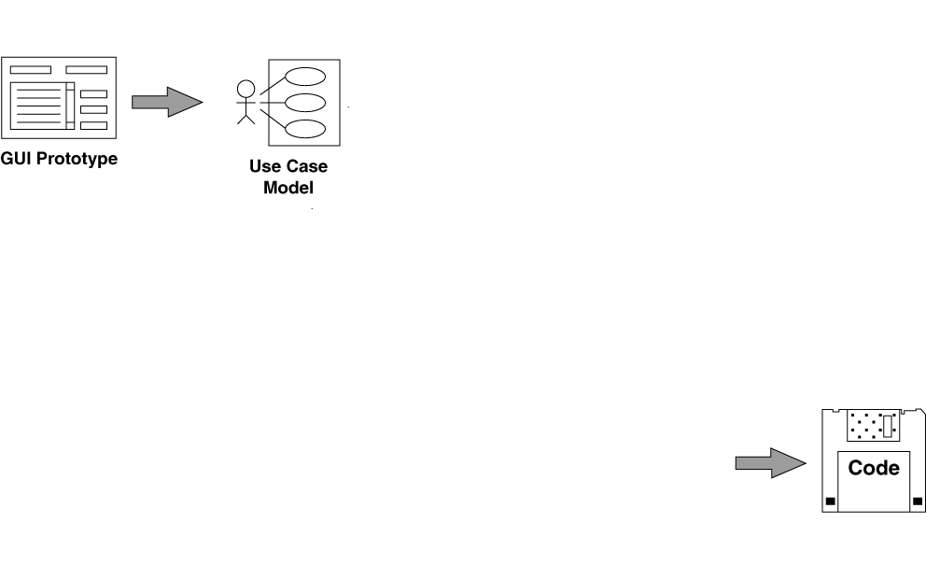
Let’s work backwards from code
Let’s assume that we’ve done a little prototyping, and started to write some use cases.
But code is our desired destination.
?

Slide 15
Before we get to code...
We need a complete set of classes, with accompanying attributes and methods.
We show this information on design-level class diagrams.

Slide 16
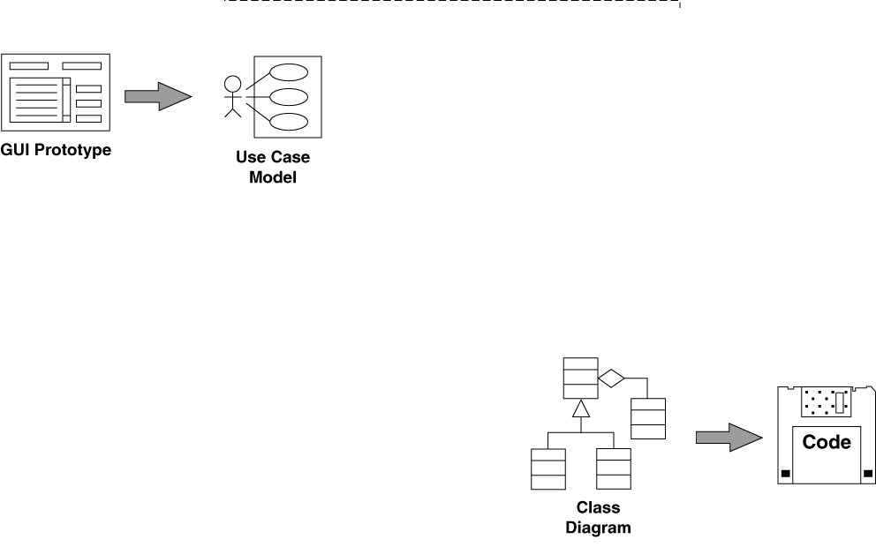
Design-Level Class Diagrams
Our design-level class diagrams serve as the structure for our code.
?

Slide 17
Before we have classes with attributes and methods, though…
We need to allocate behavior into our classes
We have only enough information to make good decisions about which classes are responsible for which methods while we are drawing sequence diagrams.
So, we need to draw a sequence diagram for each use case.

Slide 18
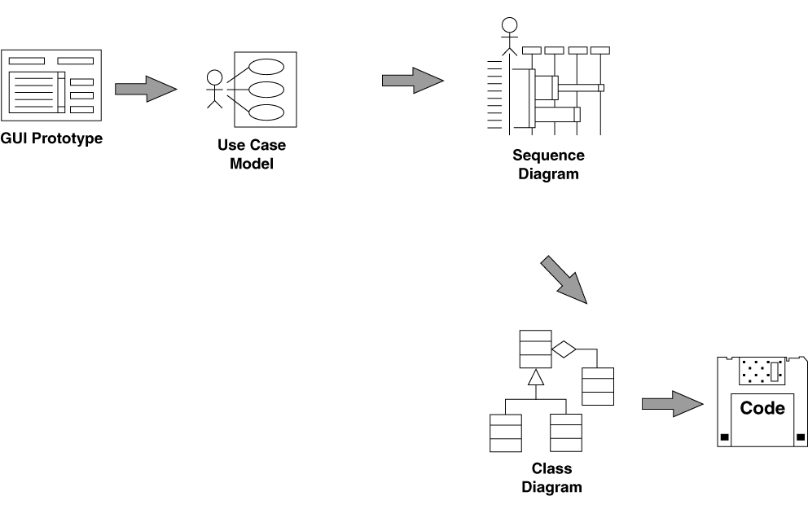
Sequence Diagrams
We allocate methods to classes as we draw sequence diagrams.
?
?

Slide 19
Before we do sequence diagrams, though...
We need to have a good idea about what objects will be performing in which use case, and what functions the system will perform as a result of user actions.
We get this information from robustness diagrams, the result of robustness analysis.

Slide 20
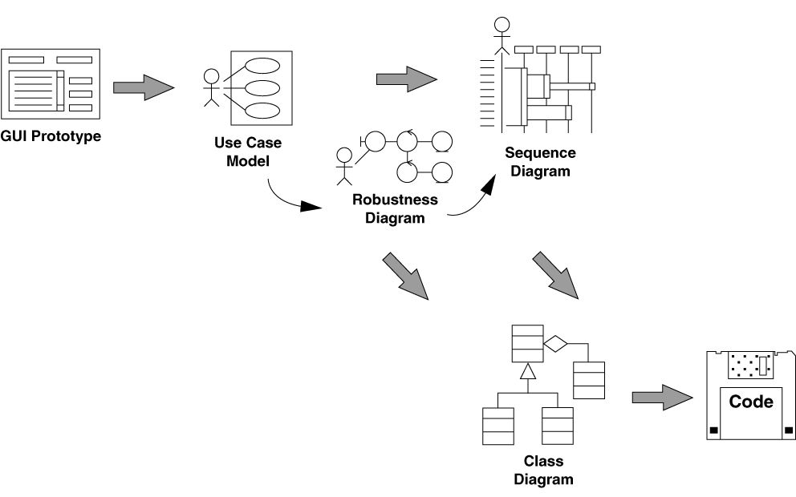
Robustness Diagrams -- the missing link!
We discover new objects, and add attributes to classes, as we draw robustness diagrams.
?

Slide 21
But we can’t draw robustness diagrams before...
We describe system usage in the context of the object model.
This means that we don’t write abstract, vague use cases that we can’t design from.
Instead, we need to write use case text that references the names of objects in the problem domain.
We also reference the names of "boundary objects" in the use case text.

Slide 22
First, though...
We need to identify the main abstractions that are present in the problem domain.
In other words, we need a domain model.
We show our domain model on class diagrams.

Slide 23
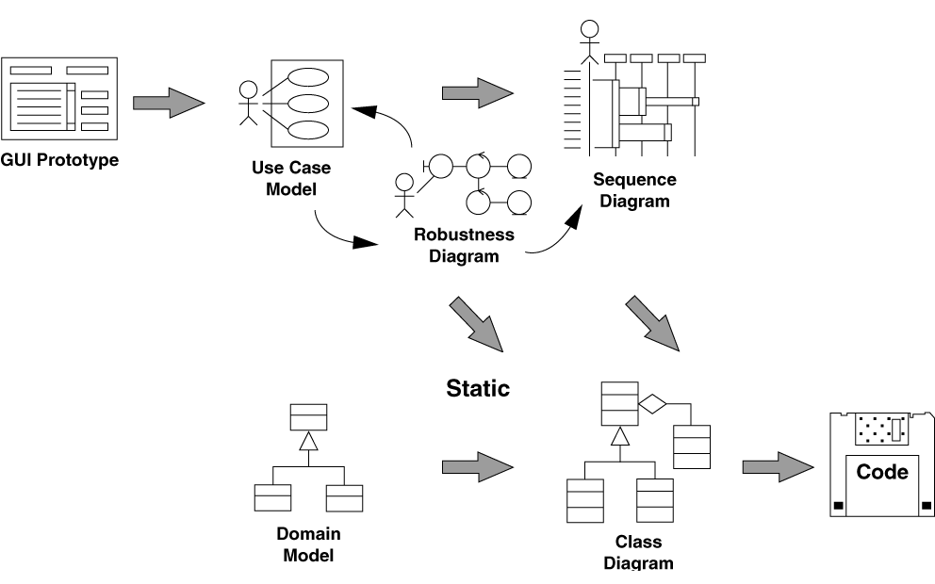
Domain Model

Slide 24
Refining our class diagrams
We'll refine our (static) analysis level class diagrams (our domain model) continuously as we explore the dynamic behavior of the system in more and more detail during analysis and design.
This will ultimately result in our design-level class diagrams, which we can code from.

Slide 25
The ICONIX Process

Slide 26
Key features of the ICONIX Process
Avoidance of analysis paralysis
Streamlined usage of the UML
Minimalist yet sufficient
High degree of traceability
Based on fundamental OOAD questions
Work from the outside in
Work from the inside out

Slide 27
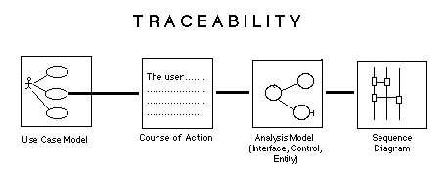
High degree of traceability
Courses of action describe what goes on in a use case (normally and in exceptional cases)
Robustness diagrams bridge the “what/how” gap
Sequence diagrams are done for each use case

Slide 28
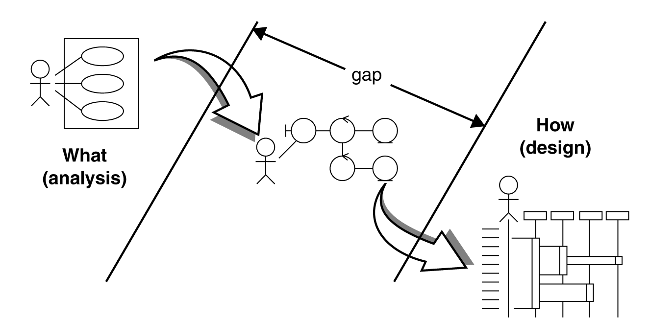
Robustness diagrams bridge the “what/how” gap
Most current UML texts do not address crossing this what/how gap.

Slide 29
Based on fundamental OOAD questions
What are the users doing? (Jacobson)
What are the objects in the real world? (Rumbaugh)
What objects are needed for each use case? (Jacobson)
How do the objects collaborate with each other? (Jacobson and Booch)
How will we implement real-time control? (state models)
How are we really going to build this system? (Booch)

Slide 30
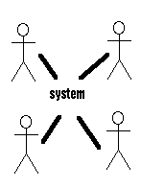
Work from the outside in
Objectory and the Unified Process are use-case driven (outside-in)
By keeping use cases as the primary unit of system decomposition, we stay user-focused
By using prototyping in conjunction with use cases, we stay user-focused

Slide 31
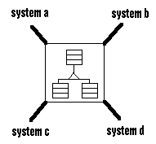
Work from the inside out
OMT was object driven (inside-out)
OMT models == real-world (domain)
Some upfront thought about the problem domain makes everything easier
Reuse across systems comes from the domain model

Slide 32
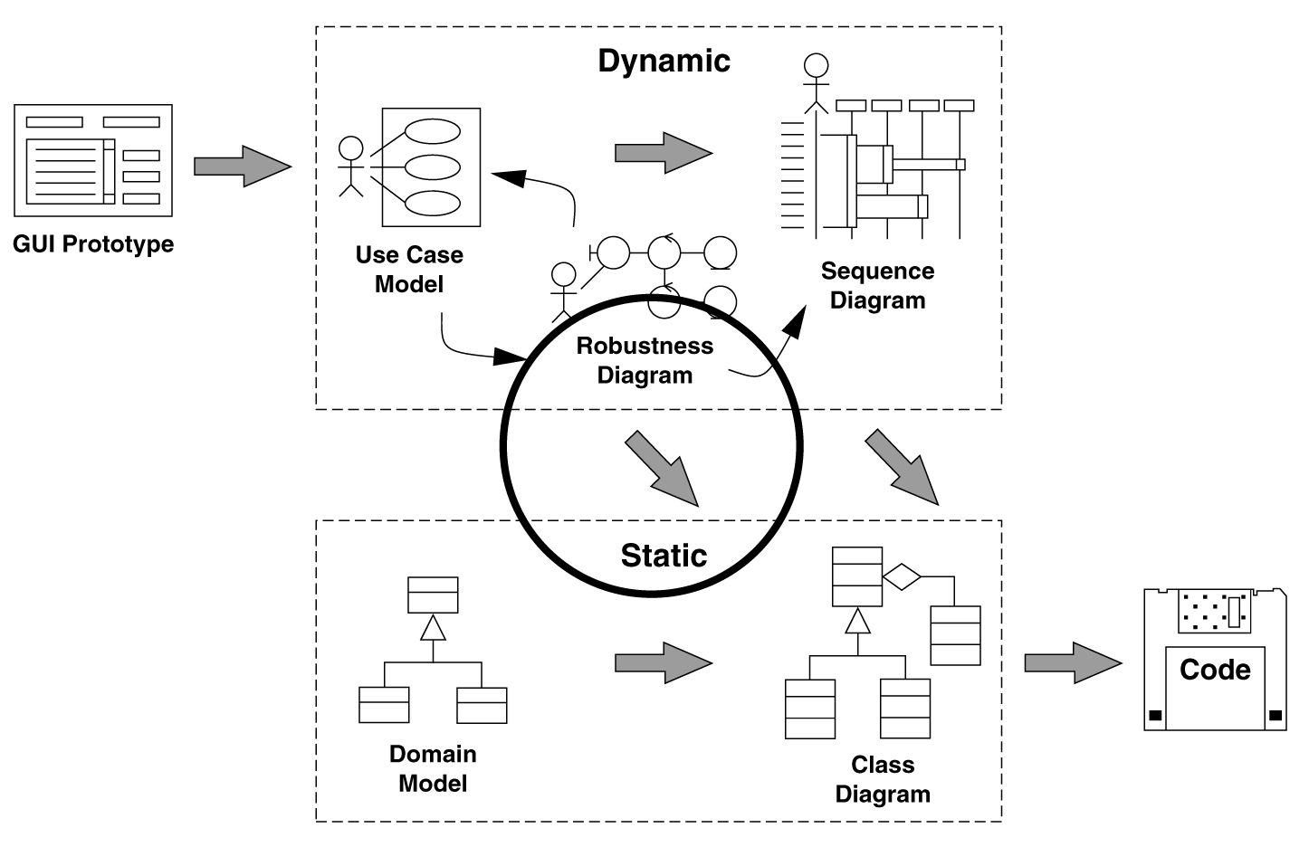
Update your domain model

Slide 33
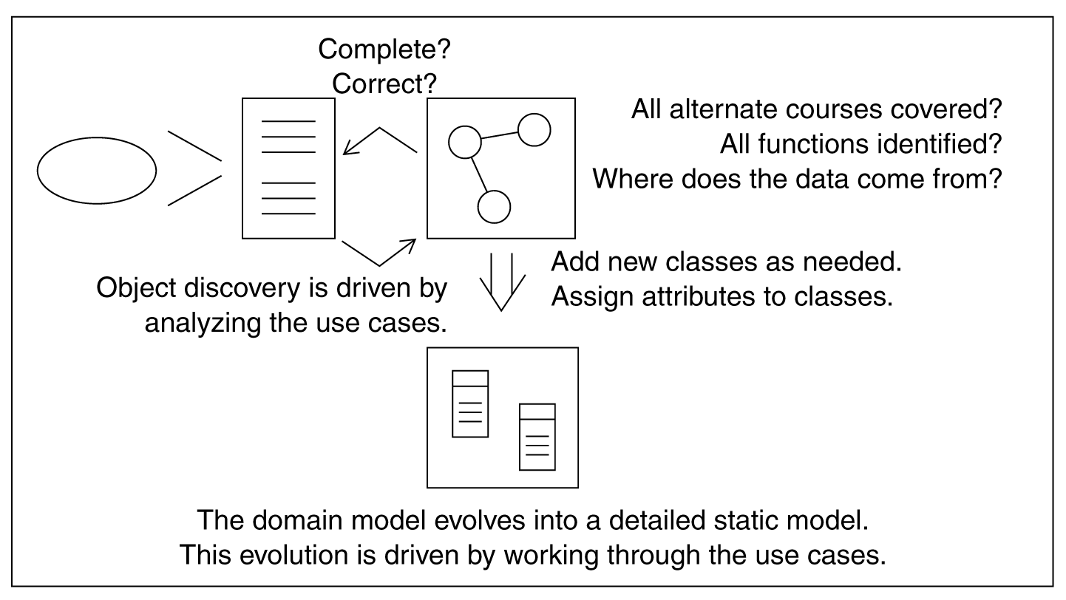
Use robustness analysis to update your static model

Slide 34
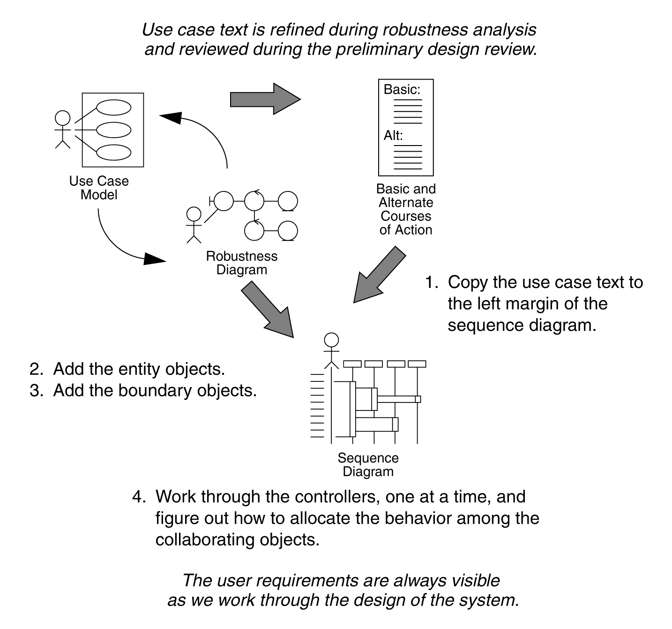
Use the robustness diagram to get the sequence diagram started

Slide 35
Use the Sequence Diagram to Allocate Behavior
Which class does an operation belong in?
Halbert and O’Brien criteria:
Reusability: does it make this class more general?
Applicability: does it fit? Is it relevant?
Complexity: is it easier to build it here or elsewhere?
Implementation knowledge: does it rely on internal details?

Slide 36
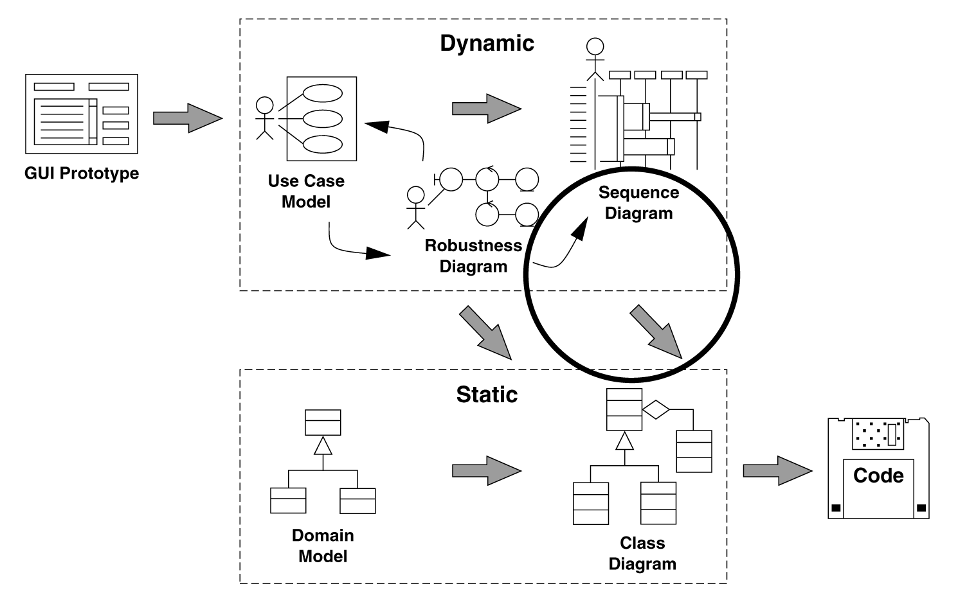
Update your static model, again

Slide 37

Add “Booch stuff” to the analysis-level UML class diagram
Booch constructs show additional design information
abstract classes, parameterized and instantiated classes
aggregation vs composition
friend, virtual, and static relationships

Slide 38
Drill down from the high-level models to detailed OOD
Booch provided the most comprehensive OOD method
Only OOD method to thoroughly treat software packaging, physical assignment across multiple processors
Especially strong for details of message synchronization, instantiation, parameter passing

Slide 39
Design-Level Class Diagrams
What is a “quality” class?
Parameterized and instantiated classes
Design patterns

Slide 40
What is a “quality” class?
Coupling: should be loosely coupled with other classes
Cohesion: should be highly cohesive
Sufficiency: does it do enough?
Completeness: does it cover all the relevant a abstractions?
Primitiveness: stick to basic operations

Slide 41
Design patterns
Component
Operation()
Add(Component)
Remove(Component)
GetChild(int)
Client
Component
Leaf
Operation()
Add(Component)
Remove(Component)
GetChild(int)
Operation()
children

Slide 42
Code and Test
Component Diagrams show packaging of classes into distributable units
Usage scenarios (use cases) become test scenarios (test cases)
We can link requirements, test cases and other software quality assurance (SQA) information to these models and follow them through the design.

Slide 43
Component Diagrams show packaging of classes into distributable units
Components are physical, replaceable parts of a system that conform to, and provide the realization of, interfaces.
Examples: dynamic link library (DLL), COM+ object, Enterprise Java Bean (EJB)
Unlike classes, components are physical, not logical, and components have operations that are reachable only through their interfaces.

Slide 44
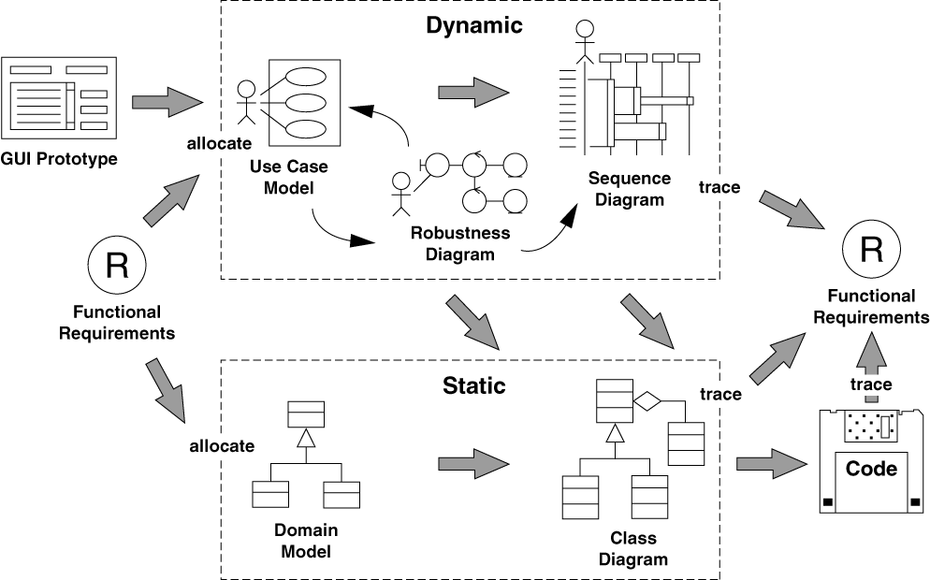
Tracing requirements

Slide 45
We CAN avoid Analysis Paralysis without skipping OOAD
We want the MINIMAL YET SUFFICIENT amount of process
Start small and tailor up as needed [opposite from RUP)
Best effort to “get it right the first time” [opposite from XP]
The ICONIX approach was synthesized from OMT, Objectory, Booch starting in 1993
It has been refined over 7+ years and hundreds of projects
It works. And it scales.
Book: “Use Case Driven Object Modeling with UML -- A Practical Approach” Addison-Wesley 1999

Slide 46
For further information
EMAIL: doug@iconixsw.com
http://www.iconixsw.com/UMLBook.html
http://www.iconixsw.com/UMLTraining.html
Phone: 310-458-0092
FAX: 310-396-3454

