Slide 1
Wilcoxon Signed Rank Test for Median
Developed in 1945 by the statistician Frank Wilcoxon.
Wilcoxon signed rank sum test is used to test the null hypothesis that the median of a distribution is equal to some value.
Elements of Wilcoxon signed ranked test
Two related groups
One dependent variable – (ordinal, interval or ratio)
Minimum of 5 pairs of observations
Can be used for pretest/post test designs
Assumptions
The paired samples are random and independent
The distribution of the differences between the groups must be symmetrical
No assumption of normality

Slide 2
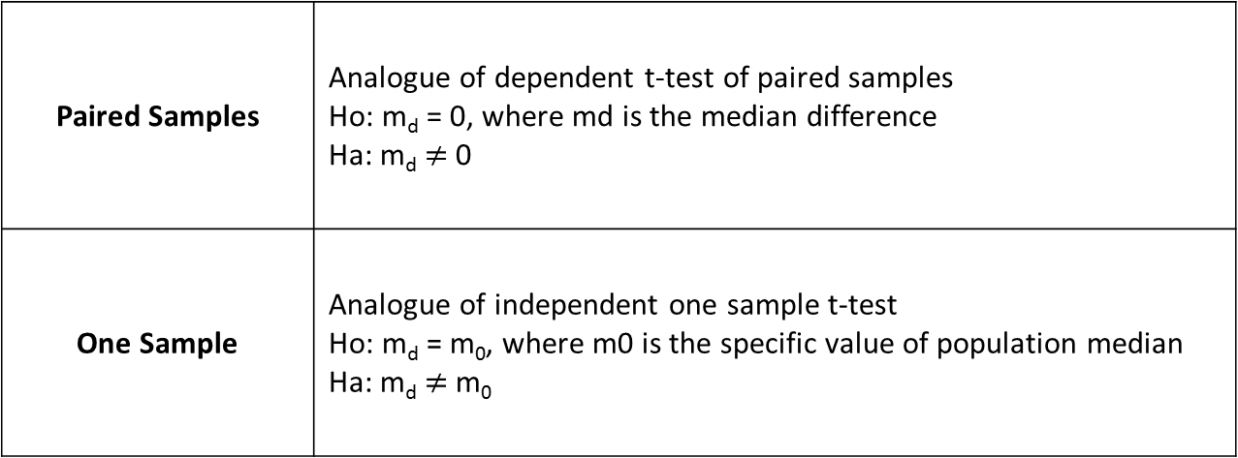
Wilcoxon Signed Rank Test for Median
Two slightly different versions of the test exist.
Paired Samples
One Sample

Slide 3
Wilcoxon Signed Rank Test for Median
Carrying out the Wilcoxon signed rank sum test.
Paired samples
1. State the null hypothesis - in this case it is that the median difference, md = 0
2. Calculate each paired difference, d_{i} = x_{i} − y_{i}, where x_{i} and y_{i} are the pairs of observations.
3. Rank the d_{i}s, ignoring the signs (i.e. assign rank 1 to the smallest |d_{i}|, rank 2 to the next etc.)
4. Label each rank with its sign, according to the sign of d_{i}.
5. Calculate W+, the sum of the ranks of the (+)d_{i}s, and W−, the sum of the ranks of the (-)d_{i}s.
One Sample
1. State the null hypothesis - the median value is equal to some value m.
2. Calculate the difference between each observation and the hypothesized median, d_{i} = x_{i} − m.
3. Apply Steps 3-5 as above.
6. Choose T_{c} (Test Statistic) = min(W−,W+).
7. Use tables of critical values for the Wilcoxon test to find the T statistic.
If computed T_{c} value ≤ the table T value, Reject Ho. Otherwise, Accept Ho

Slide 4
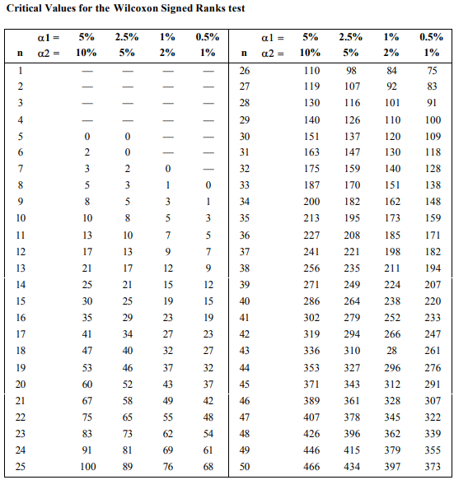
Wilcoxon Signed Rank Test for Median

Slide 5

Wilcoxon Signed Rank Test for Median
Using Normal Approximation
If the number of observations/pairs such that n(n+1) / 2 is large enough (> 20), a normal approximation can be used. For this case, we can use z-test with the following considerations.
Use min(W-, W+) for test statistic
Use the following formula for the mean: μ: n(n+1)/4.
Use the following formula for σ: √((n(n+1)(2n+1))/24)
If you have tied ranks, you must reduce σ by t³-t/48 for each of t tied ranks. For example, for 2 tied ranks reduce σ by 8-2/48 = 0.125.
z = (x – μ) / σ
Example:
x = T = W- = 7
n = 12
tied ranks = 2

Slide 6
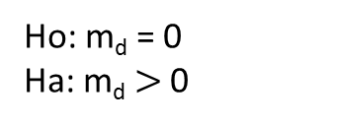
Wilcoxon Signed Rank Test for Median
Example 1 (Paired Sample)
Suppose that the marketing manager wants to make a decision about the new batter mix based not just on how many persons thought the new batter improved taste but also on the amount of the taste improvement assigned to new mix.
1
Ho: m_{d} = 0
Ha: m_{d} $>$ 0
5
W- = 6+4.5 = 10.5
W+ = 25.5
2
4
Consumers | Original Batter | New Batter | Diff. | Rank | Signed Rank
R. MacDonald | 3 | 9 | (+)6 | 8 | 8
G. Price | 5 | 5 | 0 | ignore
B. King | 3 | 6 | (+)3 | 4.5 | 4.5
L.J. Silver | 1 | 3 | (+)2 | 2.5 | 2.5
P.P. Gino | 5 | 10 | (+)5 | 7 | 7
E. J. McGee | 8 | 4 | (-)4 | 6 | -6
S. White | 2 | 2 | 0 | ignore
E. Fudd | 8 | 5 | (-)3 | 4.5 | -4.5
Y. Sam | 4 | 6 | (+)2 | 2.5 | 2.5
M. Muffet | 6 | 7 | (+)1 | 1 | 2.5
Total
3
6
T_{c} = min(W-, W+) = 10.5
7
At n = 8, α= 0.01
T = 1
Since T_{c} > T, fail to reject Ho. The new mix produces no significant taste improvement over the original batter.

Slide 7
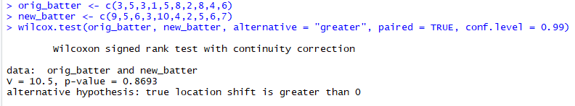
Wilcoxon Signed Rank Test for Median
Example 1 (Paired Sample)
Suppose that the marketing manager wants to make a decision about the new batter mix based not just on how many persons thought the new batter improved taste but also on the amount of the taste improvement assigned to new mix.
Using R

Slide 8
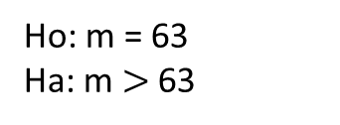
Wilcoxon Signed Rank Test for Median
Example 2 (One Sample)
A random sample of 10 students marks are as follows. Is there evidence at the 5% level to suggest that the median mark is greater than 63?
1
Ho: m = 63
Ha: m $>$ 63
5
W- = 10+6 = 16
W+ = 39
2
3
4
Grade | Grade – 63 | Rank | Signed Rank
64 | 1 | 2 | 2
69 | 6 | 7 | 7
40 | -23 | 10 | -10
64 | 1 | 2 | 2
65 | 2 | 4.5 | 4.5
65 | 2 | 4.5 | 4.5
82 | 19 | 9 | 9
59 | -4 | 6 | -6
64 | 1 | 2 | 2
74 | 11 | 8 | 8
6
T_{c} = min(W-, W+) = 16
7
At n = 10, α= 0.05, 1-tail test
T = 11
Since T_{c} > T, Accept Ho. No significance evidence that the median mark is greater than 63.

Slide 9
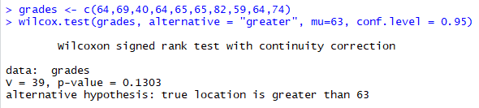
Wilcoxon Signed Rank Test for Median
Example 2 (One Sample)
A random sample of 10 students marks are as follows. Is there evidence at the 5% level to suggest that the median mark is greater than 63?
Using R

Slide 10
Wilcoxon Signed Rank Test for Median
Example 3 (Using Normal Approximation)
Suppose that the marketing manager wants to make a decision about the new batter mix based not just on how many persons thought the new batter improved taste but also on the amount of the taste improvement assigned to new mix.
n = 8, α= 0.01
n(n+1) / 2 = (8*9)/2 = 36
36 > 20, therefore normal approximation can be used
T_{c} = min(W-, W+) = 10.5
Μ = n(n+1)/4 = (8*9)/4 = 18
For tied rank = 5
sub = t³-t/48 = 5³-5/48 = 2.5
σ: √((n(n+1)(2n+1))/24) – sub = √(8*9*17)/24) – sub = 6.96
Z_{c} = (10.5 – 18)/6.96 = -1.078
Z_{(0.01)} = 2.323
Since Z_{c} < Z, fail to reject Ho. The new mix produces no significant taste improvement over the original batter.

Slide 11
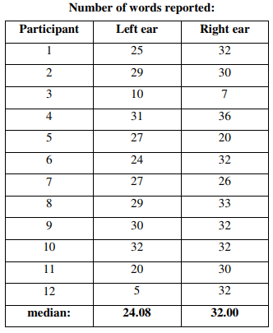
Wilcoxon Signed Rank Test for Median
Exercise 1
Suppose we wanted to know if people's ability to report words accurately was affected by which ear they heard them in. To investigate this, we performed a dichotic listening task. Each participant heard a series of words, presented randomly to either their left or right ear, and reported the words if they could. Each participant Graham Hole Research Skills, version 1.0 thus provided two scores: the number of words that they reported correctly from their left ear, and the number reported correctly from their right ear. Do participants report more words from one ear than the other?
Answer: The number of words reported correctly was not significantly affected by which ear they were presented

Slide 12
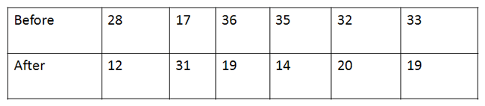
Wilcoxon Signed Rank Test for Median
Exercise 2
Ordinal data is displayed in the table below. Is there a difference between Before and After using alpha = 0.05? Use normal approximation.
Answer: There is a difference between the before and after group.

Slide 13
Wilcoxon Signed Rank Test for Median
References
https://newonlinecourses.science.psu.edu/stat414/node/319/
https://www.statisticshowto.datasciencecentral.com/wilcoxon-signed-rank-test/

Slide 14
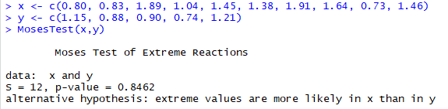
Moses Test of Extreme Reactions
Perform Moses test of extreme reactions, which can be used to determine the difference in range between two samples.
For two independent samples from a continuous field, this tests whether extreme values are equally likely in both populations or if they are more likely to occur in the population from which the sample with the larger range was drawn.
Ho: Extreme values are equally likely in both populations.
Ha: Extreme values are more likely to occur from which the sample with the larger range was drawn.
Using R, library “DescTools”

Slide 15
Moses Test of Extreme Reactions
Perform Moses test of extreme reactions, which can be used to determine the difference in range between two samples.
For two independent samples from a continuous field, this tests whether extreme values are equally likely in both populations or if they are more likely to occur in the population from which the sample with the larger range was drawn.
Ho: Extreme values are equally likely in both populations.
Ha: Extreme values are more likely to occur from which the sample with the larger range was drawn.
Using R, library “DescTools”

Slide 16
Moses Test of Extreme Reactions
References
https://www.ibm.com/support/knowledgecenter/SSLVMB_22.0.0/com.ibm.spss.statistics.algorithms/alg_nonparametric_independent_moses.htm
https://www.rdocumentation.org/packages/DescTools/versions/0.99.19/topics/MosesTest

