Slide 1
Thesis critique
Ch. 1 - Problem and its background
Research topic
Statement of the problem
Research hypothesis
Scope and limitations
Ch. 2 - Review of related literature and studies
Ch. 3 - Methodology
Research design
Sampling procedure
Research respondents
Research instruments
Statistical treatment of data
Ch. 4 - Presentation, analysis and interpretation
Ch. 5 - Summary, findings, conclusions and recommendations

Slide 2

Research Topic
- Title could be more brief and concise by removing the “An Assessment”
Avoid using the terms “An Analysis of,” “A Study of,” “An investigation of ,“ and the like. All these things are understood to have been done or to be done when research is conducted. (Calderon & Gonzales, 1993, p.27)

Slide 3
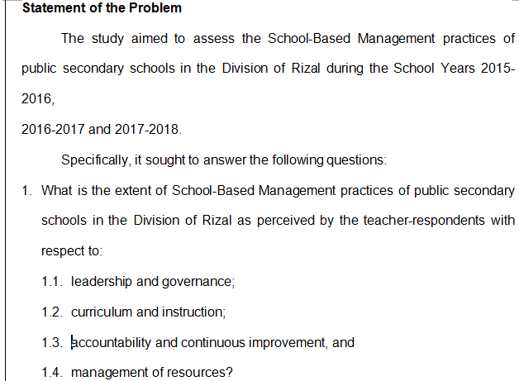
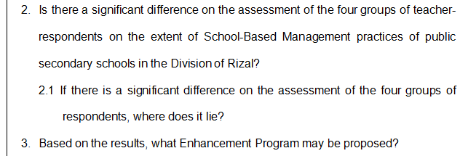
Statement of the problem
- Very clear and concise.

Slide 4
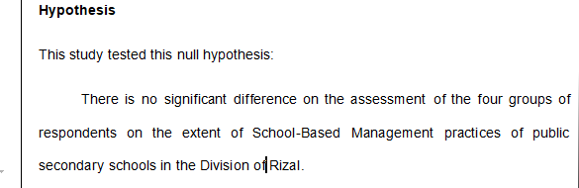
Research hypothesis
- It would have been better to to state the hypothesis in alternative form. “ There is significance difference on the assessment of the four groups ...”
- For clarity, it should have stated in the hypothesis that the testing is done for 4 key indicators of measurement (4 SBM principles).

Slide 5
Scope and limitations
The study was conducted to assess the SBM level of practice of public secondary schools in the Division of Rizal, during the school years 2014-2015, 2015-2016 and 2017-2018.
The study covered four (4) public secondary schools in Cluster BCAMT (Baras, Cardona, Morong, Teresa) namely: Baras National High School, Bernardo F. San Juan National High School, Morong National High School and Pantay National High School.
The respondents of the study were seventy (70) teachers form Bernardo F. San Juan National High School, one hundred eighteen (118) teachers from Morong National High School, thirty seven (37) teachers from Baras National High School and forty five (45) teachers from Pantay National High School with a grand total of two hundred seventy (270) teacher-respondents.
The study used descriptive survey research utilizing the Revised School-Based Management Assessment Tool (DepEd Order No. 83 s. 2012) that were administered to the four groups of respondents. The questionnaire checklist consisted of the different principles of School-Based Management such as leadership and governance, curriculum and instruction, accountability and continuous improvement and management of resources. The researcher considered these four principles as variables since these are the determinants and main indicators of the level of SBM practices of the different public schools.
Further, interviews/focus group discussion among the respondents were done for the triangulation that had significant association to the identified needs of the respondents and to further validate their responses provided on the questionnaire checklist.
- Very will defined and clear.

Slide 6
Thesis critique
Ch. 1 - Problem and its background
Research topic
Statement of the problem
Research hypothesis
Scope and limitations
Ch. 2 - Review of related literature and studies
Ch. 3 - Methodology
Research design
Sampling procedure
Research respondents
Research instruments
Statistical treatment of data
Ch. 4 - Presentation, analysis and interpretation
Ch. 5 - Summary, findings, conclusions and recommendations

Slide 7
Review of related literature and studies
Summary:
RRL done locally and abroad was presented using thematic approach.
Themes presented are: a.) School-based management, b.) Leadership and governance, c.) Curriculum and instruction, d.) Accountability and continuous improvement, and e.) Management of resources.
Synthesis (Similarities and differences between the current research and the gathered related studies) were discussed.
- RRL is too long.
- It would have been easier to understand the sythesis if matrix have been used.

Slide 8
Thesis critique
Ch. 1 - Problem and its background
Research topic
Statement of the problem
Research hypothesis
Scope and limitations
Ch. 2 - Review of related literature and studies
Ch. 3 - Methodology
Research design
Sampling procedure
Research respondents
Research instruments
Statistical treatment of data
Ch. 4 - Presentation, analysis and interpretation
Ch. 5 - Summary, findings, conclusions and recommendations

Slide 9
Research design
The study employed descriptive research.

Slide 10
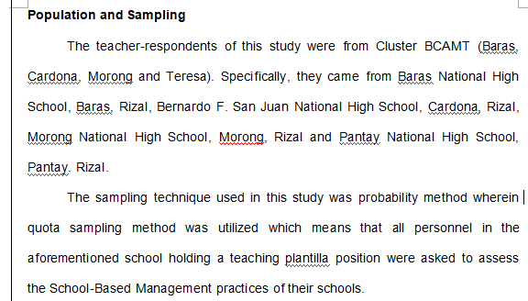
Sampling procedure
- Quota sampling is non-probability method.
- As entire population is used, this is not quota sampling but census.

Slide 11
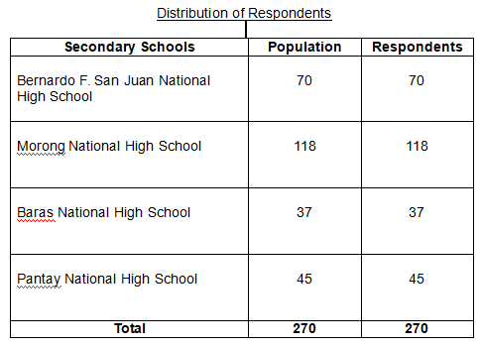
Research respondents
- This table shows that entire population is used, therefore there is no need to do statistical treatment of data like ANOVA and Scheffes test.

Slide 12
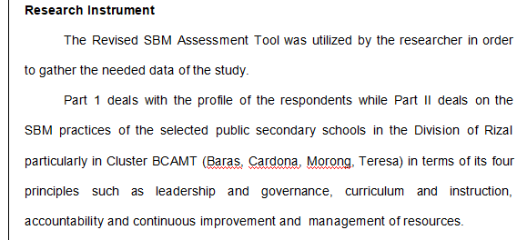
Research instrument
- Revised SBM of 2012 employs 4 level of rating scale (0,1,2,3). Why 0 (no evidence) rating was omitted?

Slide 13
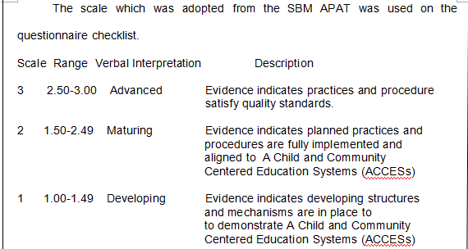
Research instrument
- Three level scale rating has a tendency to have a result of “neutral”.
From http://asq.org/quality-progress/2007/07/statistics/likert-scales-and-data-analyses.html ... “scales are sometimes truncated to an even number of categories (typically four) to eliminate the “neutral” option in a “forced choice” survey scale”
- Conversion of likert scale to corresponding range was not included in the paper.

Slide 14
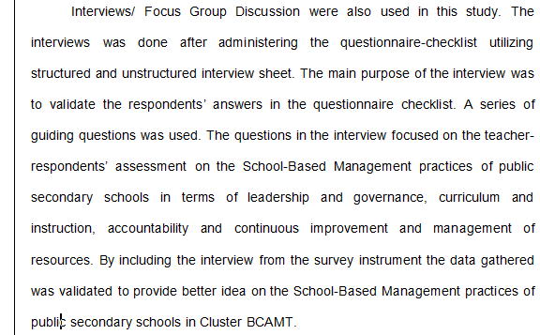

Research instrument
- Reliability test for Interview questionaire was not presented nor how it was done.
- It shows that not all respondents were able to participate in the interviews but this fact was not mentioned/considered in the analysis.

Slide 15
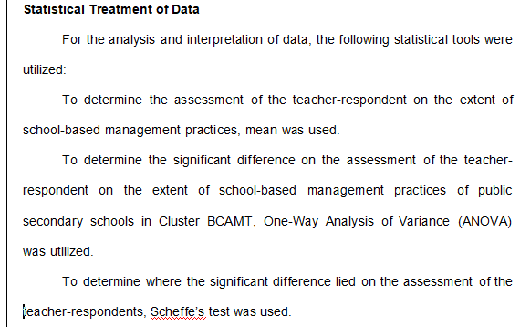
Statistical treatment of data
- There is no need for statistical treatment using one-way ANOVA and Scheffe's test since the data is from the population!

Slide 16
Thesis critique
Ch. 1 - Problem and its background
Research topic
Statement of the problem
Research hypothesis
Scope and limitations
Ch. 2 - Review of related literature and studies
Ch. 3 - Methodology
Research design
Sampling procedure
Research respondents
Research instruments
Statistical treatment of data
Ch. 4 - Presentation, analysis and interpretation
Ch. 5 - Summary, findings, conclusions and recommendations

Slide 17
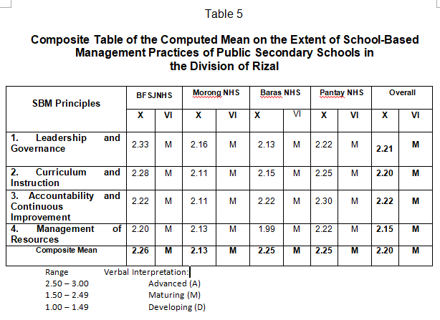
Presentation, analysis and interpretation Result for question #1
- For all SBM principles and all groups(4 schools), result falls in the middle scale.
This maybe attributed to the usage of three level scale only. Result would have been difference if 4 level scale (including 0) was used.

Slide 18
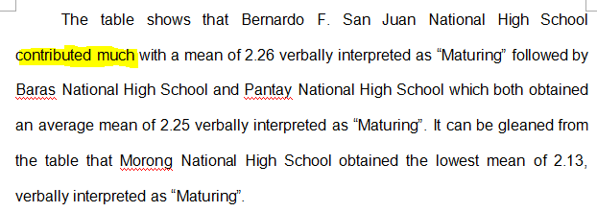
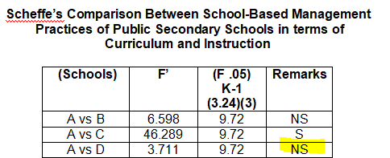
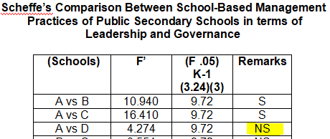
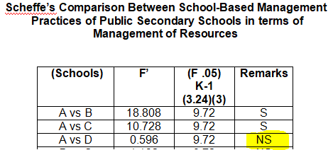
Presentation, analysis and interpretation Result for question #1
- This maybe a wrong generalization attribute to BFSJNHS only because based on Scheffes comparison, difference of BFSJNHS and Pantay NHS is not statistically significant.

Slide 19
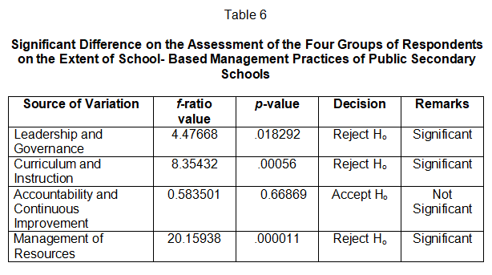
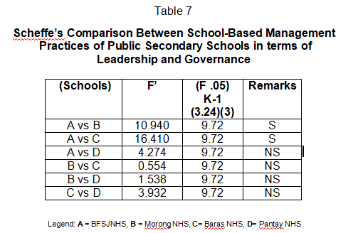
Presentation, analysis and interpretation Result for question #2
- Using one-way anova to compare population means and Scheff's test is not required since population is used.
- Assuming statistical test is required, then the following should have been done.
a.)Known assumptions for one-way ANOVA are not discussed.
b.)Could have used other visualiztion tools like boxplot for better presentation of results

Slide 20
Thesis critique
Ch. 1 - Problem and its background
Research topic
Statement of the problem
Research hypothesis
Scope and limitations
Ch. 2 - Review of related literature and studies
Ch. 3 - Methodology
Research design
Sampling procedure
Research respondents
Research instruments
Statistical treatment of data
Ch. 4 - Presentation, analysis and interpretation
Ch. 5 - Summary, findings, conclusions and recommendations

Slide 21
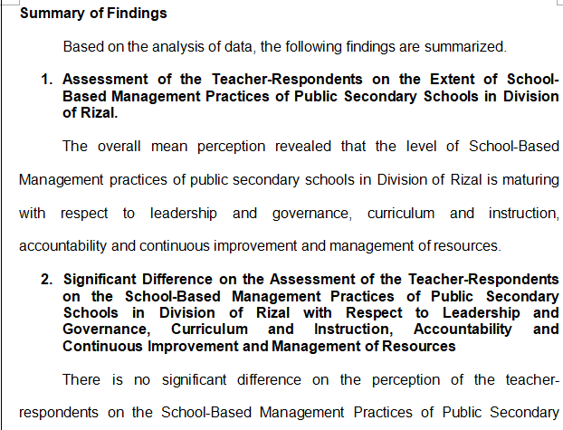
Summary, findings, conclusion and reccomendations
- Result is not conclusive due to unreliable test instrument. However, the recommendations presented to enhance the SBM practices may be still valid.

Slide 22
Statement of the problem - backup

Slide 23
Presentation, analysis and interpretation Result for question #2 - backup
- Using one-way anova to compare population means:
Factor - SBM principles
Analyzed by group (example below)
Group | Lead&Gov (ave.)
Baras NHS | 2.3
Baras NHS | 2.1
....
Morong NHS | 1.9
Morong NHS | 2.2
- Known assumptions for one-way ANOVA are not discussed.
- Could have used other visualiztion tools like boxplot for better presentation of results

Slide 24
Presentation, analysis and interpretation Result for question #2 - backup
- Sheffe’s test to find out which pairs of means are significant
- Only performed for rejected null hypothesis - that is the 3 SBM principles
- Could have also used other test method like Tukey pairwise comparison?

