Slide 1
Two-way ANOVA : Definition
An appropriate analysis method for a study with a quantitative outcome and two (or more) categorical explanatory variables.
A statistical test used to analyze the difference between the means of more than two groups.
Used to estimate how the mean of a quantitative variable changes according to the levels of two categorical variables.
Two possible mean models:
Additive Model - effects on the outcome of a particular level change for one explanatory variable does not depend on the level of the other explanatory variable.
Interaction Model - effects of a particular level change for one explanatory variable does depend on the level of the other explanatory variable.

Slide 2
Two-way ANOVA : How does the test works
F test
Statistical test used for two-way ANOVA
Considered as a group wise comparison test as it compares the variance of each group to the overall variance in the dependent variable.
Note: If the variance within groups is smaller than the variance between groups, the F-test will find a higher F-value, and therefore a higher likelihood that the difference observed is real and not due to chance.

Slide 3
Two-way ANOVA : How does the test works
Three null hypotheses for Two-way ANNOVA
There is no difference in group means at any level of the first independent variable.
There is no difference in group means at any level of the second independent variable.
The effect of one independent variable does not depend on the effect of the other independent variable (a.k.a. no interaction effect).
Note: Only the first two hypotheses are applicable for two-way ANOVA without interaction.

Slide 4
Two-way ANOVA : Assumptions
Following criteria that needs to be satisfied in-order to know if you should apply two-way ANOVA to your data:
Homogeneity of variance (also known as homoscedasticity)
The variation around the mean for each group being compared should be similar among all groups.
Independence of observations
Your independent variables should not be dependent on one another.
In addition, your dependent variable should represent unique observations so your observations should not be grouped within locations or individuals.
Normally distributed dependent variable
The values of the dependent variable should follow a bell curve.

Slide 5
Two-way ANOVA : Example
Do crowd size and gender, as well as the interaction of these two factors, influence the subjects’ mean reaction times to potentially dangerous smoke?
A social psychologist measures any delay in a subject’s alarm reaction (the dependent variable) as smoke gradually fills a waiting room occupied only but the subject, plus “crowds” of either zero, two or four (the first factor). The subjects are classified as male or female (the second factor)
 | CROWD SIZE
GENDER | ZERO | TWO | FOUR
Female | 8 | 8 | 10
 | 8 | 6 | 8
Male | 9 | 15 | 24
 | 11 | 19 | 18

Slide 6
Two-way ANOVA : Test Summary
Hypothesis:
H₀ : No main effect due to crowd size (column) [μ₀ = μ₂ = μ₄]
H₀ : No main effect due to gender (row) [μ_{Female} = μ_{Male}]
H₀ : No interaction
H₁: H₀ is not true
Decision Rule:
Reject H₀ at the 0.05 level of significance if F ratios > F critical values (F table)
Calculations:
F(column) = 6.75
F(row) = 36
F(interaction) = 5.25
Decision:
Reject all three null hypothesis
Interpretation:
Both crowd size and gender influence the subjects’ mean reaction time to smoke. The interaction indicates that the influence of crowd size depends on whether subjects are male or female. It appears that the mean reaction time of males, but not those of females, increase with crowd size.

Slide 7
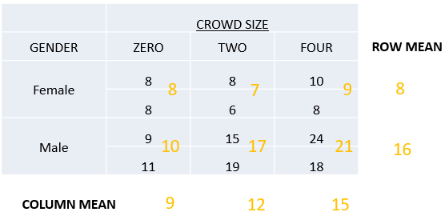
Two-way ANOVA : Graphs of Main Effects

Slide 8
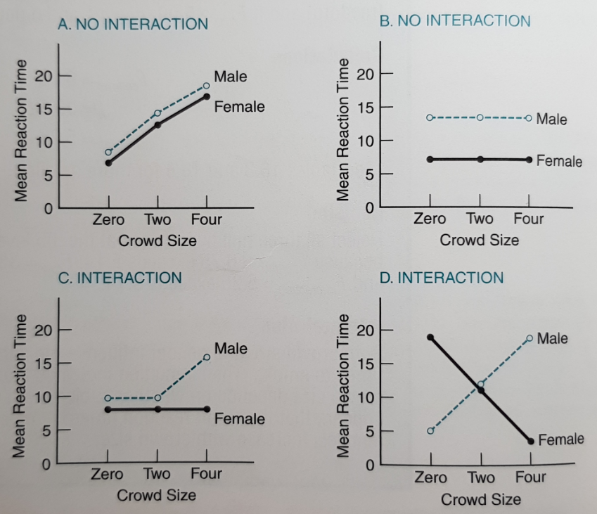
Two-way ANOVA : Interaction
Two factors interact if the effects of one factor on the dependent variable are not consistent for all of the levels of a second factor.

Slide 9
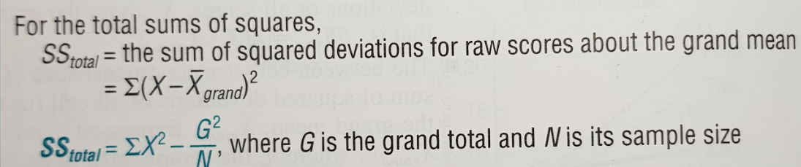
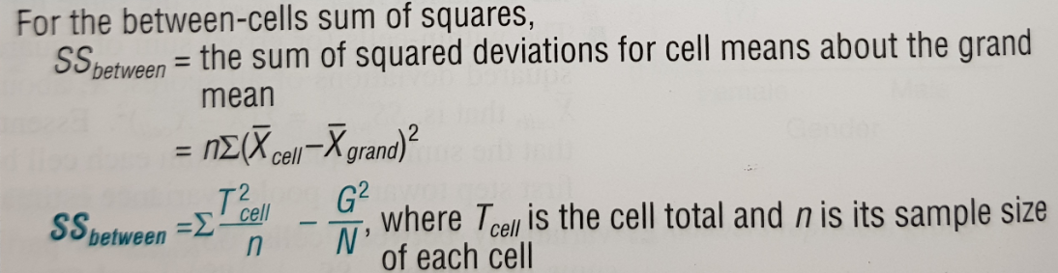
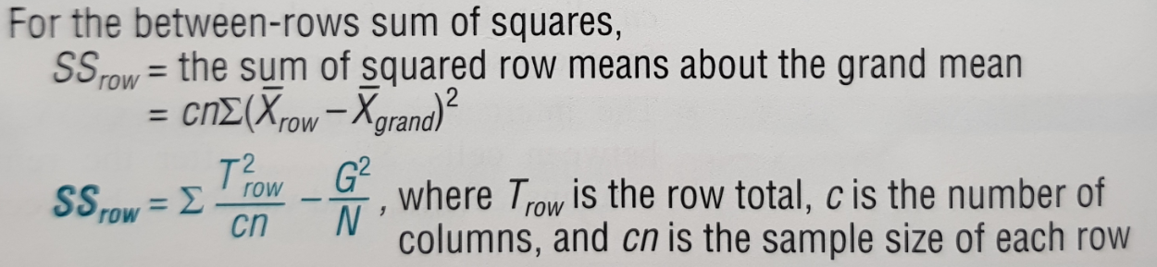
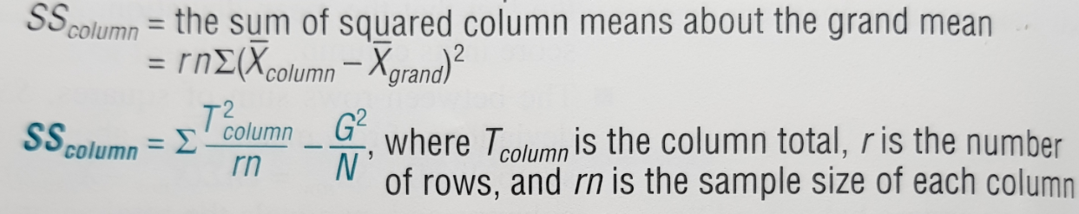
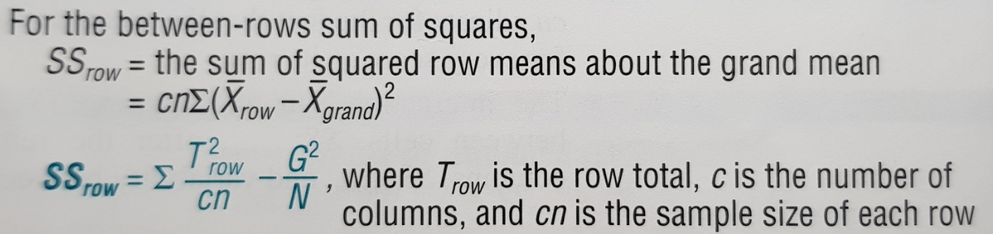
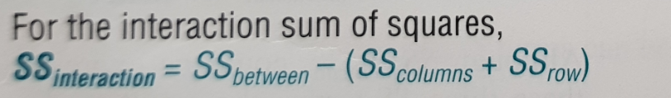
Two-way ANOVA : Formulas for SS Terms

Slide 10
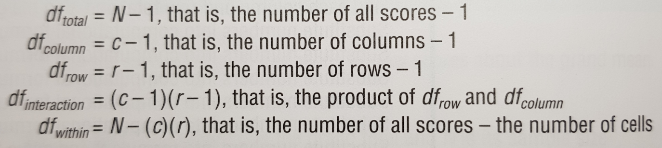
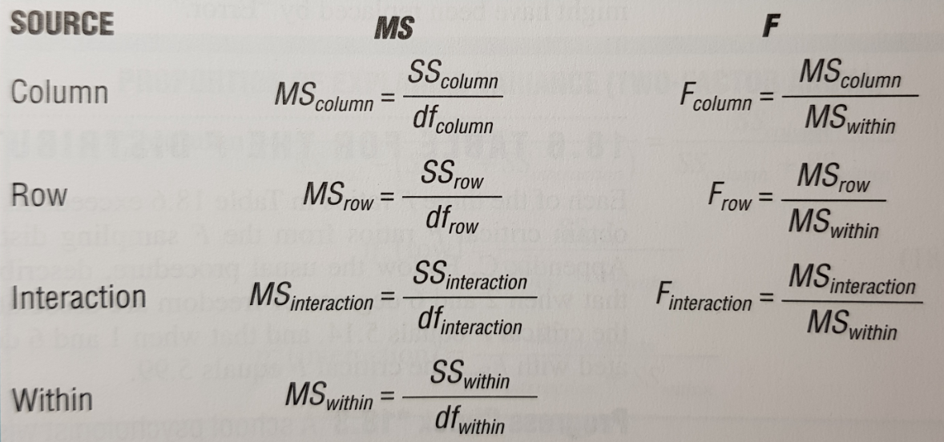
Two-way ANOVA : df, MS and F Ratios

Slide 11
Two-way ANOVA : Calculations
Excel –
https://github.com/edsonfajilagot/pupmas-dp/blob/master/g3_report/two-way-anova-manual.xlsx?raw=true
R –
https://github.com/edsonfajilagot/pupmas-dp/blob/master/g3_report/two-factor-anova.R

