Slide 1
Independent Samples t test
By: Ms. Ericka F. Pambid & Ms. Roselle Ann E. Balisacan
Statistical Data Processing
June 04, 2020

Slide 2
Independent Samples t Test
* Compares the means of two independent groups in order to determine whether there is statistical evidence that the associated population means are significantly difference.

Slide 3
It is also known as
Independent Measures t Test
Independent Two-Sample t Test
Student t Test
Two-Sample t Test
Uncorrelated Scores t Test
Unpaired t Test
Unrelated t Test

Slide 4
Variables
Dependent Variable- test variable
Independent Variable-grouping variable

Slide 5
Common uses:
Statistical differences between the means of two groups
Statistical differences between the means of two interventions
Statistical differences between the means of two change scores

Slide 6
Requirements
Dependent Variable that is continuous- interval or ratio
Independent Variable that is categorical
Cases that have values on both dependent and independent variables
Independent samples/groups
Random sample of data from the population

Slide 7
Requirements
Normal Distribution (approximately) of the dependent variable for each group
Homogeneity of variances
No Outliers

Slide 8
Procedure:
Define Null and Alternative Hypotheses
State the alpha or the significance level
Calculate degrees of freedom
State Decision Rule
Calculate Test Statistic
State the result
State the Conclusion

Slide 9
Hypotheses
There is no significant difference between the means of two independent group
Alternative Hypotheses:
There is a significant difference between the means of two independent groups

Slide 10

Hypotheses
Ho: ${ μ}_{1}$ ${=μ}_{2}$
Ha: ${ μ}_{1}$ ${≠μ}_{2}$
Directional :
Ha: ${ μ}_{1}$ ${>μ}_{2}$
Ha: ${ μ}_{1}$ ${<μ}_{2}$

Slide 11
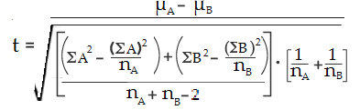
Formula

Slide 12
Example Problem
Is there any significant difference in the scores in a 20 item quiz in Statistics of the Senior High School students when they grouped according to their strand? Do this with alpha at 0.05.
Student No. | STEM(A) | ABM(B)
1 | 20 | 19
2 | 18 | 17
3 | 16 | 16
4 | 15 | 16
5 | 13 | 13
6 | 11

Slide 13


Define the Ho and Ha
Ho:
The mean score of STEM students is equal to the mean score of ABM students
Ha:
The mean score of STEM students is not equal to the mean score of ABM students

Slide 14


State the significance level
Calculate degrees of freedom

Slide 15
State the decision rule
If the absolute computed t-value >t-critical value at df=9 and level of significance 0.05, do not reject Ho
If the computed absolute t-value <t-critical value at df=9 and level of significance 0.05, reject Ho

Slide 16

Calculate Test Statistic
 | STEM (A) | ABM(B)
n | 6 | 5
Mean | 15.5 | 16.2
∑X | 93 | 81
∑ | 1495 | 1331
=-0.40786

Slide 17
State the result
Decision Rule: If the computed t-value <t-critical value at df=9 and level of significance 0.05, do not reject Ho
If the computed t-value > t-critical value at df=9 and level of significance 0.05, reject Ho
t-critical value= 2.262
t-value= 0.40786
Result: Do not reject Ho.

Slide 18
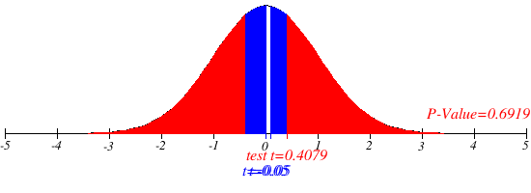

Slide 19
State the conclusion
There is no significant difference between the score of STEM students and ABM students in Statistics, t=-0.4079, at 0.05 level of significance.

Slide 20
Independent Sample t-Test in R

Slide 21
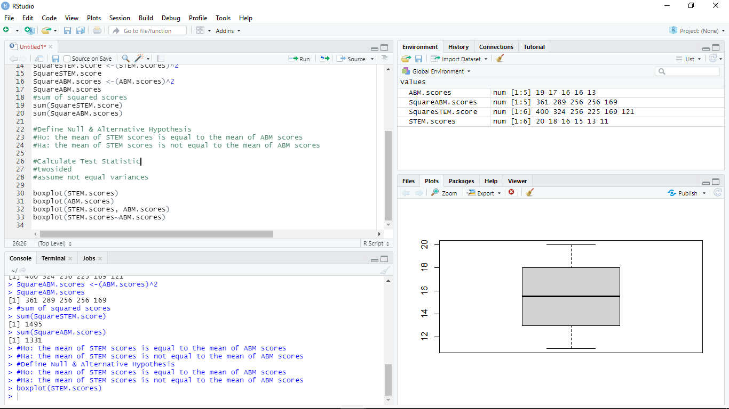

Slide 22
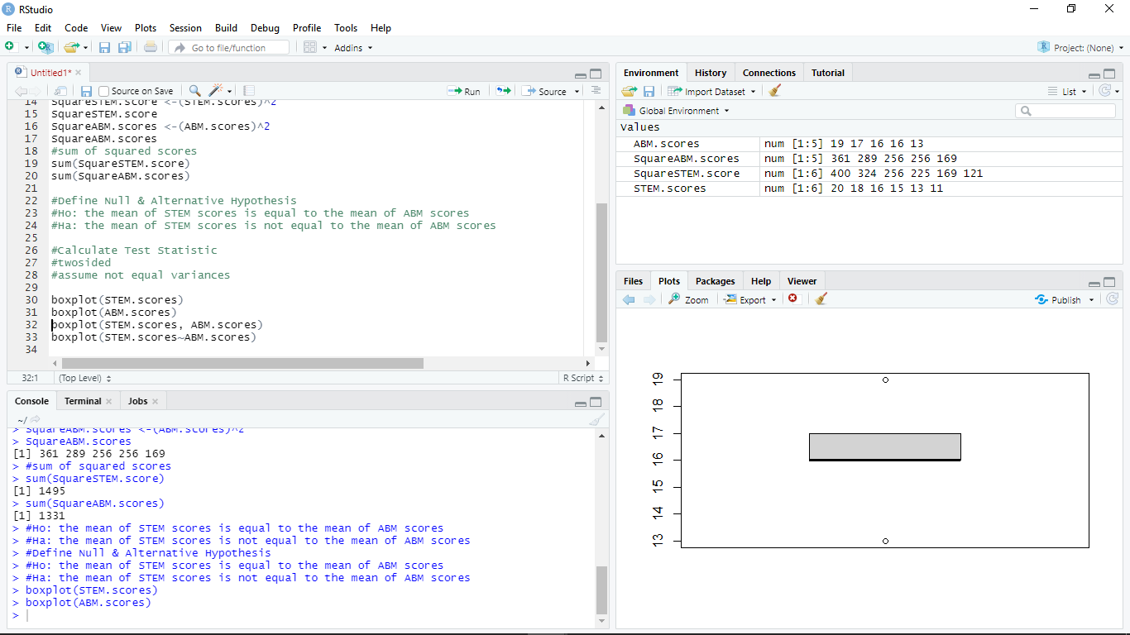

Slide 23
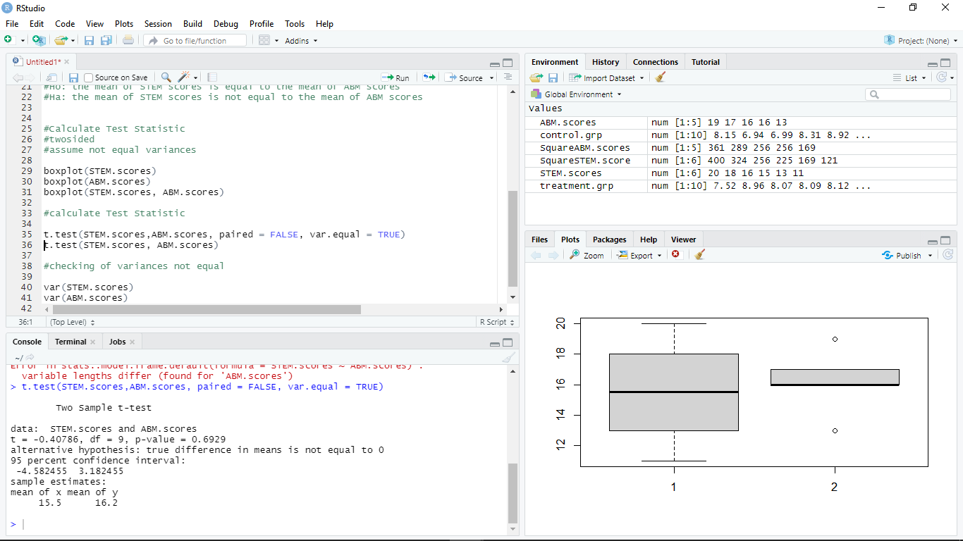

Slide 24
