Slide 1
NON-PARAMETRIC STATISTICAL TEST
Chi-Square Distribution

Slide 2
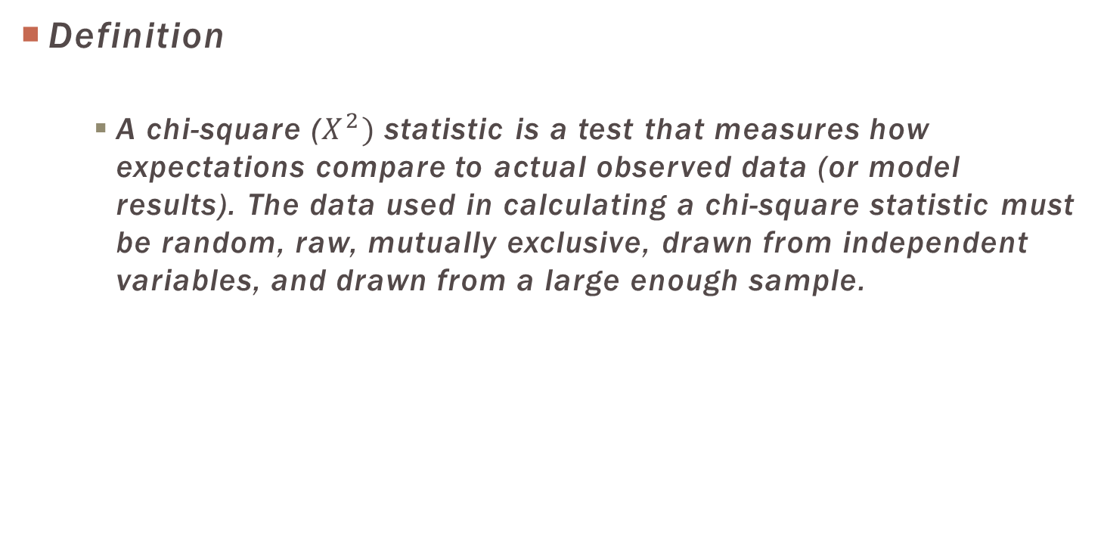
Chi-Square Distribution
Definition
A chi-square ($X^{2})$ statistic is a test that measures how expectations compare to actual observed data (or model results). The data used in calculating a chi-square statistic must be random, raw, mutually exclusive, drawn from independent variables, and drawn from a large enough sample.

Slide 3
Chi-Square Distribution
Chi-Square Test | Definition | Hypotheses
 |  | Ho | Ha
Goodness of Fit Test | Use to test whether a population with unknown distribution “fits” a known distribution. | The population fits given distribution | The population does not fit the given distribution
Test for Independence | Use to discover if there is association between two categorical variables. | The two characteristics are not related | The two characteristics are related

Slide 4
Chi-Square Distribution
Assumptions
There are 2 variables, usually at the nominal level
The 2 variables should consist of two or more categorical.
The data in the cells should be frequencies.
For a 2 by 2 table, all expected frequencies greater than 5
For a larger table all expected frequencies > 1 and no more than 20% of all cells may have expected frequencies < 5.

Slide 5

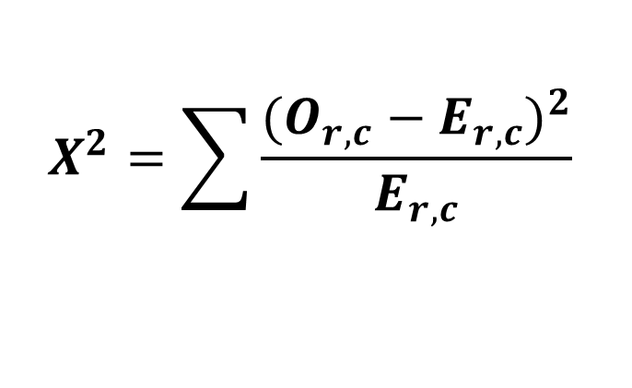
Chi-Square: Test for Independence
Observed frequencies
The frequencies obtained from the performance of an experiments and denoted by “O”.
$$X^{2}=\sum{\frac{{(O_{r,c}−E_{r,c})}^{2}}{E_{r,c}} }$$
Simplified approach
$$\frac{(row total)(column total)}{grand total}$$
Expected frequencies
The frequencies that we expect to obtain if null hypothesis is true and denoted by “E”.

Slide 6
Example
Problem:
A public opinion poll surveyed a simple random sample of 1000 voters. Respondents were classified by gender (male or female) and by voting preference (Republican, Democrat, or Independent). Results are shown in the contingency table below. Is there a gender gap? Do the men's voting preferences differ significantly from the women's preferences? Use a 0.05 level of significance.
 | Voting Preferences |  |  | Row total
 | Rep | Dem | Ind
Male | 200 | 150 | 50 | 400
Female | 250 | 300 | 50 | 600
Column total | 450 | 450 | 100 | 1000

Slide 7
HYPOTHESIS
Ho: Gender and voting preferences are independent.
Ha: Gender and voting preferences are not independent.
CONFIDENCE LEVEL
For this analysis, the significance level is 0.05. Using sample data, we will conduct a chi-square test for independence.

Slide 8
Example cont.
Df = (r - 1) * (c - 1) = (2 - 1) * (3 - 1) = 2
E_{r,c} = (n_{r} * n_{c}) / n
E_{1,1} = (400 * 450) / 1000 = 180000/1000 = 180 E_{1,2} = (400 * 450) / 1000 = 180000/1000 = 180 E_{1,3} = (400 * 100) / 1000 = 40000/1000 = 40 E_{2,1} = (600 * 450) / 1000 = 270000/1000 = 270 E_{2,2} = (600 * 450) / 1000 = 270000/1000 = 270 E_{2,3} = (600 * 100) / 1000 = 60000/1000 = 60

Slide 9
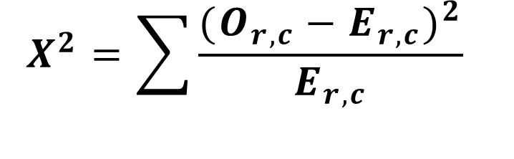
Example Cont.
$$X^{2}=\sum{\frac{{(O_{r,c}−E_{r,c})}^{2}}{E_{r,c}} }$$
Χ² = (200 - 180)²/180 + (150 - 180)²/180 + (50 - 40)²/40 + (250 - 270)²/270 + (300 - 270)²/270 + (50 - 60)²/60
Χ² = 400/180 + 900/180 + 100/40 + 400/270 + 900/270 + 100/60
Χ² = 2.22 + 5.00 + 2.50 + 1.48 + 3.33 + 1.67 = 16.2

Slide 10
Example Cont.
The P-value is the probability that a chi-square statistic having 2 degrees of freedom is more extreme than 16.2.
Interpretion of the Result results.
Since the P-value (0.0003) is less than the significance level (0.05), we cannot accept the null hypothesis. Thus, we conclude that there is a relationship between gender and voting preference.

Slide 11
CHI SQUARE: R StudiO and SPSS
R STUDIO
>rownames <- c("Male", "Female")
>colnames <- c("Republic", "Democrat", "Independent")
>problem <- c(200,250,150,300,50,50)
>matrix.problem <- matrix(problem, nrow=2,
dimnames = list(rownames, colnames))
>matrix.problem
>chisq.test(matrix.problem)
SPSS
*Analyze>Descriptive Statistics>Crosstab
*Input variable into respective Rows and Columns
*Click Statistics > Chi Square> Continue
*Cells> Check (Observed , Expected and Unstandardized)>Continue
* Click OK

Slide 12
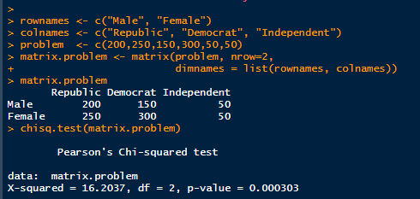
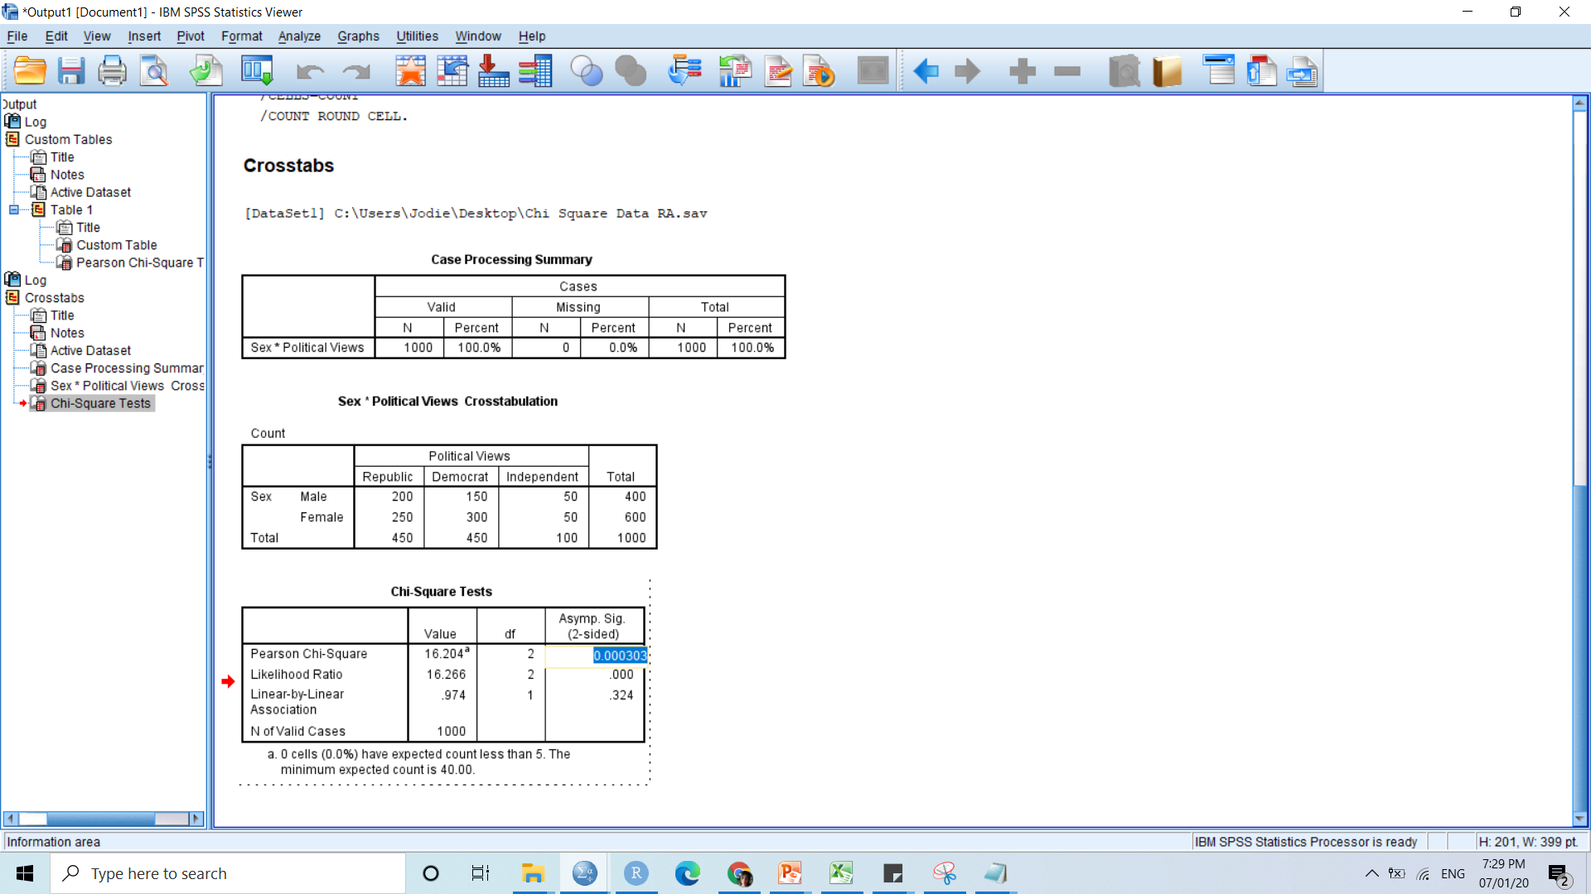
CHI SQUARE COMPARING RESULT OF R STUDIO AND IBM SPSS

