Slide 1
Two-way ANOVA : Example
Do crowd size and gender, as well as the interaction of these two factors, influence the subjects’ mean reaction times to potentially dangerous smoke?
A social psychologist measures any delay in a subject’s alarm reaction (the dependent variable) as smoke gradually fills a waiting room occupied only but the subject, plus “crowds” of either zero, two or four (the first factor). The subjects are classified as male or female (the second factor)
 | CROWD SIZE
GENDER | ZERO | TWO | FOUR
Female | 8 | 8 | 10
 | 8 | 6 | 8
Male | 9 | 15 | 24
 | 11 | 19 | 18

Slide 2
Two-way ANOVA : Test Summary
Hypothesis:
H₀ : No main effect due to crowd size (column) [μ₀ = μ₂ = μ₄]
H₀ : No main effect due to gender (row) [μ_{Female} = μ_{Male}]
H₀ : No interaction
H₁: H₀ is not true
Decision Rule:
Reject H₀ at the 0.05 level of significance if F ratios > F critical values (F table)
Calculations:
F(column) = 6.75
F(row) = 36
F(interaction) = 5.25
Decision:
Reject all three null hypothesis
Interpretation:
Both crowd size and gender influence the subjects’ mean reaction time to smoke. The interaction indicates that the influence of crowd size depends on whether subjects are male or female. It appears that the mean reaction time of males, but not those of females, increase with crowd size.

Slide 3
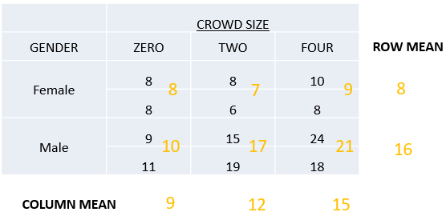
Two-way ANOVA : Graphs of Main Effects

Slide 4
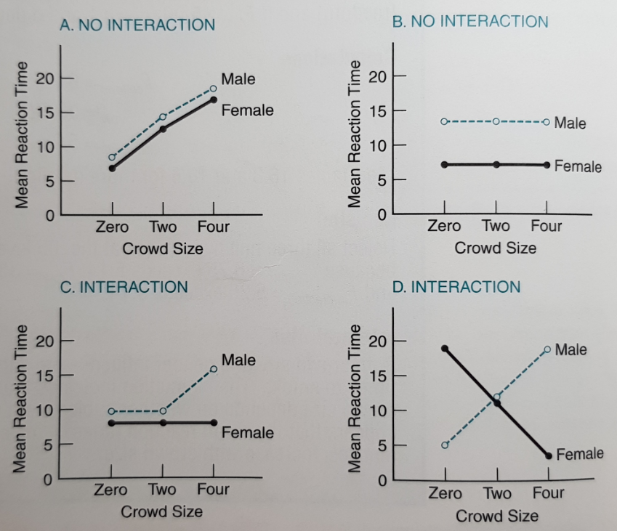
Two-way ANOVA : Interaction
Two factors interact if the effects of one factor on the dependent variable are not consistent for all of the levels of a second factor.

Slide 5
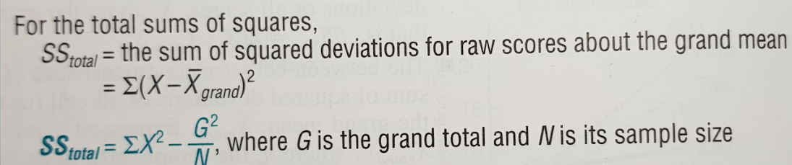
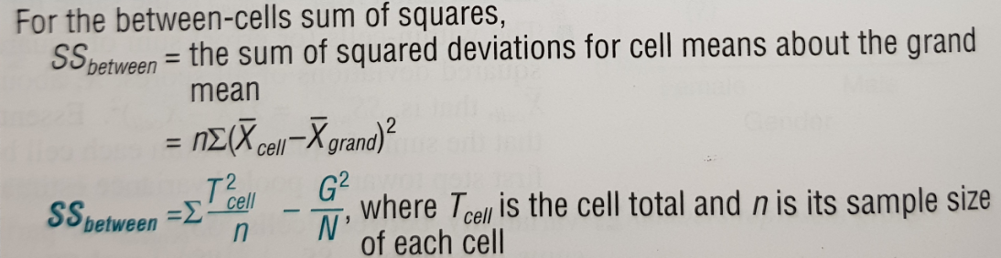
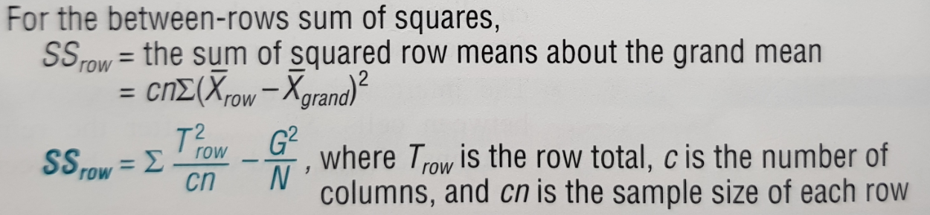
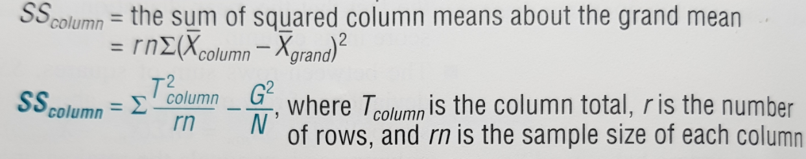
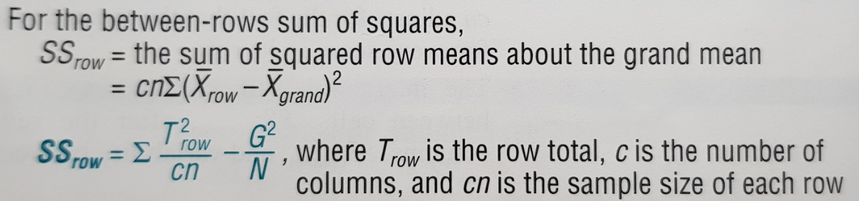
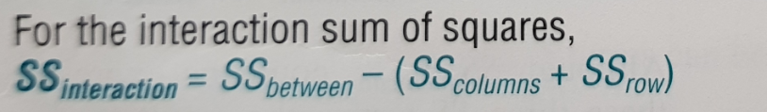
Two-way ANOVA : Formulas for SS Terms

Slide 6
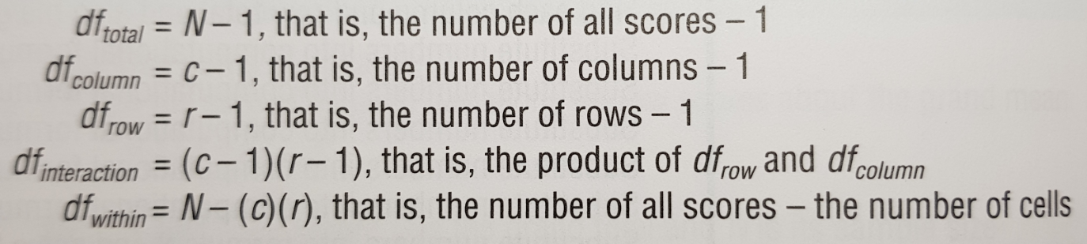
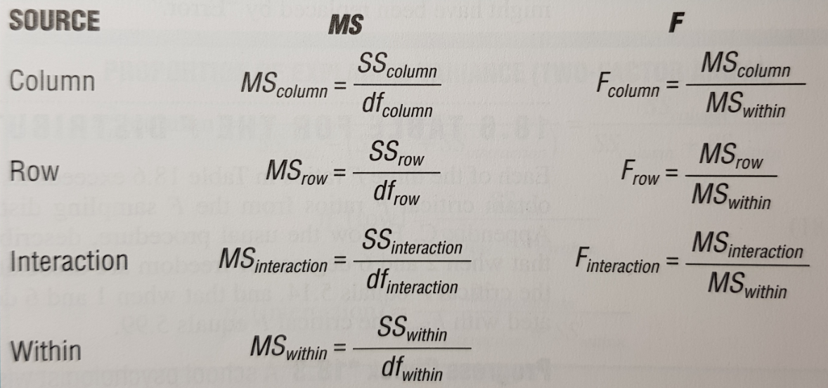
Two-way ANOVA : df, MS and F Ratios

Slide 7
Two-way ANOVA : Calculations
Excel –
https://github.com/edsonfajilagot/pupmas-dp/blob/master/g3_report/two-way-anova-manual.xlsx?raw=true
R –
https://github.com/edsonfajilagot/pupmas-dp/blob/master/g3_report/two-factor-anova.R

