Slide 1
DOCKER

Slide 2
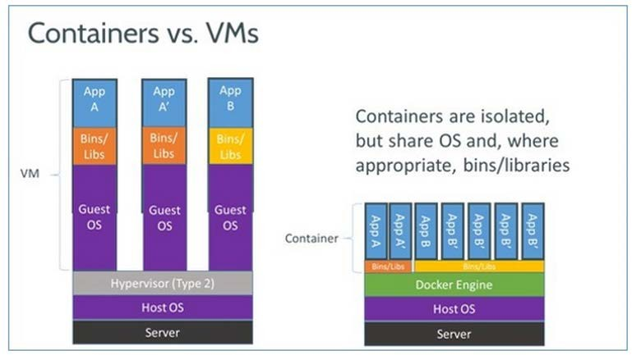
Docker containers

Slide 3
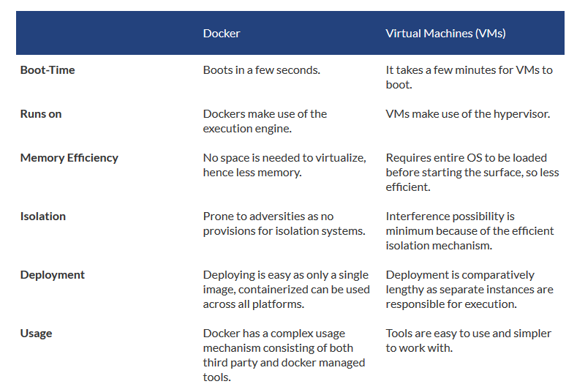

Slide 4
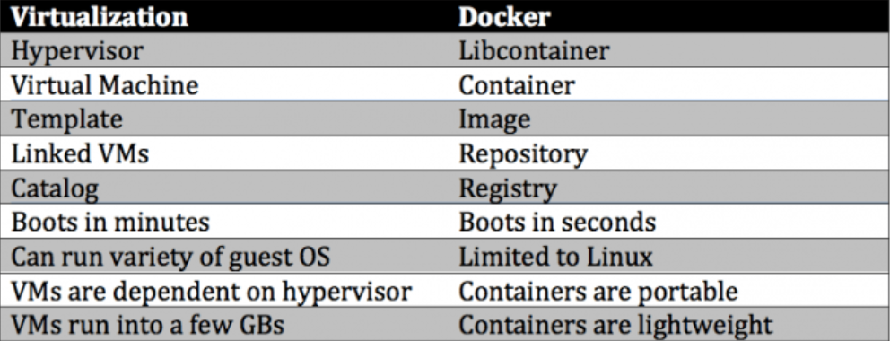

Slide 5
Docker
Docker is a very light-weight software container and containerization platform
Docker containers provide a way to run software in isolation
What does a Docker Container contain and provide?
Initially – only a base Linux operating system
A boundary or a “jail” to contain running software
Like a good jail, there are no unauthorized entries or exits
A Docker Image is the foundation for any particular Docker container
What is outside of Docker?
Other Docker containers
The operating system, kernel
Any other operating software

Slide 6
Docker
Docker is computer software used for Virtualization in order to have multiple Operating systems running on the same host. Unlike Hypervisors which are used for creating VM (Virtual machines), virtualization in Docker is performed on system-level in so-called Docker containers.
Docker containers run on top of the host's Operation system. This helps you to improves efficiency. Moreover, we can run more containers on the same infrastructure than we can run Virtual machines because containers use fewer resources.

Slide 7
Docker was originally a Linux application
Docker for Linux
It uses the kernel container functionality
It requires a 64 bit installation using a
kernel version 3.10 or later
Docker runs on many popular Linux distributions
It is available as RPM, APT, or binary
versions

Slide 8
Docker runs natively on OS X
Docker for OS X
DMG install application running in user space
Is built on the xhyve hypervisor
Requires a 2010 or newer Mac with Intel MMU and
EPT support
Requires OS X 10.10.3 Yosemite or newer
Requires at least 4GB of RAM

Slide 9
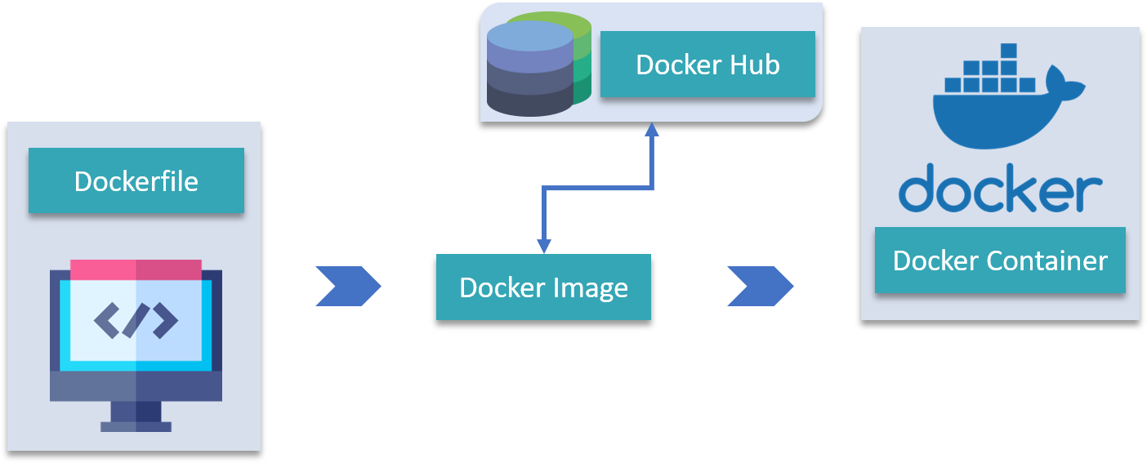

Slide 10
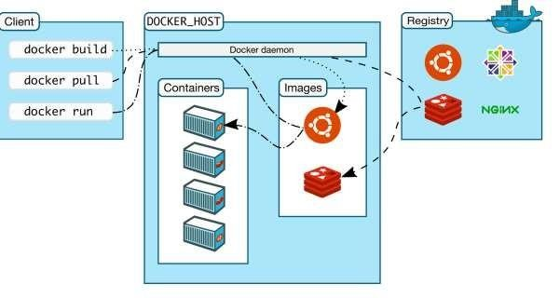
Docker Architecture
Docker uses a client-server architecture
Client
Is the primary user interface which
communicates using a REST API
Over HTTP
Over local Unix socket
•
Server
Is the Docker daemon
Responsible for building, running, and distributing containers
Registry
Responsible for the storage, management, and delivery of Docker Images
Docker Hub
Private
Other vendors

Slide 11
Running Containers
The docker `run` command starts a container based on a named Docker Image
Docker first looks for a local copy of the image
o If it does not exist it is pulled from a Docker Registry
o The default Registry is the Docker Hub Registry
A new container is created using the file system from the image
A read-write layer is added to the top of the file system
A network interface is created and an IP address is assigned from a pool
Standard input, output, and error streams are connected
A specified application is executed
o Docker container appears as a child of the daemon process, ms are connected

Slide 12
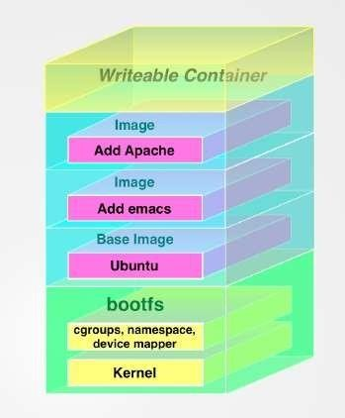
Docker Images & Containers
Docker images are read-only templates
Foundation is a simplified version of the Linux operating system
Changes to foundation, such as application installations
added to the Image
Images are the templates or build commands for Docker
Docker containers are running environments
Has OS, environment, program, network, etc.
Runs (probably one) application
All required software contained in image
Can have boot-up configuration
They can be run, started, stopped, and deleted

Slide 13
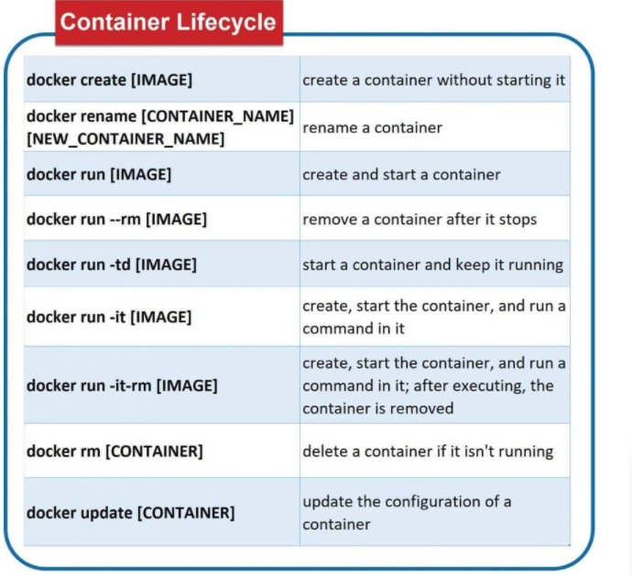

Slide 14
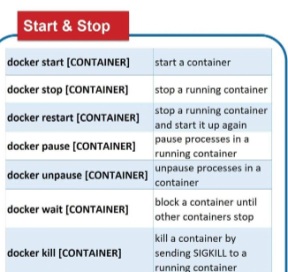

Slide 15
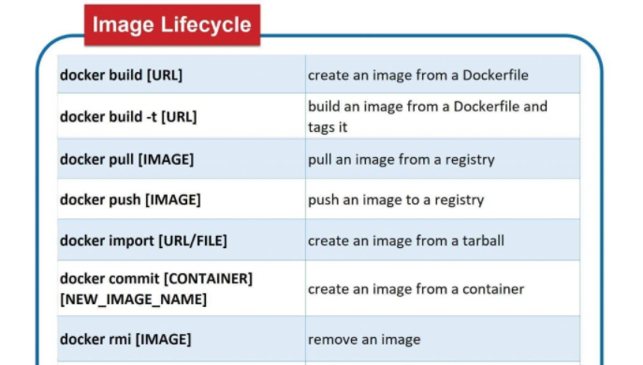

Slide 16
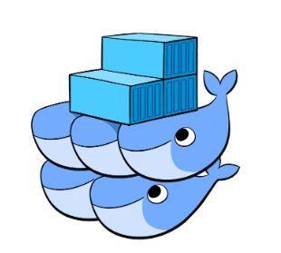
Docker Swarm
Docker Swarm is an orchestration management tool that runs on Docker applications. It helps end-users in creating and deploying a cluster of Docker nodes.
Each node of a Docker Swarm is a Docker daemon, and all Docker daemons interact using the Docker API. Each container within the Swarm can be deployed and accessed by nodes of the same cluster.

Slide 17
There are five critical elements within a docker environment:
Docker container
Docker daemon
Docker images
Docker client
Docker registry

Slide 18
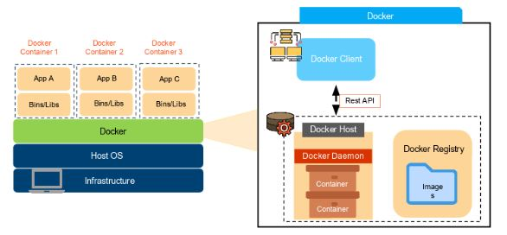

Slide 19
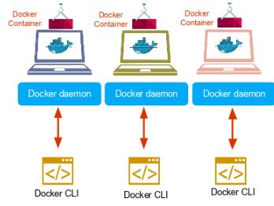
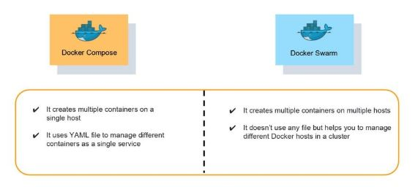

Slide 20
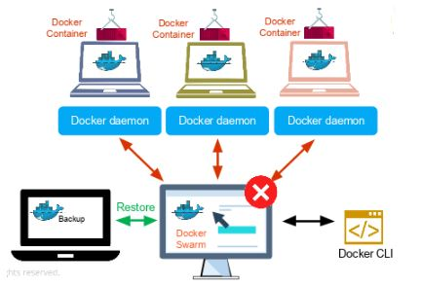
Docker Swarm can reschedule containers on node failures. Swarm node has a backup folder which we can use to restore the data onto a new Swarm.

Slide 21
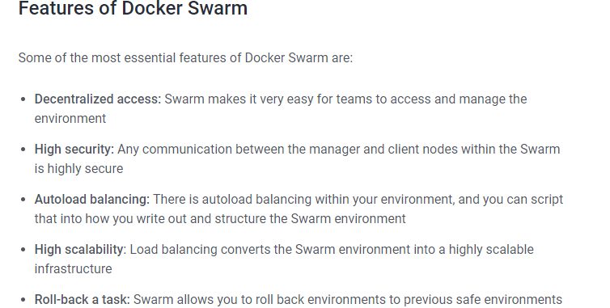

Slide 22
How Does Docker Swarm Work?
In Swarm, containers are launched using services.
A service is a group of containers of the same image that enables the scaling of applications.
Node
A Swarm node is an instance of the Docker engine.
It is possible to run multiple nodes on a single server. But in production deployments, nodes are distributed across various devices.
There are two types of nodes in Docker Swarm:
Manager node. Maintains cluster management tasks
Worker node. Receives and executes tasks from the manager node

Slide 23
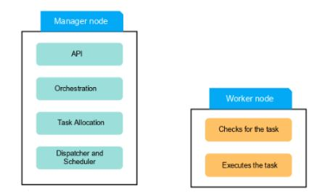

Slide 24
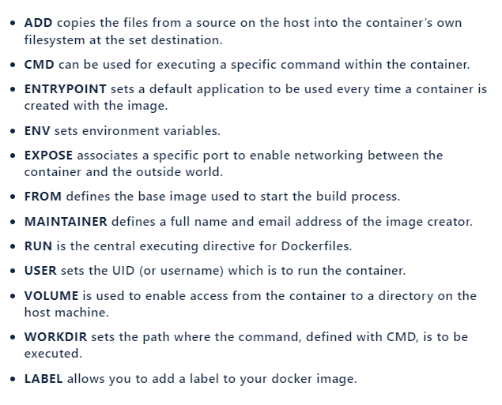

Slide 25
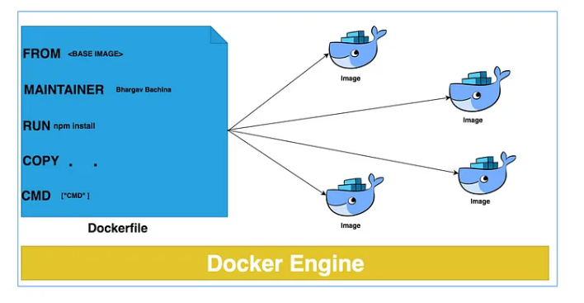

Slide 26
