Slide 1
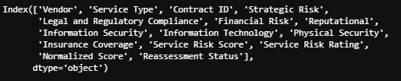
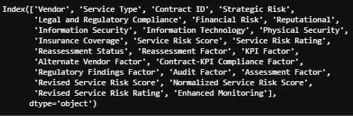
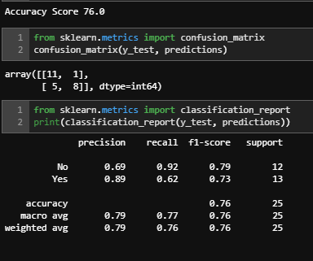
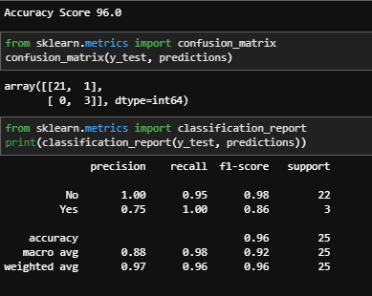
Model Optimization: VRM/TPRM Program Data
Increasing the number of independent (X) variables to improve the accuracy of a model:
Model Accuracy = [(True +ve) + (True –ve)] / [( True +ve) + (True –ve) + (False +ve) + (False –ve)]
Prepared by: Ernest Subah

