Slide 1
VRM/TPRM Reporting, Risk Analytics and Machine Learning
This program imports a sample excel file into python and performs various categorical analysis, risk reporting, analytics and machine learning techniques
Program Highlights:
Imports VRM excel file
Data cleanup
Bell-shaped curve
Categorical Data Analysis
Service Type
Contract Risk Rating
Geographic Concentration
Key Performance Indicators (KPI)
Contract/KPI Compliance
Contract aggregation by Vendor
Reassessment Status/Frequency
OCC VRM Risk Domains (subset)
Writing data to MongoDB (file storage)
Risk Scale Calibration
Vendor Risk Rating
Normalization of Risk Scoring
Best case and worst case scenarios
Enhanced Oversight/Monitoring
For, if, elif, else functions
Statistical Analysis
Subjective Risk Factors
Regulatory/Audit/Assessment
Reassessment
KPI Development
Alternate Vendor
Contract/KPI Compliance
Train/Test Model
Confusion Matrix
Classification Report
True Positives
True Negatives
False Positives
False Negative
Accuracy
Precision
Recall
Increase Independent X-variables
Re-Train/Re-Test Model
Revised Confusion Matrix
Revised Classification Report

Slide 2
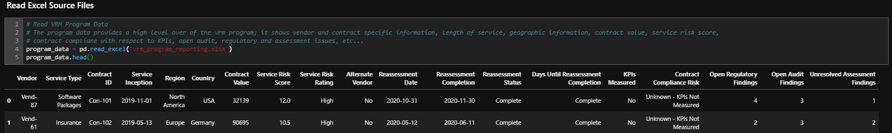

Slide 3
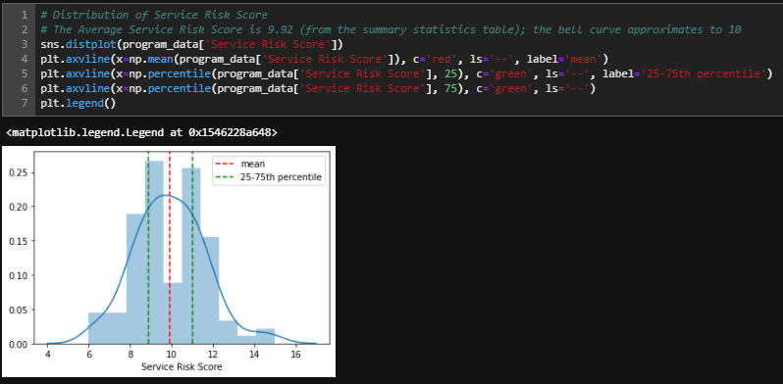
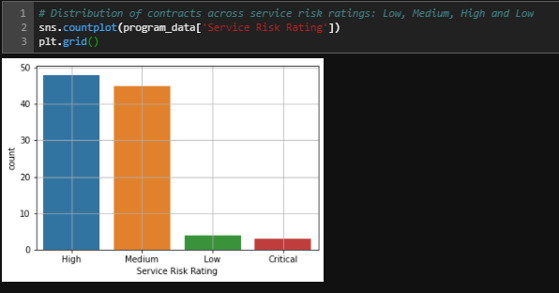

Slide 4
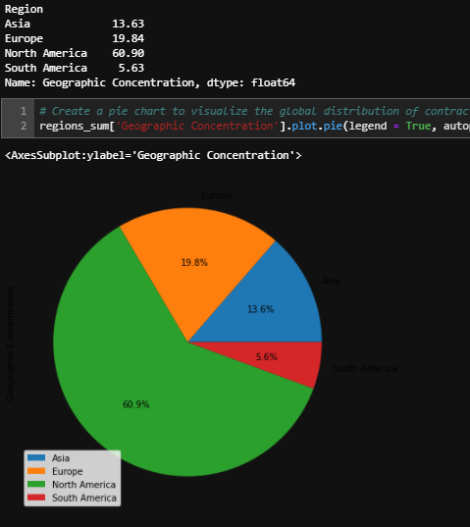

Slide 5
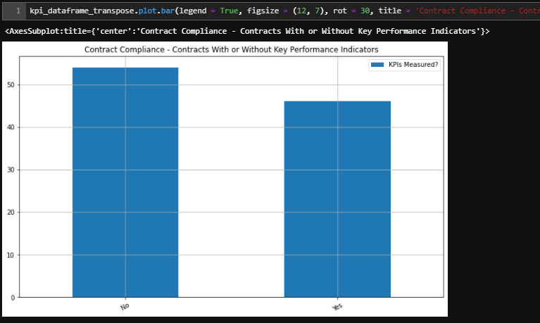

Slide 6
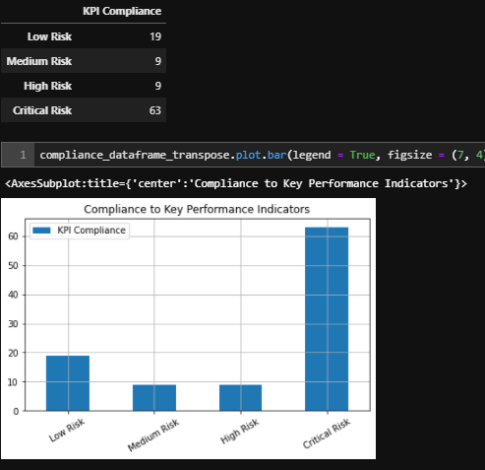

Slide 7
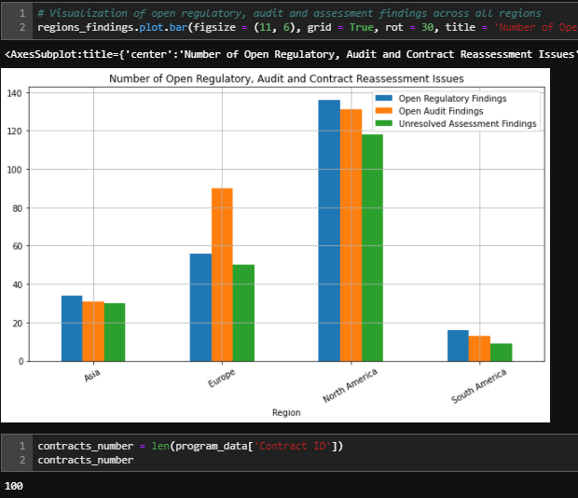

Slide 8
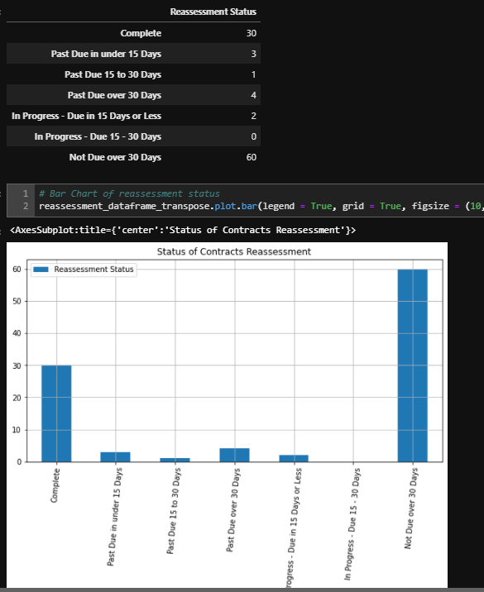

Slide 9
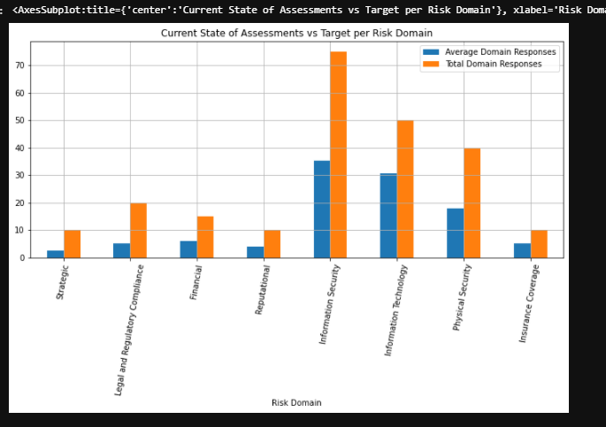

Slide 10
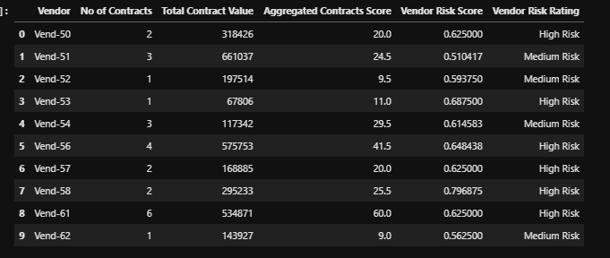

Slide 11
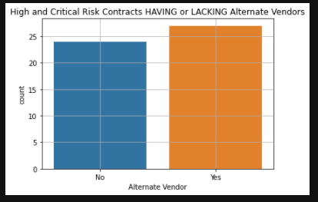

Slide 12
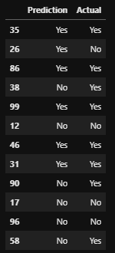
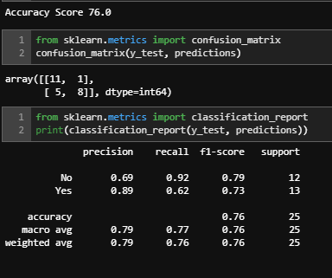

Slide 13
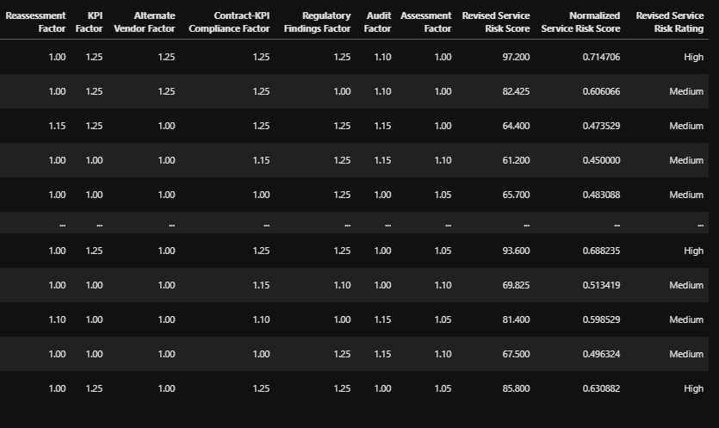

Slide 14
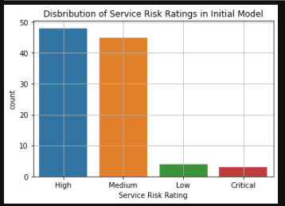

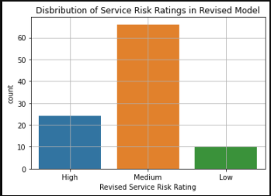


Slide 15
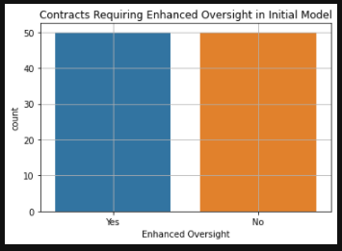

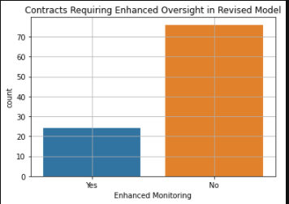


Slide 16
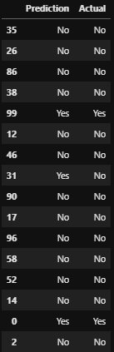
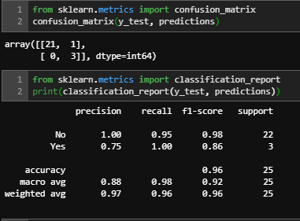

Slide 17
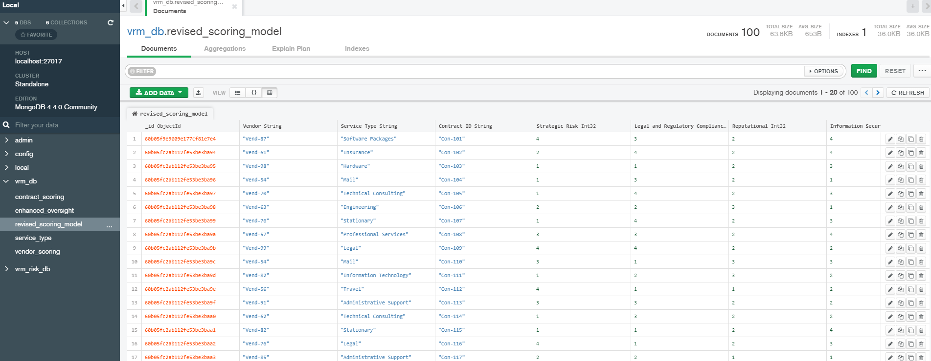

Slide 18
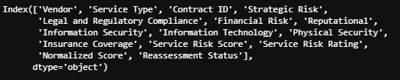
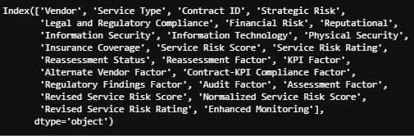
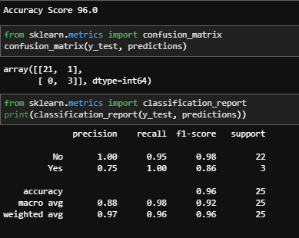
Model Optimization: VRM/TPRM Program Data

