Slide 1
Twitter in the Archives:
Building Collections of Social Media Content
Bergis Jules | UC Riverside | @bergisjules

Slide 2
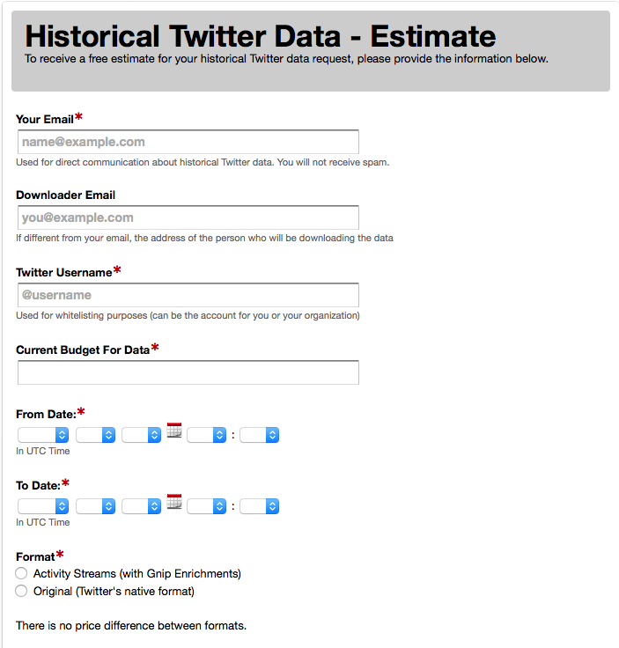

Slide 3
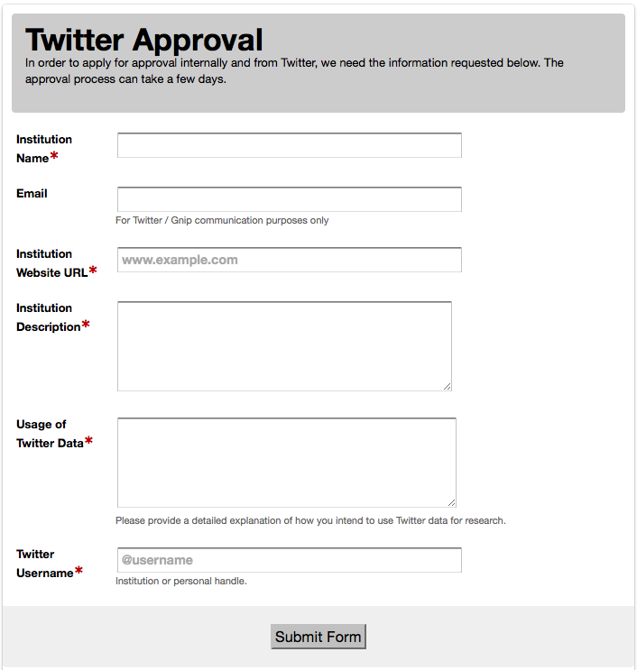

Slide 4
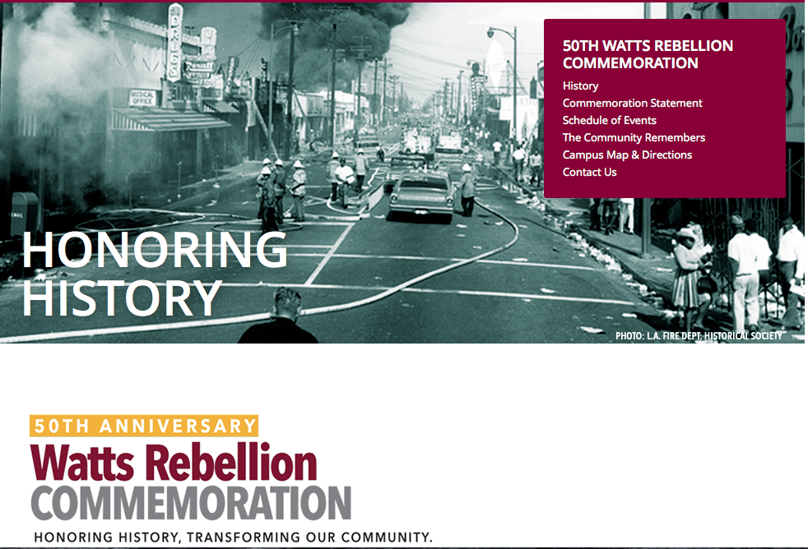
Notes:
Barnhill, John H. (2011). "Watts Riots (1965)". In Danver, Steven L. Revolts, Protests, Demonstrations, and Rebellions in American History, Volume 3. ABC-CLIO.

Slide 5
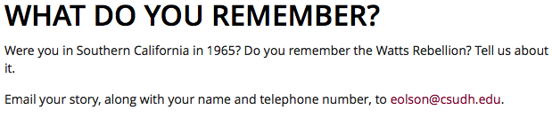
watts uPRISING, 1965

Slide 6
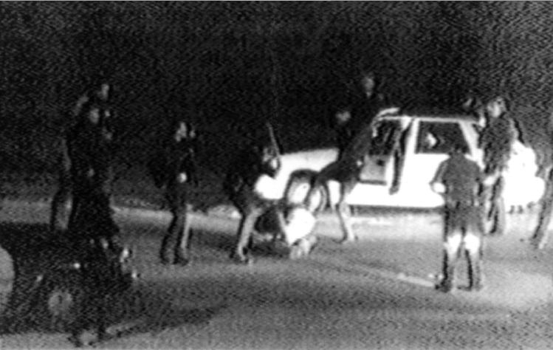
Los Angeles Uprising, 1992
Notes:
http://www.nydailynews.com/news/riots-20-yrs-gallery-1.1068886?pmSlide=1.1068857

Slide 7
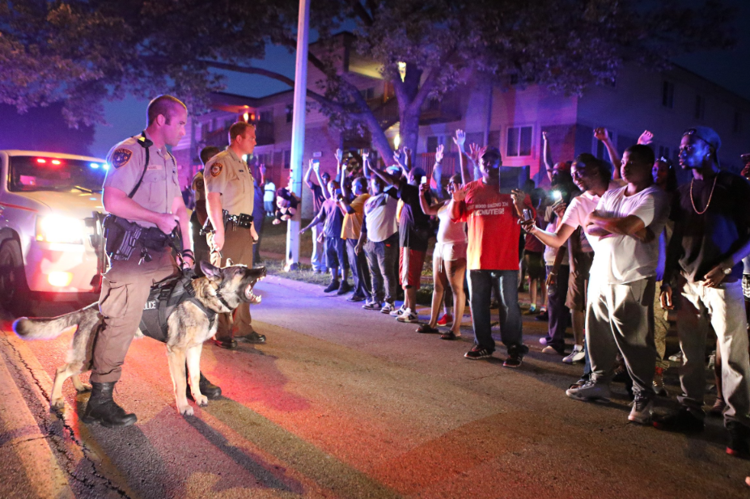
FERGUSON, 2014
Notes:
http://www.stltoday.com/news/multimedia/special/ferguson-in-pictures/html_24b2b105-90e3-5ef0-9c65-769e848c0d31.html

Slide 8
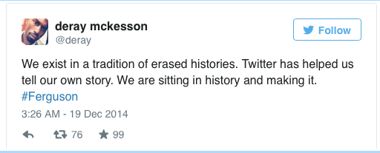

Slide 9
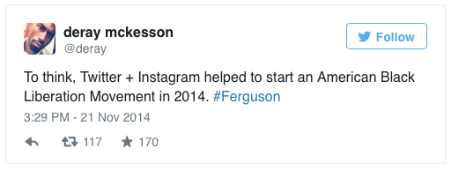

Slide 10
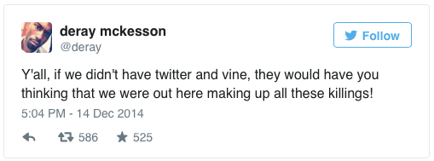

Slide 11
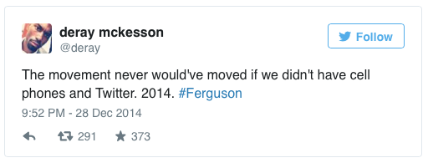

Slide 12
BALTIMORE UPRISING, 2015
#FreddieGray: 2,983,934
#BaltimoreUprising + #BaltimoreRiots: 2,195,394
#freddiegray tweet viewer http://edsu.github.io/freddiegray-tweet-viewer/

Slide 13
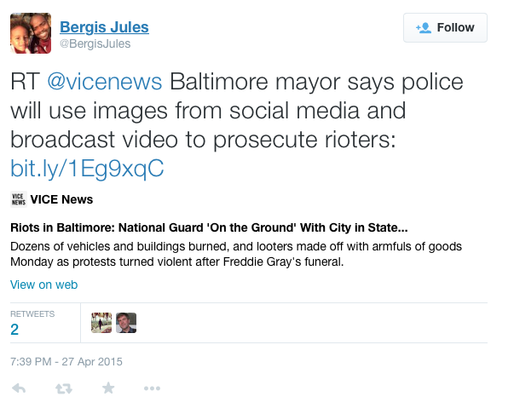
privacy and ethics

Slide 14
What does appraisal look like for social media content?
What challenges do social media collections pose for traditional archival practices?
What about ethics?

