Slide 1
Linked Data
#c4l09
or
How I got lost on Wikipedia
Ed Summers
http://inkdroid.org
Notes:
How many people consider themselves to be web developers?
Little overview of how I came to some of this linked-data semantic web stuff.

Slide 2
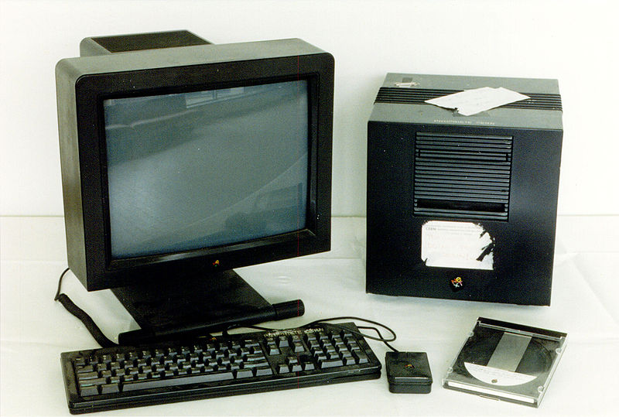
Notes:
tbl's NEXT computer, circa 1989 ... the world's first web server

Slide 3
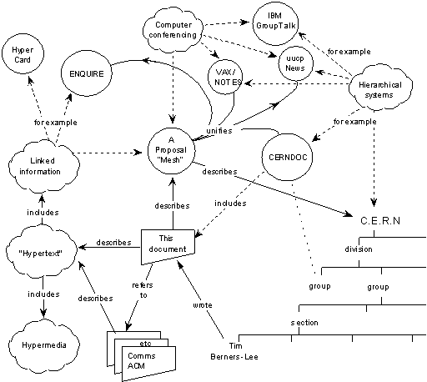
http://www.w3.org/History/1989/proposal.html
Notes:
Information Management: A Proposal
Tim Berners-Lee, CERN
March 1989, May 1990
entities: People, Software, Groups, Projects, Concepts, Documents, Hardware
relations: depends, isPartOf, made, refersTo, uses, isExampleOf
Link to DynaText

Slide 4
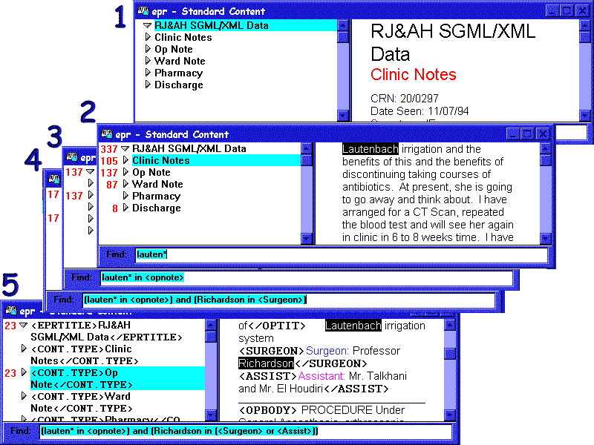
Notes:
dynatext
The role model (for the early www) was provided by EBT's (Electronic Book Technology, a spin-off from the Institute for Research in Information and Scholarship at Brown University) Dynatext SGML reader that CERN had licensed.
The Dynatext system was considered, however technically advanced (a key player in the extension of SGML ISO 8879:1986 to Hypermedia within HyTime), too expensive and with an inappropriate licensing policy for general HEP (High Energy Physics) community use: a fee for each document and each time a document was charged.http://manyeyes.alphaworks.ibm.com/manyeyes/datasets/world-wide-web/versions/1.txt

Slide 5
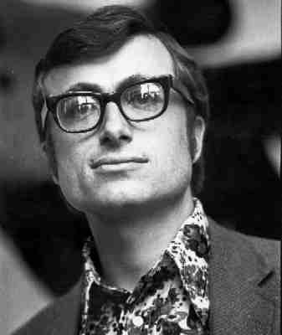
Notes:
Andy van Dam, Scholarly Technology Group, Brown. First hypertext system developed on commercial equipment.
Electronic Book Technologies later to be Inso creators of Dynatext, spun out. Steve de Rose (xquery)
Colleague of Ted Nelson
2nd person to get Ph.D. in Computer Science

Slide 6
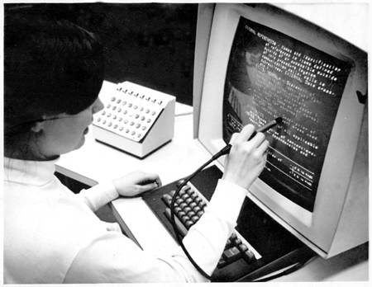
Hypertext Editing System (HES), Brown University 1967
Notes:
The Hypertext Editing System, or HES, was an early hypertext research project conducted at Brown University in 1967 by Andries van Dam, Ted Nelson, and several Brown students. HES was a pioneering hypertext system that organized data into two main types: links and branching text. The branching text could automatically be arranged into menus and a point within a given area could also have an assigned name, called a label, and be accessed later by that name from the screen.

Slide 7
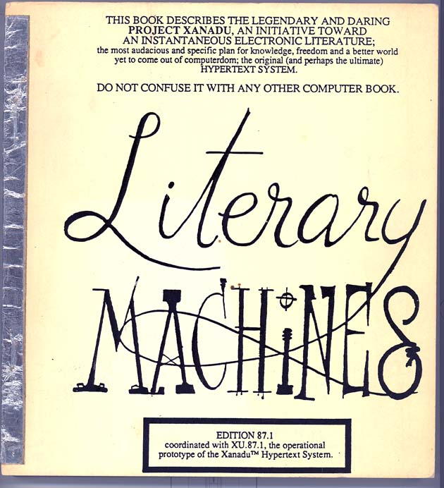

Slide 8
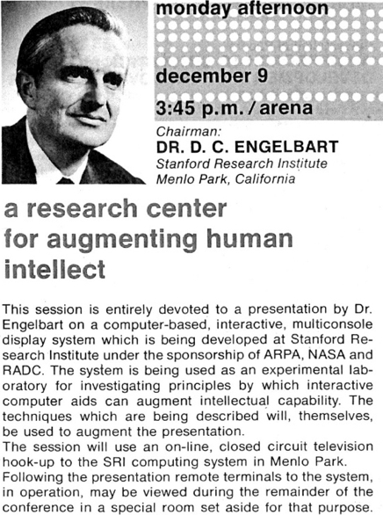
http://www.stanford.edu/dept/SUL/library/extra4/sloan/MouseSite/1968Demo.html
Notes:
"Mother of all Demos"
December 9, 1968, demo in San Francisco of NLS
the mouse, hypertext and the hash
"Doug Englebart's work was the closest to the Web design -- when I saw that the first time I was amazed. He had even used the hash sign as a delimiter for the address within a document (I guess like me by analogy with an apartment number)" --tbl

Slide 9
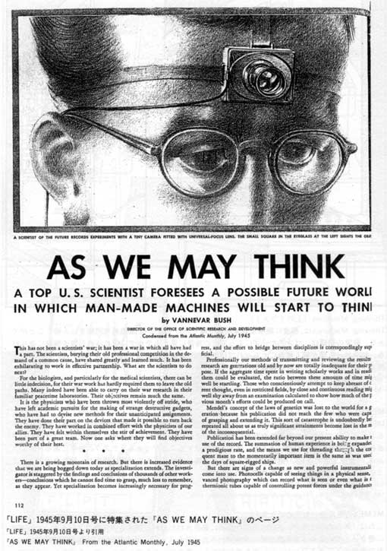
http://www.theatlantic.com/doc/194507/bush

Slide 10

Notes:
Just the tip of the iceberg: can be overwhelming.
But it's actually fun:
WebScience
How many people have heard of the semantic web?
Hypertext -> Hyperdata

Slide 11
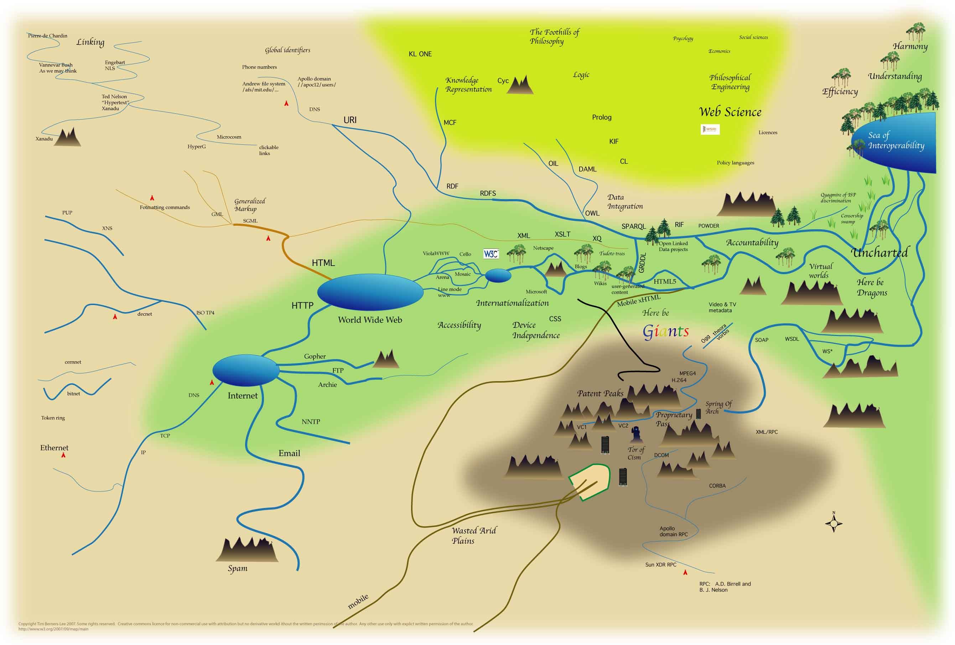
http://www.w3.org/2007/09/map/main.jpg
Notes:
Map of the Web by tbl
- TED talk, not yet released?

Slide 12
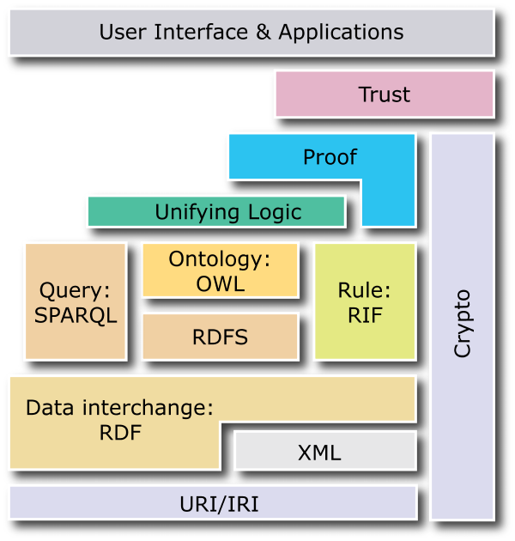
Notes:
sciam article in 2000, lots of promises about AI robots
lots of complexity, not all done
we'll be looking at rdf, xml, uri w/ iand

Slide 13
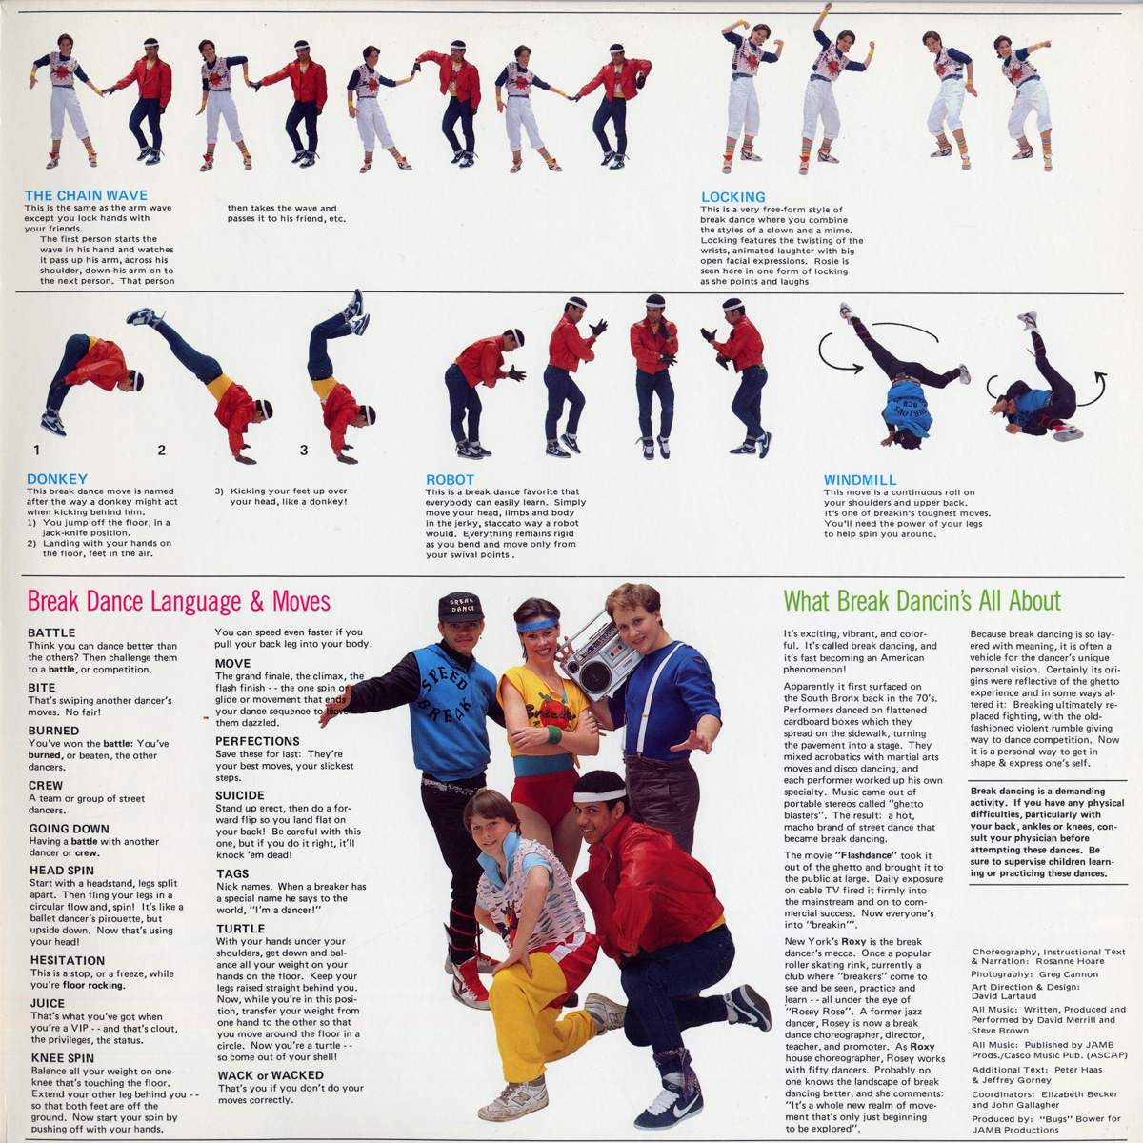

Slide 14
Linked Data
  Use URIs as names for things.
  Use HTTP URIs so people can look up those things.
  When someone looks up a URI provide useful information.
  Include links to other URIs so they can discover more things.
http://www.w3.org/DesignIssues/LinkedData.html
Notes:
tbl - 2006-07-27
maybe we're worrying about too much, and should focus on the basics?
a scoping problem
connect hypertext with hyperdata, linked-data
Follow your nose
The Self Describing Web

Slide 15
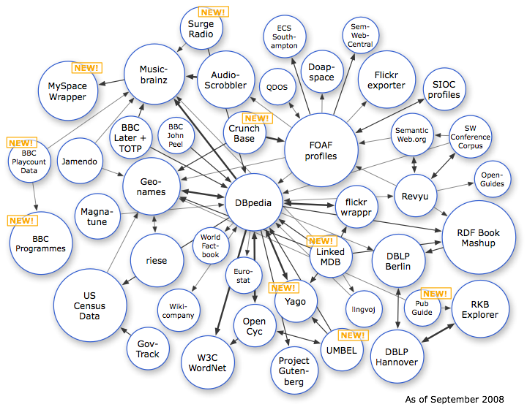
http://www4.wiwiss.fu-berlin.de/bizer/pub/lod-datasets_2008-09-18.html l
Notes:
Semantic Web Education and Outreach Working Group (W3C)
began, early 2007
over 2 billion triples in oct 2007
well over that now ... people hope this is the year that making such graphs becomes near impossible
data doesn't exist on a single machine, distributed on the web
if updated would include the Royal Library of Sweden (anders)
Needs more owners of data...

Slide 16


Slide 17

Notes:
Hello Kitty aka "Silent Kitty" - Chloe
Hello Kitty Conspiracy

Slide 18
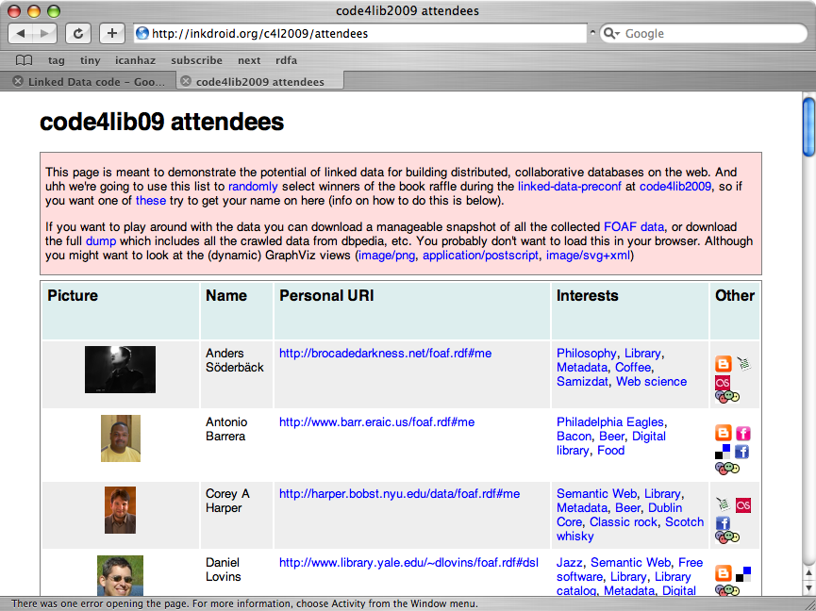

Slide 19
http://wiki.code4lib.org/index.php/LinkedData

