Slide 1

“New Dimensions in KOS”
CENDI/NKOS Workshop
September 11, 2008
Washington, DC, USA
SKOS: New Dimensions in Interoperability
Ed Summers
Jon Phipps
An international conference to share and advance knowledge and experience about standards;
the technologies that build upon them, and implementation experiences.

Slide 2
What is it?
Simple Knowledge Organisation System(s)
SKOS is …
for declaring and publishing taxonomies, thesauri or classification schemes, for use in a distributed, decentralised information system (I.e. a semantic web).
for describing Concepts and creating relationships between Concepts and Terms
A practical application of RDF
the application of library science to the semantic web.
  SKOS provides a formal language for representing controlled, structured vocabularies
9/11/2008
SKOS - 2008 Joint CENDI / NKOS Workshop

Slide 3
The SKOS data model
…views a knowledge organization system as a concept scheme comprising a set of conceptual resources (concepts).
  These concept schemes and conceptual resources are identified by URIs.
  The model is multilingual and extensible
9/11/2008
SKOS - 2008 Joint CENDI / NKOS Workshop

Slide 4
Concepts can be…
labeled with any number of strings. One label, in any given language, can be indicated as the "preferred" label for that language, and all others as "alternate“ labels, "hidden“ labels, or using a notation:
  skos:prefLabel
  skos:altLabel
  skos:hiddenLabel
  skos:notation
9/11/2008
SKOS - 2008 Joint CENDI / NKOS Workshop

Slide 5
Concepts can be…
documented with any number of notes of various types. This is intended to provide an extensible framework for more specific types of notes:
  skos:note
  skos:changeNote
  skos:definition
  skos:editorialNote
  skos:example
  skos:historyNote
  skos:scopeNote
9/11/2008
SKOS - 2008 Joint CENDI / NKOS Workshop
Notes:
This is intended to provide an extensible framework for more specific types of notes.

Slide 6
Concepts can be…
linked to one or more concept schemes.
  skos:inScheme, a property of a concept
  skos:hasTopConcept, a property of a concept scheme. (replaces skos:topConcept, a property of a concept)
9/11/2008
SKOS - 2008 Joint CENDI / NKOS Workshop

Slide 7
Concepts can be…
linked to other concepts within the same concept scheme.
Hierarchical links:
  skos:broader and skos:narrower
  skos:broaderTransitive and skos:narrowerTransitive
Associative links:
  skos:related
9/11/2008
SKOS - 2008 Joint CENDI / NKOS Workshop

Slide 8
Concepts can be…
grouped into collections, which can be labeled and/or ordered.
  skos: Collection
  skos: OrderedCollection
  skos: member
  skos: memberList
9/11/2008
SKOS - 2008 Joint CENDI / NKOS Workshop

Slide 9
Concepts can be…
mapped to other concepts in different concept schemes.
Hierarchical mapping:
  skos:broadMatch
  skos:narrowMatch
Associative mapping:
  skos:relatedMatch
  skos:closeMatch
  skos:exactMatch
9/11/2008
SKOS - 2008 Joint CENDI / NKOS Workshop

Slide 10
skosxl…
allows labels to be resources:
skosxl:Label The skosxl:Label Class
skosxl:literalForm The skosxl:Label Class
skosxl:prefLabel Preferred skosxl:Label
skosxl:altLabel Alternate skosxl:Label
skosxl:hiddenLabel Hidden skosxl:Label
skosxl:labelRelation Links Between skosxl:Labels
9/11/2008
SKOS - 2008 Joint CENDI / NKOS Workshop

Slide 11
Going, going…
Symbols:
  skos:prefSymbol
  skos:altSymbol
Subject Indexing:
  skos:subject
  skos:isSubjectOf
  skos:primarySubject
  skos:isPrimarySubjectOf
  skos:subjectIndicator
9/11/2008
SKOS - 2008 Joint CENDI / NKOS Workshop

Slide 12


Slide 13
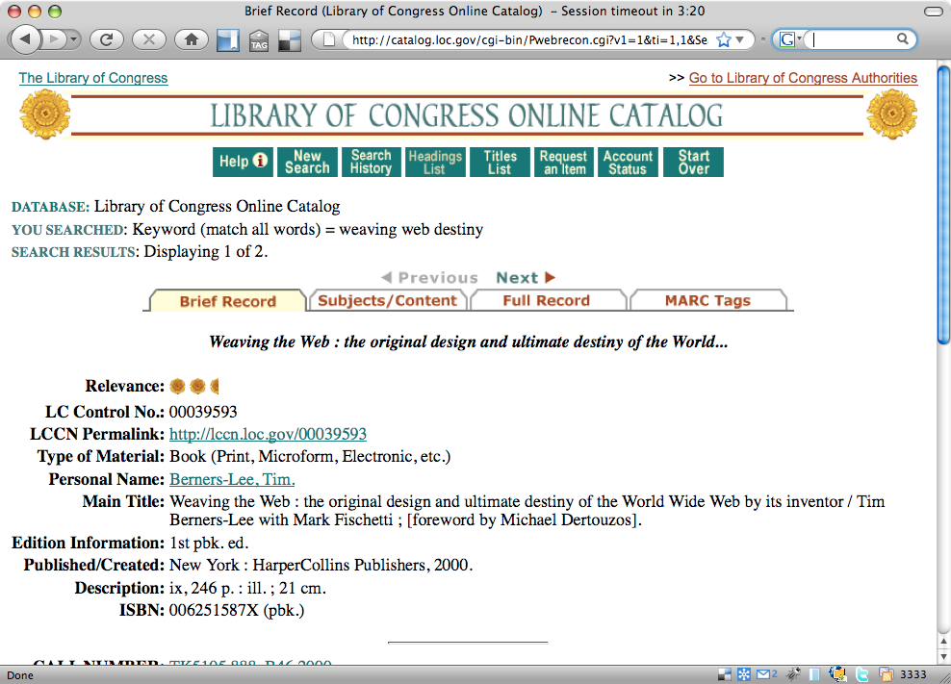

Slide 14
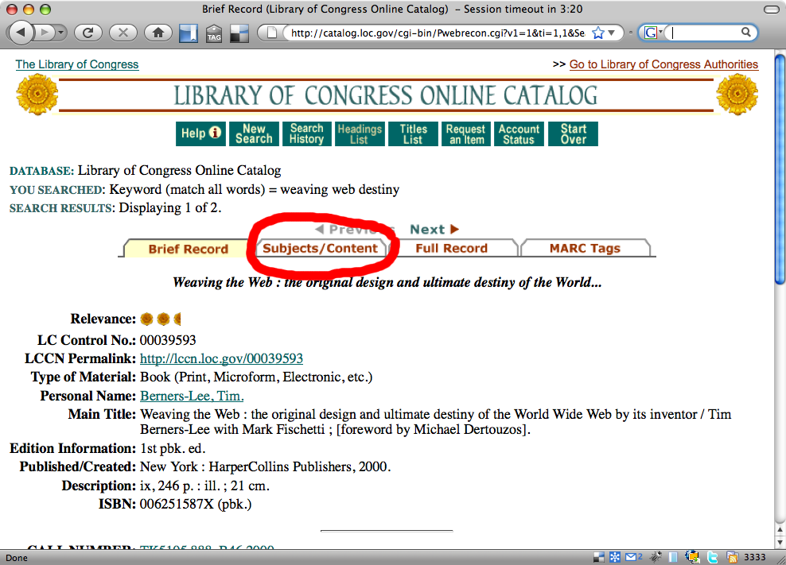

Slide 15
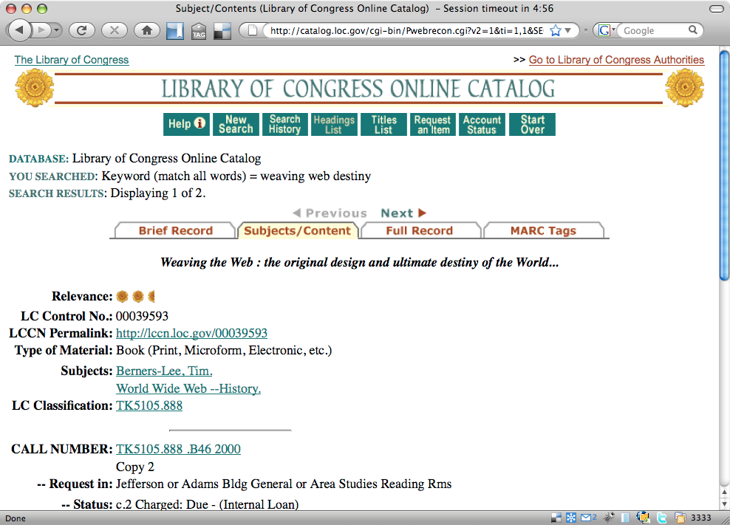

Slide 16
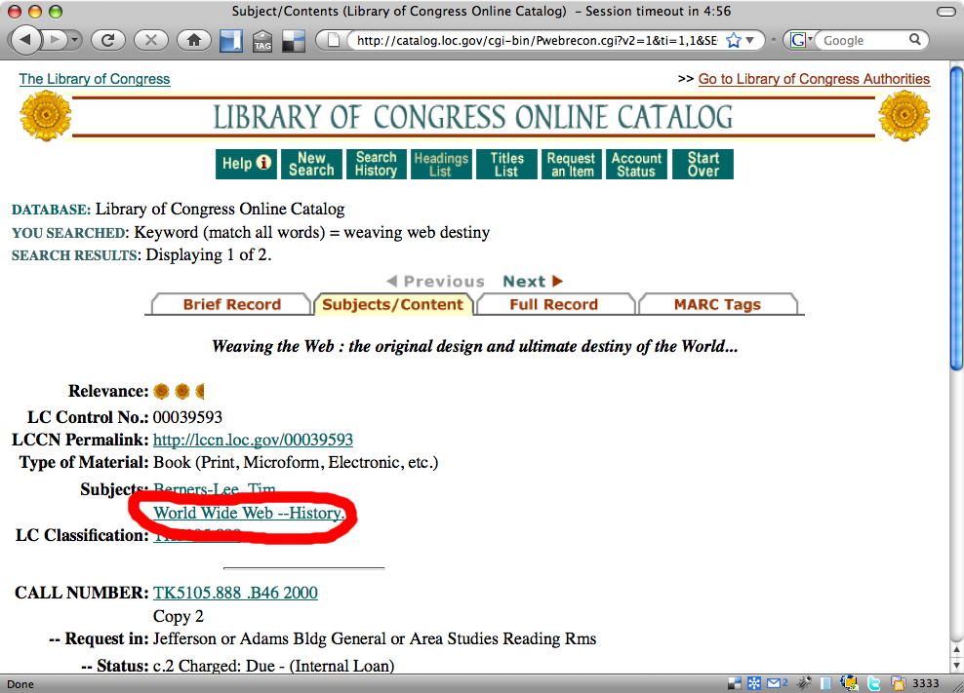

Slide 17
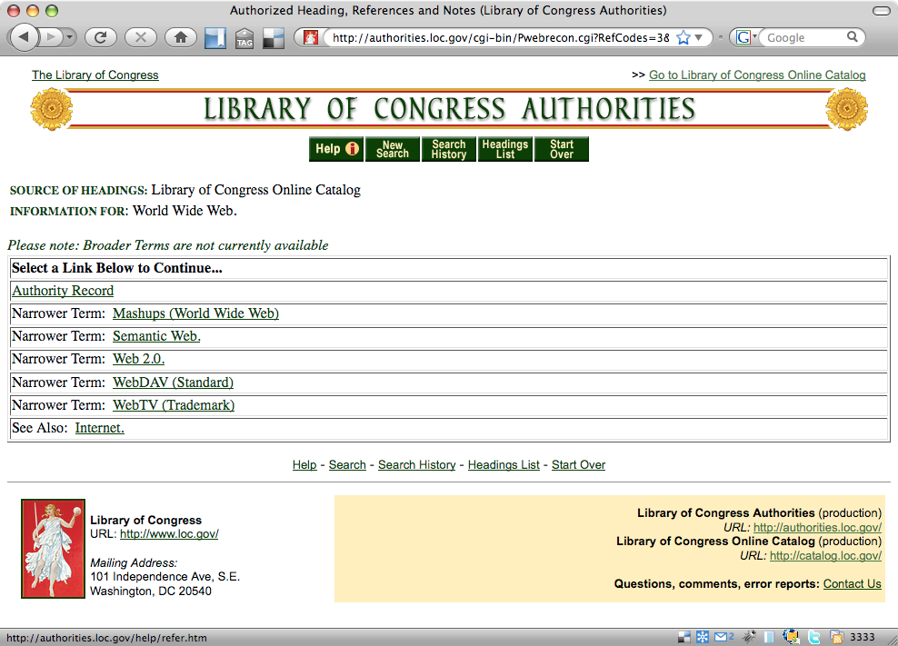

Slide 18
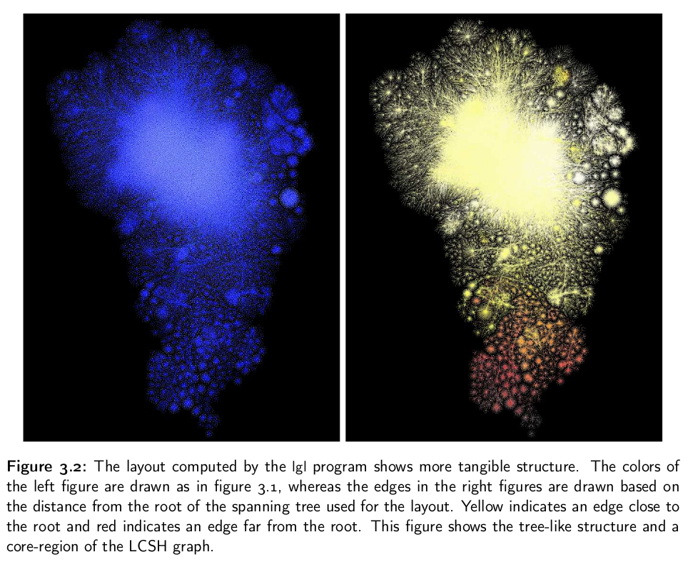

Slide 19
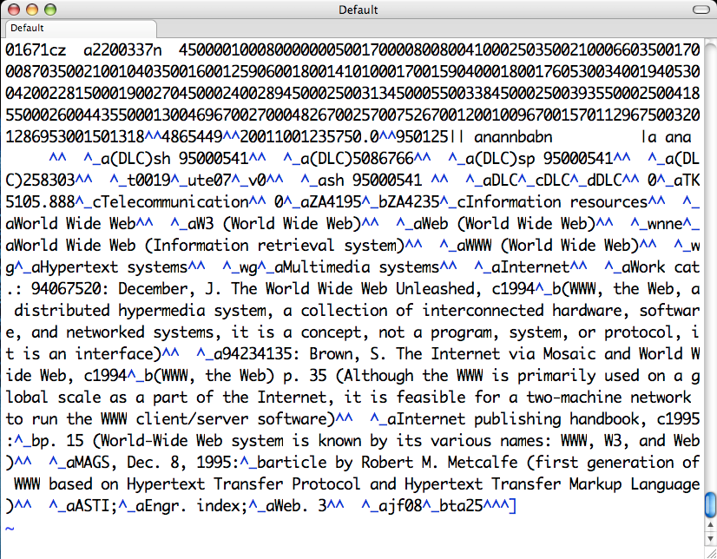

Slide 20
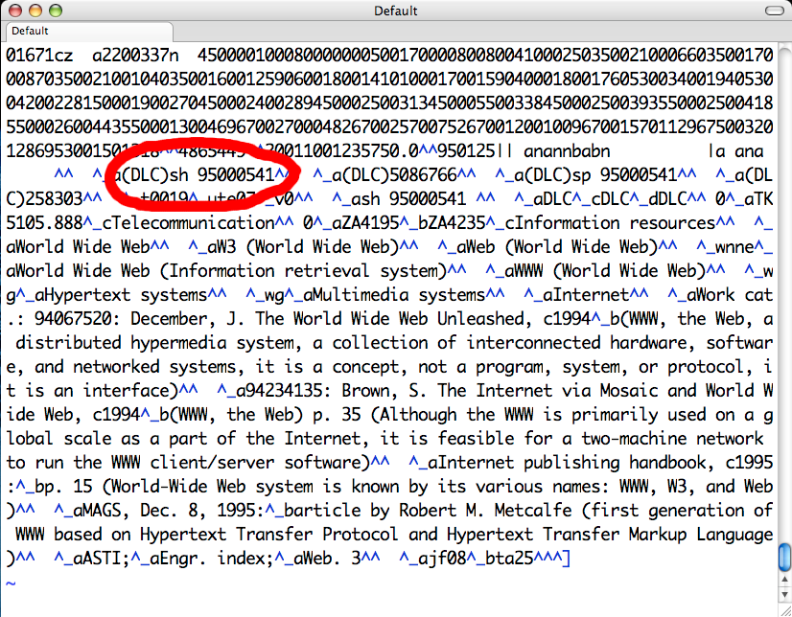

Slide 21
http://lcsh.info/sh95000541#concept

Slide 22
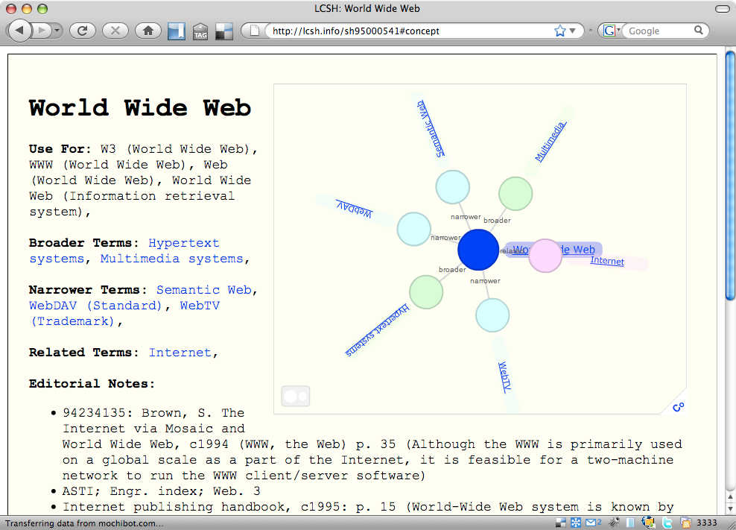

Slide 23
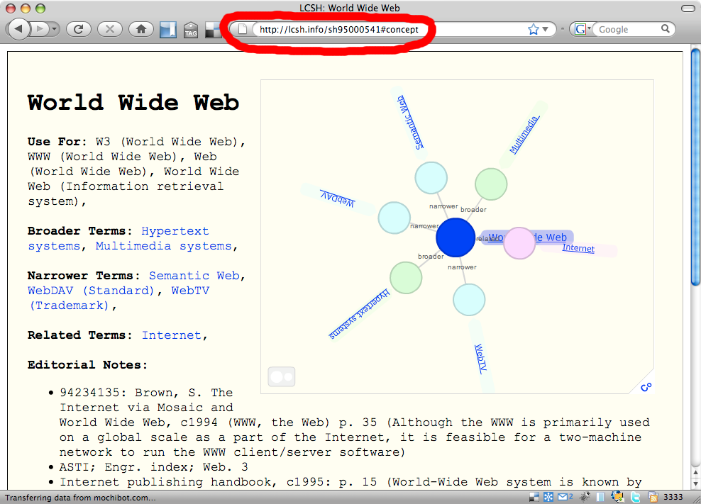

Slide 24
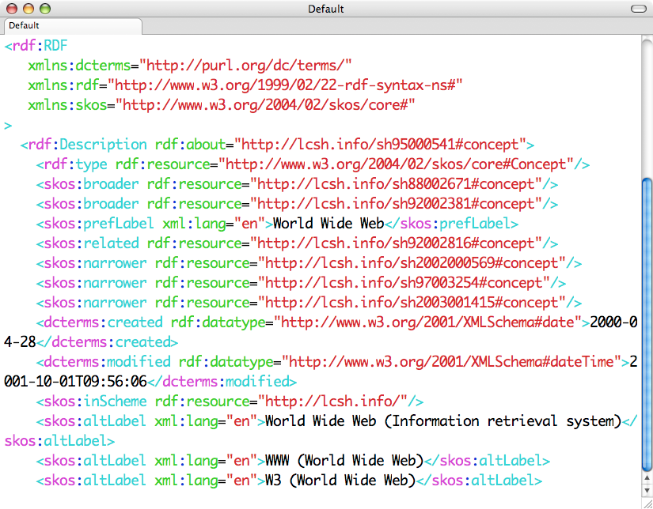

Slide 25
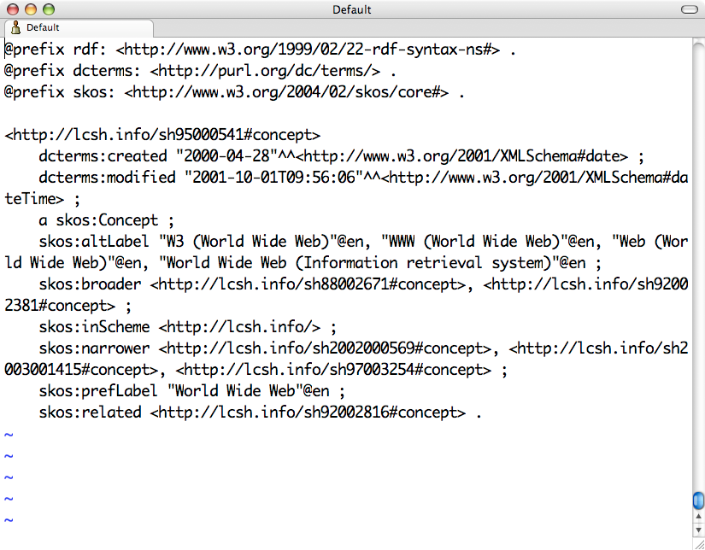

Slide 26
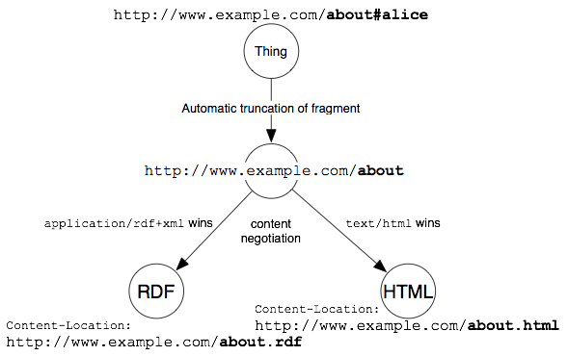

Slide 27
Cool URIs for the Semantic Web
http://www.w3.org/TR/cooluris/

Slide 28
Yeah, but so what ...

Slide 29
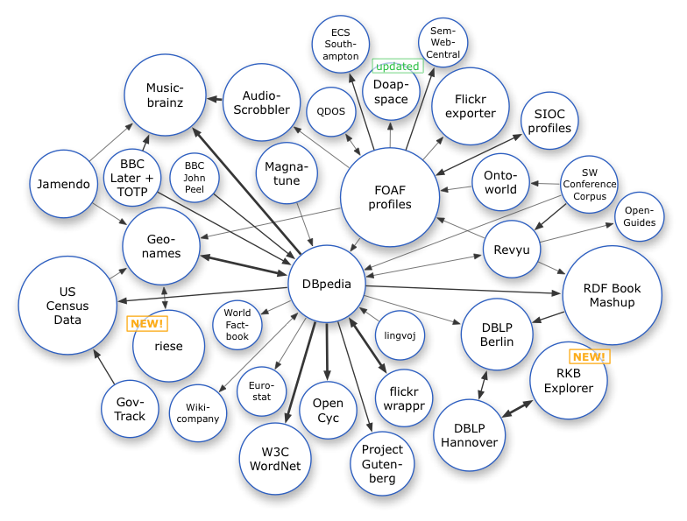

Slide 31
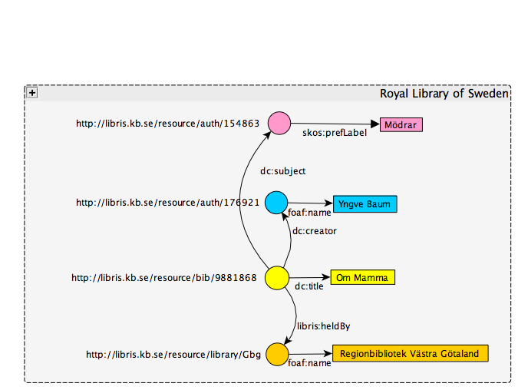

Slide 32
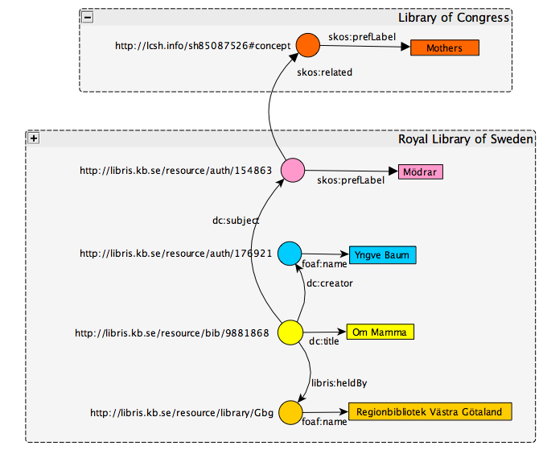

Slide 33
SKOS Documentation
W3C Semantic Web Deployment Working Group
  W3C Recommendation Track
  http://www.w3.org/2006/07/SWD/
SKOS Use Cases and Requirements
  First Working Draft Published (2007-05-16)
  http://www.w3.org/TR/skos-ucr/
SKOS Reference and Primer
  Last Call Working Draft published August 2008
  http://www.w3.org/TR/2008/WD-skos-reference-20080125/
  http://www.w3.org/TR/2008/WD-skos-primer-20080221/
  W3C Recommendation by December 31, 2008
SKOS Web Site
  http://www.w3.org/2004/02/skos/
  LCSH, SKOS and Linked data
  http://arxiv.org/abs/0805.2855
9/11/2008
SKOS - 2008 Joint CENDI / NKOS Workshop

Slide 34
Links
SKOS Homepage
http://www.w3.org/2004/02/skos/
SKOS Primer
http://www.w3.org/TR/2008/WD-skos-primer-20080221/
SKOS Reference
  http://www.w3.org/TR/2008/WD-skos-reference-20080125
SWD-WG Home Page
http://www.w3.org/2006/07/SWD/
SWD-WG Mailing list
mailto:public-swd-wg@w3.org
http://lists.w3.org/Archives/Public/public-swd-wg/
NSDL Metadata Registry
  http://metadataregistry.org
Jon Phipps
  mailto:jphipps@madcreek.com
  Thanks for listening ☺
9/11/2008
SKOS - 2008 Joint CENDI / NKOS Workshop

