Slide 1
Open Up Your Repository
With a SWORD!

Slide 2

Simple Webservice Offering Repository Deposit
http://swordapp.org

Slide 3
What is a Repository?
Notes:
This question has a lot wrapped up in it.

Slide 4
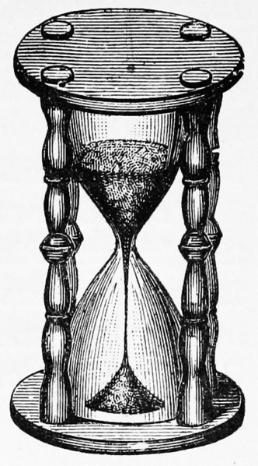
Notes:
Umm, yeah, how much time do we have?
Nasty img background on this...
OAIS - Open Archival Information System

Slide 5





Notes:
The usual suspects. Are there more?

Slide 6
teh suxx0r!
Notes:
all different apis

Slide 7
oai-pmh

Slide 8
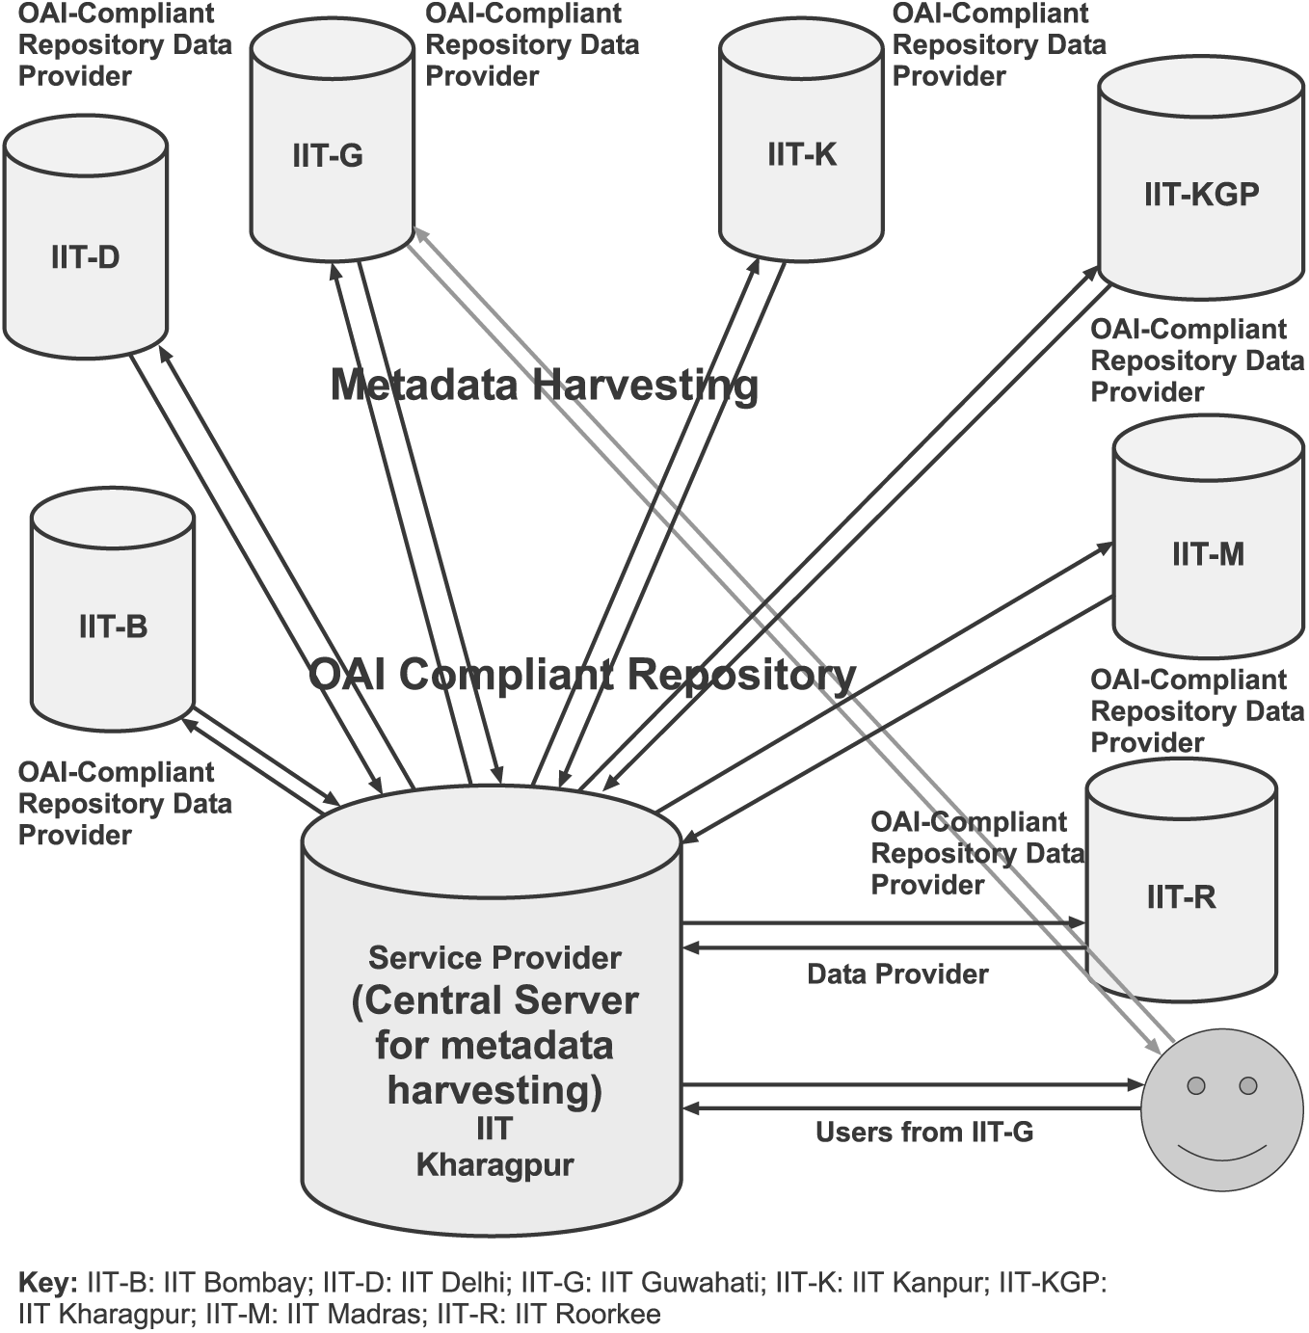

Slide 9
icanhaz repository objects???

Slide 10


Slide 11
oai-ore

Slide 12
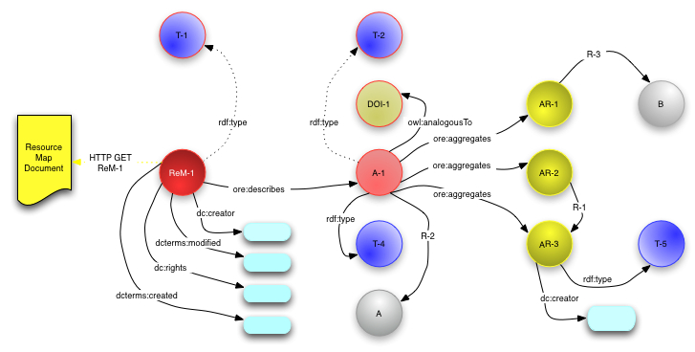

Slide 13


Slide 14
Deposit?

Slide 15
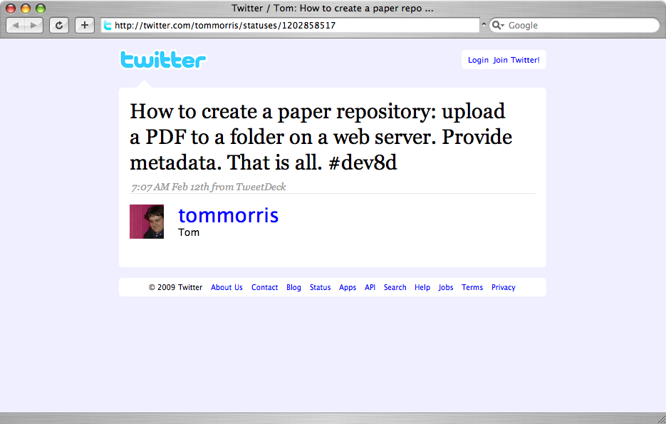

Slide 16

RFC 5023
Notes:
mention grabit

Slide 17
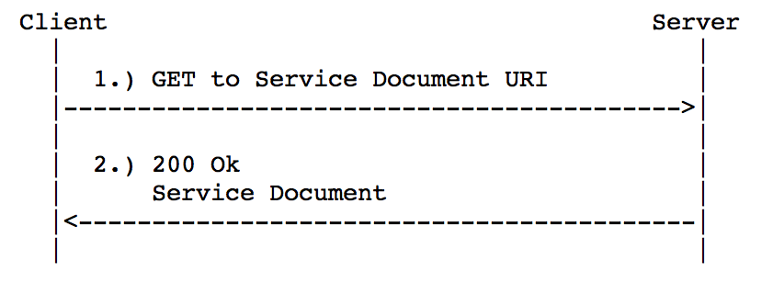
Retrieving a Service Document

Slide 18
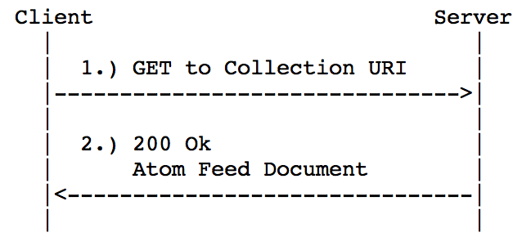
Listing Collection Members

Slide 19
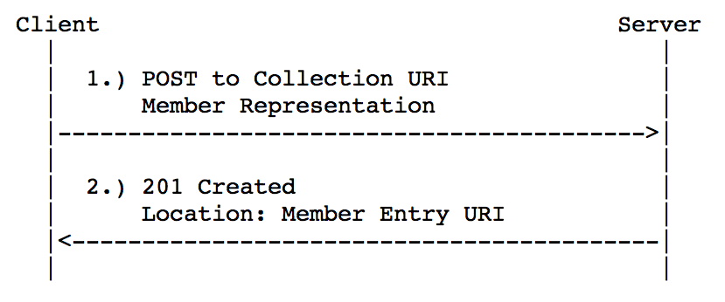
Creating a Resource

Slide 20
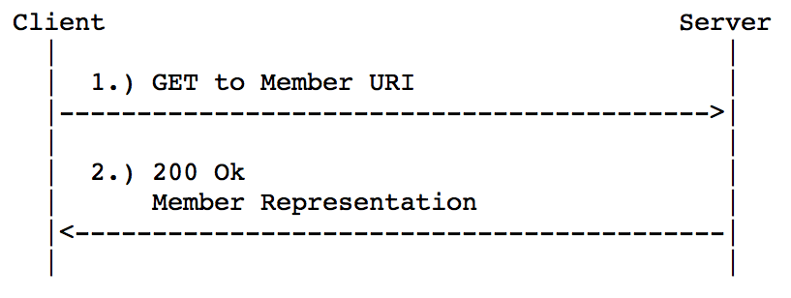
Retrieving a Resource

Slide 21
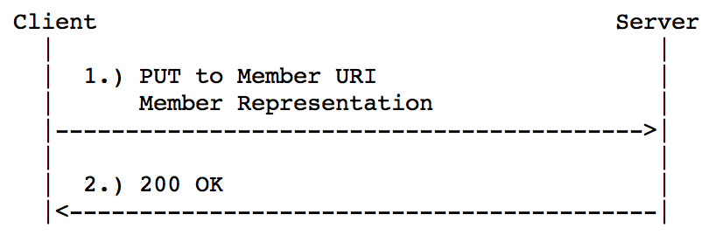
Editing a Resource

Slide 22
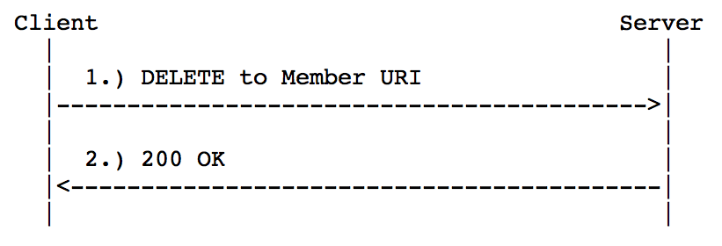
Deleting a Resource

Slide 23
Extra Bits from SWORD
  sword:version
  sword:verbose
  sword:noOp
  sword:maxUploadSize
  sword:mediation
  sword:treatment
  sword:acceptPackaging (SWORD-Types)
  sword:packaging
Notes:
atom nice, because it was designed for extensibility with namespaces
JISC - Joint Information Systems Committee
Matt Zumwalt, 11th hour switch to AtomPub...

