Slide 1
Project : Carrio Motors
Car website
Find car , search for car
Member :
-Huỳnh Quang Tuấn
-Trần Thanh Hoàng Huy
-Lê Thanh Tú
-Trần Tấn Lộc

Slide 2
Technology applied to the project
Template | ROYAL CARS Free Website Template | Free CSS Templates | Free CSS (free-css.com)
Jquery | https://code.jquery.com/jquery-3.6.1.min.js
javascript | Find file javascript , download and put in visual studio code
Bootstrap | https://getbootstrap.com/docs/5.0/getting-started/introduction/
Ajax | Find file ajax , download and put in visual studio code
Laravel | Import framework Laravel in visual studio code
Xampp | Download xampp , setting Apache and MySql

Slide 3
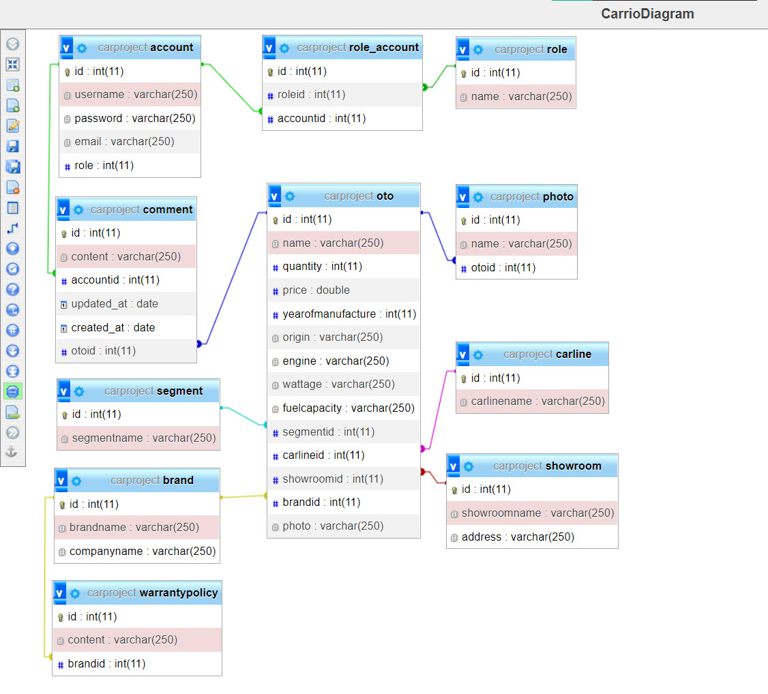
Diagram Project

Slide 4
Functions for users to interact with the website
01.
REGISTER/LOGIN
02.
COMMENT
03.
SEARCH A CAR
04.
LOOK FOR CAR DETAILS

Slide 5
01
Functions for Admin to interact with the website
EDIT A CAR
02
ADD A NEW CAR
03
Block user access
04
DELETE A CAR

Slide 6
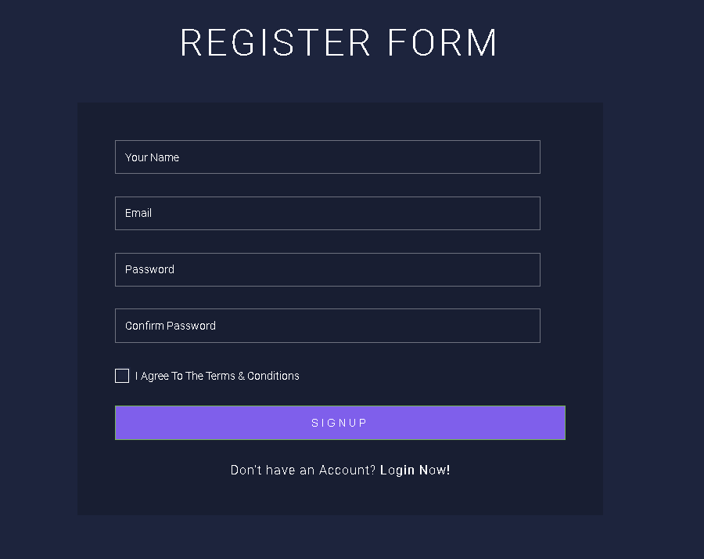
Register for user

Slide 7
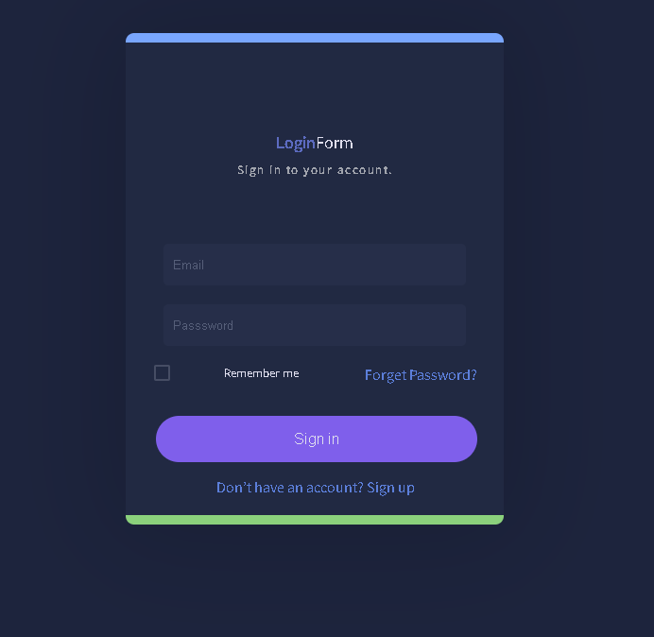
From login

Slide 8
Button click for search
Search for value car
Search for keyword car

Slide 9
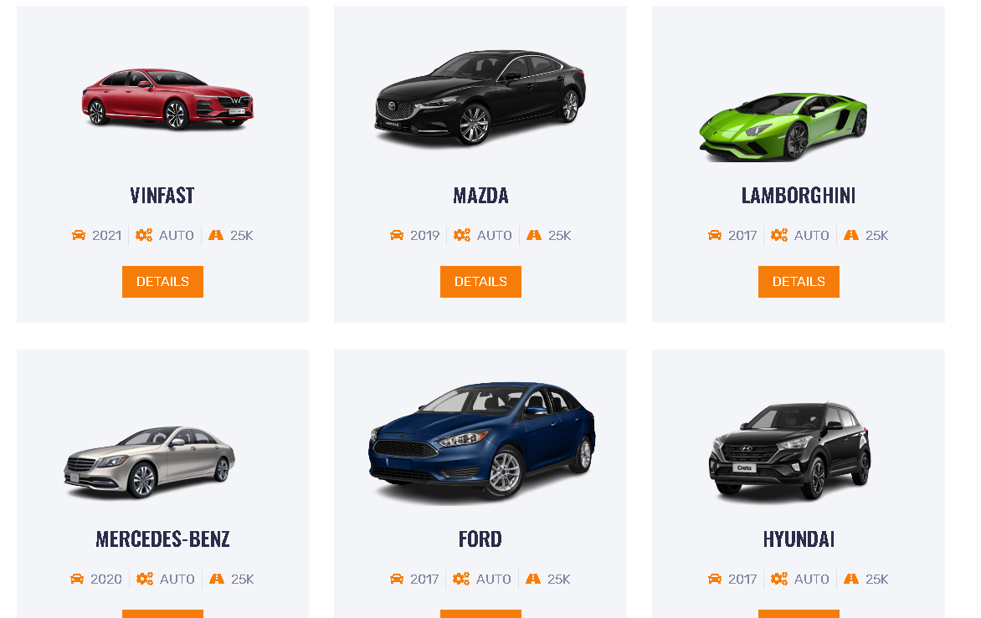
Click button => showDeatail

Slide 10
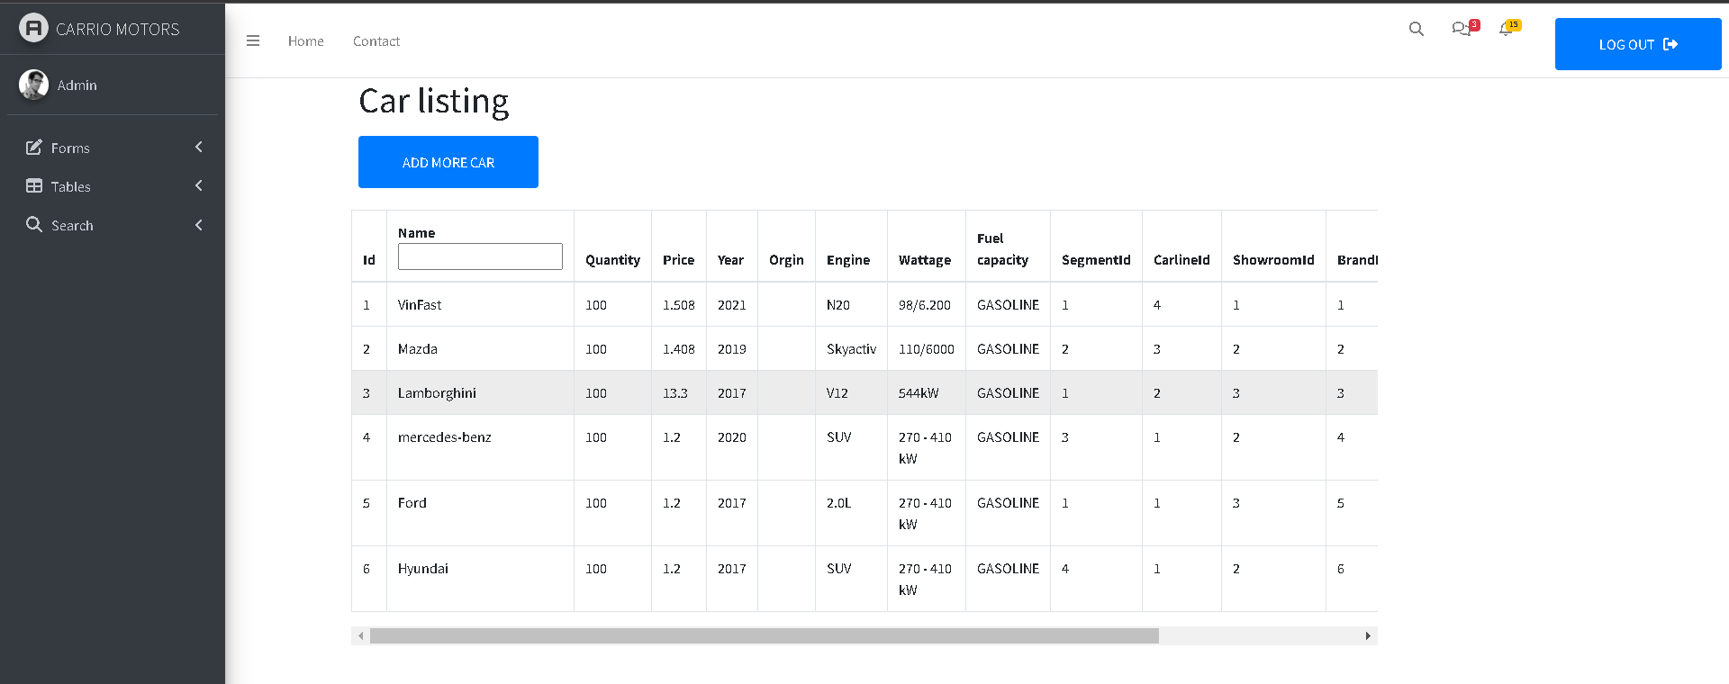
Layouts Admin

Slide 11
Now let’s experience Carrio Motors!

