Slide 1
Unlocking the future:
Identifying, Paying, and Avoiding Technical Debt

Slide 2
Agenda
Identifying Technical Debt
Business tools for measuring and managing technical debt
Automation strategies

Slide 3
Presenters
Carl Stephens
Cybersecurity Analyst – Cybersecurity Operations Center
Technology Services at Illinois
cstephns@illinois.edu
Ed Delaporte
Cybersecurity Development Manager
Technology Services at Illinois
delaport@illinois.edu
Glen Shere
Cybersecurity Engineer
Technology Services at Illinois
shere@illinois.edu

Slide 4
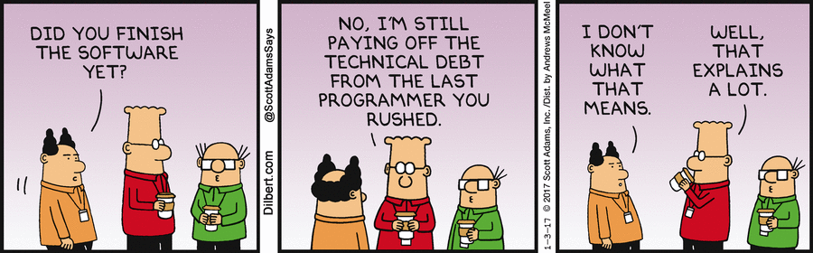
What is technical debt?

Slide 5
What is technical debt?
Any project expense deferred to future projects

Slide 6
Examples of Technical Debt
Any manual process with incomplete or out of date documentation
Deferred updates to product, dependencies, or operating environment
Proof-of-concept or prototyping tools used in production
Risks of feature set or bug fix regression during continuing development
Delayed refactoring when requirements or design has changed
Lack of alignment to standards
Modified purchased software (obscure fork in production)
Missing, incomplete, or buggy API; any challenge to non-human interaction

Slide 7
Causes of Technical Debt
Management pressure to complete a project with insufficient resources
Development before requirements documentation or design (“agile”)
A belief that a prototype is “good enough” for production
Insufficient training, mentoring, collaboration, or knowledge sharing
Parallel development that is later merged
“Quick wins”
“Job security”

Slide 8
Impacts of Technical Debt
Distorts cost accounting:
Completed projects have externalized costs not yet realized
Future projects have indirect costs not yet realized
Business decisions are made with inaccurate cost data
Can be the root cause of a cybersecurity incident
Slows information security incident response
Slows outage response
Complicates scaling and performance issue debugging
Limits continuous improvement
Can impact morale
Can impact recruiting

Slide 9
Reducing technical debt
Document manual processes; mandatory unreachable vacation
Policy to update product, dependencies, and environment (see IT04, IT10)
Refactor any proof-of-concept or prototyping tools used in production
Automated test suites; continuous integration; continuous deployment
Policy to refactor if requirements or design has changed
Standards are an implied requirement
Migrate to and use a maintained version of software (vs. a fork)
Implement any human interaction only with API calls (see AWS)
Integrated documentation

Slide 10
Extreme cases of technical debt
IPv4 address exhaustion
Telephone area code exhaustion
2G and 3G wireless devices
Adobe Flash
Internet Explorer 6

Slide 11
Managing/Measuring Technical Debt
Carl R Stephens, Technology Services

Slide 12
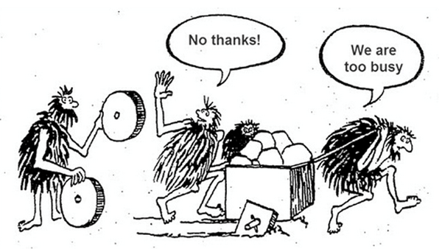

Slide 13
Respondents to the Accenture Federal Digital Decoupling Study reported:
83% believe that technical debt greatly increases their organization’s IT costs
80% believe that technical debt in their legacy systems severely limits their ability to augment or enhance these systems
81% believe that technical debt in their legacy systems must be remediated before migrating to the cloud
https://www.accenture.com/us-en/insights/us-federal-government/technical-debt-explained

Slide 14
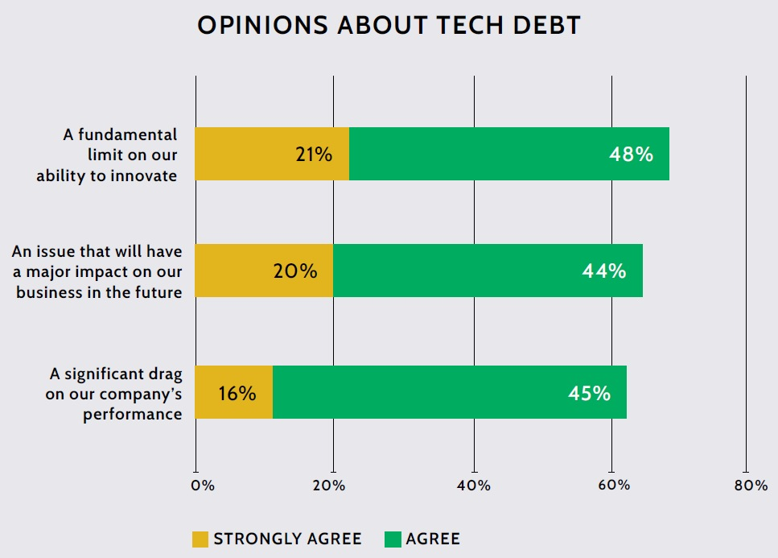
Key findings
Source: The Growing Threat of Technical Debt, OutSystems 2021

Slide 15
Hurdles of Technical Debt
69% of IT leaders say technical debt poses a fundamental limit on their ability to innovate, along with 61% saying it drags on their company’s performance and 64% agreeing it will continue to have a major impact in the future.
There is a massive opportunity cost for businesses of all sizes across all industries as they dedicate time, money, and other resources into technical debt instead of innovation.
On average, businesses spend approximately one-third of their IT budget addressing technical debt – this jumps to 41% for enterprises.
https://www.helpnetsecurity.com/2021/06/18/technical-debt-challenges/

Slide 16
Hurdles of Technical Debt 2
There isn’t a sole cause of technical debt, though IT leaders cite too many development languages/frameworks (52%), turnover within the development team (49%), and accepting known defects to meet release deadlines (43%).
Businesses continue to delay addressing technical debt, further exacerbating the issue. Only 20% say tech debt is something they’re currently managing well, though 36% report they’ll be able to manage tech debt in the future.
Technical debt compounds as companies grow. Enterprises spend 41% of their IT budget on technical debt, while small businesses spend 27%.
https://www.helpnetsecurity.com/2021/06/18/technical-debt-challenges/

Slide 17
Technical Debt Can Be Hard to Measure
What type Debt will I be incurring ?
Can I track Technical Debt for Project X
You are best served using accessible metrics like “time” and “money.”

Slide 18
Technical Debt Can Be Hard to Measure 2
Ask your technical employees practical questions like
“If we followed your suggestion, how much time will it take to implement the new framework?”
“How many hours a week are working on fixing bugs versus adding new features?”
In particularly extreme cases, it makes sense to ask, “How much would it cost to throw this whole system out and replace it?”

Slide 19
Step 1 –Preparation for Measuring Technical Debt
Policies and Procedures to Prevent Technical Debt or Measure Projects
Getting the right people to the table :
a Project Manager someone can manage the Technical Debt those that would see risks of a project but also see the opportunity costs
Notes from previous projects that might offer insight
Tools to measure technical = TDX, Time Reporting

Slide 20
Step 2-Identification of Technical Debt
To accurately track and measure one must be able to identify technical debt
Units need to agree upon a standard definition of what Technical Debt is
What specific components are included
Code
Legacy Infrastructure
Documentation
Turnover /Retention

Slide 21
Step2- Technical Debt Classification
How much debt is associated with each element of the project
Who is the owner of the service?
What Applications do we have and what technologies are used ?
Why are older technologies still being utilized?
When are we going to address these issues?
Business Risk
Technical Risk
Security -GRC
Remediation Costs

Slide 22
Breakdown of cost types from a business perspective
Cash Costs
Head Count (Salaries)
Overhead
Soft Costs
Productivity
Ongoing Cost
Cost we are incurring right now by running XYZ i.e. Cloud Dashboard
Change Tax
Adding New Features to legacy vs replace

Slide 23
Accenture’s Technical Debt Model breaks down the component costs as follows:
Principal – This is the largest and easiest to measure and includes the cost to remediate and maintain legacy systems. Like financial debt, you make measurable progress in debt reduction by paying down principal.
Interest – These are the workaround costs such as staffing, delays, and redundant systems that must be maintained because decisions to integrate or retire older systems have been deferred. By not paying down principal, interest costs mount.
Liability - When systems are fragile and vulnerable, outages, breaches, or data corruption can occur, creating significant costs to patch software, restore systems, or in some instances replace hardware. Similar to deferred maintenance on a home, other issues surface that create additional, unforeseen expenditures.
Opportunity Costs – These costs are the most difficult to measure, but are nonetheless essential to understand, as they represent borrowing from the future due to the inability to support benefit-producing initiatives today. Current gaps in cost, performance, and security grow wider for every year modernization is deferred.

Slide 24
Step 3 – Containment of Technical Debt
Stop the bleeding
If we have to much Technical Debt we should not incur more, unless it is to replace legacy
Track Technical Debt
TDX Tickets
Jira tickets
Time Reporting
Tracking in TDX
Project Management Software

Slide 25
How Do Companies Manage Technical Debt?
Documentation
Teams can use wiki pages, Trello boards, or Microsoft Excel to document technical debt issues.
Such documentation is helpful to bring visibility into technical debt across the teams.
2. Project Management tools
Jira, Hansoft, and Excel, Microsoft Project
3. Static Analyzer
Tools such as SonarQube, SonarGraph, Klockwork are used to analyze source code in search of technical debt

Slide 26
Small, Medium, and Large Technical Debt
Small pieces of debt: the type of tech debt that can be addressed as soon as the engineer spots it in the code and it’s within the scope of the ticket they're working on.
Medium pieces of debt: the type of debt that can be addressed within a sprint. It should go through the same sprint planning process as any feature work and be considered just as rigorously.
Large pieces of debt: the tech debt that cannot be addressed immediately or even in one sprint. The best companies we've interviewed have quarterly technical planning sessions in which all engineering leaders participate.

Slide 27
Technical Debt Ratio & Metrics
Technical Metrics
Financial Metrics
Time Metrics
TDR=(Remediation Cost/ X Cost) X100%

Slide 28
Measuring the cost of technical debt realized through turnover
People Leave
More Money
Better Work Environment
Productivity issues
Reward
Motivating Action
Ownership
Driving change

Slide 29
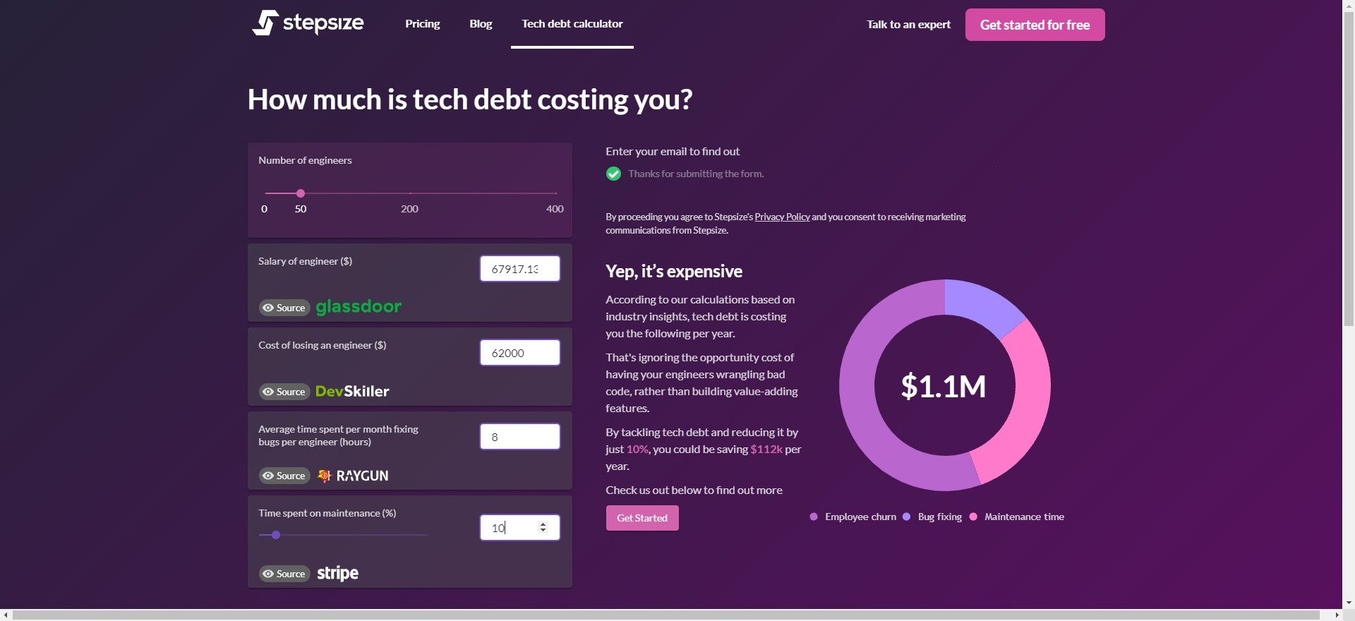
Tool from StepSize

Slide 30
Invest Against Technical Debt
Make maintenance into a routine
Make it less scary.
Make it faster.
Make it free of surprises.

Slide 31
Invest Against Technical Debt
Practical First Steps
Build a regression suite.
Have a pipeline (CI/CD).
Set up ChatOps.

Slide 32
Build a Regression Suite
Make mistakes, but don't repeat them.
Start with a checklist!
List critical things to check after each change.
Include hard-to-remember details.
Long checklists justify RobotFramework, or a PowerShell Pester suite.

Slide 33
Build a Regression Suite
Automate Regression Tests
Start the Application
Capture Page Screenshot
Click Element accessibility_id=Get Started
RobotFramework - Nearly English syntax.
PowerShell Pester - Runs anywhere, talks to everything.

Slide 34
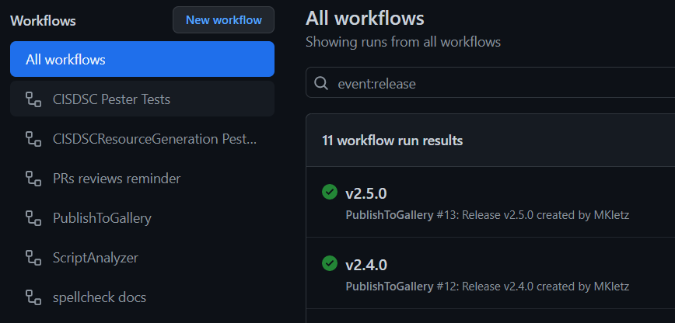
Have an Automated Pipeline (CI/CD)

Slide 35
Have an Automated Pipeline (CI/CD)
Campus has good cheap CI/CD options.
GitHub seems to be where the campus community is converging.
Jenkins is the most mature product in the space.
Azure DevOps has a solution.
AWS has a solution.
These and more are in use on campus successfully.

Slide 36
Have an Automated Pipeline (CI/CD)
Delivery is not Deployment
Do everything except release automatically.
Let the person who answers the on-call phone push the release button.
Deploy frequently.
One outage can cost a team more time than it takes to setup CI/CD.

Slide 37
Have an Automated Pipeline (CI/CD)
Enforce Change Reviews
Those who understand what changed respond most effectively to issues.
Mandatory review causes more people to know what changed.

Slide 38
Set up ChatOps
Start with Chat
Make chat rooms where things typically happen.
Add 'update the chat room' to existing playbooks.
Learn to use web deep links in chat.
Start without bots.

Slide 39
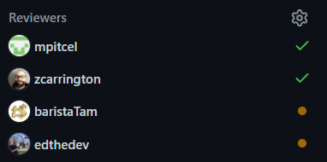
Set up ChatOps
Add DevOps to Chat
Automate information into ChatOps rooms.
Replace diverse interfaces with ChatBots.
Keep chatting with people.

Slide 40
Questions and Answers

Slide 41
Bonus slide: Enforce Style Guides
Even Quick Scripts Deserve Style
MD009/no-trailing-spaces: Trailing spaces [Expected: 0 or 2; Actual: 1]
MD012/no-multiple-blanks: Multiple consecutive blank lines [Expected: 1; Actual: 2] Started
Enforce style checks by adding PSScriptAnalyzer, Flake8, MarkdownLint to your pipelines.

