Slide 1
Mobile Integration Testing
With Robot Framework
Notes:
Priya will start the talk.

Slide 2
Contents
Robot Framework
Appium
Demonstration

Slide 3
About Robot Framework
Open Source
Human readable language
Library Extension
Easy execution process
Versatile Framework
HTML Log Files are provided automatically
Test Screenshots
https://robotframework.org/

Slide 4

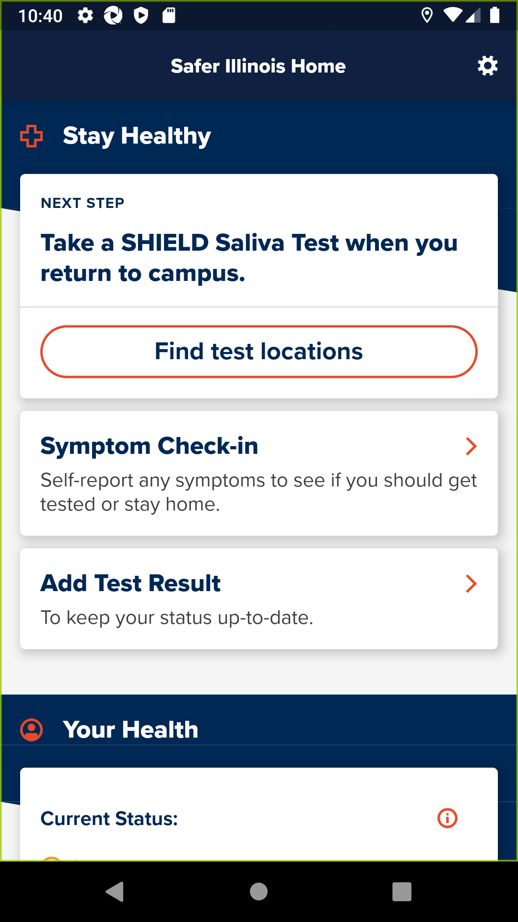
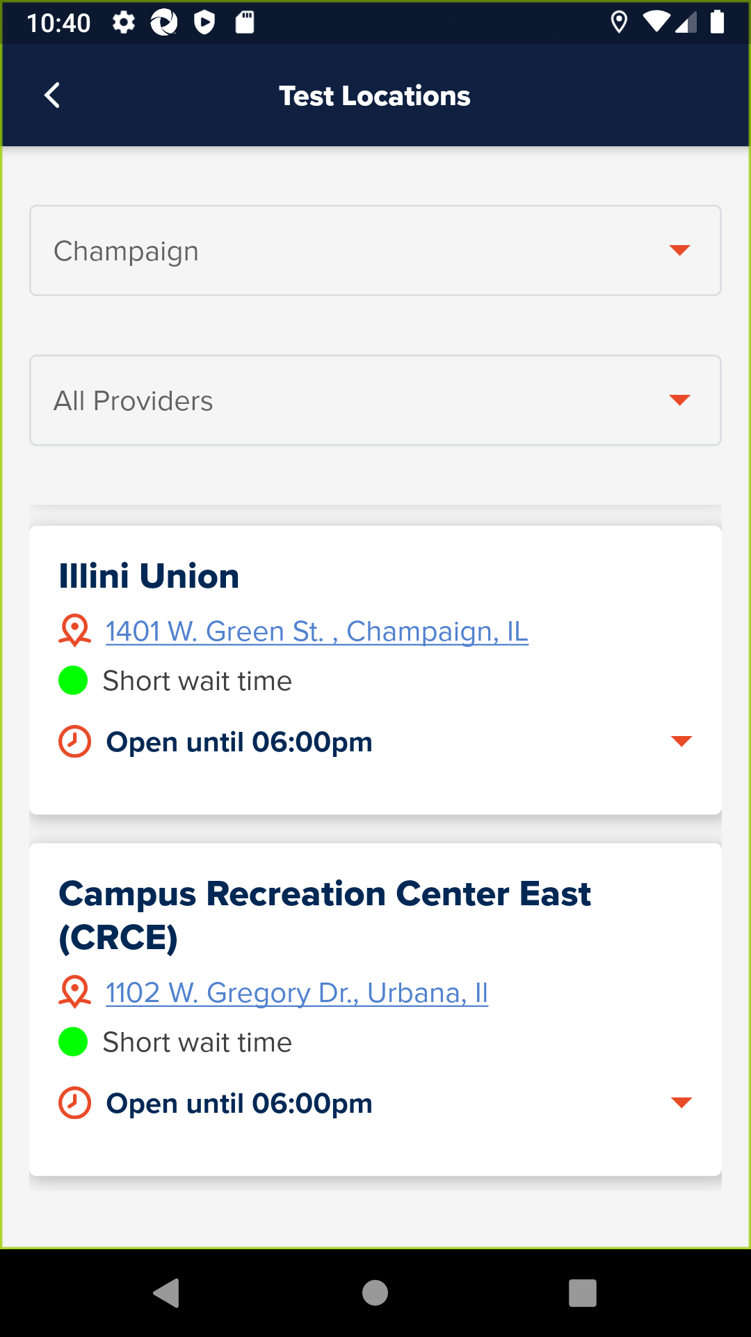
Robot Framework Screenshot Example
https://robotframework.org/
Notes:
Robot Framework generated screenshots.
Enable/disable screenshot feature. By default you only get one screenshot at the end.
Screenshots only capture the emulated phone. (It won’t capture your open email inbox.)

Slide 5
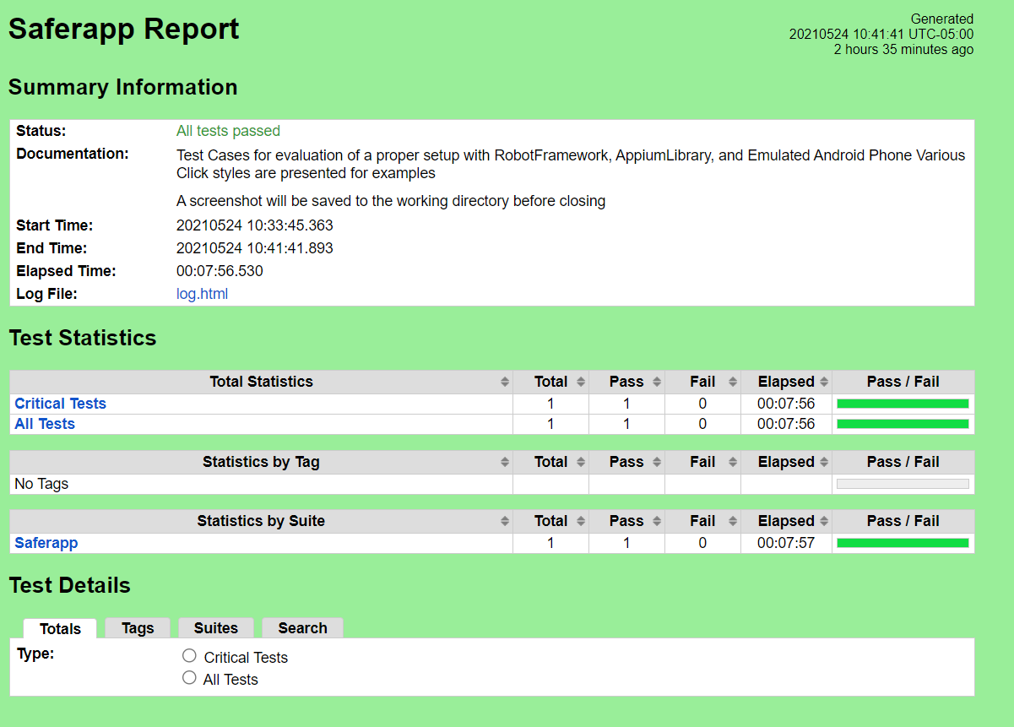
Robot Framework HTML Report File Example
https://robotframework.org/
Notes:
Reports are explorable.
RFW generates varies files at the end after running. One of them is this file a “general report” of the test outcomes.
If you have error listed in the file, we can go to auto generated LOG file.
Files contain HTML links to relevant related files, etc.
The Report file contains the final results.

Slide 6
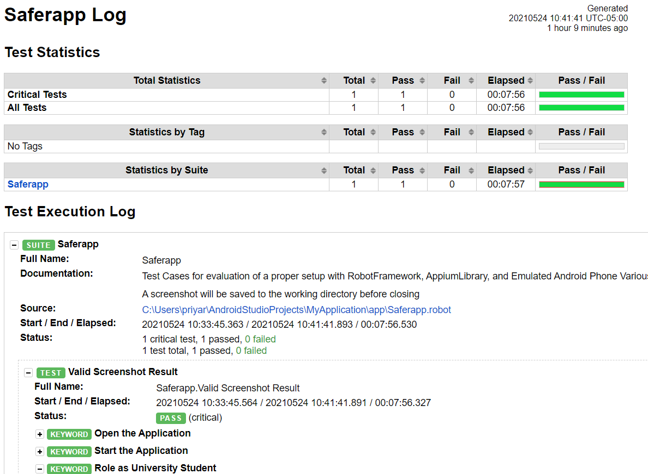
Robot Framework HTML Log File Example
https://robotframework.org/
Notes:
By default Robot Framework generates an HTML log file and an HTML report file.
The Log file contains detailed log of the run.
You can add your own custom messages to the log file.
You can also log to the console.

Slide 7
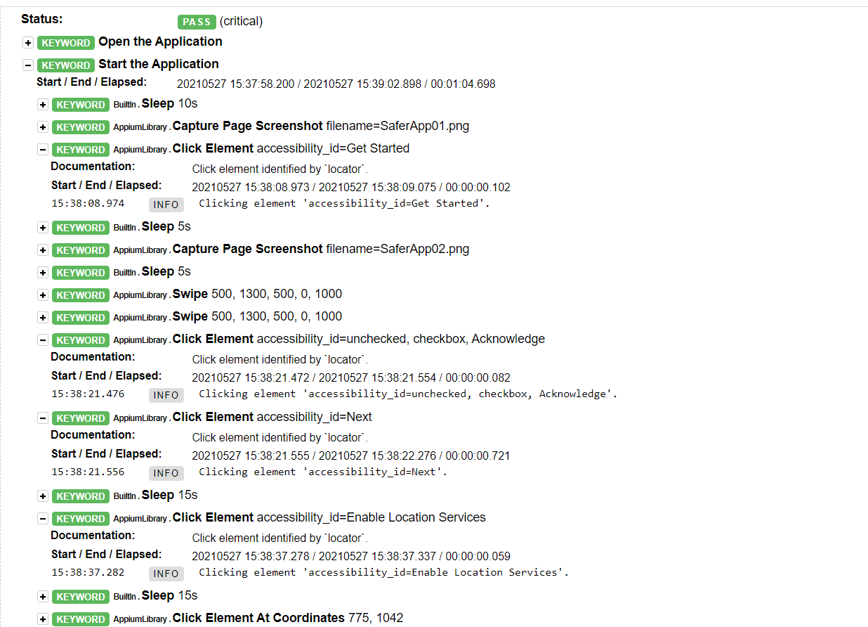
Robot Framework HTML Log File Example
https://robotframework.org/
Notes:
By default Robot Framework generates an HTML log file and an HTML report file.
The Log file contains detailed log of the run.
You can add your own custom messages to the log file.
You can also log to the console.

Slide 8
About Appium
Open Source
The connection between the test device and the Robot Framework script
Test Device herein is an Emulated Android Phone
Android Emulated Phones are created using Android Studio
IOS Emulated Phones are created using XCode
https://developer.android.com/studio , http://appium.io/docs/en/about-appium/intro/ , https://github.com/appium/appium-desktop , https://github.com/serhatbolsu/robotframework-appiumlibrary
Notes:
Michelle will take over here.

Slide 9
About Appium
An Appium Desktop GUI (preferred)
The GUI allows for the interactive inspection of an Application
Allows the User to step through the Application while writing tests
Can view element IDs, Classes, XPATHs, etc.
Note: Appium can be utilized only with the Command Line, but will not have the features described herein for inspection
https://developer.android.com/studio , http://appium.io/docs/en/about-appium/intro/ , https://github.com/appium/appium-desktop , https://github.com/serhatbolsu/robotframework-appiumlibrary

Slide 10
About Appium
Appium Library
Keyword Library utilized in the Robot Framework script
Keywords are presented in a human-readable format
https://developer.android.com/studio , http://appium.io/docs/en/about-appium/intro/ , https://github.com/appium/appium-desktop , https://github.com/serhatbolsu/robotframework-appiumlibrary

Slide 11
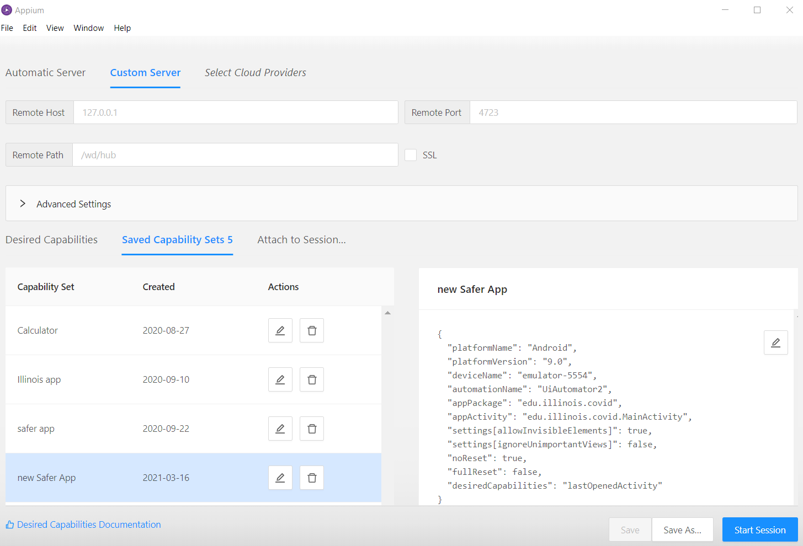
About Appium - Interface Example
https://developer.android.com/studio , http://appium.io/docs/en/about-appium/intro/ , https://github.com/appium/appium-desktop , https://github.com/serhatbolsu/robotframework-appiumlibrary
Notes:
This is the Appium setup screen.
Here you give Appium the information it needs to create the connection to the emulated device.
A Tech Services KB article contains more guidance on using this screen.

Slide 12
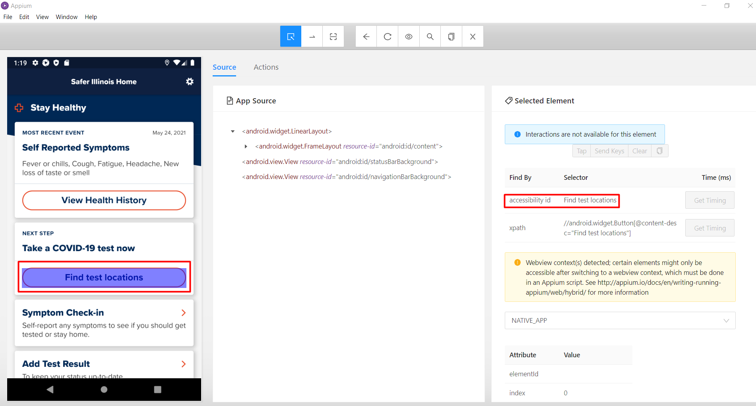
About Appium - Interface Example
https://developer.android.com/studio , http://appium.io/docs/en/about-appium/intro/ , https://github.com/appium/appium-desktop , https://github.com/serhatbolsu/robotframework-appiumlibrary
Notes:
Appium has an inspector page.
This lets you look at the objects in the app (without needing access to the code).
Includes XML, XPath information, any accessibility hints included.
Pro tip: Good accessibility hints can help Appium navigate, too!

Slide 13
How to Run a Test
Start the Emulated Phone
Start the Appium Server
Run the test from the command line for the entire test suite
robot [robot file name]
robot DemoTestFile.robot
Run the test from the command line for a single test
robot -t [test name] [robot file name]
robot -t DemoTest DemoTestFile.robot

Slide 14
Demonstration
Notes:
Priya will share screen and run the video, and describe what is happening.

Slide 15
Q & A
Notes:
Priya will open the floor to questions.

Slide 16
Question: Can this work on Mac / Linux?
Yes.
Robot is cross-platform.
Appium is cross-platform.
Android Emulator will run on any of Windows/Mac/Linux.
Note: iPhone iOS emulation requires an Apple computer.
Notes:
Ed can answer this question.

Slide 17
Question: Can this work in a pipeline?
Yes.
Robot works on the command line (headless mode).
Appium works in headless mode and still takes screenshots.
Android Emulator now works in headless mode.
https://androidstudio.googleblog.com/2019/02/emulator-2818-canary.html https://appiumpro.com/editions/58-how-to-test-on-headless-emulators-and-simulators-with-appium
Notes:
Ed can answer this question.

Slide 18
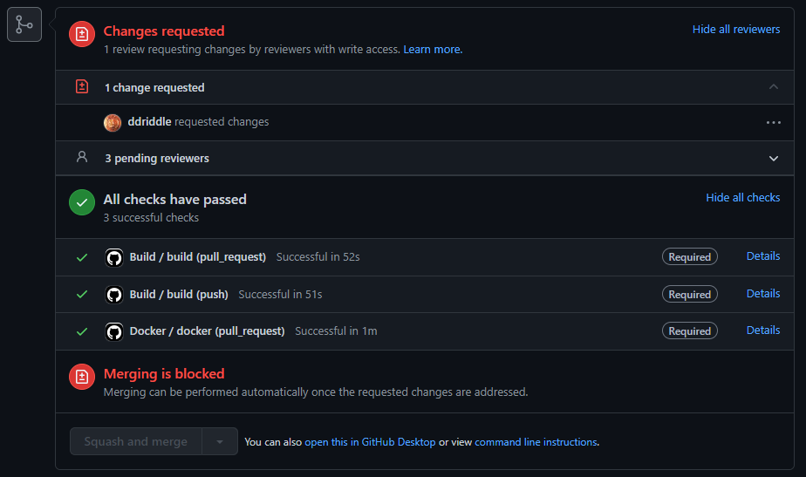
Question: How does this look in a CI/CD pipeline?
https://androidstudio.googleblog.com/2019/02/emulator-2818-canary.html https://appiumpro.com/editions/58-how-to-test-on-headless-emulators-and-simulators-with-appium
Notes:
Ed can answer this question.
The example on screen is GitHub. GitLab, Jenkins, AWS CodeDeploy look different but work similar.
Note that there’s a place for the human exper discussions at the top.
Then the code automation results are shown.
“Merging is blocked” Either human input or automation results can block a merge.

Slide 19
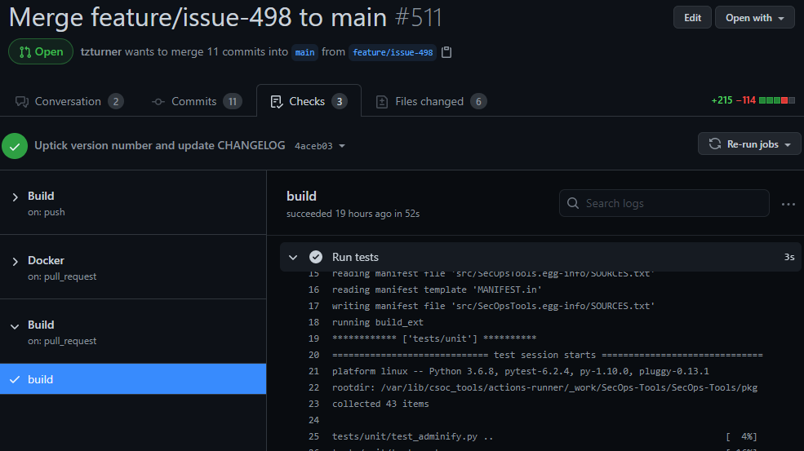
Question: How does this look in a CI/CD pipeline?
https://androidstudio.googleblog.com/2019/02/emulator-2818-canary.html https://appiumpro.com/editions/58-how-to-test-on-headless-emulators-and-simulators-with-appium
Notes:
Ed can answer this question.
The example on screen is detail view in GitHub.
The GitHub web interface displays the command line output from a Docker container for the team to review.
GitLab, Jenkins, AWS CodeDeploy look different but work similar.asdf

Slide 20
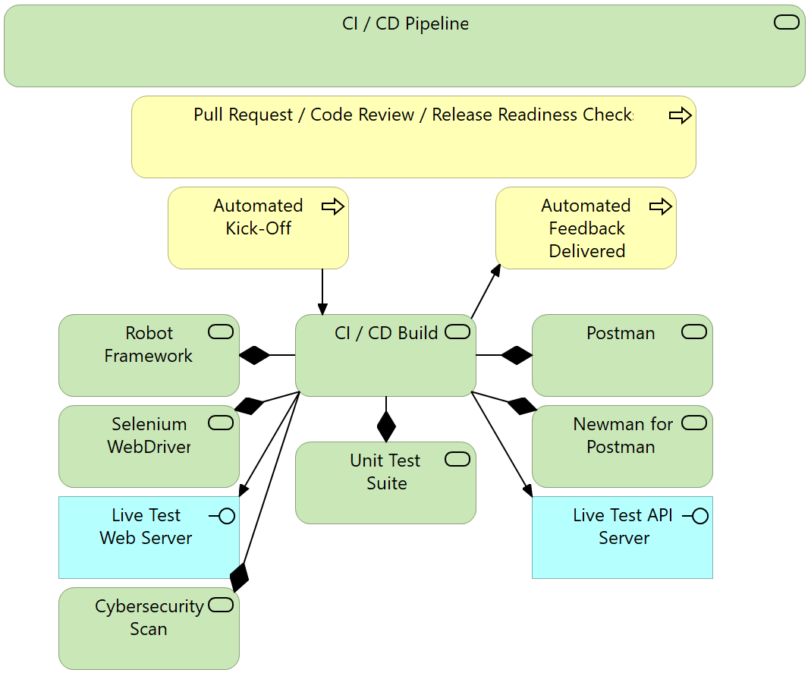
Question: How does this look in a CI/CD pipeline?
https://androidstudio.googleblog.com/2019/02/emulator-2818-canary.html https://appiumpro.com/editions/58-how-to-test-on-headless-emulators-and-simulators-with-appium
Notes:
Ed can answer this question.
There’s lots of tools you can add to a deployment pipeline. This is one excellent option.

Slide 21
References
Repository: https://github.com/techservicesillinois/secdev-robot
HOWTO Guide: https://answers.uillinois.edu/illinois/106384
Android Studio: https://developer.android.com/studio
Robot Framework: https://robotframework.org/
Appium:
http://appium.io/docs/en/about-appium/intro/
https://github.com/appium/appium-desktop
https://github.com/serhatbolsu/robotframework-appiumlibrary

Slide 22
Mobile Integration Testing
With Robot Framework
*END*

