Slide 1
Web Security:
Common Vulnerabilities
Presented by: Edward Delaporte, Programmer for CITES Application Services and Security

Slide 2
Why talk about vulnerabilities?
IT decisions are frequently trade-offs.
Awareness leads to sound decisions.
Shared terminology for future conversations.
It's fun to talk about at parties.

Slide 3
What is a vulnerability?
A vulnerability is anything that causes an application to perform an action not intended under the original intent of the application.
Risks include
  Exposing data
  Harm to users
  Denying access
  Organizational distrust

Slide 4
What are the most common types of vulnerabilities?
The most common types are:
  Cross Site Scripting (XSS)
  Cross Site Request Forgery (CSRF)
  SQL injection
  Buffer Overflow (and underflow)
  Information Leak
Why are they the most common?

Slide 5
Cross Site Scripting (XSS)
Cross Site Scripting is executing scripts on a web application viewed by other users.
This can occur using multiple languages but most commonly is javascript.
Javascript can do anything from changing the page interface to causing permanent server side actions.
Cross Site Scripting can result in a number of outcomes including stealing sensitive data or even crashing an application making it unusable.

Slide 6
Cross Site Request Forgery (CSRF)
Cross Site Request Forgery is abusing the trust between a website and the user.
CSRF can be an XSS attack.
CSRF can be a simple deceptive HTML page.
These attacks usually are an attempt to steal user information, most commonly sensitive data like usernames and passwords.

Slide 7
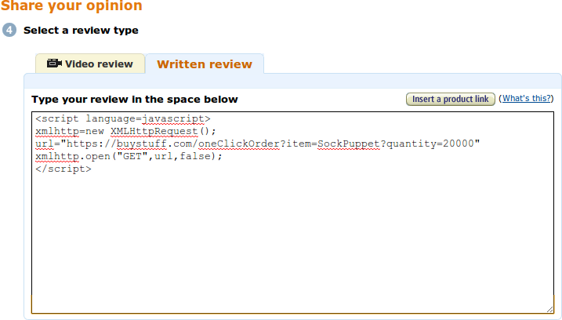
Example CSRF Attack

Slide 8
SQL Injection
SQL Injection is a vulnerability for applications using a database on the backend.
SQL Injection executes a SQL statment on the application database to perform unauthorized opertations. For example, get information beyond what the application provides or what the user is authorized to see, or drop all tables.

Slide 9
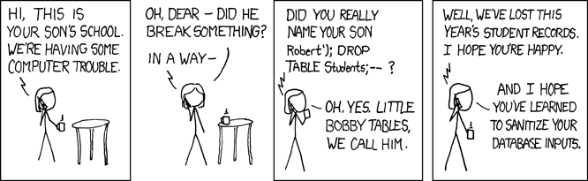
Little Bobby Tables
Did you really name your son Robert'); DROP TABLE Students; - - ?
INSERT INTO Students (name) VALUES ('Robert'); DROP TABLE Students; - - ');

Slide 10
Buffer Overflow and Underflow
Buffer Overflow is when an application data object has a finite amount of space allowed and the application allows for an input to exceed the limit of the space of the object.
Buffer Underflow is similar but opposite: when a data item is maliciously shortened.
  https://paypal.com\00.evil.attacker.com
The result of this type of attack can cause a wide array of issues, including cirumvention of security and execution of arbitrary code.

Slide 11
Buffer Overflow
Example Binary Program
Address | Command
0x023949 | Store some userdata at 0x023951
0x023950 | GOTO 0x023952
0x023951 | << data >>
0x023952 | Do some reads
0x023953 | Do some other writes
0x023954 | Jump to a subroutine
0x023955 | << some other user data >>
0x023956 | Start another subroutine
0x023957 | Do some more reads
0x023958 | Do some more writes
0x023959 | Return from subroutine
0x023960 | << more user data >>

Slide 12
Buffer Overflow
Corrupted Binary Program
Address | Command
0x023949 | Store some userdata at 0x023951
0x023950 | GOTO 0x023952
0x023951 | NO-OP
0x023952 | NO-OP
0x023953 | NO-OP
0x023954 | NO-OP
0x023955 | NO-OP
0x023956 | NO-OP a subroutine still starts here
0x023957 | NO-OP
0x023958 | Try to overwrite root password
0x023959 | Try to rewrite web root files
0x023960 | Phone home to attacker

Slide 13
Information Leak
Information leak is a vulnerability caused by an application not controlling data propely.
Information leaked can be in the form of user data or information about the application exposing another vulnerability.
In most cases this type of vulnerability is caused by improper error handling.

Slide 14
How to prevent
In General...
  Awareness
    Know the possible vulnerabilities.
    Know what you have running.
  Sanitize all of your inputs
    GET and POST data
    Any uploaded file
    AJAX, SOAP and XMLRPC calls
  Use a framework – Frameworks are designed to make coding easier and often will do a lot of the work of sanitizing or escaping data for you.

Slide 15
How to prevent (Cont.)
More Specifically...
  A great way to prevent SQL injection is to prepare your statments on the server. Preparing your statments changes the SQL executed on the server to be parameterized. This means no arbitrary SQL can be executed.
  Buffer overflow and underflow can be prevented by checking the bounds of your objects.
  Information Leak can be prevented by restricting the amount of data provided on any message to the user. Keep sensitive information out of errors and turn off debug mode. Do not use line numbers or specific exceptions from the code.

Slide 16
Resources
Frameworks
  Django or Zope for Python
  CodeIgniter for PHP
  ASP.Net
  Struts and/or Swing for Java
Parameterization libraries
  PHP: By database. (pg_query_params, mysqli::prepare)
  Perl: DBI (Database Interface)
  .Net: Active Data Objects
  Java: JDBC (Java Database Connectors)
  Python: By database. See PEP-249 for standards.

Slide 17
Resources
Vulnerability resources
  Secunia http://secunia.com/
  US CERT http://www.us-cert.gov/
Educational Resources
  OWASP http://www.owasp.org/
  Carnegie Melon Software Engineering Institute http://www.sei.cmu.edu/
  Spot the Vulnerability http://spotthevuln.com/
  Pwn2own contests

Slide 18
Summary / Question Time
The threat is real.
Being aware is the first step.
Some of the best mitigations are actually easy.
Feel free to send questions to securitysupport@illinois.edu

