Slide 1
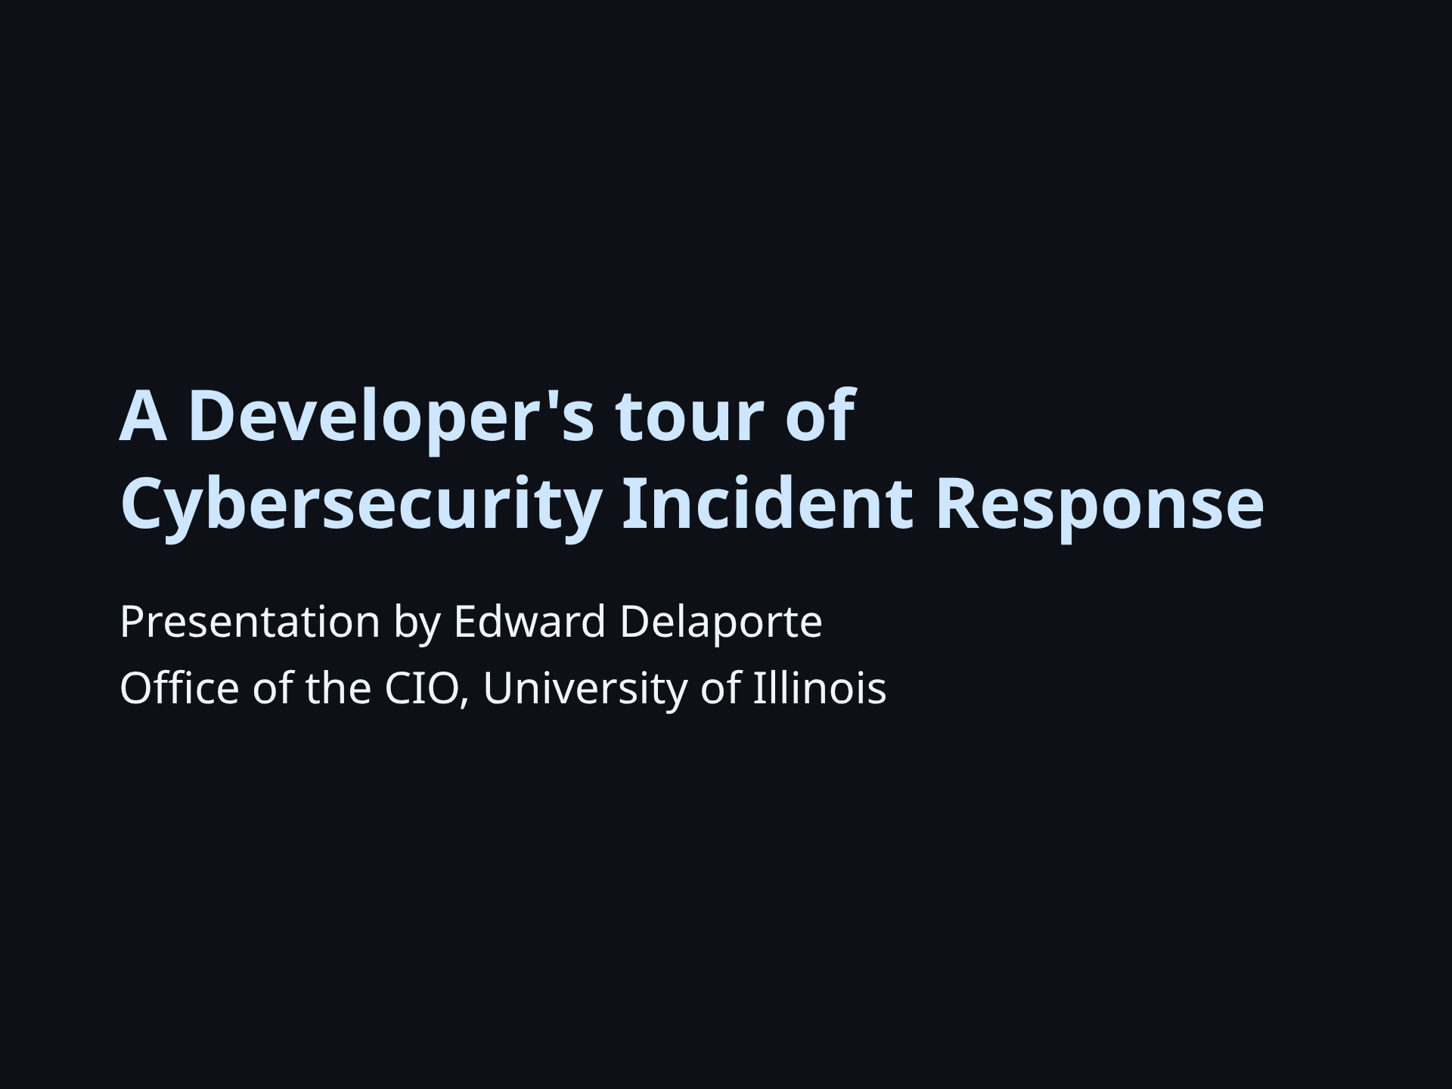

Slide 2
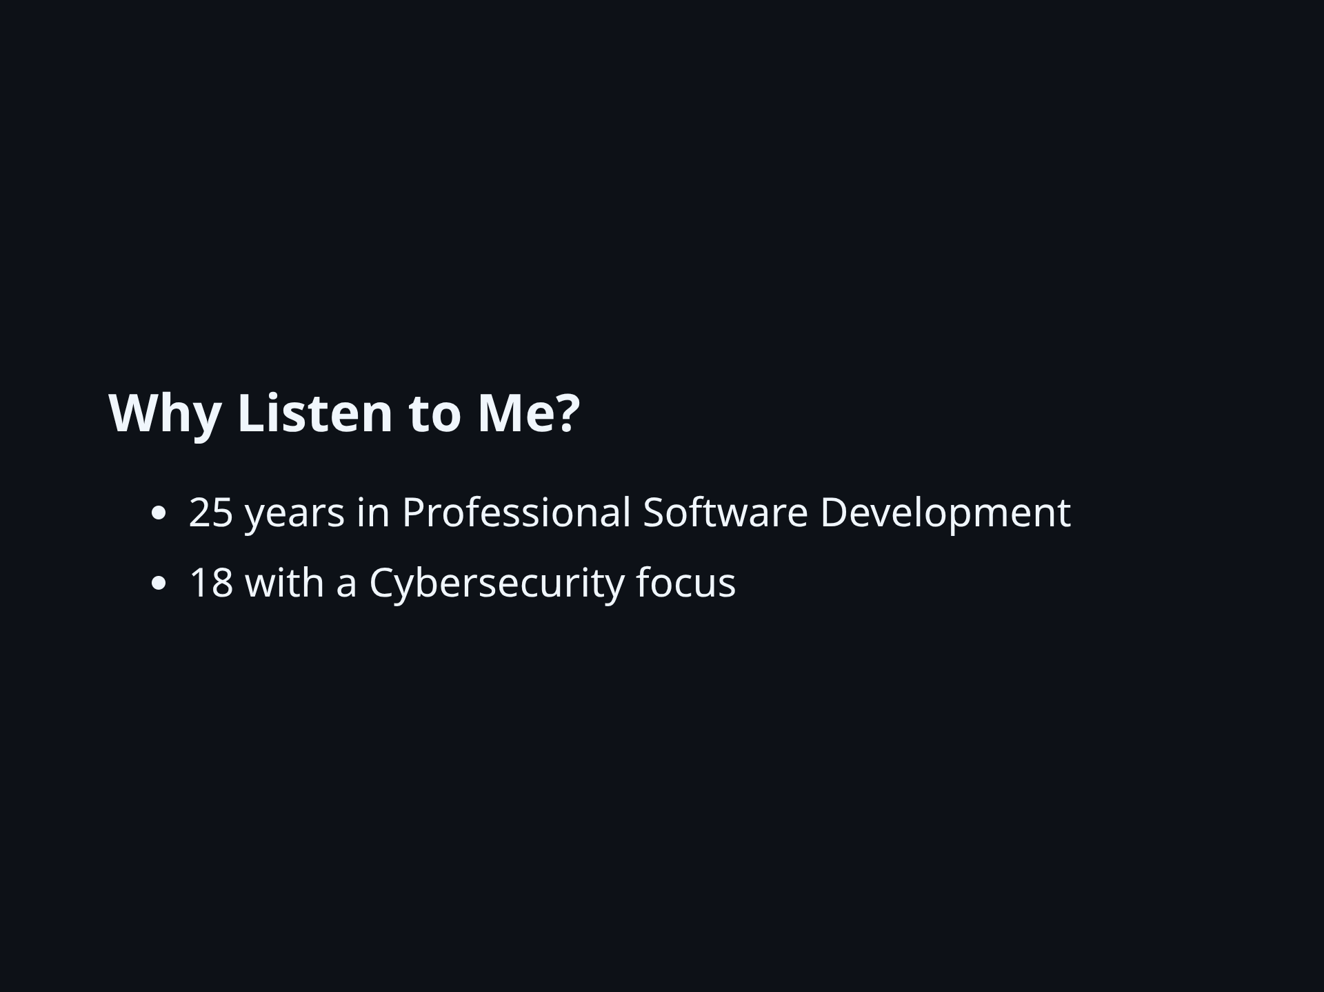
Notes:
It have been my privilege to think hard about the intersection of Cybersecurity and pragmatic development for many years.

Slide 3
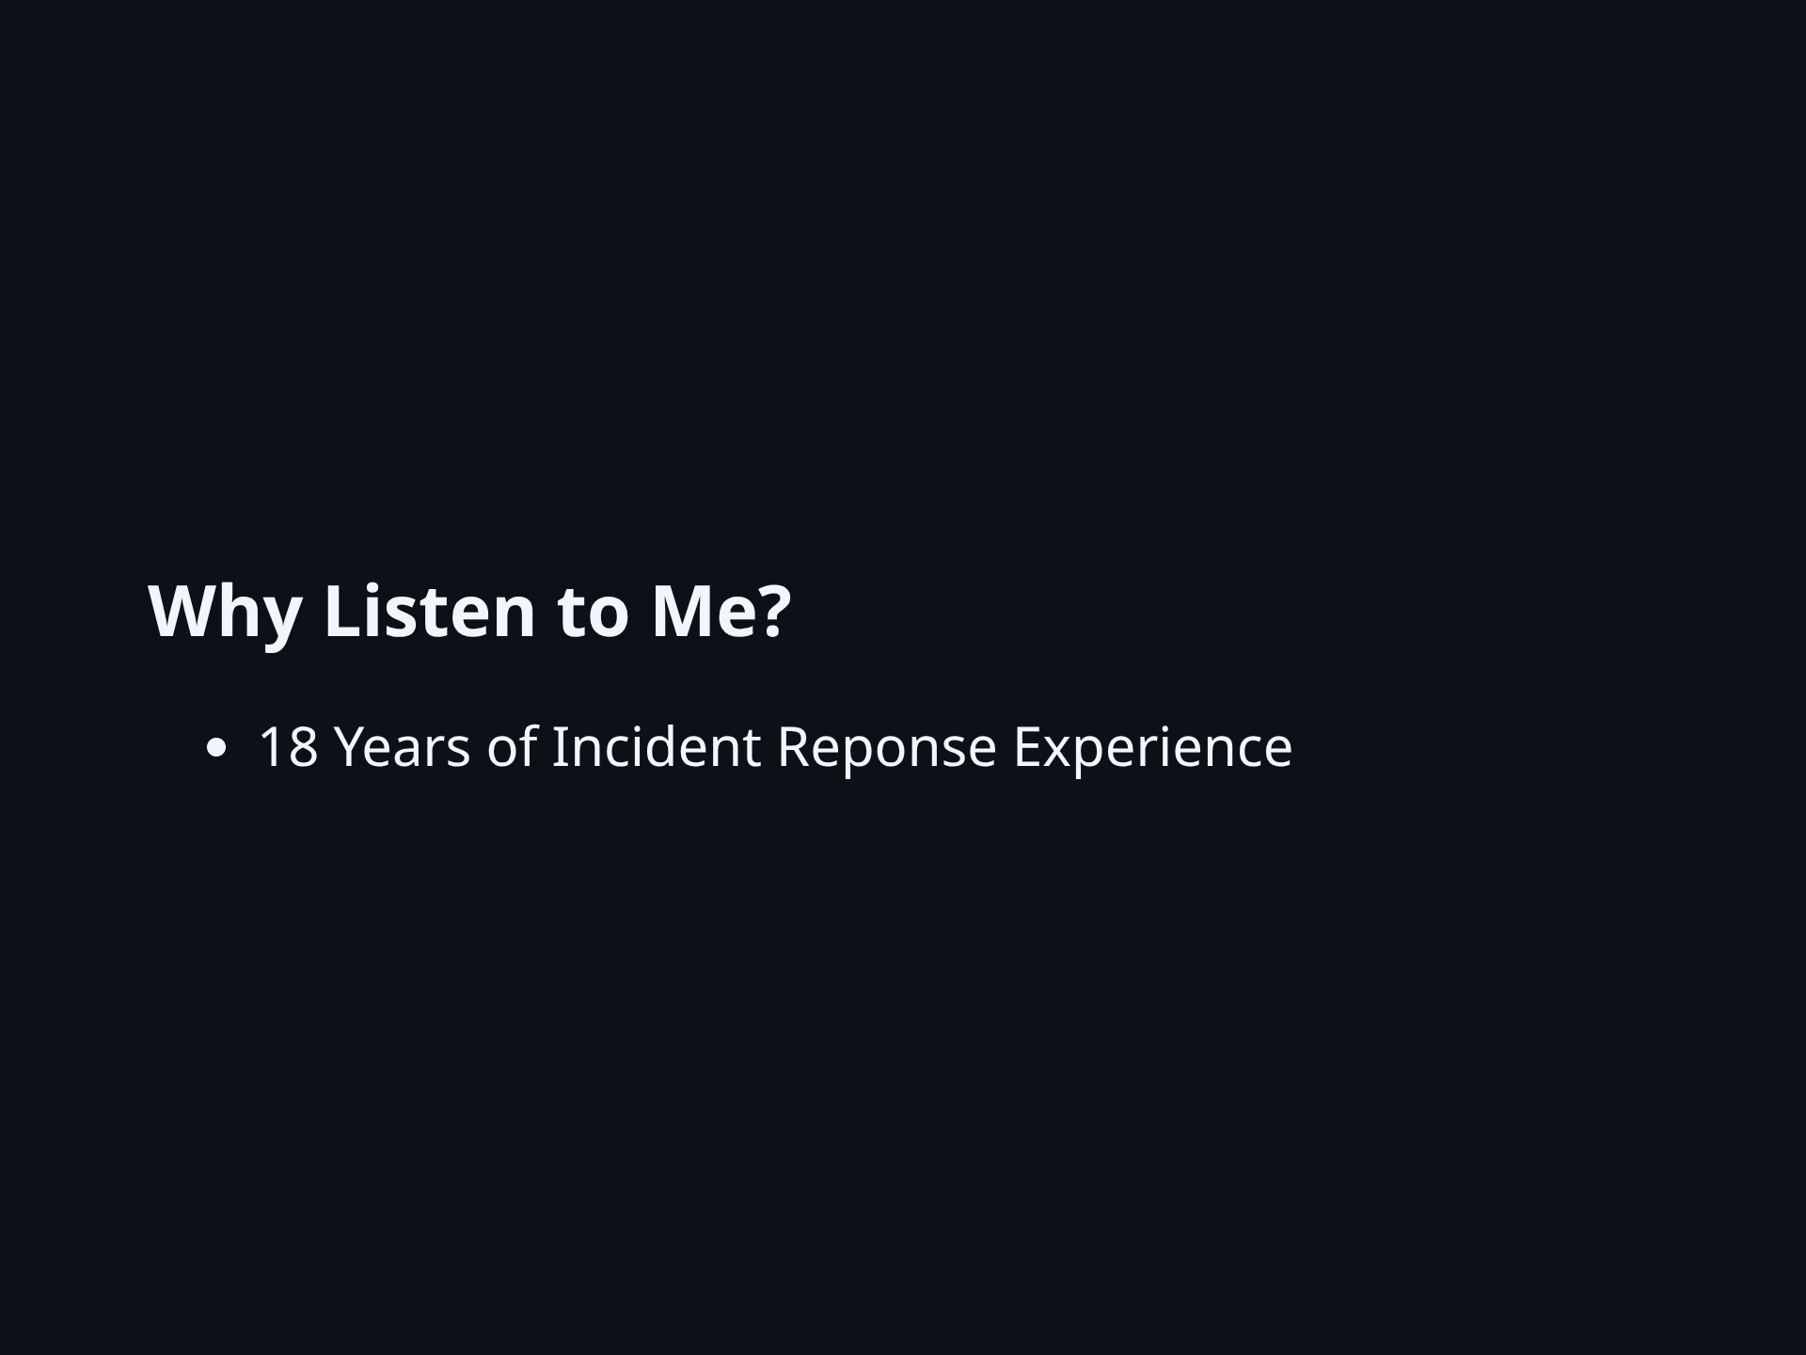
Notes:
- I'm one of the developers who get called in during a security incident involving code in a custom application. - Campus averages one such incident each year. - This can happen to any of us. - There's a good chance I will be there to help.

Slide 4
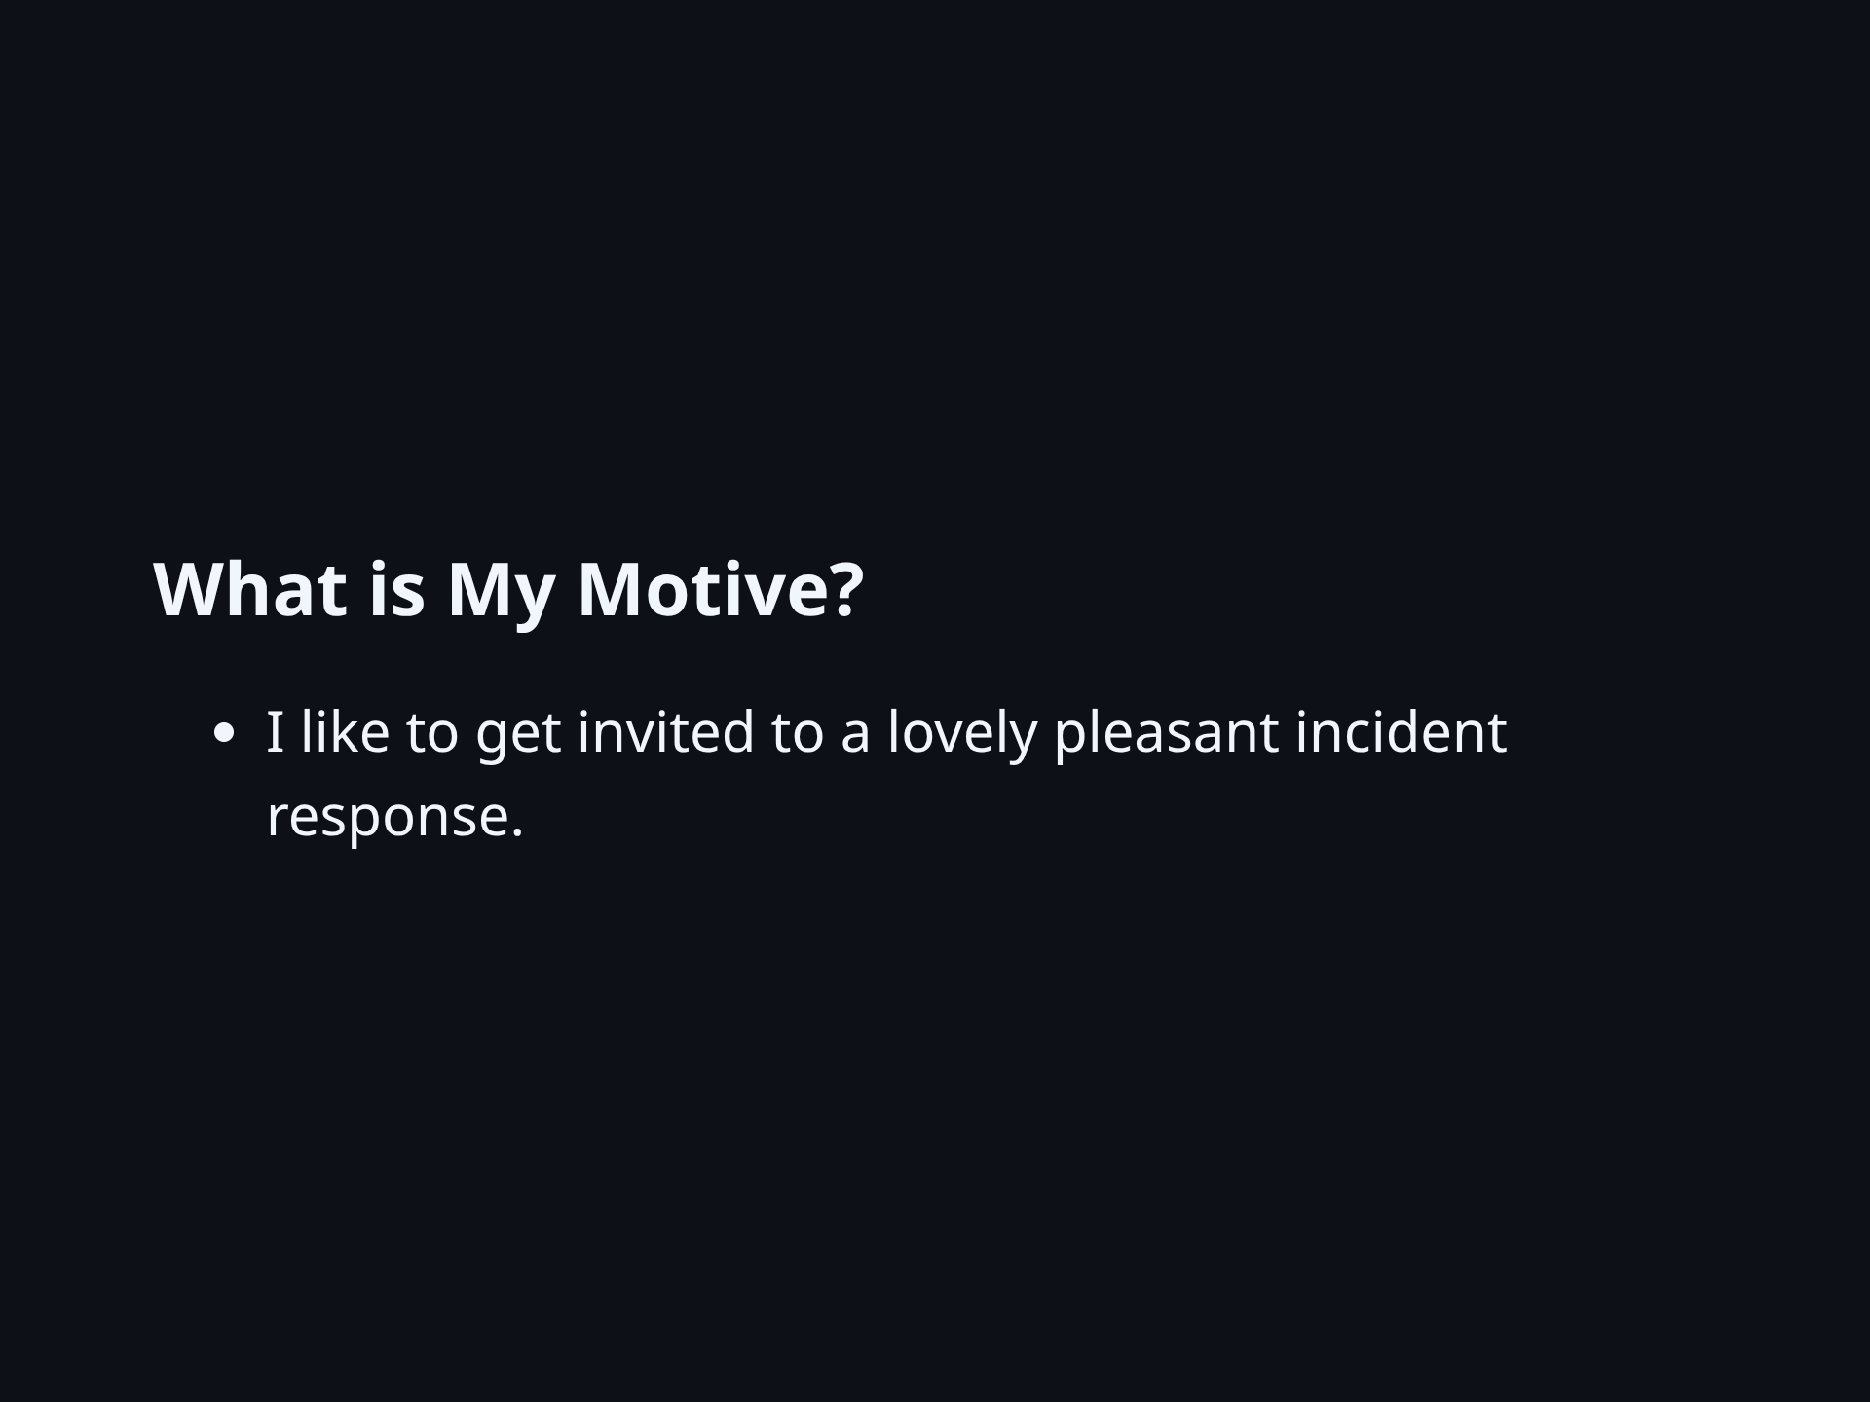
Notes:
- Yes, it is kind of sad that I have strong preferences for incident response events. - In a lovely incident response: - Compromised keys have been rotated before I even join the call. - Even though the compromised keys didn't have access to much. - We know from the logs that very little was accessed. - Deploying the fix is automated and easy.

Slide 5
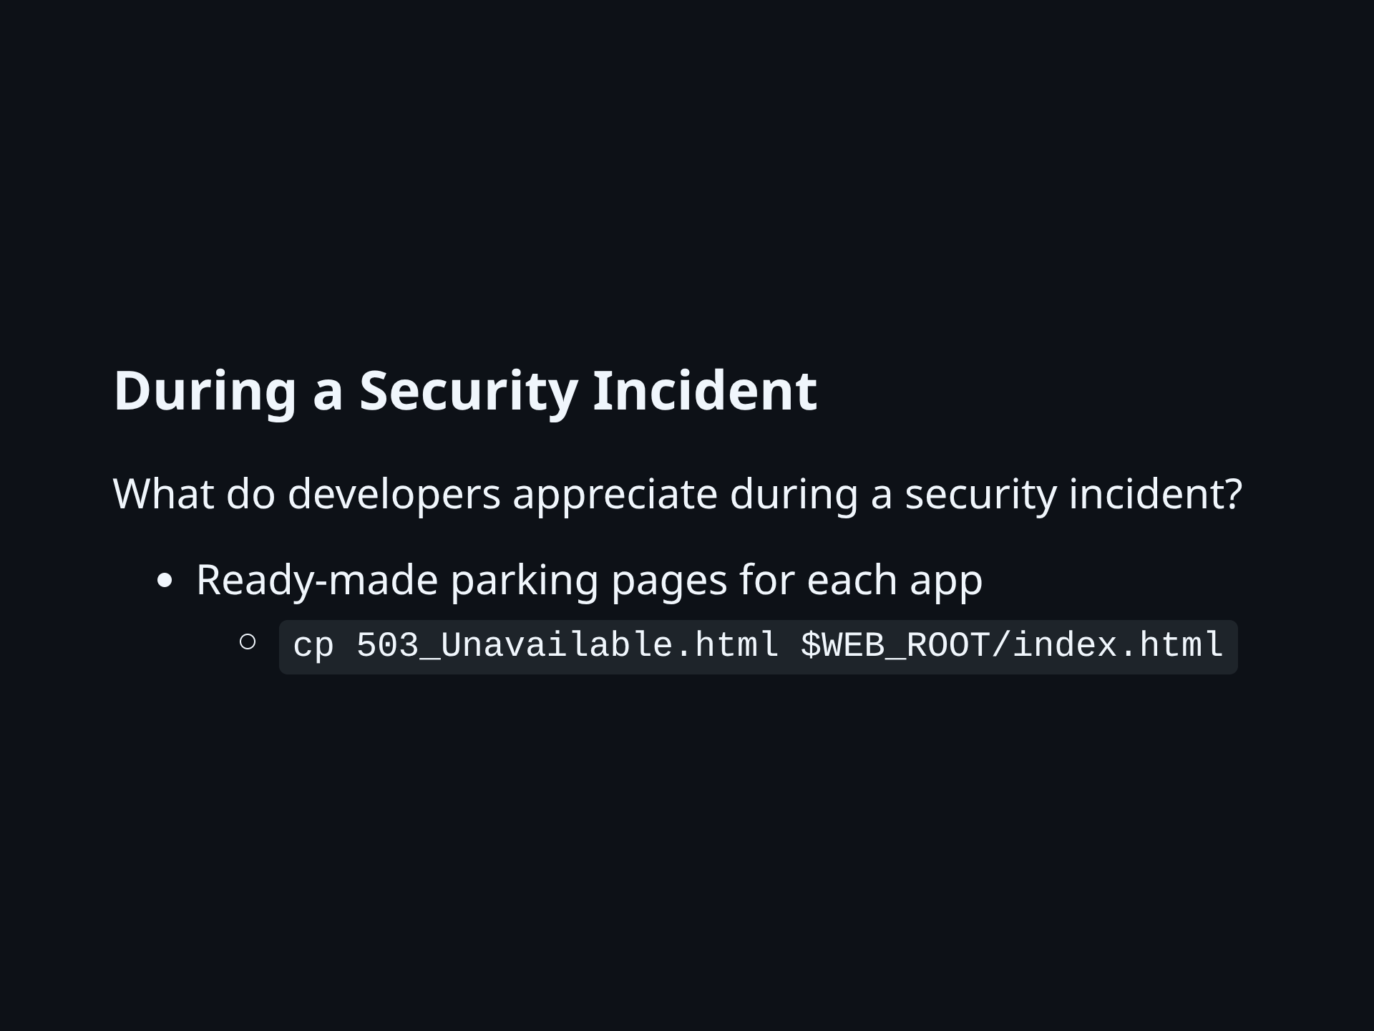
Notes:
- I write my 503 page in advance - I have decided to choose a brief app outage over potential ongoing damage. - My favorite framework may not be available to add HEADER and FOOTER

Slide 6
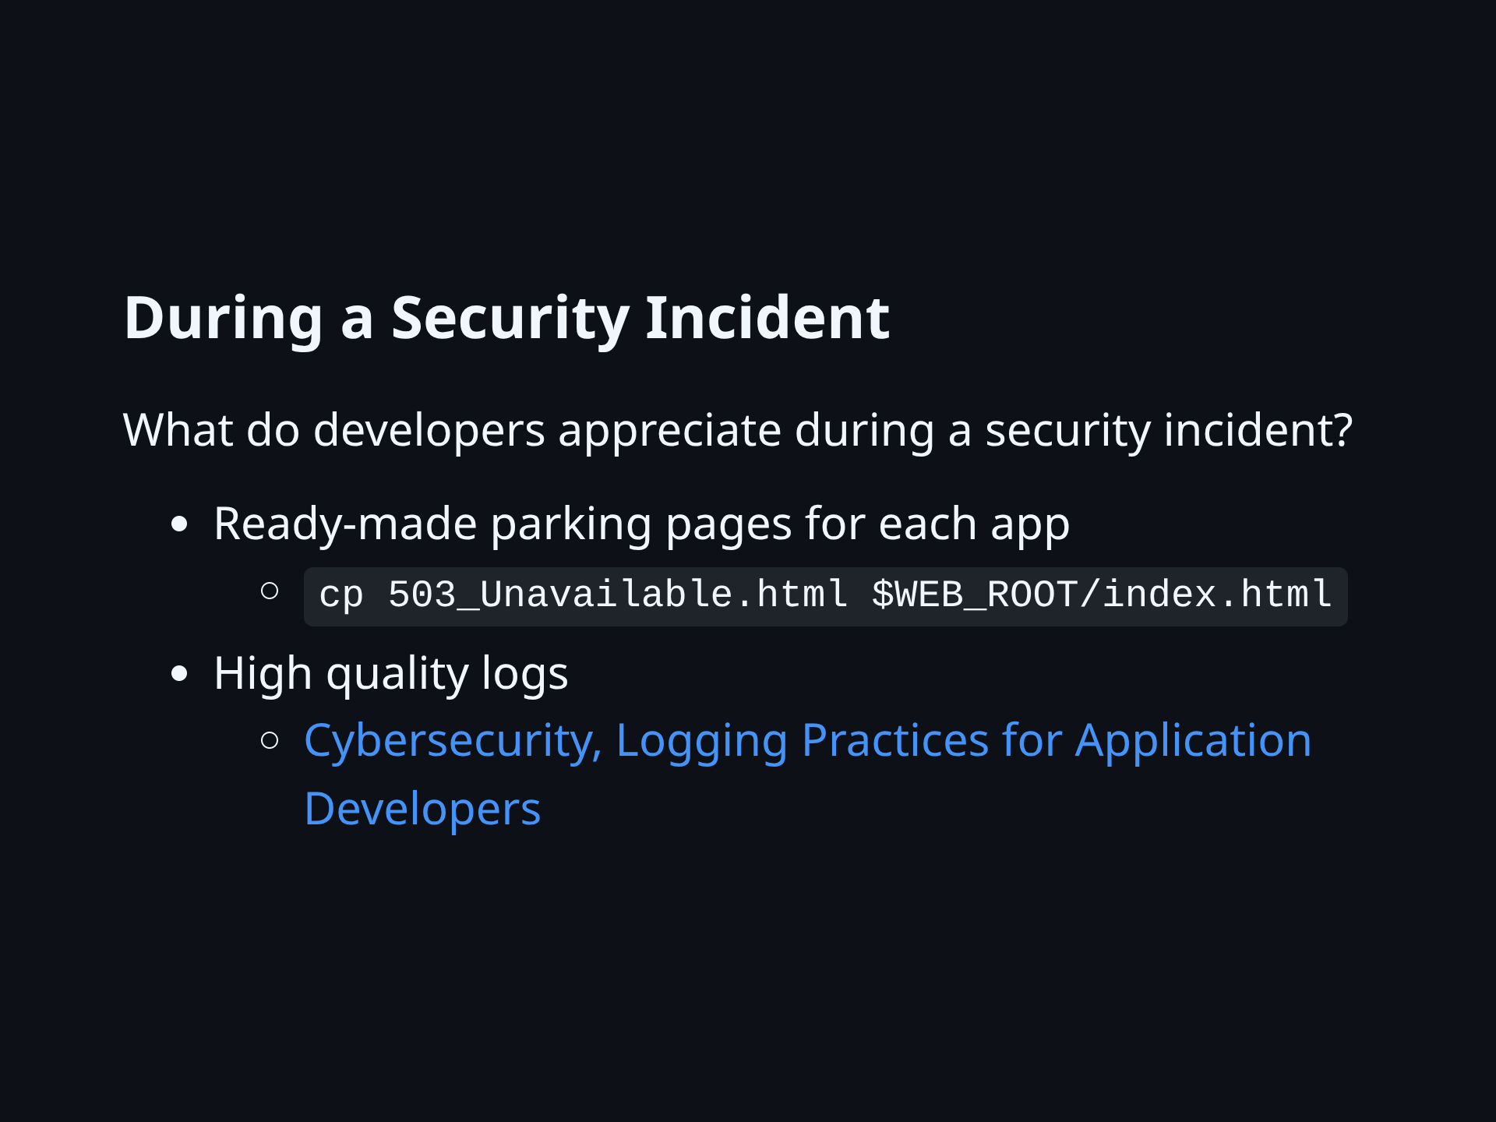
Notes:
- I have used excellent logs to make strong statements to leadership - I have linked to detailed logging guidance from experienced developers

Slide 7
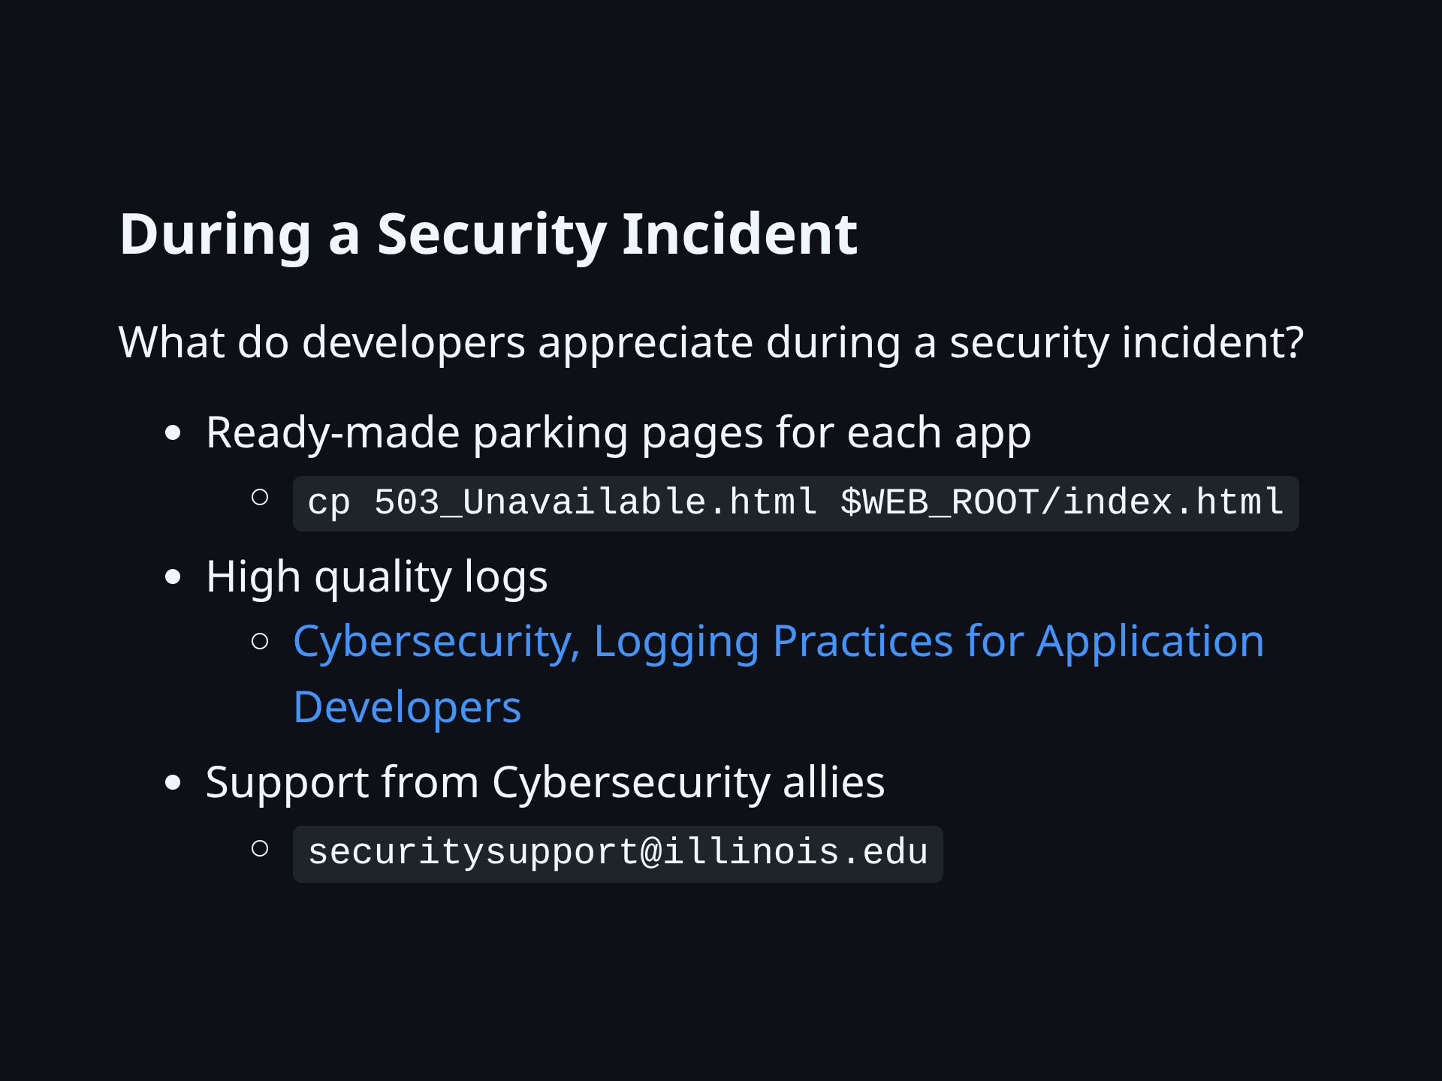
Notes:
- Start by contacting security. - However bad it is, we can help minimize the damage. - I use my communications team - To the public, I use the word 'outage', not 'security incdient', until comms says - I keep my Cybersecrity Liaison in the loop - It helps to know who your Cybersecurity Liaison is, in advance - Look for the Teams group and 'request access' if you want to join. - Full time IT professionals are welcome to join

Slide 8
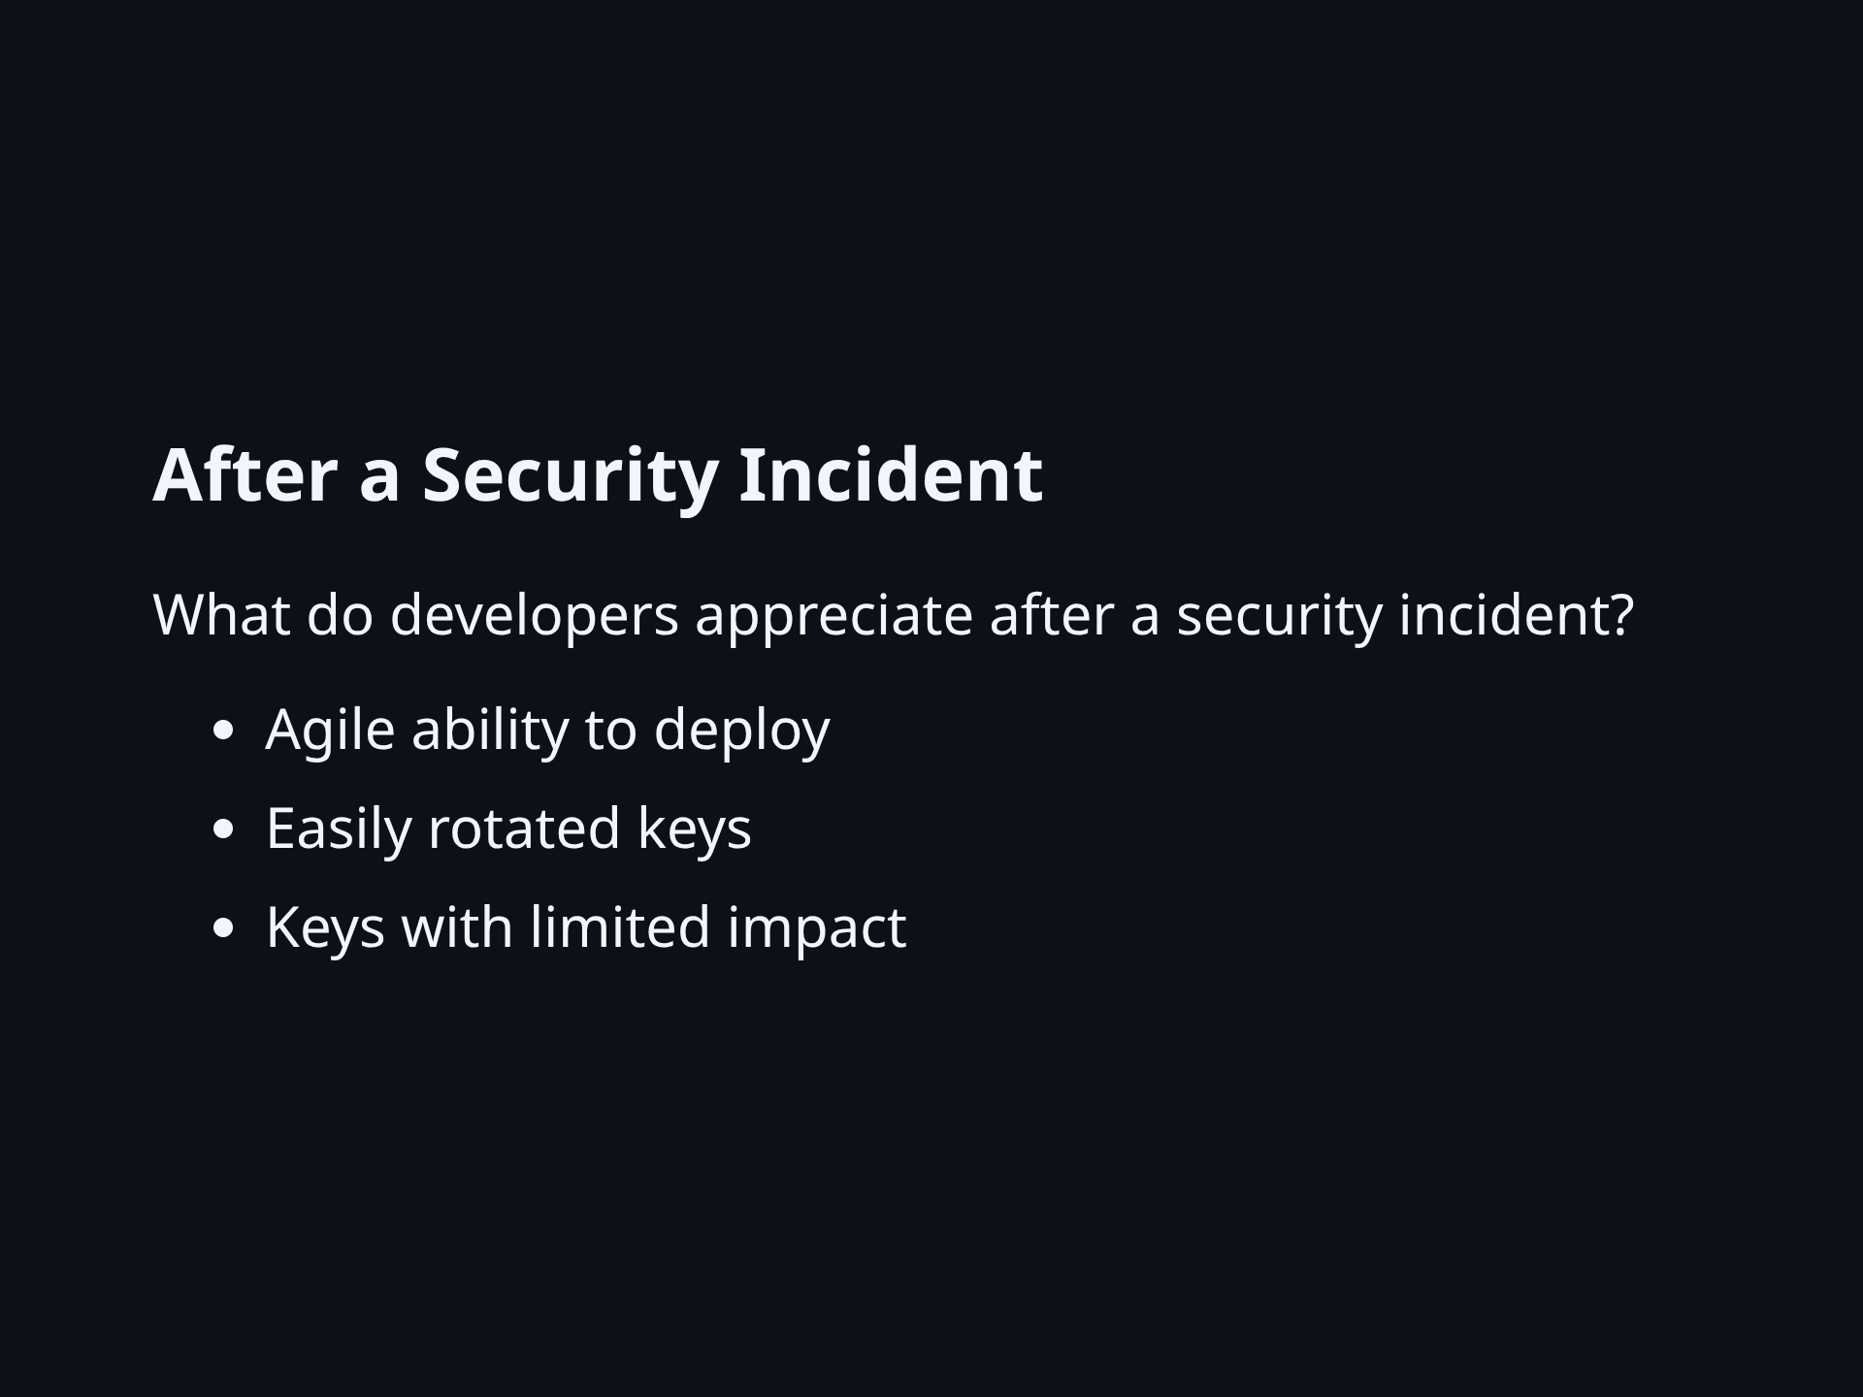
Notes:
- No one wants a stressful deploy against the clock for a simple security fix - Painful: "How many places is this password used?" - Lovely: "Just this one service will restart" - Lovely: "I already followed our 'how-to' document to rotate the affected keys"

Slide 9
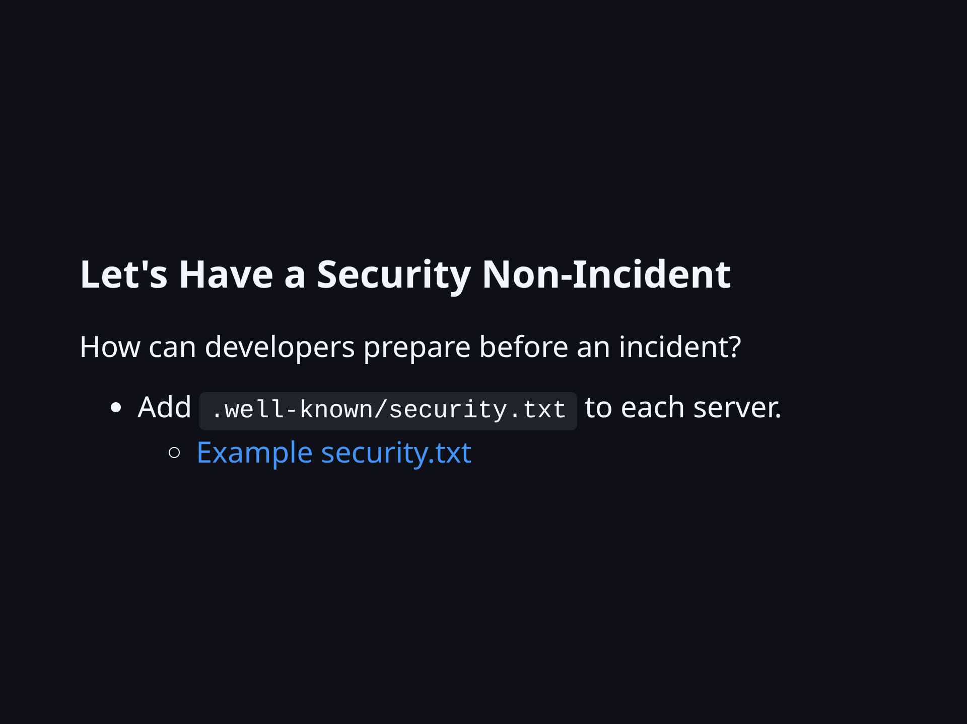
Notes:
- I wrote commit log for you. - My team wrote good enough `security.txt` file content. - I will personally thank your responsible discloser - if they disclose privately, giving you time to remediate.

Slide 10
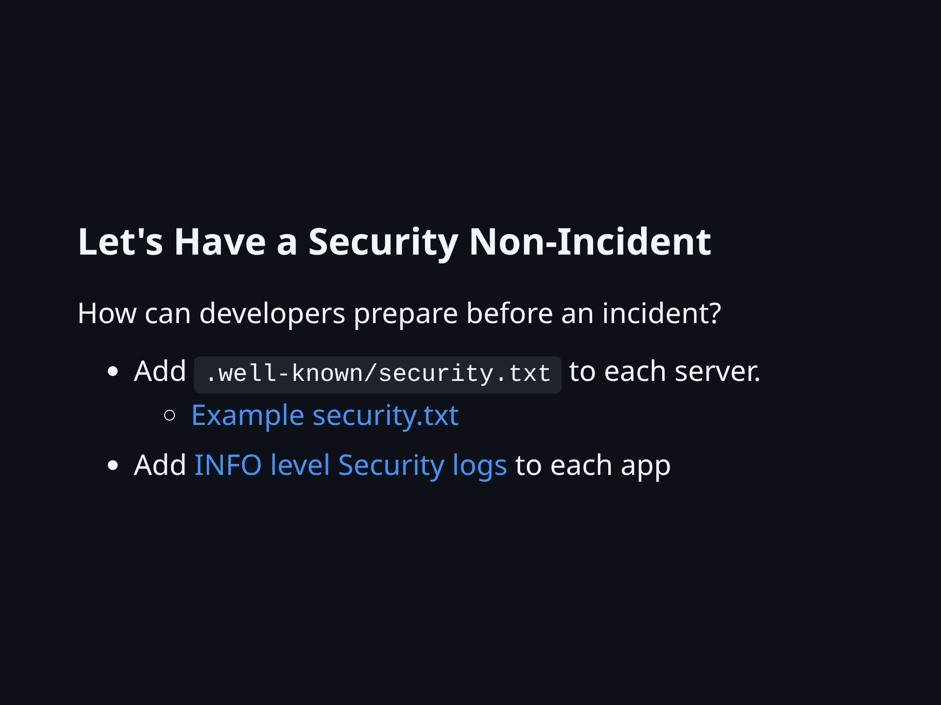
Notes:
- Nothing will save your organization more time and money after a breach than great logs - Know what to log at INFO level - Writing security logs is writing a love song to my future self

Slide 11
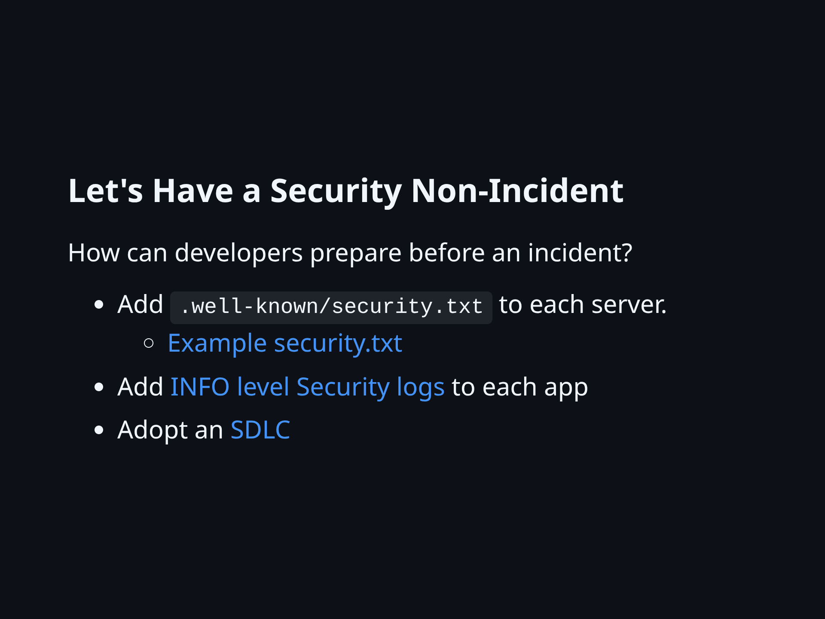
Notes:
- Great process shines during hard times - I'm preaching to the choir - Linked are some places to get started

Slide 12
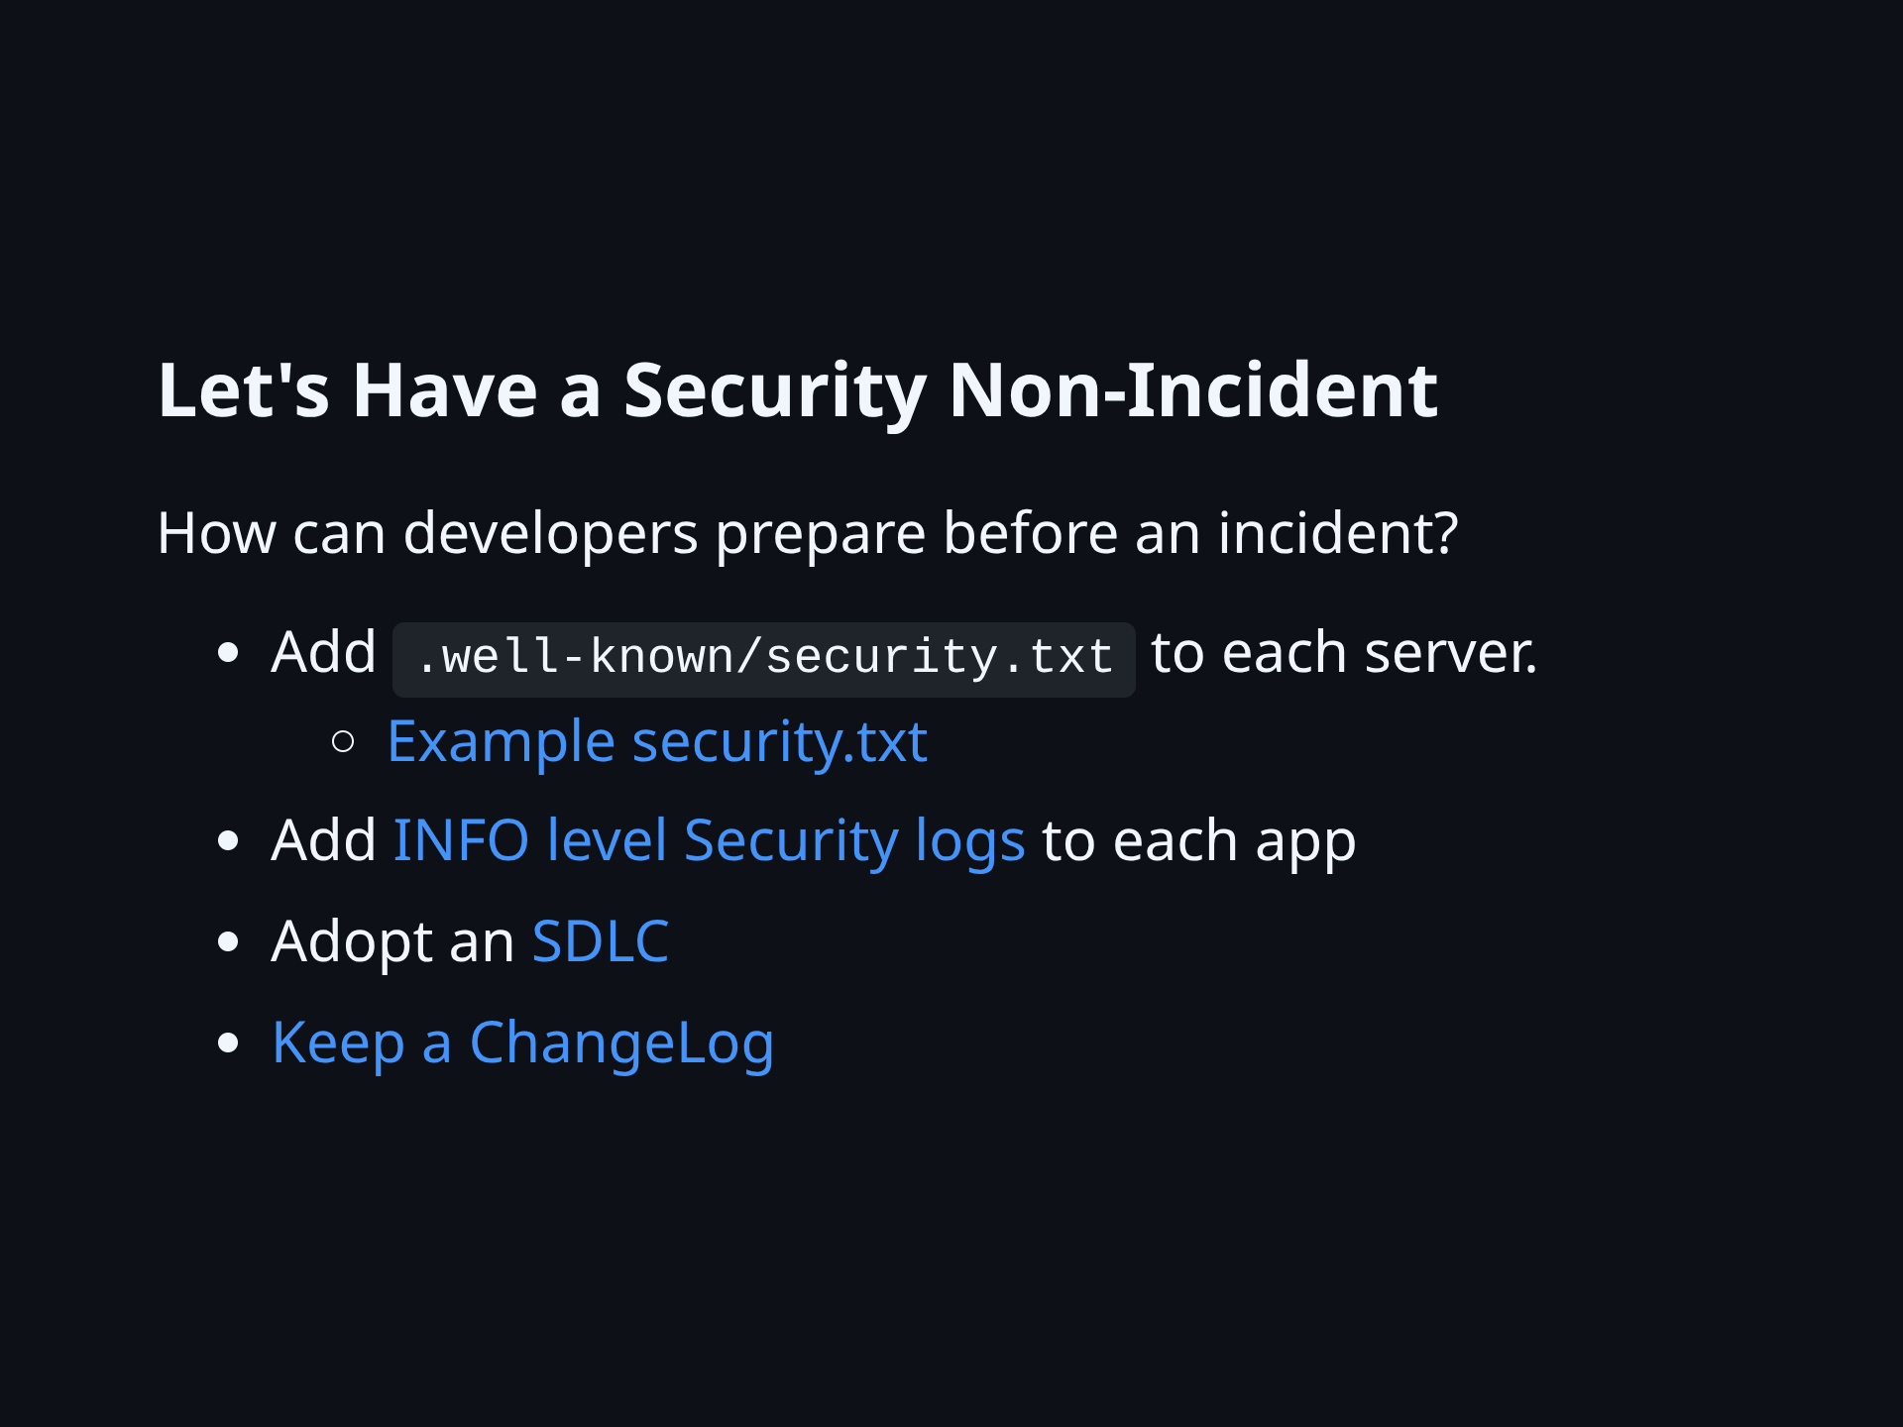
Notes:
- I've had CHANGELOGs save my ass - "When did this bug get introduced?" - "Is there a version of this app that we can deploy right now that does not have this bug?"

Slide 13
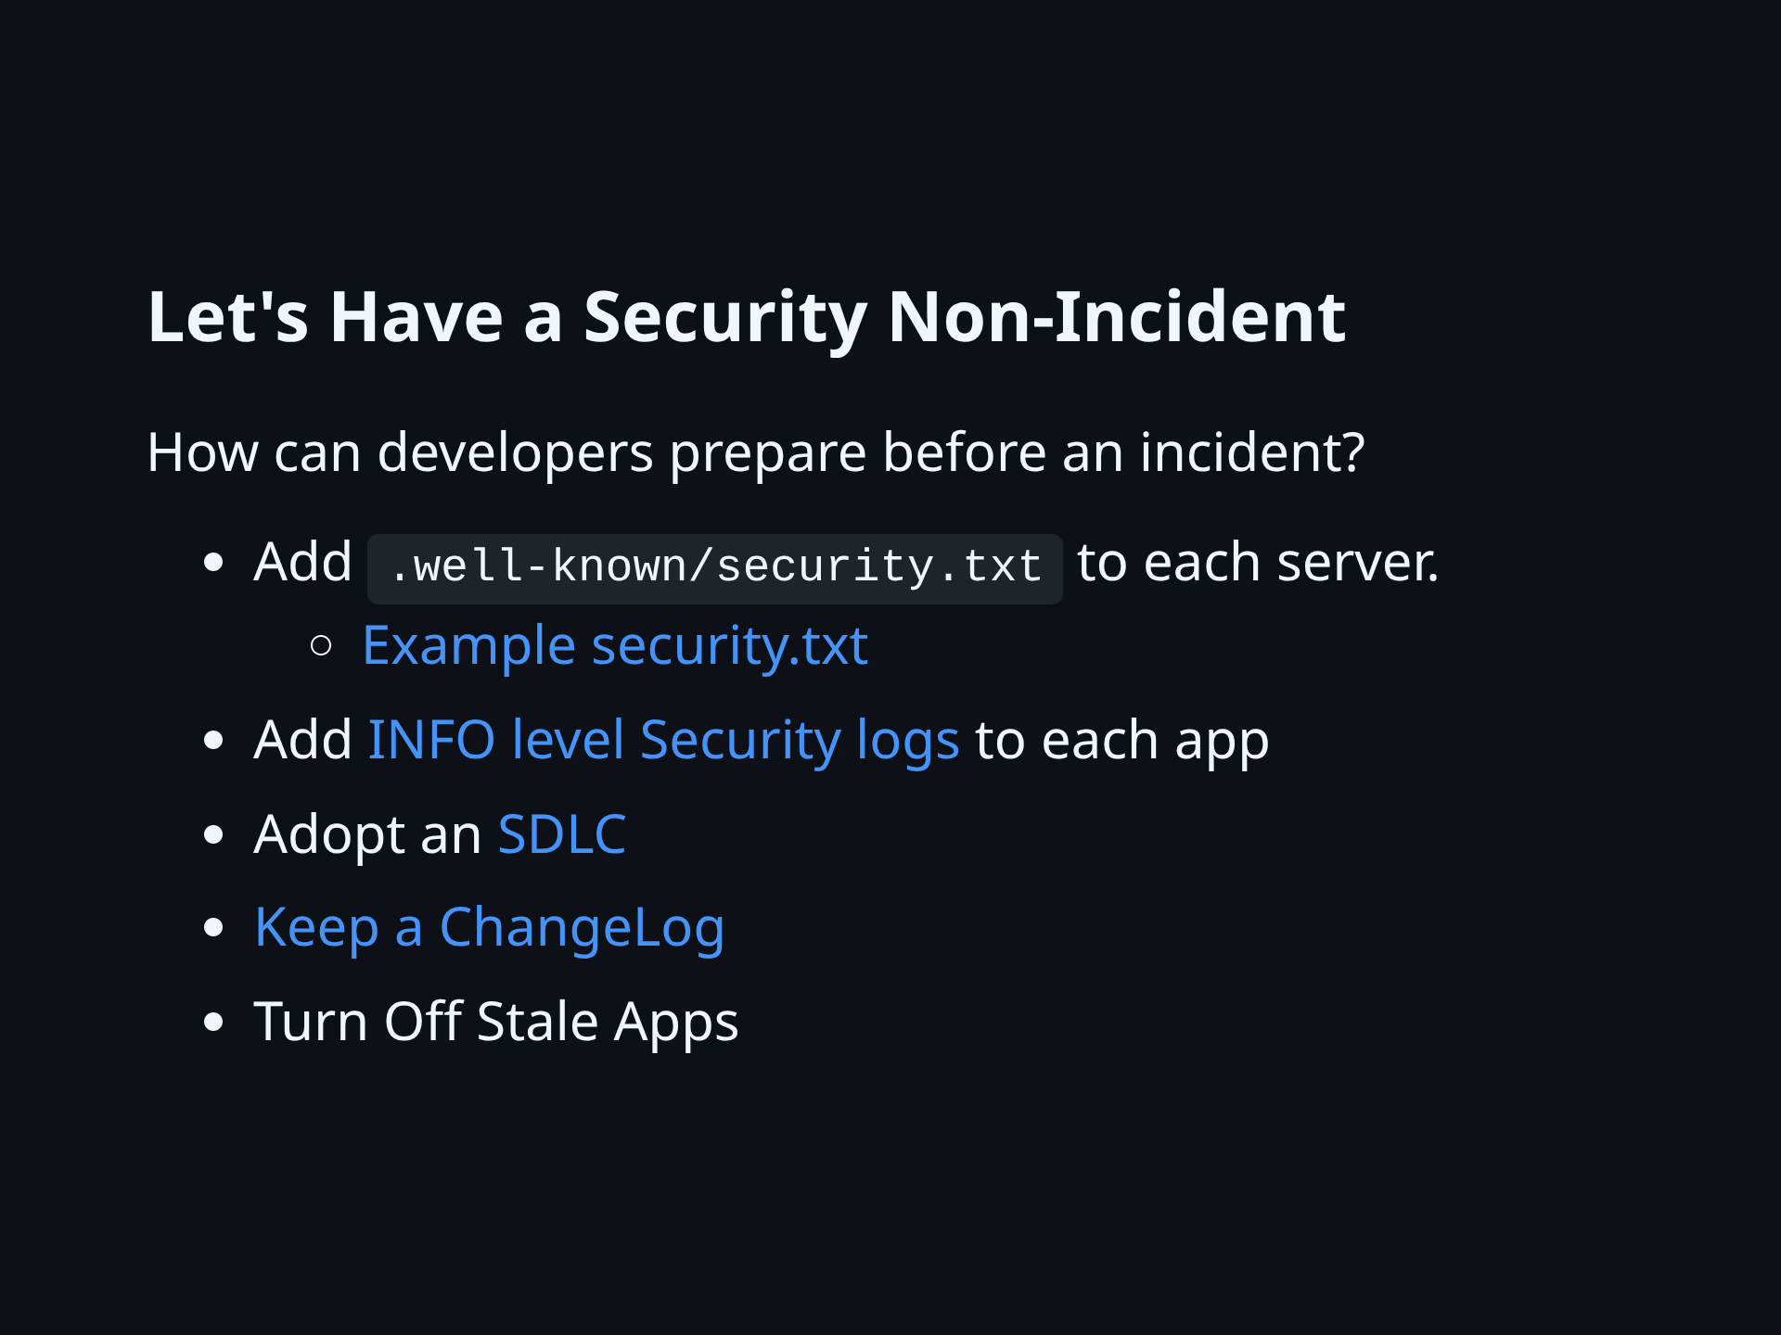
Notes:
It's so easy, right? Just turn off stale apps. Users and leaders are always so supportive of turning things off.

Slide 14
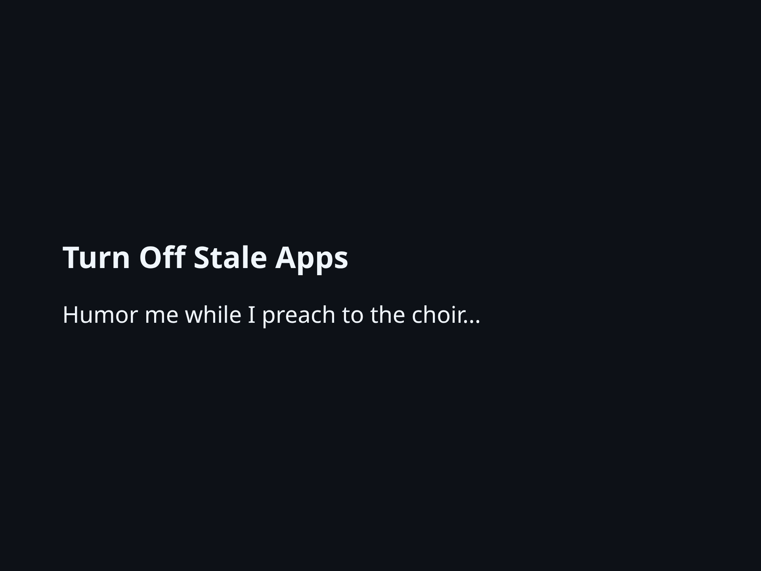
Notes:
There are many reasons to despise stale apps. Now you can add mine to your list: - Vulnerabilities are common in stale apps - Vulns are often *critical* in stale apps - Stale apps tend to be: - hard to patch - hard to re-deploy - hard to update - But people keep using them...

Slide 15
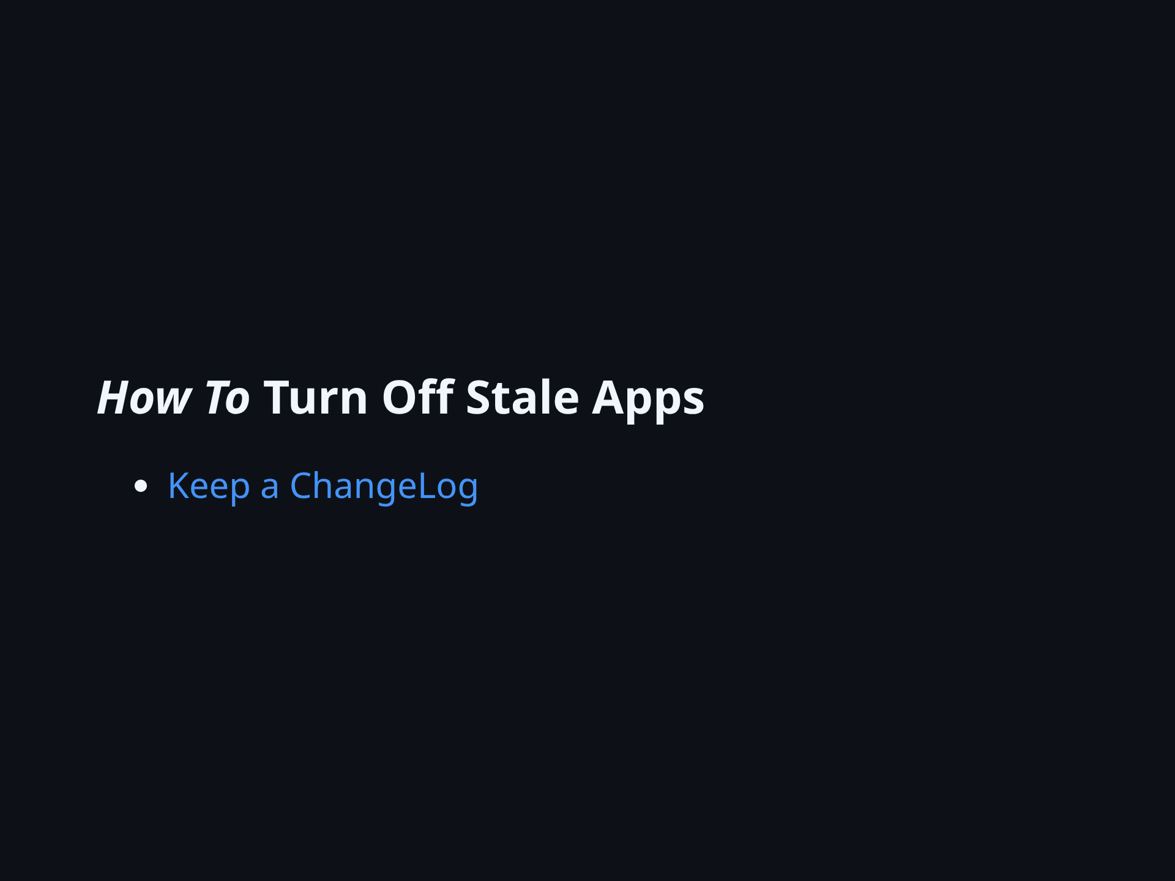
Notes:
I find my CHANGELOGs to be life savers when deciding whether to replace or abandon a stale app. - How long ago did we update this? - Do we need all of these features? - Can we replace just some of this? A good CHANGELOG is effectively a feature list.

Slide 16
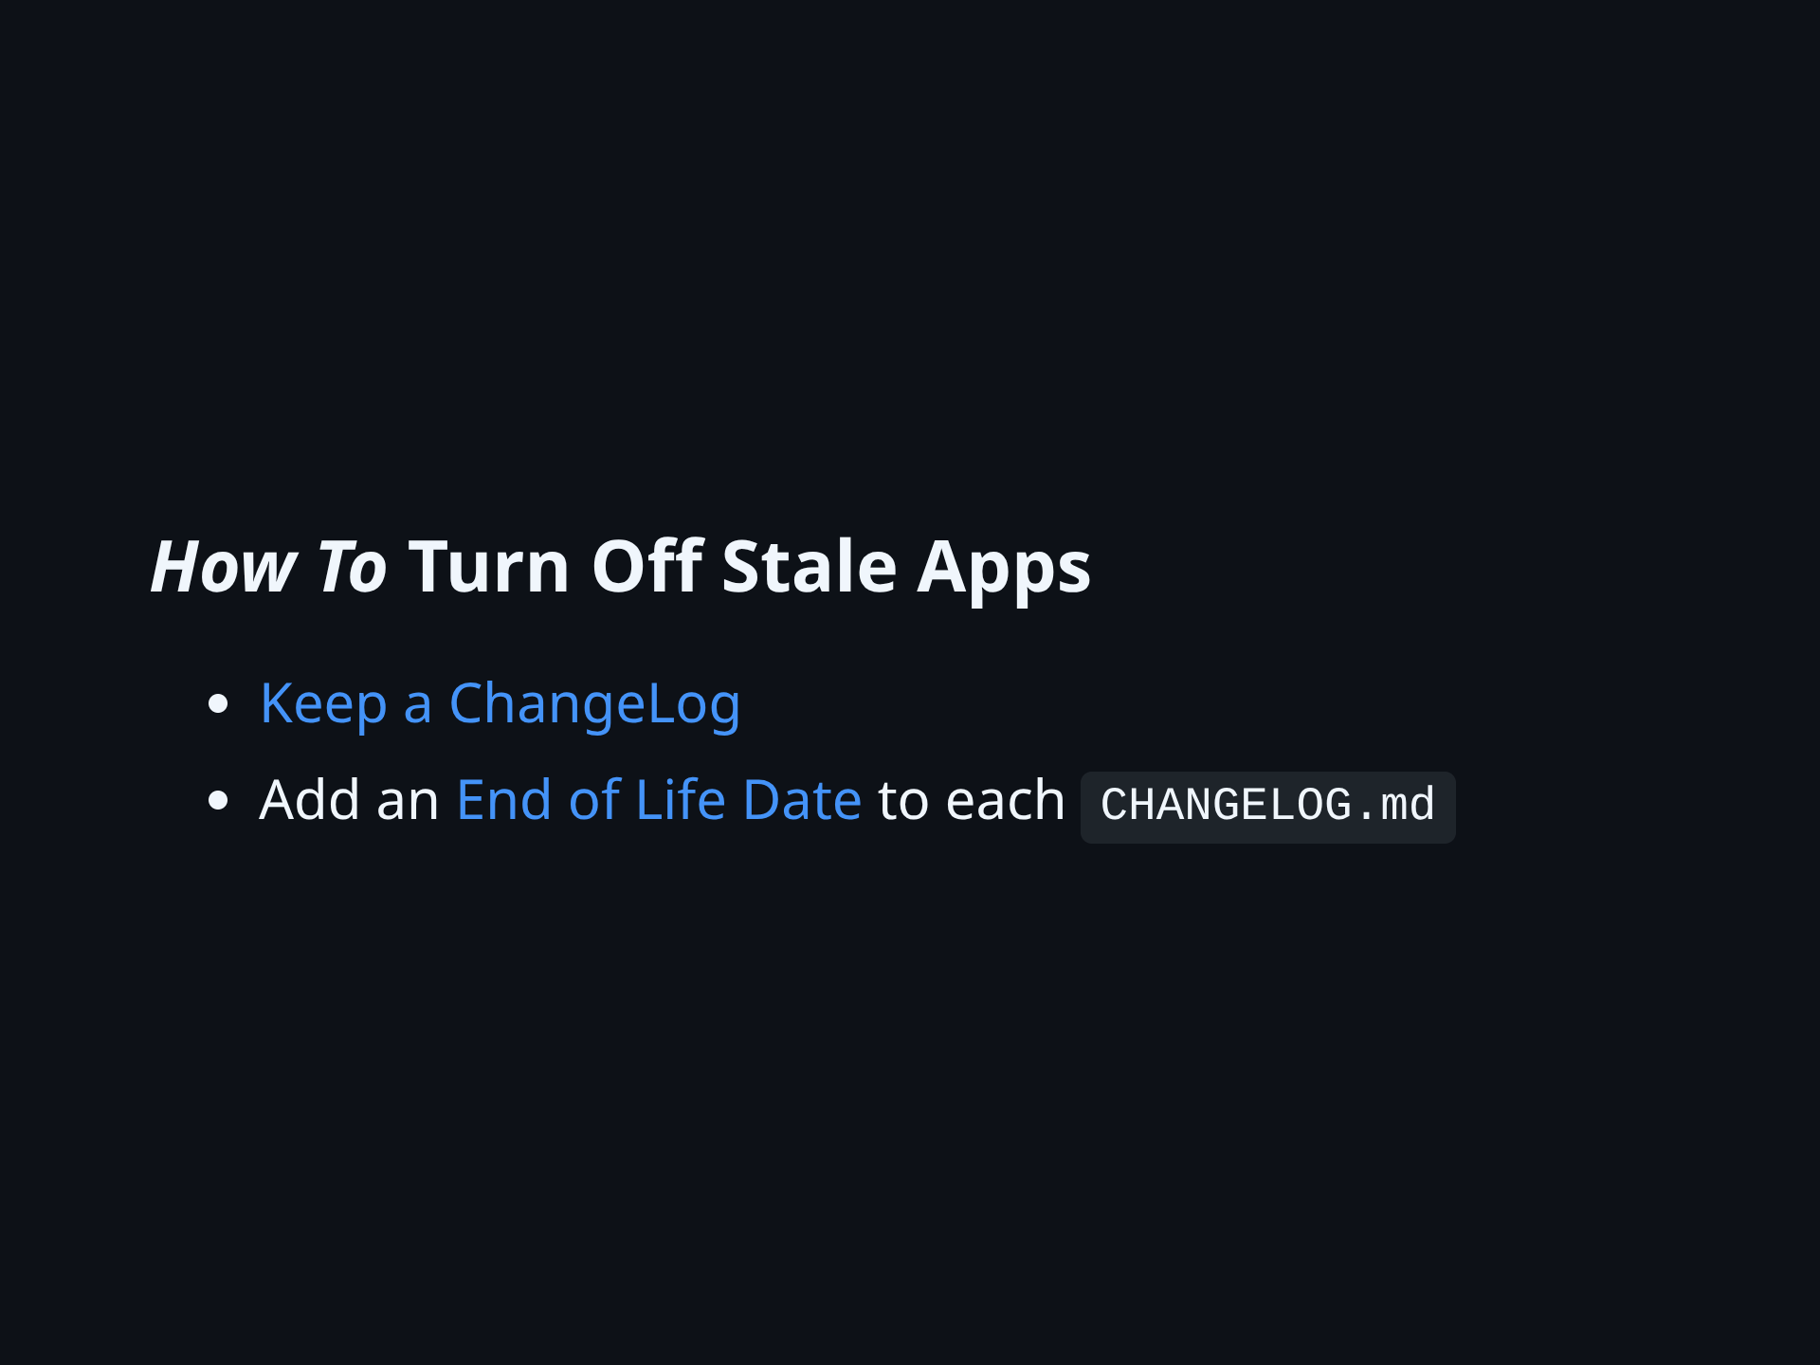
Notes:
Why document expected end-of-life? - helps kill apps that make developers (and security teams) lose sleep - I use end-of-life dates to support my hiring efforts. How?

Slide 17
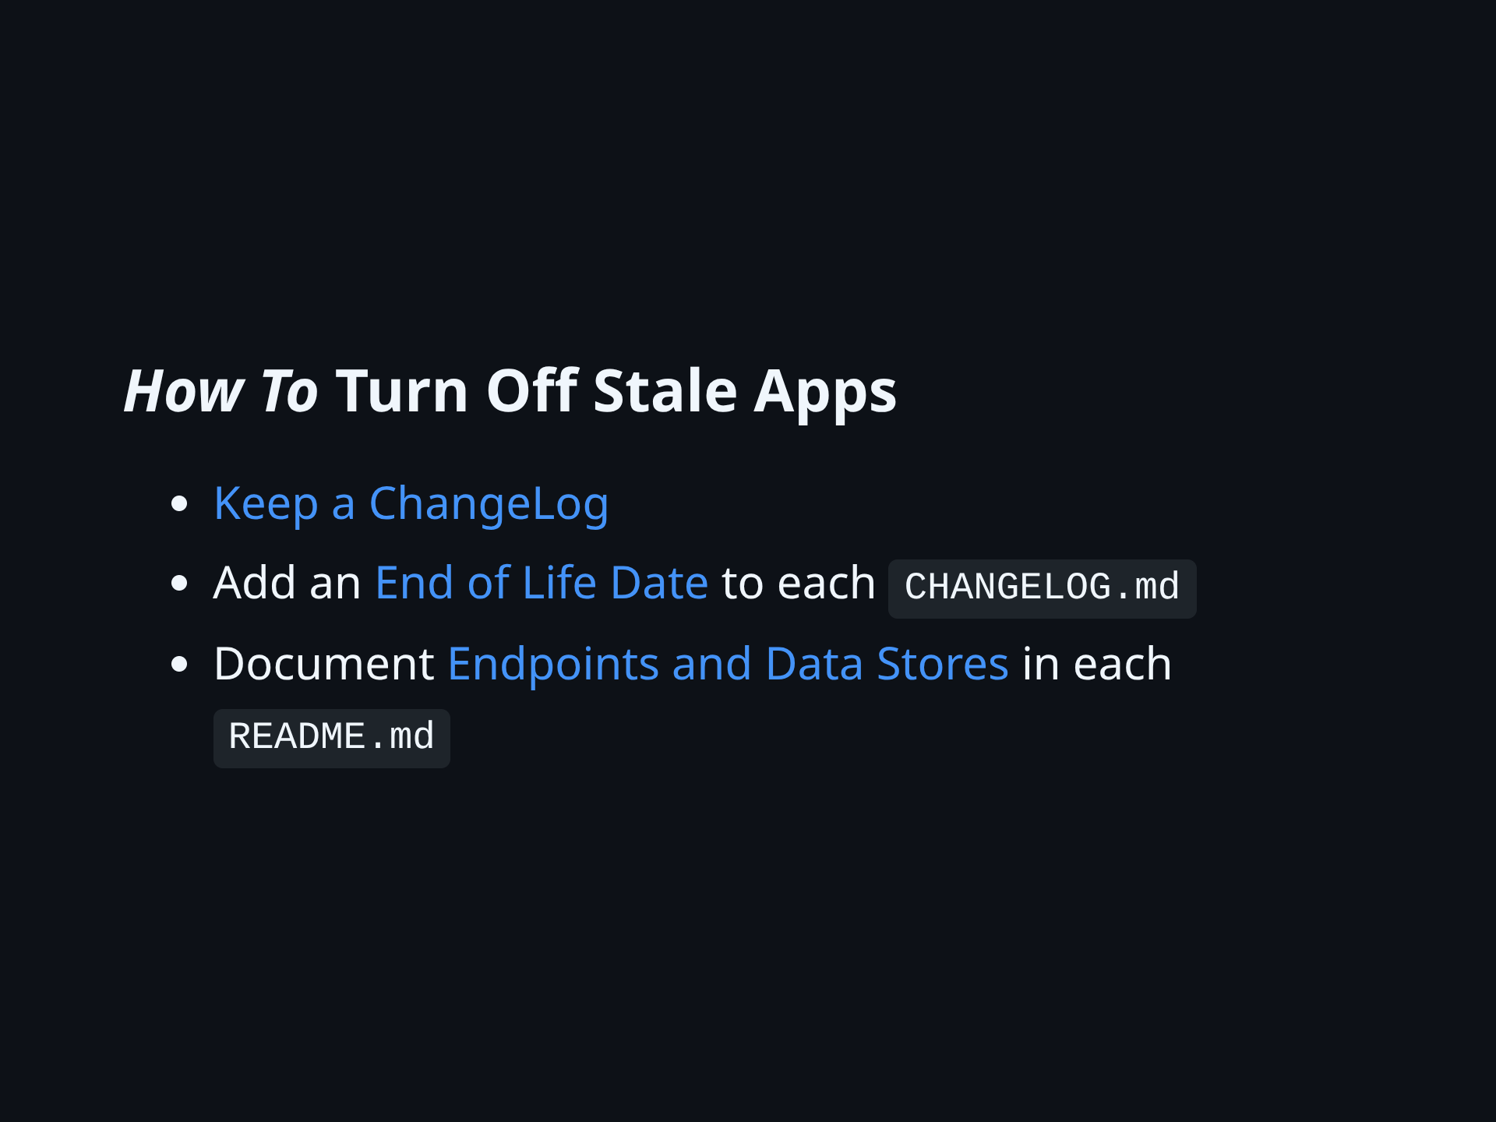
Notes:
"Can we turn this off?" starts with knowing who to talk to about the data and the connections. Campus IT Standards require this information to be documented, anyway. CHANGELOG tells us 'what it does' Endpoints and Data Stores tells us 'what does it talk to?'

Slide 18
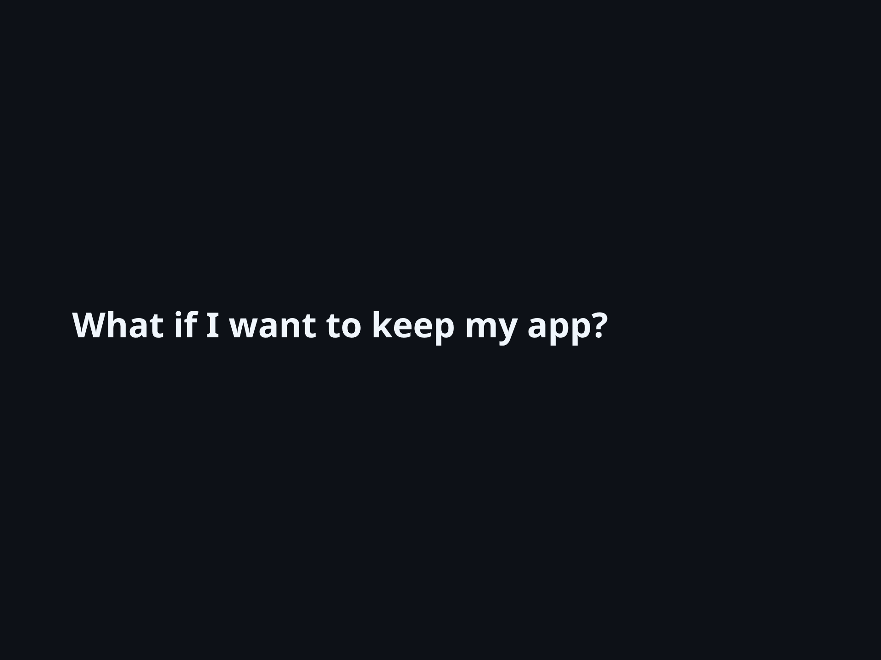

Slide 19
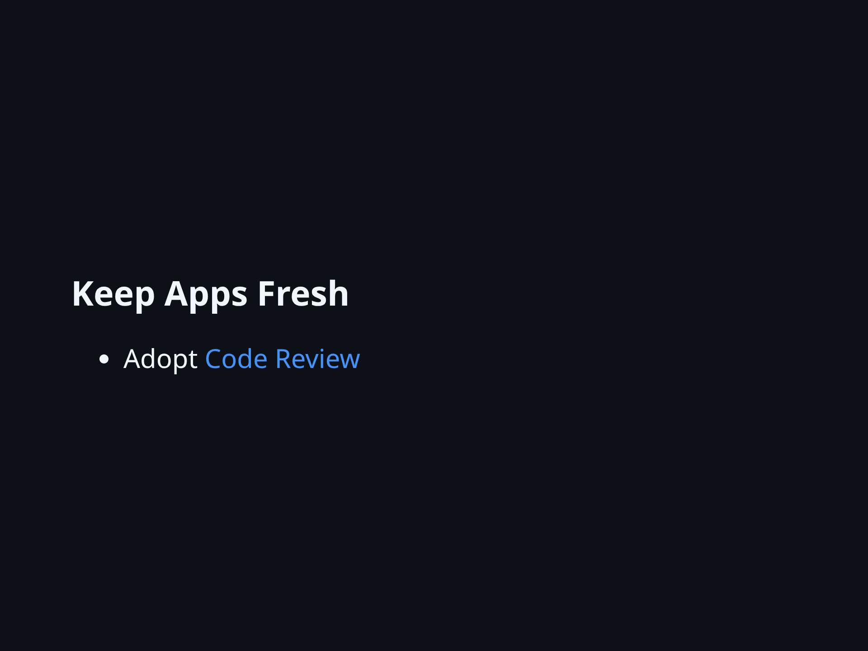
Notes:
- Code Review catches bugs before they get to production - Code review delivers correct bug-free features faster - As leaders, we can set the example - prioritize review over writing new code

Slide 20
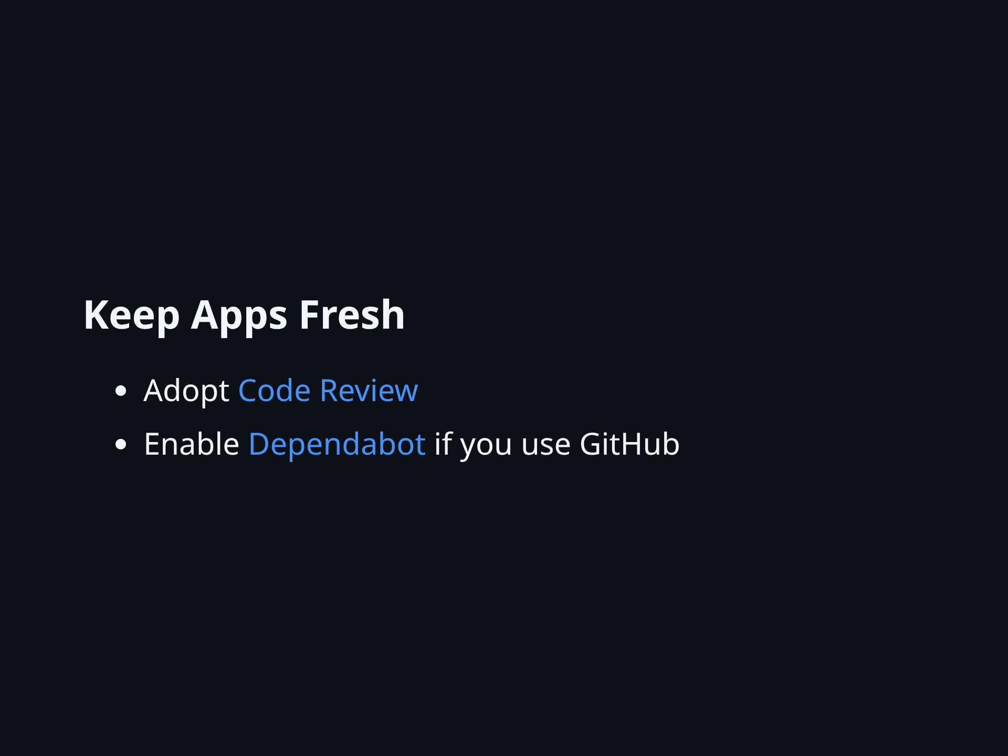
Notes:
- Dependabot is an easy paid-for parachute. - Apps get stale slower with Dependabot - Call to action: check Dependabot is enabled.

Slide 21
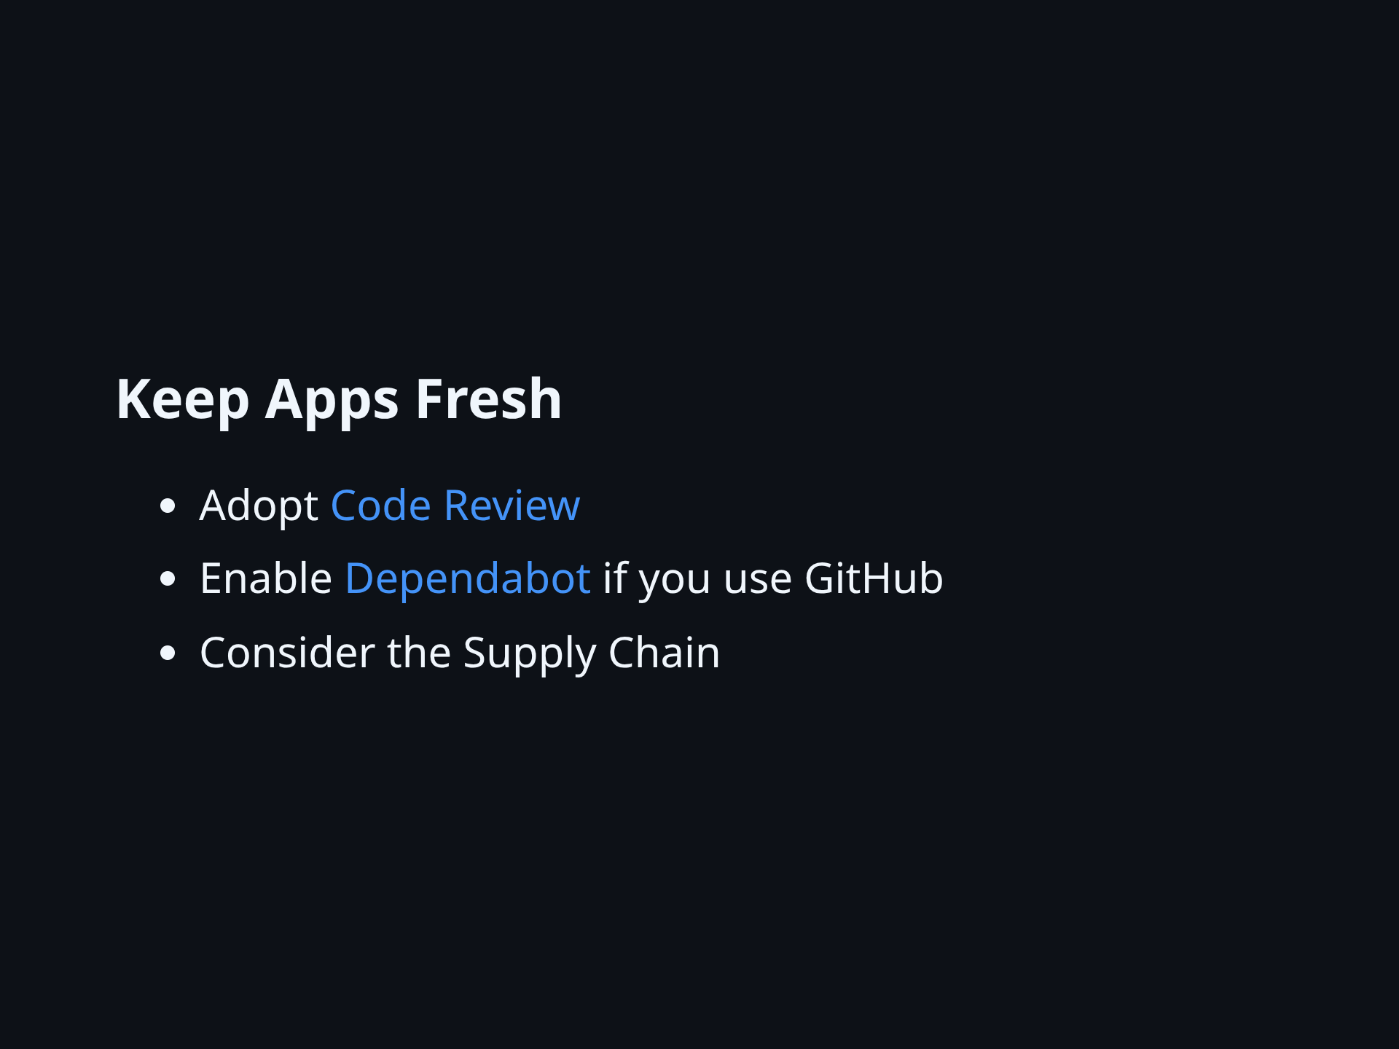
Notes:
- *Do* check in generated files that indicate which versions of libraries are in use - That history helps know when/if packages in use are vulnerable - Use 'Monthly Downloads' as a measure of security - A gazelle should know when it is far from the herd - Vulnerability handling is an early sign of library health vs end-of-life - Learn your framework's `audit` command

Slide 22
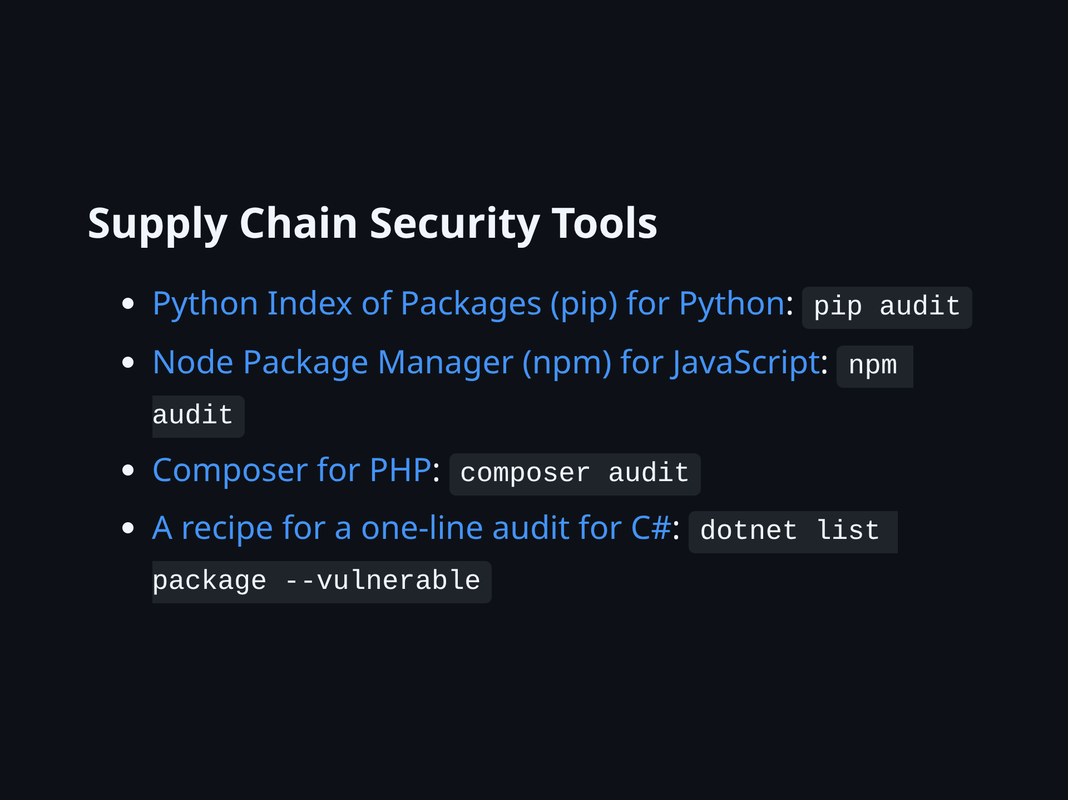
Notes:
- There have been incidents on campus where one of these tools immediately reported the root cause, after we learned we had a problem - These make great CI/CD steps and git pre-commit hooks. Supply Chain Recovery - NPM un-listed every compromised package within 4 hours - Teams with automated CI/CD updates would recover with a simple re-deploy

Slide 23
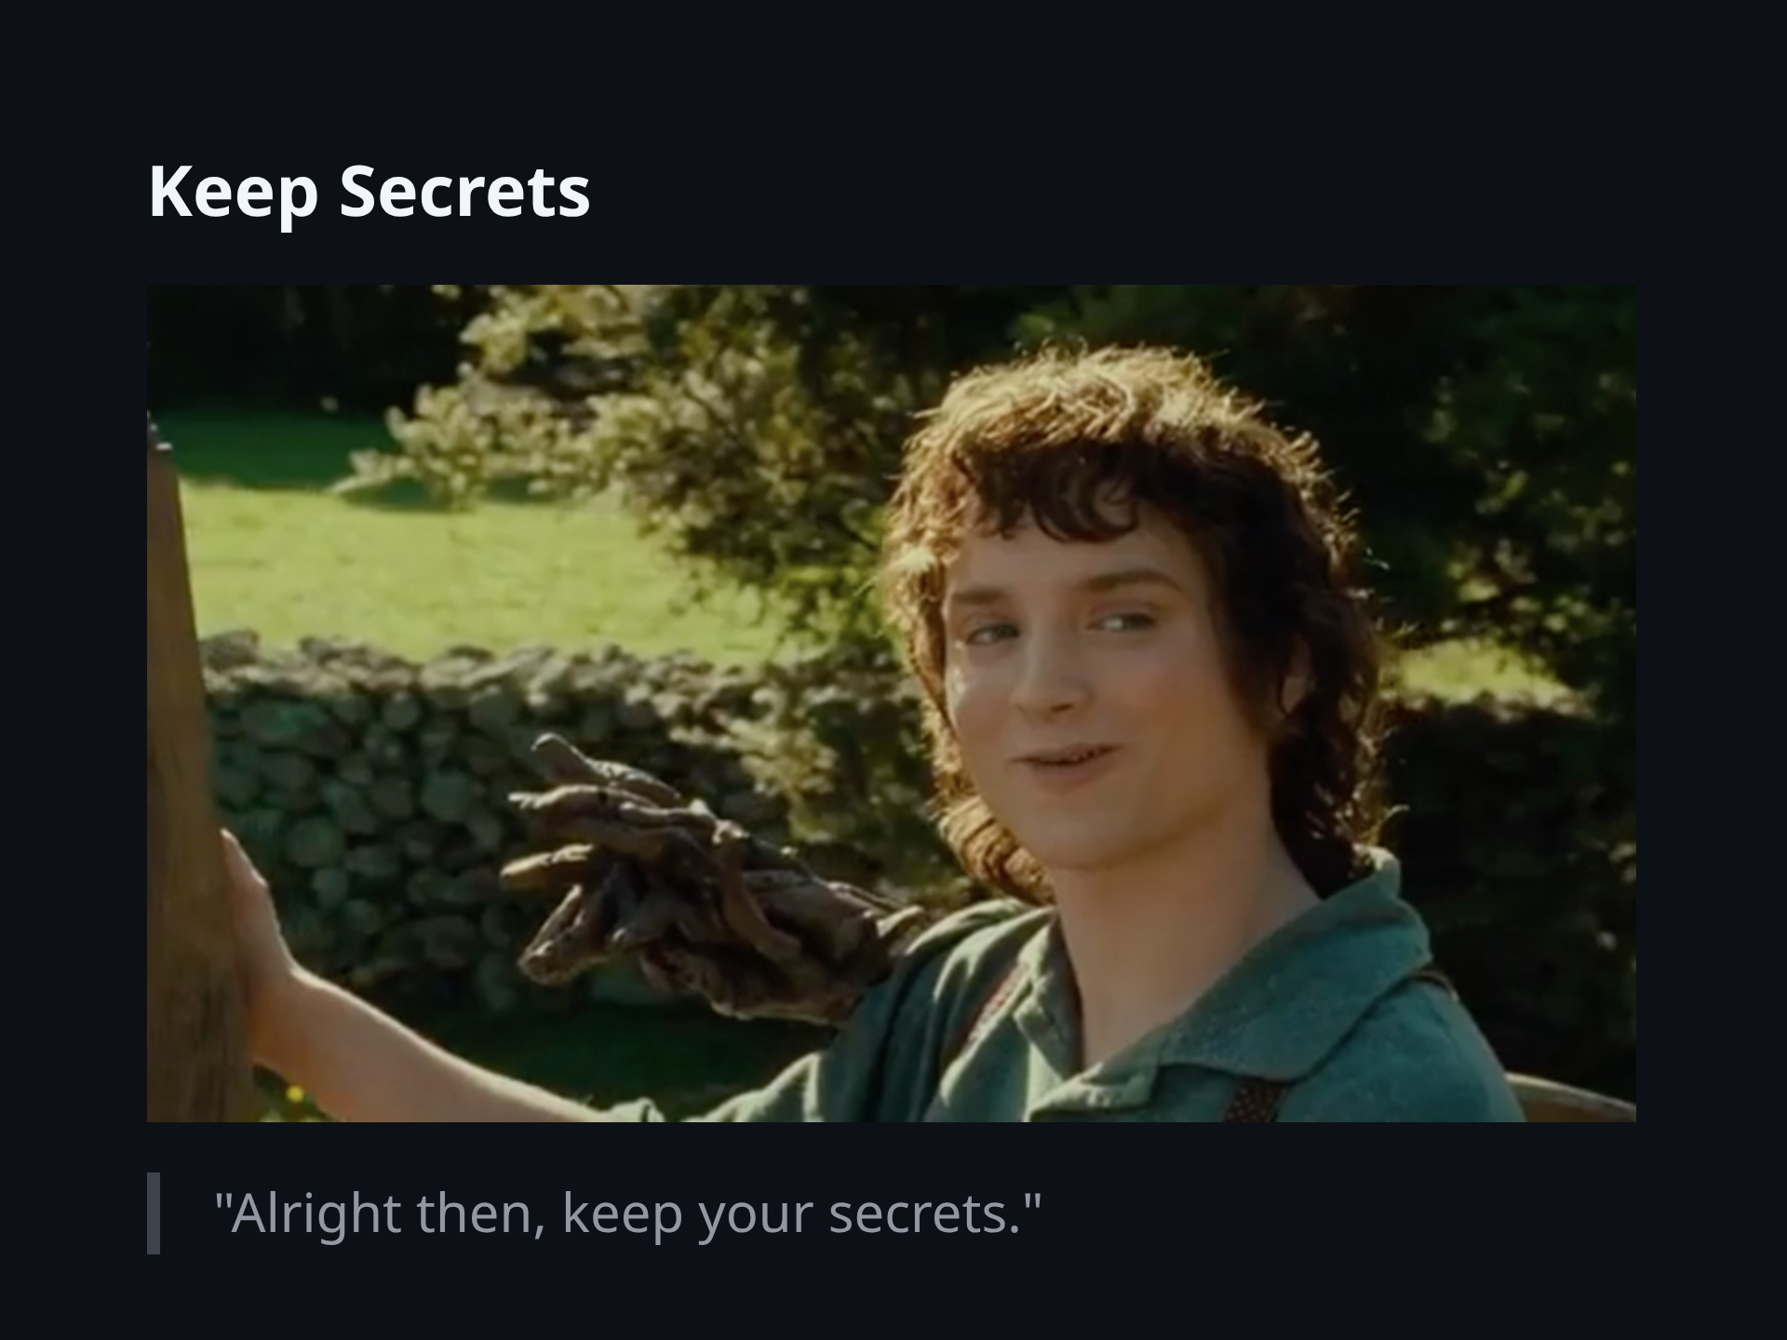

Slide 24

Notes:
Make More Secrets - I think about damage per leaked secret. - I prefer more smaller secrets. - Use a secret vault to avoid the temptation to reuse or overuse any single set of credentials. - Azure Key vault: https://learn.microsoft.com/en-us/azure/key-vault/secrets/about-secrets - Bitwarden - Keepass - Only use Keepass with appropriate additional security to protect the vault file and password separately. - HashiCorp Vault

Slide 25
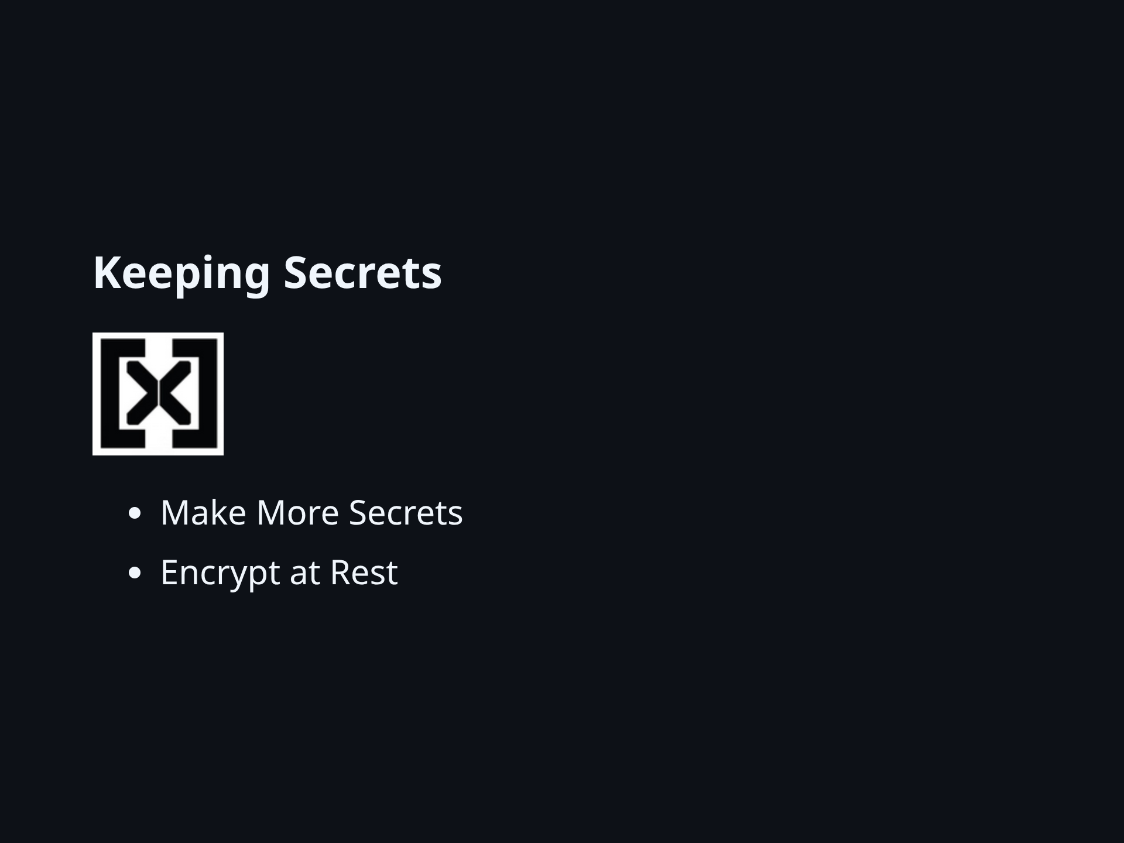
Notes:
Encrypt at Rest - If my secret cannot be easily encrypted, I should move it. - At rest - means on the drive where any process could ask for it. - I don't recommend encrypting in memory - today.

Slide 26
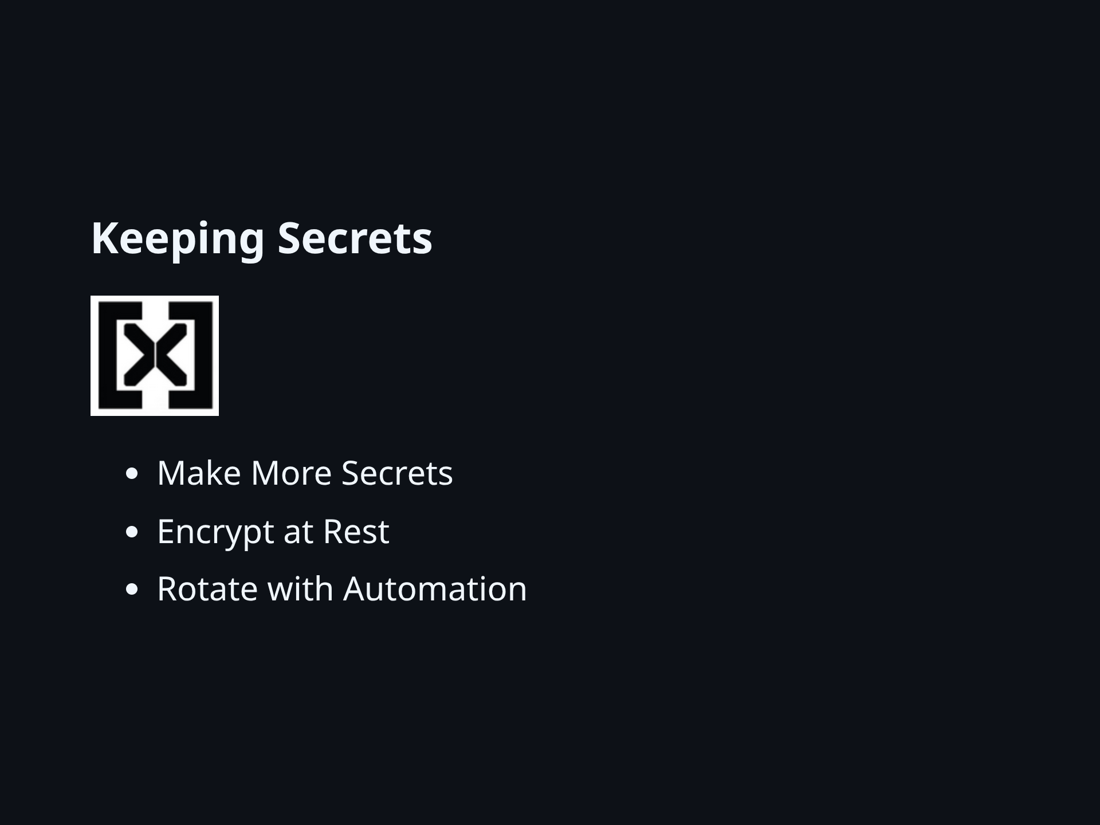
Notes:
Rotate with Automation My secret mantras: - I may need to change this during a crisis - I should practice the process - I should document the process - I should automate the process

Slide 27
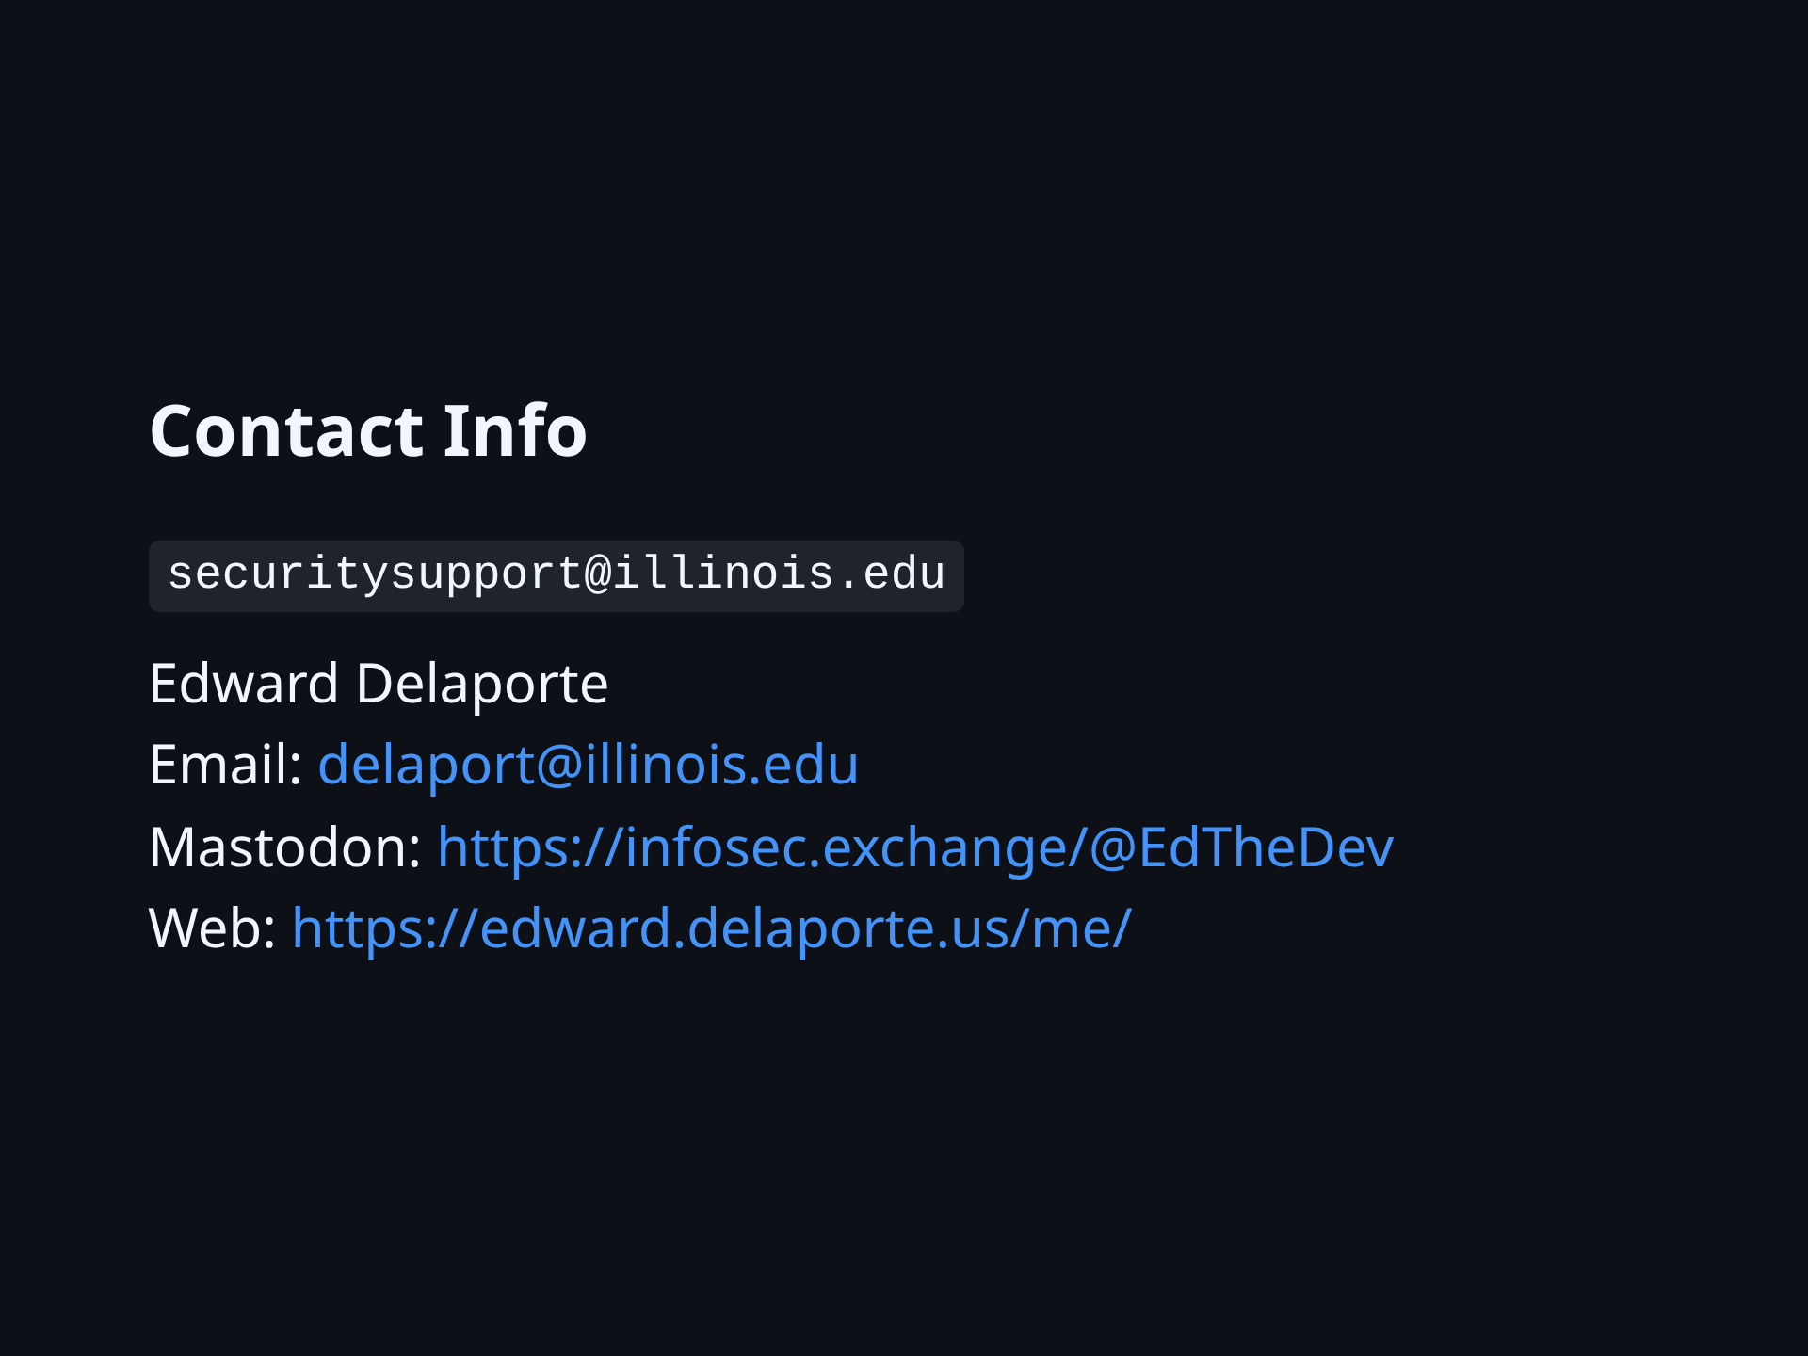

Slide 28


Slide 29
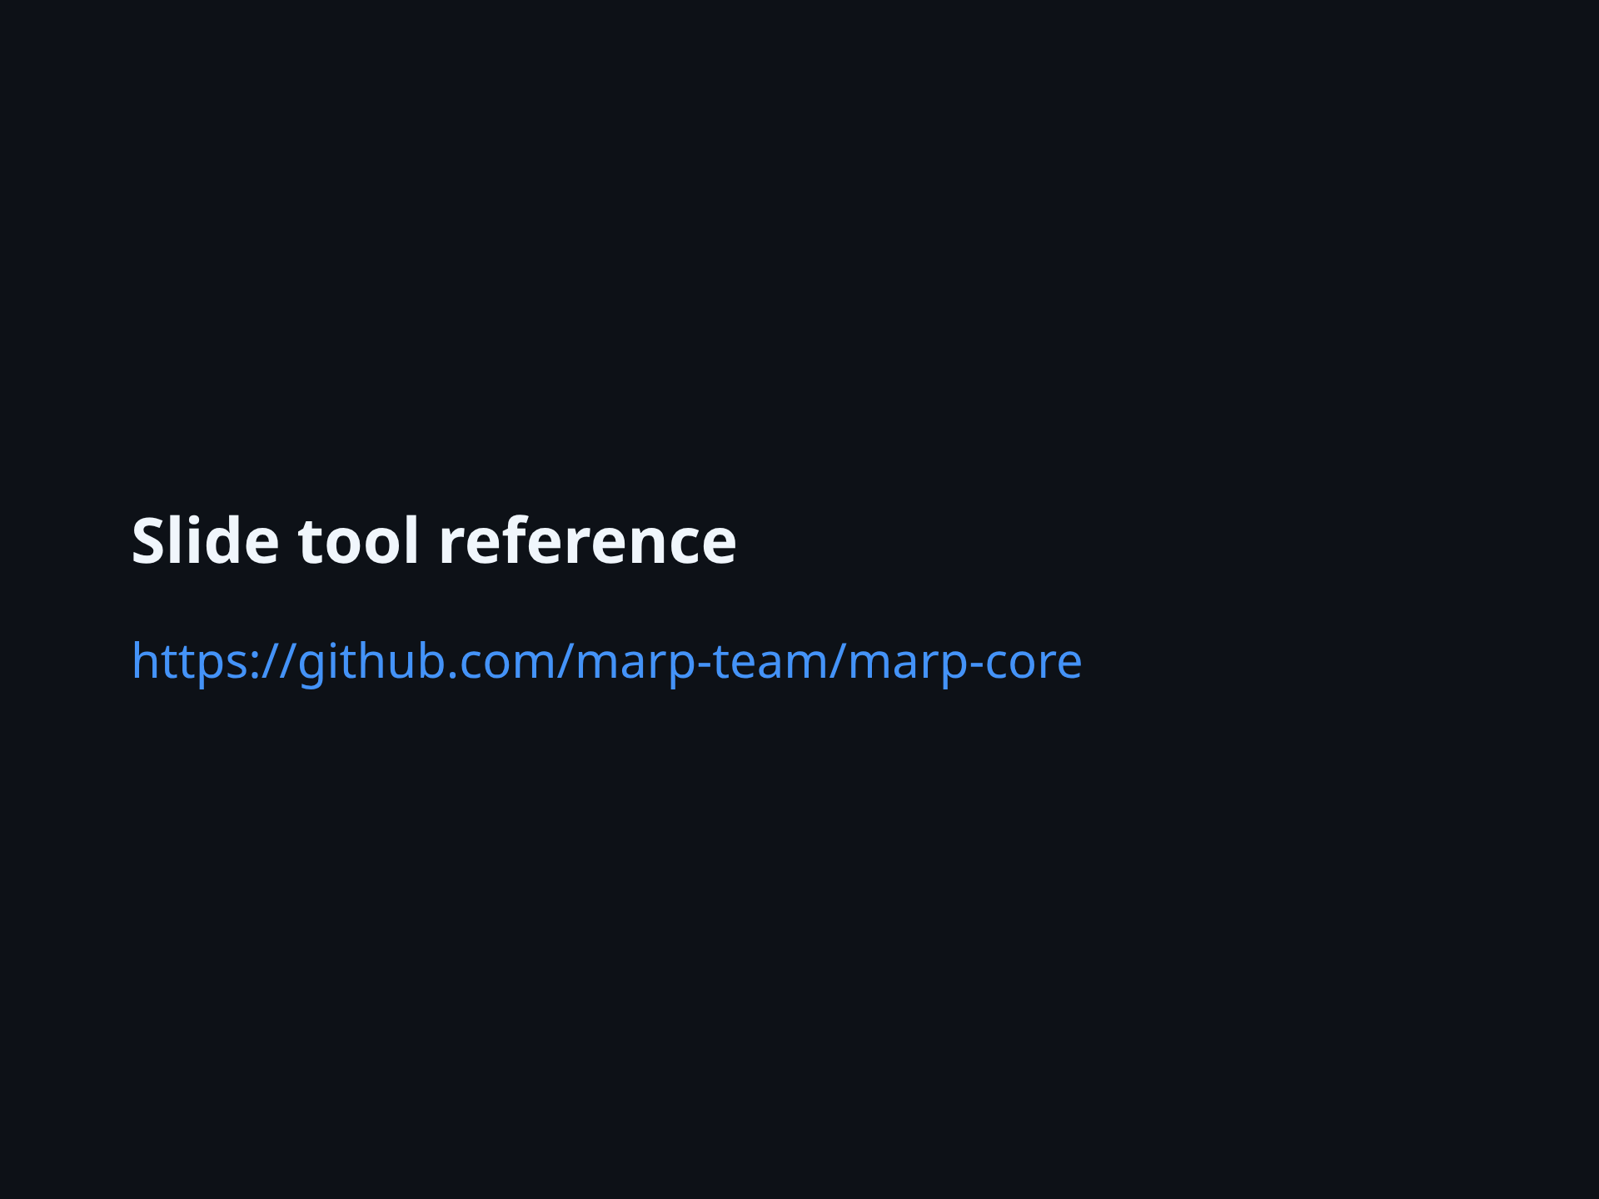

Slide 30
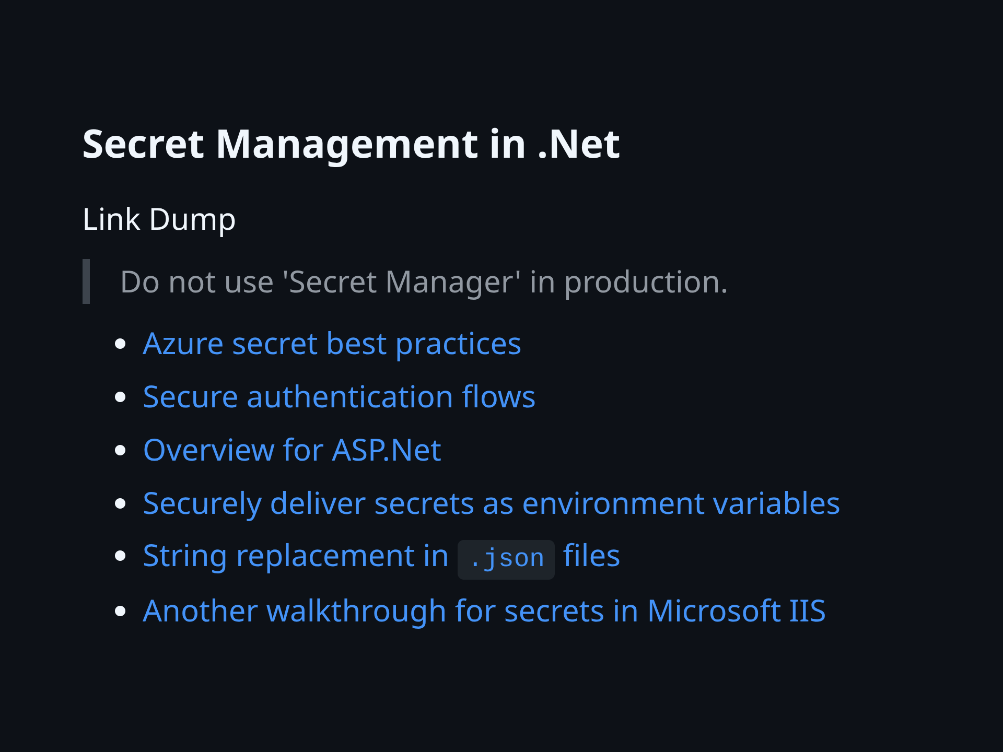

Slide 31
