Slide 1
Web Application Vulnerability Scanning

Slide 2
Presented By:
AITS QA Vulnerability Scanning
Luke Mesenbring - QA Engineer
Calvin Chen – QA Engineer
Mike Kramer - Assoc. Dir. QA
Tech Services Cybersecurity Development
David Riddle – Senior Cybersecurity Developer
Edward Delaporte – Manager Cybersecurity Dev.

Slide 3
Overview
AITS Vulnerability Testing Processes
Tech Services Cybersecurity Development Resources
Benefits of CI/CD
Examples
KB Articles
How to get in touch with our teams
Q&A

Slide 4
HCL AppScan
Dynamic Application Security Testing (DAST)
Tests web apps, web services, and mobile back-ends
Incremental scanning
Custom and industry standard reporting
HCL provides other solutions such as cloud-based scanning, IDE integrations, and endpoint scanning

Slide 5
Risk Assessment Process
New applications undergo a Risk Assessment
Risk ratings are derived through 4 categories
Data Classification |  |  | Network Scope |  |  | User Base |  |  | Content
High Risk | 5 |  | Any | 5 |  | External | 5 |  | Dynamic | 5
Sensitive | 3 |  | UI Only | 3 |  | Internal | 3 |  | Static | 1
Internal | 3 |  | AITS Only | 1 |  | Narrow | 1
Public | 1
Total Risk | Scan Frequency
16 - 20 | 6 months
<16 | 12 months

Slide 6
Scanning Process
Scan request received / scan due
Confirm scan configuration details with dev
Setup scan
Send scan event notice
Perform scan
Investigate any issues found
Generate and provide dev with reports
Log results, rescan as needed

Slide 7
Review & Remediation
Developers utilize AppScan reports to investigate and remediate issues
Additional scans may be requested to test implemented fixes
Outstanding issues are reviewed with managers in a monthly meeting
HCL (vendor) provides customer support for application questions, issues, and ideas

Slide 8
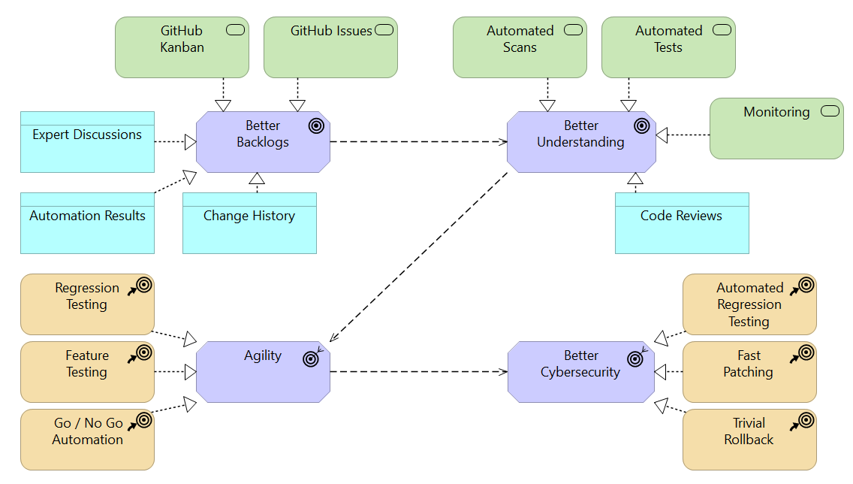
Cybersecurity for Developers
Feedback drives better agility and cybersecurity outcomes

Slide 9
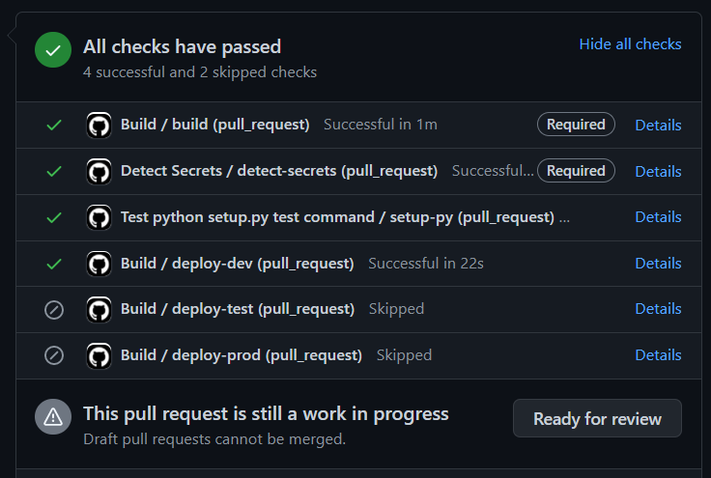
Build from pipelines
CI/CD can automatically gather and present feedback:

Slide 10
Example GitHub Action
.github/workflows/detect-secrets.yaml
name: Detect Secrets
on: pull_request
jobs:
detect-secrets:
runs-on: ubuntu-latest
container: python:latest
steps:
- uses: actions/checkout@v2
- name: Install Yelp's detect secrets
run: |
apt-get update && apt-get install -y jq
pip install yq
pip install detect-secrets==$(yq -r .repos[0].rev .pre-commit-config.yaml)
- name: Detect potential secrets
run: find -type f -not -path './.git/*' -printf '%P\n' | xargs detect-secrets-hook --baseline .secrets.baseline

Slide 11
Example Integration Test
RobotFramework .robot file
Library Dialogs
Library SeleniumLibrary
*** Keywords ***
Fill In Form
Input Text mondayTimesheetHourValue 8 clear=false
Input Text tuesdayTimesheetHourValue 8 clear=false
Input Text wednesdayTimesheetHourValue 8 clear=false
Input Text thursdayTimesheetHourValue 8 clear=false
Input Text fridayTimesheetHourValue 8 clear=false
Execute Manual Step Please Confirm or Correct Values then press Pass
Click Element //input[@name="btnSubmit"]
Page Should contain You have successfully submitted your time

Slide 12
How to?
Choose a Scan Tool?
https://answers.uillinois.edu/illinois/89291
Modernize and automate development practices?
https://answers.uillinois.edu/illinois/106122
Prevent leaked secrets in GitHub?
https://answers.uillinois.edu/illinois/112664
More topics are available:
https://answers.uillinois.edu/illinois/search.php?q=cybersecurity&cat=0

Slide 13
Where to Learn More...
Join the Security & Privacy Liaison Community to connect with your colleagues and learn about available resources.
Monthly online meetings: First Thursday of the month at 10 am.

Slide 14
Get in touch
AITS Quality Assurance Team
Email: aitsqavulnerability@uillinois.edu
Cybersecurity Development
Email: securitysupport@illinois.edu

Slide 15
Q&A

