Slide 1
APPLIED INTELLIGENCE • RESEARCH SEMINAR
Leakage-Controlled Concept Graph Construction and Cold-Start Diagnostic Protocol for Knowledge Tracing
Dao Minh Tuan, Nguyen Khanh Trinh, Nguyen Tien Duong, Ngo Quoc Khanh, Nguyen Van Hau (corresponding), Le Hoang Son
Hung Yen University of Technology and Education • Vietnam National University, Hanoi
An audit protocol — not a new KT backbone — for trustworthy graph-enhanced knowledge tracing

Slide 2
OVERVIEW
Agenda
▪ 1. Motivation: hidden leakage in graph-enhanced knowledge tracing
▪ 2. The problem: graphs as a back-channel for held-out information
▪ 3. Contributions: an audit protocol and its five components
▪ 4. Method: leakage control, DAG validation, DDR, cold-start, GT cross-validation
▪ 5. The two-factor law: throughput × reliance
▪ 6. Results: conditional harm, model-specific ordering, ground-truth divergence
▪ 7. From audit signal to deployment action (practitioner view)
▪ 8. Limitations, future work, and takeaways
Leakage-Controlled Concept-Graph Audit for Knowledge Tracing • Applied Intelligence
1

Slide 3
1. Motivation & Problem
Why graph construction is a leakage surface

Slide 4
BACKGROUND
Knowledge Tracing and concept graphs
▪ What: Knowledge Tracing (KT) estimates a learner's mastery of knowledge components (KCs) from interaction history.
  – Powers adaptive practice, intelligent tutoring, and curriculum recommendation.
▪ Trend: Evolution: BKT → deep sequential models (DKT, DKVMN, AKT, simpleKT) → graph-enhanced models (GKT, GIKT, DGEKT).
▪ Graphs: Graph-enhanced KT propagates information over a KC graph (prerequisite / similarity relations).
  – That auxiliary graph is usually built from the SAME interaction logs used for training and evaluation.
▪ Gap: Key question: is a reported graph gain real, or an artefact of how the graph was constructed?
Leakage-Controlled Concept-Graph Audit for Knowledge Tracing • Applied Intelligence
2

Slide 5
PROBLEM
The hidden leakage channel
▪ Mechanism: When edges are pooled BEFORE the train/test split, held-out information reaches the model through the graph — even if the KT optimiser only sees the training fold.
▪ Sequence-level fold splitting is necessary but NOT sufficient: the graph is a separate contamination surface.
Worked example (leakage throughput):
  – Hot KC: 20 leaked traversals change edge support 40→60 → 33% throughput.
  – Very-cold KC: the same 20 raise support 4→24 → 83% throughput.
▪ Insight: Leakage throughput scales INVERSELY with train-fold KC frequency — cold-start KCs are the highest-throughput entry points.
▪ Therefore: Aggregate AUC is a late, unreliable alarm; we need to measure the channel directly.
Leakage-Controlled Concept-Graph Audit for Knowledge Tracing • Applied Intelligence
3

Slide 6
2. Contributions
An audit protocol, not a new backbone

Slide 7
CONTRIBUTIONS
Five contributions (C1–C5)
▪ C1 Leakage-controlled construction: learner-based temporal splits + train-only prerequisite/similarity inference with per-edge provenance.
▪ C2 Tiered leakage diagnostics: builder mass, TBMR, ECR-flag / ECR-overlap — measure contamination independently of accuracy.
▪ C3 DAG validation + DDR (DAG Disruption Rate): a structural metric that separates augmentation operators.
▪ C4 Cold-start stratification: per-KC-frequency reporting that exposes where leakage and weak evidence concentrate.
▪ C5 Ground-truth cross-validation: behavioural inference vs. expert prerequisite curation (edge / direction / reachability / node-Jaccard).
▪ Framing: Positioning: a decision-support & leakage risk-scoring layer for trustworthy deployment — not a route to higher headline accuracy.
Leakage-Controlled Concept-Graph Audit for Knowledge Tracing • Applied Intelligence
4

Slide 8
3. The Audit Protocol
Construction → diagnostics → validation

Slide 9
METHOD — C1/C2
Leakage control & provenance
▪ Train-only: Split by learner and time; infer edges only from the training fold (F_train), never the pooled log.
▪ Provenance: Log fold-specific provenance for every retained edge (reproducible, cross-paper comparable exports).
Diagnostic tiers:
  – Builder mass / TBMR — within-train temporal mixing & throughput.
  – ECR-flag — learner-disjointness (can be 0 while throughput is high!).
  – ECR-overlap — cold-start neighbourhood contamination.
▪ Lesson: Fold-disjoint splits are necessary but insufficient; scalar leakage summaries can hide throughput-driven shifts.
Leakage-Controlled Concept-Graph Audit for Knowledge Tracing • Applied Intelligence
5

Slide 10
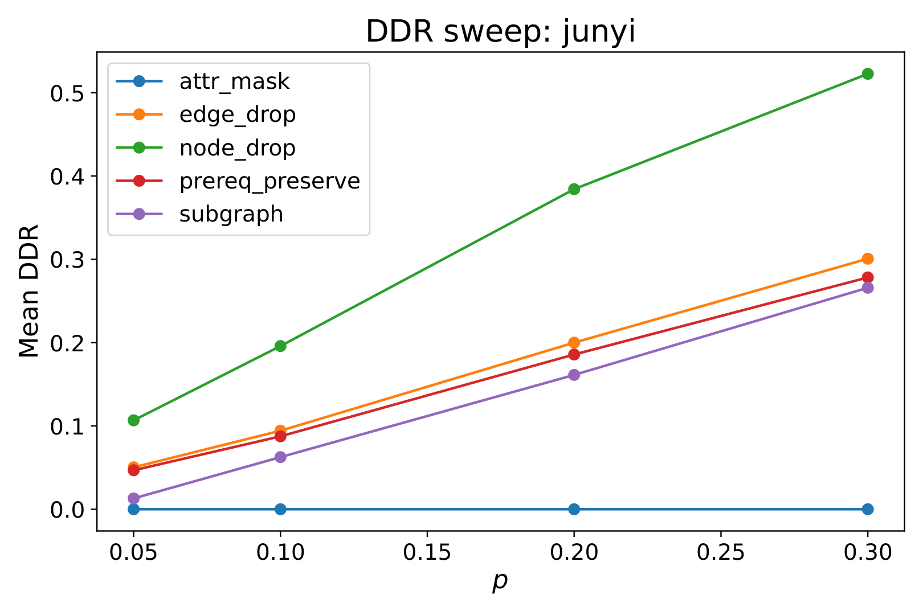
METHOD — C3
DDR: DAG Disruption Rate
▪ Idea: DDR measures how much an augmentation operator damages the prerequisite DAG at a fixed perturbation budget.
▪ Sweep: Sweeps 5 operators (edge drop, node drop, …, prereq-preserve).
▪ Finding: A prerequisite-preserving operator that protects the transitive-reduction backbone is measurably LESS disruptive than edge dropping at matched budget.
▪ Scope: DDR applies to any directed curriculum graph consumed by KT or pretraining pipelines.
DDR vs. perturbation budget (Junyi).
Leakage-Controlled Concept-Graph Audit for Knowledge Tracing • Applied Intelligence
6

Slide 11
METHOD — C4/C5
Cold-start & ground-truth cross-validation
Cold-start stratification (C4):
  – Report per-stratum metrics by KC frequency (very-cold → hot).
  – Aggregate AUC hides small-stratum behaviour; very-cold counts are small (n = 19–161) → high variance, read with n.
Ground-truth cross-validation (C5):
  – Compare train-only behavioural inference against expert prerequisite annotation on Junyi.
  – Result: node-level agreement but edge-level DIVERGENCE — behavioural inference is NOT a low-cost proxy for expert curation.
Leakage-Controlled Concept-Graph Audit for Knowledge Tracing • Applied Intelligence
7

Slide 12
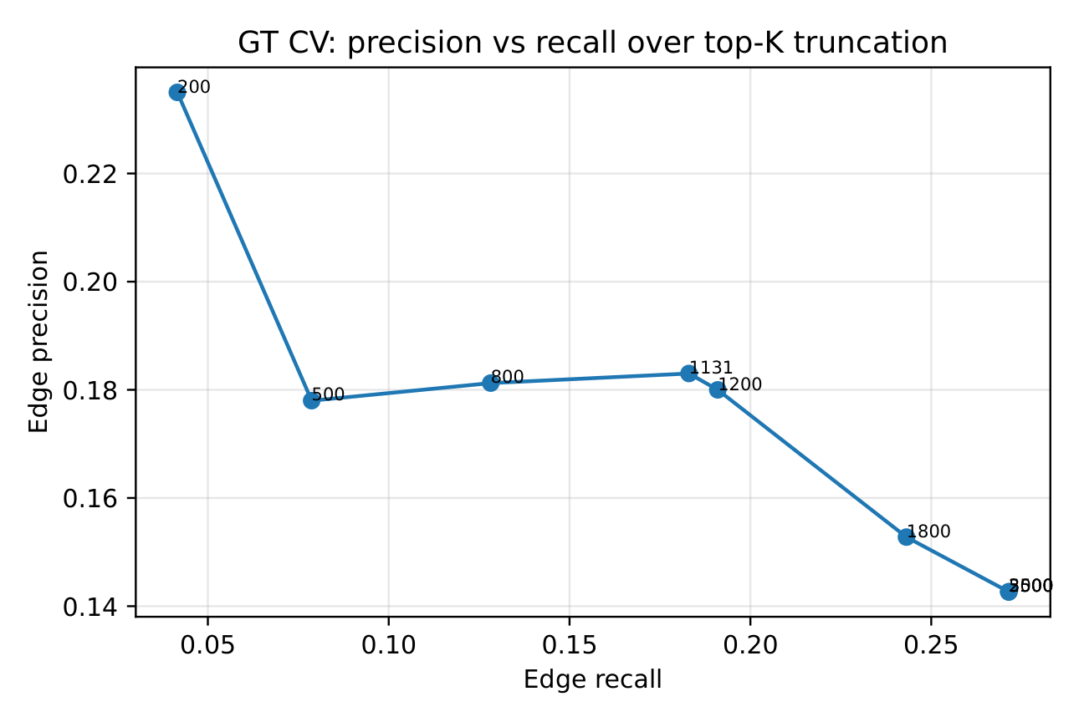
METHOD — C5
Ground-truth validation on Junyi
▪ Signal: Behavioural inference recovers expert prerequisite edges well above chance…
▪ Nuance: …but the two signals diverge at the edge level and are best treated as COMPLEMENTARY relations.
▪ So what: Recommendation: consume an inferred behavioural graph and an expert graph as separate inputs.
Precision–recall of inferred vs. expert edges.
Leakage-Controlled Concept-Graph Audit for Knowledge Tracing • Applied Intelligence
8

Slide 13
4. The Two-Factor Law & Results
When does graph leakage actually hurt?

Slide 14
SETUP
Datasets & experimental setup
▪ Primary: XES3G5M — primary model-comparison benchmark (dense, transition-rich).
▪ Secondary: ASSISTments 2012 — secondary; single-skill Q-matrix (similarity edges infeasible).
▪ GT / sanity: Junyi Academy — saturated sanity check + ground-truth cross-validation.
▪ Synthetic: Two synthetic logs — controlled concept structure.
▪ Models: Backbones: simpleKT / AKT (sequence-only), GKT & GIKT (graph-reliant), DGEKT; pyKT wiring, learner-disjoint folds, train-only graph export.
Leakage-Controlled Concept-Graph Audit for Knowledge Tracing • Applied Intelligence
9

Slide 15
KEY RESULT
The two-factor law: throughput × reliance
Graph-mediated leakage shifts AUC only when BOTH factors are high. Three of four regimes are ≈ 0.
 | Low reliance (simpleKT) | High reliance (GKT, GIKT)
Low throughput (train-only vs. full-log) | ≈ 0 | ≤ 0.003 (full-log ablation)
High throughput (20% test-fold injection) | ≈ 0 (0.850→0.858) | +0.05 GKT, +0.03 GIKT
Takeaway: harm ≈ throughput × reliance. AUC is silent in 3/4 regimes → the audit measures throughput directly instead.
Leakage-Controlled Concept-Graph Audit for Knowledge Tracing • Applied Intelligence
10

Slide 16
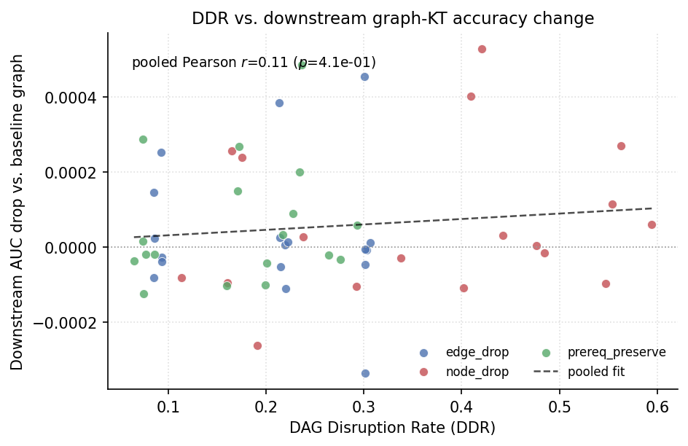
RESULT
Conditional harm: the manipulation check
▪ Test: Gate downstream claims on a manipulation check: does destroying the graph move AUC?
▪ Reliant: GKT on XES3G5M PASSES: graph destruction costs 0.07–0.09 AUC.
  – Here DDR predicts AUC loss (r = 0.97) and prereq-preserve costs the least accuracy.
▪ Inert: DGEKT & GKT on ASSISTments FAIL: total destruction moves AUC ≤ 0.002 → graph is effectively unused.
▪ So: Structural damage translates into predictive damage ONLY on graph-reliant, check-passing backbones.
DDR → downstream AUC (graph-reliant backbone).
Leakage-Controlled Concept-Graph Audit for Knowledge Tracing • Applied Intelligence
11

Slide 17
RESULT
Model-specific ordering on XES3G5M
Primary trio under the released 10-epoch budget:
  – simpleKT / AKT ≈ 0.875 • GIKT ≈ 0.878 • GKT ≈ 0.834.
▪ Gap: GKT trails simpleKT by ≈ 0.041 AUC (paired-t 95% CI [−0.044, −0.038]).
▪ Not a budget artefact: Epoch-extended GKT (30 epochs) recovers only ≈ 0.003 AUC; pooled Δ ≈ −0.038 over nine folds — the under-performance persists.
▪ Message: Graph reliance ≠ accuracy advantage: reading the graph can even cost accuracy when the sequence backbone is already strong.
Leakage-Controlled Concept-Graph Audit for Knowledge Tracing • Applied Intelligence
12

Slide 18
5. From Audit to Action
What a practitioner does differently

Slide 19
APPLIED VALUE
Decision map: audit signal → deployment action
Audit signal | Reading | Action
Builder mass / TBMR | Rises (pooled vs. train-only) | Enforce train-only graph; distrust the gain
ECR-flag = 0 but high throughput | Disjoint yet contaminated | Split is insufficient; keep provenance logs
Manipulation check | AUC unmoved by graph destruction | Graph-inert: DDR = reproducibility scaffolding
DDR vs. AUC (r ≈ 0.97) | Monotone on graph-reliant backbone | Prefer prereq-preserve; DDR is a design target
Cold-start stratum | Highest throughput at thin support | Report per-stratum provenance
Leakage-Controlled Concept-Graph Audit for Knowledge Tracing • Applied Intelligence
13

Slide 20
APPLIED VALUE
What a practitioner does differently
▪ 1. Build the graph fold-clean — infer from the train fold only and export per-edge provenance.
▪ 2. Read the throughput indicators, not the accuracy — locate the corpus in the throughput × reliance grid.
▪ 3. Gate any downstream claim on a manipulation check — verify the backbone actually reads the graph before attributing gains.
▪ 4. Prefer structure-preserving augmentation — use the prereq-preserving operator that DDR rewards.
These four steps are the actionable core of the checklist and the decision map.
Leakage-Controlled Concept-Graph Audit for Knowledge Tracing • Applied Intelligence
14

Slide 21
6. Discussion & Takeaways

Slide 22
DISCUSSION
Limitations & future work
▪ Limitation: Similarity edges depend on the Q-matrix (infeasible under single-skill coding, e.g. ASSISTments).
  – Public-benchmark leakage effects are small because an aggressive support filter throttles throughput — not because leakage is harmless in general.
  – Very-cold strata have small n → high-variance per-stratum AUC.
▪ Future: Disaggregate reported graph-KT gains: leakage-surviving vs. construction-dependent vs. backbone-dependent components.
  – Combine inferred + expert graphs as separate relations; extend manipulation-check-gated downstream tests; reachability-disruption audits.
Leakage-Controlled Concept-Graph Audit for Knowledge Tracing • Applied Intelligence
15

Slide 23
CONCLUSION
Key takeaways
▪ 1. Graph construction is a first-class experimental component — and a leakage surface — not a preprocessing afterthought.
▪ 2. Harm is conditional: it needs high throughput AND a graph-reliant, manipulation-check-passing backbone.
▪ 3. Measure the channel directly (builder mass, TBMR); AUC is a late, unreliable alarm.
▪ 4. DDR + a prereq-preserving operator give a principled, structure-aware augmentation choice.
▪ 5. The deliverable is a decision-support & risk-scoring audit layer for trustworthy graph-enhanced KT.
Leakage-Controlled Concept-Graph Audit for Knowledge Tracing • Applied Intelligence
16

Slide 24
Thank you — Questions?
Leakage-Controlled Concept-Graph Audit for Knowledge Tracing
Corresponding author: Nguyen Van Hau — nvhau666@gmail.com
Code & artefacts: github.com/tuanymc/p0_project

