Slide 1



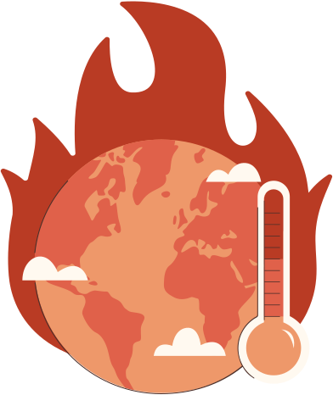
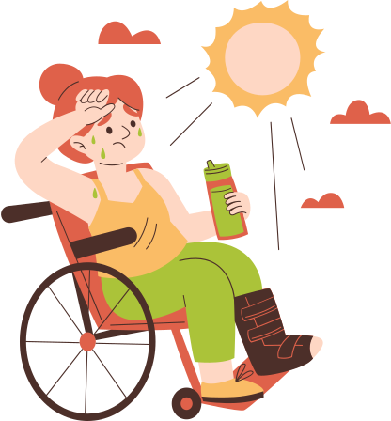
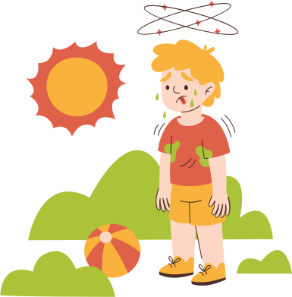

HeatQUest
Understanding the Impacts and Taking Action

Slide 2






User Problem
  Municipalities and citizens struggle to spot critical heat zones quickly.
  Climate engagement tools rarely feel actionable or fun.
  People do not receive rewards for taking action against climate change.

Slide 3


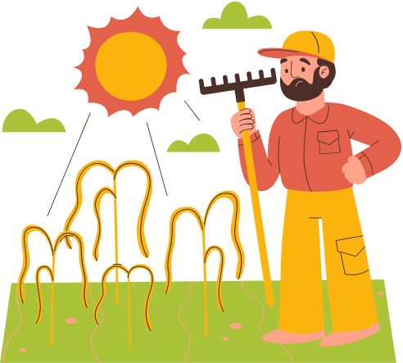
Our Solution
  Live Heatmap blending Landsat temperature + Sentinel vegetation.
  AI Reports (Vertex AI / GPT-4 Vision) summarizing causes & actions.
  Gamified Missions with XP, leaderboard, instant feedback loops.

Slide 4
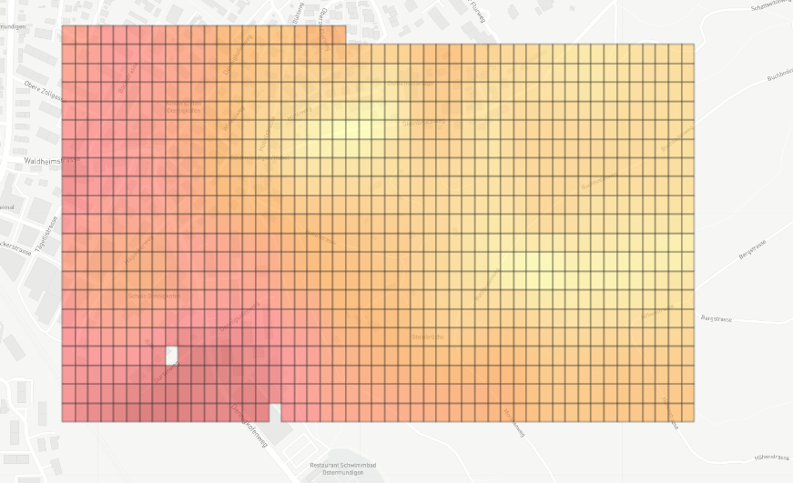

Slide 5


Slide 6
