Slide 1
Chapter 8. 分类: Advanced Methods
Notes:
这一讲的完整视频http://www.iqiyi.com/w_19rs9dry3l.html

Slide 2
Chapter 8. 分类: Advanced Methods
贝叶斯信念网络
后向传播分类 Classification by Backpropagation
支持向量机 Support Vector Machines
Classification by Using Frequent Patterns
Lazy Learners (or Learning from Your Neighbors)
其他分类方法
Additional Topics Regarding Classification
Summary

Slide 3
贝叶斯信念网络
Bayesian belief networks (又称为 Bayesian networks, probabilistic networks): 允许变量子集间定义类条件独立
(有向无环) 因果关系的图模型
  表示变量间的依赖关系
  给出了一个联合概率分布
Nodes: 随机变量
Links: 依赖关系
X,Y 是Z的双亲, Y is the parent of P
Z 和 P间没有依赖关系
没有环
X
Y
Z
P

Slide 4
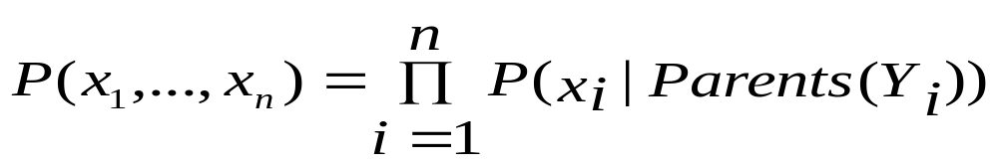
贝叶斯信念网络: An Example
Family
History (FH)
Smoker (S)
CPT: Conditional Probability Table for variable LungCancer:
(FH, S)
(FH, ~S)
(~FH, S)
(~FH, ~S)
LC
0.8
0.5
0.7
0.1
LungCancer
(LC)
Emphysema
~LC
0.2
0.5
0.3
0.9
显示父母的每个可能组合的条件概率
从CPT推倒 X的特定值得概率
Dyspnea
PositiveXRay

Slide 5
训练贝叶斯网路:几种方案
Scenario 1:给定网络结构和所有变量观察：只计算CPT
Scenario 2: 网络结构已知, 某些变量隐藏: 梯度下降法(贪心爬山), i.e., 沿着准则函数的最速下降方向搜索解
  权重初始化为随机值
  每次迭代中,似乎是对目前的最佳解决方案前进，没有回溯
  每次迭代中权重被更新，并且收敛到局部最优解
Scenario 3: 网络结构未知, 所有变量可知: 搜索模型空间构造网络拓扑
Scenario 4: 未知结构, 隐藏变量: 目前没有好的算法
D. Heckerman. A Tutorial on Learning with Bayesian Networks. In Learning in Graphical Models, M. Jordan, ed.. MIT Press, 1999.

Slide 6
Chapter 8. 分类: Advanced Methods
Bayesian Belief Networks
Classification by Backpropagation
Support Vector Machines
Classification by Using Frequent Patterns
Lazy Learners (or Learning from Your Neighbors)
Other Classification Methods
Additional Topics Regarding Classification
Summary

Slide 7
用反向传播分类
反向传播: 一种神经网络学习算法
最早是由心理学家和神经学家开创的，开发和测试神经元计算模拟
神经网络: 一组连接的输入/输出单元，其中每个连接都与一个权重关联
通过调整权重来学习, 能够输入元组的正确类别标号
又被称为连接者学习connectionist learning

Slide 8
神经网络作为分类器
弱点
  学习时间很长
  需要很多参数（常靠经验确定）, 如网络的结构
  可解释性差: 很难解释权重和网络中“隐藏单元”的含义
优势
  对噪音数据的高承受能力
  分类未经训练的模式的能力
  非常适合处理连续值的输入/输出
  成功地应用于现实数据, e.g., 手写字符识别
  算法是固有并行的
  已经发展了一些从训练好的神经网路提取规则的技术

Slide 9
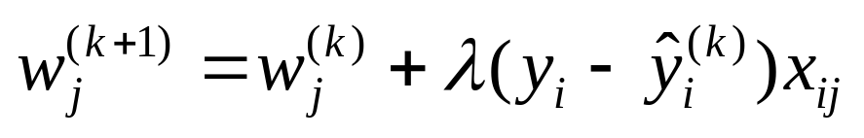
多层前馈神经网络
Output vector
输出层
隐藏层
w_{ij}
输入层
Input vector: X
Notes:
MK: Note – different notation than used in book. Will have to standardize notation.

Slide 10
多层前馈神经网络
网络的输入对应于每个训练元组的测量属性
  输入同时传给称作输入层的单元
加权后同时传递给隐藏层
隐藏层的数目是任意的, 通常只有一个
最后一个隐藏层的输出权重后作为输入传递给称为输出层，此处给出网络的预测
前馈feed-forward: 权重都不反馈到输入单元或前一层的输出单元
从统计学观点, 网络进行一个非线性回归；给定足够的隐藏单元和训练数据, 可以逼近任何函数

Slide 11
定义网络拓扑
确定网络拓扑: 给定输入层的单元数, 隐藏层数(if > 1), 每个隐藏层的单元数, 输出层的单元数
规格化训练元组的输入值 [0.0—1.0]
  对于离散值，可重新编码，每个可能的值一个输入单元并初始化0
输出, 如果涉及超过两个类别则一个输出单元对应一个类别
一旦一个训练好的网络其准确率达不到要求时，用不同的网络拓扑和初始值重新训练网络

Slide 12
反向传播Backpropagation
迭代地处理训练数据 & 比较网络的预测值和实际的目标值
对每个训练元组, 修改权重最小化目标的预测值和实际值之间的mean squared error
这种修改后向进行: 从输出层开始, 通过每个隐藏层直到第一个隐藏层
步骤
  初始化权重为一个小的随机数, 以及偏倚 biases
  向前传播输入 (应用激励函数)
  向后传播误差 (更新权重和偏倚)
  停止条件 (当误差非常小, etc.)

Slide 13
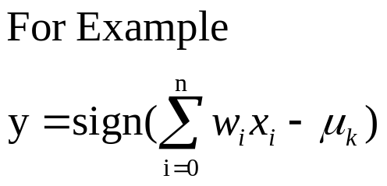
神经元: 一个隐藏/输出层单元
bias
μ_{k}
x₀
w₀
x₁
w₁
∑
f
output y
x_{n}
w_{n}
输入向量x
weight
vector w
权重和
激励
一个n-维输入向量x被映射到变量y，通过非线性函数映射
单元的输入是前一层的输出. 被乘上权重后求和且加上此单元的偏倚. 然后应用一个非线性激励函数.
Notes:
MK Oct 2009: I removed “neuron = perceptron” from title since we do not use that term in the book.

Slide 14
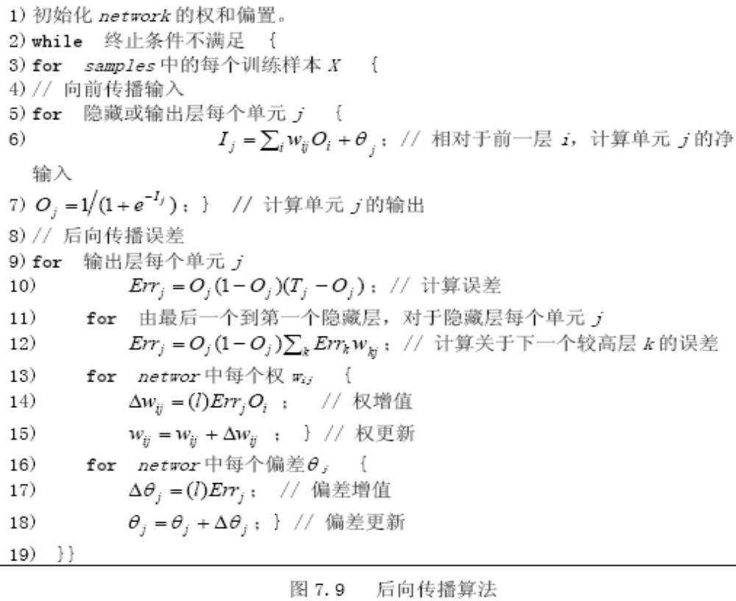
后向传播算法
1) 初始化network的权和偏置。
2) while终止条件不满足{
3) for samples中的每个训练样本X{
4) //向前传播输入
5) for 隐藏或输出层每个单元j{
6) I,wO，,;//相对于前一层i，计算单元j的净输入 ,jijiji
,Ij7) ;}//计算每个单元j的输出 O,1(1，e)j
8) //后向传播误差
9) for 输出层每个单元j
10) ;//计算误差 Err,O(1,O)(T,O)jjjjj
11) for 由最后一个到第一个隐藏层，对于隐藏层每个单元j
12) Err,O(1,O)Errw;//计算关于下一个较高层k的误差 ,jjjkjkk
13) for network中每个权w { ij
14) ;//权增值 ,W,(l)ErrOijji
15) ;}//权更新 W,W，,Wijijij
16) for network中每个偏差 { ,j
17) ;//偏差增值 ,,,(l)Errjj
18) ;}//偏差更新 ,,,，,,jjj
19) }}

Slide 15
效率和可解释性
向后传播的效率: 每次迭代 O(|D| * w), |D|为元组数，w 个权重, 最坏的情况下迭代的次数可能是元组数的指数
为了更容易理解: 通过网络修剪提取规则
  简化网络结构，去除对训练的网络有最弱影响的权重连接
  对连接, 单元, or 活跃值聚类
  输入和活跃值集合用来推导描述输入和隐藏层间关系的规则
Sensitivity analysis: 评估一个给定的输入变量对网络输出的影响。从中获得的知识可以表示为规则。
  IF X 减少5% THEN Y增加…

Slide 16
Chapter 8. 分类: Advanced Methods
贝叶斯信念网络
后向传播分类 Classification by Backpropagation
支持向量机 Support Vector Machines
Classification by Using Frequent Patterns
Lazy Learners (or Learning from Your Neighbors)
其他分类方法
Additional Topics Regarding Classification
Summary

Slide 17
分类:一个数学映射
Classification:预测分类的类标签
  E.g., 个人主页分类
    x_{i} = (x₁, x₂, x₃, …), y_{i} = +1 or –1
    x₁ : # of word “homepage”
    x₂ : # of word “welcome”
x ∈ X = ℜ^{n}, y ∈ Y = {+1, –1},
  推导一个函数 f: X → Y
线性分类
  二元分类问题
  红线上面的点属于 class ‘x’
  下面的点属于 class ‘o’
  Examples: SVM, Perceptron, Probabilistic Classifiers
x
x
x
x
x
x
x
x
x
o
o
x
o
o
o
o
o
o
o
o
o
o
o

Slide 18
SVM—Support Vector Machines
一个相对新的分类方法，适用于linear and nonlinear data
使用一个非线性映射把原始训练数据变换到高维空间中
在新的维上, 搜索线性优化分离超平面hyperplane (i.e., “决策边界”)
用一个合适的足够高维的映射, 两类数据总是可以被超平面分开
SVM 使用support vectors (“基本” 选练元组) 和边缘margins (由支持向量定义)发现超平面

Slide 19
SVM—历史和应用
Vapnik and colleagues (1992)—基础工作来自于Vapnik & Chervonenkis’ statistical learning theory in 1960s
Features: 训练慢但是准确度高，由于能够建模非线性决策边界 (margin maximization)
Used for: 分类和数值预测
应用:
  手写数字识别, object recognition, speaker identification, 基准时间序列预测检验

Slide 20
支持向量机的一般哲学
Small Margin边界
Large Margin
Support Vectors

Slide 21


SVM—Margins and Support Vectors
Data Mining: Concepts and Techniques

Slide 22
SVM—当数据线性可分时
m
D 为(X₁, y₁), …, (X_{|D|}, y_{|D|}), 其中 X_{i} 带标签yi的训练元组
有无数条直线(hyperplanes) 可以分离两个类，但我们需要发现最好的一个(对未知数据有最小化的分类误差)
SVM searches for the hyperplane with the largest margin, i.e., maximum marginal hyperplane (MMH)

Slide 23
SVM—线性可分
一个分离超平面可以写成
    W ● X + b = 0
  W={w₁, w₂, …, w_{n}} 权重向量和标量b (bias)
对于2-D，可以写成
    w₀ + w₁ x₁ + w₂ x₂ = 0
超平面定义了边缘的边界:
    H₁: w₀ + w₁ x₁ + w₂ x₂ ≥ 1 for y_{i} = +1, and
    H₂: w₀ + w₁ x₁ + w₂ x₂ ≤ – 1 for y_{i} = –1
任何一个位于超平面H₁ or H₂ (i.e., the sides defining the margin) 的样本为 support vectors
最大边缘是 2/‖w‖→max
是一个 constrained (convex) quadratic optimization problem: 二次目标函数和线性约束 → Quadratic Programming (QP) → Lagrangian multipliers

Slide 24
Why Is SVM Effective on High Dimensional Data?
训练后的分类器的complexity由支持向量数而不是数据维度刻画
支持向量support vectors是基本的/临界的训练元组—离决策边界最近 (MMH)
如果其他的样本删掉后重新训练仍然会发现相同的分离超平面
支持向量的数目可用于计算（svm分类器）期望误差率的上界 (upper), 其独立于数据维度
一个只有少量支持向量的svm有很好的推广性能, 即使数据的维度很高时

Slide 25


SVM—线性不可分
把原始输入数据变换到一个更高维的空间
Search for a linear separating hyperplane in the new space

Slide 26
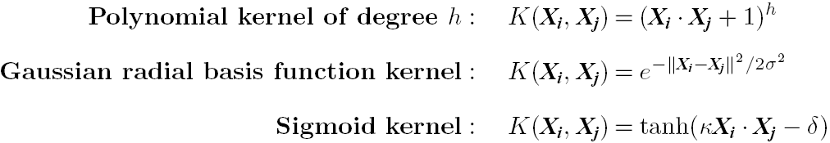
SVM: 不同的核函数
计算变换后数据的点积, 数学上等价于应用一个核函数K(X_{i}, X_{j}) 于原始数据, i.e., K(X_{i}, X_{j}) = Φ(X_{i}) Φ(X_{j})
Typical Kernel Functions
SVM 也可用于多类数据 (> 2)和回归分析(需要附加参数)

Slide 27
SVM vs. Neural Network
SVM
  Deterministic algorithm
  Nice generalization properties
  Hard to learn – 使用 quadratic programming techniques批量学习
  Using kernels can learn very complex functions
Neural Network
  Nondeterministic algorithm
  Generalizes well but doesn’t have strong mathematical foundation
  Can easily be learned in incremental fashion
  To learn complex functions—use multilayer perceptron (nontrivial)

Slide 28
SVM Related Links
SVM Website: http://www.kernel-machines.org/
Representative implementations
  LIBSVM: an efficient implementation of SVM, multi-class classifications, nu-SVM, one-class SVM, including also various interfaces with java, python, etc.
  SVM-light: simpler but performance is not better than LIBSVM, support only binary classification and only in C
  SVM-torch: another recent implementation also written in C

Slide 29
Chapter 8. 惰性学习
Bayesian Belief Networks
Classification by Backpropagation
Support Vector Machines
Classification by Using Frequent Patterns
Lazy Learners (or Learning from Your Neighbors)
Other Classification Methods
Additional Topics Regarding Classification
Summary

Slide 30
Lazy vs. Eager Learning
Lazy vs. eager learning
  Lazy learning (e.g., 基于实例的学习): 仅存储数据 (或稍加处理) 直到碰到检验元组才开始处理
  Eager learning (前面介绍的方法): 给定训练数据,在遇到待处理的新数据前构造分类模型
Lazy: 训练用时很少，预测时用时多
准确性
  惰性学习方法可以有效地利用更丰富的假设空间，使用多个局部线性函数来对目标函数形成一个隐式的全局逼近
  Eager: 必须限于一个假设，它覆盖了整个实例空间

Slide 31
Lazy Learner:基于实例的方法
Instance-based learning:
  Store training examples and delay the processing (“lazy evaluation”) until a new instance must be classified
典型的方法
  k-nearest neighbor approach
    实例表示为欧氏空间中的点.
  Locally weighted regression
    Constructs local approximation
  基于案例的推理Case-based reasoning
    使用符号表示和知识为基础的推理

Slide 32
k-最近邻算法
所有的样本对应于n-D 空间的点
通过Euclidean distance, dist(X₁, X₂) 定义最近邻居
目标函数可以是discrete- or real- 值
对于离散值, k-NN 返回与目标元组最近的k个训练样本的多数类
Vonoroi diagram: the decision surface induced by 1-NN for a typical set of training examples
_
.
.
_
_
+
_
.
.
+
.
_
x_{q}
+
_
.
+

Slide 33
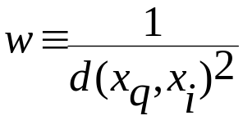
k-NN Algorithm的讨论
k-NN：元组的未知实值的预测时
  返回与未知元组k个最近邻居的平均值（对应属性）
Distance-weighted nearest neighbor algorithm
  根据与目标元组的距离权重组合k个近邻的贡献
    Give greater weight to closer neighbors
Robust to noisy data by averaging k-nearest neighbors
Curse of dimensionality: 邻居间的距离会被无关联的属性影响
  坐标轴伸缩或去除次要的属性

Slide 34
基于案例的推理 (CBR)
CBR: 使用一个问题解的数据库来求解新问题
存储符号描述(tuples or cases)—不是Euclidean space的点
应用: 顾客-服务台 (产品有关的诊断), 合法裁决
Methodology
  实例表示为复杂的符号描述(e.g., function graphs)
  搜索相似的案例, 组合多个返回的例子
  Tight coupling between case retrieval, knowledge-based reasoning, and problem solving
Challenges
  Find a good similarity metric
  Indexing based on syntactic similarity measure, and when failure, backtracking, and adapting to additional cases

Slide 35
Chapter 8. 分类: 其他方法
Bayesian Belief Networks
Classification by Backpropagation
Support Vector Machines
Classification by Using Frequent Patterns
Lazy Learners (or Learning from Your Neighbors)
Other Classification Methods
Additional Topics Regarding Classification
Summary

Slide 36
遗传算法 (GA)
Genetic Algorithm: 模仿生物进化
使用随机产生的规则组成一个最初的population
  每个规则有一系列位表示
  E.g., if A₁ and ¬A₂ then C₂ can be encoded as 100
  如果一个属性有 k > 2 个值, 使用k位
基于适者生存原理, 最适合的规则及其后代组成新的种群
规则的拟合度用它在训练样本的准确率来评估
通过交叉和突变来产生后代
此过程持续下去，直到种群P进化到其中的每个规则满足给定的拟合度阈值
算法慢，但易于并行

Slide 37

Fuzzy Set Approaches
Fuzzy logic 使用[0.0, 1.0]真值来表示类的成员的隶属度
属性值被转化成模糊值. Ex.:
  对于每个离散类别收入{low, medium, high}，x 被分配一个模糊的隶属值, e.g. $49K 属于 “medium income” 0.15，属于“high income” 的隶属值是0.96
  模糊隶属值的和不一定等于1.
每个可用的规则为类的隶属贡献一票
通常, 对每个预测分类的真值求和, 并组合这些值

Slide 38
Chapter 8. 分类: Advanced Methods
Bayesian Belief Networks
Classification by Backpropagation
Support Vector Machines
Classification by Using Frequent Patterns
Lazy Learners (or Learning from Your Neighbors)
Other Classification Methods
Additional Topics Regarding Classification
Summary

Slide 39
多类分类
分类时设计多个类别 (i.e., > 2 Classes)
Method 1. One-vs.-all (OVA): 每次学习一个分类器
  给定m个类, 训练m个分类其，每个类别一个
  分类器 j: 把类别 j的元组定义为 positive & 其他的为 negative
  为分类样本 X, 所有分类器投票来集成
Method 2. All-vs.-all (AVA): 为每一对类别学习一个分类器
  Given m classes, construct m(m-1)/2 binary classifiers
  使用两个类别的元组训练一个分类器
  为分类元组X, 每个分类器投票. X is assigned to the class with maximal vote
Comparison
  All-vs.-all tends to be superior to one-vs.-all
  Problem: Binary classifier is sensitive to errors, and errors affect vote count

Slide 40
多类分类的Error-Correcting Codes
最初目的是在数据传输的通讯任务中通过探索数据冗余来修正误差。例:
  A 7-bit codeword associated with classes 1-4
Class | Error-Corr. Codeword
C₁ | 1 | 1 | 1 | 1 | 1 | 1 | 1
C₂ | 0 | 0 | 0 | 0 | 1 | 1 | 1
C₃ | 0 | 0 | 1 | 1 | 0 | 0 | 1
C₄ | 0 | 1 | 0 | 1 | 0 | 1 | 0
  给定未知元组X, 7个分类器的结果为: 0001010
  Hamming distance: # 两个码字间不同位数的和
  H(X, C₁) = 5, 检查 [1111111] & [0001010]间不同位数和
  H(X, C₂) = 3, H(X, C₃) = 3, H(X, C₄) = 1, thus C₄ as the label for X
Error-correcting codes can correct up to (h-1)/h 1-bit error, where h is the minimum Hamming distance between any two codewords
If we use 1-bit per class, it is equiv. to one-vs.-all approach, the code are insufficient to self-correct
When selecting error-correcting codes, there should be good row-wise and col.-wise separation between the codewords

Slide 41
半监督分类
Semi-supervised: 使用有标签和无标签数据构造分类器
Self-training:
  Build a classifier using the labeled data
  Use it to label the unlabeled data, and those with the most confident label prediction are added to the set of labeled data
  重复以上过程
  Adv: 容易理解; disadv: 可能增大误差
Co-training: Use two or more classifiers to teach each other
  每个学习者使用元组的相互独立的特征集合来训练一个好的分类器F1
  然后 f₁ and f₂ 用来预测未知元组 X 的类别标签
  Teach each other: The tuple having the most confident prediction from f₁ is added to the set of labeled data for f₂, & vice versa
Other methods, e.g., joint probability distribution of features and labels

Slide 42
主动学习
获取类标签是昂贵
Active learner: query human (oracle) for labels
Pool-based approach: Uses a pool of unlabeled data
  L: D中有标签的样本子集, U: D的一个未标记数据集
  使用一个查询函数小心地从U选择1或多个元组，并咨询标签an oracle (a human annotator)
  The newly labeled samples are added to L, and learn a model
  Goal: Achieve high accuracy using as few labeled data as possible
Evaluated using learning curves: Accuracy as a function of the number of instances queried (# of tuples to be queried should be small)
Research issue: How to choose the data tuples to be queried?
  Uncertainty sampling: choose the least certain ones
  Reduce version space, the subset of hypotheses consistent w. the training data
  Reduce expected entropy over U: Find the greatest reduction in the total number of incorrect predictions

Slide 43
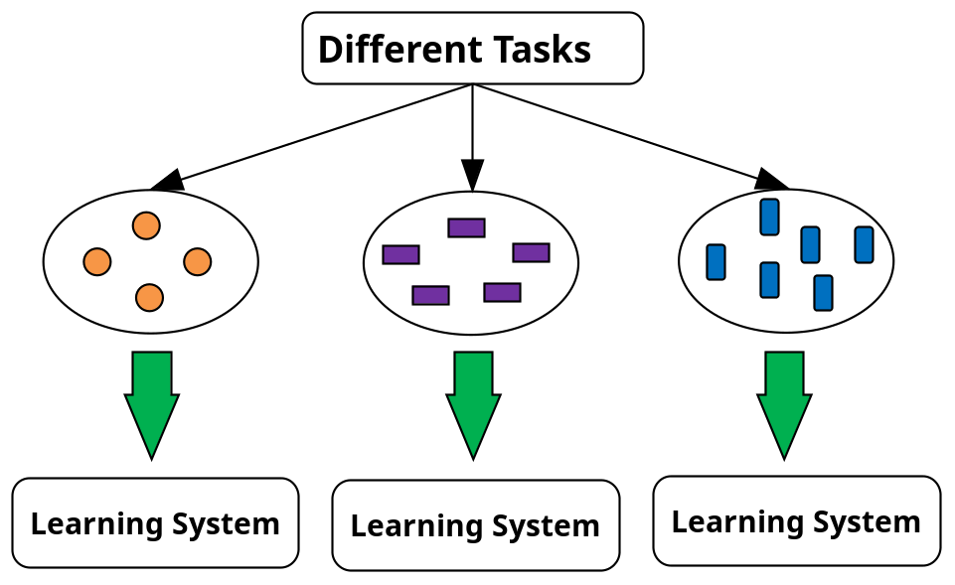
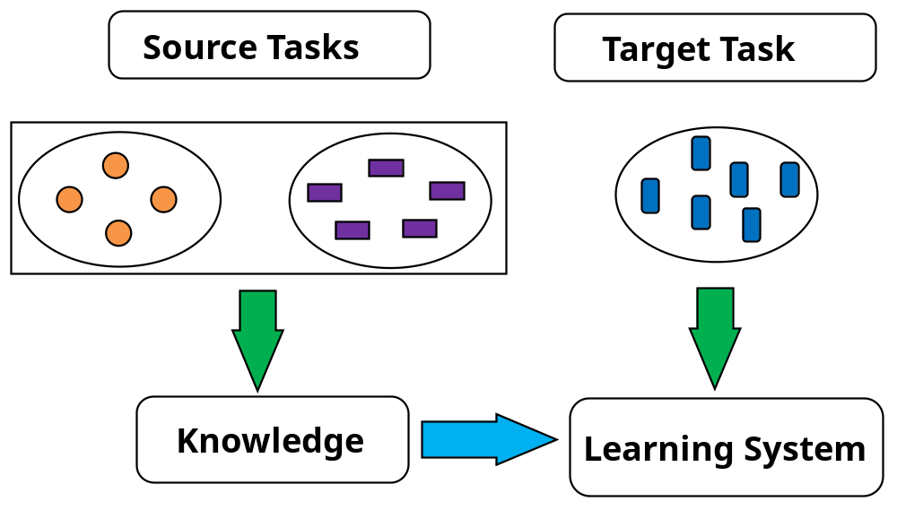
迁移学习：概念框架
Transfer learning: Extract knowledge from one or more source tasks and apply the knowledge to a target task
Traditional learning:每一个任务建立分类器
Transfer learning: Build new classifier by applying existing knowledge learned from source tasks
Traditional Learning Framework
Transfer Learning Framework

Slide 44
迁移学习: Methods and Applications
应用:数据过时或分布的变化时, e.g., Web document classification, e-mail spam filtering
Instance-based transfer learning: Reweight some of the data from source tasks and use it to learn the target task
TrAdaBoost (Transfer AdaBoost)
  假定源和目标数据用相同的属性和类别描述, but rather diff. distributions
  Require only labeling a small amount of target data
  训练中使用源数据: When a source tuple is misclassified, reduce the weight of such tupels so that they will have less effect on the subsequent classifier
Research issues
  Negative transfer: When it performs worse than no transfer at all
  Heterogeneous transfer learning: Transfer knowledge from different feature space or multiple source domains
  Large-scale transfer learning

Slide 45
Chapter 8. 分类:频繁模式
Bayesian Belief Networks
Classification by Backpropagation
Support Vector Machines
Classification by Using Frequent Patterns
Lazy Learners (or Learning from Your Neighbors)
Other Classification Methods
Additional Topics Regarding Classification
Summary

Slide 46
关联分类
关联分类: 主要步骤
  挖掘关于频繁模式(属性-值对的联结) 和类标签间的强关联
  产生以下形似的关联规则
      P₁ ^ p₂ … ^ p_{l} → “A_{class} = C” (conf, sup)
  组织规则，形成基于规则的分类器
为什么有效?
  可以发现（在多个属性间）高置信度的关联，可以克服决策树规约引入的约束, 决策树一次考虑一个属性
  研究发现，关联分类通常比某些传统的分类方法更精确, 例如C4.5

Slide 47
典型的关联分类方法
CBA (Classification Based on Associations: Liu, Hsu & Ma, KDD’98)
  挖掘可能关联规则：Cond-set (属性-值 的集合) → class label
  建立分类器: 基于置信度和支持度的下降序组织规则
CMAR (Classification based on Multiple Association Rules: Li, Han, Pei, ICDM’01)
  分类: 多个规则的统计分析
CPAR (Classification based on Predictive Association Rules: Yin & Han, SDM’03)
  产生预测性规则 (FOIL-like analysis) 允许覆盖的元组以降低权重形式保留下来构造新规则
  （根据期望准确率）使用最好的k 个规则预测
  更有效（产生规则少）, 精确性类似CMAR

Slide 48
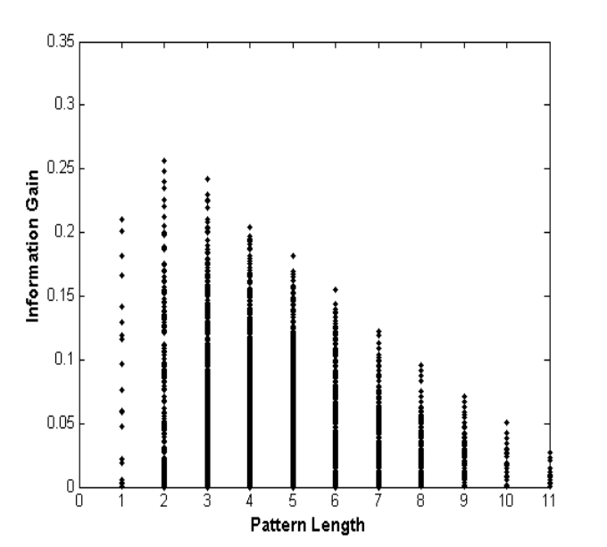
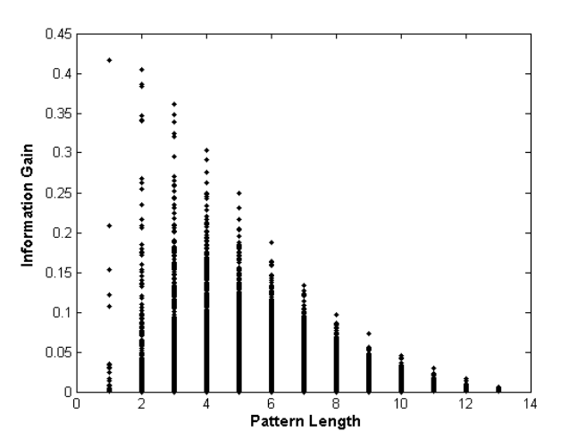
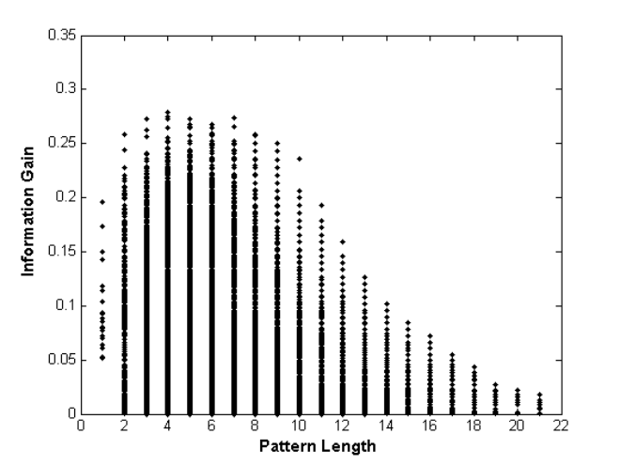
频繁模式 vs. 单个特征
  某些频繁模式的判别能力高于单个特征.
(a) Austral
(b) Cleve
(c) Sonar
Fig. 1. Information Gain vs. Pattern Length

Slide 49
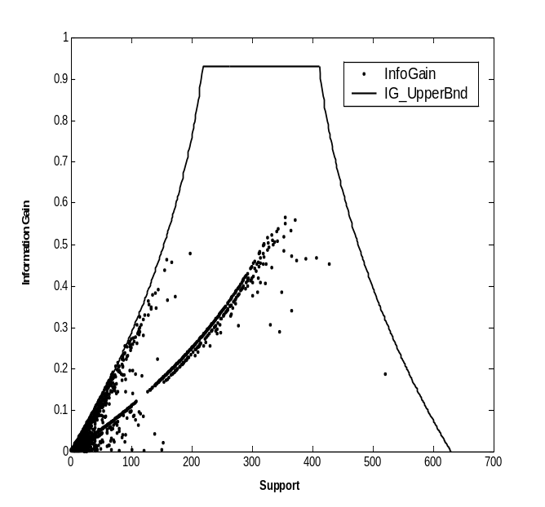
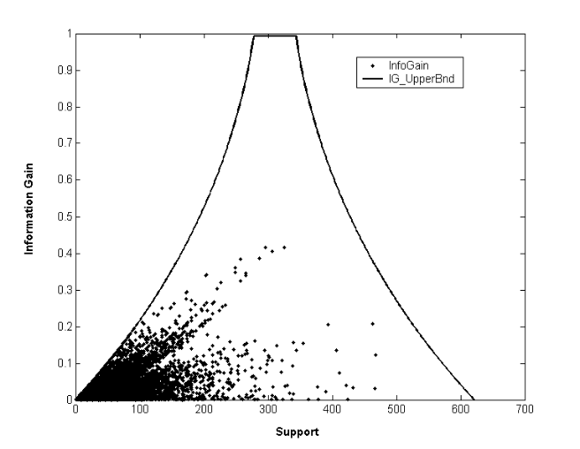
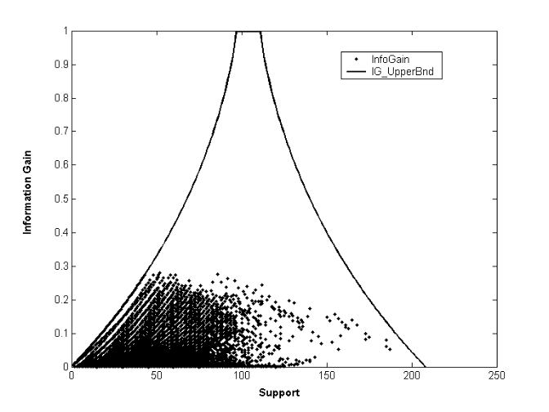
经验结果
(a) Austral
(b) Breast
(c) Sonar
Fig. 2. Information Gain vs. Pattern Frequency

Slide 50
特征选择Feature Selection
给定频繁模式集合, 存在non-discriminative和redundant 的模式, 他们会引起过度拟合
我们希望选出discriminative patterns，并且去除冗余
借用Maximal Marginal Relevance (MMR)的概念
  A document has high marginal relevance if it is both relevant to the query and contains minimal marginal similarity to previously selected documents

Slide 51
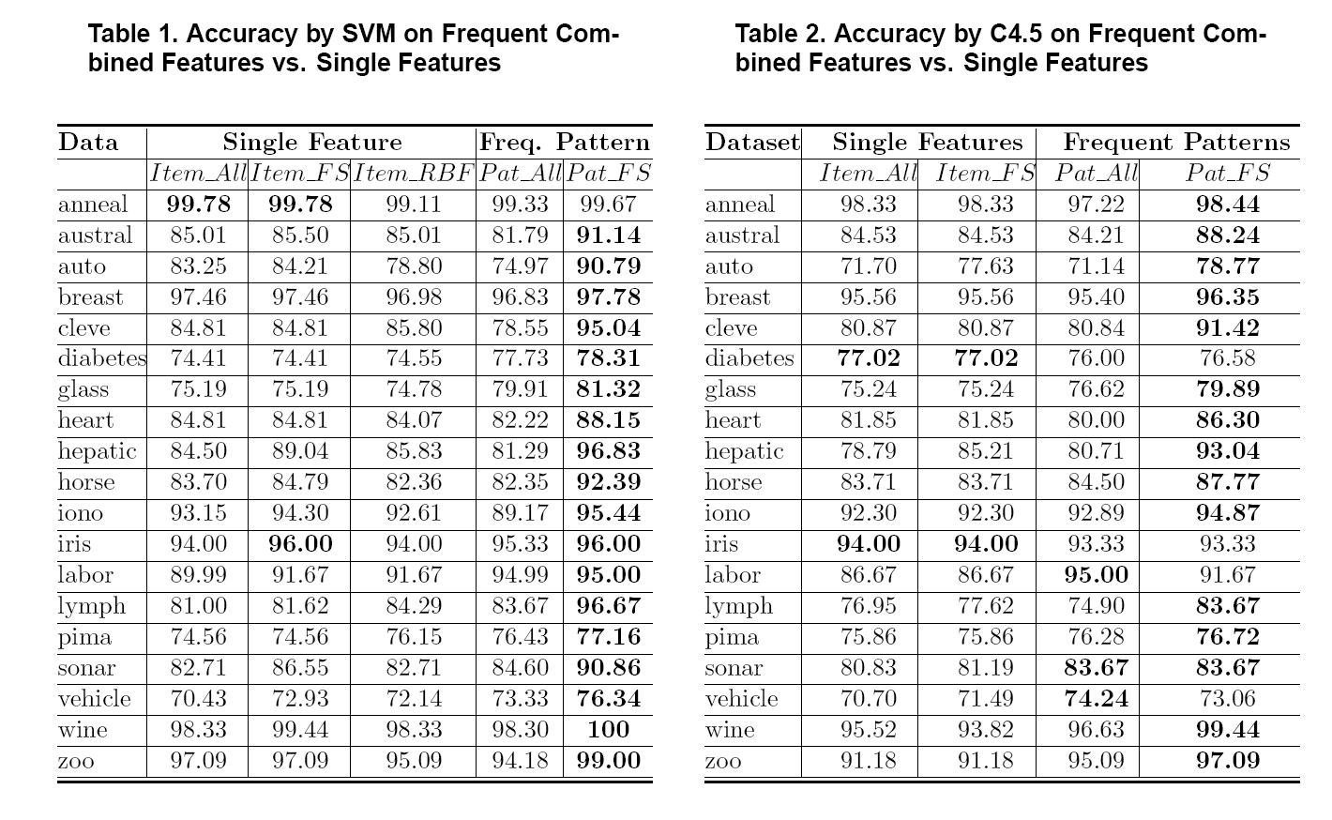
实验结果

Slide 52
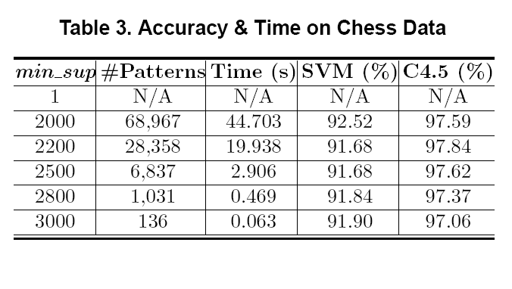
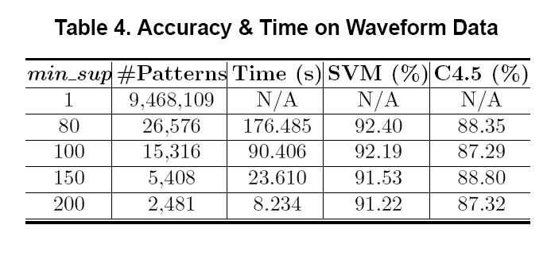
Scalability Tests

Slide 53
基于频繁模式的分类
H. Cheng, X. Yan, J. Han, and C.-W. Hsu, “Discriminative Frequent Pattern Analysis for Effective Classification”, ICDE'07
Accuracy issue问题
  Increase the discriminative power
  Increase the expressive power of the feature space
Scalability issue问题
  It is computationally infeasible to generate all feature combinations and filter them with an information gain threshold
  Efficient method (DDPMine: FPtree pruning): H. Cheng, X. Yan, J. Han, and P. S. Yu, "Direct Discriminative Pattern Mining for Effective Classification", ICDE'08

Slide 54
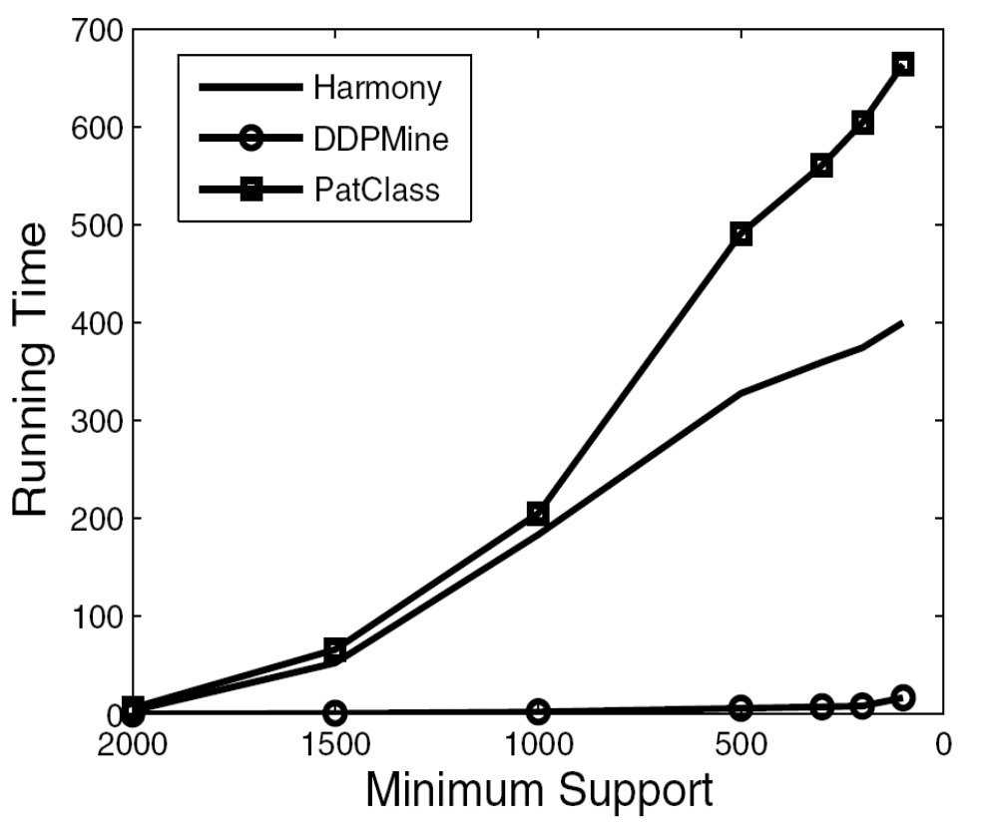
DDPMine Efficiency: Runtime
PatClass
Harmony
PatClass: ICDE’07 Pattern Classification Alg.
DDPMine
Notes:
One fig

Slide 55
Summary
Effective and advanced classification methods
  Bayesian belief network (probabilistic networks)
  Backpropagation (Neural networks)
  Support Vector Machine (SVM)
  Pattern-based classification
  Other classification methods: lazy learners (KNN, case-based reasoning), genetic algorithms, rough set and fuzzy set approaches
Additional Topics on Classification
  Multiclass classification
  Semi-supervised classification
  Active learning
  Transfer learning

Slide 56
References (1)
C. M. Bishop, Neural Networks for Pattern Recognition. Oxford University Press, 1995
C. J. C. Burges. A Tutorial on Support Vector Machines for Pattern Recognition. Data Mining and Knowledge Discovery, 2(2): 121-168, 1998
H. Cheng, X. Yan, J. Han, and C.-W. Hsu, Discriminative Frequent pattern Analysis for Effective Classification, ICDE'07
H. Cheng, X. Yan, J. Han, and P. S. Yu, Direct Discriminative Pattern Mining for Effective Classification, ICDE'08
N. Cristianini and J. Shawe-Taylor, Introduction to Support Vector Machines and Other Kernel-Based Learning Methods, Cambridge University Press, 2000
A. J. Dobson. An Introduction to Generalized Linear Models. Chapman & Hall, 1990
G. Dong and J. Li. Efficient mining of emerging patterns: Discovering trends and differences. KDD'99

Slide 57
References (2)
R. O. Duda, P. E. Hart, and D. G. Stork. Pattern Classification, 2ed. John Wiley, 2001
T. Hastie, R. Tibshirani, and J. Friedman. The Elements of Statistical Learning: Data Mining, Inference, and Prediction. Springer-Verlag, 2001
S. Haykin, Neural Networks and Learning Machines, Prentice Hall, 2008
D. Heckerman, D. Geiger, and D. M. Chickering. Learning Bayesian networks: The combination of knowledge and statistical data. Machine Learning, 1995.
V. Kecman, Learning and Soft Computing: Support Vector Machines, Neural Networks, and Fuzzy Logic, MIT Press, 2001
W. Li, J. Han, and J. Pei, CMAR: Accurate and Efficient Classification Based on Multiple Class-Association Rules, ICDM'01
T.-S. Lim, W.-Y. Loh, and Y.-S. Shih. A comparison of prediction accuracy, complexity, and training time of thirty-three old and new classification algorithms. Machine Learning, 2000

Slide 58
References (3)
B. Liu, W. Hsu, and Y. Ma. Integrating classification and association rule mining, p. 80-86, KDD’98.
T. M. Mitchell. Machine Learning. McGraw Hill, 1997.
D.E. Rumelhart, and J.L. McClelland, editors, Parallel Distributed Processing, MIT Press, 1986.
P. Tan, M. Steinbach, and V. Kumar. Introduction to Data Mining. Addison Wesley, 2005.
S. M. Weiss and N. Indurkhya. Predictive Data Mining. Morgan Kaufmann, 1997.
I. H. Witten and E. Frank. Data Mining: Practical Machine Learning Tools and Techniques, 2ed. Morgan Kaufmann, 2005.
X. Yin and J. Han. CPAR: Classification based on predictive association rules. SDM'03
H. Yu, J. Yang, and J. Han. Classifying large data sets using SVM with hierarchical clusters. KDD'03.

Slide 59
SVM—Introductory Literature
“Statistical Learning Theory” by Vapnik: extremely hard to understand, containing many errors too.
C. J. C. Burges. A Tutorial on Support Vector Machines for Pattern Recognition. Knowledge Discovery and Data Mining, 2(2), 1998.
  Better than the Vapnik’s book, but still written too hard for introduction, and the examples are so not-intuitive
The book “An Introduction to Support Vector Machines” by N. Cristianini and J. Shawe-Taylor
  Also written hard for introduction, but the explanation about the mercer’s theorem is better than above literatures
The neural network book by Haykins
  Contains one nice chapter of SVM introduction

Slide 60
Notes about SVM—Introductory Literature
“Statistical Learning Theory” by Vapnik: difficult to understand, containing many errors.
C. J. C. Burges. A Tutorial on Support Vector Machines for Pattern Recognition. Knowledge Discovery and Data Mining, 2(2), 1998.
  Easier than Vapnik’s book, but still not introductory level; the examples are not so intuitive
The book An Introduction to Support Vector Machines by Cristianini and Shawe-Taylor
  Not introductory level, but the explanation about Mercer’s Theorem is better than above literatures
Neural Networks and Learning Machines by Haykin
  Contains a nice chapter on SVM introduction
Notes:
MK: Do we need this slide here?? We don’t give references for other topics until the reference section

