Slide 1
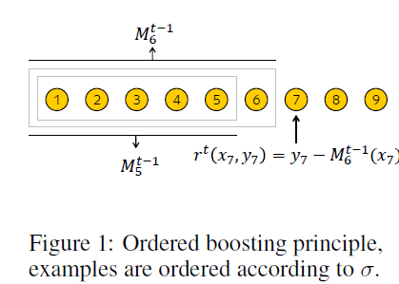
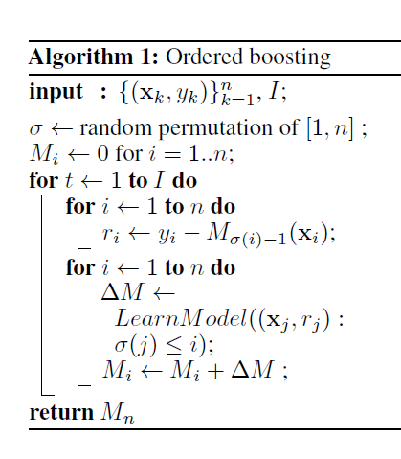
Assume that we learn a model with I trees

Slide 2
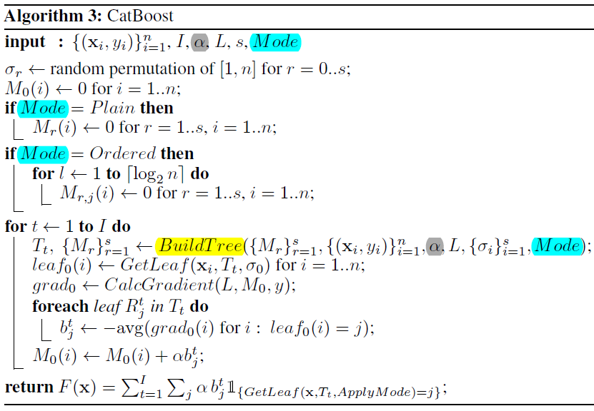
PART1
1. GetLeaf

Slide 3
PART2
1. GetLeaf

Slide 4
1. GetLeaf

Slide 5
1. GetLeaf

Slide 7
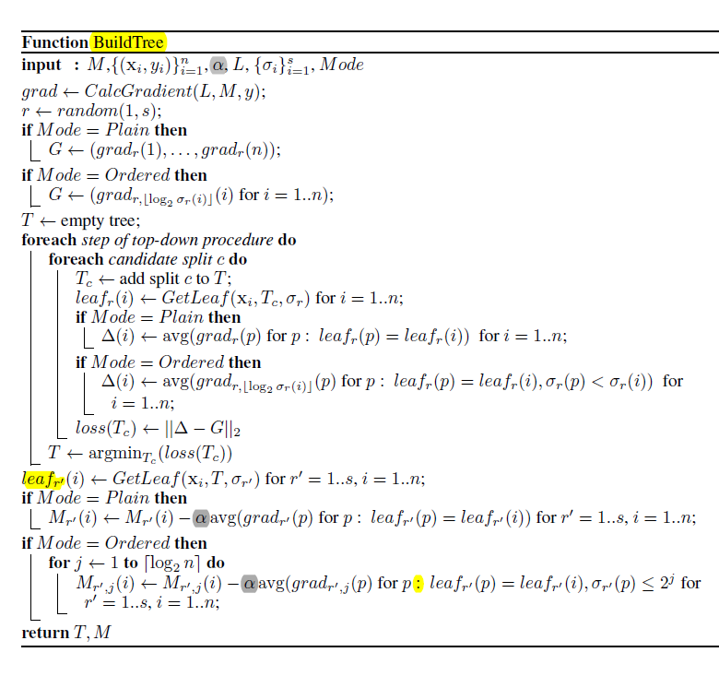

Slide 8
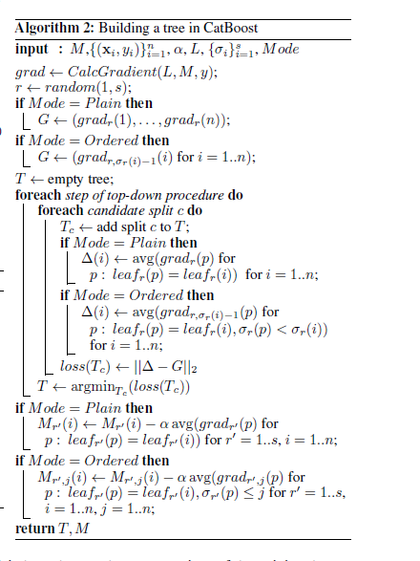

Slide 9
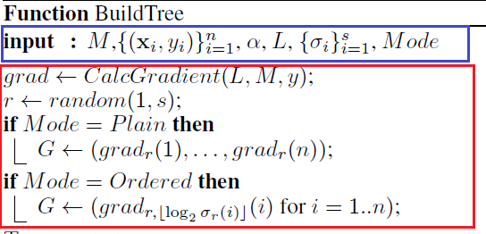
第1部分

Slide 10
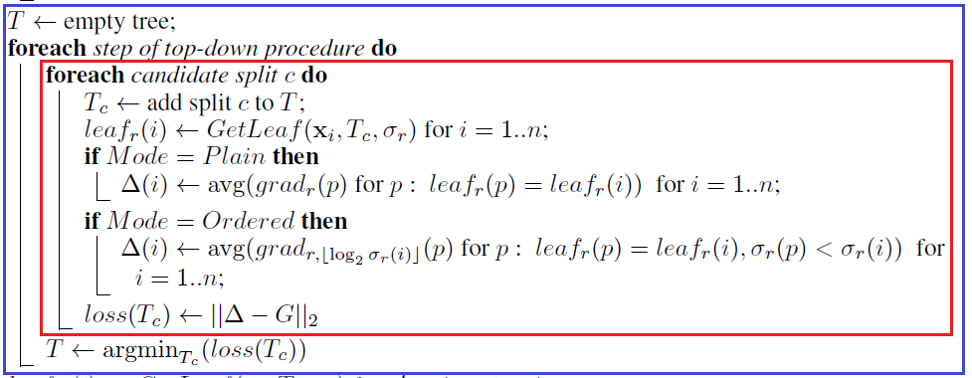
第二部分
第2部分

Slide 11
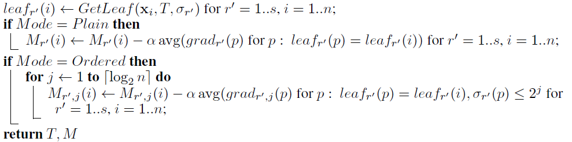
第3部分

Slide 12
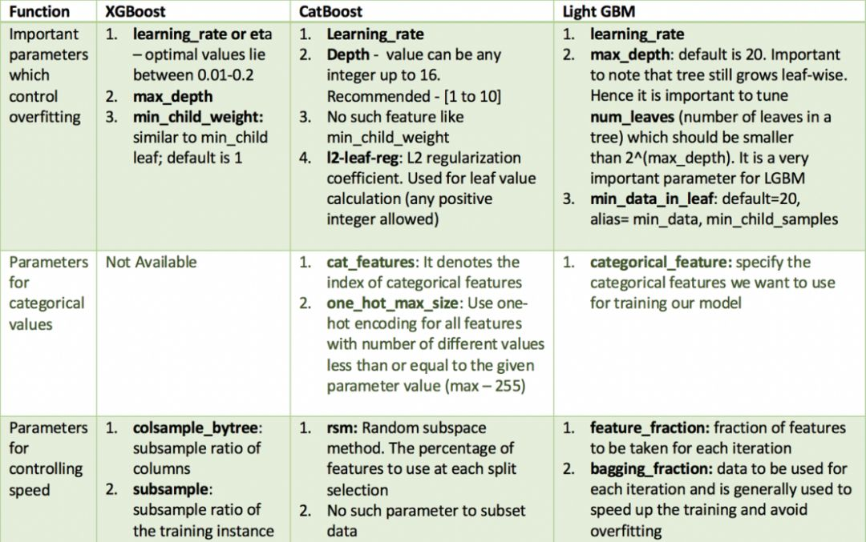

Slide 13
https://tech.yandex.com/catboost/doc/dg/concepts/python-reference_catboostclassifier-docpage/
https://tech.yandex.com/catboost/doc/dg/concepts/python-reference_catboostregressor-docpage/
https://tech.yandex.com/catboost/doc/dg/concepts/parameter-tuning-docpage/
https://github.com/catboost/tutorials
https://blog.csdn.net/cheney2000/article/details/79478654
http://lightgbm.apachecn.org/cn/latest/Installation-Guide.html
https://blog.csdn.net/lvsehaiyang1993/article/details/80619495
https://blog.csdn.net/chenhaouestc/article/details/78358065
https://www.lfd.uci.edu/~gohlke/pythonlibs/

Slide 14
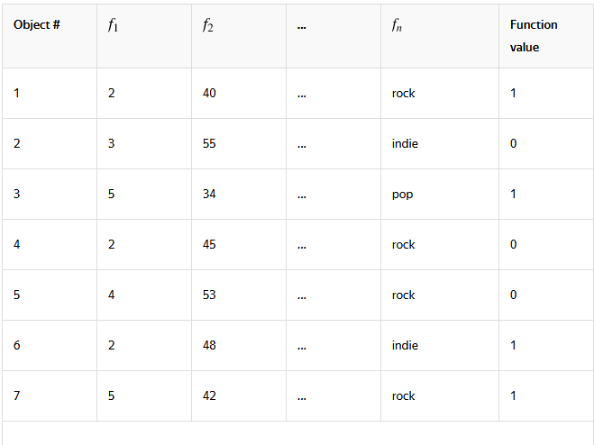

Slide 15


