Slide 1
Designing and 3D Printing Customised Phase Plates based on Modified Gerchberg-Saxton Algorithm
Major Category: Optoelectronics (光電領域)
Group Number: B476
Advisor: 楊尚樺 Yang, Shang-Hua
Mentor: Seyed Mostafa Latifi
Author: 施哨亮 Eugenius Edward Setiadi

Slide 2

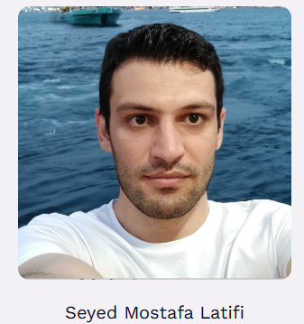
Member
Mentor:

Slide 3
Introduction
Terahertz (THz) spectroscopy is a powerful tool for imaging and testing applications, where it needs elements to manipulate the intensity and shape of the beam.
Flexible and rapid prototyping capabilities can be needed for this optical elements
Code-based design using the Gerchberg-Saxton algorithm allows for an efficient exploration of various target intensity profiles before 3D printing the final phase plate.

Slide 4
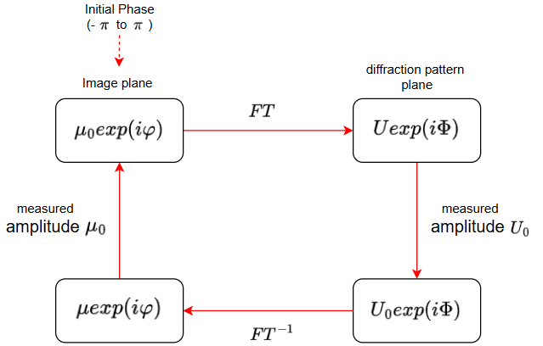
Computational Design with Gerchberg-Saxton Algorithm
Gerchberg-Saxton algorithm: A powerful computational method for designing diffractive optical elements like phase plates.
GS algorithm uses an Iterative approach
Key step in each iteration:
Forward propagation: Simulate how the light wave propagates from the source plane.
Enforcing target intensity: Adjust the wavefront to match the desired intensity pattern at the target plane.
Backward propagation: Simulate how the modified light wave propagates back to the source plane.
Enforcing input intensity: Adjust the wavefront again to ensure it maintains the original intensity profile at the source plane.

Slide 5
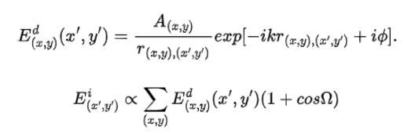
Huygens Principle
Every point on a wavefront acts as a source of secondary spherical wavelets, and the new wavefront is the envelope of these wavelets' forward propagation.

Slide 6

Implementation
Will be done using python language
Modified GS algorithm integrating the Huygens principle
Inital input Beam set with a beam width of 80 mm and 200 GHz
l = 75 mm; distance between the output beam and the phase plate

Slide 7
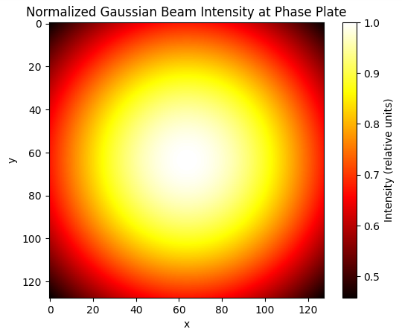
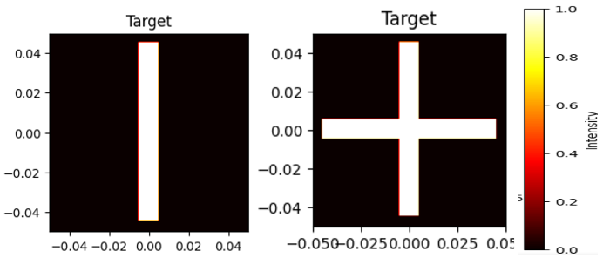
Implementation
input and target intensity:
simulation is done with a plate with 128 grid size and 100x100 mm in size

Slide 8

Implementation
Another formula is also used to calculate the thickness of the calculated phase plate
n = 1.7

Slide 9
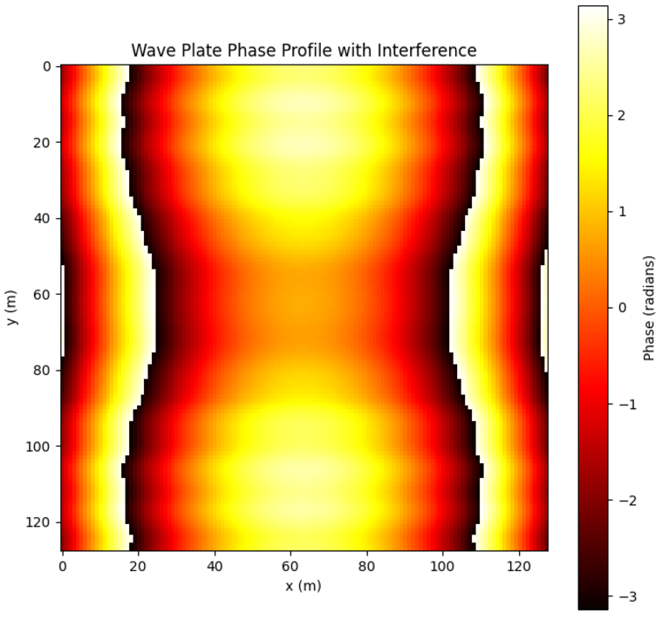
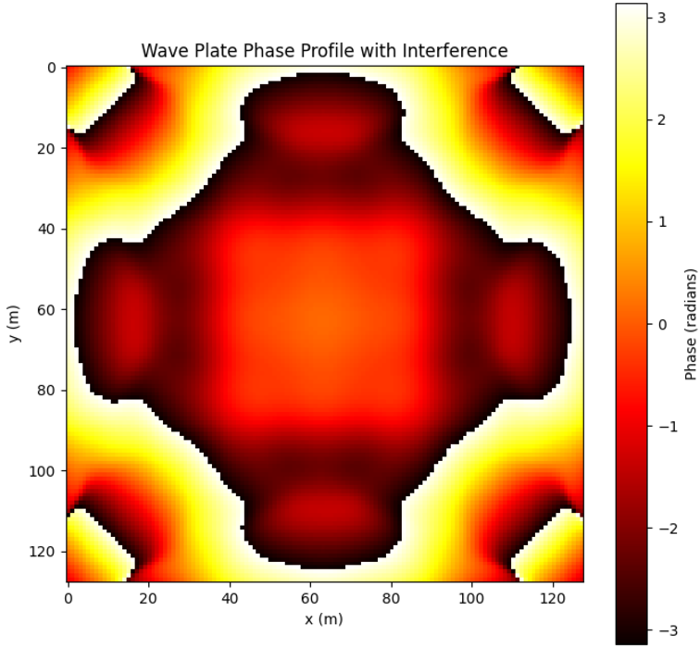
Results
After running the algorithm, the phase profile for both target output intensities is acquired, and the thickness to design the phaes plate can be calculated.

Slide 10
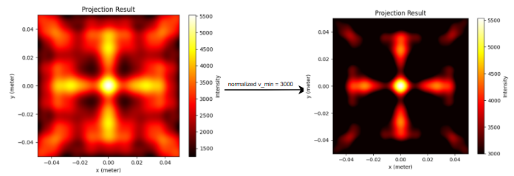
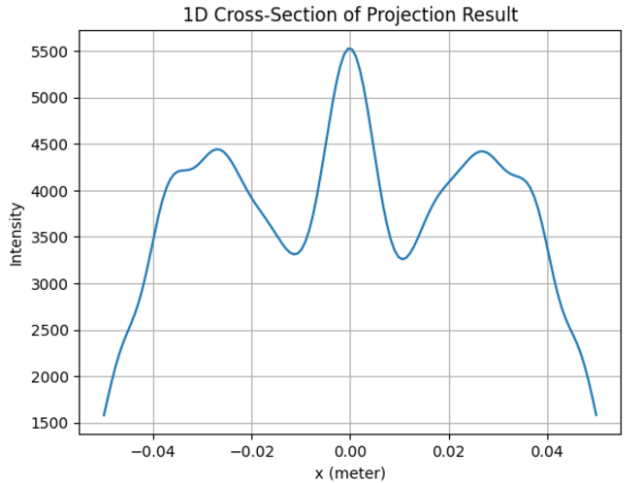
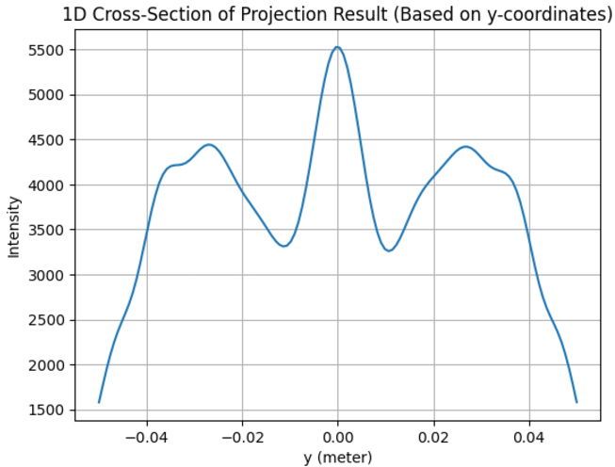
Results
The accuracy of the generated phase plate can be observed by doing another simulation.

Slide 11
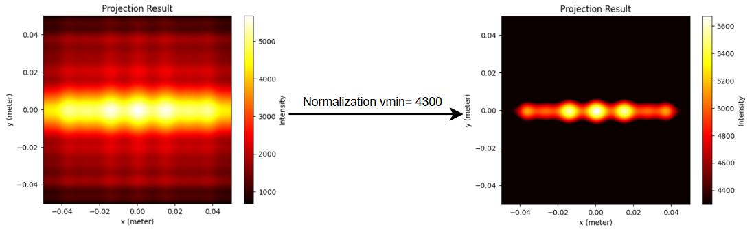
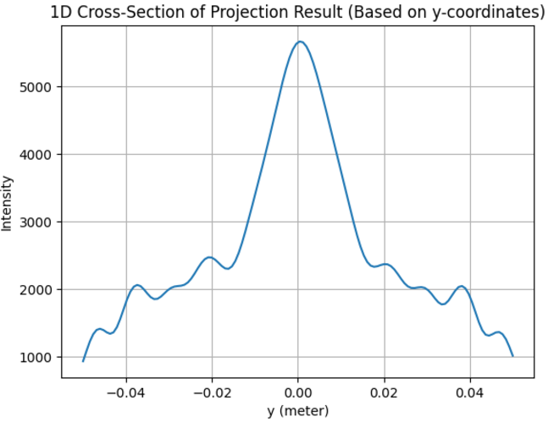
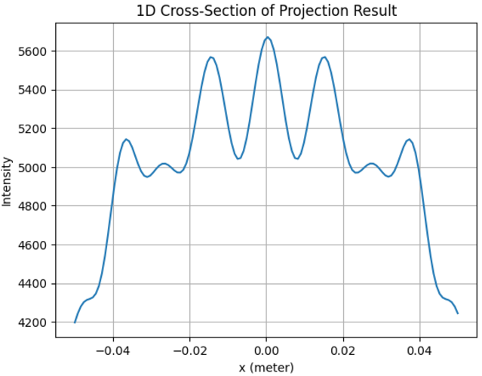
Results
The accuracy of the generated phase plate can be observed by doing another simulation.

Slide 12
Conclusion
Simulation results closely matched target intensities, validating the algorithm's effectiveness under simulated conditions.
Identified Challenges:
Mismatched output patterns in some cases.
Need for improvements in plotting processes and parameter optimization.
Based on computational calculations, the methodology offers a robust framework for designing and fabricating THz optical components.
Demonstrates promising applications in advancing optoelectronic device development.

Slide 13
Citation
Anderson, F. L. (2021, October 12). Huygens' Principle geometric derivation and elimination of the wake and backward wave. Huygens' Principle: geometric derivation and elimination of the wake and backward wave | Scientific Report. Retrieved October 21, 2024, from https://www.nature.com/articles/s41598-021-99049-7#:~:text=Huygens'%20Principle%20(1678)%20implies,to%20all%20the%20secondary%20wavelets
Dzhirkirba, K. R., Gusikhin, P. A., Murav'ev, V. M., Kukushkin, I. V., Gospodaric, J., & Pimenov, A. (2022, April). 3D-PRINTED PHASE WAVE PLATES FOR CREATION OF TERAHERTZ BEAMS WITH LINEAR POWER DISTRIBUTION. Radiophysics and Quantum Electronics, 65(4), 10.1007/s11141-023-10212-8
Gospodaric, J., Kuzmenko, A., Pimenov, A., Huber, C., Suess, D., Rotter, S., & Pimenov, A. (2018). 3D-printed phase waveplates for THz beam shaping. Applied Physics Letters, 112(221104), -. 10.1063/1.5027179
Reichel, S., Petzoid, U., Biertuempfel, R., & Vogt, H. (2009, February 19). Flat-hat glass diffractive optical beam shaper. Proceedings of SPIE, 7194(-), 10.1117/12.807932
Ye, X., Xiang, F., You, C. W., Wang, K., Yang, Z., Liu, J., & Wang, S. L. (2018). Generation of a terahertz collimated top-hat beam by using two thin diffractive phase plates. OSA CONTINUUM, 1(4),

