Slide 1
Work Progress
Eugenius Edward Setiadi
110006219

Slide 2
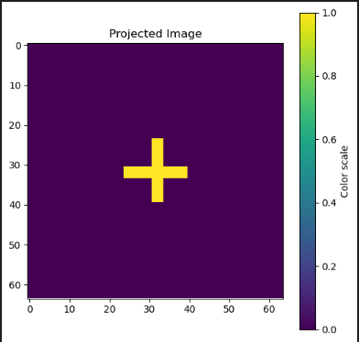
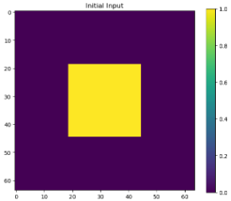
Determining the input (support) and the target
Target image :
Input (support) :

Slide 3

Method that are used
The Gerchberg Saxton Algorithm (100 iterations)
The Fresnell Kirchoff diffraction formula:

Slide 4
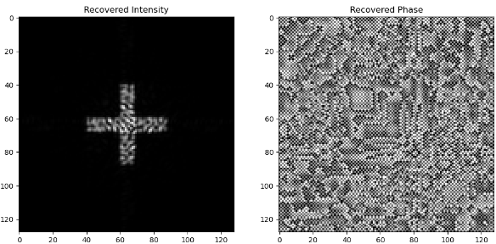
Results

