Slide 1
Work Progress
Eugenius Edward Setiadi
110006219

Slide 2
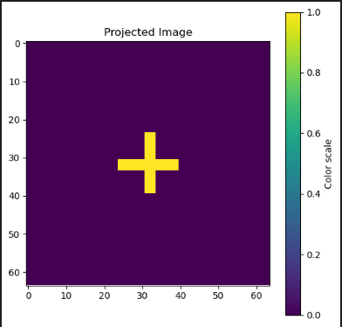
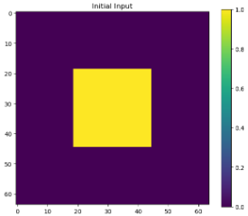
Determining the input (support) and the target
Target image :
Input (support) :

Slide 3
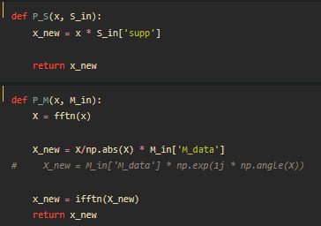
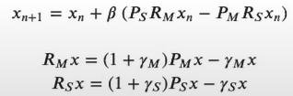
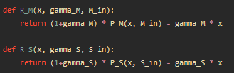
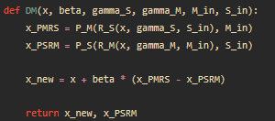
The equation that are used
Ps = Support Projection
Rm = Relaxed Magnitude
Pm = Project Magnitude
Rs = Relaxed Support
We then combine the relaxed magnitude and support projection
iteratively to update the input signal

Slide 4
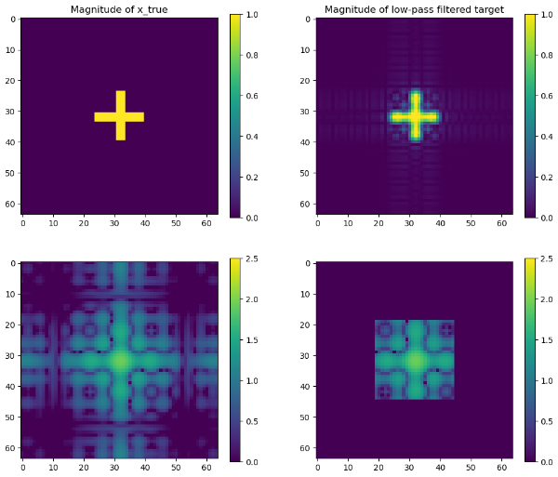
Convolving the input with the target

Slide 5
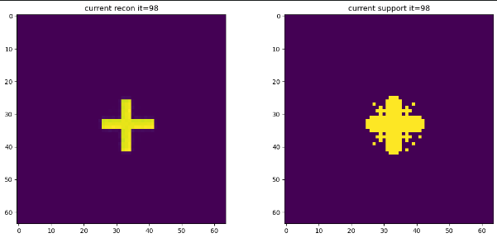
Phase retrieval
Phase retrieval is doing in an iterative way
Value to be considered:
Beta = 0.7
100 iterations
Left is the results after the iterations, right is the state of the input after the iterations

