Slide 1
Work Progress
Eugenius Edward Setiadi
110006219

Slide 2
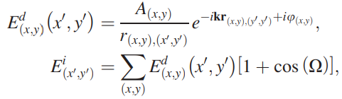
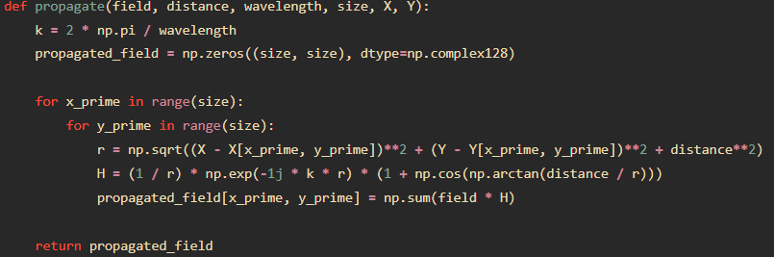
The propagation equation
Equation :
Implementation :

Slide 3
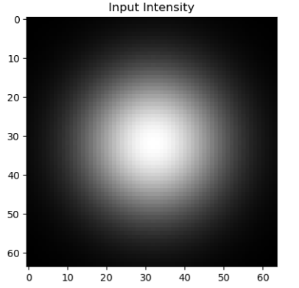
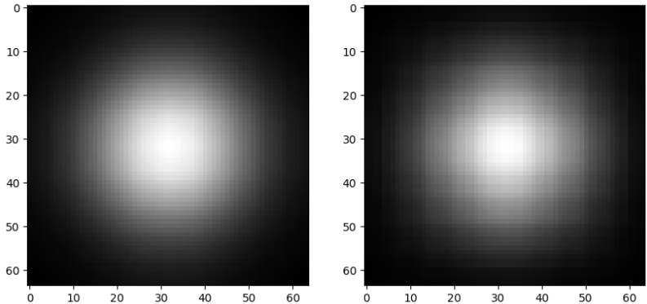
Checking the function
We want to check if the beam is propagated in certain distance before touching the phase plate
Input beam
Propagation in 5mm
Propagation in 30mm

Slide 4
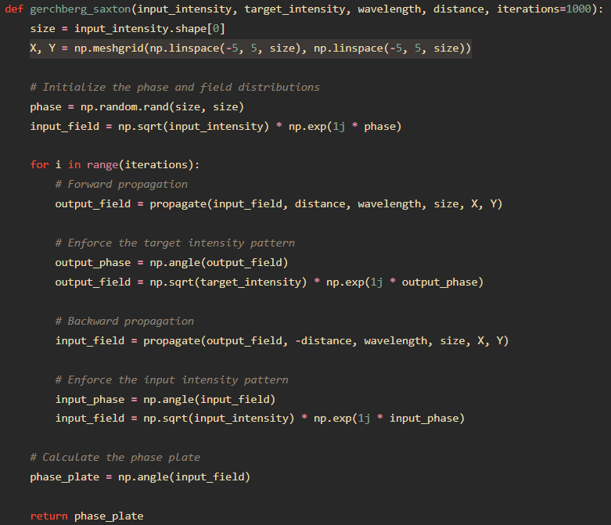
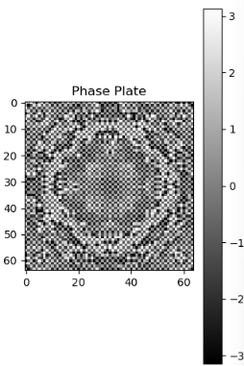
Phase Retrieval using GS
Generated phase profile
(distance= 30mm
Iterations= 100):

Slide 5
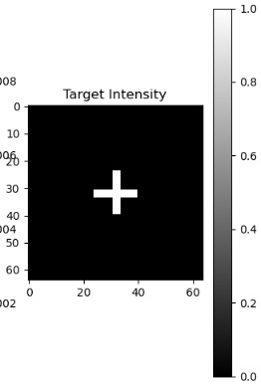
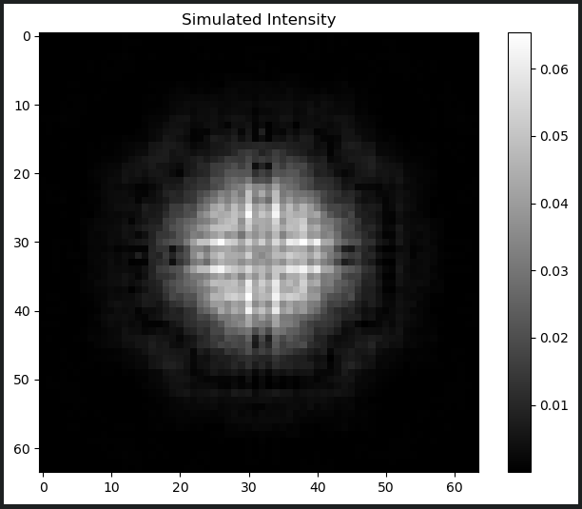
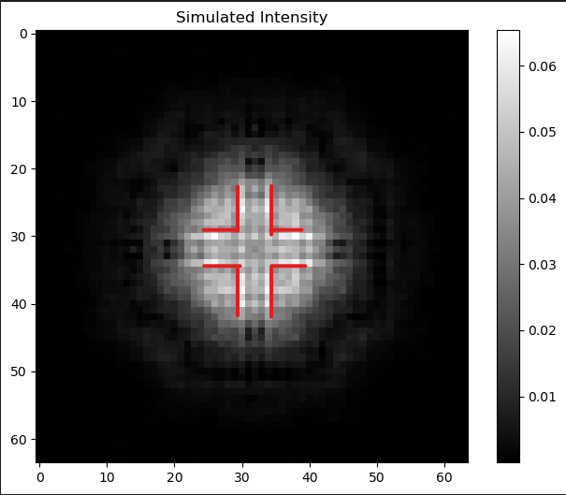
Image received from generated phase profile
*The generated image is trying to form the target image that are set.
Target image
Generated image
The simulated image generated by the phase plate design shows promising progress towards achieving the target intensity pattern. Further refinement of the phase profile is recommended for optimal performance.

