Slide 1
Work Progress
Eugenius Edward Setiadi
110006219

Slide 2
In and out algorithm
Gerchberg-saxton algorithm
Iterative fourier transform algorithm (IFTA)

Slide 3
Gerchberg-saxton algorithm
used for phase retrieval and design of phase-only elements, such as masks or phase plates.
Procedure:
Start with random initial phase
Perform fourier transform
Replace amplitude
Inverse the fourier transform to the input plane
Update
Iterate it

Slide 4
IFTA
used for designing diffractive optical elements, and it can handle more complex amplitude and phase distributions.
Consideration from the gerchberg-saxton is that more versatile since it allows manipulation for both amplitude and phase. So very suitable for designing complex phase profiles.

Slide 5
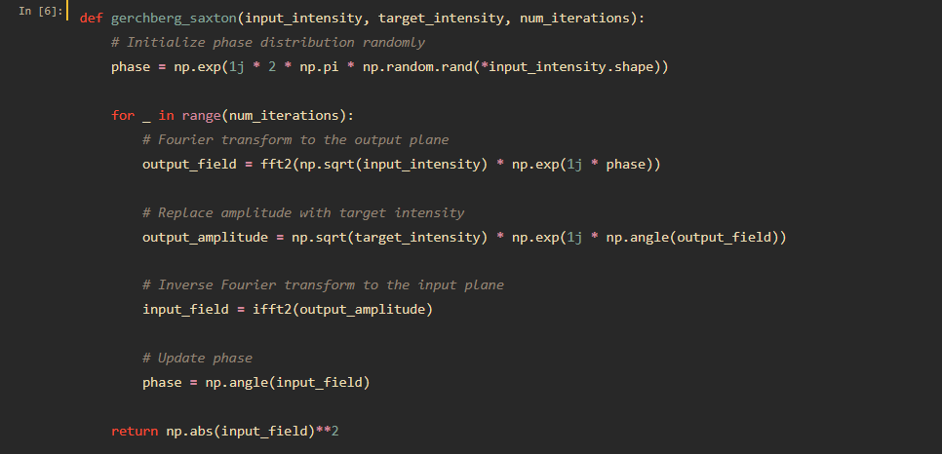
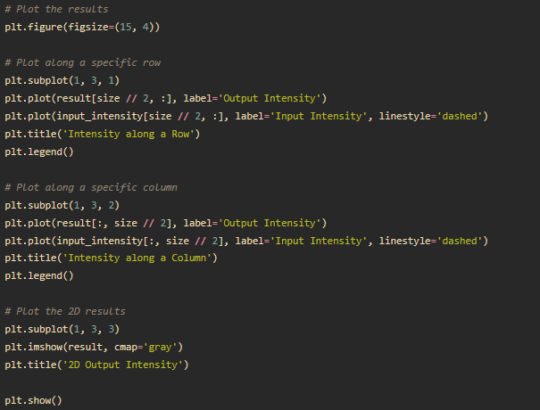
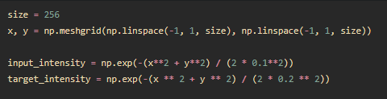



Slide 6
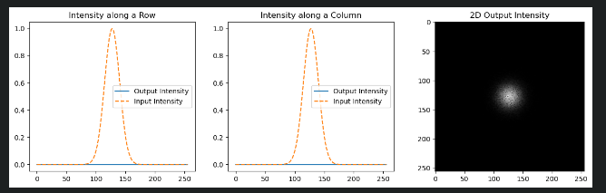
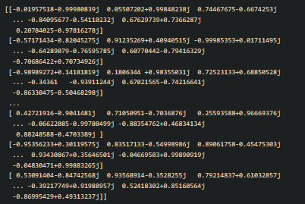
Results
Phase distribution
Next work?
Implementing gradient descent for more optimal iteration times
Try to implement others algorithm (?)

Slide 7
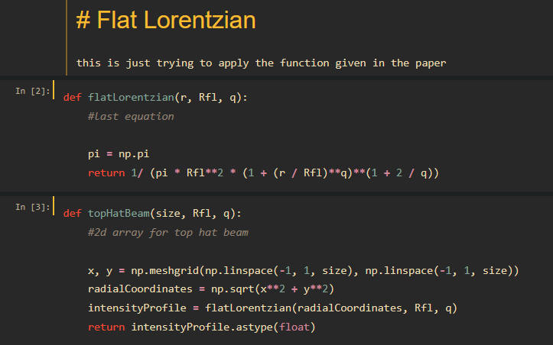
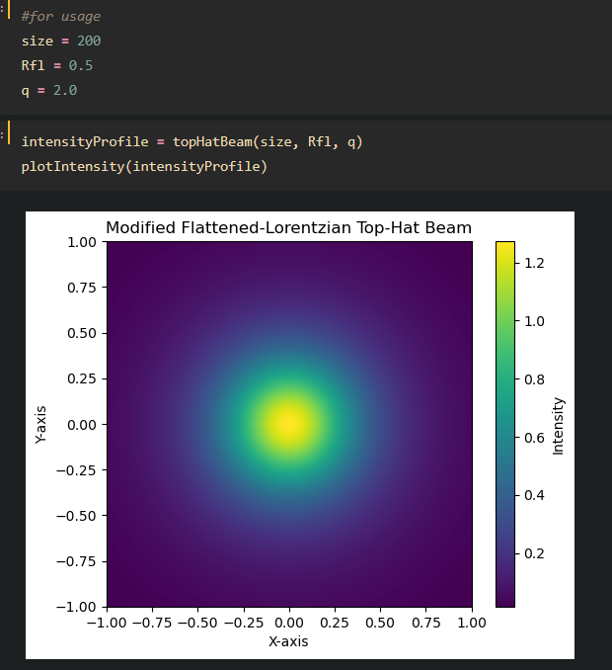
Some other work

