Slide 1
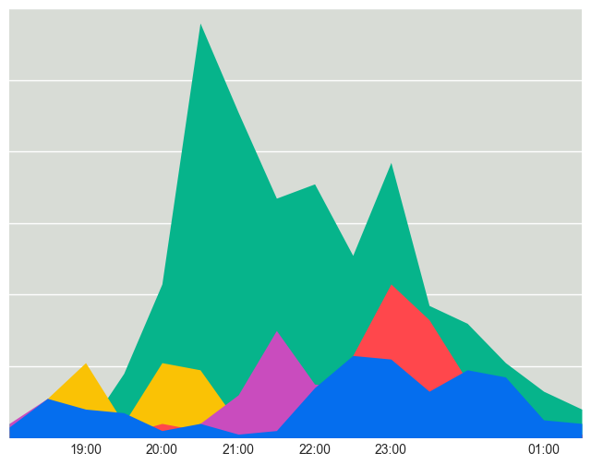
Top mentioned bands on Thursday
Primavera Sound 2017
Mishima
Arcade Fire
Bon Iver
Solange
The Afghan Whigs

