Slide 1
Parking reservation bot
stage 3

Slide 2
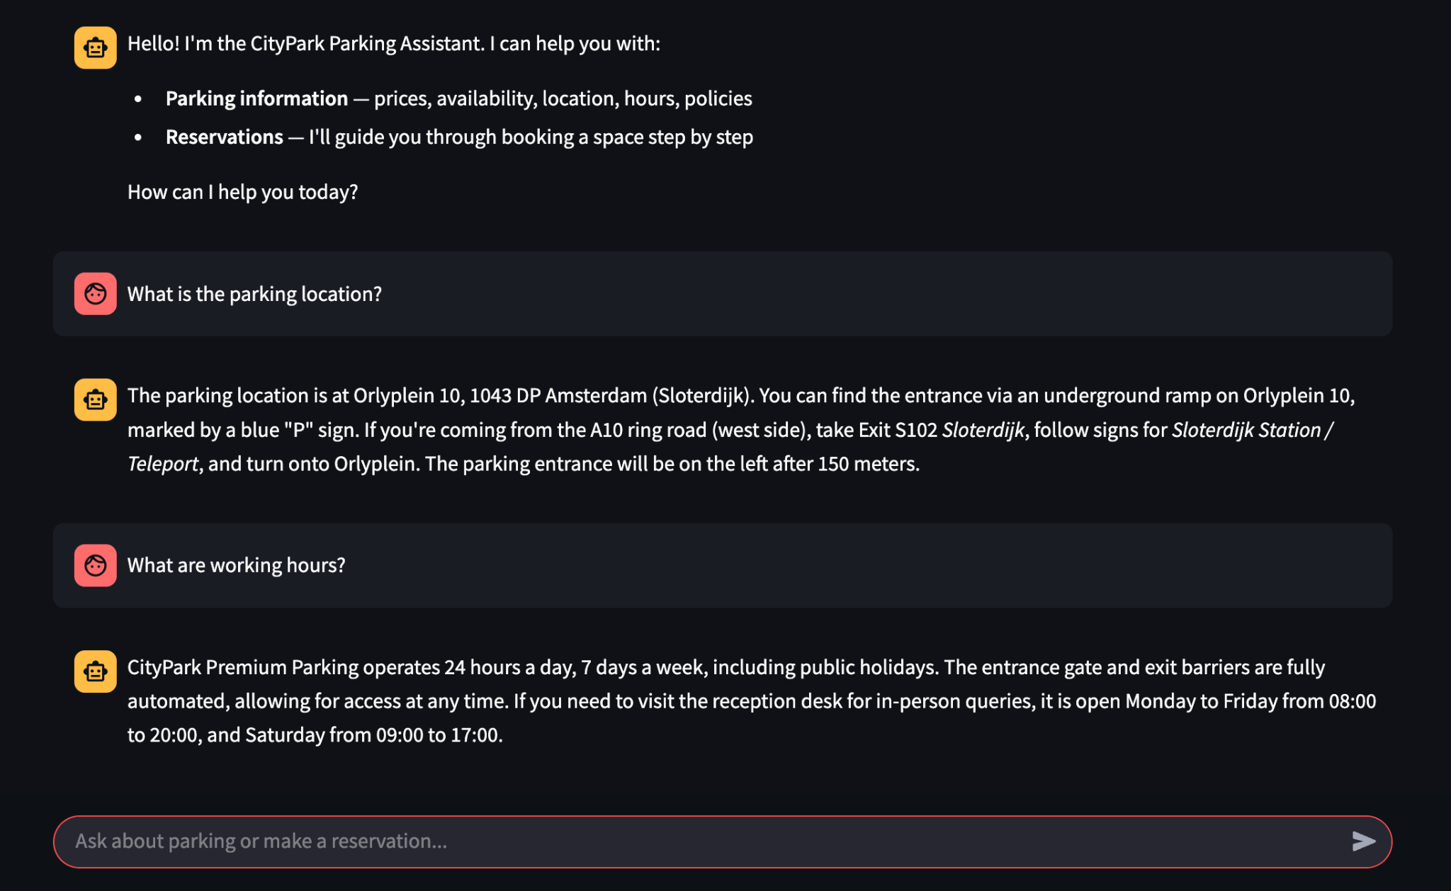
Answering general questions

Slide 3
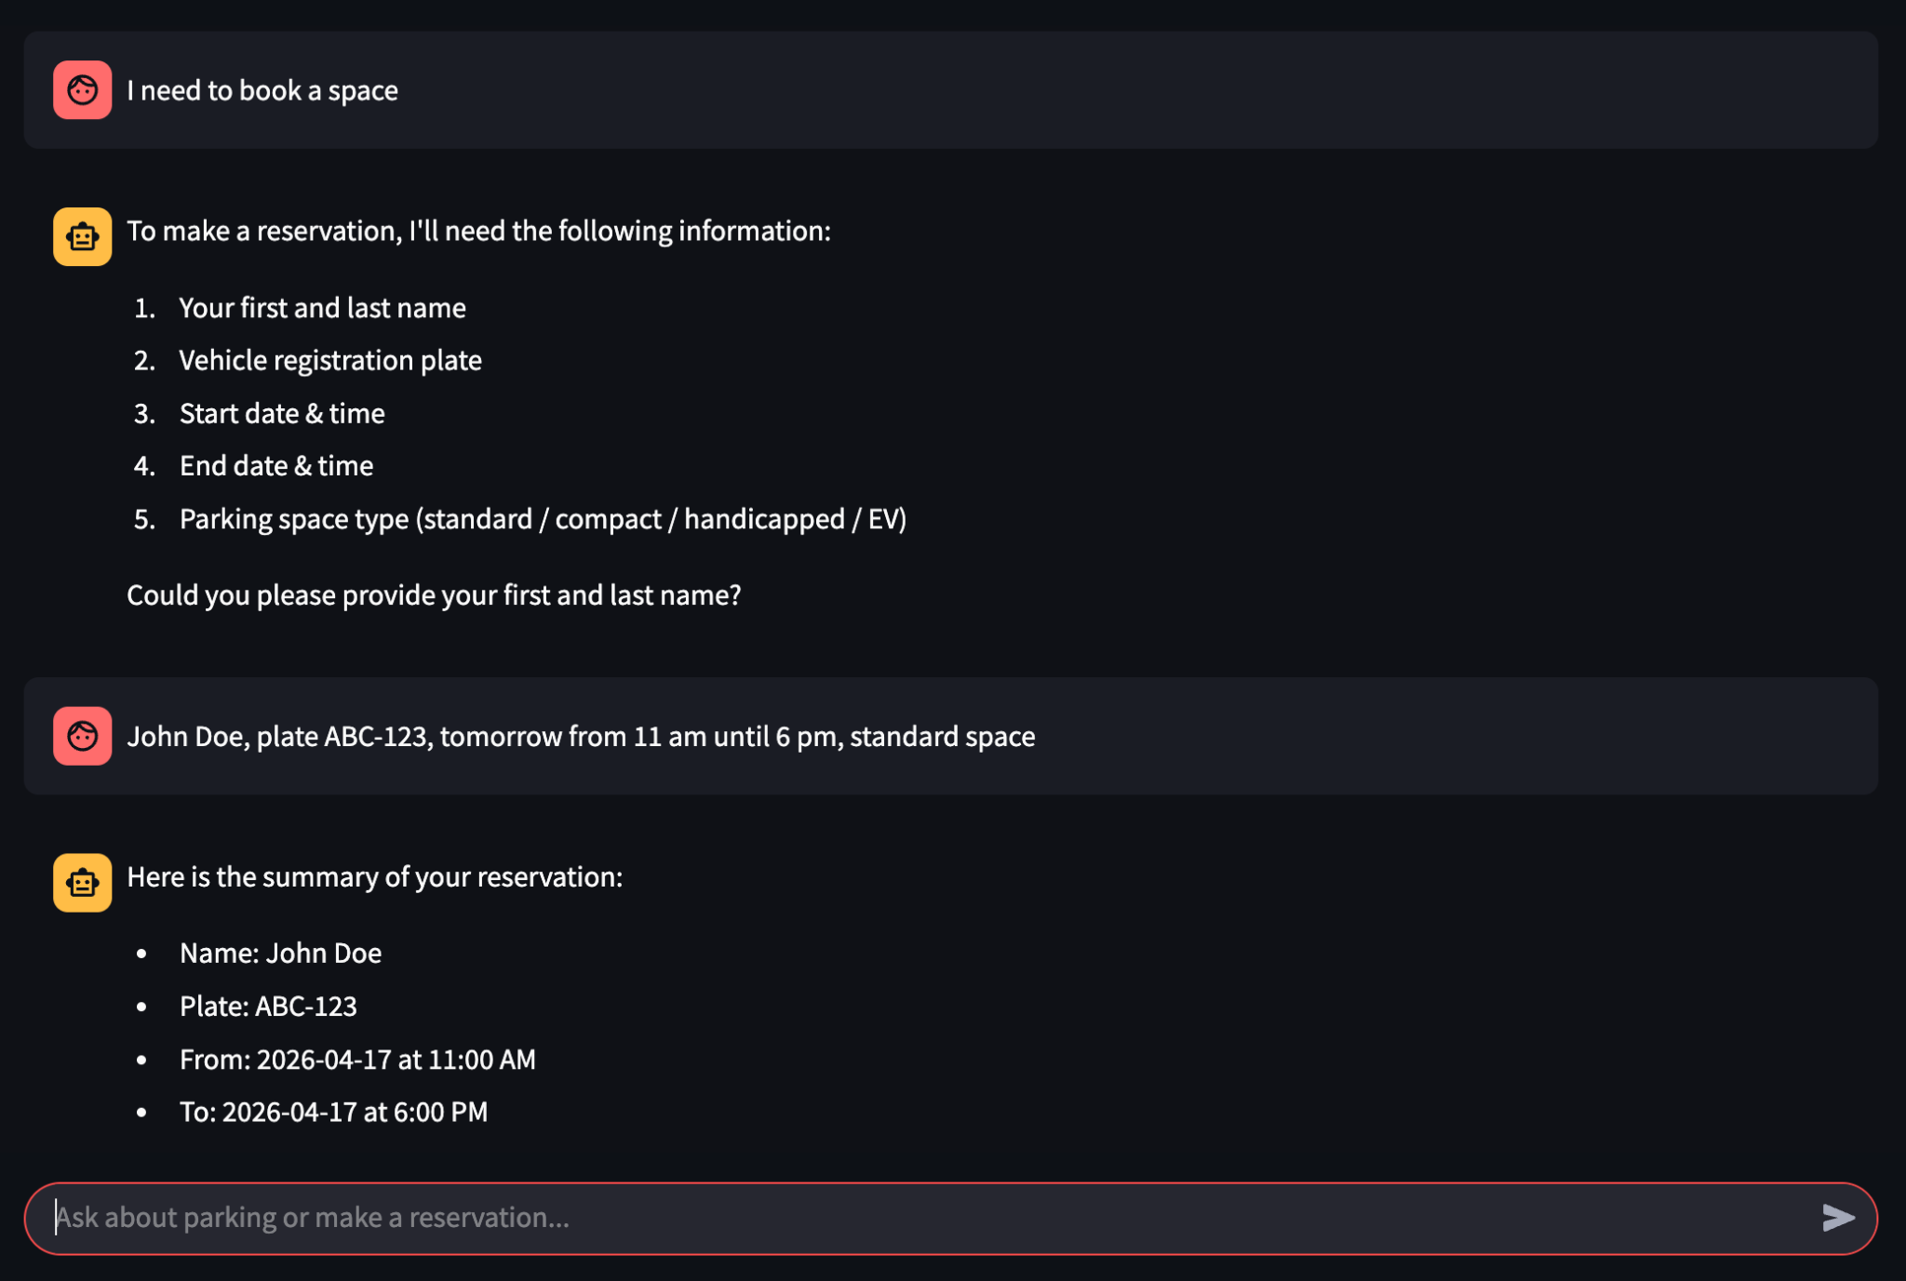
Booking process and retrieving data from user

Slide 4
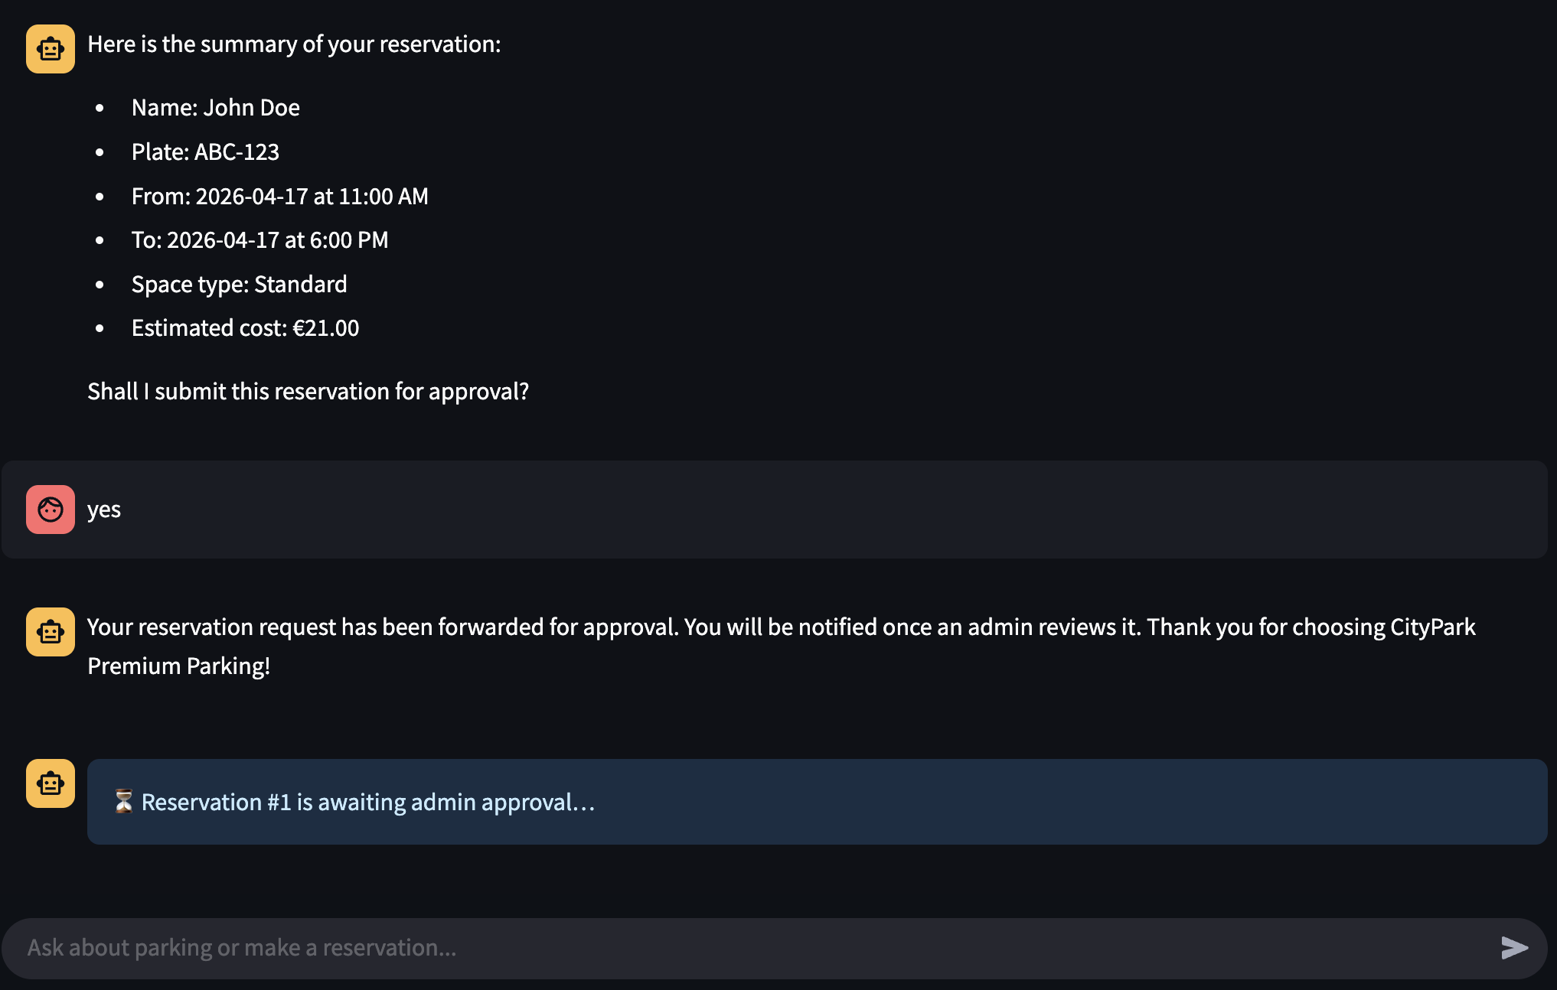
Getting confirmation from human admin (via API)

Slide 5
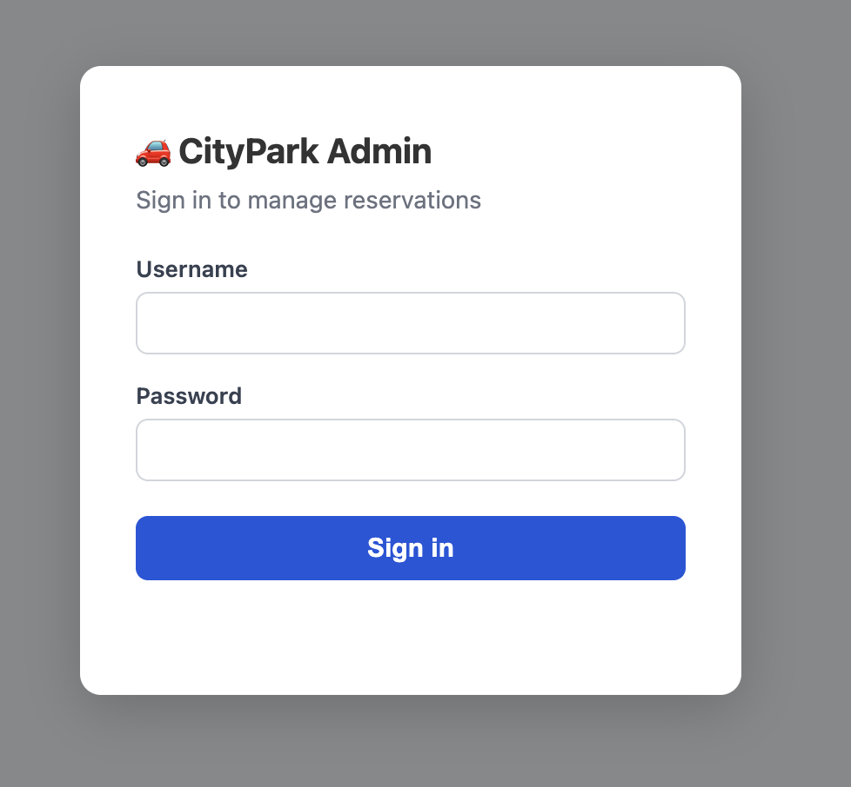
Getting confirmation from human admin (via API)

Slide 6
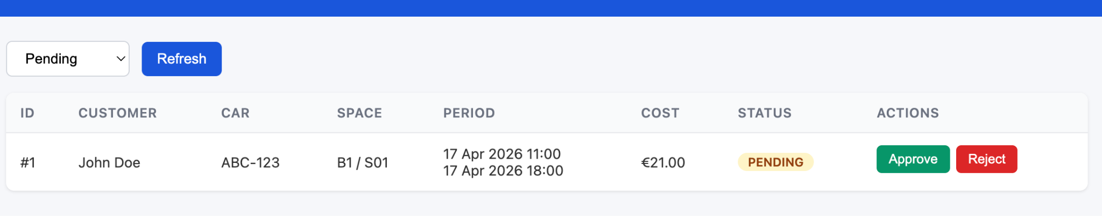
Getting confirmation from human admin (via API)

Slide 7
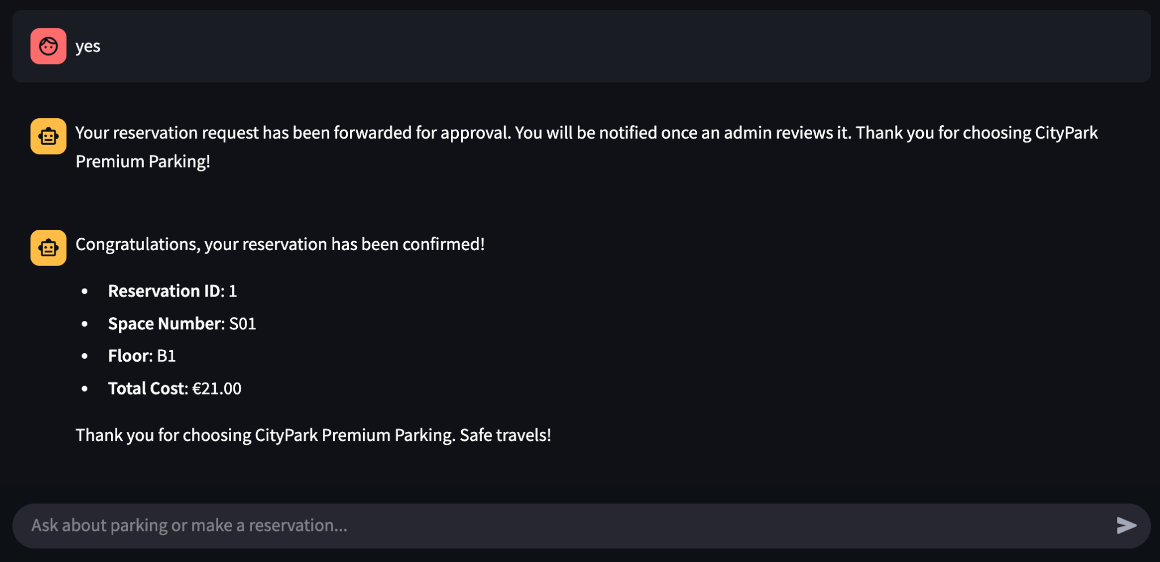
Chat resumes with additional details after admin approves/rejects

Slide 8
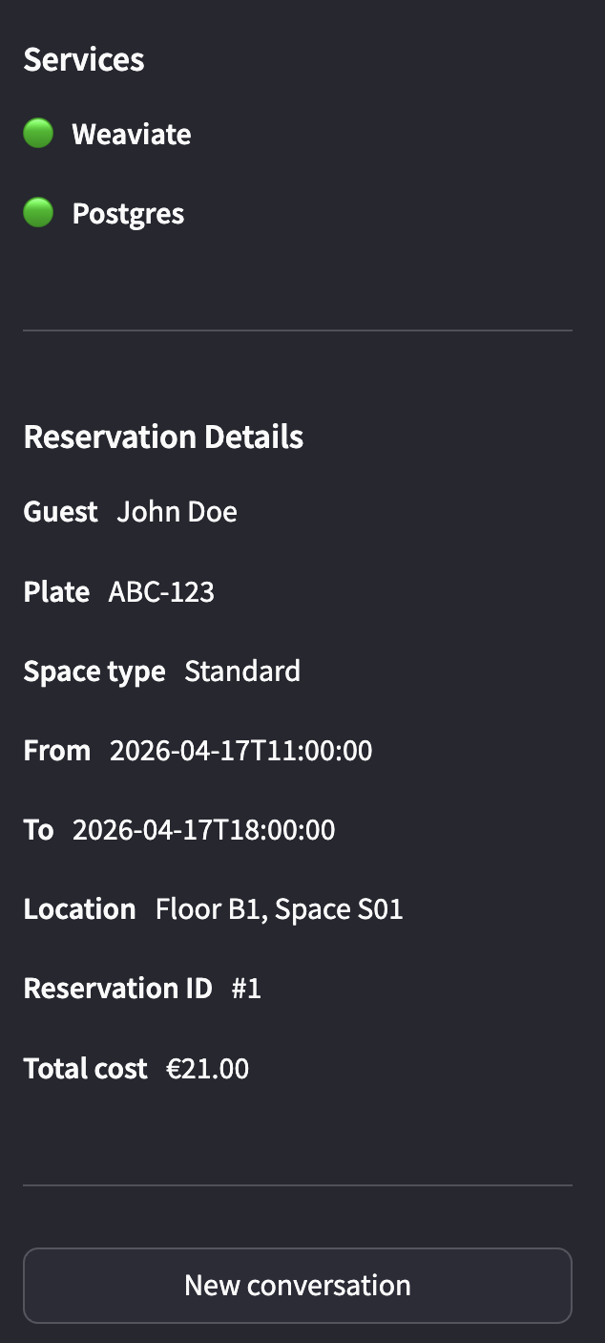
Collected details shown on the sidebar during the process of collecting them
Also statuses of connections are show. And there is possibility to start new conversation

Slide 9
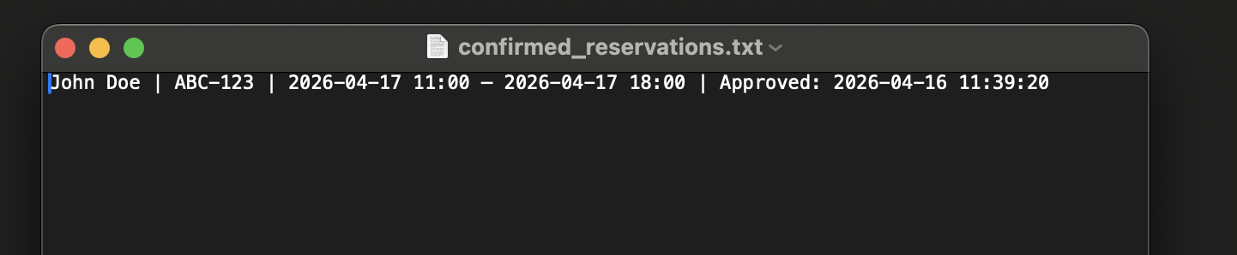
Triggering MCP server
Agent 2, after confirmation, triggers MCP server via a tool call to write reservation details to a file. It is saved to directory in the project root data/reservations.

Slide 10
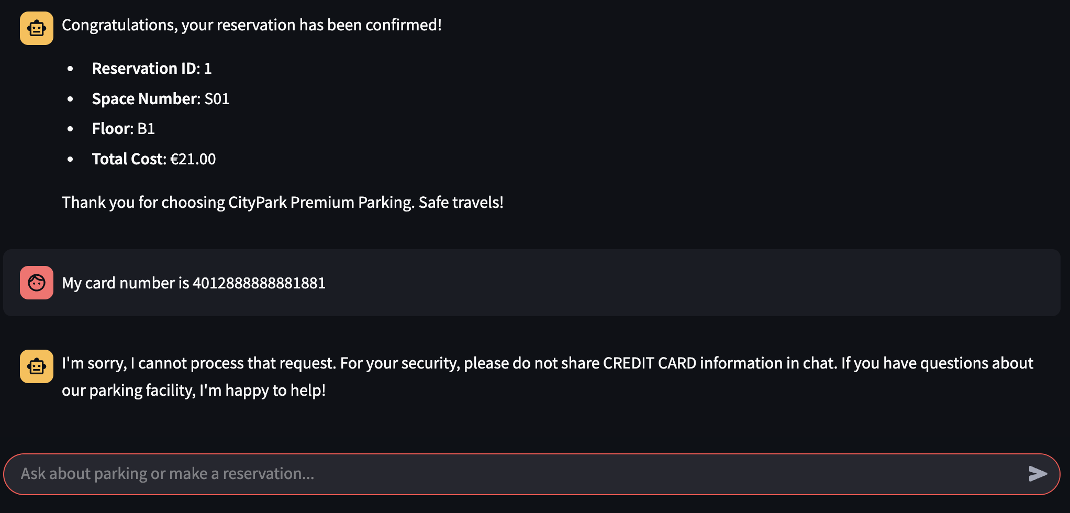
Guardrail mechanism

Slide 11
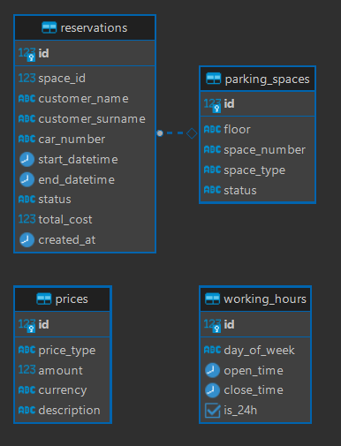
Data model

Slide 12
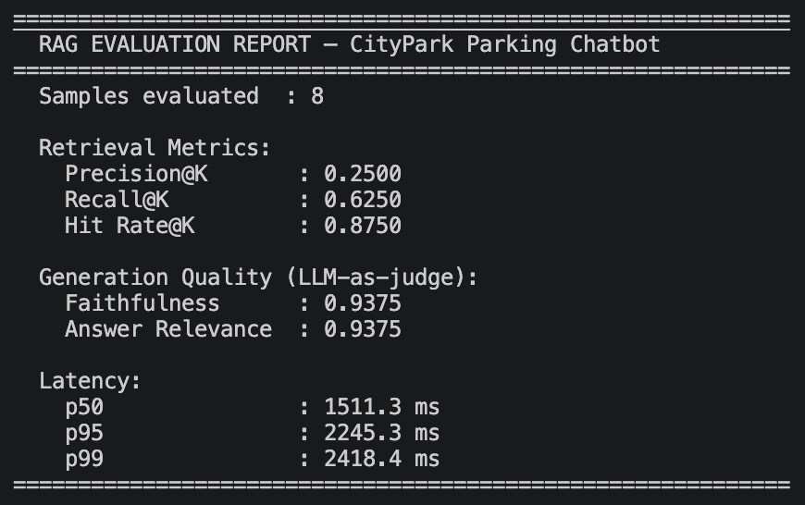
Evaluation

