Slide 1
Opening a new restaurant in North York, Ontario.

Slide 2
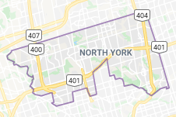
The problem:
The objective of this presentation is to share my discoveries when analyzing which could be the best neighborhood in which to open a new restaurant.
We will see the two different approaches I thought this problem can be solved.

Slide 3
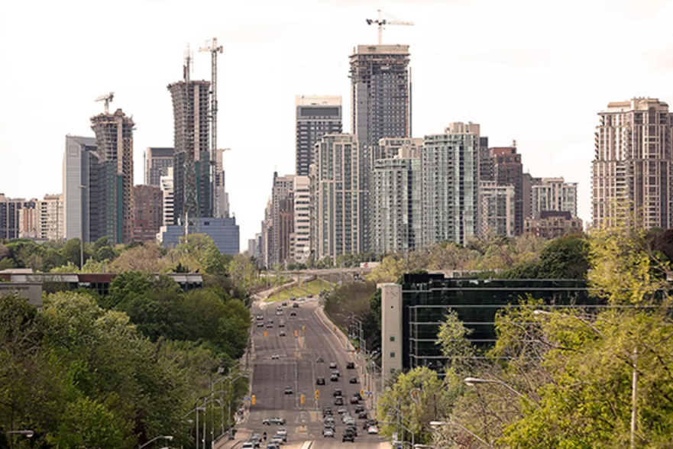
How are we going to solve it:
We are going to use a python notebook and the Foursquare API to count the number of alredy opened restaurant on each of the North York’s neighborhoods.
Then, we will use the information found to analize the two different approaches.

Slide 4
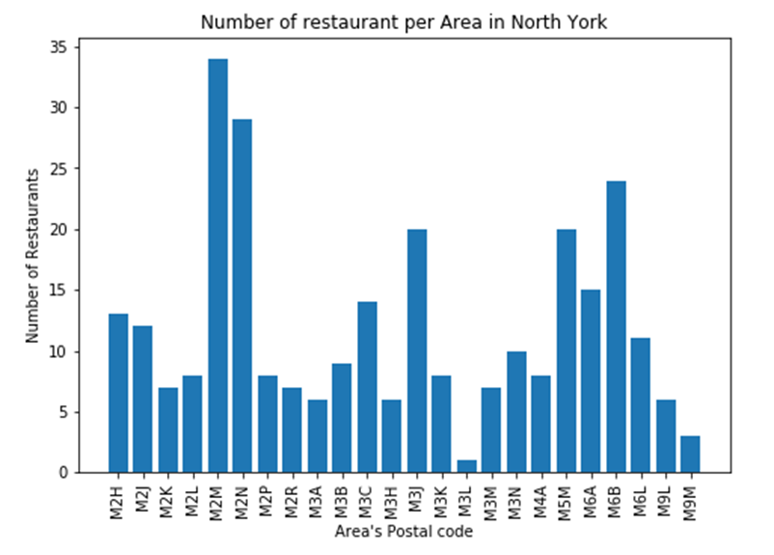
Results:
This graph shows the number of existeng restaurants on each área, the X axis is the postal code of any neighborhood, and the Y axis represents the ammount of existing restaurants within 1500 meters around.
We can see that the M3L área that corresponds to the Downsview has only one existing restaurant.
We also can see that the área with the postal code M2M and corresponds to the Willowdale and Newtonbrook Neighborhoods has 34 restaurants.

Slide 5
First Approach:
As is easy to imagine, an interesting approach to solve this problem could be by finding the área with the least restaurants.
So, following the information we found, the best área to open a new restaurant in the North York Borough is in the Downsview Neighborhood.

Slide 6
Second Approach:
Another interesting way to solve the problem is by finding the neighborhood that has the most opened reataurants near, so we can consider it as the most economic active área of North York.
If we consider that as the way t solve the problem, we would find that the best área to open a new restaurant is in the Willowdale and Newtonbrook Neighborhoods, because there are 34 restaurants near.

