Slide 1

IMPACT OF THE ADOPTION OF ARTIFICIAL INTELLIGENCE ON THE STRUCTURE OF EUROPEAN EMPLOYMENT (2023-2024): AN EMPIRICAL ANALYSIS BY SECTOR AND OCCUPATION
Author: Eduardo Fernández Dionicio
Supervisor: Javier Fernández-Blanco
Degree: Economics
2 June 2025

Slide 2
RESEARCH QUESTION
HISTORICAL EFFECTS OF AUTOMATION
Will artificial intelligence follow a similar pattern to that of technological advances in the past?

Slide 3
OBJECTIVE & HYPOTHESIS
Objective: To analyse how the adoption of AI by businesses affects the relative distribution of employment across NACE sectors and ISCO occupations in Europe in recent years
Main hypothesis: The adoption of AI will have a heterogeneous effect on employment depending on the type of predominant tasks.

Slide 4
MOTIVATION
Gaps in current empirical evidence
Lack of actual adoption data
European context
Contribution of the study

Slide 5
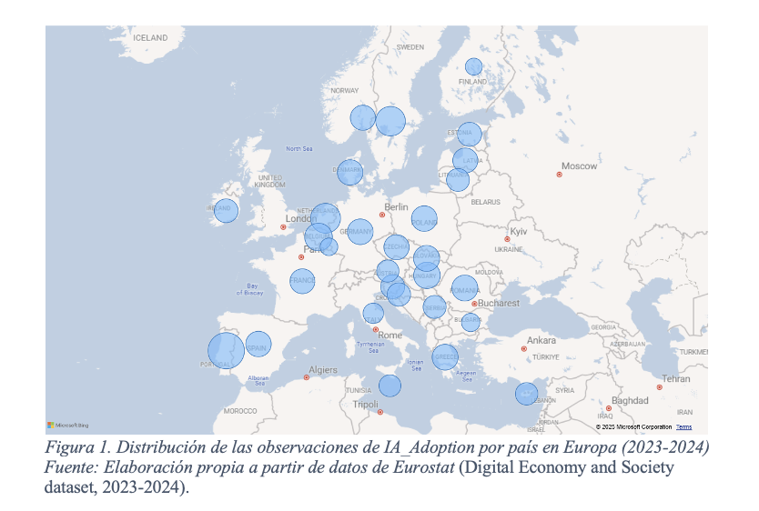
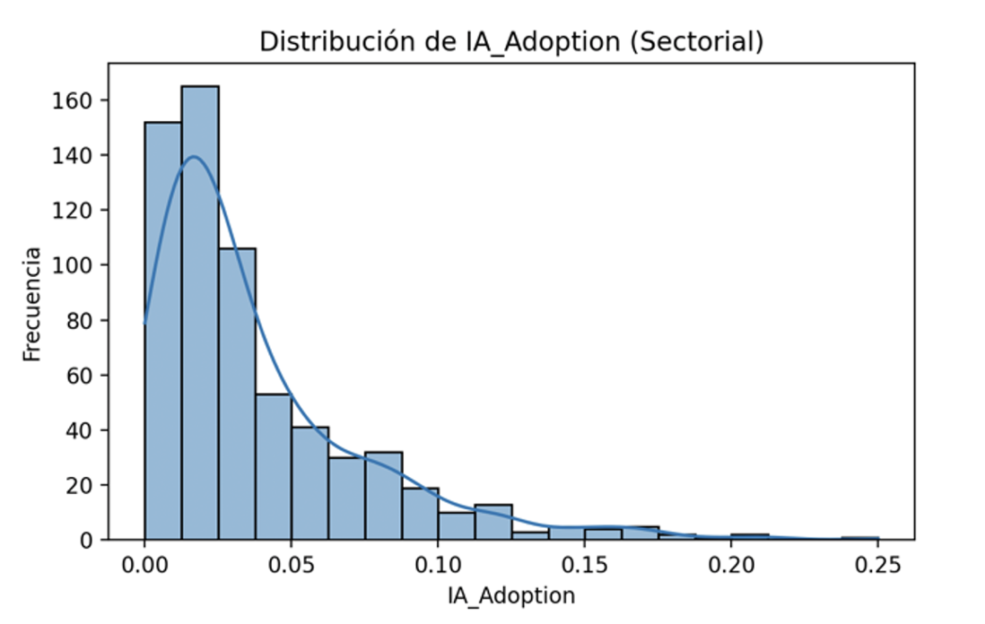
DATA AND METHODOLOGY

Slide 6
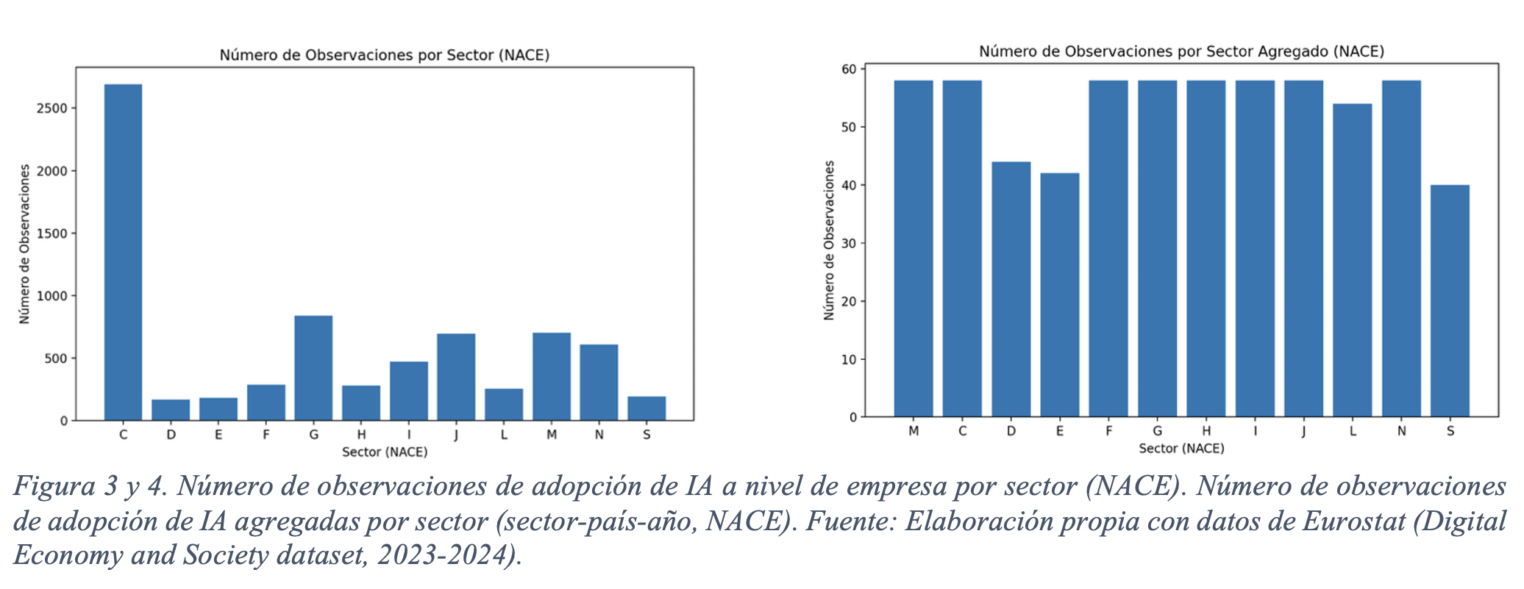

Slide 7
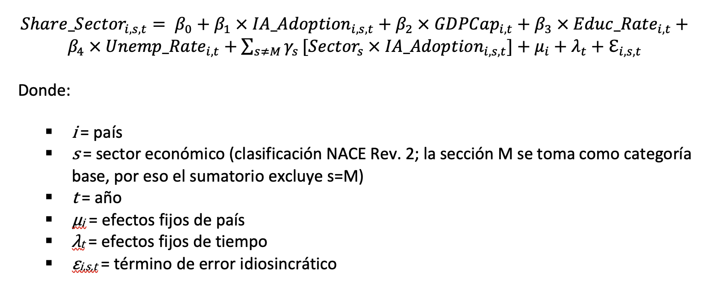
Sectoral model (NACE Rev. 2 classification)

Slide 8
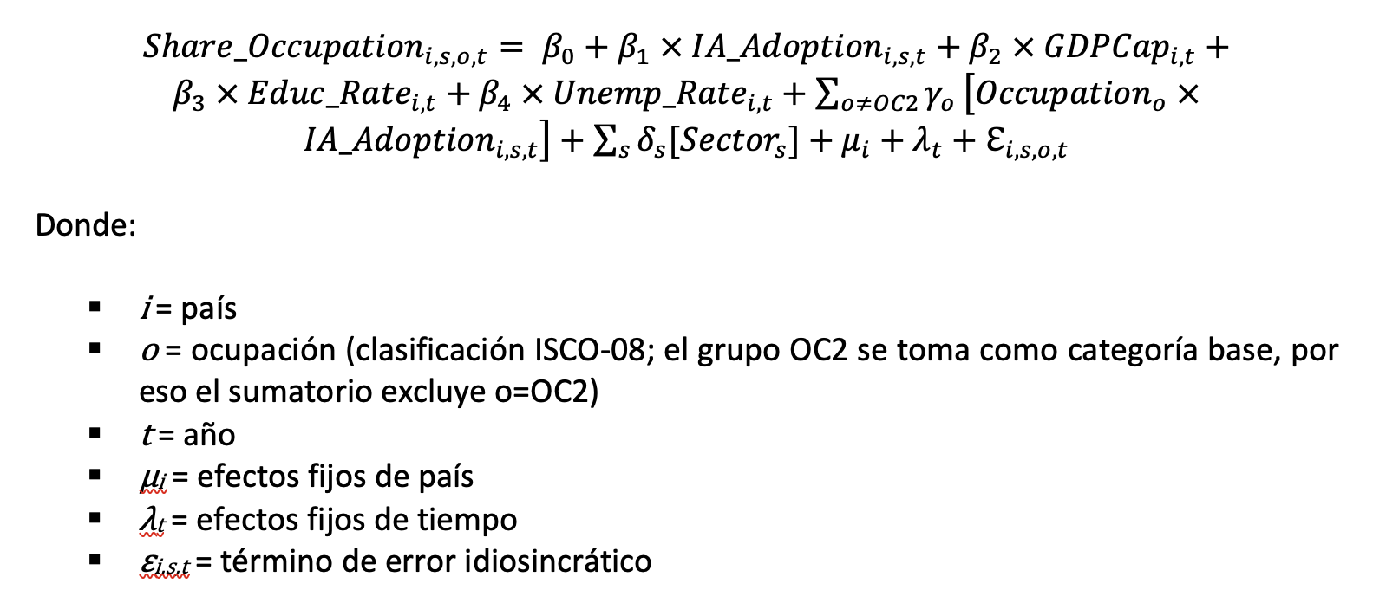
Occupational model (ISCO-08 classification)

Slide 9
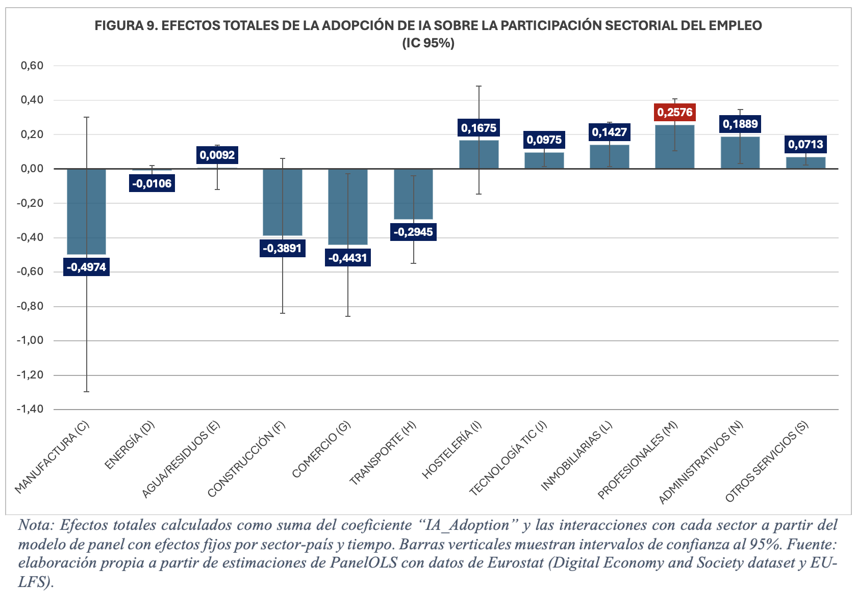

Slide 10
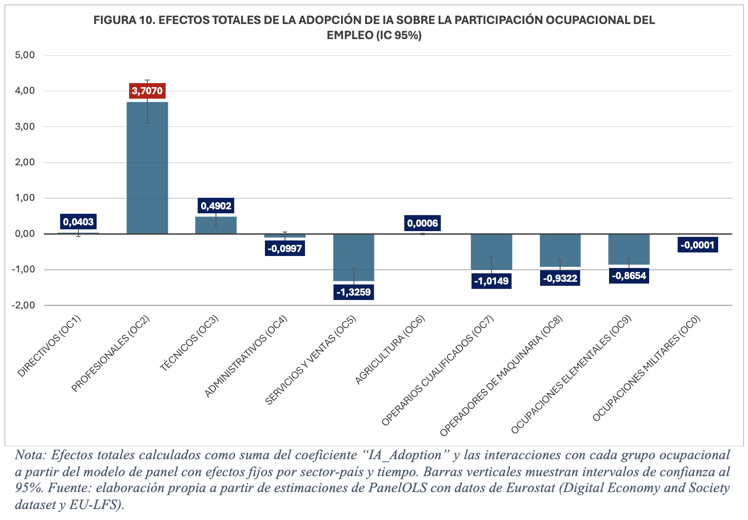

Slide 11
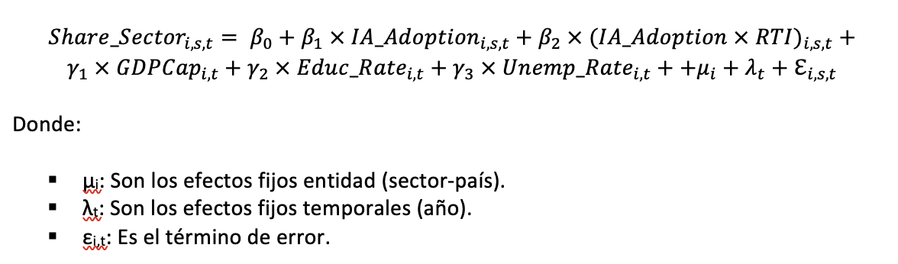
CONTRAST WITH THEORY: ROUTINE VS NON-ROUTINE TASKS

Slide 12
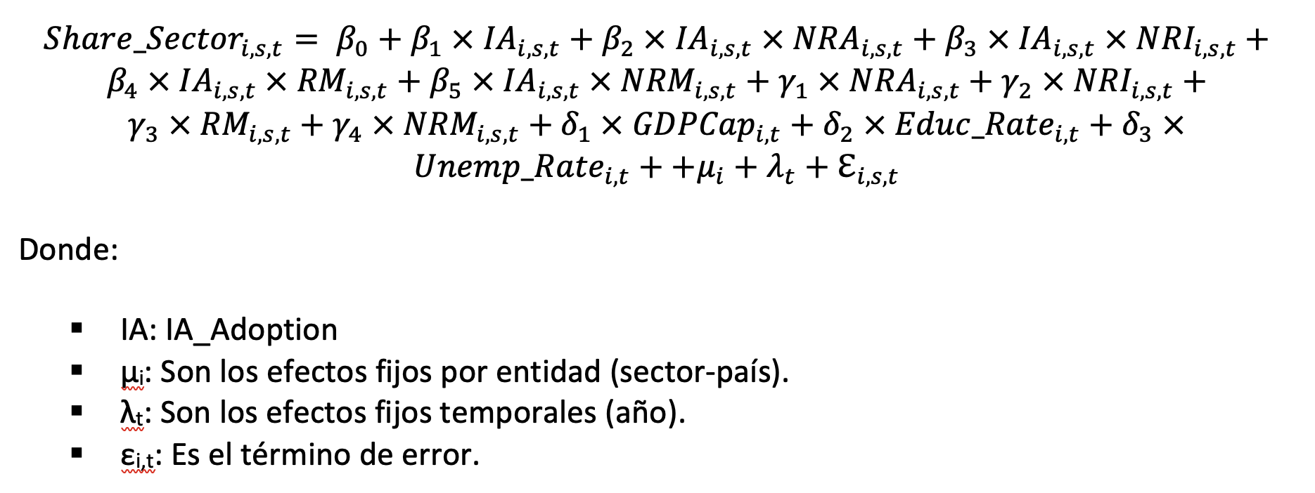
CONTRAST WITH THEORY: SUB-TASKS

Slide 13
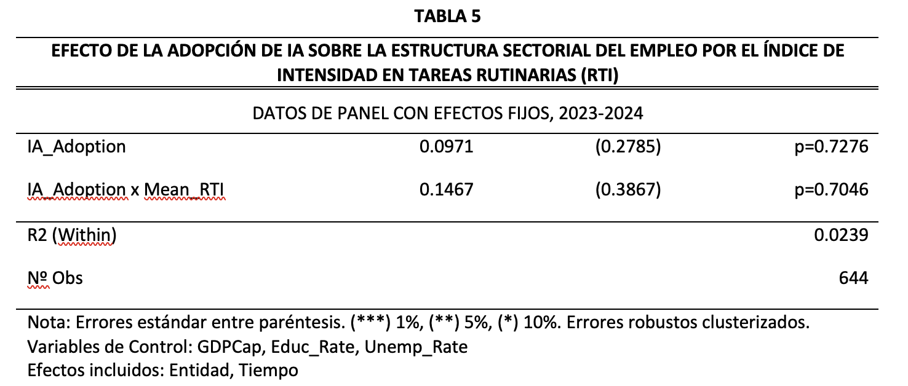

Slide 14
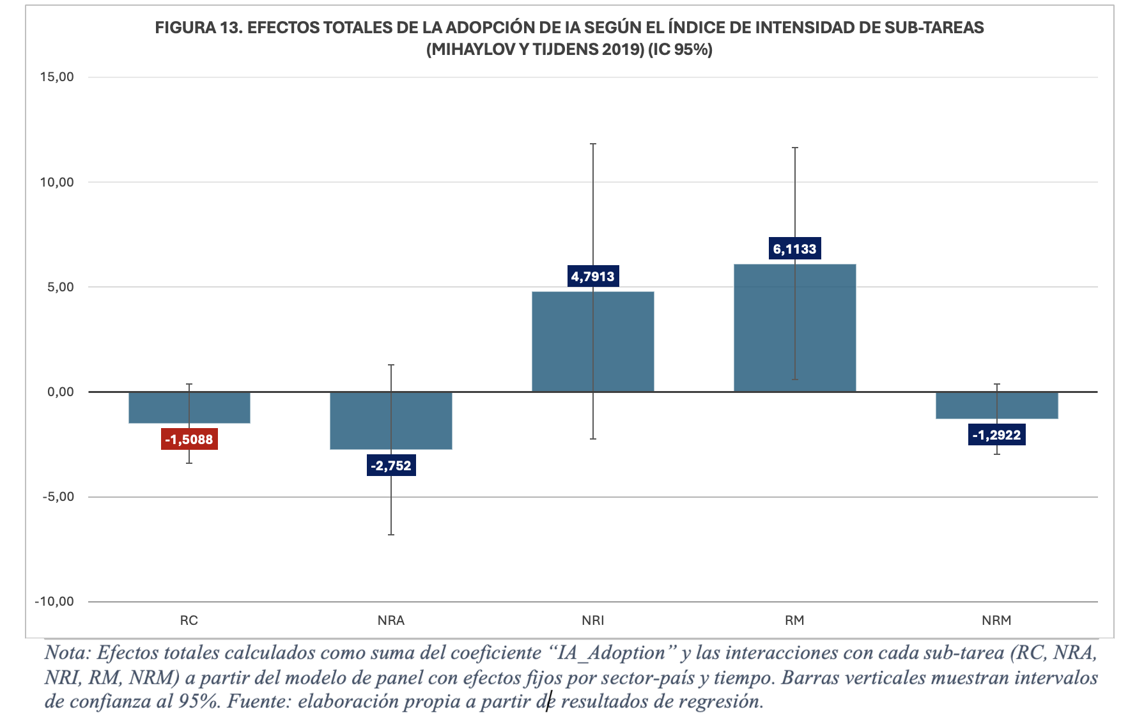

Slide 15
DISCUSSION AND IMPLICATIONS
Heterogeneous effects of AI (2023–24)
Insufficient task theory
Mechanisms still unclear
Continuing education and retraining
Incentives for sectoral restructuring
Employment protection and guidance systems

Slide 16
CONCLUSIONS AND LIMITATIONS
Short-term window (2023–24)
Aggregate data
Limited AI measurement
Sectors not included

Slide 17
THANK YOU

