Slide 1
Comunicações Móveis
Lab3: 5G
2024

Slide 2
Free5GC summary
https://github.com/free5gc/free5gc/wiki
Main components of the 5GCore, Control and User Planes
3GPP Release 15 (R15)
Each component is configured by a specific yaml file
E.g. amfcfg.yaml, nssfcfg.yaml and upfcfg.yaml

Slide 3
UERANSIM summary
https://github.com/aligungr/UERANSIM/wiki
Two main componentes: UE and gNB
Usage:
$ nr-ue -c myconfig1.yaml
$ nr-gnb -c myconfig2.yaml
https://github.com/aligungr/UERANSIM/wiki/Configuration

Slide 4
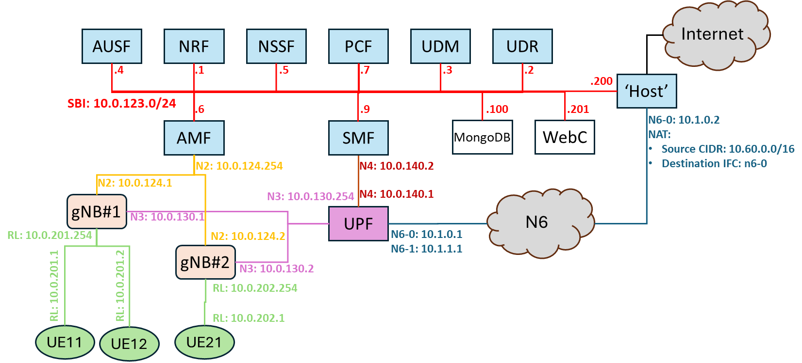
Network topology
RL: emulated Radio Link over IP/UDP

Slide 5
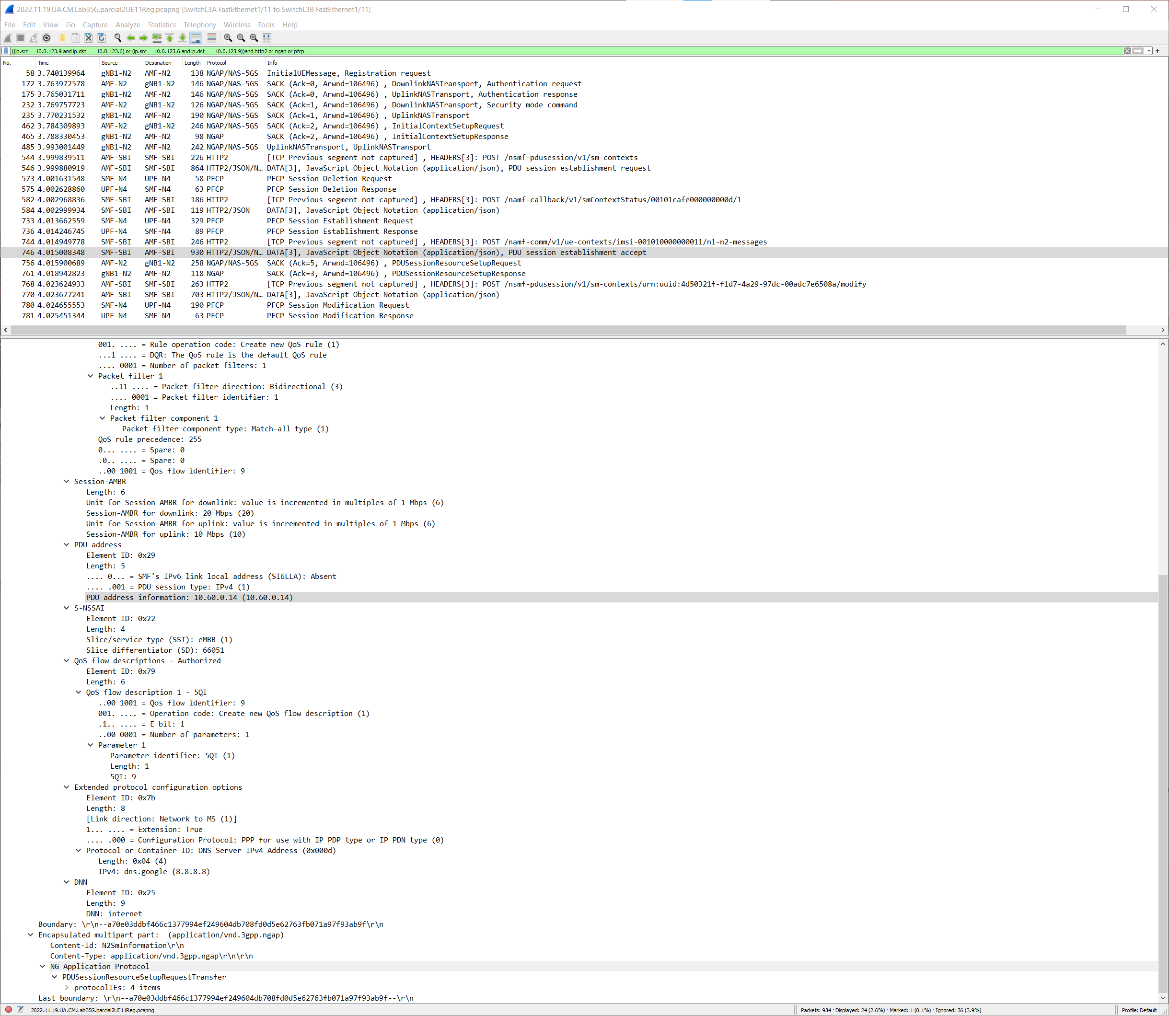
5.4
UE registration
Initial data plane setup at UPF
Data plane setup at gNB
Final data plane setup at UPF

Slide 6
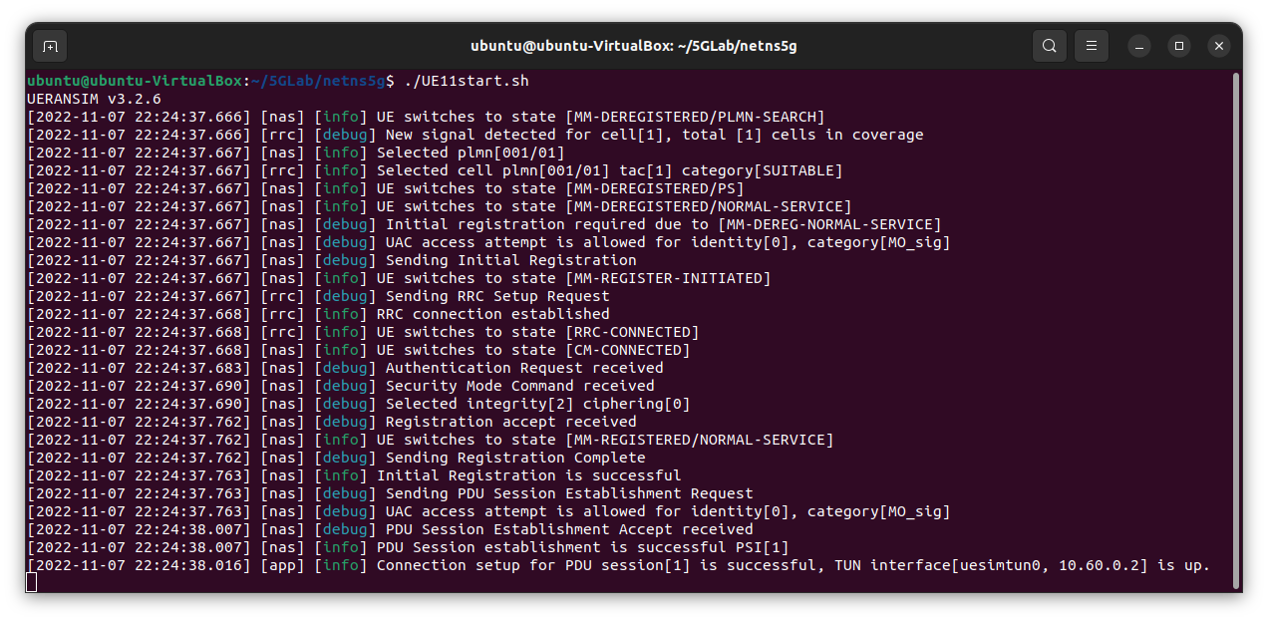
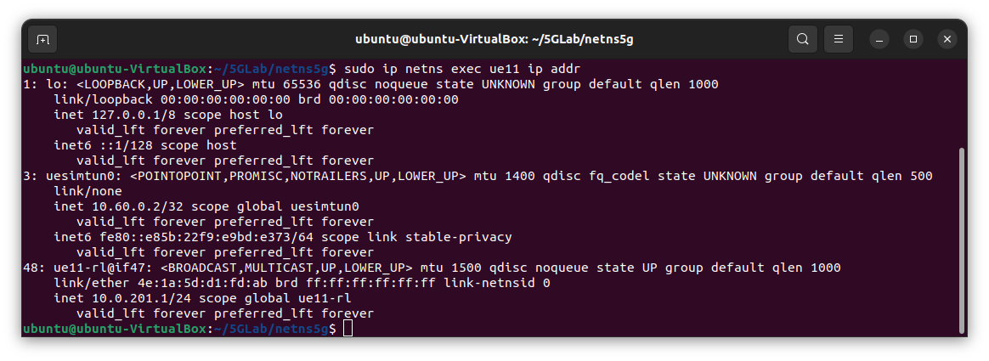
5.4 e 5.6 UE11

Slide 7
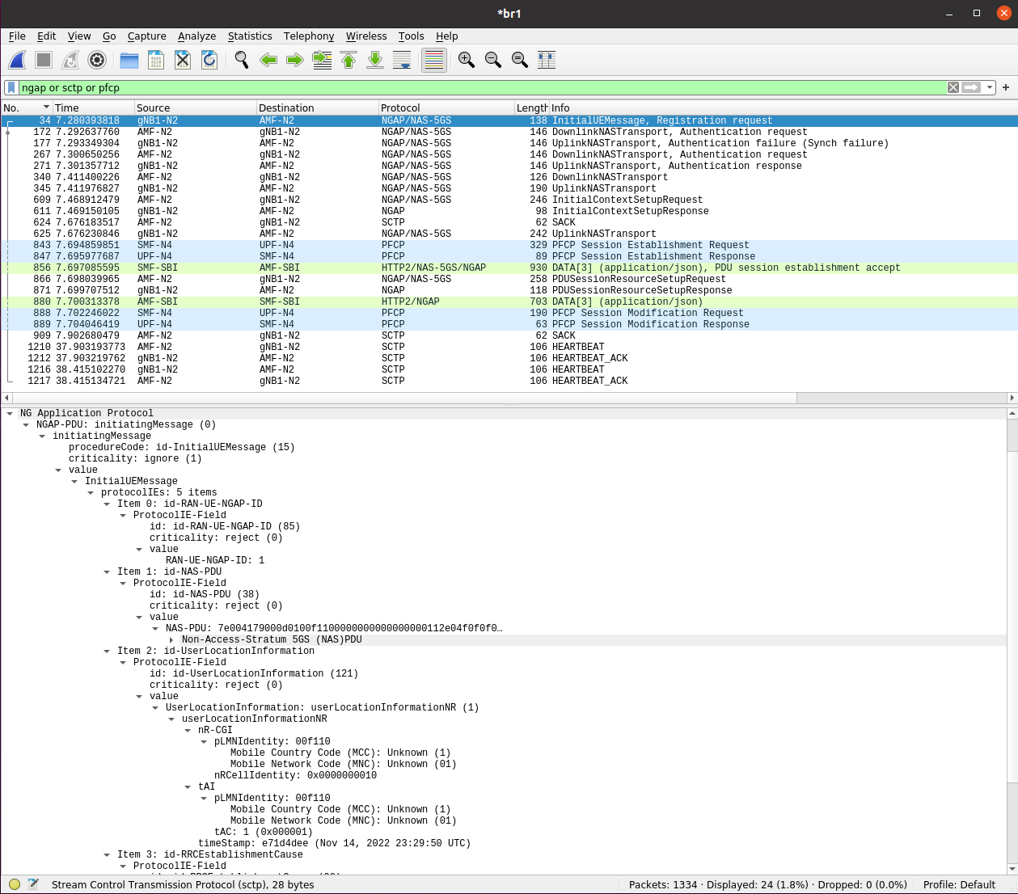
5.5, 5.6

Slide 8
5.6
ARP
HTTP2
HTTP2
HTTP2/NAS-5GS: AMF→SMF
HTTP2/NAS-5GS/NGAP: SMF→MF
HTTP2/NGAP: AMF→SMF
NGAP
NGAP: gNB1-N2 → AMF
NGAP/NAS-5GS: AMF ←→gNB2-N2
PFCP: SMF-N4 ←→UPF-N4
SCTP: AMF-N2 ←→gNB1-N2 (Sack e heartbeats)
UDP & TCP

Slide 9
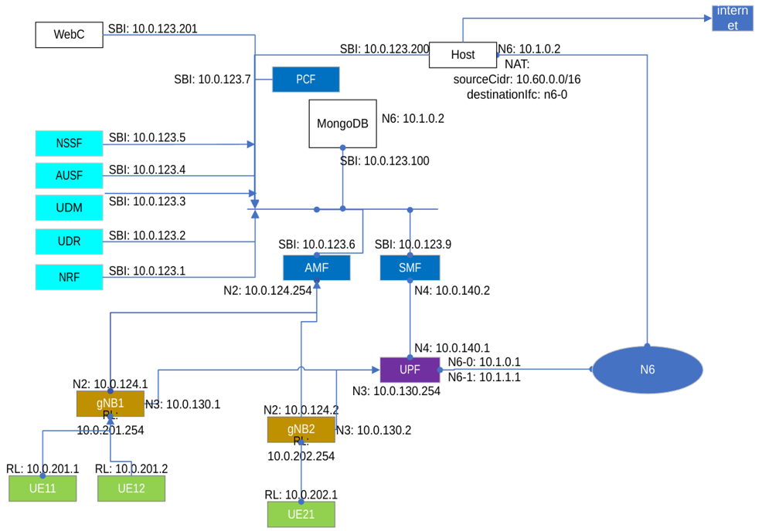
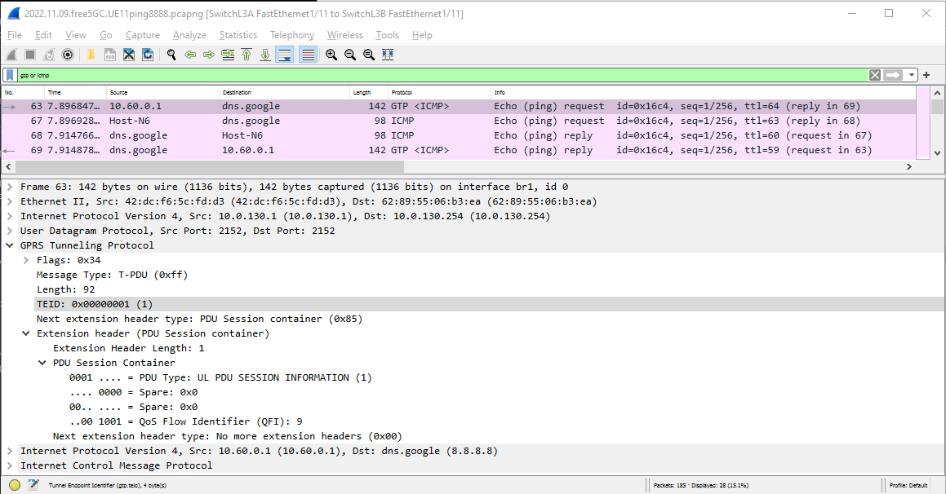
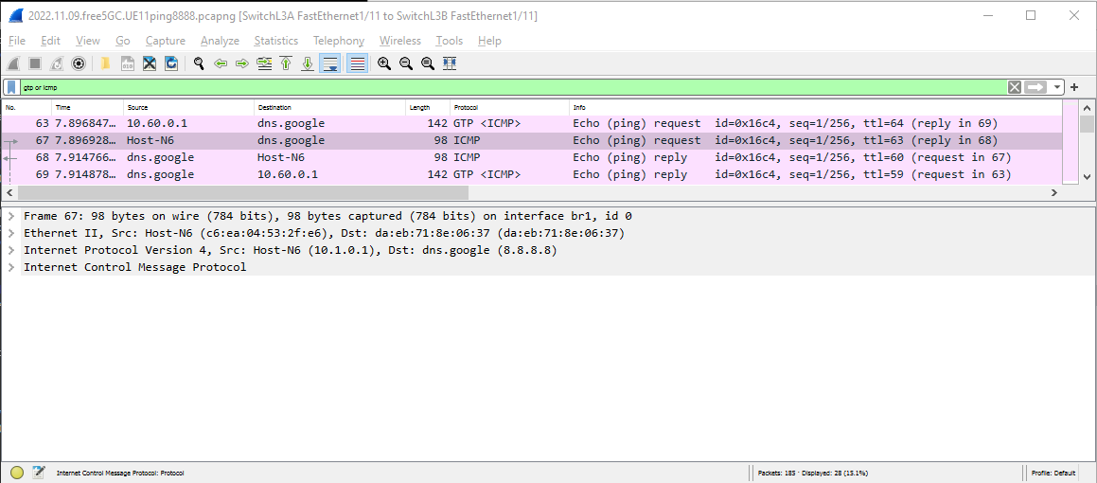
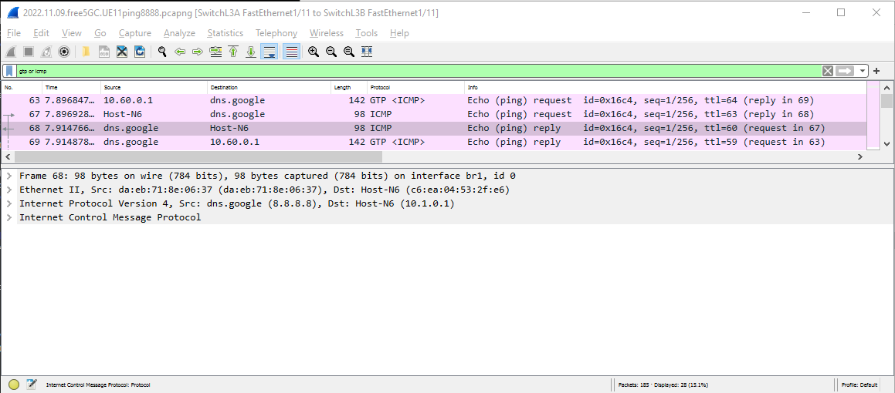
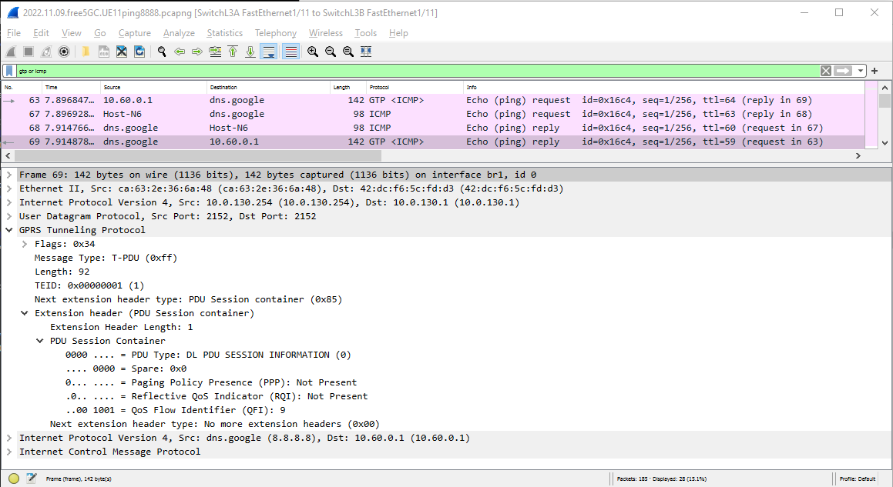
6.3 and 6.4: UE11 ping to 8.8.8.8
~/5GLab/netns5G$ sudo ip netns exec ue11 ping 8.8.8.8 -I uesimtun0
ICMP packet gNB1→ UPF (N3)
1
1
2
ICMP packet UPF (N6)→ Internet (8.8.8.8)
SA: gNB1 N3
DA: UPF N3
2
ICMP packet Internet (8.8.8.8) → UPF (N6)
2
ICMP packet UPF (N3) → gNB1
1
‘clean’ ICMP packet
UE IP address is ‘NATed’ to UPF N6 IP address
SA: UPF N3
DA: gNB1 N3
O ip 10.1.0.1 é do UPF e não do host-n6. esse é o 10.1.0.2
Corrigir no ficheiro de hosts

Slide 10
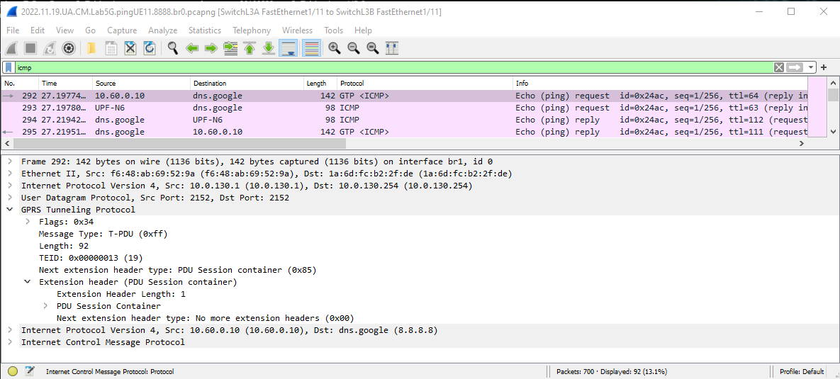
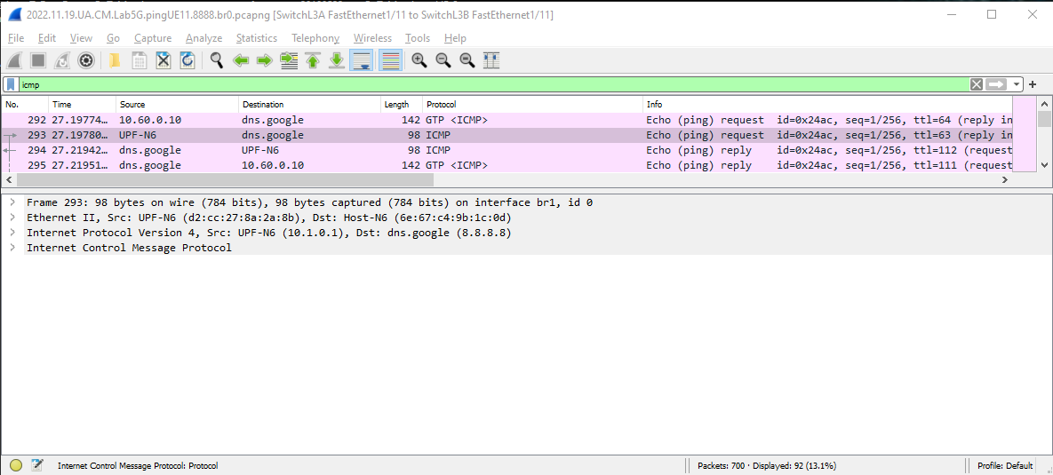
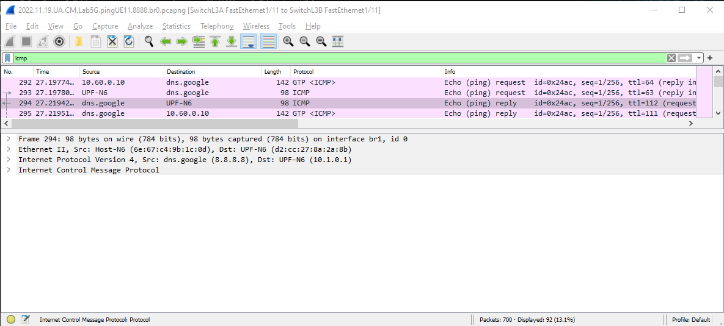
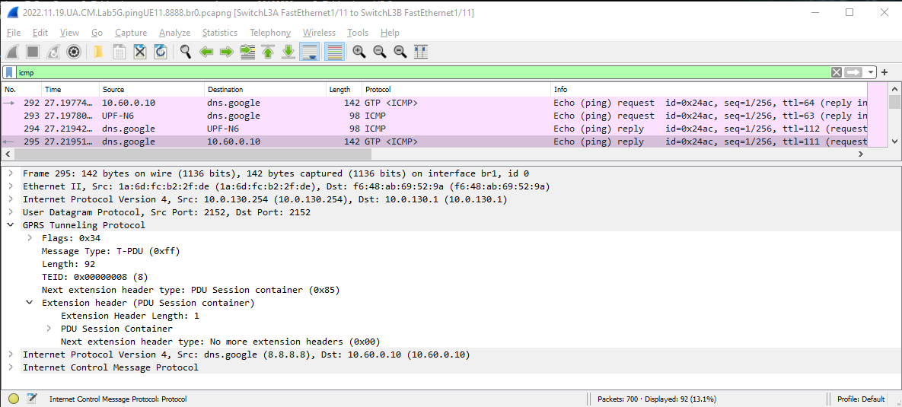
6.3 and 6.4: UE11 ping to 8.8.8.8
~/5GLab/netns5G$ sudo ip netns exec ue11 ping 8.8.8.8 -I uesimtun0
ICMP packet gNB1→ UPF (N3)
1
1
2
SA: gNB1 N3
DA: UPF N3
ICMP packet UPF (N6)→ Internet (8.8.8.8)
2
ICMP packet Internet (8.8.8.8) → UPF (N6)
2
ICMP packet UPF (N3) → gNB1
1
‘clean’ ICMP packet
UE IP address is ‘NATed’ to UPF N6 IP address
SA: UPF N3
DA: gNB1 N3

Slide 11
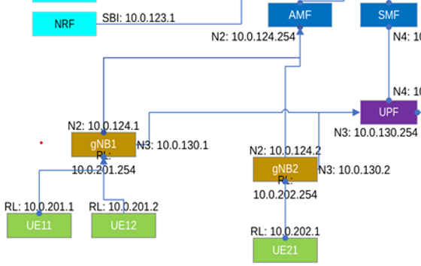
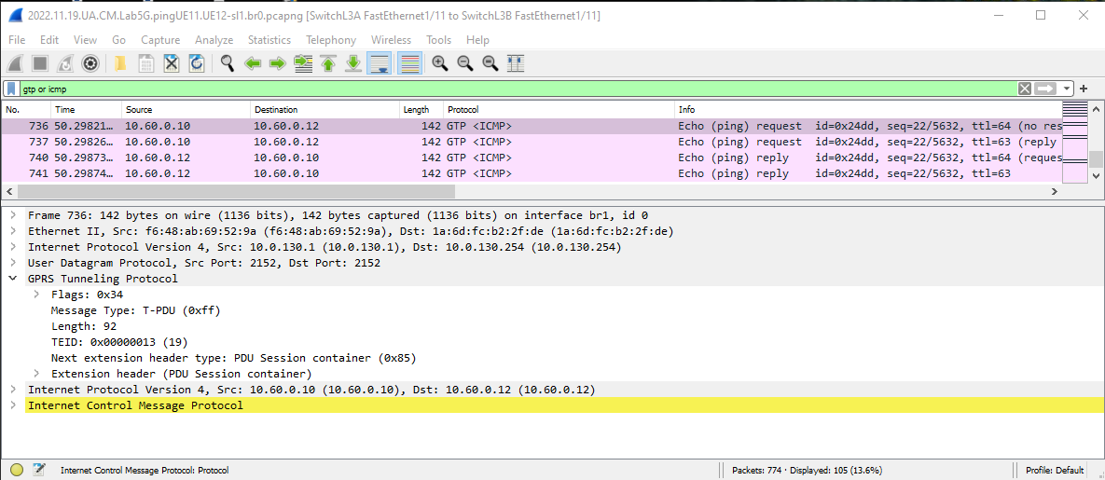
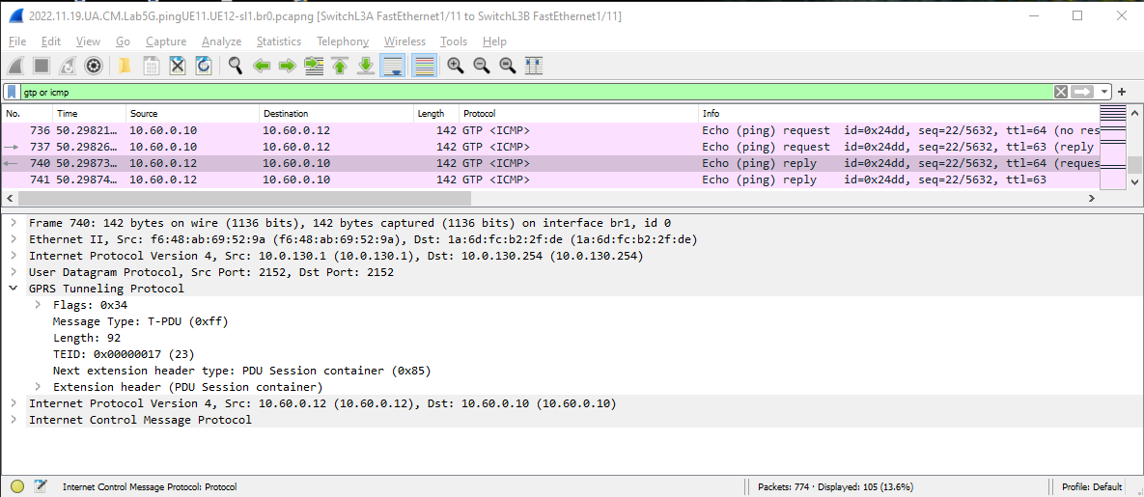

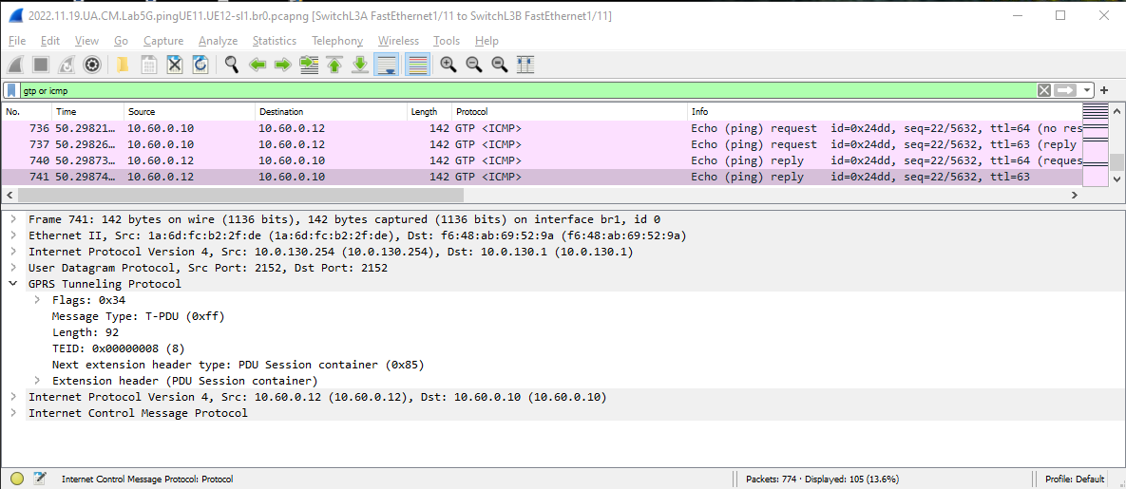
6.6: UE11-UE12(sl1) ping
ICMP packet gNB1→ UPF (N3)
1
ICMP packet gNB2 → UPF (N3)
ICMP packet UPF (N3)→ gNB2 (N3)
ICMP packet UPF (N3) → gNB1

Slide 12
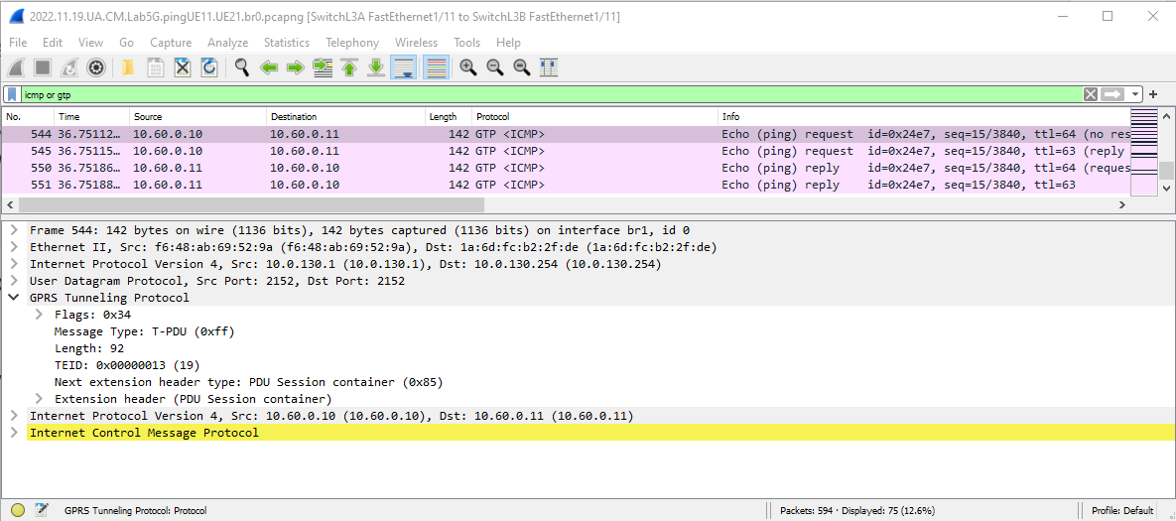
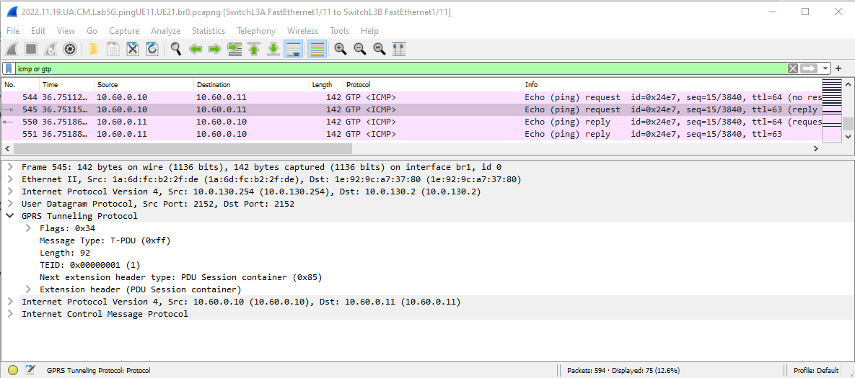
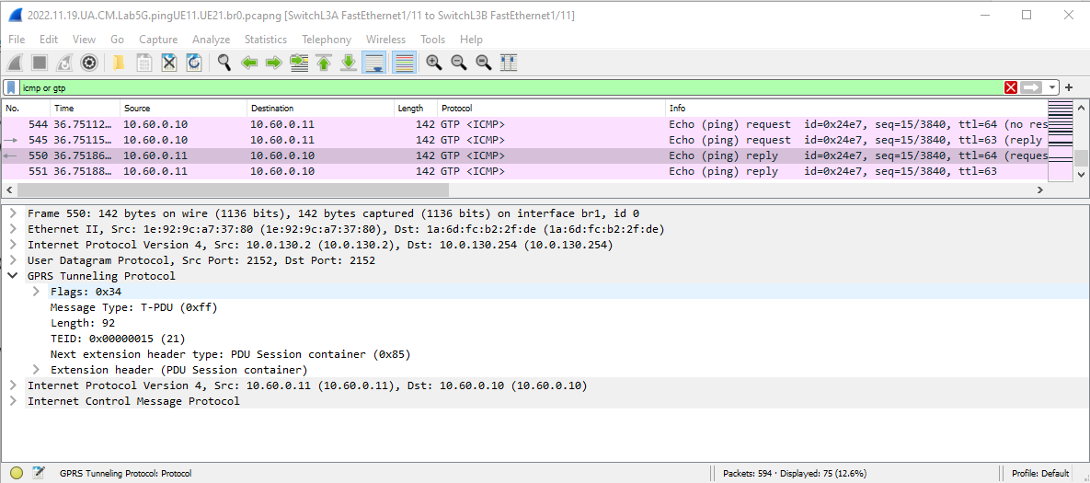
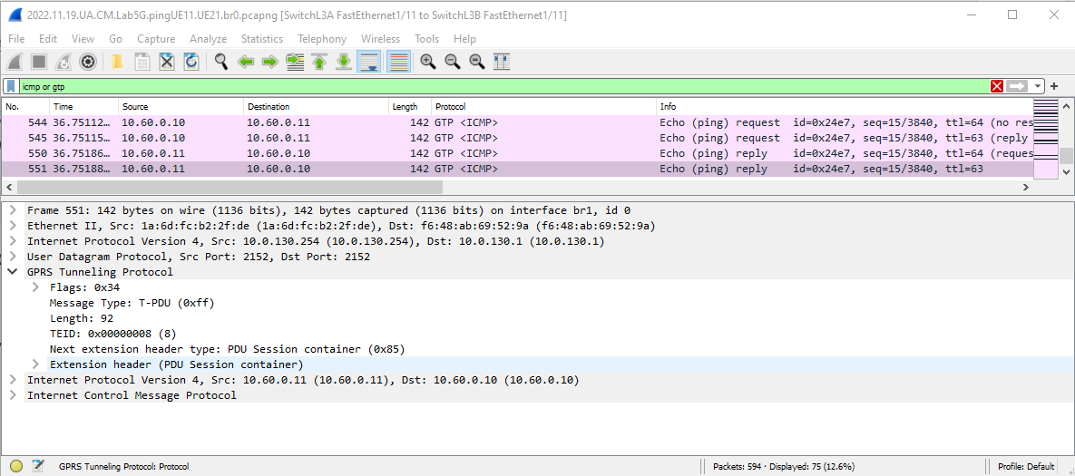
6.8: UE12-UE21 ping
1
10.61.0.1
Ping are seen twice
ICMP packets travel via the UPF in GTP tunnels
10.0.130.1 to 10.0.130.254 (ICMP Req)
10.0.130.254 to 10.0.130.2 (ICMP Req)
10.0.130.2. to 10.0.130.254 (ICMP Reply)
10.0.130.254 to 10.0.130.1 (ICMP Reply)
TEIDs:
UE11: 19 and 8
UE21: 1 and 21

Slide 13
7.x: iperf3
UE11 (with IP 10.60.10); UL/DL: 10/20Mbps
ubuntu@ubuntu-VirtualBox:~/5GLab/netns5g$ sudo ip netns exec ue11 iperf3 -c 10.1.0.2 -B 10.60.0.10
Connecting to host 10.1.0.2, port 5201
[ 5] local 10.60.0.10 port 47875 connected to 10.1.0.2 port 5201
[ ID] Interval Transfer Bitrate Retr Cwnd
[ 5] 0.00-1.00 sec 3.62 MBytes 30.4 Mbits/sec 536 17.1 KBytes
[ 5] 1.00-2.00 sec 1.17 MBytes 9.83 Mbits/sec 187 21.1 KBytes
[ 5] 2.00-3.00 sec 1.17 MBytes 9.83 Mbits/sec 124 1.32 KBytes
[ 5] 3.00-4.01 sec 1.11 MBytes 9.25 Mbits/sec 153 15.8 KBytes
[ 5] 4.01-5.01 sec 1.11 MBytes 9.31 Mbits/sec 148 19.7 KBytes
[ 5] 5.01-6.00 sec 1.17 MBytes 9.89 Mbits/sec 145 18.4 KBytes
[ 5] 6.00-7.00 sec 1.17 MBytes 9.84 Mbits/sec 173 17.1 KBytes
[ 5] 7.00-8.01 sec 1.11 MBytes 9.26 Mbits/sec 170 17.1 KBytes
[ 5] 8.01-9.00 sec 1.17 MBytes 9.93 Mbits/sec 137 19.7 KBytes
[ 5] 9.00-10.00 sec 1.17 MBytes 9.83 Mbits/sec 167 34.2 KBytes
- - - - - - - - - - - - - - - - - - - - - - - - -
[ ID] Interval Transfer Bitrate Retr
[ 5] 0.00-10.00 sec 14.0 MBytes 11.7 Mbits/sec 1940 sender
[ 5] 0.00-10.05 sec 12.6 MBytes 10.5 Mbits/sec receiver
iperf Done.
ubuntu@ubuntu-VirtualBox:~/5GLab/netns5g$ sudo ip netns exec ue11 iperf3 -c 10.1.0.2 -R -B 10.60.0.10
Connecting to host 10.1.0.2, port 5201
Reverse mode, remote host 10.1.0.2 is sending
[ 5] local 10.60.0.10 port 55073 connected to 10.1.0.2 port 5201
[ ID] Interval Transfer Bitrate
[ 5] 0.00-1.00 sec 4.64 MBytes 38.9 Mbits/sec
[ 5] 1.00-2.00 sec 2.25 MBytes 18.9 Mbits/sec
[ 5] 2.00-3.00 sec 1.95 MBytes 16.4 Mbits/sec
[ 5] 3.00-4.00 sec 2.63 MBytes 22.0 Mbits/sec
[ 5] 4.00-5.00 sec 2.14 MBytes 18.0 Mbits/sec
[ 5] 5.00-6.00 sec 2.14 MBytes 17.9 Mbits/sec
[ 5] 6.00-7.00 sec 2.67 MBytes 22.4 Mbits/sec
[ 5] 7.00-8.00 sec 2.20 MBytes 18.4 Mbits/sec
[ 5] 8.00-9.00 sec 2.12 MBytes 17.8 Mbits/sec
[ 5] 9.00-10.00 sec 2.14 MBytes 17.9 Mbits/sec
- - - - - - - - - - - - - - - - - - - - - - - - -
[ ID] Interval Transfer Bitrate Retr
[ 5] 0.00-10.04 sec 25.2 MBytes 21.1 Mbits/sec 2881 sender
[ 5] 0.00-10.00 sec 24.9 MBytes 20.9 Mbits/sec receiver
UE12 (with IP 10.60.0.12); UL/DL: 100/200Mbps
ubuntu@ubuntu-VirtualBox:~/5GLab/netns5g$ sudo ip netns exec ue12 iperf3 -c 10.1.0.2 -B 10.60.0.12
Connecting to host 10.1.0.2, port 5201
[ 5] local 10.60.0.12 port 37897 connected to 10.1.0.2 port 5201
[ ID] Interval Transfer Bitrate Retr Cwnd
[ 5] 0.00-1.00 sec 23.9 MBytes 201 Mbits/sec 406 126 KBytes
[ 5] 1.00-2.00 sec 11.7 MBytes 98.4 Mbits/sec 792 40.8 KBytes
[ 5] 2.00-3.00 sec 11.8 MBytes 98.9 Mbits/sec 632 57.9 KBytes
[ 5] 3.00-4.00 sec 10.3 MBytes 86.5 Mbits/sec 543 282 KBytes
[ 5] 4.00-5.00 sec 11.7 MBytes 98.2 Mbits/sec 722 11.8 KBytes
[ 5] 5.00-6.00 sec 11.1 MBytes 93.2 Mbits/sec 528 63.2 KBytes
[ 5] 6.00-7.00 sec 12.3 MBytes 104 Mbits/sec 761 79.0 KBytes
[ 5] 7.00-8.02 sec 11.7 MBytes 96.6 Mbits/sec 670 11.8 KBytes
[ 5] 8.02-9.00 sec 11.8 MBytes 100 Mbits/sec 585 31.6 KBytes
[ 5] 9.00-10.00 sec 10.3 MBytes 86.7 Mbits/sec 458 18.4 KBytes
- - - - - - - - - - - - - - - - - - - - - - - - -
[ ID] Interval Transfer Bitrate Retr
[ 5] 0.00-10.00 sec 127 MBytes 106 Mbits/sec 6097 sender
[ 5] 0.00-10.04 sec 125 MBytes 105 Mbits/sec receiver
iperf Done.
ubuntu@ubuntu-VirtualBox:~/5GLab/netns5g$ sudo ip netns exec ue12 iperf3 -c 10.1.0.2 -R -B 10.60.0.12
Connecting to host 10.1.0.2, port 5201
Reverse mode, remote host 10.1.0.2 is sending
[ 5] local 10.60.0.12 port 40459 connected to 10.1.0.2 port 5201
[ ID] Interval Transfer Bitrate
[ 5] 0.00-1.00 sec 41.1 MBytes 344 Mbits/sec
[ 5] 1.00-2.00 sec 25.3 MBytes 212 Mbits/sec
[ 5] 2.00-3.00 sec 21.3 MBytes 178 Mbits/sec
[ 5] 3.00-4.00 sec 23.4 MBytes 196 Mbits/sec
[ 5] 4.00-5.00 sec 24.3 MBytes 204 Mbits/sec
[ 5] 5.00-6.01 sec 20.8 MBytes 173 Mbits/sec
[ 5] 6.01-7.00 sec 24.2 MBytes 205 Mbits/sec
[ 5] 7.00-8.01 sec 24.2 MBytes 202 Mbits/sec
[ 5] 8.01-9.00 sec 20.1 MBytes 170 Mbits/sec
[ 5] 9.00-10.01 sec 24.0 MBytes 200 Mbits/sec
- - - - - - - - - - - - - - - - - - - - - - - - -
[ ID] Interval Transfer Bitrate Retr
[ 5] 0.00-10.05 sec 250 MBytes 208 Mbits/sec 6496 sender
[ 5] 0.00-10.01 sec 249 MBytes 208 Mbits/sec receiver
UE21 (with IP 10.60.0.11); UL/DL: 1/2Mbps
ubuntu@ubuntu-VirtualBox:~/5GLab/netns5g$ sudo ip netns exec ue21 iperf3 -c 10.1.0.2 -B 10.60.0.11
Connecting to host 10.1.0.2, port 5201
[ 5] local 10.60.0.11 port 49023 connected to 10.1.0.2 port 5201
[ ID] Interval Transfer Bitrate Retr Cwnd
[ 5] 0.00-1.00 sec 519 KBytes 4.25 Mbits/sec 88 1.32 KBytes
[ 5] 1.00-2.00 sec 126 KBytes 1.03 Mbits/sec 18 1.32 KBytes
[ 5] 2.00-3.00 sec 126 KBytes 1.04 Mbits/sec 16 2.63 KBytes
[ 5] 3.00-4.00 sec 126 KBytes 1.03 Mbits/sec 16 2.63 KBytes
[ 5] 4.00-5.00 sec 126 KBytes 1.04 Mbits/sec 16 1.32 KBytes
[ 5] 5.00-6.00 sec 126 KBytes 1.04 Mbits/sec 13 2.63 KBytes
[ 5] 6.00-7.00 sec 126 KBytes 1.04 Mbits/sec 19 1.32 KBytes
[ 5] 7.00-8.00 sec 0.00 Bytes 0.00 bits/sec 8 1.32 KBytes
[ 5] 8.00-9.00 sec 126 KBytes 1.04 Mbits/sec 18 2.63 KBytes
[ 5] 9.00-10.00 sec 126 KBytes 1.03 Mbits/sec 15 1.32 KBytes
- - - - - - - - - - - - - - - - - - - - - - - - -
[ ID] Interval Transfer Bitrate Retr
[ 5] 0.00-10.00 sec 1.49 MBytes 1.25 Mbits/sec 227 sender
[ 5] 0.00-10.04 sec 1.26 MBytes 1.05 Mbits/sec receiver
iperf Done.
ubuntu@ubuntu-VirtualBox:~/5GLab/netns5g$ sudo ip netns exec ue21 iperf3 -c 10.1.0.2 -R -B 10.60.0.11
Connecting to host 10.1.0.2, port 5201
Reverse mode, remote host 10.1.0.2 is sending
[ 5] local 10.60.0.11 port 60013 connected to 10.1.0.2 port 5201
[ ID] Interval Transfer Bitrate
[ 5] 0.00-1.00 sec 455 KBytes 3.72 Mbits/sec
[ 5] 1.00-2.00 sec 216 KBytes 1.77 Mbits/sec
[ 5] 2.00-3.00 sec 274 KBytes 2.25 Mbits/sec
[ 5] 3.00-4.00 sec 219 KBytes 1.79 Mbits/sec
[ 5] 4.00-5.01 sec 221 KBytes 1.80 Mbits/sec
[ 5] 5.01-6.00 sec 271 KBytes 2.23 Mbits/sec
[ 5] 6.00-7.00 sec 219 KBytes 1.79 Mbits/sec
[ 5] 7.00-8.00 sec 225 KBytes 1.84 Mbits/sec
[ 5] 8.00-9.00 sec 220 KBytes 1.80 Mbits/sec
[ 5] 9.00-10.00 sec 275 KBytes 2.26 Mbits/sec
- - - - - - - - - - - - - - - - - - - - - - - - -
[ ID] Interval Transfer Bitrate Retr
[ 5] 0.00-10.05 sec 3.06 MBytes 2.56 Mbits/sec 628 sender
[ 5] 0.00-10.00 sec 2.53 MBytes 2.13 Mbits/sec receiver

Slide 14
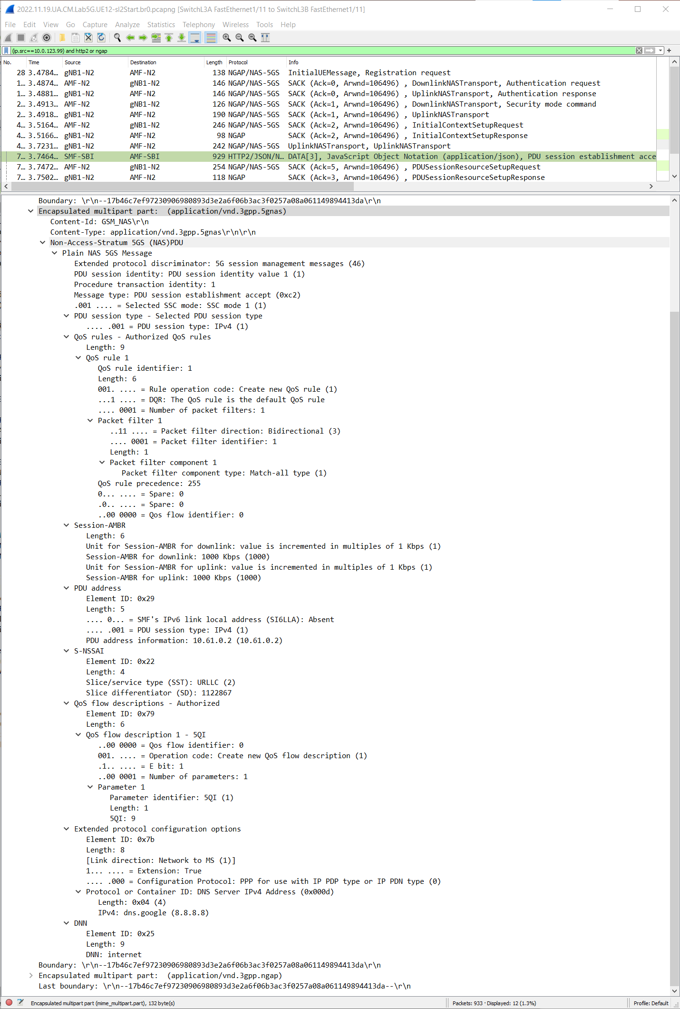
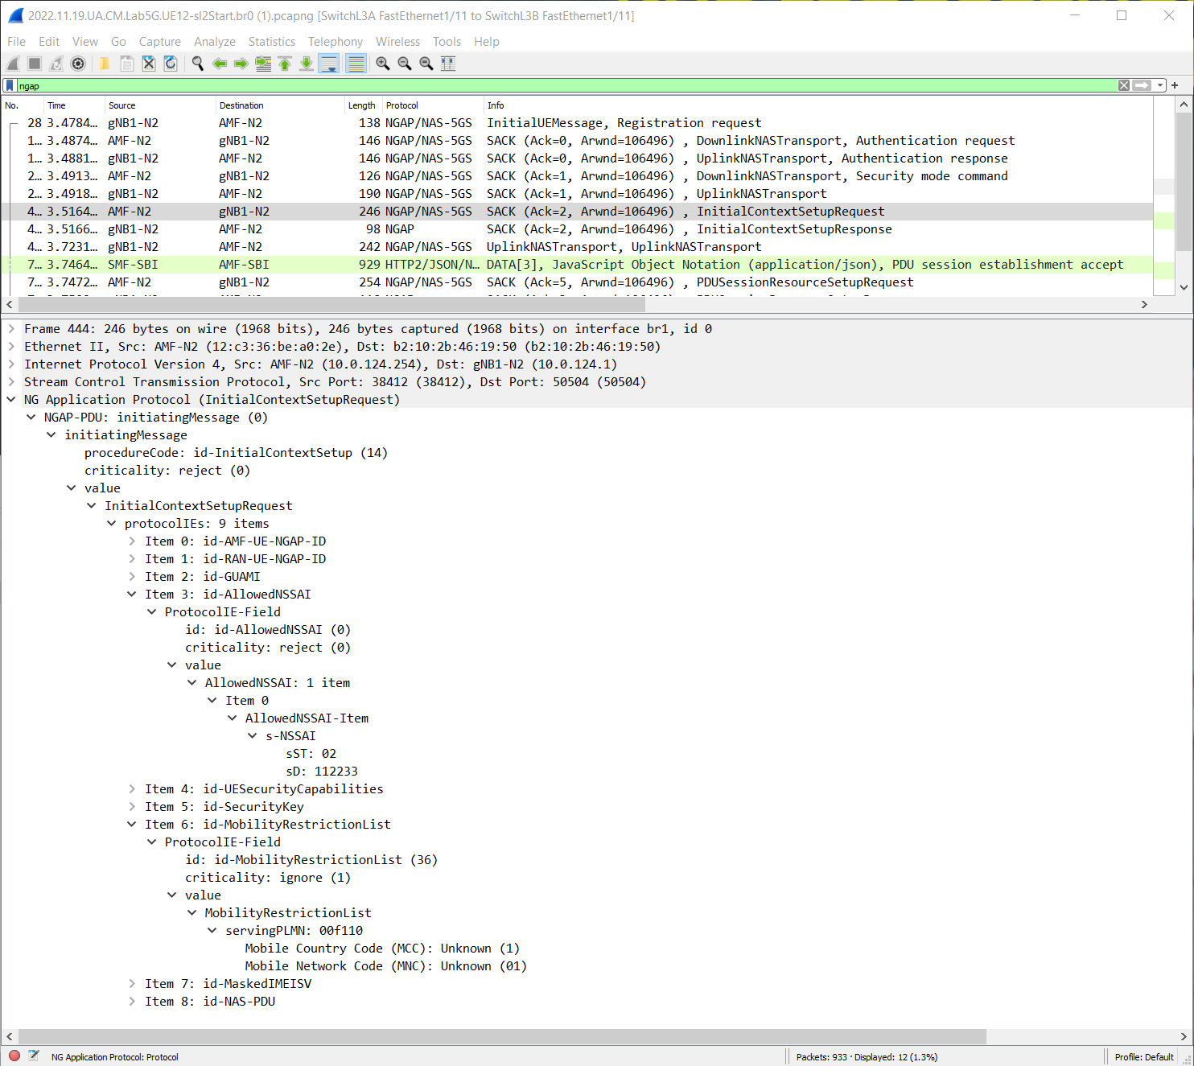
8.2 and 8.3
UE12 is allowed in Slice 2/112233
Assigned IP address is 10.61.0.2 by SMF
???

Slide 15
8.4
ubuntu@ubuntu-VirtualBox:~/5GLab/netns5g$ sudo ip netns exec ue11 ping 10.61.0.2 -I uesimtun0 PING 10.61.0.2 (10.61.0.2) from 10.60.0.15 uesimtun0: 56(84) bytes of data. ^C --- 10.61.0.2 ping statistics --- 5 packets transmitted, 0 received, 100% packet loss, time 4092ms
ubuntu@ubuntu-VirtualBox:~/5GLab/netns5g$ sudo ip netns exec ue11 ping 10.61.0.2 -I uesimtun0 PING 10.61.0.2 (10.61.0.2) from 10.60.0.15 uesimtun0: 56(84) bytes of data. 64 bytes from 10.61.0.2: icmp_seq=1 ttl=63 time=1.43 ms From 10.0.130.254: icmp_seq=2 Redirect Host(New nexthop: 10.61.0.2) 64 bytes from 10.61.0.2: icmp_seq=2 ttl=63 time=1.81 ms From 10.0.130.254: icmp_seq=3 Redirect Host(New nexthop: 10.61.0.2) 64 bytes from 10.61.0.2: icmp_seq=3 ttl=63 time=1.41 ms From 10.0.130.254: icmp_seq=4 Redirect Host(New nexthop: 10.61.0.2) 64 bytes from 10.61.0.2: icmp_seq=4 ttl=63 time=1.39 ms From 10.0.130.254: icmp_seq=5 Redirect Host(New nexthop: 10.61.0.2) 64 bytes from 10.61.0.2: icmp_seq=5 ttl=63 time=1.47 ms From 10.0.130.254: icmp_seq=6 Redirect Host(New nexthop: 10.61.0.2) 64 bytes from 10.61.0.2: icmp_seq=6 ttl=63 time=1.64 ms 64 bytes from 10.61.0.2: icmp_seq=7 ttl=63 time=2.14 ms From 10.0.130.254: icmp_seq=8 Redirect Host(New nexthop: 10.61.0.2) 64 bytes from 10.61.0.2: icmp_seq=8 ttl=63 time=2.47 ms 64 bytes from 10.61.0.2: icmp_seq=9 ttl=63 time=1.84 ms 64 bytes from 10.61.0.2: icmp_seq=10 ttl=63 time=2.46 ms From 10.0.130.254: icmp_seq=11 Redirect Host(New nexthop: 10.61.0.2) 64 bytes from 10.61.0.2: icmp_seq=11 ttl=63 time=2.71 ms 64 bytes from 10.61.0.2: icmp_seq=12 ttl=63 time=1.72 ms 64 bytes from 10.61.0.2: icmp_seq=13 ttl=63 time=1.74 ms 64 bytes from 10.61.0.2: icmp_seq=14 ttl=63 time=2.12 ms 64 bytes from 10.61.0.2: icmp_seq=15 ttl=63 time=2.49 ms 64 bytes from 10.61.0.2: icmp_seq=16 ttl=63 time=1.31 ms ^C
ubuntu@ubuntu-VirtualBox:~/5GLab/netns5g$ sudo ip netns exec upf ip route default via 10.1.0.2 dev upf-n6-0 10.0.130.0/24 dev upf-n3 proto kernel scope link src 10.0.130.254 10.0.140.0/24 dev upf-n4 proto kernel scope link src 10.0.140.1 10.1.0.0/24 dev upf-n6-0 proto kernel scope link src 10.1.0.1 10.1.1.0/24 dev upf-n6-1 proto kernel scope link src 10.1.1.1 10.60.0.0/24 dev upfgtp proto static ubuntu@ubuntu-VirtualBox:~/5GLab/netns5g$ sudo ip netns exec upf ip route add 10.61.0.0/24 dev upfgtp ubuntu@ubuntu-VirtualBox:~/5GLab/netns5g$ sudo ip netns exec upf ip route default via 10.1.0.2 dev upf-n6-0 10.0.130.0/24 dev upf-n3 proto kernel scope link src 10.0.130.254 10.0.140.0/24 dev upf-n4 proto kernel scope link src 10.0.140.1 10.1.0.0/24 dev upf-n6-0 proto kernel scope link src 10.1.0.1 10.1.1.0/24 dev upf-n6-1 proto kernel scope link src 10.1.1.1 10.60.0.0/24 dev upfgtp proto static 10.61.0.0/24 dev upfgtp scope link

Slide 16
7.5 : UE11-UE12 ping in different slices
7.5: Há conectividade porque a DNN é a mesma

