Slide 1

by Del Siegle
del.siegle@uconn.edu
www.delsiegle.info
Press the space bar or mouse button to advance through this presentation.
This program may be used for instructional purposes.
The Excel file described in this presentation can be downloaded from my web site.

Slide 2
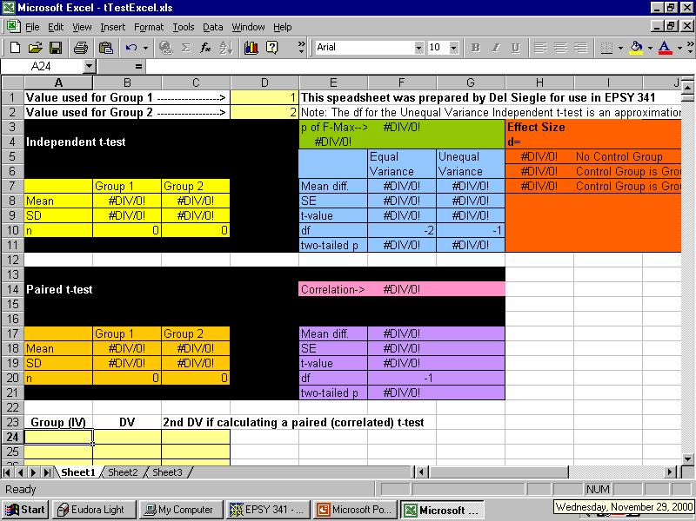
The first step in analyzing data is to enter it in a statistics program. I have created an Excel spreadsheet to analyze data from two groups. Let’s assume we have reading scores from
two groups of students and we are interested in knowing whether there is a significant difference in the scores of the two groups (t test). We need to enter each student’s score.

Slide 3
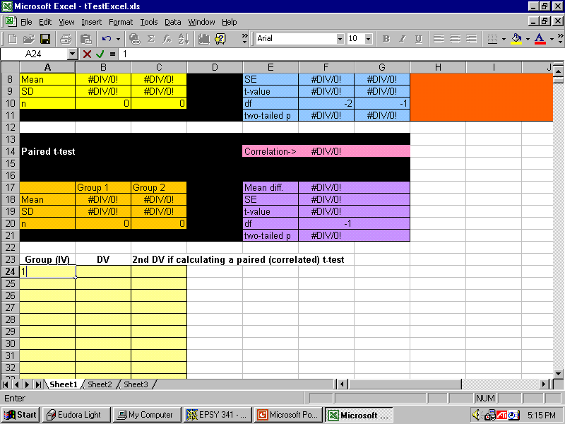
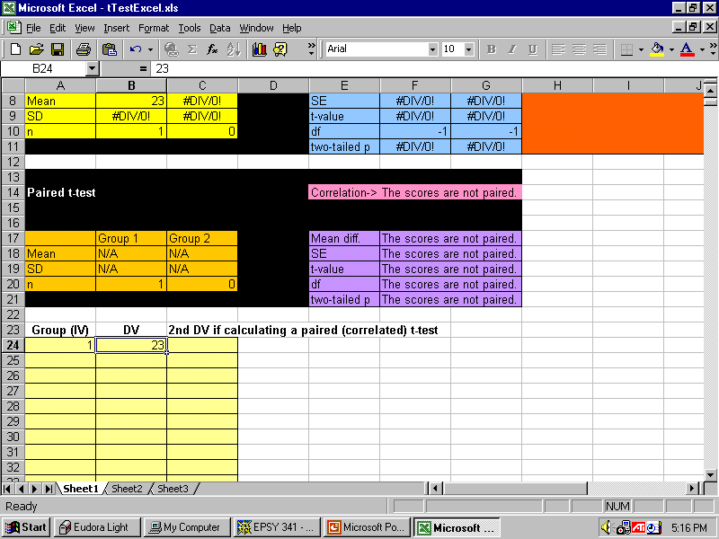

Assume that our first student is in Group 1 and has a score of 23.
We enter 1 in the Group (IV) [independent variable] column.
We enter her score of 23 in the DV (dependent variable) column

Slide 4

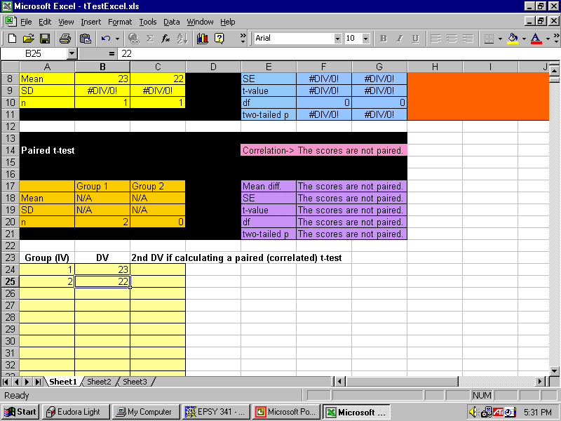
Assume that our second student is in Group 2 and has a score of 22.
We enter 2 in the Group (IV) [independent variable] column.
We enter her score of 22 in the DV (dependent variable) column

Slide 5
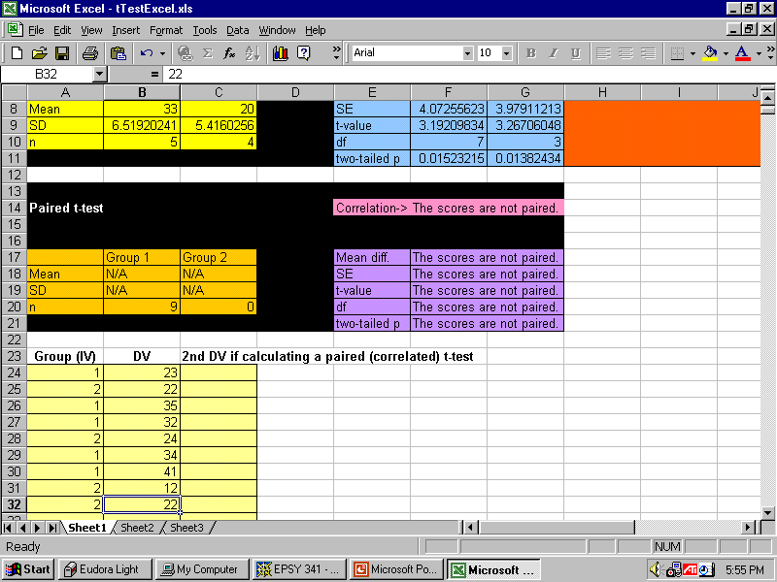


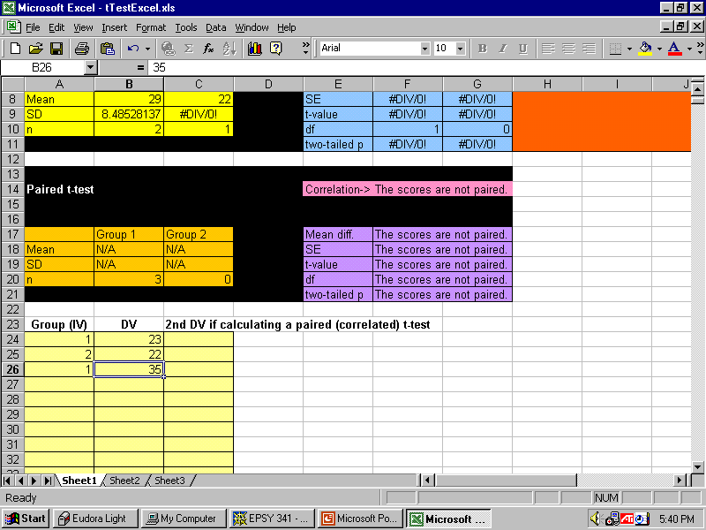

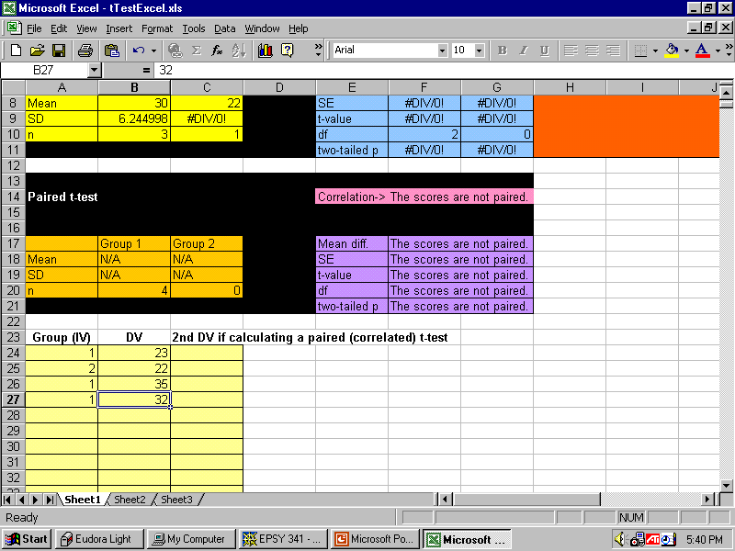
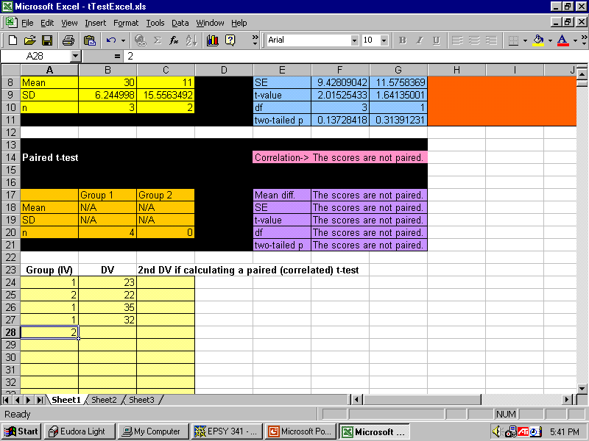

We would continue to add student scores in the same manner.
A student in Group 1 has a score of 35.
A student in Group 1 has a score of 32.
A student in Group 2 has a score of 24.
And we continue the process….

Slide 6
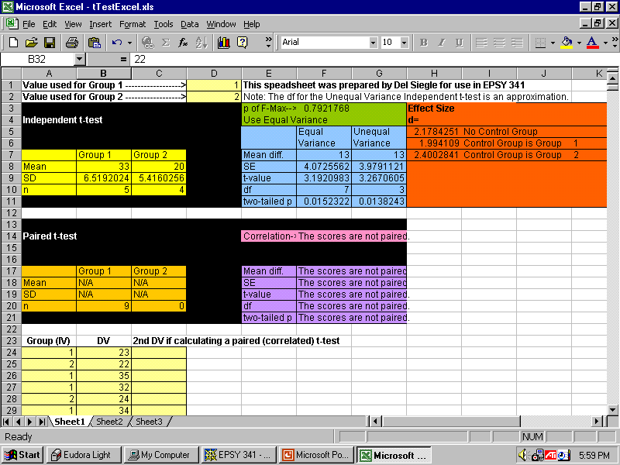
As we enter our data, the results are reported at the top of the spreadsheet.
Descriptive results for each of our groups are reported in the yellow box.
We have the mean,
standard deviation,
and number of subjects in each group.

Slide 7
The green box tells us that the equal variance t test is the appropriate independent t test to use.
This is based on the fact that, although the number of subject in the two groups is not equal,
the variances of the two groups is not sufficiently different (in this case, p > .05) to warrant an unequal variance test.

Slide 8
We will therefore read the t test information for an equal variance independent t test.
The most important piece of information is the two-tailed p-value.
The orange box calculates Cohen’s d (effect size or practical significance).
Since p < .05, we can confidently state that there was a difference between the means of the two groups.

Slide 9
Here is a spreadsheet example for a different set of data.

Slide 10
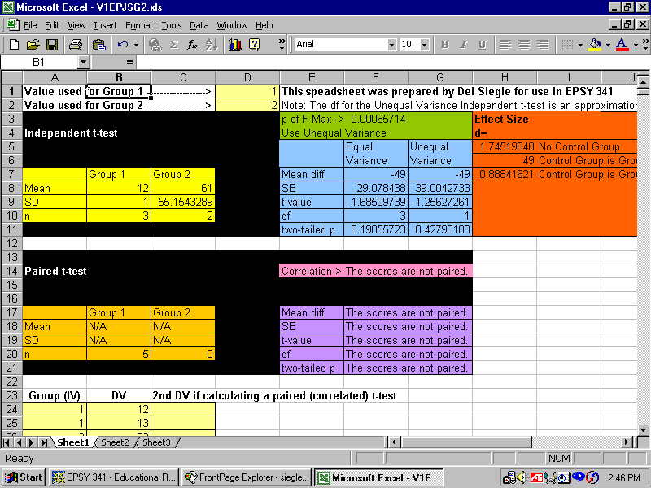
The spreadsheet indicates that an unequal variance test is appropriate. This is because the number of subjects in the groups differed and the variance of the two groups differed.
Because of the above, we should read the results for the unequal variance t test.
Because the p (significance level) of this two-tailed t test is greater than .05, we report there was no difference in the means of the two groups. In other words, we fail to reject the null hypothesis.
Instructions for Reading the t test Spreadsheet
Table 1
Number of Pushups Performed by Each Gender
--------------------------------------------------------------------
Gender M SD n
--------------------------------------------------------------------
Females 12 1 3
Males 61 55.15 2
--------------------------------------------------------------------
Mean table for a t test
t (1) = 1.26, p = .43, d = 1.75.

