Slide 1
Service-Oriented Programming
Basic Concepts/Standards/Technologies
SOA, XML, WSDL, SOAP, REST

Slide 2
SOP Basis: Service-Oriented Architecture (SOA)
Service
Registry
UDDI Registry
Publish
Web Browser
Find
UDDI Publication
UDDI Inquiry
Service
Consumer
message
has
defines
Service
Provider
Web Service
exchange
SOAP
Service Description
Web Service
WSDL

Slide 3
SOA: Roles of Interaction
Web services provider
Owns Web service and implements business logic
Hosts and controls access to the service
Examples: Microsoft, Amazon, Facebook, …
Web services requestor
Requires the certain functions to be satisfied
Looks for and invokes the service
Examples: a client, a server, or another web service
Web services registry
Searchable directory where service descriptions can be published and searched
Examples: UDDI registry

Slide 4
DEMO
Postman consuming a SOAP web service

Slide 5
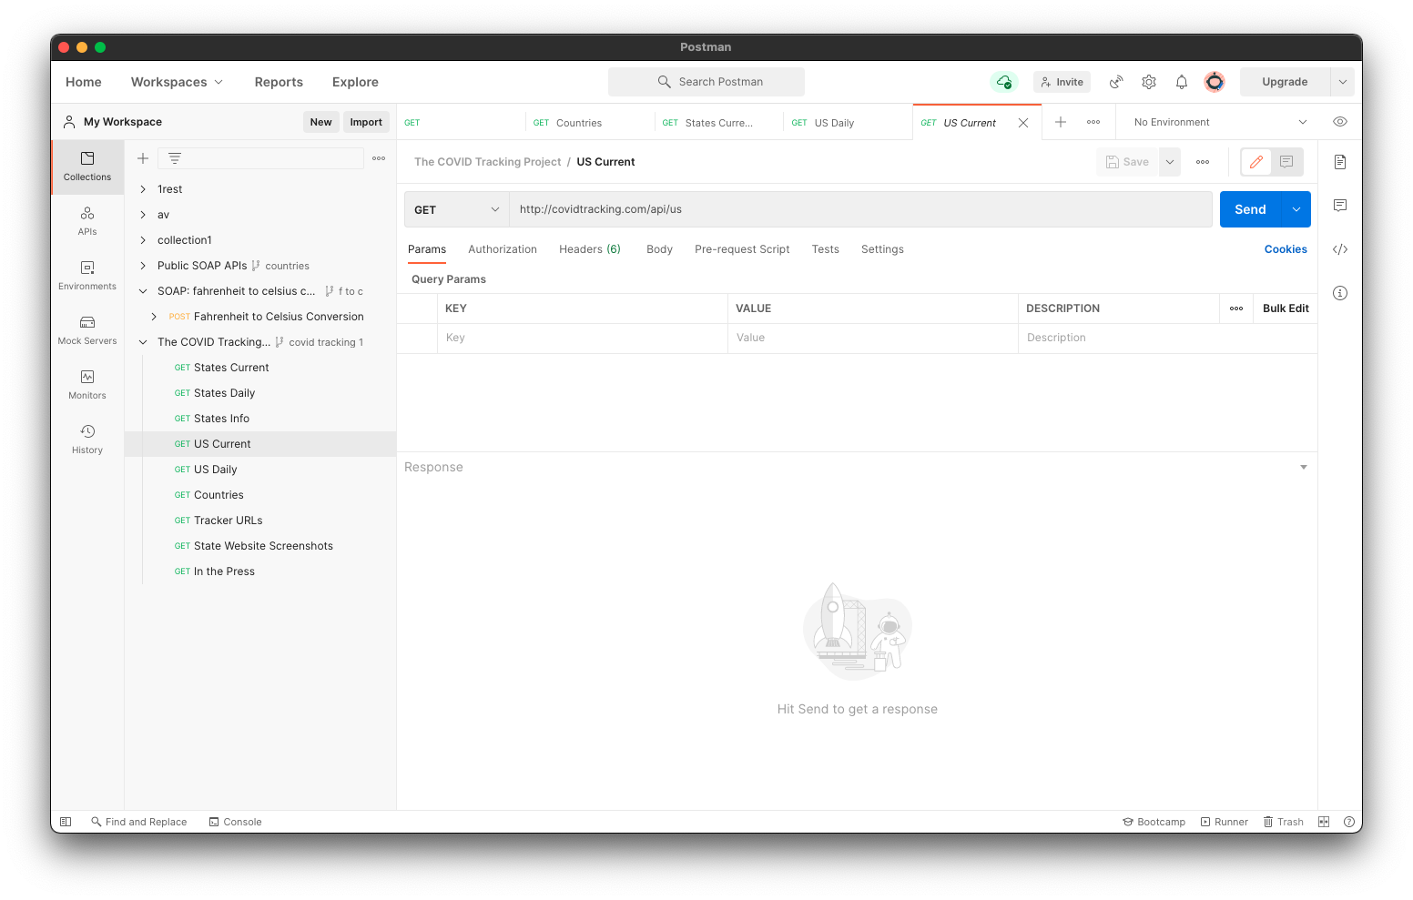

Slide 6
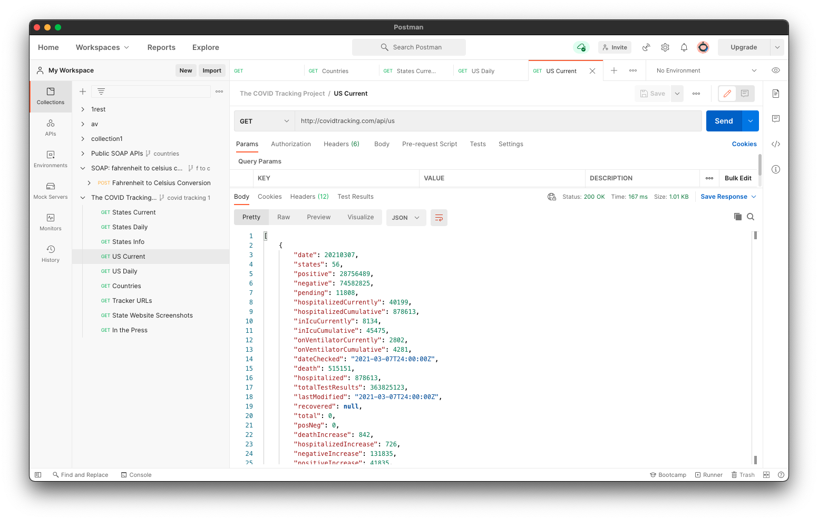

Slide 7
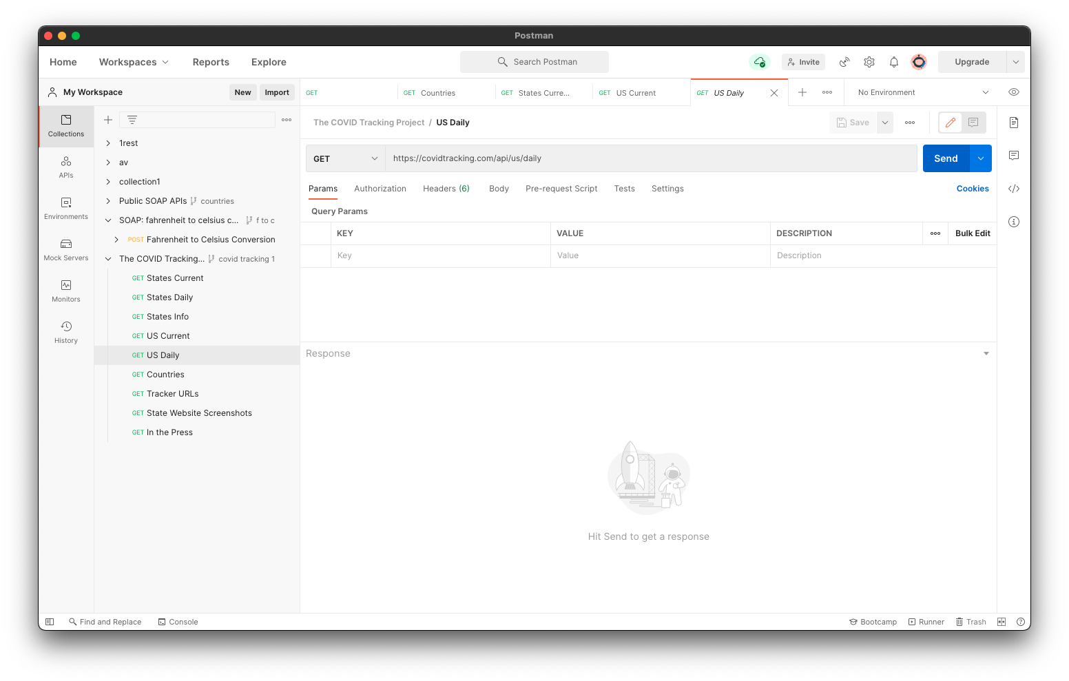

Slide 8


Slide 9
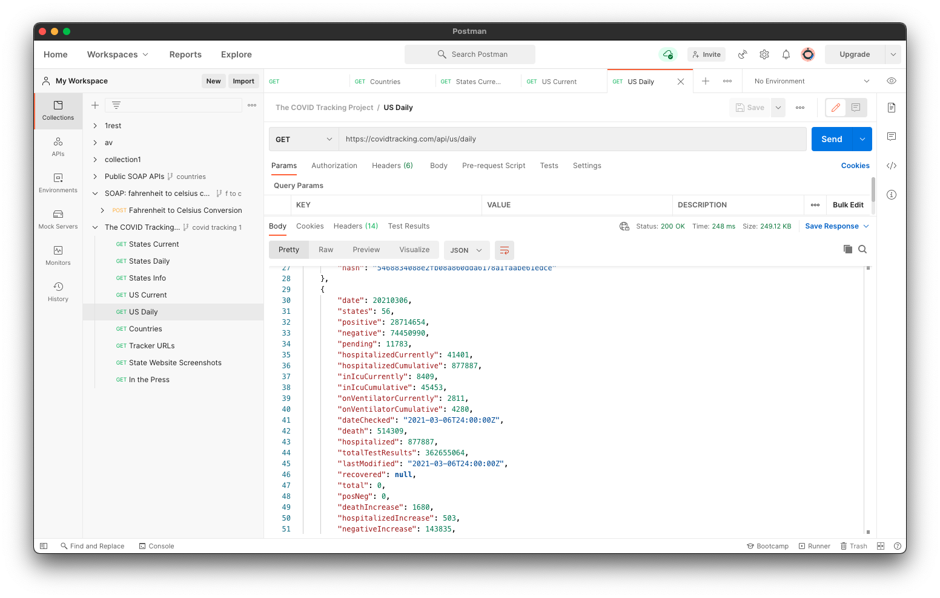

Slide 10
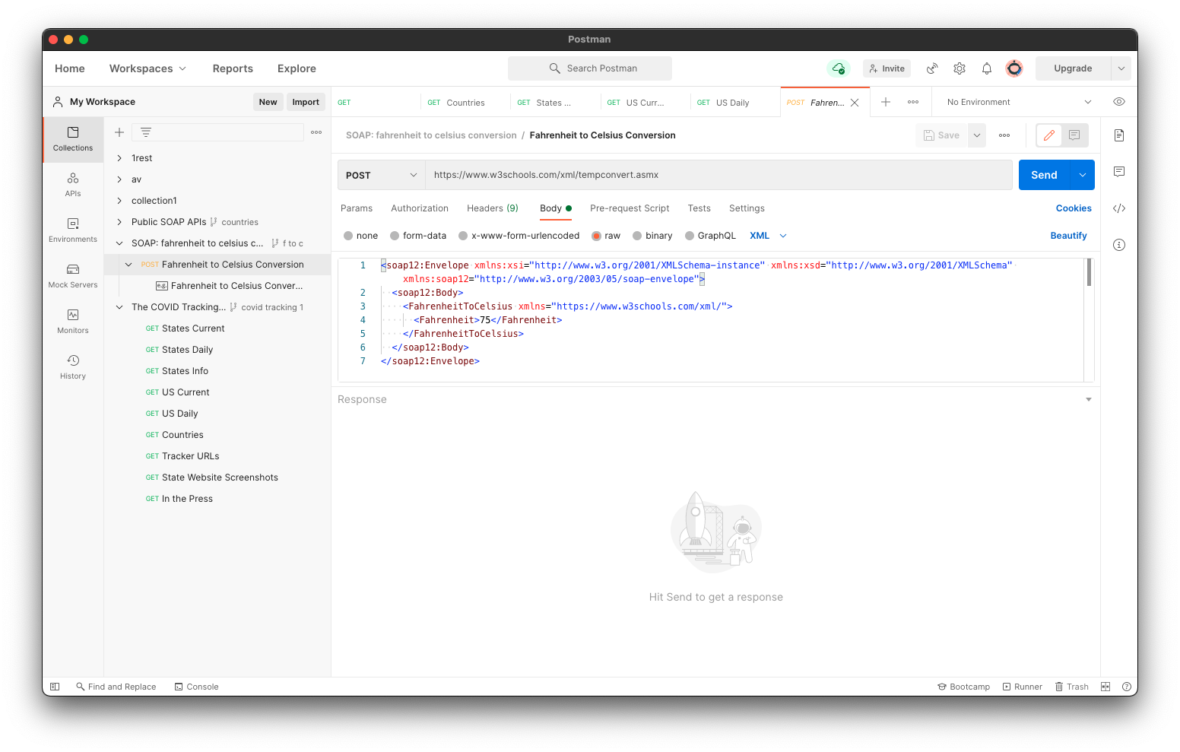

Slide 11
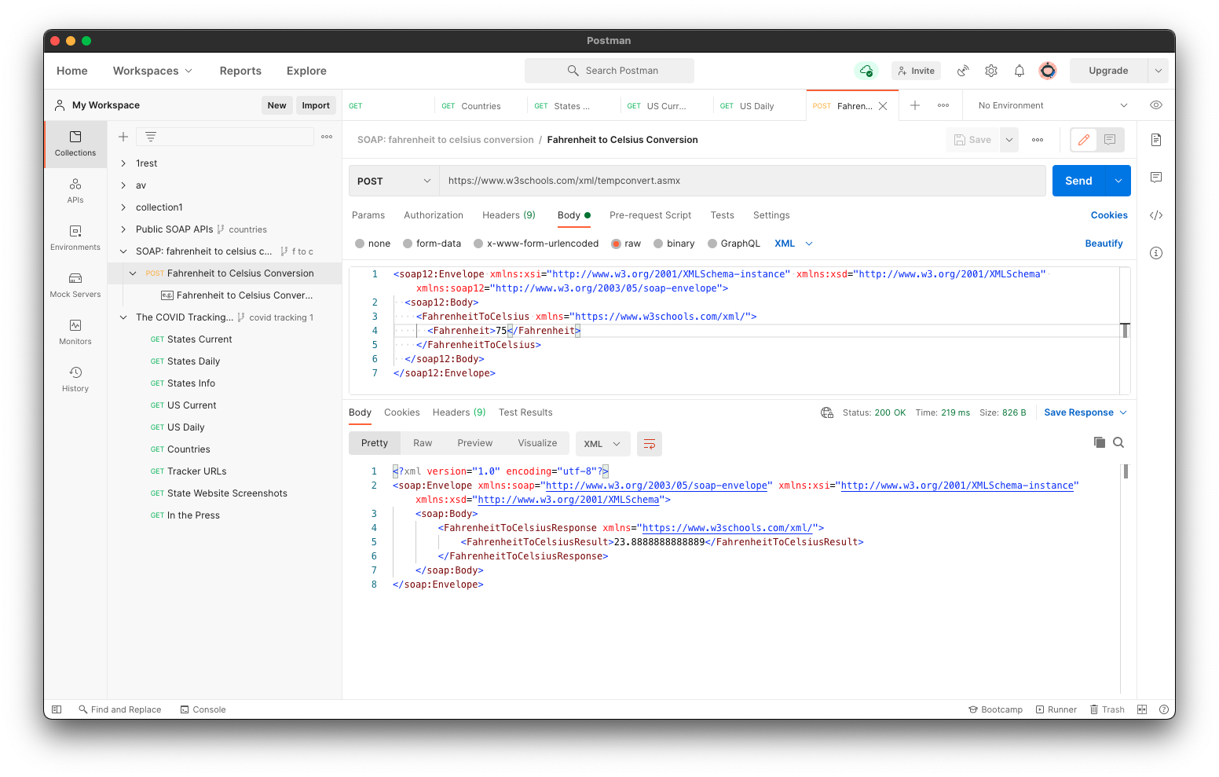

Slide 12
XML
XML: eXtensible Markup Language
Universal format for structured documents and data on the Web
Common data format of Web services
Supports semi-structured data model

Slide 13
Example
<book price = “95” currency = “USD”>
<title> Programming Language Pragmatics</title>
<author> Michael Scott </author>
<publisher> Morgan Kaufmann </publisher>
<edition> 3rd </edition>
…
<year> 2009 </year>
</book>

Slide 14
XML: Key Concepts
Document
Elements
Attributes, e.g. Text
Others
Namespace declarations, comments, processing instructions, …

Slide 15
Elements
Enclosed in tags:
Book, title, author, …
Start tag: <book> End tag: </book>
Empty element <red></red> OR <red/>
Elements are ordered, may be repeated or nested

Slide 16
Basic XML Tag Syntax
Tags written as with HTML, but …
Case-sensitive names
Always need end tags
Special empty-element
Always quote attribute values
Some other constraints for tags
Start with a letter or underscore
After first character, numbers, -, and . are allowed
Cannot contain white-spaces

Slide 17
Attributes
Associated to Elements, …
<book price=“20”>
Attributes
Unordered
Names must be unique
Cannot be nested
Provide metadata for element
Value enclosed in “ ”
Multiple attributes separated by spaces
Same naming conventions as elements

Slide 18
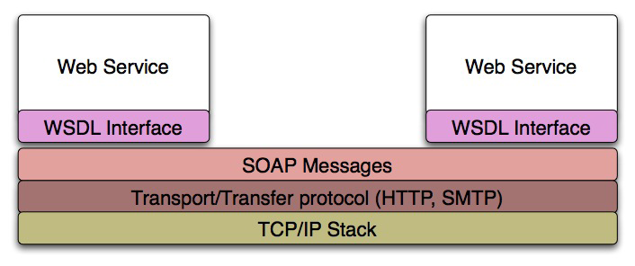
Simple Object Access Protocol
Standard messaging protocol used by web services
Supports inter-application communication

Slide 19
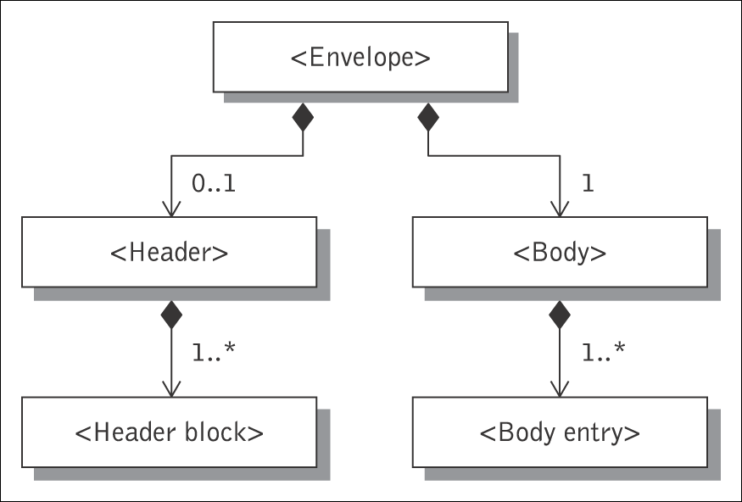
SOAP Message
SOAP envelope
SOAP header
header block
SOAP body
body block
SOAP messages are seen as enveloper where the application encloses the data to be sent
Consists of an <Envelope> element containing an optional <Header> and a mandatory <Body> element

Slide 20
SOAP Request (Example)
<SOAP-ENV:Envelope
xmlns:SOAP-ENV=“http://schemas.xmlsoap.org/soap/envelope/”
SOAP-ENV:encodingStyle="http://schemas.xmlsoap.org/soap/encoding/”>
<SOAP-ENV:Header>
<t:transId xmlns:t=“http://a.com/trans”>345</t:transId>
</SOAP-ENV:Header>
<SOAP-ENV:Body>
<m:Add xmlns:m=“http://a.com/Calculator”>
<n1>3</n1>
<n2>4</n2>
</m:Add>
</SOAP-ENV:Body>
</SOAP-ENV:Envelope>

Slide 21
SOAP Response (Example)
<SOAP-ENV:Envelope
xmlns:SOAP-ENV=“http://schemas.xmlsoap.org/soap/envelope/”
SOAP-ENV:encodingStyle="http://schemas.xmlsoap.org/soap/encoding/”>
<SOAP-ENV:Header>
<t:transId xmlns:t=“http://a.com/trans”>345</t:transId>
</SOAP-ENV:Header>
<SOAP-ENV:Body>
<m:AddResponse xmlns:m=“http://a.com/Calculator”>
<result>7</result>
</m:AddResponse>
</SOAP-ENV:Body>
</SOAP-ENV:Envelope>

Slide 22
Another Example
Sample SOAP Request and Response Message for Google's Web Service Interface
http://www.w3.org/2004/06/03-google-soap-wsdl.html
For illustration only

Slide 23
WSDL
WSDL: Web Service Description Language
Pronounced “Whiz Dull”
XML-based
Why we need WSDL for web services?
Web services are designed to support machine-to-machine interaction
No human in the loop
Needs a specified and self-explanatory programming interface

Slide 24
Contents of a WSDL File (1)
WSDL describes a service’s functionality
A service interface
Operations that can be invoked by service users
For each operation
Input parameters whose values are provided by service users, such as zipcode, address, …
Output parameters whose value will be returned to service users, such as directions, map image, …
By parsing a WSDL file, a program can …
Determine if service is suitable, how to format the request, and how to handle the response

Slide 25
Contents of a WSDL File (2)
Describes how to bind a service
Messaging style
Formatting (encoding) style
Transport protocol such as http, smtp, soap
Describes where to locate a web service
A set of ports
A port defines the location of a web service, e.g., network address location or URL
By parsing a WSDL file, a program can:
Locate and bind a web service

Slide 26
WSDL Document Content
Abstract (interface) definitions
<types> data type definitions
<message> operation parameters
<operation> abstract description of service actions
<portType> set of operation definitions
Concrete (implementation) definitions
<binding> operation bindings
<port> association of endpoint with a binding
<service> location/address for each binding
Example
http://webservices.amazon.com/AWSECommerceService/AWSECommerceService.wsdl

Slide 27
DEMO
Consuming a SOAP service
Python Zeep library
Netbeans 8 with Java EJB
Publishing a SOAP service
Python Spyne library
Netbeans 8 with Java EJB

Slide 28
REST (Representational State Transfer)
The Client references a Web resource using a URL
A resource representation returned (an HTML document)
Representation (e.g., Boeing747.html) puts client in new state
When client selects hyperlink in Boeing747.html, it accesses another resource
New representation places client into yet another state
Client transfers state with each resource representation
http://www.boeing.com/boeing/commercial/747family
Resource
Client
Fuel requirements
Maintenance schedule
...
Boeing747.html

Slide 29
Web Resources
Information from database
invoice, resume, price, phone number,…
Image
map, photo, ...
Audio
song, speech, …
Video
movie clip, …
Others

Slide 30
Resource Representation
Each resource is represented as a distinct Uniform Resource Identifier (URI)
Uniform Resource Name (URN)
e.g., isbn-10: 3642078885
Uniform Resource Locator (URL)
e.g., http://www.imdb.com/title/tt0068646/?ref_=fn_al_tt_1

Slide 31
REST Design Pattern
Create a resource for every service
Uniquely identify each resource with a logical URL
Design your information to link to other information
That is, the information that a resource returns to a client should link to other information in a network of related information

Slide 32
REST Design Pattern (2)
All interactions between a client and a web service are done with simple operations
Most web interactions are done using HTTP and just four operations:
Retrieve information (HTTP GET)
Create information (HTTP PUT)
Update information (HTTP POST)
Delete information (HTTP DELETE)

Slide 33
An Example of RESTful Web Service
Service: Get a list of parts
Web service makes an available URL to a parts list resource
A client uses this URL to get the parts list
http://www.parts-depot.com/parts
Note
How web service generates the parts list is completely transparent to the client
This is loose coupling

Slide 34
Data Returned: Parts List
Each resource is identified as a URL
Parts list has links to get each part’s detailed info
Key feature of REST design pattern
Client transfers from one state to next by examining and choosing from alternative URLs in the response document
<?xml version="1.0"?>
<Parts>
<Part id="00345" href="http://www.parts-depot.com/parts/00345"/>
<Part id="00346" href="http://www.parts-depot.com/parts/00346"/>
<Part id="00347" href="http://www.parts-depot.com/parts/00347"/>
<Part id="00348" href="http://www.parts-depot.com/parts/00348"/>
</Parts>

Slide 35
Second Web Service
Get detailed information about a particular part
Web service makes available a URL to each part resource
For example, here's how a client requests a specific part:
http://www.parts-depot.com/parts/00345
Data returned
<?xml version="1.0"?>
<Part>
<Part-ID>00345</Part-ID>
<Name>Widget-A</Name>
<Description>This part is used within the frap assembly</Description>
<Specification href="http://www.parts-depot.com/parts/00345/specification"/>
<UnitCost currency="USD">0.10</UnitCost>
<Quantity>10</Quantity>
</Part>

Slide 36
Web Service Examples
Weather service
http://vhost3.cs.rit.edu/weather/Service.svc
IMDB service
http://vhost3.cs.rit.edu/IMDB/Service.svc
Calculator service
http://vhost3.cs.rit.edu/Calculator/Service.svc
Test the services via the following link
http://vhost3.cs.rit.edu/Application/
Some source code and sample services
http://vhost3.cs.rit.edu/CentralRepository/index.aspx

Slide 37
Response Formats of RESTful Web Services
XML: eExtensible Markup Language
Universal format for structured documents and data on the Web
Common data format of Web services
JSON: Javascript Object Notation
Derived from the JavaScript scripting language
Used for serializing and transmitting structured data

Slide 38
XML-Formatted Response Example
<root response="True">
<Movie Title="Titanic" Year="1997" imdbID="tt0120338" Type="movie"/>
<Movie Title="Titanic II" Year="2010" imdbID="tt1640571" Type="movie"/>
<Movie Title="Titanic: The Legend Goes On..." Year="2000" imdbID="tt0330994" Type="movie"/>
<Movie Title="Titanic" Year="1953" imdbID="tt0046435" Type="movie"/>
<Movie Title="Titanic" Year="1996" imdbID="tt0115392" Type="movie"/>
<Movie Title="Raise the Titanic" Year="1980" imdbID="tt0081400" Type="movie"/>
<Movie Title="Titanic" Year="2012" imdbID="tt1869152" Type="series"/>
<Movie Title="The Chambermaid on the Titanic" Year="1997" imdbID="tt0129923" Type="movie"/>
<Movie Title="Titanic: Blood and Steel" Year="2012" imdbID="tt1695366" Type="series"/>
<Movie Title="Titanic" Year="1943" imdbID="tt0036443" Type="movie"/>
</root>
(http://www.omdbapi.com/?s=titanic&r=xml)

Slide 39
Json-Formatted Response Example
{"Search":[{"Title":"Titanic","Year":"1997","imdbID":"tt0120338","Type":"movie"},{"Title":"Titanic II","Year":"2010","imdbID":"tt1640571","Type":"movie"},{"Title":"Titanic: The Legend Goes On...","Year":"2000","imdbID":"tt0330994","Type":"movie"},{"Title":"Titanic","Year":"1953","imdbID":"tt0046435","Type":"movie"},{"Title":"Titanic","Year":"1996","imdbID":"tt0115392","Type":"movie"},{"Title":"Raise the Titanic","Year":"1980","imdbID":"tt0081400","Type":"movie"},{"Title":"Titanic","Year":"2012","imdbID":"tt1869152","Type":"series"},{"Title":"The Chambermaid on the Titanic","Year":"1997","imdbID":"tt0129923","Type":"movie"},{"Title":"Titanic: Blood and Steel","Year":"2012","imdbID":"tt1695366","Type":"series"},{"Title":"Titanic","Year":"1943","imdbID":"tt0036443","Type":"movie"}]}
(http://www.omdbapi.com/?s=titanic)

Slide 40
DEMO
Consuming a REST service
CURL Command line
Postman
Publishing a REST service
Python Spyne library

