Slide 1
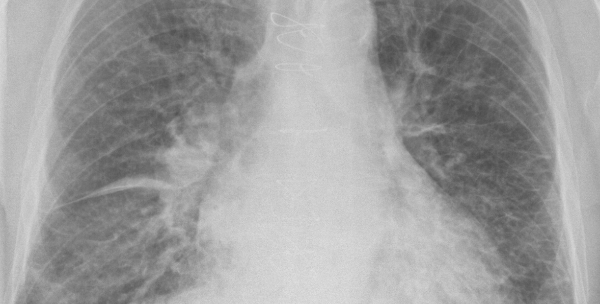
TEB | THE CORE IDEA
An agent is not a better model. It is a system that pursues a goal.
CHATBOT
produces an answer
versus
AGENT
produces an outcome
The difference is the loop: the system chooses actions, observes the result, and only then decides whether it is done.
OBSERVE
→
DECIDE
→
ACT
→
VERIFY
→
STOP
goal + model + instructions + tools + state + stop condition
Concept source: Gruppetta, Anatomy of an Agent (2026). Image: Wikimedia Commons.
01
Notes:
Suggested time: 60–75 seconds. Open with the distinction between answering and completing. Do not discuss frameworks yet. The radiograph is visual context only and does not represent clinical use.
[Sources]
- https://www.thepythoncodingstack.com/p/2-anatomy-of-an-agent
- https://upload.wikimedia.org/wikipedia/commons/c/ca/Chest_radiograph_of_a_lung_with_Kerley_B_lines.jpg
[/Sources]

Slide 2
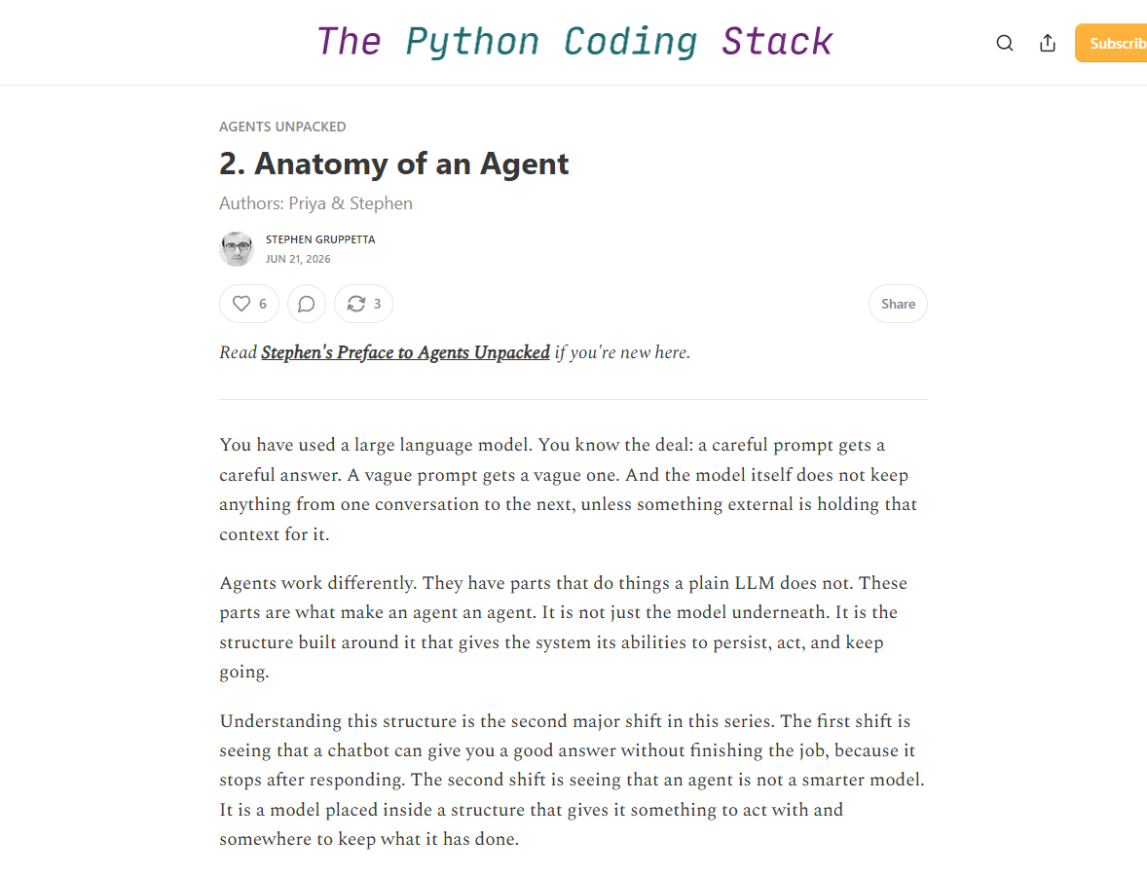
TEB | ANATOMY OF AN AGENT
The loop turns an answer into work
OPERATIONAL FORMULA
AGENT =
MODEL
+
INSTRUCTIONS
+
MEMORY / STATE
+
TOOLS
+
EXECUTION LOOP
Without repeat, this is a well-instructed call. It is not goal pursuit.
Source: Gruppetta, Anatomy of an Agent, 21 Jun 2026.
02
Notes:
Suggested time: 75 seconds. Use the formula as vocabulary for the notebook. Emphasize that memory is state outside the model and that the loop needs a completion criterion.
[Sources]
- https://www.thepythoncodingstack.com/p/2-anatomy-of-an-agent
[/Sources]

Slide 3
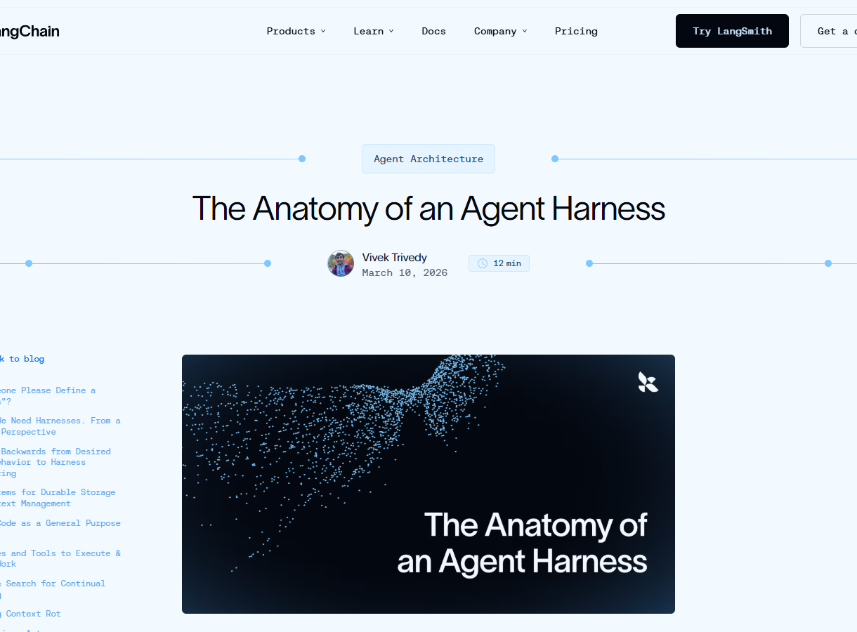
TEB | MODEL + HARNESS
The harness makes the loop operational
AGENT = MODEL + HARNESS
The model provides capability. The harness defines observable behavior.
CONTEXT
prompts, memory, retrieval
ACTION
tools, code, browser, filesystem
CONTROL
orchestration, permissions, logs, limits
Source: Trivedy, The Anatomy of an Agent Harness, LangChain, 10 Mar 2026.
03
Notes:
Suggested time: 75 seconds. This is the pivot for editorial reading: papers should describe the harness, not merely name the model. Point to the notebook's local tool, RAG, limits, and logs.
[Sources]
- https://www.langchain.com/blog/the-anatomy-of-an-agent-harness
[/Sources]

Slide 4
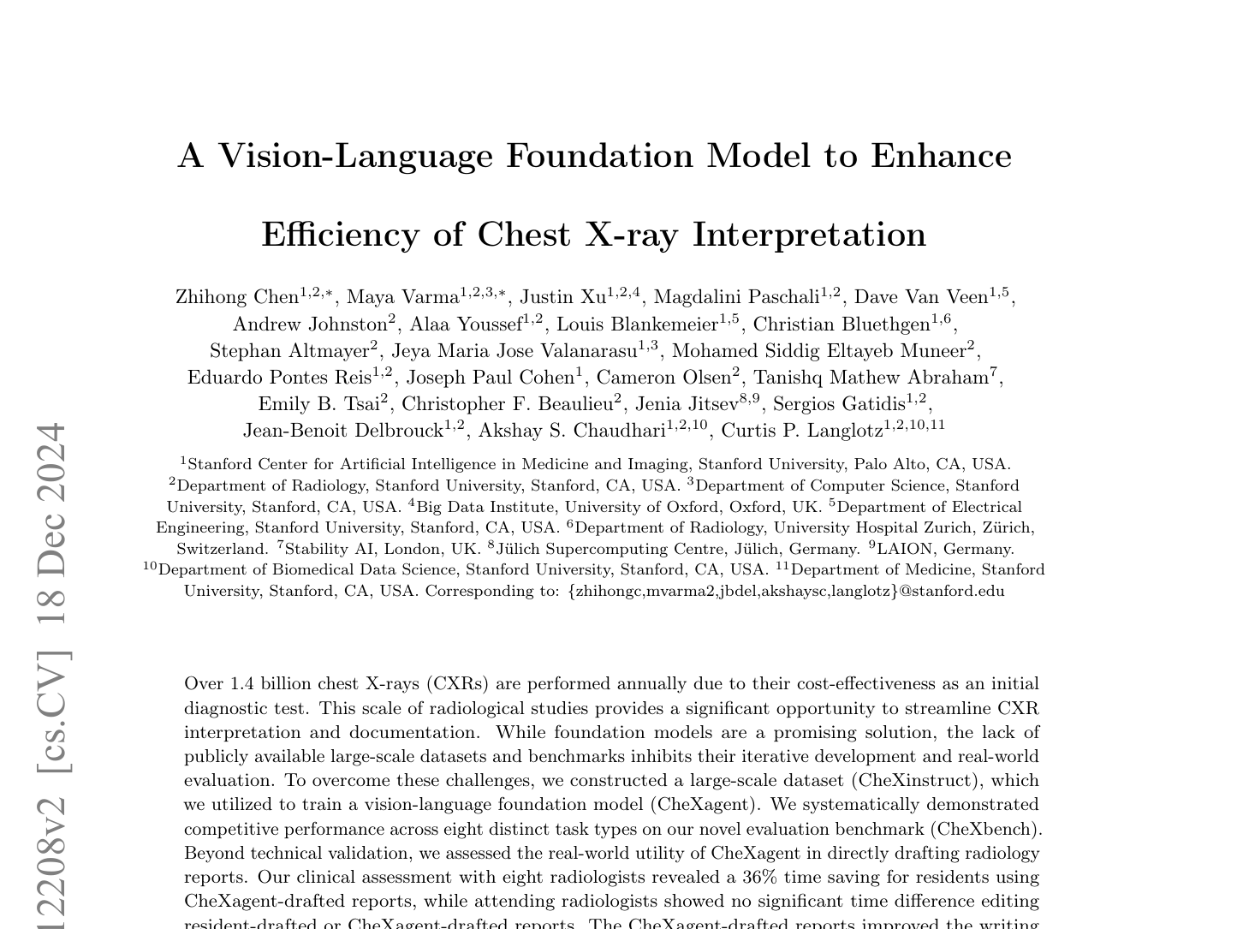
TEB | PAPER FOR DISCUSSION
CheXagent: ‘agent’ in the name does not prove agentic behavior
PREPRINT | ARXIV 2401.12208
It is a multimodal foundation model for chest X-rays.
•
Evaluates eight task types in CheXbench.
•
Tests report drafts with eight radiologists.
•
The abstract does not describe a tool-selection and verification loop.
EDITORIAL QUESTION
Where is the iterative action mechanism?
Chen et al. arXiv:2401.12208. Slide status: preprint.
04
Notes:
Suggested time: 60 seconds. Read it fairly: CheXagent is a historical name, and the paper describes a foundation model. The editorial inference is that nomenclature does not replace a description of mechanism.
[Sources]
- https://arxiv.org/abs/2401.12208
- https://arxiv.org/pdf/2401.12208
[/Sources]

Slide 5
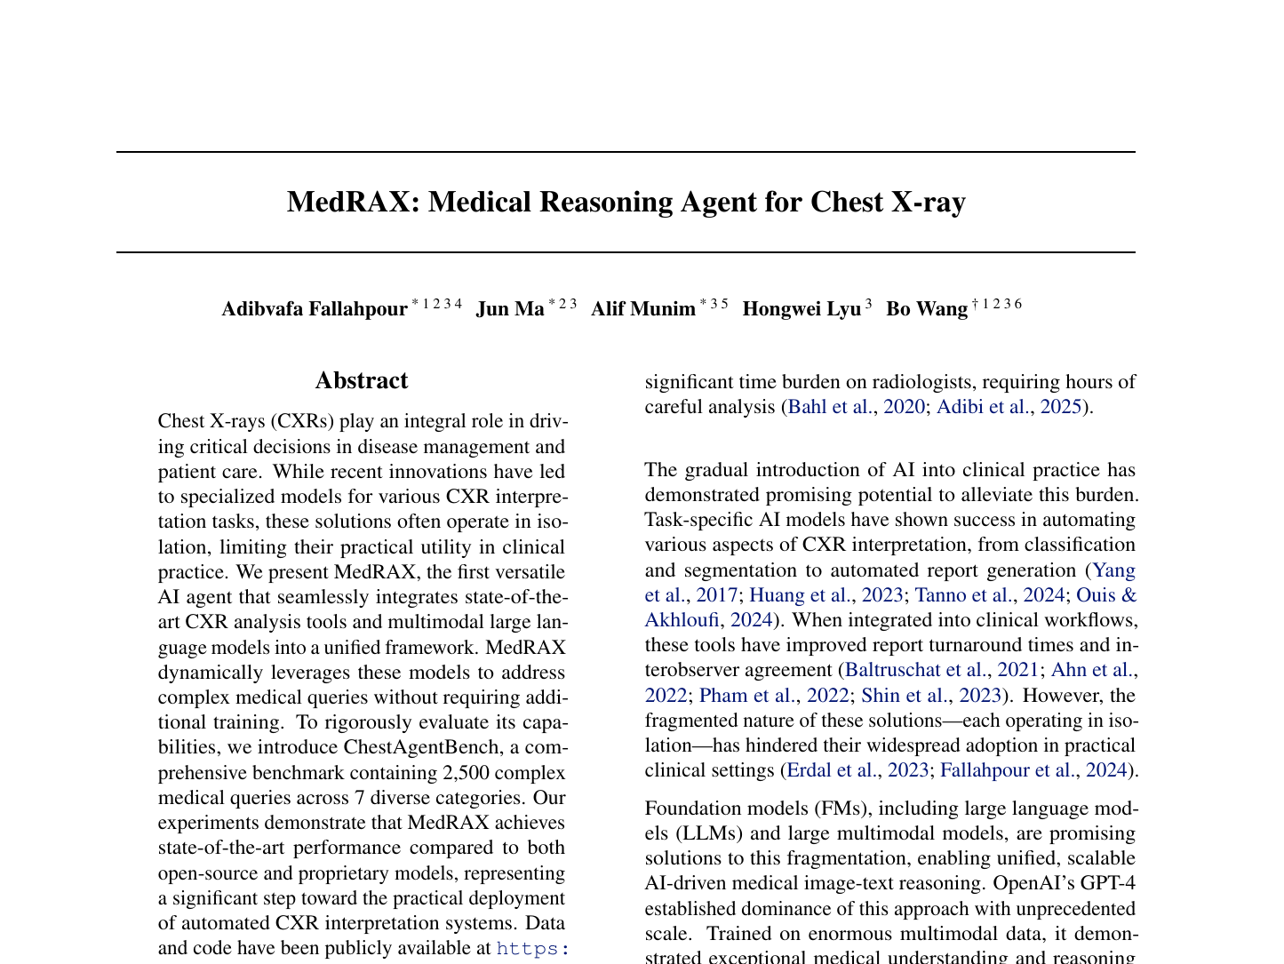
TEB | PAPER FOR DISCUSSION
MedRAX: the agent orchestrates specialized tools
ICML 2025 | PEER REVIEWED
The LLM selects and sequences chest X-ray analysis models.
•
Integrates specialized tools and multimodal models.
•
Acts on complex queries without additional training.
•
ChestAgentBench: 2,500 queries across seven categories.
EDITORIAL QUESTION
Does the evaluation measure the system or only the final answer?
Fallahpour et al. ICML 2025; PMLR 267:15661-15676.
05
Notes:
Suggested time: 60 seconds. This is the first clearly agentic example in the set: tools are selected dynamically. Use the question to introduce trajectory, tool selection, and cost as outcomes.
[Sources]
- https://proceedings.mlr.press/v267/fallahpour25a.html
- https://raw.githubusercontent.com/mlresearch/v267/main/assets/fallahpour25a/fallahpour25a.pdf
[/Sources]

Slide 6
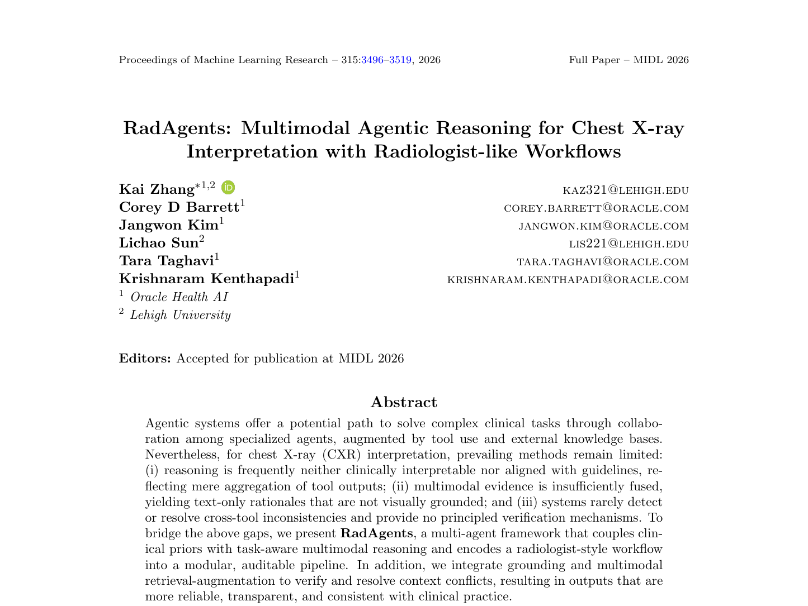
TEB | PAPER FOR DISCUSSION
RadAgents: radiologist-like decomposition improves auditability
MIDL 2026 | PEER REVIEWED
Seven agents encode a radiologist-like workflow.
•
Five ABCDE subagents, plus Orchestrator and Synthesizer.
•
Integrates grounding, retrieval, and conflict resolution.
•
Keeps intermediate artifacts for inspection of the trajectory.
EDITORIAL QUESTION
Does traceability explain, or merely narrate?
Zhang et al. MIDL 2026; PMLR 315:3496-3519.
06
Notes:
Suggested time: 60 seconds. The editorial strength is an inspectable trajectory. The caveat is not to confuse a long rationale with a causal explanation or evidence of safety.
[Sources]
- https://proceedings.mlr.press/v315/zhang26b.html
- https://raw.githubusercontent.com/mlresearch/v315/main/assets/zhang26b/zhang26b.pdf
[/Sources]

Slide 7
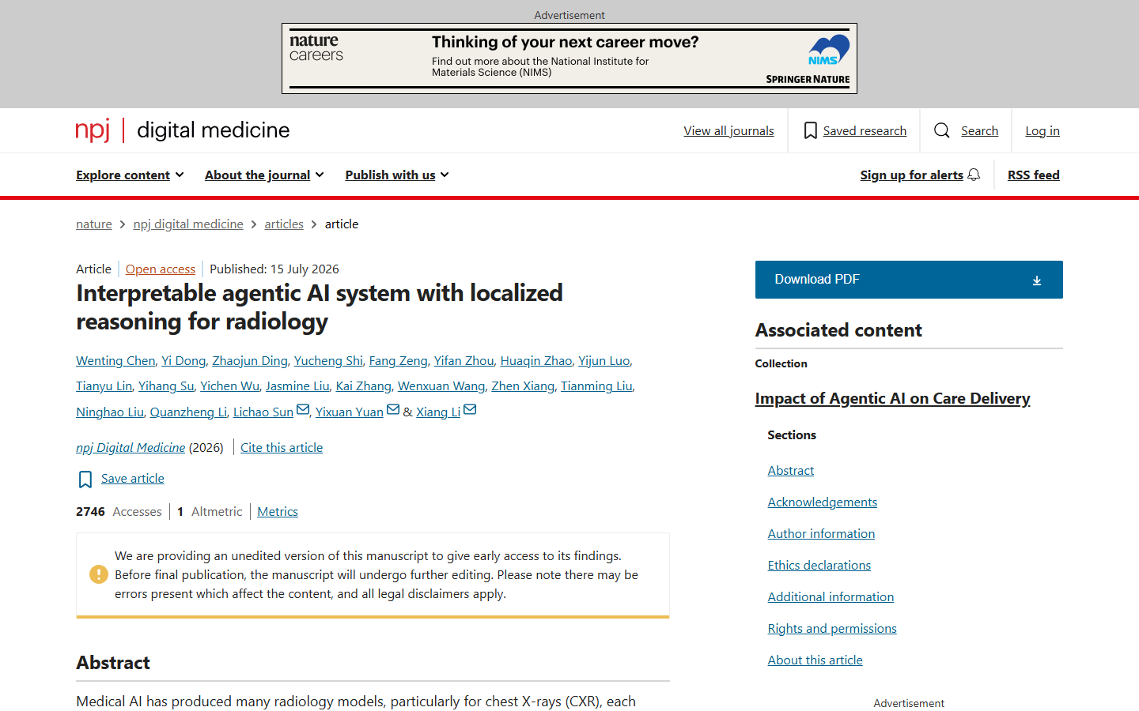
TEB | PAPER FOR DISCUSSION
RadFabric: many models, one orchestration protocol
NPJ DIGITAL MEDICINE 2026 | PEER REVIEWED
The system integrates heterogeneous and potentially conflicting outputs.
•
Orchestrates 14 chest X-ray analytical models and two VLMs.
•
One agent anchors findings to anatomy.
•
Another agent synthesizes signals into a single output.
EDITORIAL QUESTION
How should each component and the composed error be validated?
Chen et al. npj Digital Medicine, 15 Jul 2026. DOI 10.1038/s41746-026-02994-8.
07
Notes:
Suggested time: 60 seconds. Emphasize that the final error depends on a chain of components. The site states that this is an unedited version of the accepted manuscript.
[Sources]
- https://www.nature.com/articles/s41746-026-02994-8
- https://doi.org/10.1038/s41746-026-02994-8
[/Sources]

Slide 8

TEB | PAPER FOR DISCUSSION
CARE-X: tool use in one component does not make the whole system agentic
PREPRINT | 4 AUG 2026
The core is a VLM with auxiliary supervision and reward alignment.
•
Classification and grounding heads complement generation.
•
Optimization uses task-specific rewards.
•
Measurement tools appear separately in measurement-dependent tasks.
EDITORIAL QUESTION
What was evaluated: the VLM, tool calling, or the pipeline?
Ranjit et al. CARE-X. arXiv:2608.03890. Slide status: preprint.
08
Notes:
Suggested time: 60 seconds. CARE-X is a timely example of a hybrid frontier. Avoid treating it as a complete agent without examining measurement tool calling and its stop condition.
[Sources]
- https://arxiv.org/abs/2608.03890
- https://arxiv.org/pdf/2608.03890
[/Sources]

Slide 9
TEB | CLOSING
The editorial question has changed: what did the system do, with which tools, and under what limits?
RESEARCH FRONTIERS
01
trajectory benchmarks, not only final answers
02
composed error and tool-selection failures
03
human–agent interaction and escalation
04
external, prospective, workflow-aware validation
REVIEWER CHECKLIST
DECISION
TOOLS
STATE
STOP
EVALUATION
who chooses the next step?
what can act, and with which permissions?
what persists across steps and cases?
how does the loop end or escalate?
trajectory, safety, cost, and utility?
The model provides capability. The harness defines behavior.
Synthesis for editorial discussion. CLAIM 2024: DOI 10.1148/ryai.240300.
09
Notes:
Suggested time: 90 seconds. Connect directly to the notebook: local tool, editorial prompt, CLAIM-grounded RAG, multimodal input, and guardrails. Then open Colab. This slide can remain on screen for final questions.
[Sources]
- https://www.langchain.com/blog/the-anatomy-of-an-agent-harness
- https://www.thepythoncodingstack.com/p/2-anatomy-of-an-agent
- https://doi.org/10.1148/ryai.240300
[/Sources]

