Slide 1


Angular Flex-Layout
Eduardo Florence
Angular Rio Meetup #01 - First
@eduardoflorence

Slide 2
O que é?
Angular Flex Layout é uma biblioteca que automatiza de maneira inteligente o processo de aplicação do Flexbox CSS + mediaQuery e permite que os desenvolvedores especifiquem facilmente diferentes layouts, tamanhos e visibilidade para diferentes tamanhos de viewport e dispositivos de exibição.

Slide 3
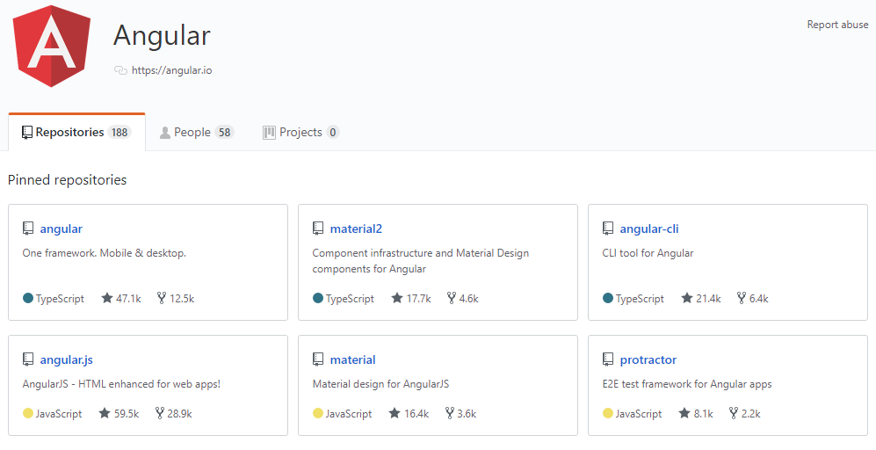
De onde vem?

Slide 4
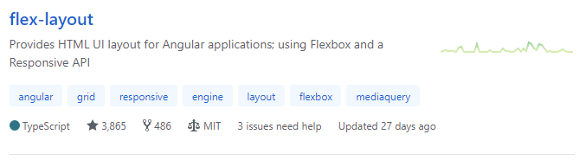
De onde vem?

Slide 5
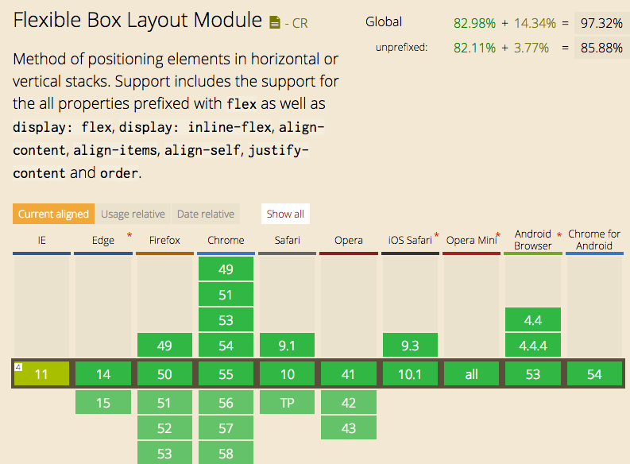

Slide 6
Instalação
npm i --save @angular/flex-layout @angular/cdk
app.module.ts:
import { FlexLayoutModule } from '@angular/flex-layout';
...
@NgModule({
...
imports: [
FlexLayoutModule
]
...
});

Slide 7
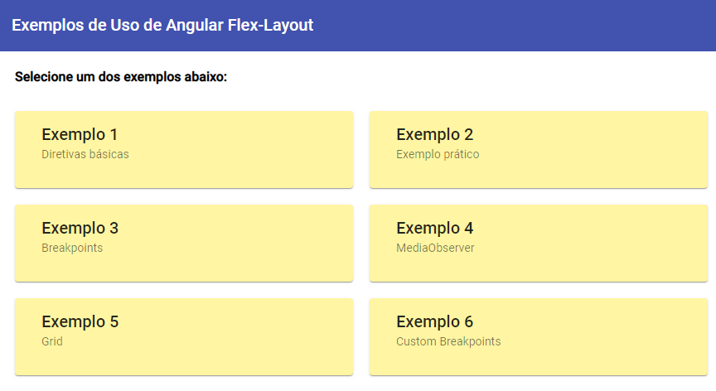
Praticando

Slide 8
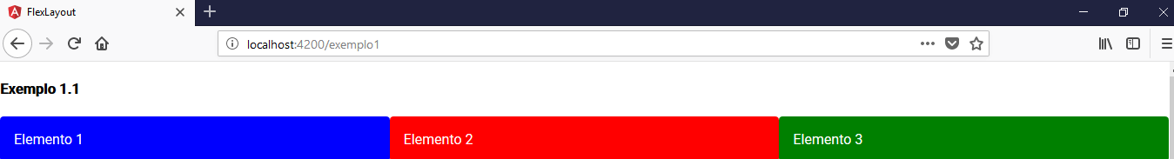
<div fxLayout="row">
<mat-card fxFlex class="blue">Elemento 1</mat-card>
<mat-card fxFlex class="red">Elemento 2</mat-card>
<mat-card fxFlex class="green">Elemento 3</mat-card>
</div>

Slide 9
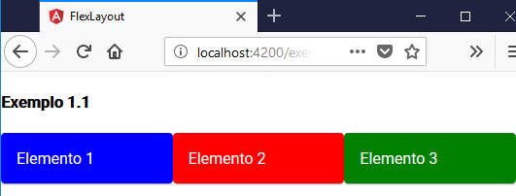
<div fxLayout="row">
<mat-card fxFlex class="blue">Elemento 1</mat-card>
<mat-card fxFlex class="red">Elemento 2</mat-card>
<mat-card fxFlex class="green">Elemento 3</mat-card>
</div>

Slide 10
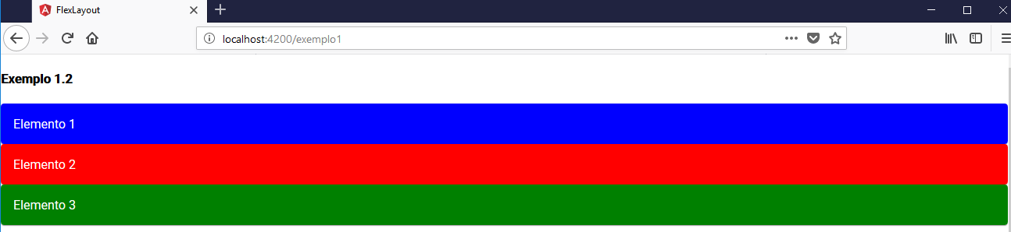
<div fxLayout="column">
<mat-card fxFlex class="blue">Elemento 1</mat-card>
<mat-card fxFlex class="red">Elemento 2</mat-card>
<mat-card fxFlex class="green">Elemento 3</mat-card>
</div>

Slide 11
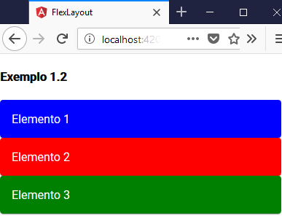
<div fxLayout="column">
<mat-card fxFlex class="blue">Elemento 1</mat-card>
<mat-card fxFlex class="red">Elemento 2</mat-card>
<mat-card fxFlex class="green">Elemento 3</mat-card>
</div>

Slide 12
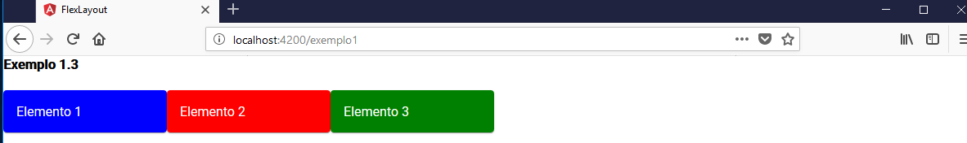
<div fxLayout="row wrap">
<mat-card fxFlex="200px" class="blue">Elemento 1</mat-card>
<mat-card fxFlex="200px" class="red">Elemento 2</mat-card>
<mat-card fxFlex="200px" class="green">Elemento 3</mat-card>
</div>

Slide 13
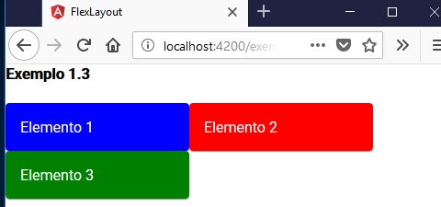
<div fxLayout="row wrap">
<mat-card fxFlex="200px" class="blue">Elemento 1</mat-card>
<mat-card fxFlex="200px" class="red">Elemento 2</mat-card>
<mat-card fxFlex="200px" class="green">Elemento 3</mat-card>
</div>

Slide 14
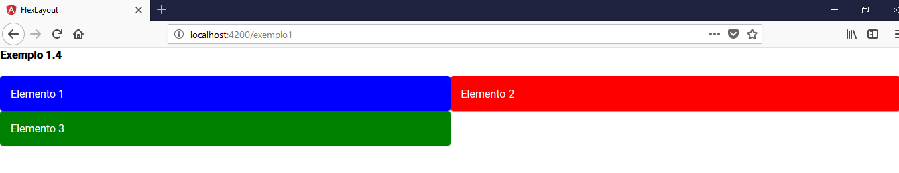
<div fxLayout="row wrap">
<mat-card fxFlex="50%" class="blue">Elemento 1</mat-card>
<mat-card fxFlex="50%" class="red">Elemento 2</mat-card>
<mat-card fxFlex="50%" class="green">Elemento 3</mat-card>
</div>

Slide 15
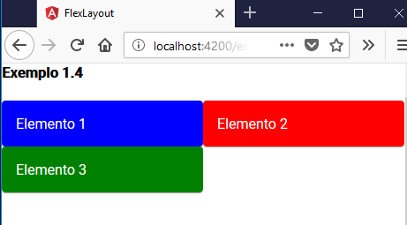
<div fxLayout="row wrap">
<mat-card fxFlex="50%" class="blue">Elemento 1</mat-card>
<mat-card fxFlex="50%" class="red">Elemento 2</mat-card>
<mat-card fxFlex="50%" class="green">Elemento 3</mat-card>
</div>

Slide 16
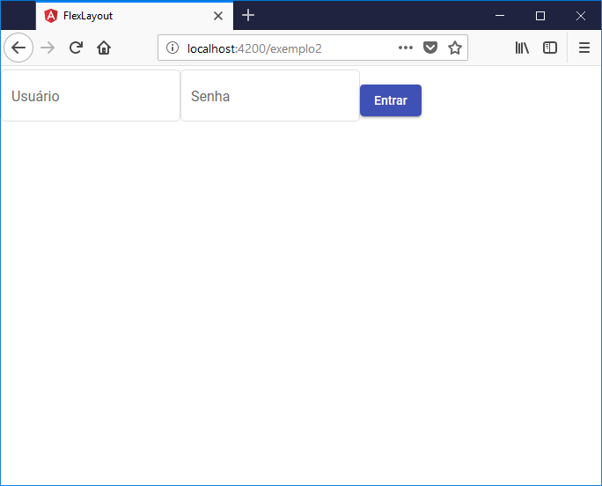
Formulário de Login
<mat-form-field appearance="outline">
<mat-label>Usuário</mat-label>
<input matInput>
</mat-form-field>
<mat-form-field appearance="outline">
<mat-label>Senha</mat-label>
<input matInput type="password">
</mat-form-field>
<button mat-raised-button
color="primary">
Entrar
</button>

Slide 17
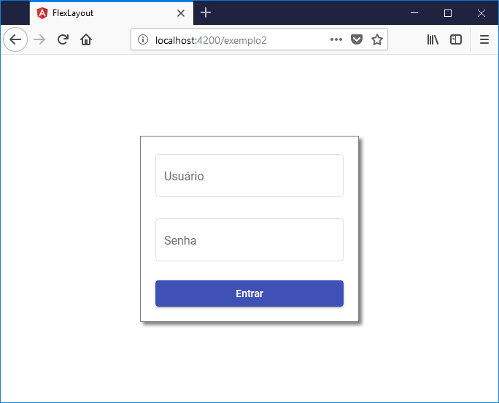

Slide 18
<div fxLayout fxLayoutAlign="center center“ class="container">
<div fxFlex="0 1 300px" fxLayout="column“ class="login-box">
<mat-form-field appearance="outline" fxFlex>
<mat-label>Usuário</mat-label>
<input matInput>
</mat-form-field>
<mat-form-field appearance="outline" fxFlex>
<mat-label>Senha</mat-label>
<input matInput type="password">
</mat-form-field>
<button mat-raised-button color="primary" fxFlex>
Entrar
</button>
</div>
</div>
.container {
width: 100%;
height: 100%;
}
.login-box {
border: 1px solid grey;
box-shadow: 4px 4px 4px grey;
padding: 20px;
}

Slide 19
Breakpoints
breakpoint | mediaQuery
xs | 'screen and (max-width: 599px)'
sm | 'screen and (min-width: 600px) and (max-width: 959px)'
md | 'screen and (min-width: 960px) and (max-width: 1279px)'
lg | 'screen and (min-width: 1280px) and (max-width: 1919px)'
xl | 'screen and (min-width: 1920px) and (max-width: 5000px)'
breakpoint | mediaQuery
lt-sm | 'screen and (max-width: 599px)'
lt-md | 'screen and (max-width: 959px)'
lt-lg | 'screen and (max-width: 1279px)'
lt-xl | 'screen and (max-width: 1919px)'
breakpoint | mediaQuery
gt-xs | 'screen and (min-width: 600px)'
gt-sm | 'screen and (min-width: 960px)'
gt-md | 'screen and (min-width: 1280px)'
gt-lg | 'screen and (min-width: 1920px)'

Slide 20
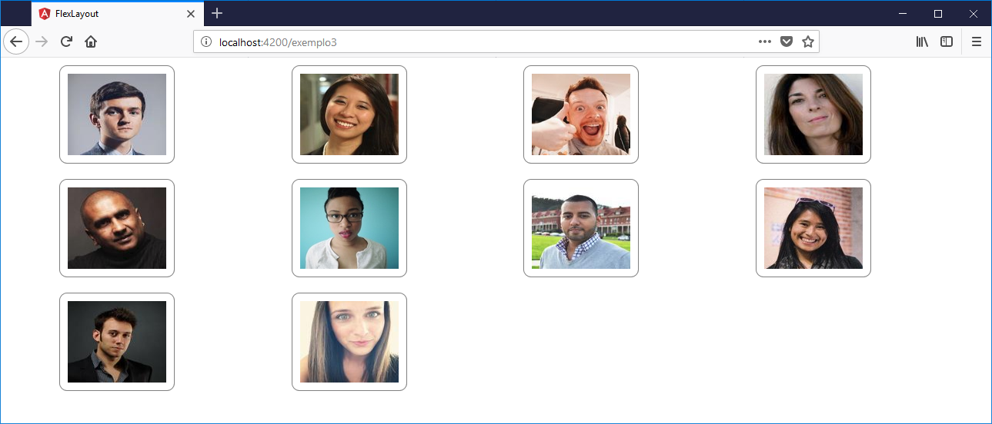

Slide 21
<div fxLayout="row wrap" fxLayout.xs="column">
<div *ngFor="let usuario of usuarios; let odd=odd"
fxFlex="0 1 calc(25%-20px)"
fxFlex.md="0 1 calc(33%-20px)"
fxFlex.sm="0 1 calc(50%-20px)"
fxLayout fxLayoutAlign="center">
<img src="https://randomuser.me/api/portraits/{{odd?'women':'men'}}/{{usuario}}.jpg?nat=br"
src.xs="https://randomuser.me/api/portraits/thumb/{{odd?'women':'men'}}/{{usuario}}.jpg"
ngClass="foto" ngClass.xs="foto foto-xs">
</div>
</div>

Slide 23
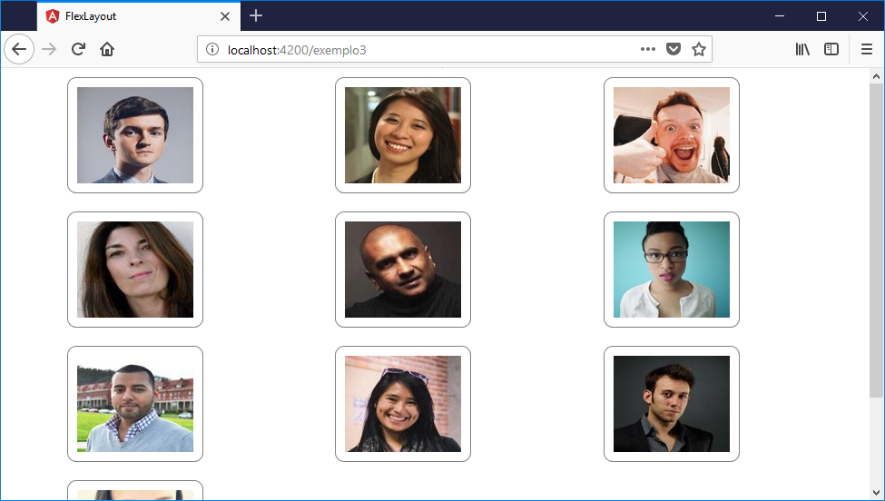

Slide 24
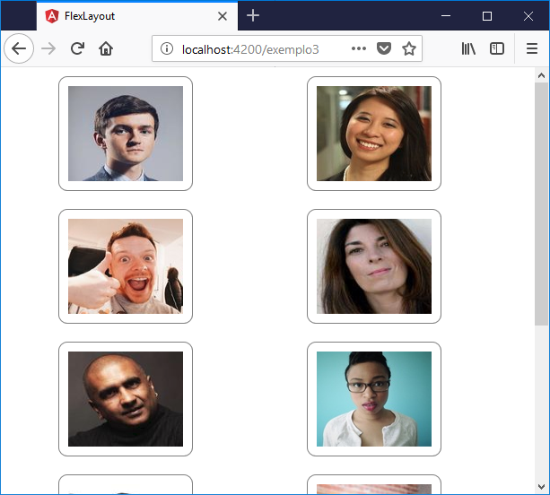

Slide 25
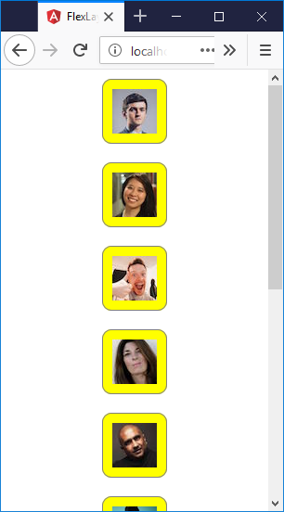

Slide 26
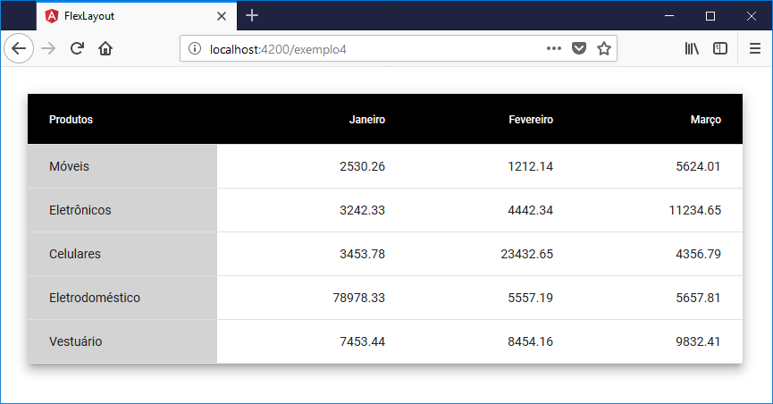
Uso de Flex-Layout na Classe do Componente

Slide 27
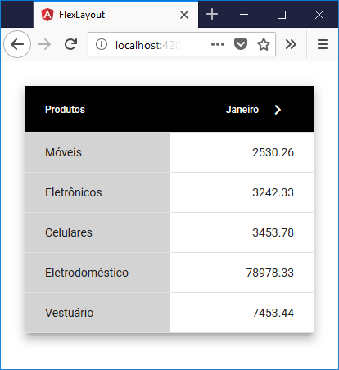

Slide 28
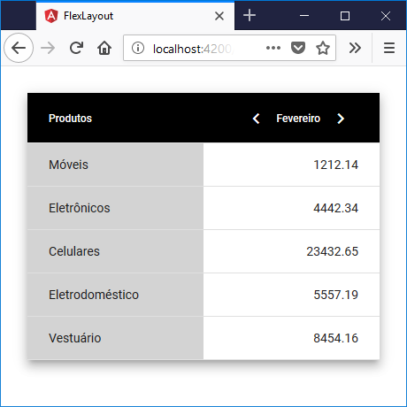

Slide 29
...
import { Subscription } from 'rxjs';
import { MediaChange, MediaObserver } from '@angular/flex-layout’;
... export class Exemplo4Component implements OnInit, OnDestroy {
watcher: Subscription;
... constructor(public mediaObserver: MediaObserver) {}
ngOnInit() {
this.watcher = this.mediaObserver.asObservable().subscribe(
(changes: MediaChange[]) => {
if (changes.some(change => change.mqAlias === 'xs')) {
this._setMobileContent();
}
this._setDesktopContent();
}
);
}
ngOnDestroy() {
this.watcher.unsubscribe();
} }

Slide 30
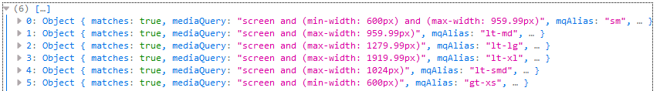
changes
Exemplo: Largura do navegador igual a 640px

Slide 31
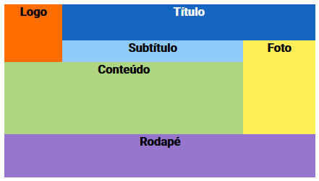
Grid

Slide 32
<div class="carteira">
<div gdAreas="logo titulo titulo | logo subtitulo foto | conteudo conteudo foto | rodape rodape rodape"
gdRows="50px 30px 100px 60px" gdColumns="80px 250px 100px">
<div gdArea="logo" class="logo">
<div>Logo</div>
</div>
<div gdArea="titulo" class="titulo">
<div>Título</div>
</div>
<div gdArea="subtitulo" class="subtitulo">
<div>Subtítulo</div>
</div>
<div gdArea="foto" class="foto">
<div>Foto</div>
</div>
<div gdArea="conteudo" class="conteudo">
<div>Conteúdo</div>
</div>
<div gdArea="rodape" class="rodape">
<div>Rodapé</div>
</div>
</div>
</div>

Slide 33
Breakpoints customizados
Construir um Provider com adições de breakpoints
Estender as Diretivas do Flex-Layout
Desabilitar os Breakpoints padrões

Slide 34
Breakpoints
breakpoint | mediaQuery
xs | 'screen and (max-width: 599px)'
sm | 'screen and (min-width: 600px) and (max-width: 959px)'
md | 'screen and (min-width: 960px) and (max-width: 1279px)'
lg | 'screen and (min-width: 1280px) and (max-width: 1919px)'
xl | 'screen and (min-width: 1920px) and (max-width: 5000px)'
breakpoint | mediaQuery
lt-sm | 'screen and (max-width: 599px)'
lt-md | 'screen and (max-width: 959px)'
lt-lg | 'screen and (max-width: 1279px)'
lt-xl | 'screen and (max-width: 1919px)'
breakpoint | mediaQuery
gt-xs | 'screen and (min-width: 600px)'
gt-sm | 'screen and (min-width: 960px)'
gt-md | 'screen and (min-width: 1280px)'
gt-lg | 'screen and (min-width: 1920px)'

Slide 35
import { BREAKPOINT } from '@angular/flex-layout';
const CUSTOM_BREAKPOINTS = [
{
alias: 'smd’, suffix: 'SMd',
mediaQuery: 'screen and (min-width: 769px) and (max-width: 1024px)',
overlapping: false
},
{
alias: 'lt-smd’, suffix: 'LtSMd',
mediaQuery: 'screen and (max-width: 1024px)',
overlapping: false
},
{
alias: 'gt-smd’, suffix: 'GtSMd',
mediaQuery: 'screen and (min-width: 1025px)',
overlapping: false
}
];
export const CustomBreakPointsProvider = {
provide: BREAKPOINT, useValue: CUSTOM_BREAKPOINTS, multi: true
};
custom-breakpoints.ts

Slide 36
...
import { CustomBreakPointsProvider } from './breakpoints/custom-breakpoints’;
...
@NgModule({
...
providers: [
...
CustomBreakPointsProvider,
...
],
...
})
app.module.ts

Slide 37
custom-flex.directive.ts
import { Directive } from '@angular/core';
import { FlexDirective } from '@angular/flex-layout';
const selector = '[fxFlex.smd], [fxFlex.lt-smd], [fxFlex.gt-smd]’;
const inputs = [
'fxFlex.smd',
'fxFlex.lt-smd',
'fxFlex.gt-smd'
];
@Directive({ selector, inputs })
export class CustomFlexDirective extends FlexDirective {
protected inputs = inputs;
}

Slide 38
import { Directive } from '@angular/core';
import { ShowHideDirective } from '@angular/flex-layout';
const selector = `
[fxHide.smd], [fxHide.lt-smd], [fxHide.gt-smd],
[fxShow.smd], [fxShow.lt-smd], [fxShow.gt-smd]
`;
const inputs = [
'fxHide.smd',
'fxHide.lt-smd',
'fxHide.gt-smd',
'fxShow.smd',
'fxShow.lt-smd',
'fxShow.gt-smd'
];
@Directive({selector, inputs})
export class CustomShowHideDirective extends ShowHideDirective {
protected inputs = inputs;
}
custom-show-hide.directive.ts

Slide 39
...
import { CustomFlexDirective } from './breakpoints/custom-flex.directive';
import { CustomShowHideDirective } from './breakpoints/custom-show-hide.directive’;
...
@NgModule({
...
declarations: [
...
CustomFlexDirective,
CustomShowHideDirective,
...
],
...
})
app.module.ts

Slide 40
Deabilitar os breakpoints padrões
app.module.ts
import { FlexLayoutModule } from '@angular/flex-layout';
...
@NgModule({
...
imports: [
FlexLayoutModule
]
...
});
.withConfig({disableDefaultBps: true})

Slide 41
Referências
https://github.com/angular/flex-layout
https://github.com/angular/flex-layout/wiki/API-Documentation
https://github.com/angular/flex-layout/wiki/Responsive-API#mediaqueries-and-aliases
https://github.com/angular/flex-layout/wiki/Breakpoints
https://cssreference.io/flexbox/

Slide 42



Contatos
Eduardo Florence
Angular, RxJS, TypeScript, SASS, PWA, NativeScript,
NodeJS, JavaScript, PostgreSQL, MongoDB, Serverless
@eduardoflorence
eduardo@infolink.com.br
github.com/eduardoflorence/angular-flex-layout

