Slide 1
Accident Severity Analysis
Greater Manchester, uk

Slide 2
Table of Contents
Introduction
Data
Methodology
Results
Conclusions

Slide 3
Introduction
Traffic accidents are a common occurrence of everyday life. These can cause material losses, personal injury, emotional distress, traffic disruption and unfortunately in some cases death.
The objective of the capstone project is to predict the severity of a traffic accident in Greater Manchester, UK.
Using data science and machine learning techniques, this project will analyse accident data from 2018 to understand the factors that affect the severity of an accident.

Slide 4
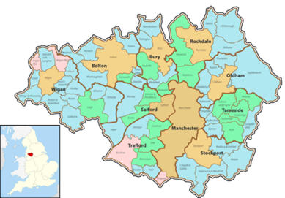
Data
The data being used has been gathered by the UK Department of Transport and it includes all traffic accidents during 2018 in the Greater Manchester area. Greater Manchester is a large metropolitan area in the north of England with an approximate population of 2.8 million.

Slide 5
Data
The data includes more than 122,000 data points and more than 30 attributes such as:
Accident data: location, number of vehicles involved, date
Environmental data: light conditions, weather conditions, road conditions,
Others: local authority, special conditions, police attendance
The dataset uses 3 different attributes to identify the severity of the accidents – Fatal (1), Serious (2) and Slight (3).

Slide 6
Methodology
Total data includes 32 attributes and 122,635 rows
Data Cleaning
Remove unnecessary data:
Attributes related to the police or authority: Police_Force, Local_Authority_(District), Did_Police_Officer_Attend_Scene_of_Accident
Attribute too specific to be relevant to the study: Special_Conditions_at_Site, Pedestrian_Crossing-Human_Control, Location_Easting_OSGR, Location_Northing_OSGR, 1st_Road_Class, 1st_Road_Number
Remove any unknown, missing or other data.
After the clean-up total dataframe became 116,806 so less than 5% data loss.

Slide 7
Methodology
Analysis
After this clean-up, the study ended up with 6 relevant attributes and the predicted one:
Day of Week: Monday through Sunday
Road Type: One way, single carriageway, double carriageway, slip road or roundabout
Light Conditions: Daylight, dark-lit and dark-unlit
Urban or Rural Area
Road Surface Conditions: Dry, Wet, Snow, Ice or Flood
Weather Conditions: Fine, Rain, Snow or Fog

Slide 8
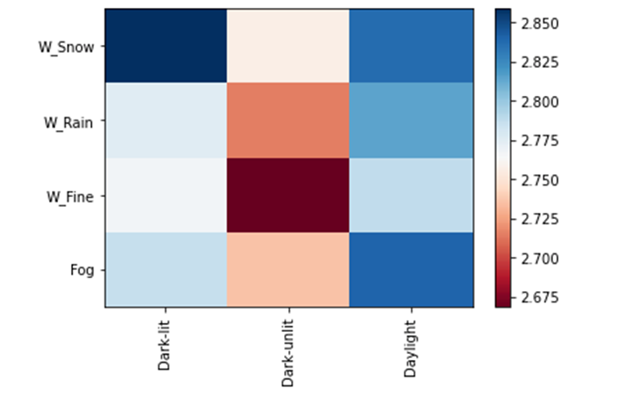
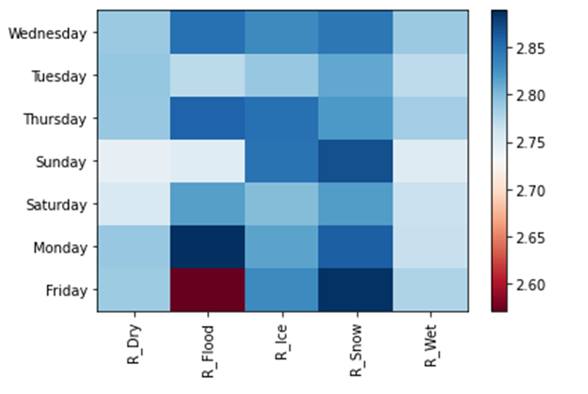
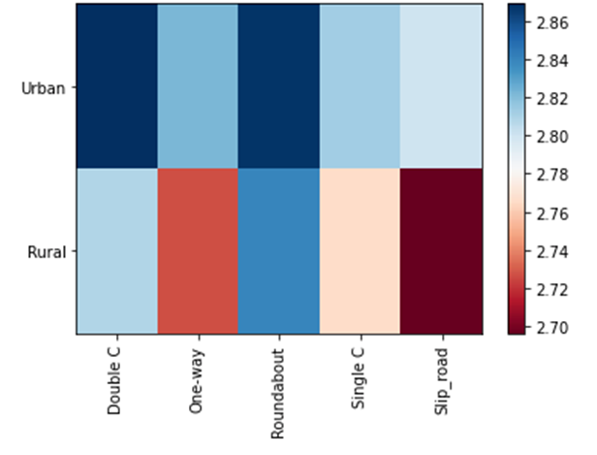
Methodology
Analysis
Categorical Variables
Correlation between the variables using heatmaps

Slide 9
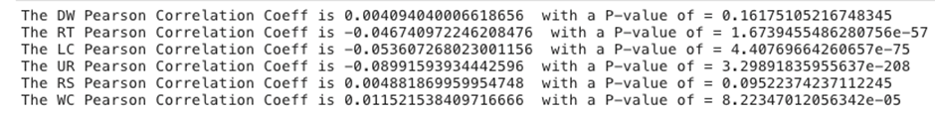
Methodology
Pearson Correlation
Removed 2 of the variables due to a very low correlation
Day of Week
Road Surface Condition

Slide 10
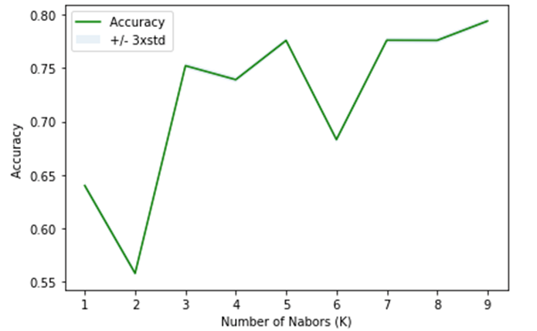
Methodology
Split data into Test and Train
Prediction Modelling
K-Nearest Neighbour (k=9)
Decision Tree
Logistic Regression
Support Vector Machines
Consistent 79% predictable results

Slide 11
Results
Accidents in unlit darkness are more serious than in lit darkness. Further analysis can be made to see where these accidents are more common to possibly invest in public lighting.
Accidents are more severe in winter due to the darkness, so maybe temporary staff might be needed in health departments.
Accidents are more severe in wet conditions, so might be relevant for insurance companies to incentivise the purchase and use of wet tread tyres. Another option would be to review the speed limits in some of these zones.

Slide 12
Results
This report and analysis would be interesting for various stakeholders in accident managementssuch as:
Insurance companies
Hospitals
Police departments
Road designers
Government councils

Slide 13
Conclusion
In conclusion, the Capstone allowed me to go through the process of identifying a problem, accessing publicly available data and have a good understanding of it. Afterwards cleaning and preparing it for analysis and looking for relations between the variables which can give us a good prediction. Lastly looked at different modelling for accurate prediction

