Slide 1
Duplicate Bug Report Detection with a combination of Text Retrieval and Topic Modeling
Nguyen, Lo, Sun
Presented by Eduardo Jaime

Slide 2
Key questions
What is the problem that the authors are solving?
What is the thesis of the paper?
Did the authors convince you? Summarize the arguments.
What is the novelty?
Summarize the good and bad ideas in the paper. Provide arguments

Slide 3
The Problem
Duplicate bug report detection.
But how?
Many people are interacting with the system. Devs, testers, final users...
Common issue in large scale systems: Eclipse, Firefox, Open source…
But, not so common in small systems: Calendar app for my company...
Everyone has different backgrounds and interactions with it.
GUI designers, Developers, Accountants...

Slide 4
The Problem
Different reports may refer to the same issue while using different technical definitions.
Remember, people use different terminologies or styles, or even describe the same issue using different phenomena:
Execution traces, outputs, screenshots (happened to me a lot)…
A bug is reported and recorded in an issue-tracking database.
Jira, Bugzilla, etc…

Slide 5
Why are duplicates an issue?
By detecting duplicates we can:
Save time and effort in triaging bugs… Translated to money?
Reduce maintenance efforts…Money again?
Get more information related to the same issue from different points of views.
Automating this process is also critical and many approaches have been proposed:
IR-based, strict but do not detect topic similarities.
Topic Modeling, less strict but detect topic similarities.

Slide 6
So… What did they propose?
The authors propose an approach named DBTM, that combines two models:
An IR Based one called BM25F:
Measures textual similarity.
A Topic Based one called T-Model:
Their own novelty model.
Addresses textual dissimilarity between duplicate reports.

Slide 7
The basics of DBTM
A report is considered a textual document describing one or more technical issues/topics in a system.
Duplicate bug reports describe the shared technical issue/topic in addition to their own topics with different phenomena.
The authors apply Ensemble Averaging technique to combine the IR and Topic based methods.
DBTM is trained on historical data with identified duplicate reports.

Slide 8
Topic Modeling with LDA
A system is considered to have K technical aspects/functionality.
Each is considered a topic, represented via certain words/terms.
The bug database is a collection of bug reports.
Each bug report is considered a textual document containing a number of words/terms to report on one or multiple technical issues.

Slide 9
Vocabulary, Topic and Word Selection
The words in all bug reports under consideration are collected into a common vocabulary (Voc) of size V.
To describe a topic, one might use words drawn from that Vocabulary.
Each word in Voc has different usage frequency in describing a topic k.
A topic k can be described via one or multiple words. Thus, represented as a set of words with their probabilities. (word-selection vectors)
LDA uses word-selection vectors ϕk. Each vector is meaningful for the entire collection of reports.

Slide 10
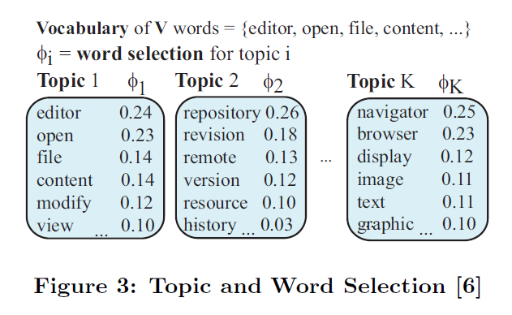
Representation of a Topic k
All the vectors for K topics from the per-topic word distribution matrix: (ϕ)

Slide 11
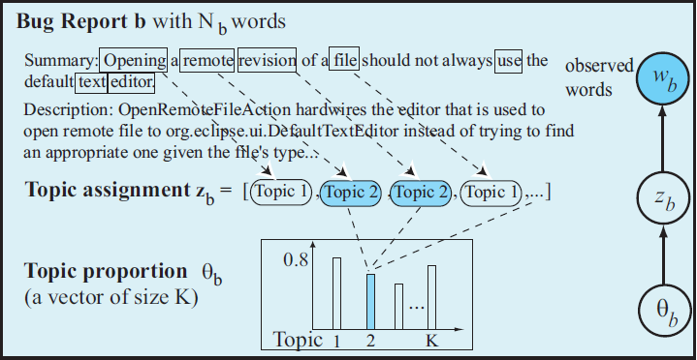
Bug Report Modeling
All texts from the description and summaries in a bug report are extracted to form the words of the textual document b, which describes a technical issue.

Slide 12
Bug Report Modeling
Document b contains Nb words, each document has two parameters associated:
Topic Assignment Vector zb. Each Nb position in b describes one topic. zb for b has the length of Nb.
Topic Proportion θb. b can describe multiple topics. LDA associates a topic proportion to each document b to represent the significance of all topics in b.
This is a vector with K elements, with a value [0-1]. As an example:
if θb = [0.20, 0.24, 0.12, ...], 20% of all words in b are about file editing, 24% are about file versioning, and so on totalling 100%.

Slide 13
T-Model for Duplicate Bug Reports
Novel topic model developed by the authors.
Each bug report b is modeled by a LDA, represented with 3 variables:
Topic proportion θb, topic assignment (zbi), and word selection (ϕ).
zbi is generated based on θb, then a word wb is generated based on topic assignment (zbi), and word selection (ϕ) for that corresponding topic.
Shared technical issues F are considered as topics and its topic proportion/distribution denoted by θF.

Slide 14
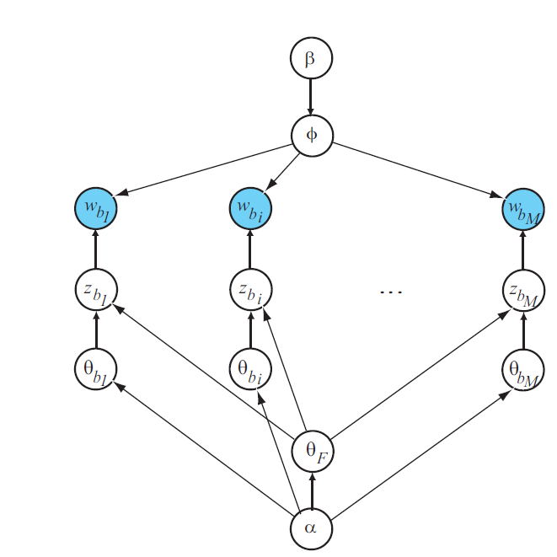
T-Model Example
b1,..., bM denote M duplicate bug reports for the shared technical issue F.
Those M reports describe that technical topic as well as their own local topics.
Local topics for each report bi are modeled by the topic proportion θbi

Slide 15
T-Model Example
Combined topic proportion θ*bi for a bug report bi is a combination of its local topic proportion θbi and θF
θbi = θbi × θF (Hadamard product)
If a topic k has high proportion in both θbi and θF , it also has a high proportion in θ*bi .

Slide 16
T-Model Example
Hyper parameters: α (uniform Dirichlet prior on topic distributions θbi and θF) and β (uniform Dirichlet prior on the per-topic word selection distribution ϕ)
The parameters of the T-Model can be learned from training stage and then used in predicting stage to estimate the topics of bug reports and to detect the duplicate ones.

Slide 17
Training
DBTM will be trained from historical data including bug reports and their duplication information.
The observed words of bug reports and duplicate relations among them will be used to estimate the topic assignment vectors of all bug reports, the topic proportion of the shared technical issue(s), and the local topic proportions of the bug reports.
The variables will be trained to make the model fit most with both the report contents and the duplicate relations.

Slide 18
Prediction
Apply DBTM to a new bug report bnew.
It uses the trained parameters to estimate the topic proportion θbnew of bnew. θbnew is used to find groups of duplicate bug reports which could share technical issue(s), i.e having high topic proportion similarity, and therefore are potentially duplicate of bnew.
Finally, all duplicate report groups Gjs are ranked, and the top-k most similar groups are shown to bug triagers to check for potential duplications for bnew

Slide 19
BM25F for Textual Similarity Measure
BM25F is an advanced document similarity function based on weighted word vectors.
Retrieves structured documents composed of several fields.
Each field correspond to a word vector (bag of words).
Each field could be assigned different degrees of importance in the retrieval process.

Slide 20
What does it do?
Given a set D of N documents, every document d has F fields, and the bag of words in the fth field is denoted by d[f], where 1 =< f =< F.
Bug reports are composed by two fields: summary and description.
BM25F computes the similarity between a query and a document based on the common words.
Two importance factors: global, measured by computing the inverse document frequency (IDF) and local measured by computing the term frequency (TFD)
Based on these factors, BM25F computes a score for a document d d and a query q.

Slide 21
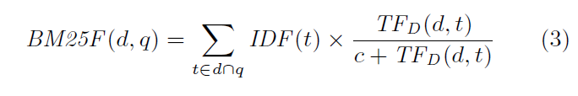
The magic formula!
t is the word that appears in both d and q
c (c => 0) is a parameter that controls the relative contribution of TFD(d, t) to the final score.
Parameters to be specified: wf and bf for each field f, and c. These can be automatically determined based on a set of training data.

Slide 22
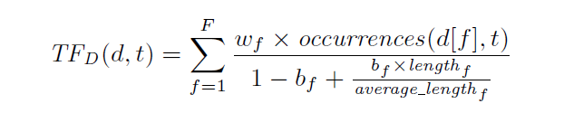

Formulas with parameters
To compute TDF of a word t (local importance)
To compute IDF of a word t (global importance)

Slide 23
Combining the models into DBTM
Two prediction experts, y1 (T-Model), and y2 (BM25F).
The two experts have different advantages in the prediction of duplicate bug reports.
y2 is stricter and better in the detection of duplicate bug reports written with the same textual tokens. However, it does not work well with the bug reports that describe the same issue with different terms. On the other hand,
y1 can detect the topic similarity between two bug reports even when they are not similar in texts. This is less strict in comparison.

Slide 24
Combining the models into DBTM
The authors applied a machine learning technique called Ensemble Averaging.
The combined expert is a linear combination of the two experts:
y = α1 y1 + α2 y2
α1 and α2 are the parameters to control the significance of experts in estimating duplicate bug reports, satisfying α1 + α2 = 1.

Slide 25
Combining the models into DBTM
If α1 = 1 and α2 = 0, only topic-based expert is used.
If α1 = 0 and α2 = 1, only text-based one is used.
The optimal values of α1 and α2 are learned from the training set

Slide 26
Training DBTM
Since DBTM is linearly combined from T-Model and BM25F, we need to determine α1 and α2 for calculating the similarity between bug reports and duplicate report groups.
Since α1 + α2 = 1 by definition, DBTM has to learn α1 only. α1 can be learned from the training set.
A training set is used for k-fold cross validation, thus, at each cross validation step, we have (k−1) folds of training duplicate report groups Gtrain and one remaining fold of testing group Gtest.

Slide 27
Training DBTM
DBTM first trains T-Model and BM25F model.
The parameters of trained models are used for estimating text similarity levels and topic similarity levels of a test bug report and a duplicate report group.
Those similarity levels are combined into sim(Btest, Ctest) via a varying weight α1 with the step of 0.01.
The combined similarity values are used to rank the links between bug reports and duplicate report groups.
The higher the combined similarity, the more likely bnew is a duplicate of the reports in G.

Slide 28
Evaluation
DBTM’s detection accuracy was compared to REP [24] and RTM
Same data sets and evaluation settings as REP: reports sorted in chronological order.
First, sensitivity of DBTM’s accuracy with respect to different numbers of topics K.
When the number of topics increases, accuracy increases as well and becomes stable at some ranges.
However, as K is larger (K>380), accuracy starts decreasing, nuanced topics appear and topics may begin to overlap semantically with each other.

Slide 29
Evaluation
Second, accuracy comparison using the parameter K selected after fine-tuning for best results in the previous step.
DBTM achieves very high accuracy in detecting bug reports.
For a new bug report, in 57% of the detection cases, DBTM can correctly detect the
duplication with a single recommended bug report
Within a list of top-5 resulting bug reports, it detects duplication in 76% of the cases. With a list of 10 reports, it detects 82% of the cases.
It can relatively improve REP by up to 20% in accuracy.

Slide 30
Evaluation
Efficiency results:
Importantly, DBTM is highly efficient.
For a large project like Mozilla, it took about 5 minutes for training (run in background).
For predicting, on average, prediction time for one bug report are just 0.031s, 0.035s, and 0.041s for OpenOffice, Eclipse, and Mozilla, respectively.

Slide 31
Conclusion
Scalable and efficient model.
It was only evaluated in Eclipse, Mozilla and OpenOffice.
The author’s would want to validate their method against commercial software.
Although, those three projects are sufficient for their analysis.
DBTM can learn sets of terms describing the same issue.
DBTM can improve other approaches by 20% in accuracy.
My personal opinion…?

Slide 32
Questions
In your experience, have you been exposed to duplicate bug reports? If so, what has been done to address this issue in your case?
Combining two approaches, as the authors did, is apparently a good idea as showed in their results. What’s your stance on combining IR based methods with Topic Modeling features?
The authors used Open Source projects for their evaluation. Do you think that evaluating these models using commercial software will provide different results?

