Slide 1
Projeto Faculdade
Crie um novo projeto Faculdade;
Crie um Layout: LinearLayout com um ListView;
<?xml version="1.0" encoding="utf-8"?>
<LinearLayout xmlns:android="http://schemas.android.com/apk/res/android"
android:orientation="vertical" android:layout_width="match_parent"
android:layout_height="match_parent">
<ListView
android:layout_width="wrap_content"
android:layout_height="wrap_content"
android:id="@+id/listView" />
</LinearLayout>

Slide 2
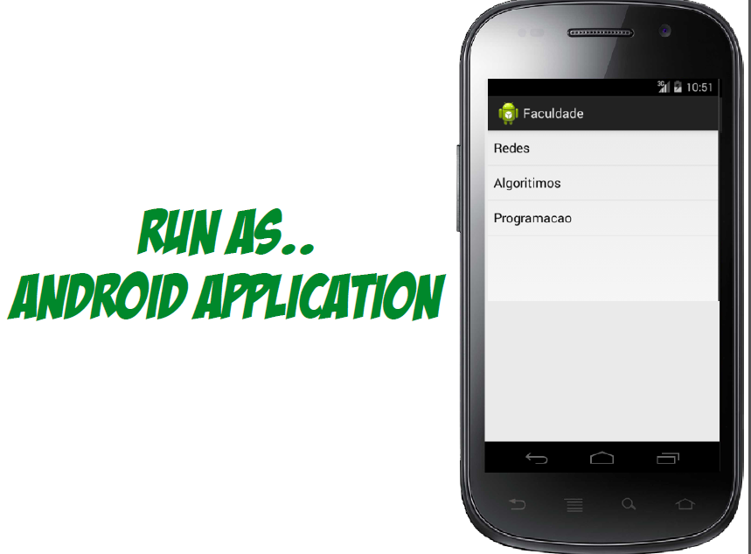
Projeto Faculdade
@Override
protected void onCreate(Bundle savedInstanceState) {
super.onCreate(savedInstanceState);
setContentView(R.layout.lista_disciplinas_layout);
String[] disciplinas = {"Redes", "Algoritmos", "Programacao"};
int layout = android.R.layout.simple_list_item_1;
ArrayAdapter<String> adapter =
new ArrayAdapter<String>(this,layout, disciplinas);
ListView lista = (ListView) findViewById(R.id.listView);
lista.setAdapter(adapter);
}

Slide 3
Projeto Faculdade
Criando um evento de click no item da lista
public class ListaDisciplinasActivity extends Activity {
@Override
protected void onCreate(Bundle savedInstanceState) {
…..
lista.setOnItemClickListener(new AdapterView.OnItemClickListener() {
public void onItemClick(AdapterView<?> adapter, View view,
int posicao, long id) {
Toast.makeText(ListaDisciplinasActivity.this, "Clicou " + posicao,
Toast.LENGTH_SHORT).show();
}
});

Slide 4
Projeto Faculdade
Criando um evento de Log click no item da lista e obtendo o seu descritivo;
public class ListaDisciplinasActivity extends Activity {
@Override
protected void onCreate(Bundle savedInstanceState) {
…..
lista.setOnItemLongClickListener(new AdapterView.OnItemLongClickListener() {
public boolean onItemLongClick(AdapterView<?> adapter,
View view, int posicao, long id) {
Toast.makeText( ListaDisciplinasActivity.this,
adapter.getItemAtPosition(posicao).toString(),
Toast.LENGTH_SHORT).show();
return false;
}
});

Slide 5
Projeto Faculdade
Crie uma nova Activity
DisciplinaActivity
disciplina_layout.xml

Slide 6
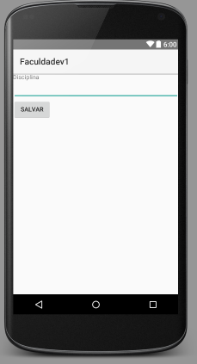
Projeto Faculdade (Formulário disciplina_layout.xml)
<?xml version="1.0" encoding="utf-8"?>
<LinearLayout xmlns:android="http://schemas.android.com/apk/res/android"
android:orientation="vertical" android:layout_width="match_parent"
android:layout_height="match_parent">
<TextView
android:layout_width="wrap_content"
android:layout_height="wrap_content"
android:text="Disciplina" />
<EditText android:id="@+id/disciplina"
android:layout_width="match_parent"
android:layout_height="wrap_content"
android:ems="10" >
<requestFocus />
</EditText>
<Button
android:id="@+id/botao"
android:layout_width="wrap_content"
android:layout_height="wrap_content"
android:text="Salvar" />
</LinearLayout>

Slide 7
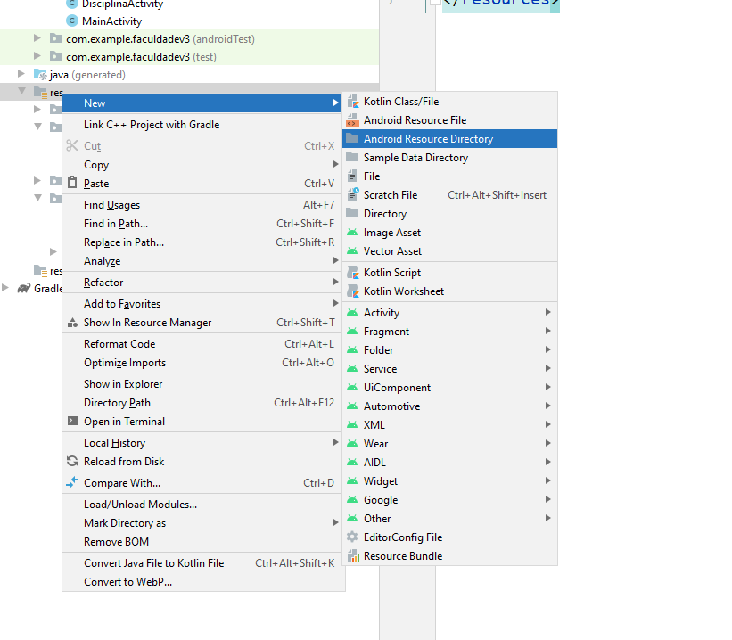
Diretório para arquivo de menu

Slide 8
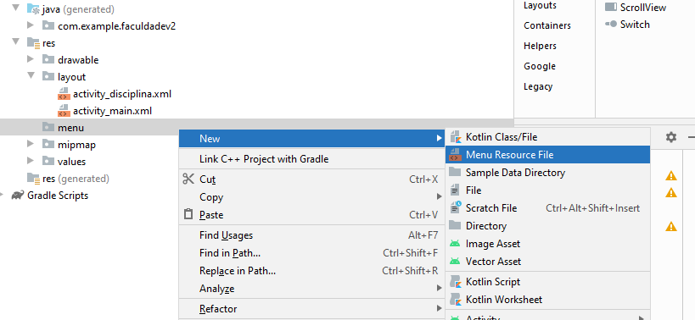
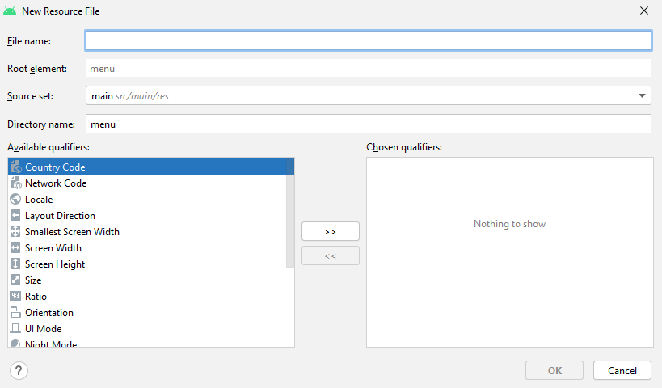
Criando o arquivo de menu

Slide 9
Projeto Faculdade
Crie um menu para adicionar novas disciplinas
menu_lista_disciplinas .xml
<menu xmlns:android="http://schemas.android.com/apk/res/android"
xmlns:tools="http://schemas.android.com/tools" tools:context=".ListaDisciplinasActivity">
<item android:id="@+id/action_new" android:title="@string/action_new"
android:orderInCategory="100" />
<item android:id="@+id/action_settings" android:title="@string/action_settings"
android:orderInCategory="100" />
</menu>
string .xml
<?xml version="1.0" encoding="utf-8"?>
<resources>
<string name="app_name">Faculdade</string>
<string name="hello_world">Hello world!</string>
<string name="action_settings">Settings</string>
<string name="action_new">Nova Disciplina</string>
<string name="title_activity_disciplina">DisciplinaActivity</string>
</resources>

Slide 10
@Override
public boolean onCreateOptionsMenu(Menu menu) {
// Inflate the menu; this adds items to the action bar if it is present.
getMenuInflater().inflate(R.menu. menu_lista_disciplinas, menu);
return true;
}

Slide 11
Projeto Faculdade (Chamando a Atctivity de Disciplina)
@Override
public boolean onOptionsItemSelected(MenuItem item) {
// Handle action bar item clicks here. The action bar will
// automatically handle clicks on the Home/Up button, so long
// as you specify a parent activity in AndroidManifest.xml.
int id = item.getItemId();
//noinspection SimplifiableIfStatement
if (id == R.id.action_settings) {
return true;
}
if (id == R.id.action_new) {
Intent intent = new Intent(this, DisciplinaActivity.class);
startActivity(intent);
return true;
}
return super.onOptionsItemSelected(item);
}

Slide 12
Projeto Faculdade: Voltando para a Activity Principal
public class DisciplinaActivity extends Activity {
@Override
protected void onCreate(Bundle savedInstanceState) {
super.onCreate(savedInstanceState);
setContentView(R.layout.disciplina_layout);
Button button = (Button) findViewById(R.id.botao);
button.setOnClickListener(new View.OnClickListener() {
@Override
public void onClick(View v) {
finish();
}
});
}
<?xml version="1.0" encoding="utf-8"?>
<LinearLayout xmlns:android="http://schemas.android.com/apk/res/android"
android:orientation="vertical" android:layout_width="match_parent"
android:layout_height="match_parent">
<TextView
android:layout_width="wrap_content"
android:layout_height="wrap_content"
android:text="Disciplina" />
<EditText android:id="@+id/disciplina"
android:layout_width="match_parent"
android:layout_height="wrap_content"
android:ems="10" >
<requestFocus />
</EditText>
<Button
android:id="@+id/botao"
android:layout_width="wrap_content"
android:layout_height="wrap_content"
android:text="Salvar" />
</LinearLayout>

Slide 13
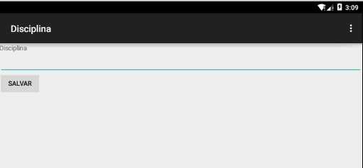
Resultado da Chamada da DisciplinaActivity

Slide 14
Montando a base de dados para Incluir, alterar e excluir disciplinas

Slide 15
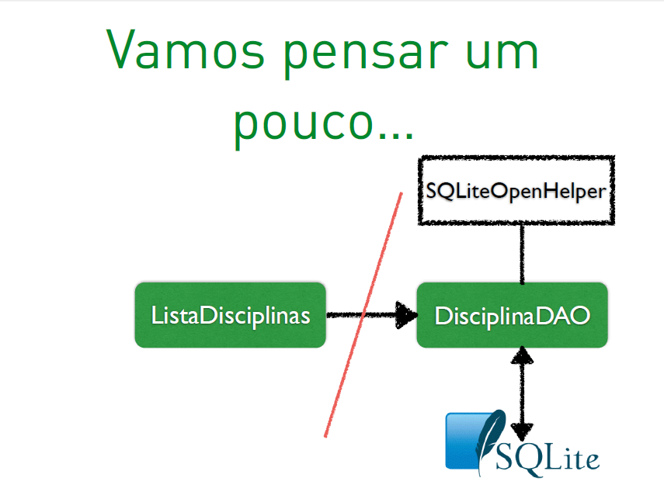

Slide 16
DisciplinaValue
implements java.io.Serializable
private Long id;
private String nome;
Get/Set
public String toString()

Slide 17
DisciplinaDAO: Criação DDL
public class DisciplinaDAO extends SQLiteOpenHelper {
private static final String DATABASE = "BancoDisciplinas";
private static final int VERSAO = 1;
public DisciplinaDAO(Context context) {
super(context, DATABASE, null, VERSAO);
}
public void onCreate(SQLiteDatabase db) {
String ddl ="CREATE TABLE Disciplina (id INTEGER PRIMARY KEY,"
+ " nome TEXT UNIQUE NOT NULL);";
db.execSQL(ddl);
}
@Override
public void onUpgrade(SQLiteDatabase db, int velha, int nova) {
String ddl ="DROP TABLE IF EXISTS Disciplina";
db.execSQL(ddl);
onCreate(db);
}

Slide 18
DisciplinaDAO: Criação DML
public void salvar(DisciplinaValue disciplinaValue) {
ContentValues values = new ContentValues();
values.put(“nome", disciplinaValue.getNome());
getWritableDatabase().insert("Disciplina", null, values );
}
public List getLista(){
List<DisciplinaValue> disciplinas = new LinkedList<DisciplinaValue>();
String query = "SELECT * FROM " + "Disciplina order by nome";
SQLiteDatabase db = this.getWritableDatabase();
Cursor cursor = db.rawQuery(query, null);
DisciplinaValue disciplina = null;
if (cursor.moveToFirst()) {
do {
disciplina = new DisciplinaValue();
disciplina.setId(Long.parseLong(cursor.getString(0)));
disciplina.setNome(cursor.getString(1));
disciplinas.add(disciplina);
} while (cursor.moveToNext());
}
return disciplinas;
}
}

Slide 19
Projeto Faculdade: ListaDisciplinasActivity
public class ListaDisciplinasActivity extends Activity {
protected ListView lista;
@Override
protected void onCreate(Bundle savedInstanceState) {
super.onCreate(savedInstanceState);
setContentView(R.layout.lista_disciplinas_layout);
int layout = android.R.layout.simple_list_item_1;
DisciplinaDAO dao = new DisciplinaDAO(this);
ArrayList<DisciplinaValue> disciplinas= (ArrayList<DisciplinaValue>) new ArrayList(dao.getLista());
dao.close();
ArrayAdapter<DisciplinaValue> adapter =
new ArrayAdapter<DisciplinaValue>(this,layout, disciplinas);

Slide 20
Projeto Faculdade: ListaDisciplinasActivity
//Colocar lista como uma variável da classe
public class ListaDisciplinasActivity extends AppCompatActivity {
private ListView lista=null;
@Override
protected void onCreate(Bundle savedInstanceState) {
protected void onResume() {
super.onResume();
DisciplinaDAO dao = new DisciplinaDAO(this);
ArrayList<DisciplinaValue> disciplinas= new ArrayList(dao.getLista());
dao.close();
int layout = android.R.layout.simple_list_item_1;
ArrayAdapter<DisciplinaValue> adapter =
new ArrayAdapter<DisciplinaValue>(this,layout, disciplinas);
lista.setAdapter(adapter);
}

Slide 21
Projeto Faculdade (funções de Apaga e Editar)
menu_lista_disciplinas .xml
<menu xmlns:android="http://schemas.android.com/apk/res/android"
xmlns:tools="http://schemas.android.com/tools" tools:context=".ListaDisciplinasActivity">
<item android:id="@+id/action_new" android:title="@string/action_new"
android:orderInCategory="100" android:showAsAction="never" />
<item android:id="@+id/action_update" android:title="@string/action_update"
android:orderInCategory="100" android:showAsAction="never" />
<item android:id="@+id/action_delete" android:title="@string/action_delete"
android:orderInCategory="100" android:showAsAction="never" />
</menu>
string .xml
<?xml version="1.0" encoding="utf-8"?>
<resources>
<string name="app_name">Faculdade</string>
<string name="hello_world">Hello world!</string>
<string name="action_settings">Settings</string>
<string name="action_new">Nova</string>
<string name="action_update">Editar</string>
<string name="action_delete">Apagar</string>
<string name="title_activity_disciplina">DisciplinaActivity</string>
</resources>

Slide 22
DisciplinaDAO: Criação do Método para apagar a disciplina
public void deletar(DisciplinaValue disciplinaValue) {
String[] args = { disciplinaValue.getId().toString() };
getWritableDatabase().delete("Disciplina", "id=?", args);
}

Slide 23
DisciplinaDAO: Criação do Método para alterar a disciplina
public void alterar(DisciplinaValue disciplinaValue) {
ContentValues values = new ContentValues();
values.put(“nome", disciplinaValue.getNome());
getWritableDatabase().update("Disciplina", values,
"id=?", new String[]{disciplina.getId().toString()});
}

Slide 24
Criando um menu flutuante e uma lista com dados do banco

Slide 25
ListaDisciplinasActivity
public class ListaDisciplinasActivity extends Activity {
protected ListView lista;
protected DisciplinaValue disciplinaValue;
protected ArrayAdapter<DisciplinaValue> adapter;

Slide 26
ListaDisciplinasActivity Vincular o menu de contexto com a lista
protected void onCreate(Bundle savedInstanceState) {
super.onCreate(savedInstanceState);
setContentView(R.layout.lista_disciplinas_layout);
int layout = android.R.layout.simple_list_item_1;
DisciplinaDAO dao = new DisciplinaDAO(this);
ArrayList<DisciplinaValue> disciplinas= (ArrayList<DisciplinaValue>) new ArrayList(dao.getLista());
dao.close();
adapter =
new ArrayAdapter<DisciplinaValue>(this,layout, disciplinas);
lista = (ListView) findViewById(R.id.listView);
lista.setAdapter(adapter);
lista.setOnCreateContextMenuListener(this);
registerForContextMenu(lista);
}

Slide 27
Criando um Disciplina de Teste
DisciplinaDAO dao = new DisciplinaDAO(this); DisciplinaValue disciplinaValue = new DisciplinaValue(); disciplinaValue.setId((new Long("1")).longValue()); disciplinaValue.setNome(“Banco de Dados"); dao.salvar(disciplinaValue);

Slide 28
ListaDisciplinasActivity
public void onCreateContextMenu(ContextMenu menu, View v,ContextMenu.ContextMenuInfo menuInfo) {
super.onCreateContextMenu(menu, v, menuInfo);
MenuInflater inflater = getMenuInflater();
inflater.inflate(R.menu.menu_lista_disciplinas, menu);
}

Slide 29
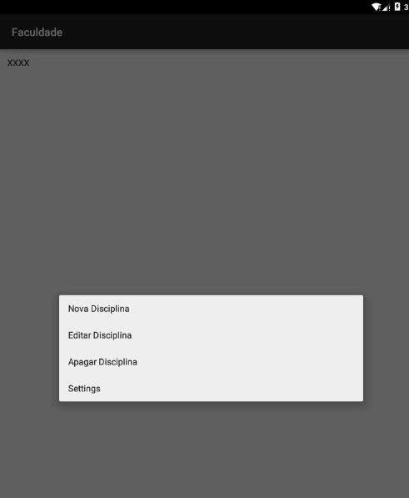
Resultado do Menu de Contexto

Slide 30
ListaDisciplinasActivity
protected void onResume() {
super.onResume();
DisciplinaDAO dao = new DisciplinaDAO(this);
ArrayList<DisciplinaValue> disciplinas= new ArrayList(dao.getLista());
dao.close();
int layout = android.R.layout.simple_list_item_1;
adapter =
new ArrayAdapter<DisciplinaValue>(this,layout, disciplinas);
lista.setAdapter(adapter);
}

Slide 31
ListaDisciplinasActivity
@Override
public boolean onCreateOptionsMenu(Menu menu) {
// Inflate the menu; this adds items to the action bar if it is present.
getMenuInflater().inflate(R.menu.menu_disciplina, menu);
return true;
}
menu_disciplina.xml
<menu xmlns:android="http://schemas.android.com/apk/res/android"
xmlns:tools="http://schemas.android.com/tools" tools:context=".FaculdadeActivity">
<item android:id="@+id/action_new" android:title="@string/action_new"
android:orderInCategory="100" android:showAsAction="never" />
<item android:id="@+id/action_update" android:title="@string/action_update"
android:orderInCategory="100" android:showAsAction="never" />
<item android:id="@+id/action_delete" android:title="@string/action_delete"
android:orderInCategory="100" android:showAsAction="never" />
<item android:id="@+id/action_settings" android:title="@string/action_settings"
android:orderInCategory="100" android:showAsAction="never" />
</menu>

Slide 32
ListaDisciplinasActivity
public boolean onContextItemSelected(final MenuItem item) {
disciplinaValue= (DisciplinaValue) this.adapter.getItem(((AdapterView.AdapterContextMenuInfo) item.getMenuInfo()).position);
int id = item.getItemId();
if (id == R.id.action_new) {
Intent intent = new Intent(this, DisciplinaActivity.class);
startActivity(intent);
return true;
}
if (id == R.id.action_update) {
Intent intent = new Intent(this, DisciplinaActivity.class);
intent.putExtra("disciplinaSelecionada", disciplinaValue);
startActivity(intent);
return true;
}
if (id == R.id.action_delete) {
DisciplinaDAO dao = new DisciplinaDAO(ListaDisciplinasActivity.this);
dao.deletar(disciplinaValue);
dao.close();
this.onResume();
return true;
}
return true;
}

Slide 33
ListaDisciplinasActivity
@Override
public boolean onOptionsItemSelected(MenuItem item) {
int id = item.getItemId();
if (id == R.id.action_new) {
Intent intent = new Intent(this, DisciplinaActivity.class);
startActivity(intent);
return true;
}
return super.onOptionsItemSelected(item);
}
@Override
protected void onActivityResult(int codigo,int reultado,Intent it){
this.adapter.notifyDataSetChanged();
}

Slide 34
DisciplinaActivity
public class DisciplinaActivity extends Activity {
protected EditText editTextDisciplin;
protected DisciplinaValue disciplinaSelecionada;
@Override
protected void onCreate(Bundle savedInstanceState) {
super.onCreate(savedInstanceState);
setContentView(R.layout.disciplina_layout);
Button button = (Button) findViewById(R.id.botao);
this.editTextDisciplin = (EditText) findViewById(R.id.disciplina);
this.editTextDisciplin.setText("teste1");
Intent intent = getIntent();
disciplinaSelecionada = (DisciplinaValue) intent.getSerializableExtra("disciplinaSelecionada");
if(disciplinaSelecionada!=null){
button.setText("Alterar");
editTextDisciplin.setText(disciplinaSelecionada.getNome());
}
....

Slide 35
String.xml
<string name="action_new">Nova</string>
<string name="action_update">Editar</string>
<string name="action_delete">Apagar</string>

Slide 36
DisciplinaActivity (Salvar/Alterar)
button.setOnClickListener(new View.OnClickListener() {
@Override
public void onClick(View v) {
DisciplinaDAO dao = new DisciplinaDAO(DisciplinaActivity.this);
if (disciplinaSelecionada==null) {
DisciplinaValue disciplinaValue = new DisciplinaValue();
disciplinaValue.setDisciplina(editTextDisciplin.getText().toString());
dao.salvar(disciplinaValue);
}else{
disciplinaSelecionada.setNome(editTextDisciplin.getText().toString());
dao.alterar(disciplinaSelecionada);
}
finish();
}
});
}

Slide 37
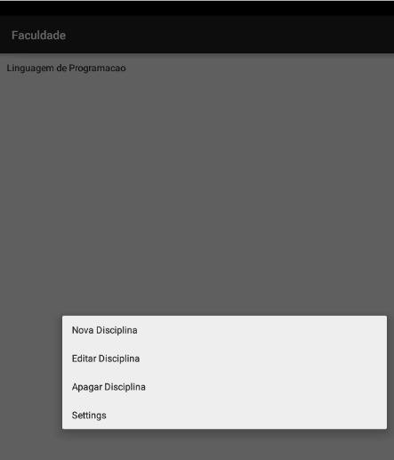
Projeto Faculdade

Slide 38
Consumindo as Disciplinas de um Json (Activity SplashScreen)
public class SplashScreen extends Activity { // Splash screen timer private static int SPLASH_TIME_OUT = 3000; private TextView textView=null; @Override protected void onCreate(Bundle savedInstanceState) { super.onCreate(savedInstanceState); setContentView(R.layout.activity_splash_screen); //ActionBar actionBar = this.getActionBar(); //actionBar.hide(); textView = (TextView) this.findViewById(R.id.textView); textView.setText("Aguarde Carregando.......");

Slide 39
Consumindo as Disciplinas de um Json (Activity SplashScreen)
@Override protected void onCreate(Bundle savedInstanceState) { ....
new Handler().postDelayed(new Runnable() { @Override public void run() { new JSONParse().execute(); } }, SPLASH_TIME_OUT);
}

Slide 40
Consumindo as Disciplinas de um Json (Activity SplashScreen)
public class JSONParse extends AsyncTask<String, String, JSONObject> { private ProgressDialog pDialog; @Override protected void onPreExecute() { super.onPreExecute(); pDialog= new ProgressDialog(SplashScreen.this); pDialog.setMessage("Obtendo Dados"); pDialog.setIndeterminate(false); pDialog.setCancelable(true); pDialog.show(); }

Slide 41
Consumindo as Disciplinas de um Json (Activity SplashScreen)
public class JSONParse extends AsyncTask<String, String, JSONObject> { @Override protected JSONObject doInBackground(String... args) { JSONObject json = null; DisciplinaDAO disciplinaDAO = new DisciplinaDAO(SplashScreen.this); disciplinaDAO.dropAll(); JSONArray link = null; json= Json(); int count=0; try { // Getting JSON Array link = json.getJSONArray("Lista"); for (int i = 0; i < link.length(); i++) { JSONObject c = link.getJSONObject(i); DisciplinaValue disciplinaValue = new DisciplinaValue(); disciplinaValue.setDisciplina(c.getString("disciplina")); disciplinaDAO.salvar(disciplinaValue); disciplinaDAO.close(); } }catch(Exception e){ e.printStackTrace(); } return json; }

Slide 42
Consumindo as Disciplinas de um Json (Activity SplashScreen)
public class JSONParse extends AsyncTask<String, String, JSONObject> { @Override protected void onPostExecute(JSONObject json) { try { pDialog.dismiss(); Intent i = new Intent(SplashScreen.this, FaculdadeActivity.class); startActivity(i); finish(); // MainActivity.this.onResume(); } catch (Exception e) { } }

Slide 43
Consumindo as Disciplinas de um Json (Activity SplashScreen)
public static JSONObject Json(){ JSONObject json = null; String resp=null; try { // Create connection to send GCM Message request. URL url1 = new URL("http://www.ictios.com.br/emjorge/appfaculdade/"+ "index1.php"); HttpURLConnection conn = (HttpURLConnection) url1.openConnection(); conn.setRequestProperty("Content-Type", "application/json"); conn.setRequestMethod("POST"); conn.setDoOutput(true); // Read GCM response. InputStream inputStream = conn.getInputStream(); resp = IOUtils.toString(inputStream); json = new JSONObject(resp); return json; }catch (Exception e){ e.printStackTrace(); } return null; }

Slide 44
emjorge1974@gmail.com https://github.com/eduardojorge

