Slide 1
NBA Player Scoring Analysis
How player performance and draft background relate to scoring output
Eduardo Maduro
BSAN 360
March 2026
GitHub repository link
https://github.com/<your-username>/bsan-360-nba-scoring-project
Final managerial deck
Replace the placeholder with your real repo URL before submitting.
8 slides, executive style, no code shown
BSAN 360 Final Project
1
Notes:
[Sources] - Course submission requirements from the uploaded file “Final Project Deliverables (1).docx”. - Dataset source for the link line on later slides: Kaggle, Justinas, NBA Players dataset. [/Sources]

Slide 2
Project overview
Dataset, scope, and objective
DATASET
This project uses a public multi season NBA player statistics dataset to study what best explains scoring output and whether draft background is associated with different scoring outcomes.
Source
Kaggle: NBA Players
Public dataset used throughout the project
Rows
Columns
Mean age
12,844
22
27.0
Key variables
player season records in the original dataset
performance, demographics, team, and draft variables
average age in the raw data
pts, gp, reb, ast, usg_pct, age, draft_round
Core measures used in the final analyses
Business question
Which signals are most useful for understanding NBA scoring output?
The project builds from data cleaning, exploratory analysis, grouping, and model testing into a final story about performance drivers and draft related differences in scoring.
BSAN 360 Final Project
2
Notes:
[Sources] - Original dataset shape, column count, and descriptive statistics from “annotated-Project 2 BSAN 360 - Colab-1.pdf”. - Public dataset listing from Kaggle, Justinas, “NBA Players”. [/Sources]

Slide 3
Data preparation and modeling sample
How the weekly assignments rolled into the final analysis
PREP
Relevant columns
Missingness check
Final sample
11
0
10,720
Why this matters
reduced to the fields needed for scoring analysis
missing values remaining after filtering relevant columns
players with at least 20 games played
A cleaner sample makes the final statistics more credible.
Started with the full dataset, then focused on scoring related variables such as points, rebounds, assists, age, usage, and draft information.
Professor feedback led to removing very low sample players so outliers from tiny workloads would not distort results.
Earlier exploratory work also used a stricter filter of gp >= 20 and pts >= 3, producing 9,614 rows for visuals and transformations.
Intermediate work created season_start, total_contribution, grouped team summaries, and Yeo Johnson transformations for skewed variables.
The final deck does not repeat every weekly output. Instead, it highlights the steps that materially improved the quality of the final story.
Key prep milestones
• Relevant variable selection
• Missing data check
• Low sample filtering
• Transformations and grouped summaries
BSAN 360 Final Project
3
Notes:
[Sources] - Missingness and selected columns from “annotated-Project 2 BSAN 360 - Colab-1.pdf”. - Low sample filtering counts and grouped preparation details from “annotated-BSAN 360 project 3.pdf”, “annotated-Project_5_with_explanation.pdf”, and “annotated-Project_last_with_final_comment (1).pdf”. [/Sources]

Slide 4
Research questions and hypotheses
The final story is built around three core questions
QUESTIONS
What do the distributions and visual relationships suggest about scoring?
1
Exploratory visuals
How much do rebounds, assists, age, and net rating explain points per game?
2
Regression model
Does scoring differ across Round 1, Round 2, and other or undrafted players?
3
ANOVA test
BSAN 360 Final Project
4
Notes:
[Sources] - Slide structure requirement from “Final Project Deliverables (1).docx”. - Research questions synthesized from the uploaded analysis PDFs covering exploratory visuals, regression, and ANOVA. [/Sources]

Slide 5
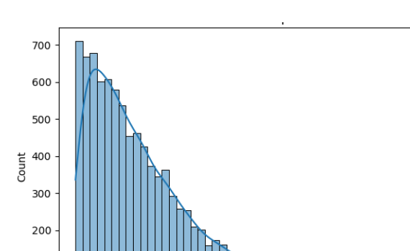
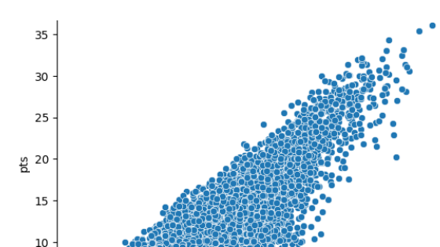
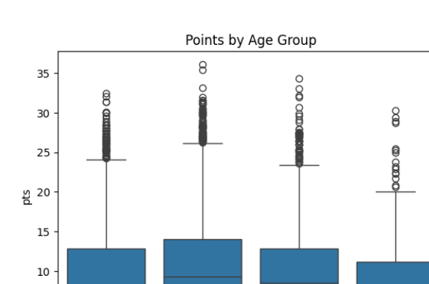
Exploratory findings
Scoring is skewed, usage is a strong signal, and age may matter nonlinearly
RQ1
Distribution of points
Usage vs points
Main takeaways
Points, rebounds, and assists were right skewed, which signaled that raw performance metrics were not normally distributed.
Usage percentage showed one of the clearest positive relationships with points, making offensive involvement a key indicator of scoring output.
Age looked more meaningful in grouped views than as a perfectly linear trend, suggesting that scoring peaks may cluster within prime age bands.
Points by age group
Why it matters: the visuals informed the later modeling choices instead of treating every variable as simple and linear from the start.
BSAN 360 Final Project
5
Notes:
[Sources] - Visuals and narrative findings from “annotated-Project_4_with_Findings (1).pdf”. [/Sources]

Slide 6
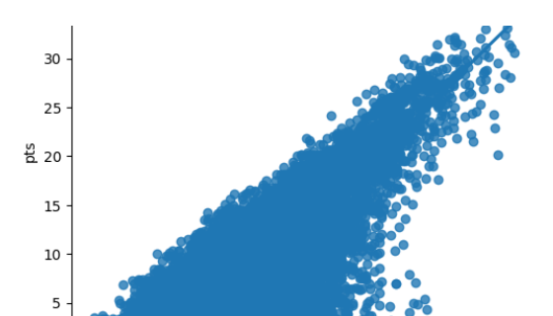
Regression results
How much of scoring can be explained by the selected performance variables
RQ2
R²
Rows used
Mean PPG
0.64
10,720
9.22
moderately strong fit
final regression sample
from the modeled sample
Estimated coefficients
Usage helps show the upward scoring pattern seen before modeling.
Assists had the largest positive coefficient in the final model, followed by rebounds. Age had a small negative coefficient, while net rating added a small positive effect.
BSAN 360 Final Project
6
Notes:
[Sources] - Final regression sample statistics, R², and coefficients from “annotated-Project_last_with_final_comment (1).pdf”. [/Sources]

Slide 7
ANOVA results by draft group
Scoring differs significantly across draft background categories
RQ3
F statistic
p value
Groups
662.188
< 0.001
3
Interpretation
The ANOVA result shows that average scoring is not the same across all draft groups.
Draft background captures meaningful differences in player scoring outcomes beyond random variation.
This supports the broader conclusion that both on court performance variables and player background matter for understanding scoring output.
strong between group separation
reject the null hypothesis
Round 1, Round 2, and other or undrafted
Sample sizes by group
Group counts: Round 1 = 6,734, Round 2 = 2,417, Other / undrafted = 1,569
BSAN 360 Final Project
7
Notes:
[Sources] - Final ANOVA statistics and group counts from “annotated-Project_last_with_final_comment (1).pdf”. [/Sources]

Slide 8
Conclusions and recommendations
The final project story in executive form
SO WHAT
Key conclusions
Managerial recommendations
Scoring is shaped by multiple factors, not one single metric.
Offensive involvement and playmaking related variables are especially informative.
Draft background still separates player scoring outcomes in a statistically meaningful way.
Use usage, assists, and rebounds together when evaluating scoring potential.
Avoid judging players with tiny workloads the same way as regular rotation players.
Combine statistical output with player background rather than relying on draft status alone.
BSAN 360 Final Project
8
Notes:
[Sources] - Final conclusions from “annotated-Project_last_with_final_comment (1).pdf”. - Submission format requirement from “Final Project Deliverables (1).docx”. [/Sources]

