Slide 1
Predicting Health Insurance – Checkpoint 1 Group G
Daniel Carneiro, up202108832
Gonçalo Costa, up202108814
Eduardo Oliveira, up202108690

Slide 2
Index
Loading Data / Data Exploration
Data Preprocessing
Models / Submission File
Difficulties
Future Developments

Slide 3
Loading Data / Data Exploration
15 Columns (But 3 are not necessary: ‘Unnamed: 0’, ‘custid’, ‘code_column’)
Zero duplicated rows
1686 Missing Values in ‘housing_type’, ‘num_vehicles’, ‘gas_usage’ and ‘recent_move_b’ (25515 in ‘is_employed’ are not considerate missing values)

Slide 4
Data Preprocessing
Dropped the unnecessary columns (‘Unnamed: 0’, ‘custid’, ‘code_column’)
Handling with missing values (‘housing_type’ -> Unknown, ‘num_vehicles’ -> 0 , ‘gas_usage’ -> 0 and ‘recent_move_b’ -> Unknown)
Handling Outliers
‘gas_usage’ : (we did a log)
‘income’ : (we divide by 12 for put all values in month scale)

Slide 5
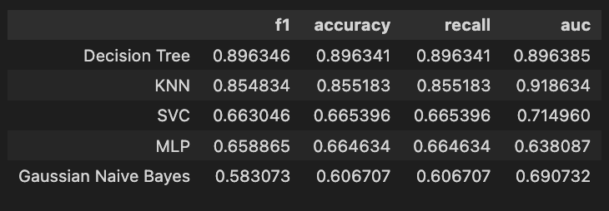
Models / Submission File
Before we train the model:
Label encoding and Binarization
Did some tests between SMOTE and Oversampling
Trainning models:
90% for train and 10% for test
KNN ; Decision Tree ; SVC ; Naïve Bayes ; Neural Networks ;
Submission File:
Best result until now was 0.70168:

Slide 6
Difficulties
Income outliers
Missing Values in ‘housing_type’, ‘num_vehicles’, ‘gas_usage’ and ‘recent_move_b’

Slide 7
Future Developments
Improve the models
Test different ways to deal with outliers and Missing values
Add more columns with a good relation
Basically, have a better score in submission

