Slide 1
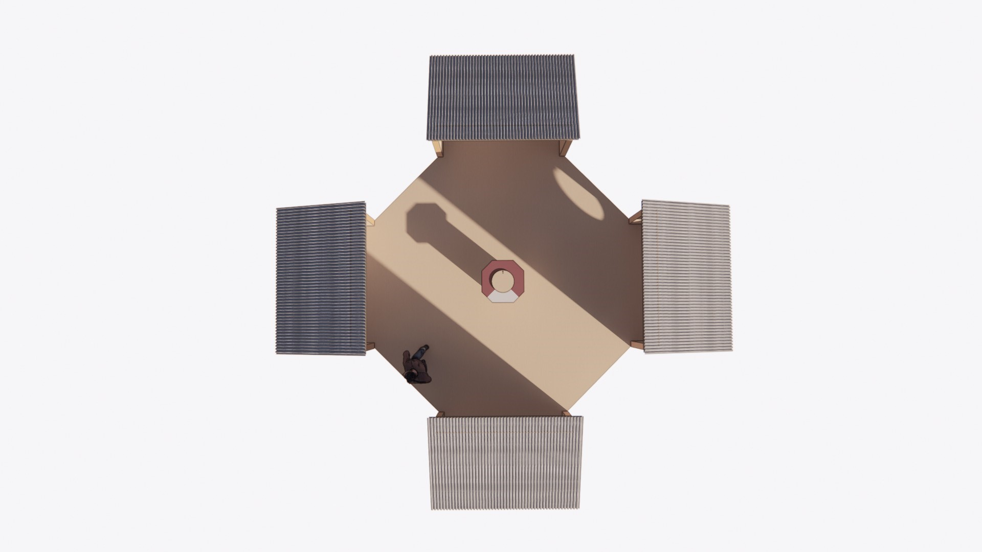

Slide 2
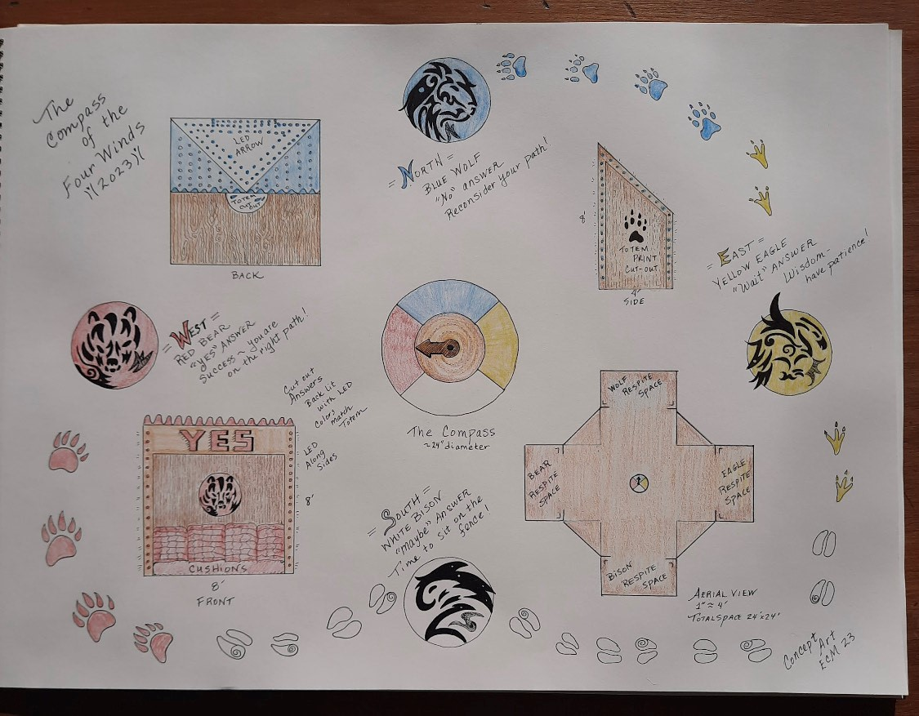

Slide 3
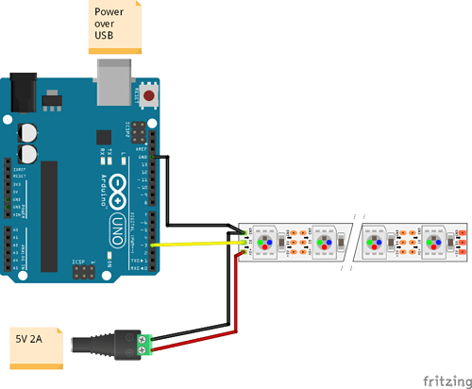
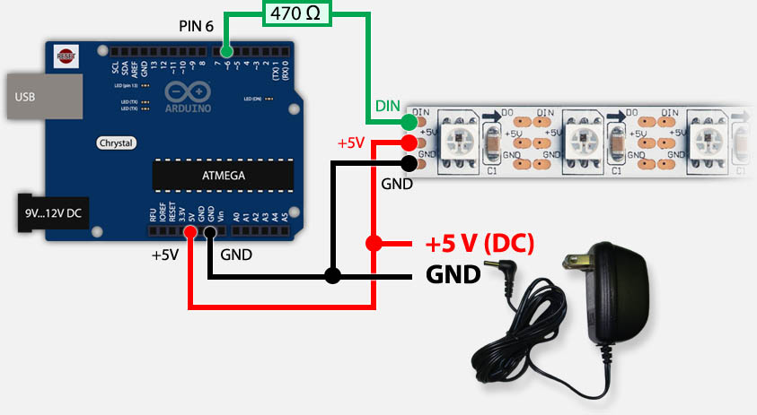
Controller + LED Strip Technical Integration Examples

Slide 4
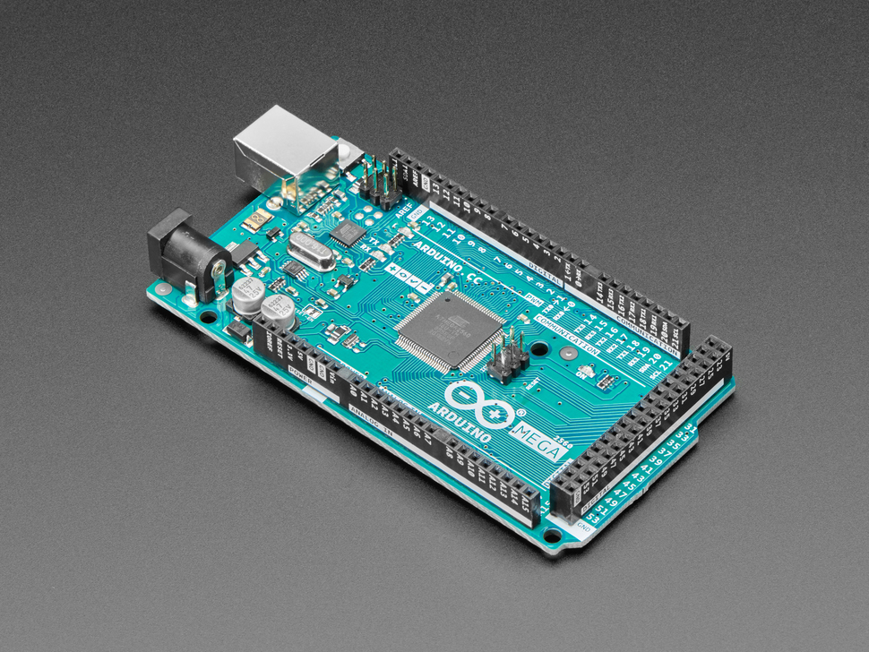
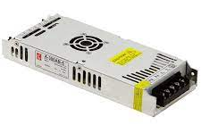
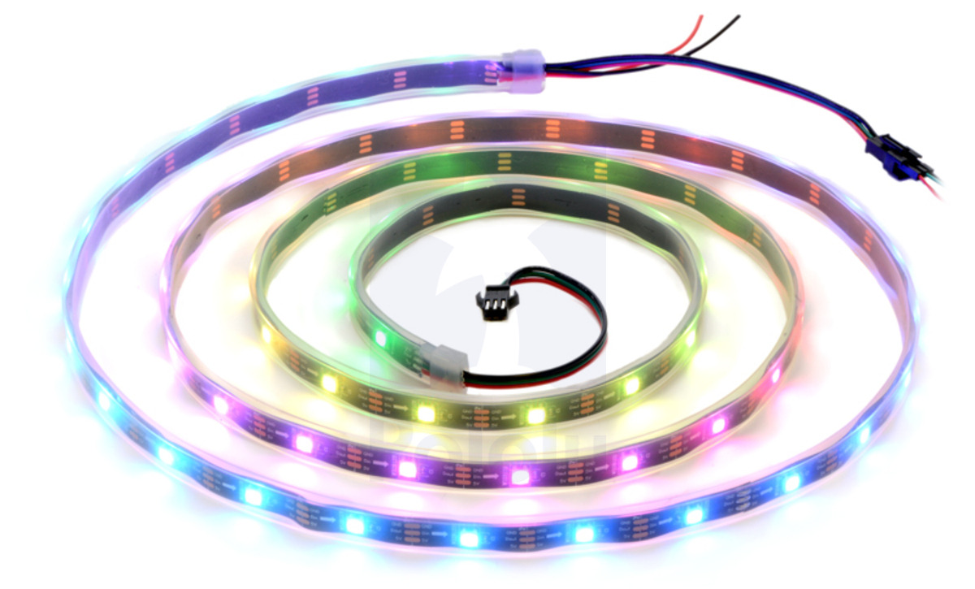
Block Level Diagram for each Totem (also spinny thing)
Generator/Battery Supply (TBD)
+

Slide 5
Prototype Materials (I think I have these? – Eduardo)
Item | Cost | Link | TOTAL
Wire Cutters | 7.99 | AMAZON | 97.41
MEGA Atmega Board | 20.99 | AMAZON
12v 5A power supply | 24.71 | AMAZON
Soldering Kit | 12.56 | AMAZON
SK6812 | 31.16 | AMAZON

Slide 6
Blue Wolf
Red Bear
Simple Wiring
5 loops from central power supply
Spinny Thing
Yellow Eagle
VDD
Generator/Battery Supply (TBD)
White Bison
GND

